Slide 1

MD results during LHC Run-II & plans for Run-III
G. Sterbini, S. Fartoukh, N. Karastathis, S. Koustoglou, S. Papadopoulous,
Y. Papaphilippou, A. Poyet, A. Rossi and K. Skoufaris on behalf of the
HL-LHC wire compensation team.
WP2/WP13 HL-LHC Wire Compensation Meeting, Fermilab, 17th October 2019

Slide 2
Outlook
Experimental constraints and optimization of the wires settings
Experimental objectives and results (Run-II)
Next steps (Run-III)
Summary

Slide 3
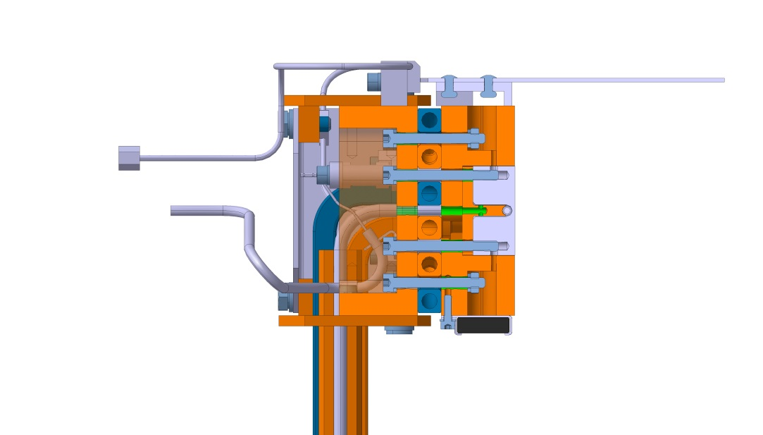
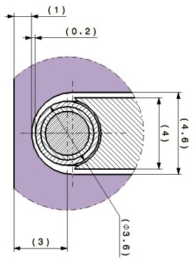

The LHC wire demonstrators
2.48 mm
3 mm
Courtesy of L. Gentini
Layout of the wire installation, not to scale
Front view
Since 2018 four wire demonstrators are installed in LHC (B2, IR1+IR5) with the aim to explore the potential of the wires in
Notes:
Since 2018 four wire demonstrators are installed in LHC (B2, IR1+IR5) with the aim to explore the potential of the wires in HL-LHC.
3

Slide 4
Longitudinal position of the wires
The longitudinal position of the wires was driven by the present position of the collimators and the integration constraints.
Symmetric position in the IR5.
Wire demonstrator | s from the Interaction Point [m]
L1, collimator not-used in operation | -176.17
R1, tertiary collimator | 145.94
L5, IP debris collimator | -150,03
R5, tertiary collimator | 147.94
Notes:
The longitudinal position of the wires was driven by the present position of the collimators and the integration constraints. They are summarized in this table. The wire are approximately at 150 m from the IP when the two beams are almost fully separated.
In these plots, you can see the beam reference orbits with respect to the laboratory frame. In red you have the focusing quadruples and in blues the separation dipoles. It is important to note that the layout of the wires in IR1 and IR5 are different.
4

Slide 5
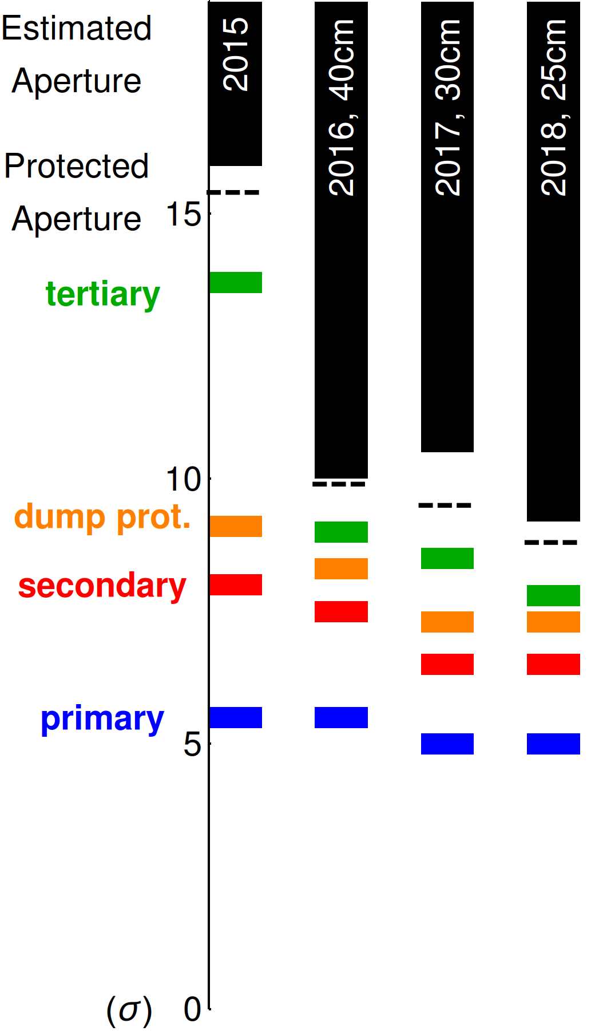
Transverse positions of the wires
The wire are installed in the crossing plane of the Interaction Region, i.e.,
  vertical in IR1,
  horizontal in IR5.
Given the constraints of the LHC collimation hierarchy, two classes of experiments were performed
  LI: Low Intensity experiment with wire-collimator just in the shadow of the primary collimators
  HI: High-Intensity experiment with wire-collimator at the operational position.
HI experiment
wire collimator at operational positions
LHC collimation hierarchy
LI experiment
wire collimator position at 5.5 σ¹
Courtesy of R. Bruce
Wire demonstrator | LI experiment | HI experiment
 | beam-wire distance [mm]
L1 | -7.41 | not powered
R1 | 7.42 | 9.83
L5 | -7.15 | not powered
R5 | 8.24 | 11.10
¹ An ε_{n}=3.5 mm mrad assumed.
Notes:
===READ===
Concerning the transverse position of the wires
The wire are installed in the crossing plane of the Interaction Region, i.e.,
vertical in IR1,
horizontal in IR5.
Given the constraints of the LHC collimation hierarchy and the machine protection, two classes of experiments were performed.
LI: Low Intensity experiment with wire-collimator just in the shadow of the primary collimators.
HI: High-Intensity experiment with wire-collimator at the operational position (tertiary
In the table, you can see that for the LI experiment the beam-wire distance between 7-8 mm whereas for the HI experiment it is 10-11 mm.

Slide 6
Filling schemes and beam-beam encounters
Low Intensity experiment
High Intensity experiment
In the LI experiment the first bunch of B2 see only two head-on’s (in IP1 and IP5) and the second bunch experiences head-on and long-range encounters.
In the HI experiment we have a rich distribution of beam-beam interactions in IR1/5.
Notes:
The limit on the beam intensity has a direct impact on the filling schemes adopted in the experiments, as one can see in these plots.
For the LI experiment we have the bunches in B2: the first colliding only head-on and the second experiencing also the long-range interaction.
For the HI intensity experiment we have many more beam-beam interaction patterns.

Slide 7
Wire current settings I
The experimental setup allowed to minimize only two Resonance Driving Terms.
We set the wire currents to compensate the (4,0) and (0,4) RDT: first order amplitude detuning.
For the HI experiment, due the larger beam-wire distance, the current for the compensation is not compatible with the standard wire configuration.
Notes:
The experimental setup allowed to minimize only two Resonance Driving Terms.
We targeted the resonance (4,0) and (4,0): first order amplitude detuning.
As function of the collimator jaw position the needed wire current for the 4 demonstrators scales as indicated.
The LI experiment is within the current limit of the demonstrator (green region), But for the HI experiment the standard setup cannot be used.
7

Slide 8
Wire current settings II
LI experiment: 1-jaw powered
HI experiment: 2-jaws powered
In the wire-collimator, both jaws house a wire.
In the LI experiment only the wire of one single jaw was powered.
For the HI experiments the wires of both jaws where powered: this allowed to double the integrated strength of the quadrupolar, octupolar, etc., components.
OFF
ON
ON
ON
Wire demonstrator | LI experiment | HI experiment
 | Current [A]
L1 | 350 x 1 | not powered
R1 | 320 x 1 | 350 x 2
L5 | 190 x 1 | not powered
R5 | 340 x 1 | 350 x 2
Notes:
To get closer to the target current of the HI experiment, we make use of the second wire available in the wire-collimator demonstrator.
this allowed to double the integrated strength of the quadrupolar, octupolar, etc., components.
In the table the wire current intensity is resported.

Slide 9
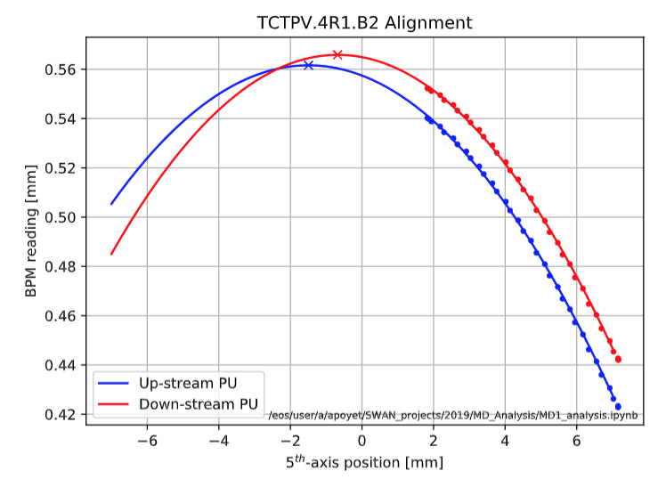
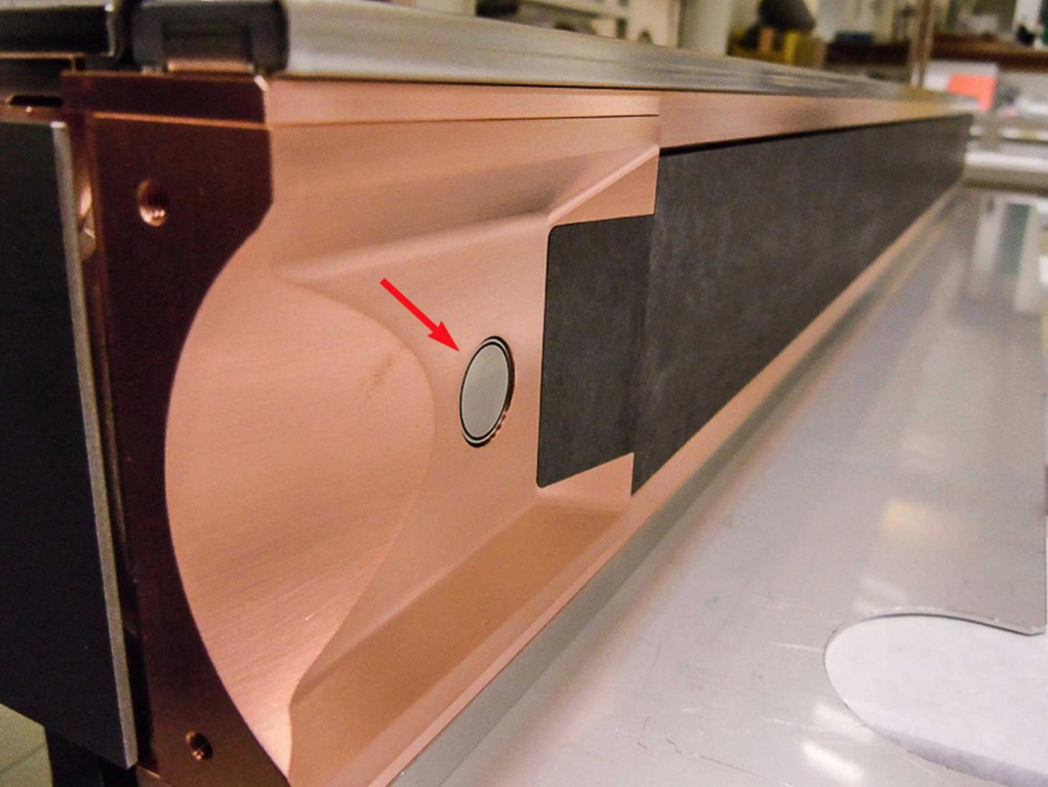
Beam-wire alignment
Alignment of the wire is critical. The jaw of the collimators has 2 button pick-up that allows
to center the beam within jaws,
to align the wire and the beam.
Courtesy of A. Poyet
button
pick-up
Courtesy of the Collimation Team
Notes:
To get closer to the target current of the HI experiment, we make use of the second wire available in the wire-collimator demonstrator.
this allowed to double the integrated strength of the quadrupolar, octupolar, etc., components.
In the table the wire current intensity is resported.

Slide 10
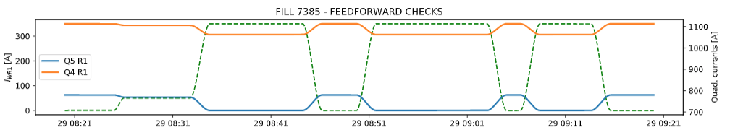
Orbit and tune feed-forward
The effect of the wires on the orbit (dipole) and linear optics (quadrupoles) where locally compensated using
CO corrector close to Q4 trims (+ orbit feedback)
Q4 and Q5 trims
CO corrector
wire
Q4 Q5
Courtesy of A. Poyet
Notes:
To get closer to the target current of the HI experiment, we make use of the second wire available in the wire-collimator demonstrator.
this allowed to double the integrated strength of the quadrupolar, octupolar, etc., components.
In the table the wire current intensity is resported.

Slide 11
Outlook
Experimental constraints and optimization of the wires settings
Experimental objectives and results (Run-II)
Next steps (Run-III)
Summary
Notes:
I will start with a short introduction about the wire compensation principles, and after presenting the experiment’s constraints and rationale, I will show the results and how they compare with the numerical simulations.

Slide 12
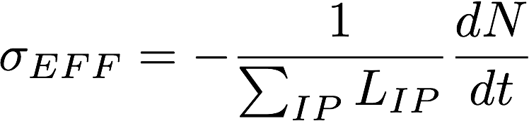
Objectives of the experiments
Prove a beneficial effect of the wires demonstrators in a regime dominated by long-range beam-beam effect. The compensation should not degrade the lifetime of the head-on bunches.
We need to guarantee the beam-wire alignment and that the linear effects of the wire (orbit and tunes) are compensated with feedforwards.
The main observables are the beam losses, its lifetime and the bunch effective cross-section (σ_{eff})..
Intensity loss-rate
Instantaneous luminosity
Notes:
The goal of the experiment is to prove a beneficial effect of the wires demonstrators in a regime dominated by long-range beam-beam effect.
During the experiment we need to guarantee the beam-wire alignment and that the linear effects of the wire (orbit and tunes) are compensated with feedforwards.
Our observables are the beam losses, the beam lifetime and the bunch effective cross-section (σ_{eff}), that is the bunch intensity loss-rate normalized to the bunch luminosity.
In the ideal case the effective cross section corresponds to the physical p-p cross section (around 80 mbarn).
As an example, you see the two phases of an ideal experiment were the effective cross section of the Head-on and long-range bunches is plotted.
While the wires are one, the goal is to approach the effective cross section of the long range bunch to the physical cross section (80 mbarn) without affecting the head-on bunch cross-section.
The compensation should not degrade the lifetime of the head-on bunches.
12

Slide 13
The experimental campaign
Winter 2017-18
Installation of the IR1 wires
Experiment with wires in IR5
Experiment with wires in IR1 and IR5
LI experiments
HI experiments
9 h
12 h
14th June 2018
FILL6797-8-9
24th July 2018
FILL6972
1st July 2017
FILL5898-5900
14th September
FILL7169
29th October
FILL7386
Compensation with 2 wires (validation)
From 2 to 4 wires
(validation)
4 wires compensation
Reducing crossing angle
TRAINS and NEW cabling
7 h
26th July 2018
FILL6984
7 h
10 h
10 h
29th Nov 2017
FILL6434-6435
From SETUP BEAM to TRAINS
Compensation with 2 wires
1 h
HI experiments
A rich experimental campaign was performed during the last 2 years: the compensation effect was systematically observed.
Notes:
A rich experimental campaign was performed during the last 2 years (7 different sessions of measurements): the compensation effect was systematically observed.
Most of the times was devoted for the LI experiment. We will show In the following the results of one LI and HI experiment.

Slide 14
Low-Intensity experiment
Almost full compensation, even at reduced crossing angle, for regular bunch whereas head-on bunch not degraded.
Notes:
Concerning the LI experiment, in this plot you have time in the x-axis and effective versus effective cross-section and wires current.
In the first part of the experiment we set the crossing angle between the beams to a moderate values (140 urad). By switching on the wires we observe that the HO+LR bunch approached the physical cross-section (80 mbarn).
We reduce to 130 urad to go to more aggressive condition in terms of BB effect.
We see an increase of losses (equivalent cross-section). The situation is clearly worsening by switching off the compensation.

Slide 15
HI experiment (operational conditions)
Compensation provides a reduction of B2 losses of ~20%.
Notes:
In the HI experiment, we se the Beam Losses as metric for the compensation.
On the horizontal axis there is time vs wire currents and beam losses.
We started with a relaxed BB crossing angle (160 urad) already observing the beneficial effect of the compensation. The experiment continued exploring more aggressive BB settings. Showing also in this case the systematic beneficial effect of the wires demonstrators.

Slide 16
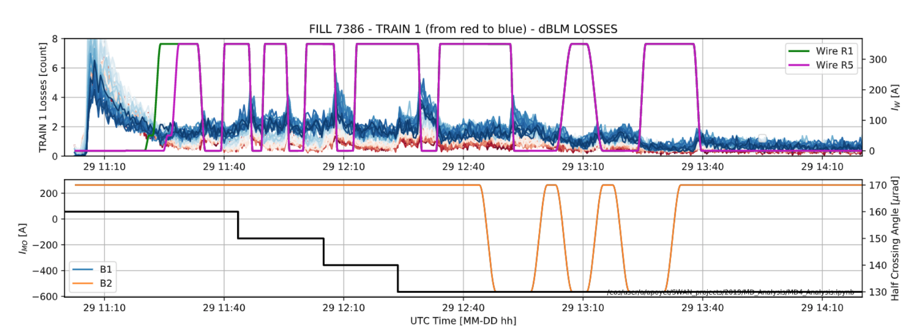
Bunch-by-bunch analysis (I)
trailing bunches
leading bunches
In the HI experiment the wire is more effective for the trailing bunches.

Slide 17
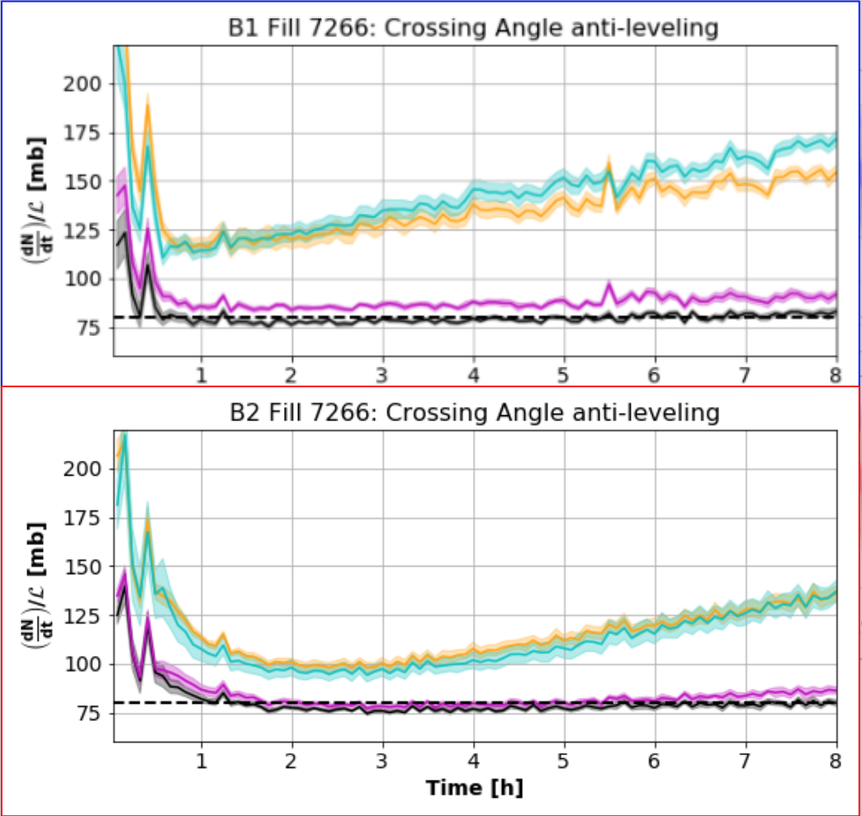
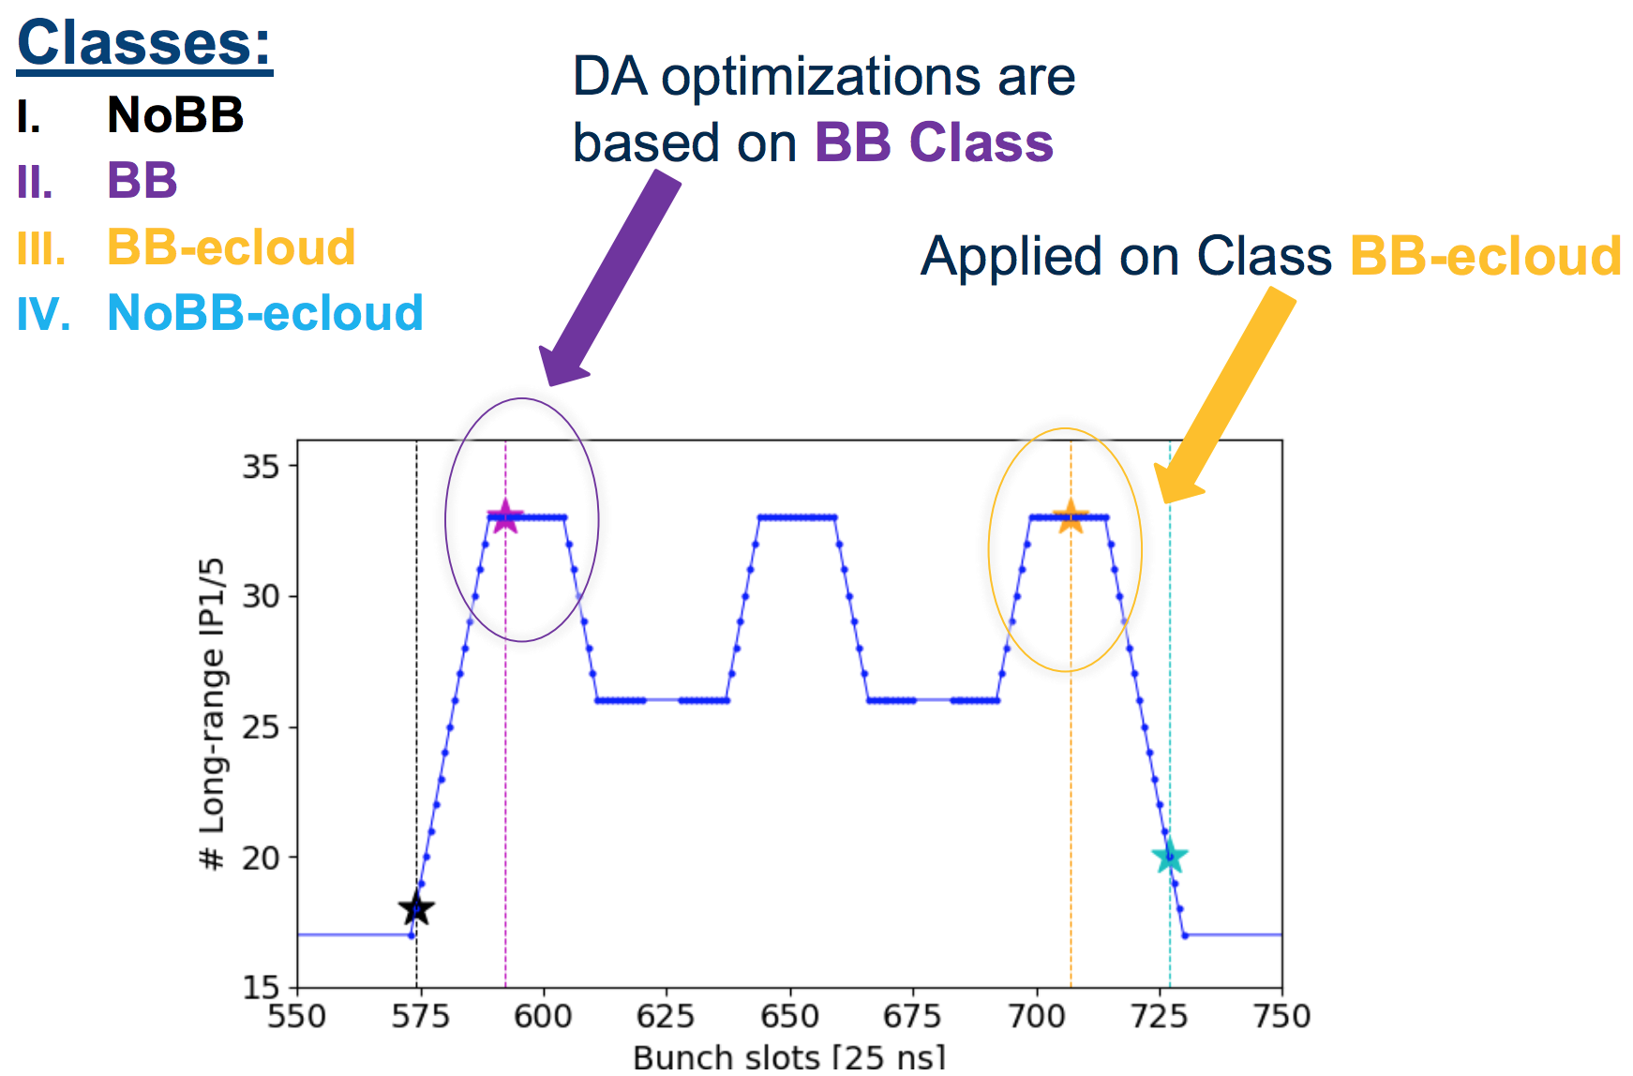
Bunch-by-bunch analysis (II)
Several observation during 2018 run showed indeed that the trailing bunches are the most critical in terms of losses.
Beam 1
trailing bunches
leading bunches
Beam 2
Courtesy of S. Kostoglou and S. Papadopoulous

Slide 18
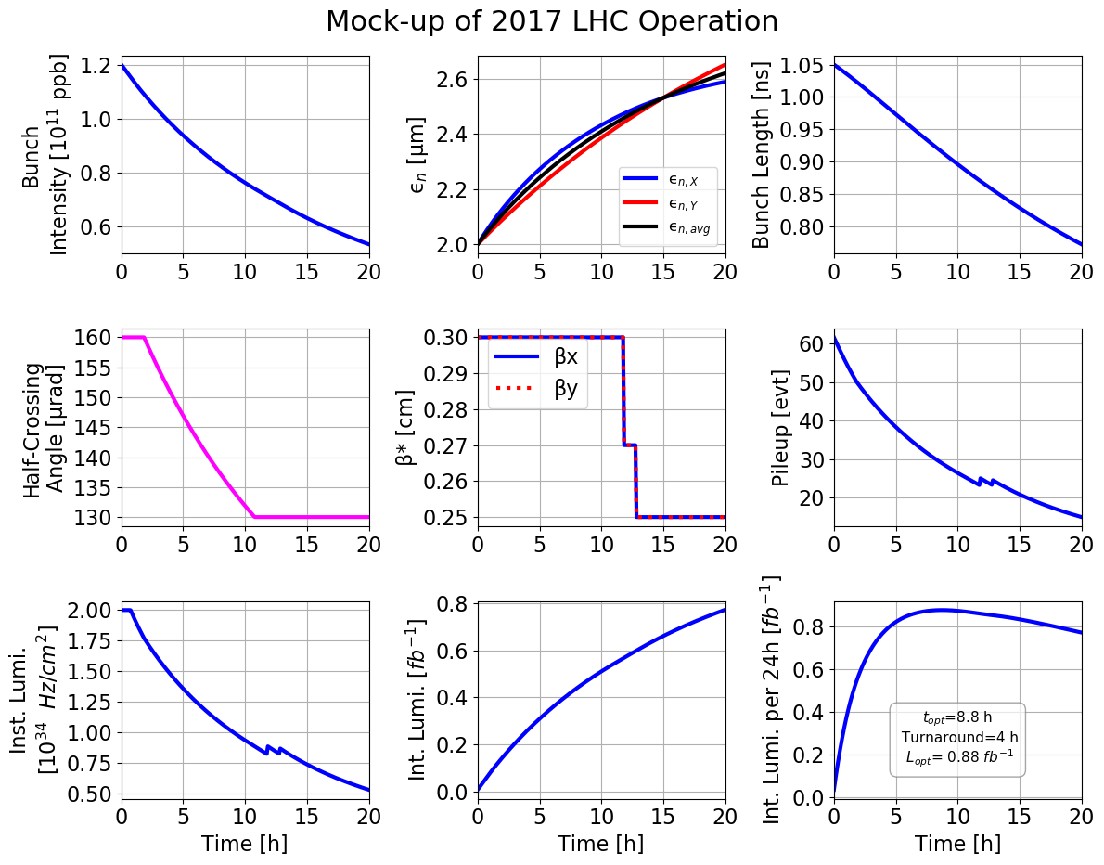
Run-II (2018) Fill Profile
The crossing angle reduction and its interplay with e-cloud and BB are considered the responsible of the losses on the trailing bunches.
In Run3 one can use the wire to alleviate this effect.
Courtesy N. Karastathis

Slide 19
Outlook
Experimental constraints and optimization of the wires settings
Experimental objectives and results (Run-II)
Next steps (Run-III)
Summary
Notes:
I will start with a short introduction about the wire compensation principles, and after presenting the experiment’s constraints and rationale, I will show the results and how they compare with the numerical simulations.

Slide 20
Run-III Fill Profile (2021-23)
In 2021: round optics with IP1 crossing in V-plane and IP5 crossing in H-plane.
The wires could be switched on at the end of the leveling.
We assume Run-III collimation settings similar to Run-II ones.
Courtesy of S. Fartoukh and N. Karastathis
Notes:
20

Slide 21
Next steps and proposals
Following these encouraging results, it was proposed
  to use the wires routinely during the next LHC operation period in the High-Intensity configuration
  to equip also the Beam 1 with wires by moving two wire demonstrators (L1 and L5) from Beam 2 to Beam 1.
Notes:
Following these encouraging results, it was proposed
to use the wires routinely during the next LHC operation period in the High-Intensity configuration
to equip also the Beam 1 with wires by moving two wire demonstrators (L1 and L5) from Beam 2 to Beam 1.
First iterations for a HL-LHC wire design are on-going.
21

Slide 22
Summary
In 2017-18 a rich measurements campaign was performed to explore the potential of the wire compensation for HL-LHC. For the first time in a hadron collider, the positive effect of the compensation was systematically observed in operational-like conditions.
Following these results we proposed to use the wire demonstrators operationally for the next LHC run. Using the wire in Run-III will maximize what we can learn from the present demonstrators in view of HL-LHC possible applications.

Slide 23
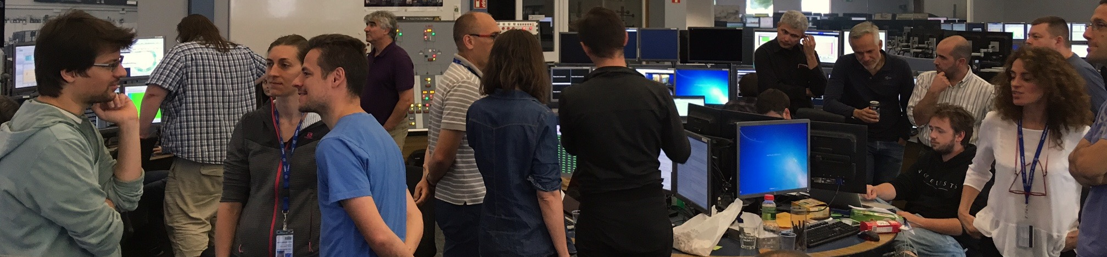
Thank you for the attention.
J.-P. Koutchouk et al.
Wires in the SPS
Since 2004
W. Fischer et al.
Wires in RHIC
2006
C. Milardi et al,
Wires in DAΦNE
Since 2006
F. Zimmermann et al.
Specification of the
LHC wires, 2013
1st Workshop on (HL-)LHC
Wire Compensation
December 2015
Experiment in the LHC
2017-2018
1997
V. Shilsev et al.
e⁻ Q-compression
2000
J.-P. Koutchouk
DC wires for LHC
2008
U. Dorda
PhD Thesis
2012
T. Rijoff
M.Sc.Thesis
2015
S. Fartoukh et al.
PRST-AB 18, 121001
March 2017
2nd Workshop on (HL-)LHC
Wire Compensation
1999
Y. Papaphilippou, F. Zimmermann
PRST-AB 2, 104001
2004
B. Erdeley, T. Sen
FERMILAB-TM-2268-AD
2007
H. J. Kim, T. Sen
PAC07-THPAN114
2016
A.S. Patapenka et al.
NAPAC2016-TUPOB17
On behalf of the HL-LHC wire compensation team
D. Amorim, G. Arduini, H. Bartosik, A. Bertarelli, R. Bruce, X. Buffat, L. Carver, C. Castro, G. Cattenoz, E. Effinger, S. Fartoukh, M. Fitterer, N. Fuster, M. Gasior, M. Gonzales, A. Gorzawski, G.-H. Hemelsoet, M. Hostettler, G. Iadarola, R. Jones, D. Kaltchev, K. Karastatis, S. Kostoglou, I. Lamas Garcia, T. Levens, A. Levichev, L. E. Medina, D. Mirarchi, J. Olexa, S. Papadopoulou, Y. Papaphilippou, D. Pellegrini, M. Pojer, L. Poncet, A. Poyet, S. Redaelli, A. Rossi, B. Salvachua, H. Schmickler, F. Schmidt, K. Skoufaris, M. Solfaroli, G. Sterbini, R. Tomas, G. Trad, A. Valishev, D. Valuch, J. Wenninger, C. Xu, C. Zamantzas, P. Zisopoulos and all participants to the design, production and commissioning of the wire compensator demonstrators.

Slide 24
BACKUP SLIDES

Slide 25
Low-Intensity experiment
Transverse blow-up and BBLR signature
Current scan example
COMPENSATION ON
~80 mb
Wire alignment
COMPENSATION ON
Reduction of crossing angle
COMPENSATION OFF
Almost full compensation, even at reduced crossing angle, for regular bunch whereas head-on bunch not degraded.

Slide 26
HI experiment (operational conditions)
Reduction of crossing angle
COMPENSATION ON
COMPENSATION OFF
Very good reproducibility
Compensation provides a reduction of B2 losses of ~20%.

