Slide 1

Modelling of MD Results and Effects of Crossing Angle
A. Poyet
HL-LHC Satellite Meeting: Wire Compensation – Fermilab – 17th October 2019

Slide 2
Outline
Introduction and simulations parameters
BBCW in an ideal setup
Simulating the MD setup in the LHC
  1-jaw powering configuration (MD#3)
  2-jaws powering configuration (MD#4)
BBCW: Towards an implementation in operation during the LHC Run III
  Tune optimization
  Octupoles and wires compromise
  Effect of the crossing angle

Slide 3
Outline
Introduction and simulations parameters
BBCW in an ideal setup
Simulating the MD setup in the LHC
  1-jaw powering configuration (MD#3)
  2-jaws powering configuration (MD#4)
BBCW: Towards an implementation in operation during the LHC Run III
  Tune optimization
  Octupoles and wires compromise
  Effect of the crossing angle

Slide 4
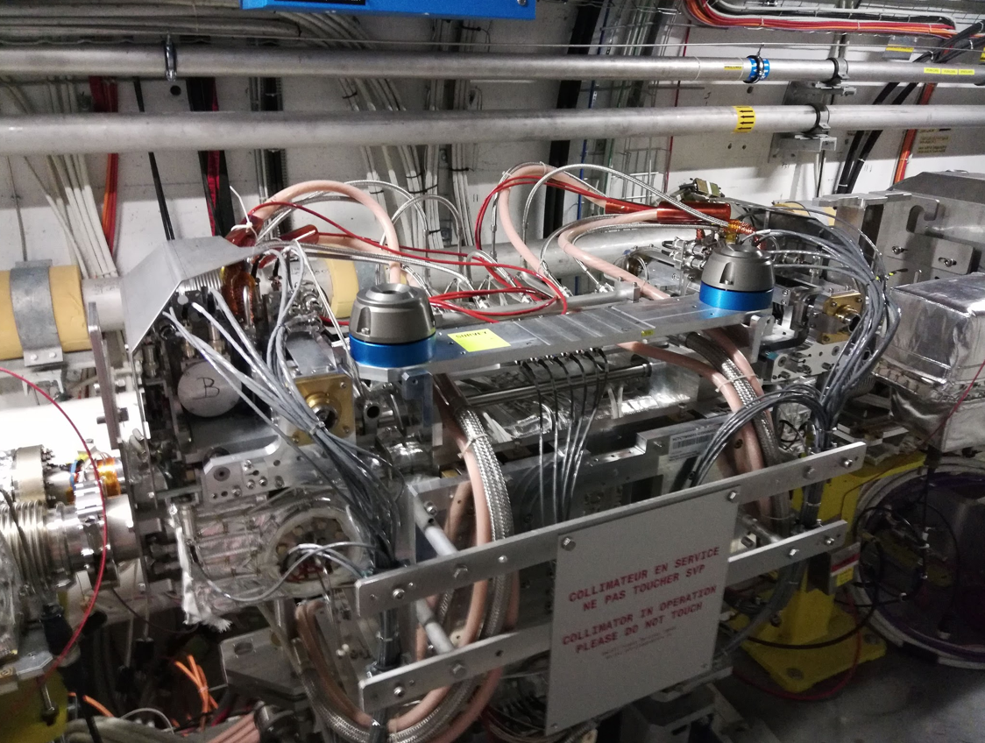
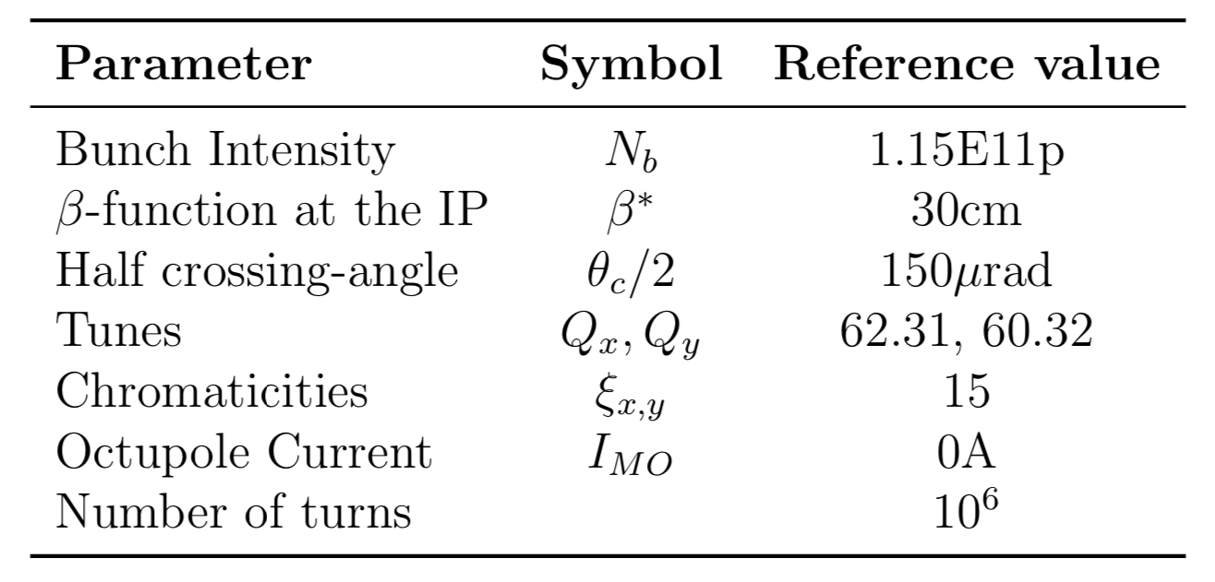
Simulating the BBCW in the LHC
LHC Ring and the BBCW
BBCW are currently installed and have been tested in the LHC [1]
For further studies, simulations are required
The observable is DA, obtained by running MAD-X and SixTrack
LHC Machine with novel optics scheme: ATS Optics [2]
Only B1 is simulated and the wires are therefore installed on this beam
Wires in collimator
Simulation reference parameters

Slide 5
Outline
Introduction and simulations parameters
BBCW in an ideal setup
Simulating the MD setup in the LHC
  1-jaw powering configuration (MD#3)
  2-jaws powering configuration (MD#4)
BBCW: Towards an implementation in operation during the LHC Run III
  Tune optimization
  Octupoles and wires compromise
  Effect of the crossing angle

Slide 6
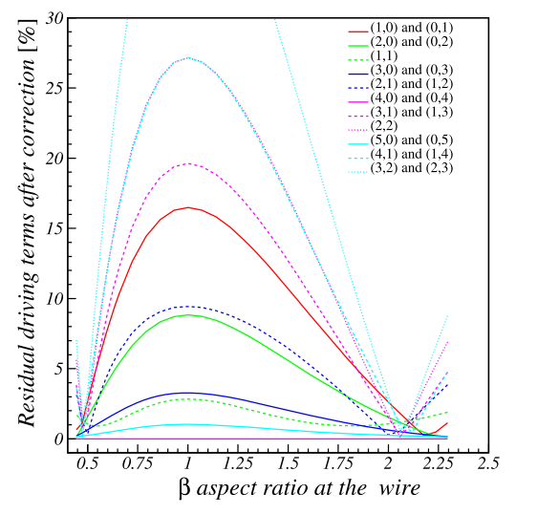
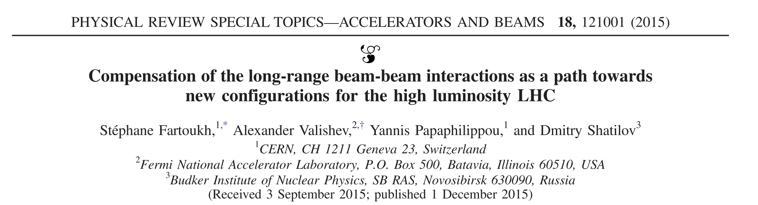
BBCW in an ideal setup
In 2015, it has been shown that compensating 2 RDTs lead to the minimization of all [3]:
  Proposed for HL-LHC
  2 wires per IP per beam
  Located at a given aspect ratio
Resonances compensation lines cross at the predicted point
Large “blue” area → Do we need a compensation of all RDTs?
Residual after compensation of the (4,0)-(6,0) RDTs
DA results for the ideal setup

Slide 7
Outline
Introduction and simulations parameters
BBCW in an ideal setup
Simulating the MD setup in the LHC
  1-jaw powering configuration (MD#3)
  2-jaws powering configuration (MD#4)
BBCW: Towards an implementation in operation during the LHC Run III
  Tune optimization
  Octupoles and wires compromise
  Effect of the crossing angle

Slide 8
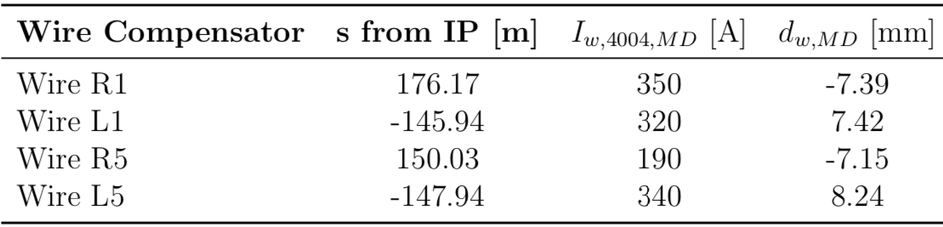
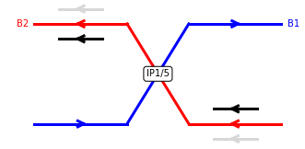
Simulating the MD setup: MD#3
  First experimental setup: 1-jaw powering configuration
    Only internal wire powered
    Safe beam: collimators closed at 5.5𝜎
    Wires powered to compensate the (4,0)-(0,4) RDT
  DA analysis: no more crossing of the RDT lines but still ~1.3 𝜎 DA gain
  Better gain in the vertical plane due to asymmetric DA in the bare machine
DA dependency on wires current/position (1-jaw powering config.)
DA in configuration space for MD#3

Slide 9
Effect of a 5th-axis misalignment
  After installing the wire prototypes in IR1, a misalignment of the 5th-axis was observed (~2mm) [4]
  The first MD was an opportunity to measure this misalignment and to partially realign the collimator during the following technical stop
  DA study was done to understand the sensitivity on this alignment
  Below ~1mm misalignment, the effect on DA is negligible
  Results obtained after the re-alignment showed that it had a beneficial effect (misalignment < 1mm)
Alignment procedure during the MD
DA dependency on the misalignment

Slide 10
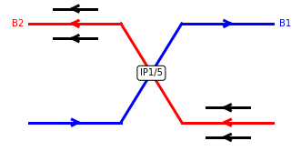
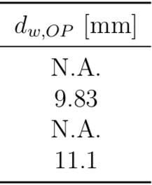
Simulating the MD setup: MD#4
  Second experimental setup: 2-jaws powering configuration
    Both internal/external wires powered
    Only 1 collimator per IP
    Non-safe beam: collimators opened at 8.5𝜎 (operational settings)
    Wires powered up to their maximal possible currents
  From the scan, similar possible improvements (not reachable experimentally)
  In configuration space, effect not so visible but still ~0.8𝜎 gain in minimum DA
DA dependency on wires current/position (2-jaws powering config.)
DA in configuration space for MD#4

Slide 11
Outline
Introduction and simulations parameters
BBCW in an ideal setup
Simulating the MD setup in the LHC
  1-jaw powering configuration (MD#3)
  2-jaws powering configuration (MD#4)
BBCW: Towards an implementation in operation during the LHC Run III
  Tune optimization
  Octupoles and wires compromise
  Effect of the crossing angle

Slide 12
Towards Run III: Wires and tune optimization
  Wires are now prepared to be used in operation during the LHC Run III
  In those conditions, tertiary collimators are foreseen to be opened at 8.5𝜎¹
  It is known that DA can be optimized by adjusting the tunes [5]
  Wires open the tune space
    Especially around the 3rd integer resonance
    Interesting to accommodate additional non-linear effects (e-cloud)
DA dependency on tunes (no wires)
DA dependency on tunes (2 wires, coll. at 8.5𝜎)
¹ For comparison, the case with the collimators opened at 7.5𝜎 was also studied

Slide 13
Towards Run III: Compromise wires/octupoles
  Experimentally, it has been shown that octupoles can be used to mitigate BBLR interactions (with high tele-index) [6]
  Octupoles are needed for coherent stability
  A compromise between wires and octupoles can be considered
  Negative octupoles could help the compensation scheme of the wires

Slide 14
Run III: Effect on the crossing angle
  Experimentally, we observed that it is possible to reduce the crossing angle, without increasing the losses [1]
  DA dependency on crossing angle and bunch intensity confirms this result
  Run III scenario: crossing angle anti-levelling up to 162 𝜇rad [7]
  Possible use of the wires: power at the end of the fill to reduce the crossing angle, keeping the DA ~ 5𝜎
  Clear possible gain:
    1.2e11 p → 150 𝜇rad
    0.8e11 p → 135 𝜇rad
DA as a function of wire currents (coll. at 8.5 𝜎)
DA with 2 wires (coll at 8.5 𝜎)

Slide 15
Conclusions
  Simulations are reproducing the observations made during the experiments, showing a beneficial effect of the BBCW
  In an ideal setup (i.e., compensation of all RDTs), the wires can bring up a DA improvement up to 1.5 𝜎.
  But the BBCW are flexible (i.e., no need to compensate all RDTs) and even further form this ideal setup, improvements above 1 𝜎 are observed.
  Going closer to operation, effects on DA are less visible (< 1 𝜎) but simulations show the possibility of closing the crossing angle.
  The BBCW are promising and their implementation in operation during the LHC Run III should give us more experience in operating those devices in view of HL-LHC.
  Next steps: continuing to explore scenario for Run III (in terms of intensity, beta star, crossing angle…) and take into consideration collisions in IP2/8.

Slide 16
Thank you for your attention
Credits to the wire team, and to the ABP-HSI section for the work on the simulations!

Slide 17
References
[1] G. Sterbini, MD results during LHC Run II, and plans for Run III, this meeting
[2] S. Fartoukh, An Achromatic Telescopic Squeezing (ATS) Scheme for the LHC Upgrade, IPAC 2011
[3] S. Fartoukh and al., Compensation of the bean-beam long-range interaction as a path towards new configurations for the high-luminosity LHC, PRAB, 18, 121001, 2015
[4] A. Poyet and al., MD3263: Beam-Beam Long-Range Compensation using DC wires in the LHC, not published yet
[5] D. Pellegrini and al., Multi-parametric response of the LHC Dynamic Aperture in presence of beam-beam effects, IPAC17
[6] S. Fartoukh, Round Telescopic Optics with Large Telescopic Index, CERN-ACC-2018-0032
[7] N. Karastathis, Beam-Beam Bases Optimization of the LHC Performances: A View Towards Run III, Beam-Beam & Luminosity WG, May 2019, https://indico.cern.ch/event/817173/contributions/3445803/attachments/1858856/3054202/nkarast_BBLS_31052019.pdf

