Slide 1
Correction of Hamiltonian driving terms with wires
Dobrin Kaltchev, TRIUMF
With many thanks for the discussions: Yannis Papaphilippou, Stephane Fartoukh, Kyriacos and Nikos
Fermilab 2019 meeting on Wire Compensation

Slide 2
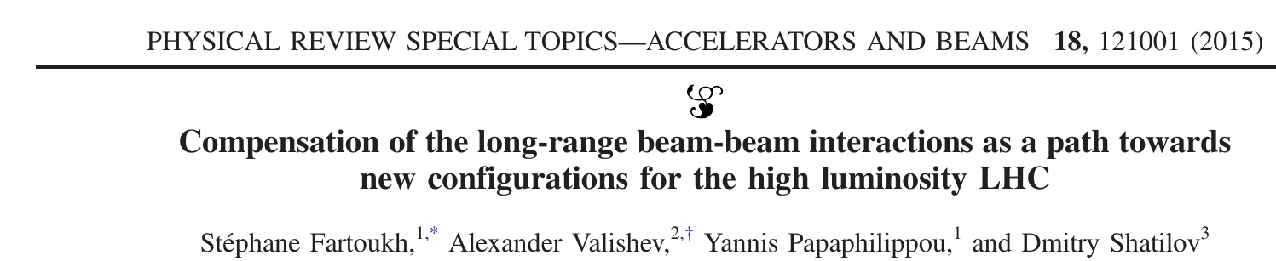
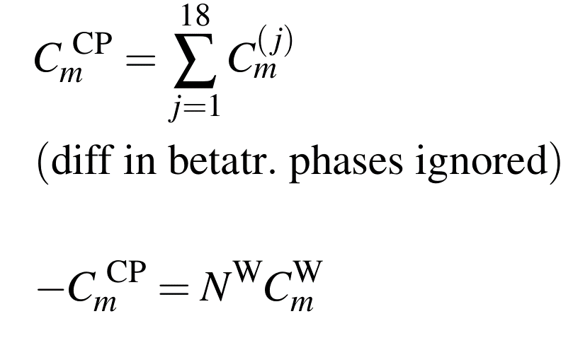
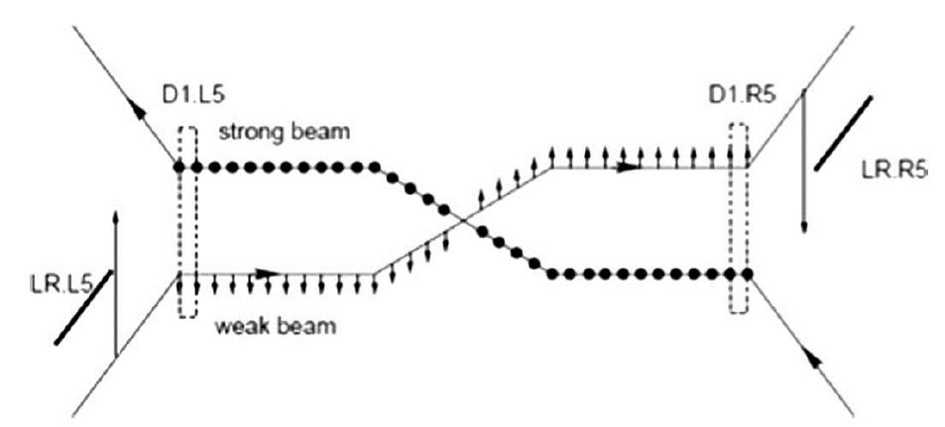
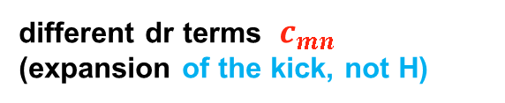

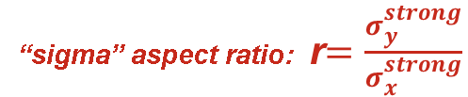




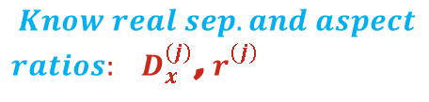
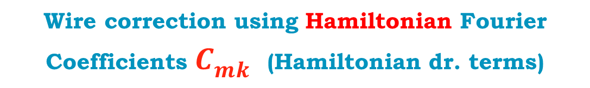
Wire correction using Hamiltonian Fourier Coefficients $C_{mk}^{}$ (Hamiltonian dr. terms)
S. Fartoukh et al.
PRST-AB 18, 121001
different dr terms $c_{mn}^{}$ (expansion of the kick, not H)
Left-right independent optimization of two wires
in the plane of separation (x). So k=0.
Wish to install a wire than cancels this sum
for some m.
Consider 1D correction
X-plane in IR5
Collision points (CP)
$18$ CPs left
$18$ CPs right
$$D_{x}^{(j)}$$
$$σ_{x,y}^{\left(j\right), strong}$$
$$Know real sep. and aspect$$
$ratios: D_{x}^{(j)}$, $r_{}^{(j)}$
Want these: ${{ D}_{x}^{W} , r}_{}^{W}=?,$ $N_{}^{W}=?$
“sigma” aspect ratio: r$=\frac{σ_{y}^{strong}}{σ_{x}^{strong}}$

Slide 3
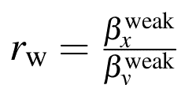
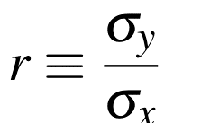
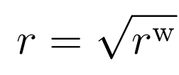
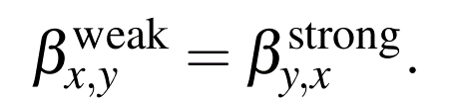
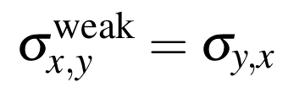

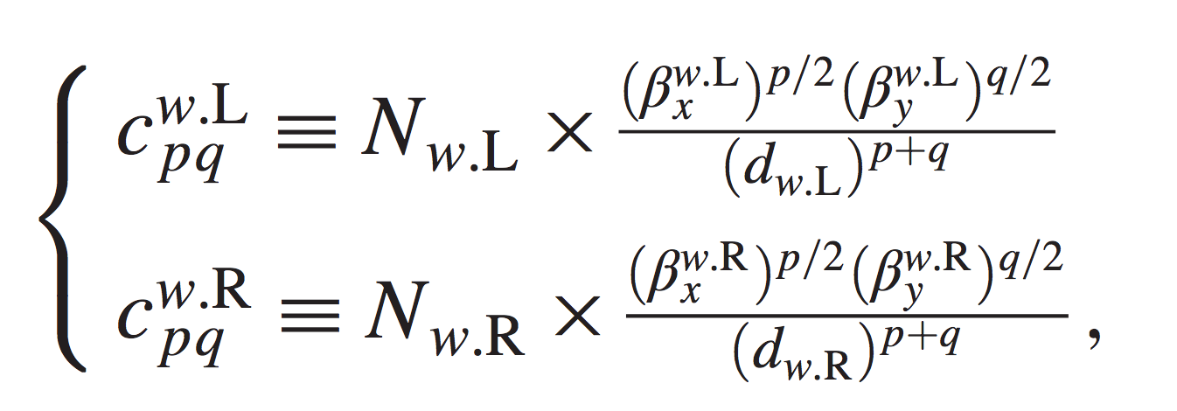
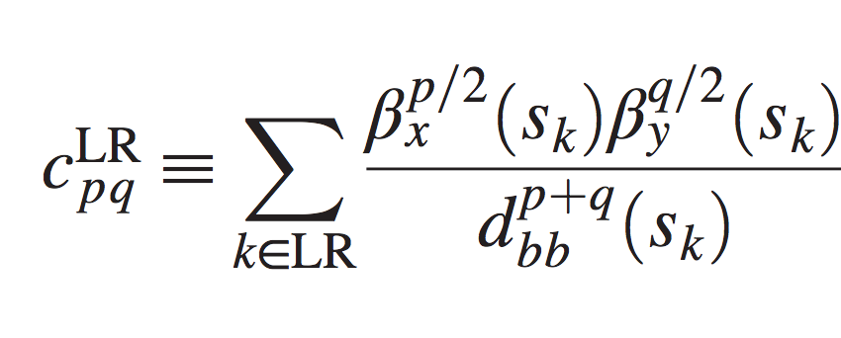
Comparison of approaches: $C_{mk}^{} and c_{mk}^{}$
S. Fartoukh et al.
PRST-AB 18, 121001
Here everything depends on strong beam (Ham. approach):
CP participates with beta aspect ratio at its location:
CP participates with sigma aspect ratio:
Exact anti-symmetry:
Exact anti-symmetry:
Optimization in 2D produces these
For now Left-Right independent.

Slide 4
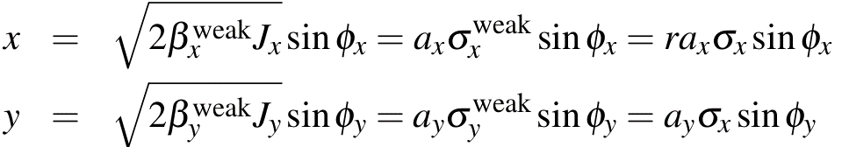
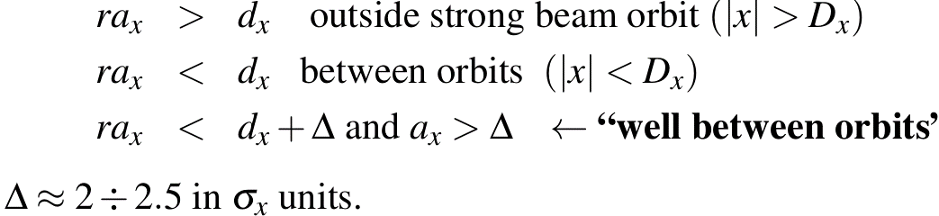

Comparison of approaches: $C_{mk}^{} and c_{mk}^{}$
Here:
S. Fartoukh et al.
PRST-AB 18, 121001
$a_{x,y}^{}$ n-sigma amplitudes
No dependence on amplitude
Define amplitude region: well between orbits

Slide 5

Comparison of results
S. Fartoukh et al.
PRST-AB 18, 121001
Here:
If for a pair m,k canceled, then all are approximately canceled
Confirmed that all can be canceled in single plane (of collision)
and working on 2D
above true for locations with
$r^{w}$ ~ 2 or 1/2
For single plane any location works
and working on 2D
Verified with:
tune-shifts
MadX, SixTrack
FMA
DA
Verified with
MadX tracking and
Effective Hamiltonian
(beam-beam invariant)

Slide 6
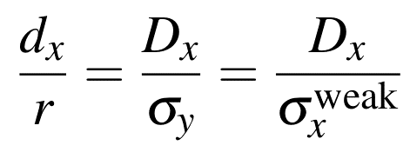
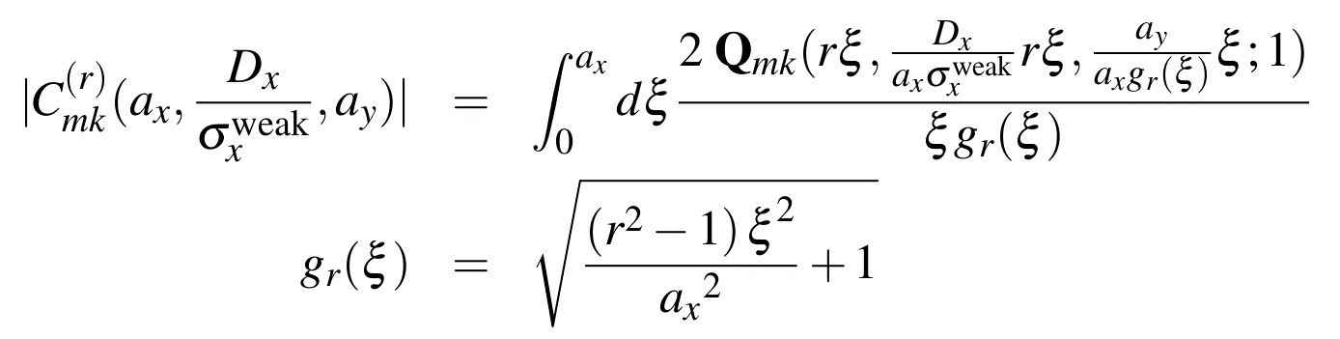



2D Fourier coefficient (modulo) as an integral along parametrized curve. It depends only on aspect ratio r and
normalized separation to weak-beam sigma:
for wire, also observed in
S. Fartoukh et al.
PRST-AB 18, 121001
CP lattice location participates only via r and norm. sep:
$$C_{mk}^{} (s,x,y,D_{x})$$
$$C_{mk}^{(r)} (a_{x},d_{x},a_{y})$$
prefer to work with the modulo D=|C|
“well-between beams” parametric curves become parametric lines

Slide 7
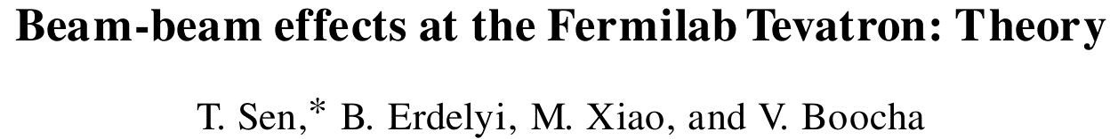
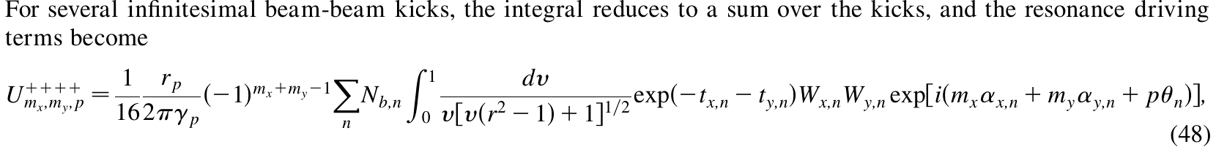
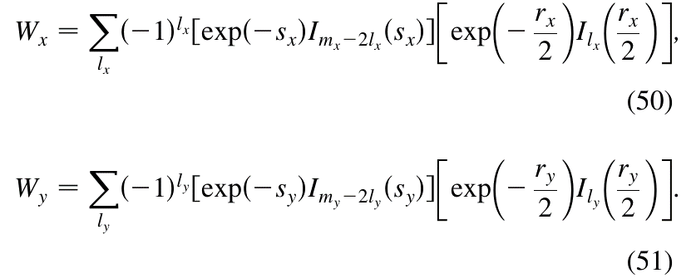
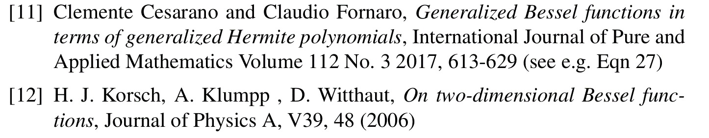
Using novel basis: Generalized 2D Bessel functions
The Q above are the W in this paper
it turns out these W are known objects called 2D Bessels
Gaussian factor (near strong beam core)

Slide 8
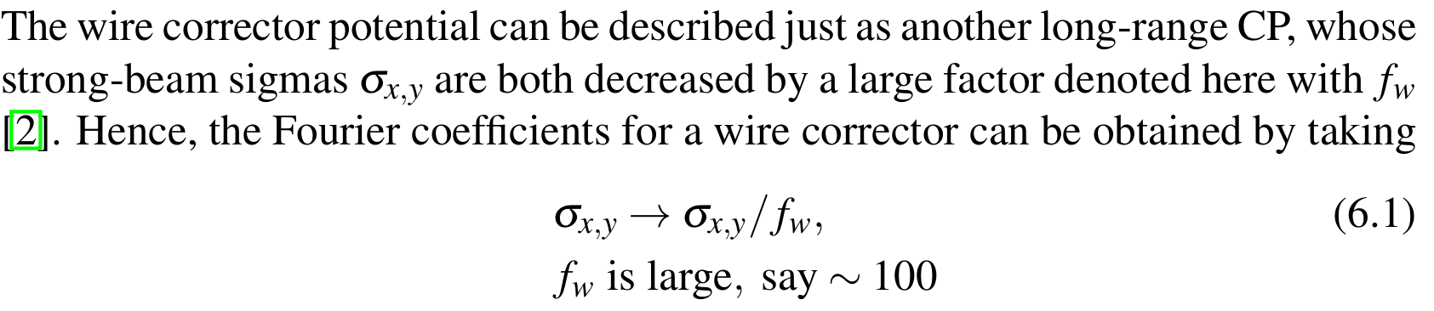
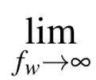
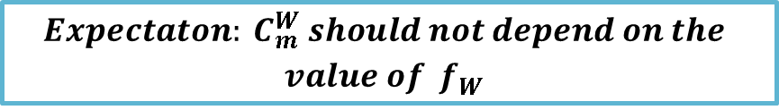
Wire Fourier coefficient
$${ Expectaton: C}_{m}^{W} should not depend on the$$
$$value of{ f}_{W}^{}$$

Slide 9
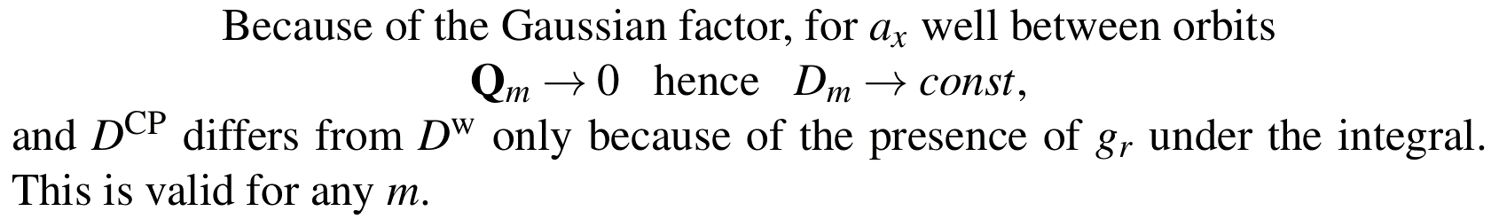
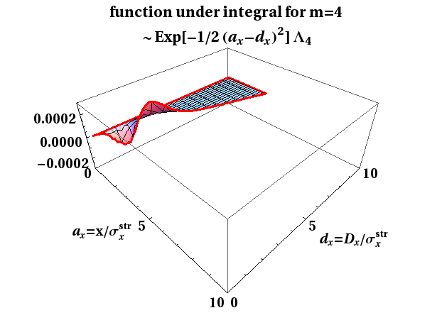
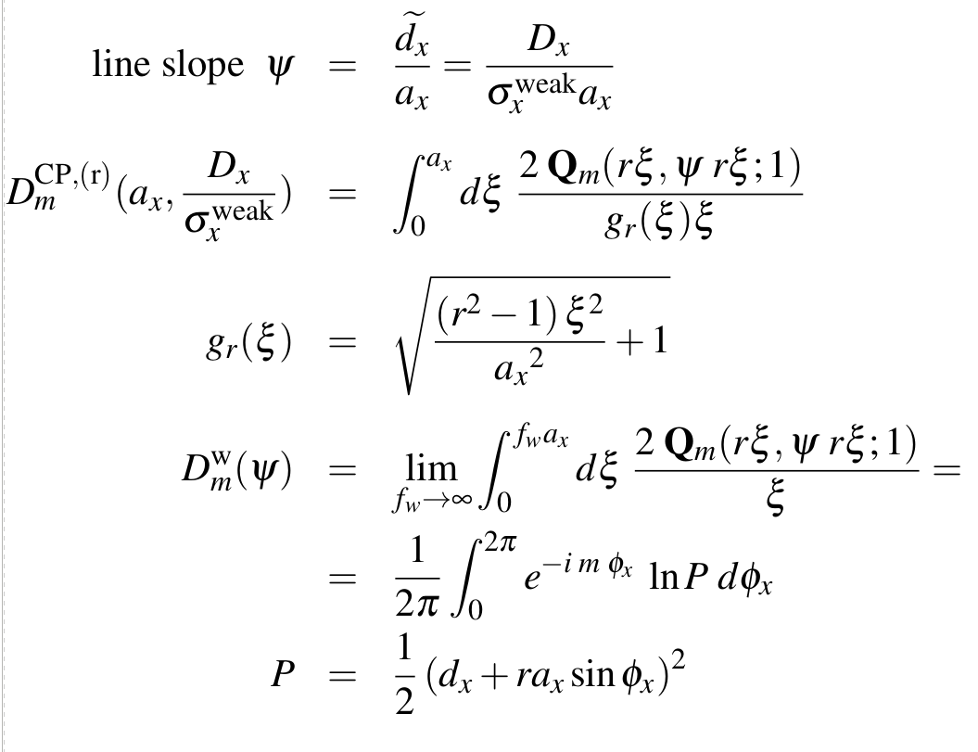

X-plane. CP and Wire Fourier coef. modulo D=|C| as an integral along parametrized line
$Q_{m}^{}$ surface
param.line

Slide 10
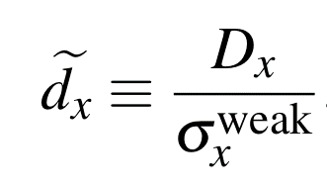



Wire coef $D_{m}^{W}$ is just the asymptotic of $D_{m}^{CP}$
$D_{m}^{W}$ contour is just a line
$D_{m}^{CP}$ contour
$a_{x}^{}$
For ax “well between orbits” the only difference is in form factor g under int.

Slide 11
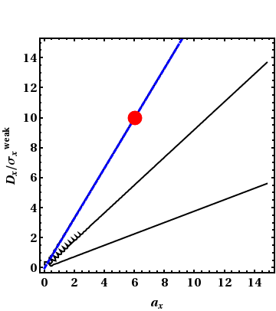
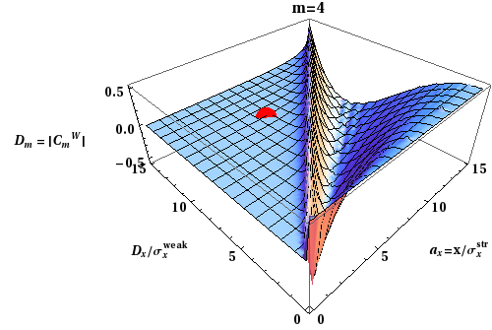
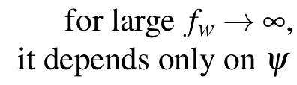
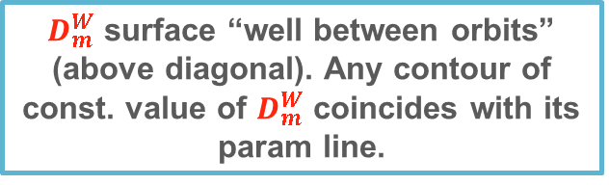
Well between orbits wire coef. depends only on param line
$D_{m}^{W}$ surface “well between orbits”
(above diagonal). Any contour of const. value of $D_{m}^{W}$ coincides with its param line.

Slide 12
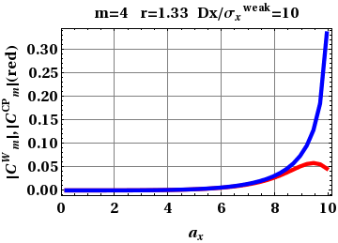
Detour: Single CP and Wire both at same norm sep
Showing sections here
of the two surfaces:
CP (red) and wire (blue)
ax near strong beam core
ax “well between orbits”

Slide 13
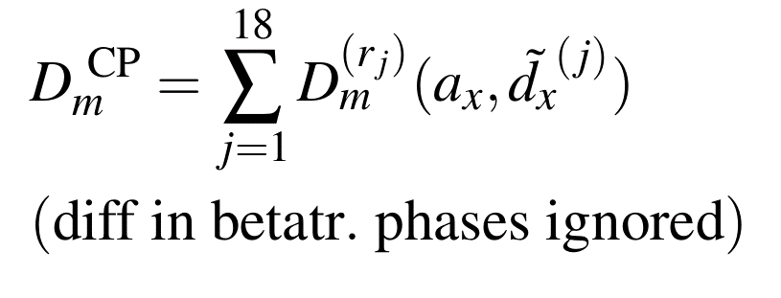
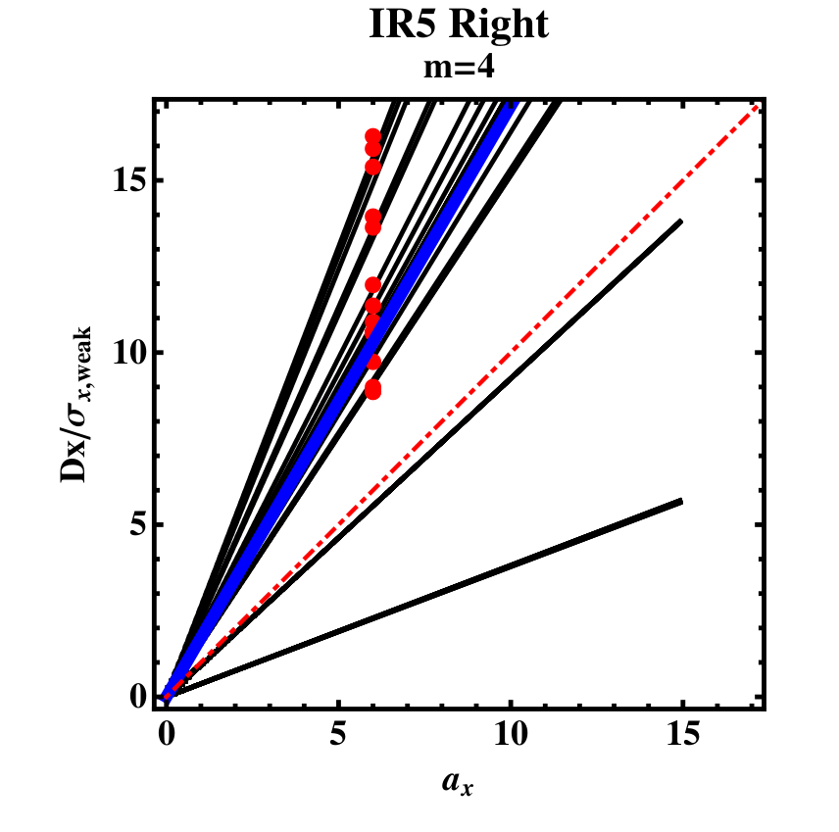
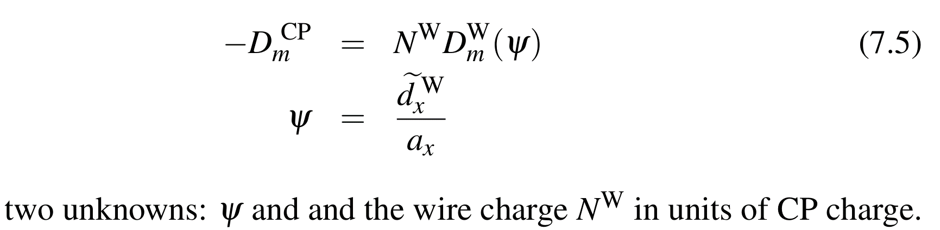
Need to solve this Equation for IR5 Left or Right.
(intensity 2.2 E11, 250 mkrad)
D. Kaltchev

Slide 14
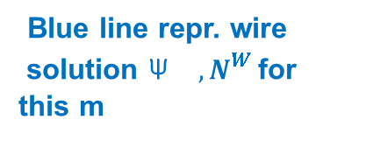
Illustration for m=4, ax=6
Red points represent
18 CP (stay same on plot for any m)
Black lines repr. wire contours for red-point values. They deviate slightly from red pts because of factors g.
Blue line repr. wire
solution ${\text{Ψ}}_{}^{}$ ${, N}_{}^{W }$for
this m
“well betw orbits” means above diagonal
Any ax “well between orb” will give the same
D. Kaltchev

Slide 15
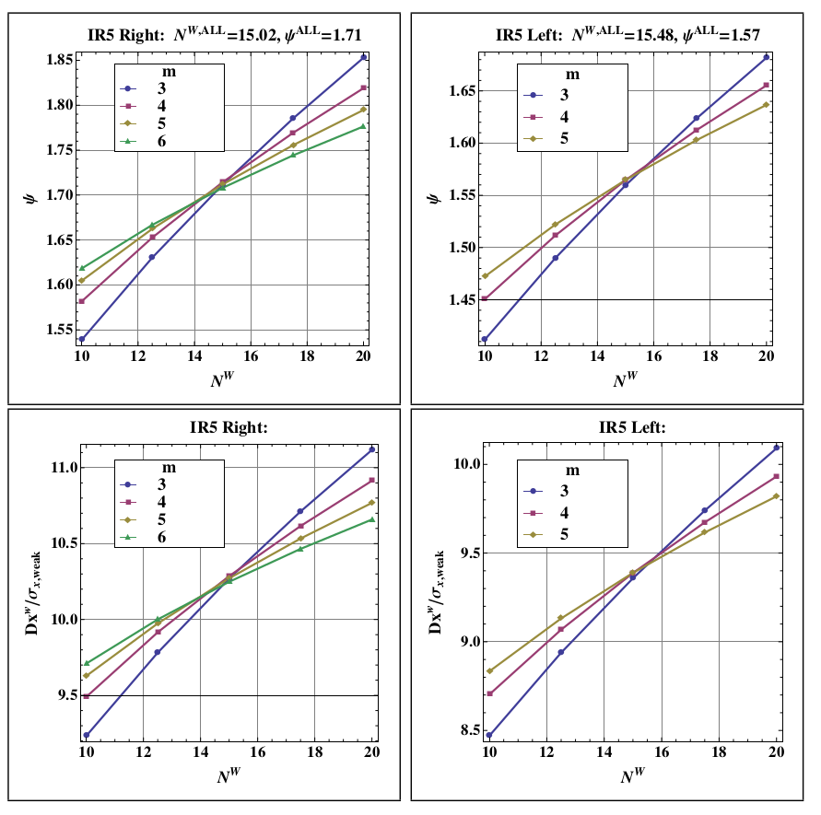
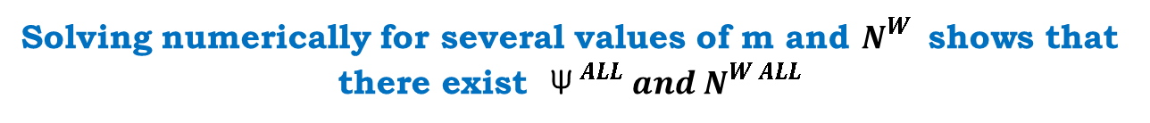
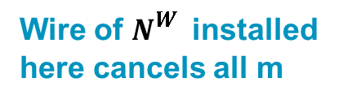
Solving numerically for several values of m and $N_{}^{W }$ shows that there exist ${\text{Ψ}}_{}^{ ALL} {and N}_{}^{W ALL}$
m=1, m=2
excluded
(lin. and quad.
terms in H)
Wire of $N_{}^{W }$ installed
here cancels all m

Slide 16
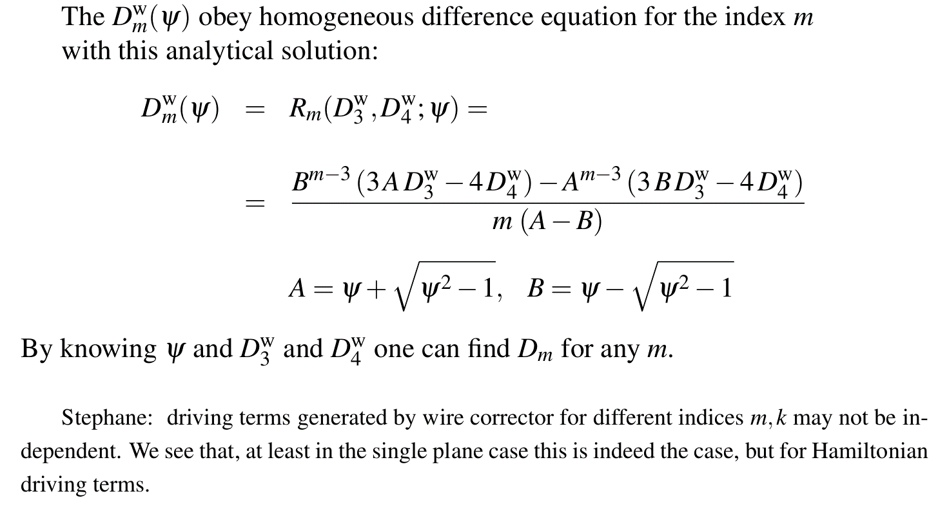

Recursion property of wire Fourier coefficient.
It explains existence of ${\text{Ψ}}_{}^{ ALL} {and N}_{}^{W ALL}$
D. Kaltchev

Slide 17
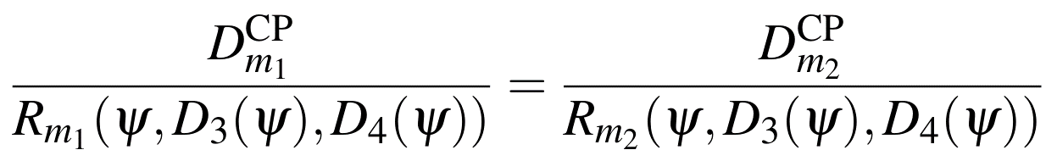
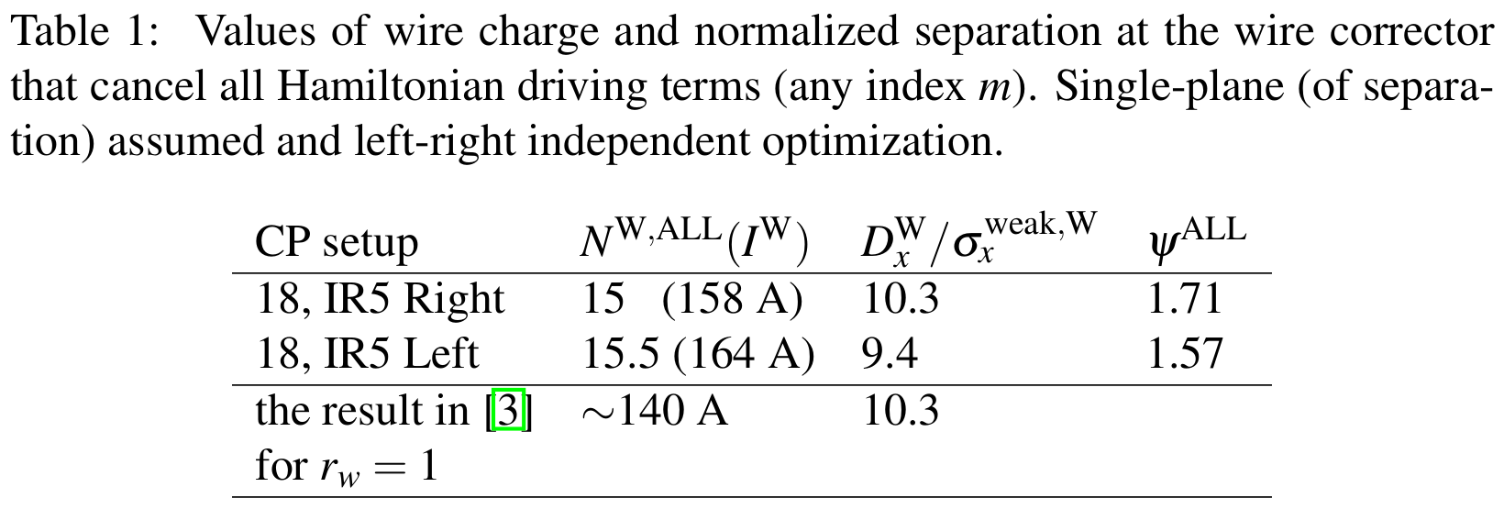
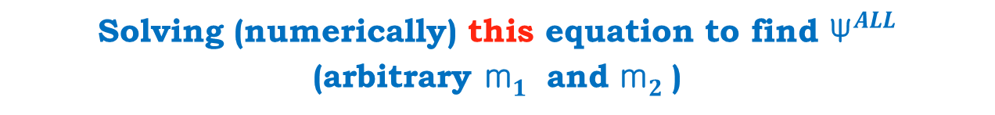
Solving (numerically) this equation to find ${\text{Ψ}}_{}^{ALL}$
(arbitrary ${\text{m}}_{1}^{}$ and ${\text{m}}_{2}^{}$)
S. Fartoukh et al.
PRST-AB 18, 121001

Slide 18
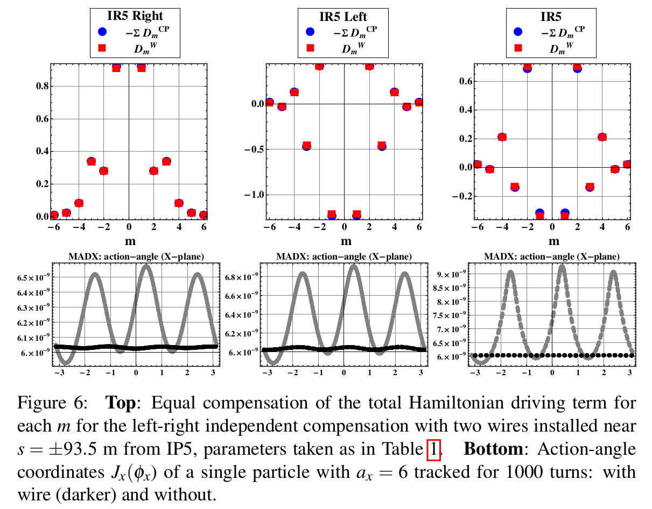

Testing with MadX tracking. Wires installed at ${\text{Ψ}}_{}^{ ALL} {and N}_{}^{W ALL}$ as in Table 1 (x-plane)
No wire
With wire

Slide 19
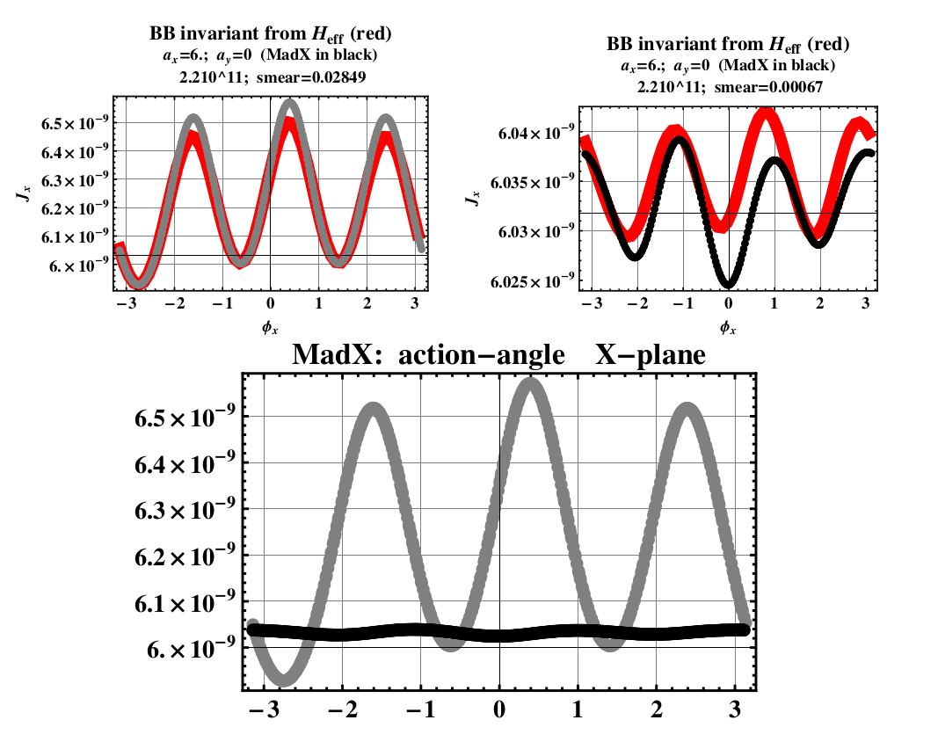

Testing with BB Invariant (x plane)
No wire
With wire
ll
The octupolar
$${action J}_{x}^{}$$
angle

Slide 20
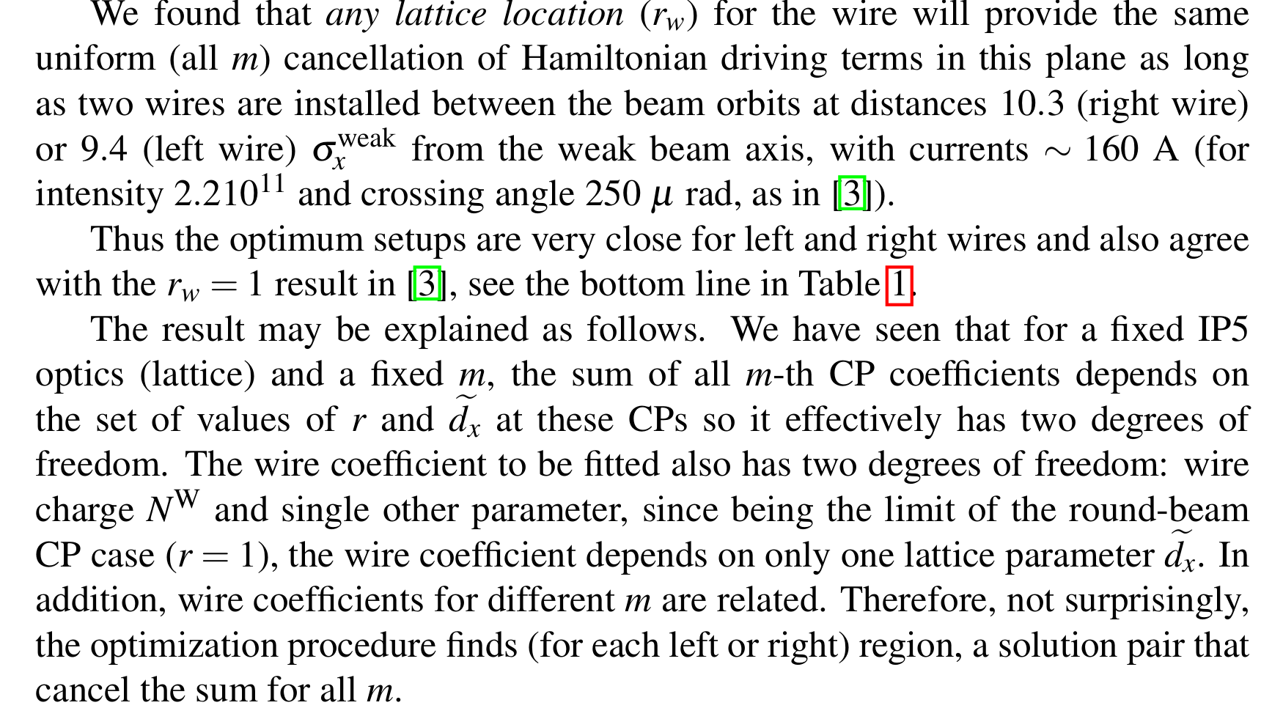
Summary

Slide 21
Many Thanks for your attention

Slide 22



