Slide 1
Potential Canadian contribution to the wire corrector project for
HL-LHC
Oliver Kester
ALD Accelerator Division
October 17, 2019
TRIUMF

Slide 2


Candian contribution via TRIUMF - Overview
Canada contributes via TRIUMF beam physics support and the cryomodules for the RFD crab cavities that will be produced within the US AUP.
Beam physics studies (Dobrin Kaltchev, Rick Baartman) focus on the general understanding of the impact of resonances to the choice of the optimal working point at collision.
→ HL-LHC optimization at collision including the option of flat optics and investigations of
wire compensation
Scope on the crab cavity (CC) cryomodules (HL-LHC-WP4) includes string assembly, fabrication of the cryostats, integration and cold tests (including RF power tests)
→ Qualified RFD CC will be provided by Fermilab
2

Slide 3
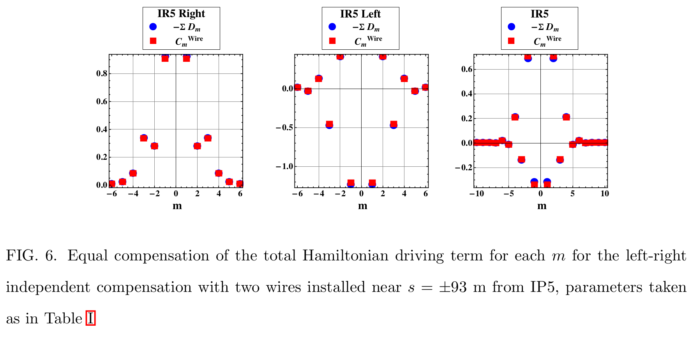
Beam physics involvement in the long-range beam-beam interactions compensation using DC wires
Canada contributes via TRIUMF beam physics support and Dobrin Kaltchev participates in the beam physics modelling of the wire compensation of the long-range beam-beam effects in the LHC.
Wire corrector modelled as element of the beam-beam Hamiltonian
→ Compensation of the full beam-beam potential.

Slide 4
Canadian interest to contribute via TRIUMF to the wire compensation project
Canada contributes via TRIUMF beam physics support including the wire compensation activities in the LHC.
Dobrin work on wire optimization with H driving terms – extension into 2D
Short-term tracking test with MadX and the BB Invariant.
Testing wire on sixtrack (long term track and DA tune-scans)
Support for Yannis, Kyriacos and Nikos who are running DA calculations with wire
In the long term → moving to flat-beam optics scenario for both 1. and 2. above.
Work is supported by the Natural Sciences and Engineering Research Council of Canada (NSERC)

Slide 5
Canadian interest to contribute via TRIUMF to the wire compensation project
First beam tests with DC wire prototypes in LHC have been run successfully and TRIUMF would like to participate in future beam tests.
Canadian community via TRIUMF could contribute to the construction and realization of a wire compensation system for HL-LHC via technical expert groups.
Will need to go through TRIUMF’s Policy and Planning Advisory Committee (PPAC) before we apply for funds from Canadian Foundation for Innovation (CFI) for instance.

Slide 6
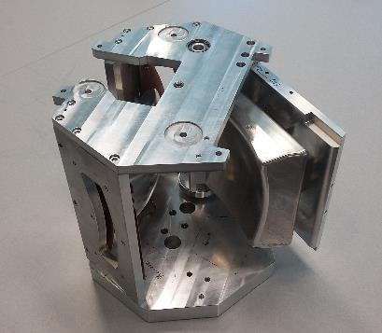
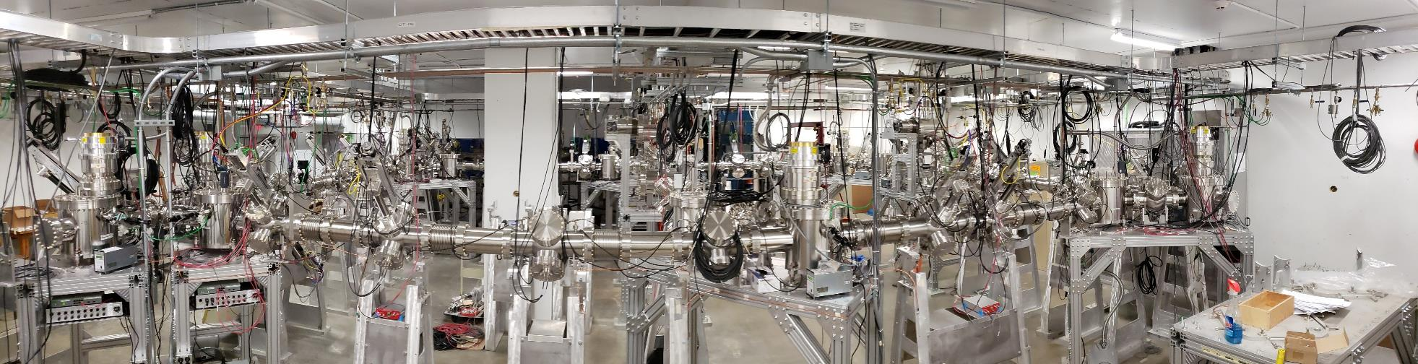
Expertise in beam transport and accelerator systems
Beam line engineering physics group (M. Marchetto)
Beam optics design
Hardware design, engineering and installation of electrostatic and magnetic beam line systems
OPERA® Elektra calculation for electric field
Custom feedthrough developed in collaboration with vender
UHV assembly procedure

Slide 7
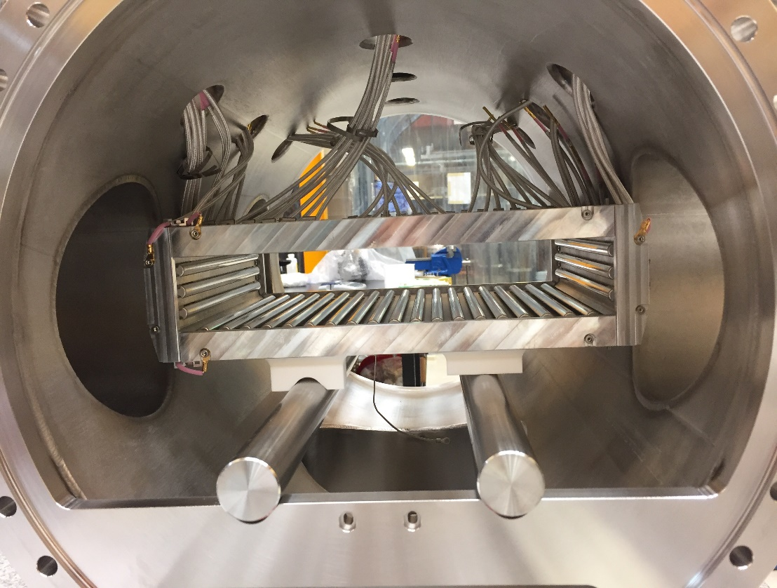
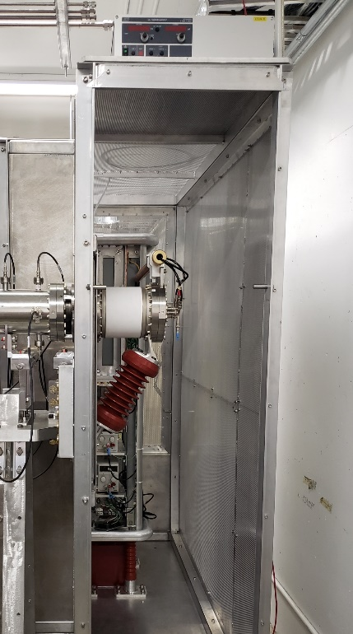
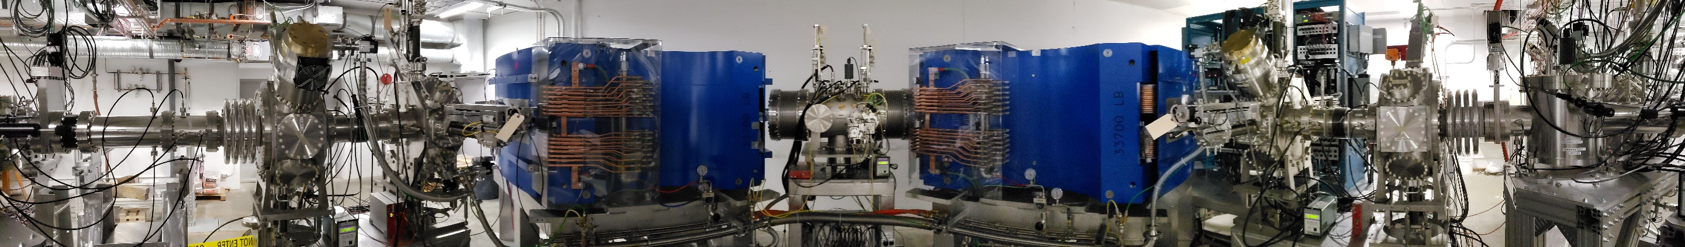
Expertise in special element’s design and construction
Ion source design and engineering
Optics and magnetic dipole design of the high resolution mass separator system (20,000 resolving power for 3 μm transmitted emittance)
Design of multipole corrector
OPERA® Tosca calculation for magnetic field
High manufacturing tolerances
(less than 10 μm)

Slide 8
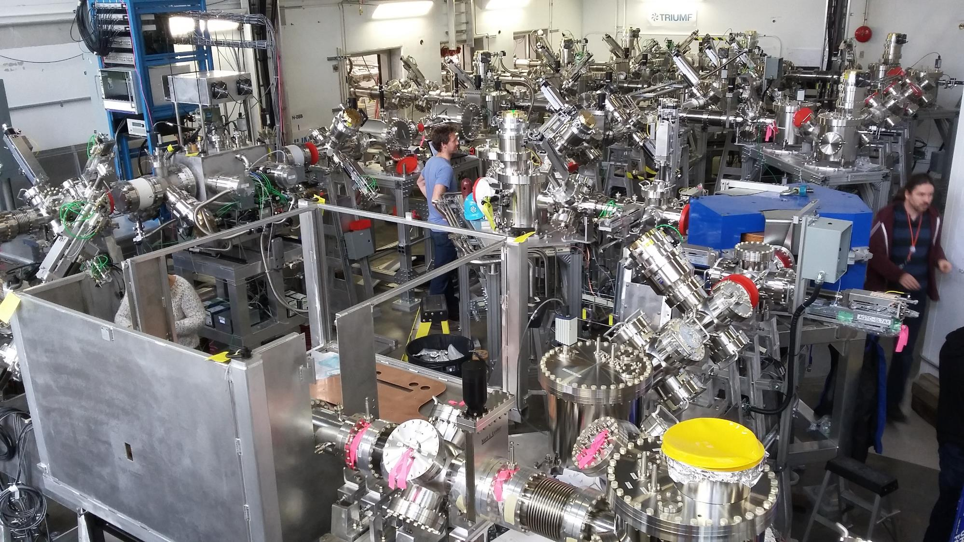

Slide 9
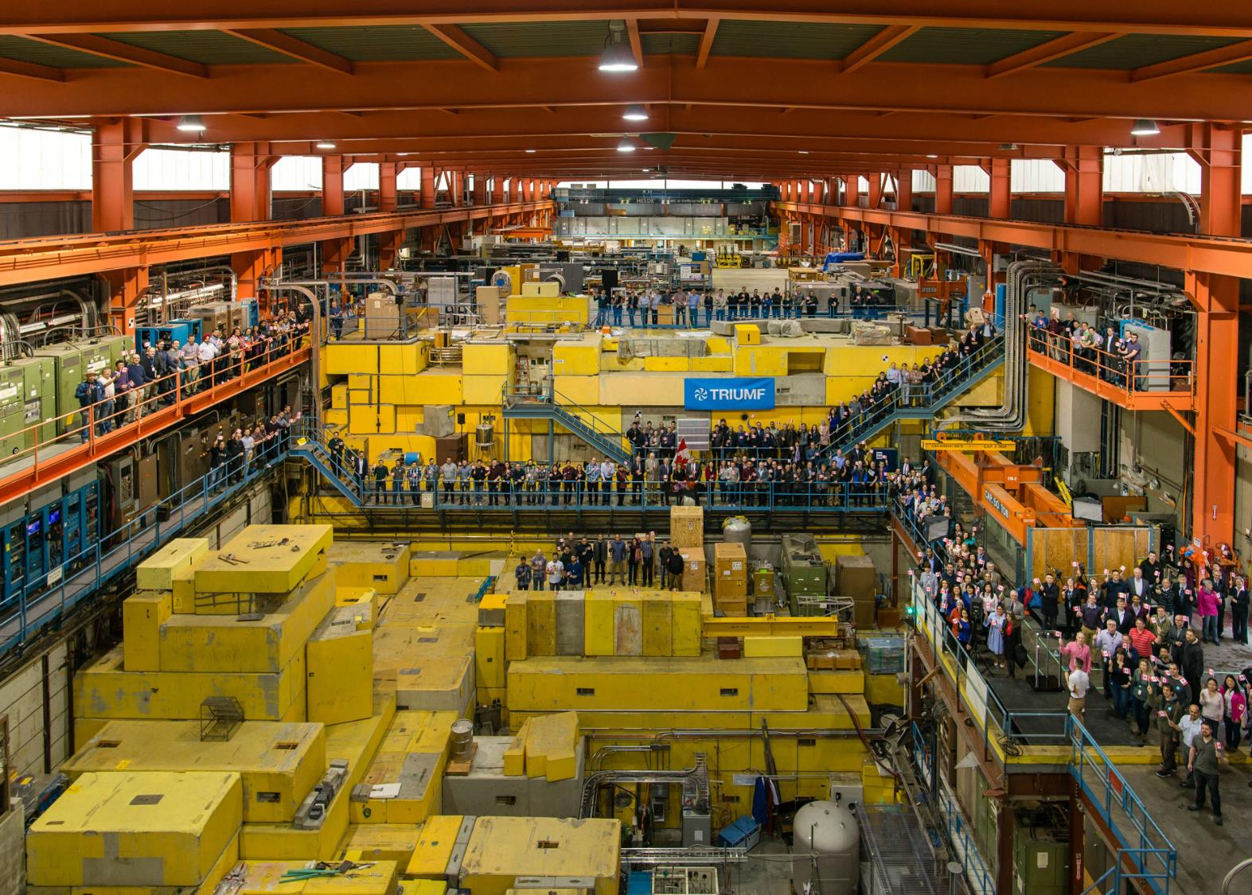



Thank you!
www.triumf.ca
@TRIUMFLab

