Slide 1

Test results MCBXFBP1d
HCMCBXFB001-E9000014
G. Willering, F. Toral, J.C. Perez, M. Bajko, J. Feuvrier, R. Bouvier, J.L. Guyon and with support from many others.
04-09-2019
TE-MSC-TF SM18 magnet test facility

Slide 2
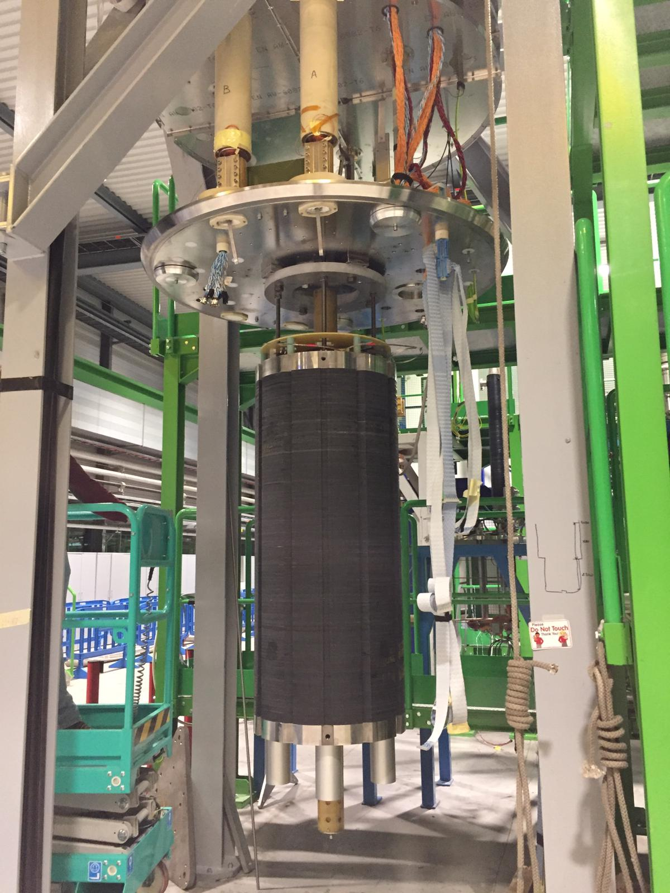
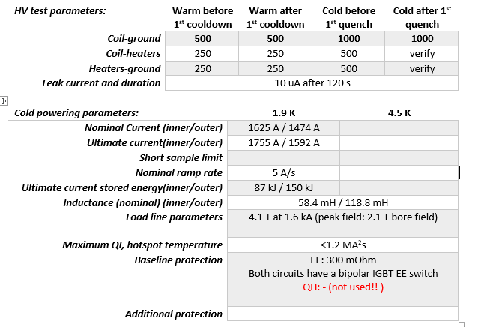
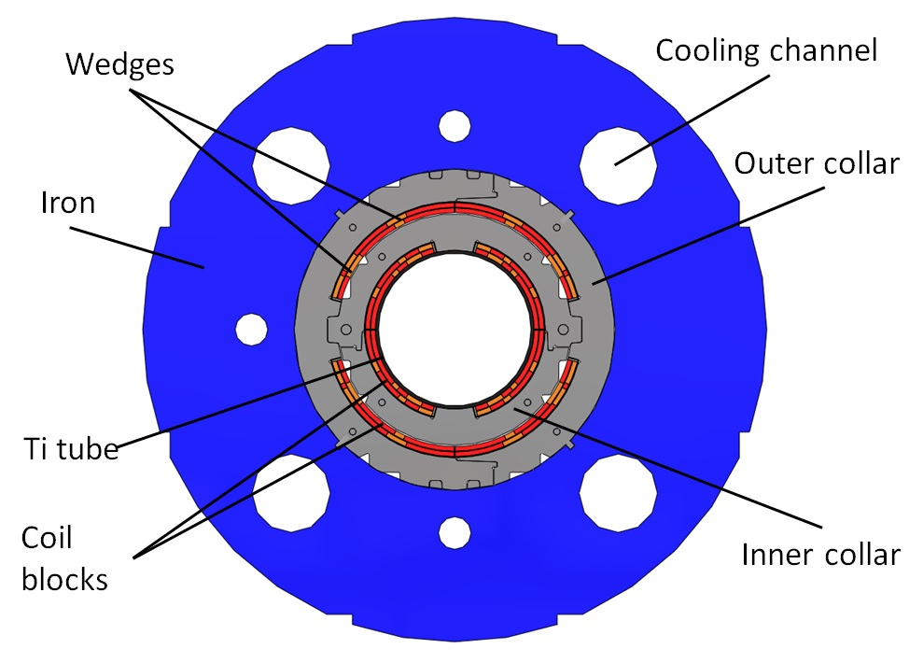
Test program and parameters
Test program outlined in EDMS 2166022

Slide 3
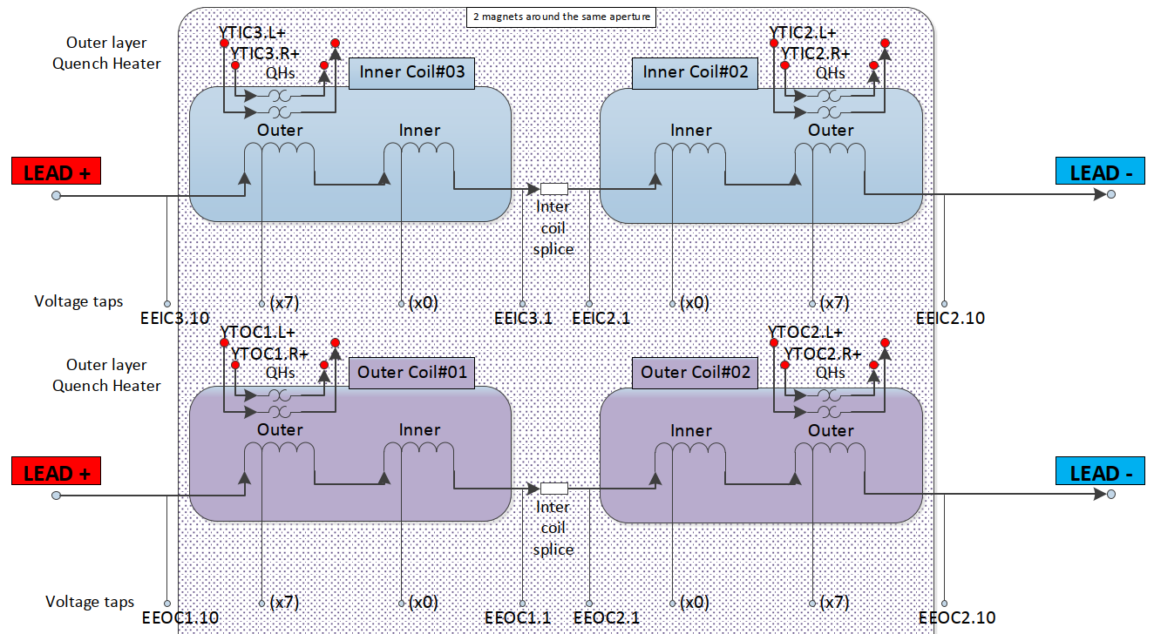
Electrical Layout
Two independently powered nested dipoles.

Slide 4
Individual powering

Slide 5
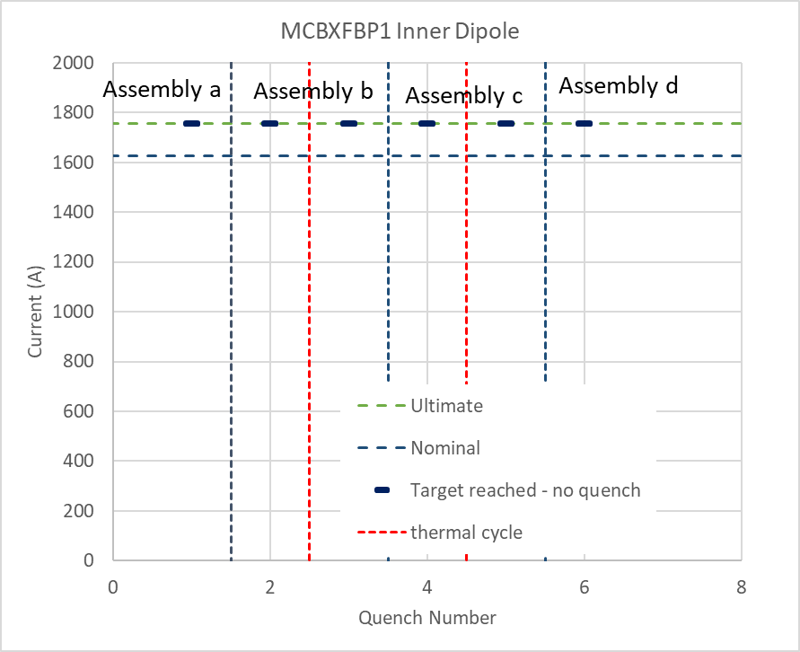
Individual training Inner and outer Dipole
The inner dipole never quenched during individual powering.
Ramp rates:
At 1.9 K to 1755 A no quench at 2 A/s
11 Quenches in first cool down during initial training in assembly b
3 Quenches in first cool down of assembly c
0 quenches in assembly d
No detraining quenches following combined powering tests.
Coil memory very good.

Slide 6
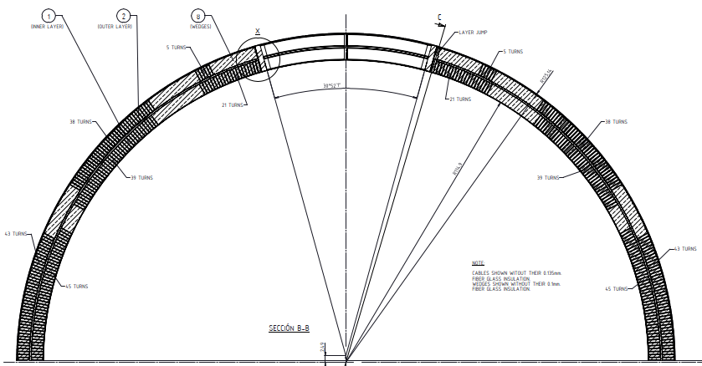
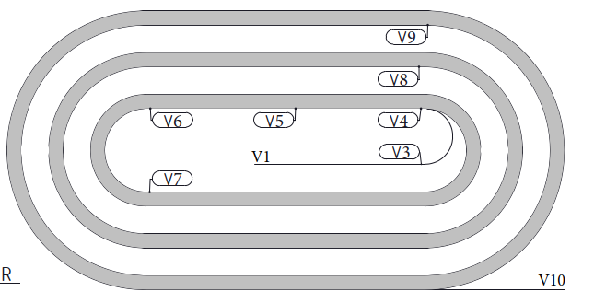
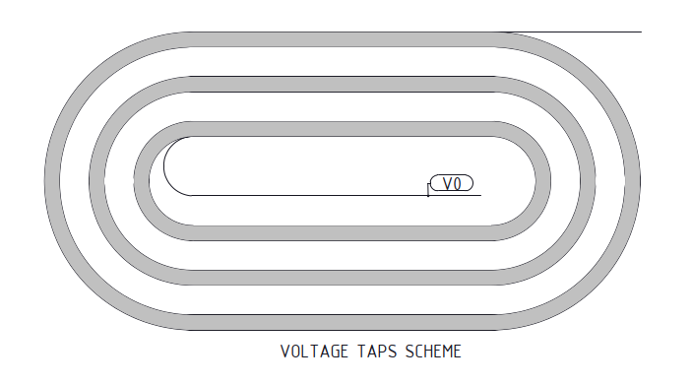
Quench locations Individually powered outer dipole
V4-V6
V3
V8
V7
Assembly b – CD 1
Dipole | Coil | Segment | # quenches
Outer | 1 | Inner layer (V1-V3) | 2
Outer | 2 | Inner layer (V1-V3) | 3
Outer | 1 | Outer pole turn head (V6-V7) | 3
Outer | 2 | Outer pole turn head (V6-V7) | 1
Outer | 1 | Outer multiturn (V8-V9) | 1
Outer | 2 | Outer multiturn (V7-V8) | 1
 |  | Total | 11
V9
V10
V1
Assembly c – CD 1
V1
Dipole | Coil | Segment | # quenches
Outer | 1 | Inner layer (V7-V8) | 3
 |  | Total | 3
Outer layer
Inner layer

Slide 7
Combined powering

Slide 8
Overview all powering
For completeness.

Slide 9
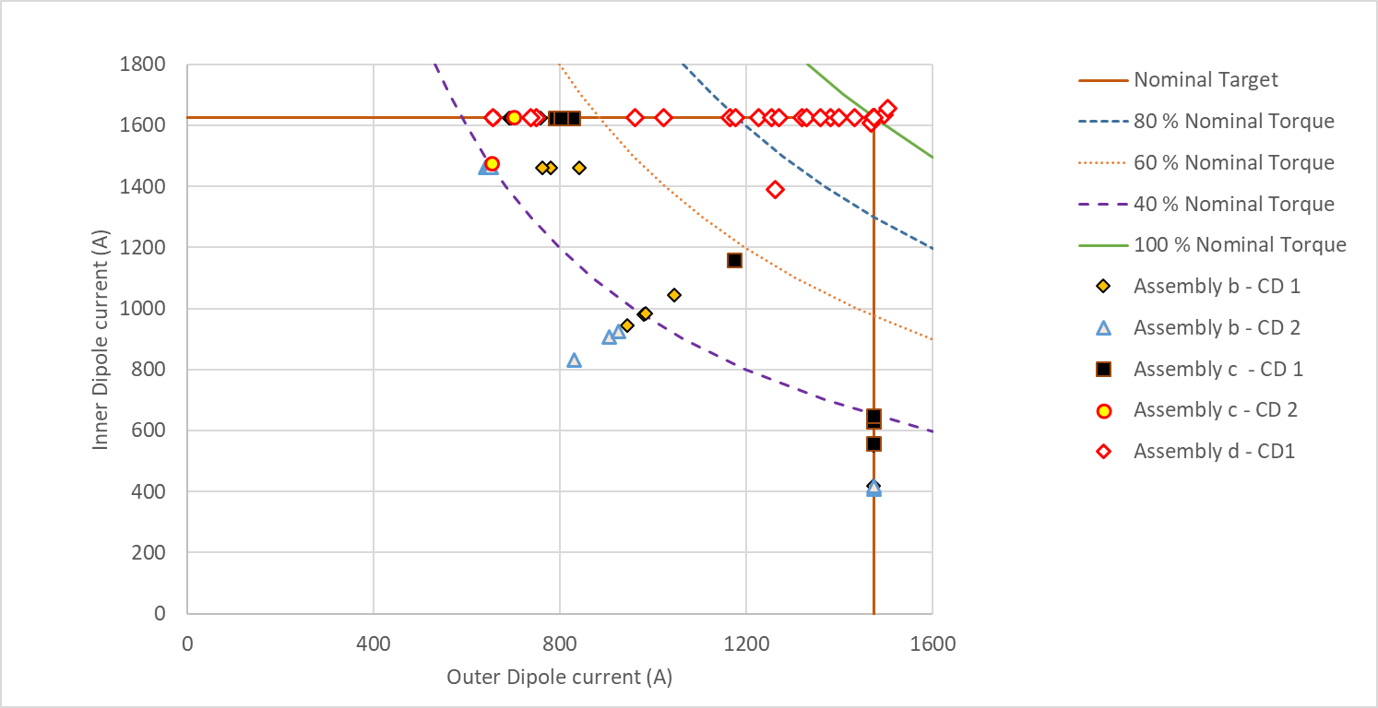
Combined powering. Assembly b, c and d compared
Assembly b and c had limited performance. Highest percentage of about 50 % of the nominal torque reached.
Assembly d trained to nominal current in both dipoles. Later a maximum of 104 % of nominal torque was reached (102 % I_{nom})
Main conclusion
First assembly reaching nominal!

Slide 10
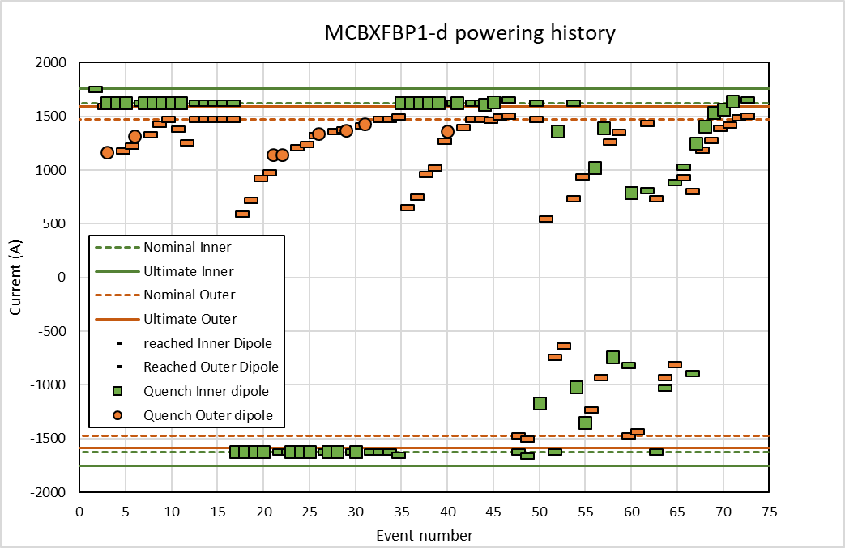
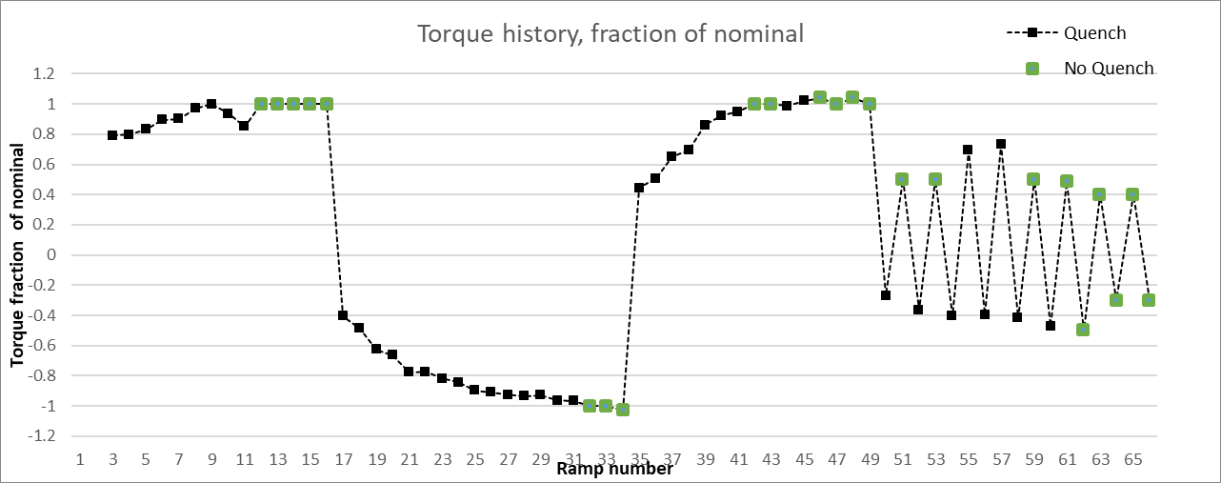
Combined powering – changing torque direction
Training 1 was rather fast
Training 2 in the other quadrant (different torque direction) started at a lower current, but still reached nominal current.
Retraining in the first quadrant, started at a lower current than training 1, but was increasing faster.
Training 1
Special training, switching torque direction each powering cycle, see next slide
Training 2
Inversed
Retraining

Slide 11
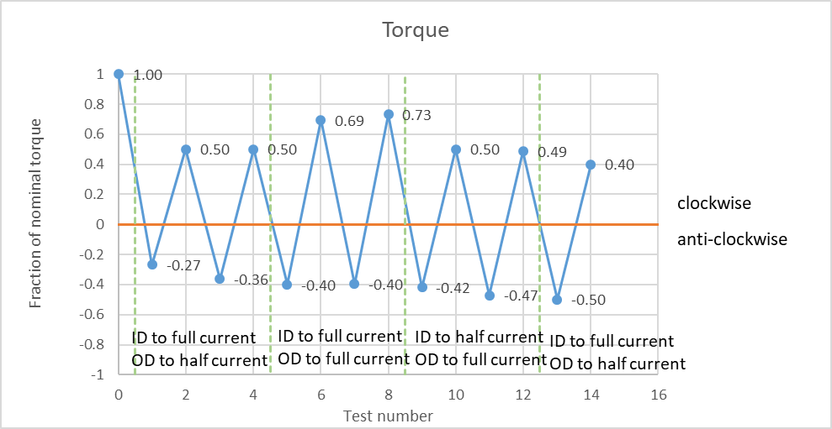
Changing torque direction from test to tests
With various directions of current
(I_{ID} = 0.5 I_{OD} , I_{ID} = I_{OD} and I_{ID} = 2 I_{OD})
In Quadrant 1 and 3 the quenches occur at a torque of 40 to 73 % and in quadrant 2 and 4 between 36 and 50 % of the torque.
Possibly some training effect seen.
Very laborious work, since we do not have bi-polar power converters yet. Manual invertion of the powering cables needed.

Slide 12
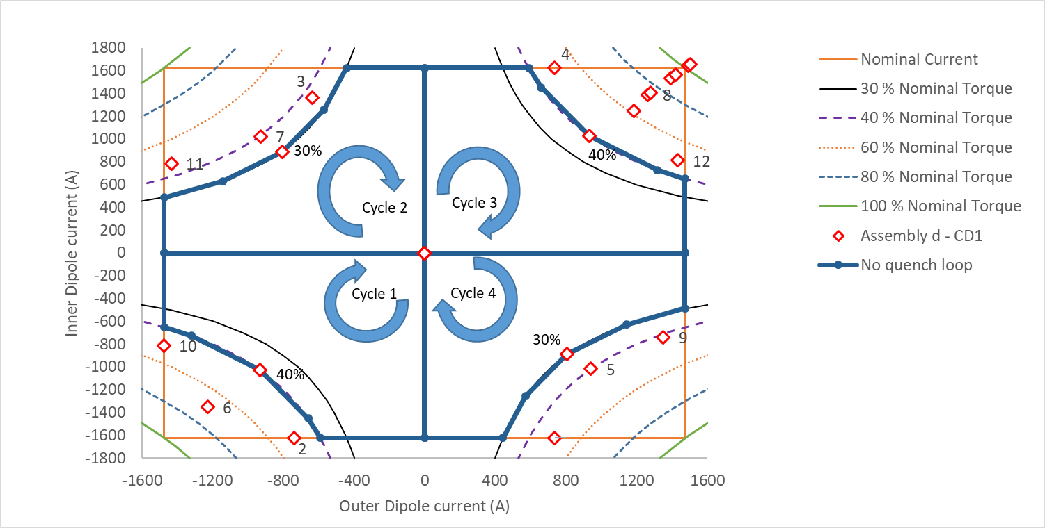
No quench cycle
A cycle was made to shown a non-quench surface.
It follows the 40 % torque line in quadrant 1 and 3 and 30 % torque line in quadrant 2 and 4.
No quench was recorded, so this is a stable zone.

Slide 13
No quench cycle
A second cycle is defined following input from our beams colleagues.
The cycle in orange is foreseen to be done today.

Slide 14
Termal cycle

Slide 15
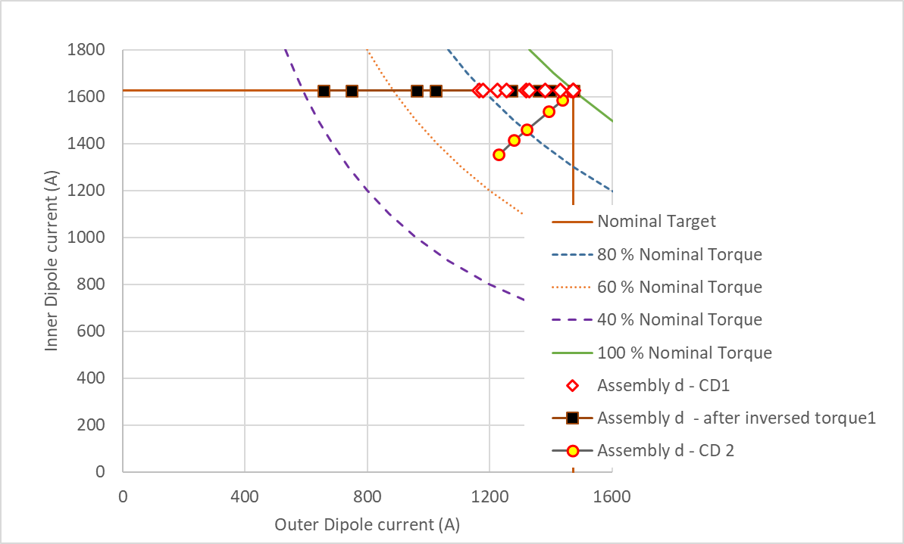
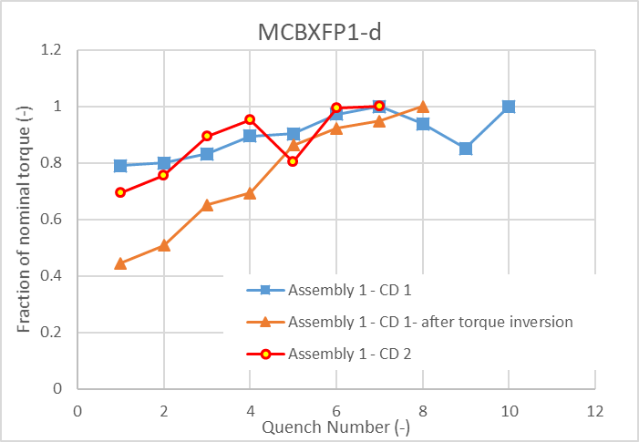
Retraining after thermal cycle
CD 1 training: ramp inner, then outer dipole
CD 2 training: simultaneous ramp
(with quenches mainly in the inner coil, the diagonal may give a slight advantage in quench margin).
Note: Cool down 1 ended with a fully trained magnet in Quadrant 1.
Fraction of torque for easier characterization:
Virgin training in quadrant 1 started at rather high torque for first quench.
Cool down 2 retraining is in about the same rate as virgin training: loss of memory.
Training in quadrant 1 after having a fully trained magnet in quadrant 2 leads to longer retraining than thermal cycle.

Slide 16
Conclusion
Individual powering: Great performance. No quenches in assembly d.
Combined powering: First magnet trained to 102 % of nominal current and 104 % of nominal torque!! Good performance.
Swapping torque directions creates significant detraining. This is is a main remaining challenge for this magnet.
Thermal cycle shows loss of memory, but reached again nominal current in combined powering.

