Slide 1

MCBXFBP1 magnet protection
Alejandro Fernandez Navarro and Fernando Toral Fernandez
(CIEMAT)
4th September 2019

Slide 2
Outline
Magnet and conductor specifications
Electro-thermal models for quench simulation
Models comparison to measuremenets and correction
Reference test predictions for the ID
Reference test predictions for the OD
Conclusions

Slide 3
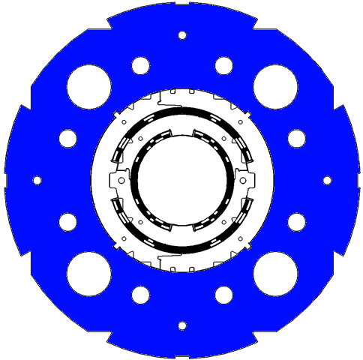
Magnet and conductor specifications
Magnet Parameters | Units | MCBXFA |  | MCBXFB
 |  | Inner Dipole | Outer Dipole | Inner Dipole | Outer Dipole
Nominal current | A | 1584 | 1402 | 1625 | 1474
Bore nominal field | T | 2.18 | 2.20 | 2.23 | 2.31
Bore nominal field (ID + OD) | T | 2.92 |  | 3.06
Ultimate current (2D ROXIE calculation) | A | 1697 | 1514 | 1742 | 1594
Bore ultimate field (factor 7.5/7) | T | 2.33 | 2.36 | 2.39 | 2.47
Superconductor | - | Nb-Ti |  | Nb-Ti
Operating temperature | K | 1.9 |  | 1.9
Aperture | mm | 156 | 230 | 156 | 230
Magnetic length | m | 2.2 |  | 1.2
Differential inductance at nominal current | mH | 107.1 | 232.3 | 58.4 | 124.8
Stored energy at nominal current | kJ | 133.8 | 239.4 | 76.8 | 143.2
Number of layers per coil | - | 2 | 2 | 2 | 2
Number of turns per coil | - | 140 | 191 | 140 | 191
Conductor Parameters | Units | Value
Cable type | - | Rutherford
Number of strands | - | 18
Strand diameter | mm | 0.48
Cu/Sc | - | 1.75
RRR | - | 140 (meas.)
Bare cable width | mm | 4.37
Bare cable mid-thickness | mm | 0.86
Cable insulation type | - | 66TEX933 fiberglass
Cable insulation thickness | mm | 0.135
Key-stone angle | deg | 0.67
Cable twist-pitch | mm | 66

Slide 4
Electro-thermal models for quench simulation
Modeled and simulated each dipole magnet independently (inners/Outers). Conservative assumption.
Induced currents (quench back) not modeled. Conservative assumption.
Modeled both transversal and longitudinal quench propagation.
Cables adiabatic to the He bath (fiber glass impregnated cables).
Quench integral calculated from the moment of the initial quench.
Quench detection parameters: for model validation, quench detection time from measurements. For test predictions, detection voltage 100 mV and minimum detection time 20 ms. Quench validation time: 10 ms.
For test predictions initial quench in the pole turn conductor (highest field).
Initially assumed RRR=120. Measured RRR≈140 for both ID and OD.
SQUID
ROXIE
CIEMAT in-house code in Matlab language. Finite differences method.
CERN in-house code. BEM-FEM.

Slide 5
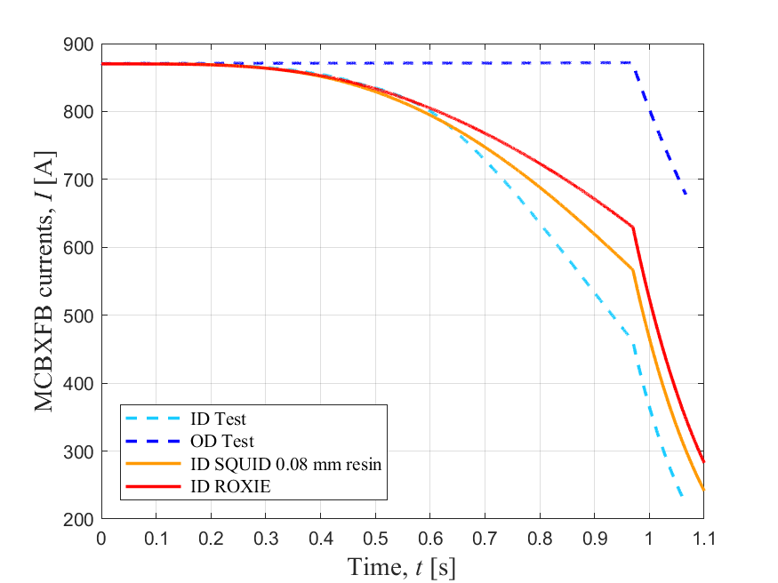
Quench with dump resistor with 900 ms delay
(April 2019)
Quench in the end coil midplane of the Inner Dipole with both dipoles powered at 870 A.
t=0 at the initial quench. 60 ms for quench detection plus 10 ms for quench validation.
0.3 Ohm dump resistor with 900 ms delay from validated quench.
Assumed RRR=120.
SQUID model corrected by increasing the resin thickness between cables from 0.002 mm to 0.08 mm (separation in cables with higher resin amount have been observed in the pole region of the actual manufactured coils, where the quench starts). Magnetic field from both dipoles taken into account.
ROXIE matches the test measurements the first 600 ms. Good prediction without correction factors for low current and quench in the midplane.
The ROXIE model and the corrected SQUID model still should be considered as conservative.

Slide 6
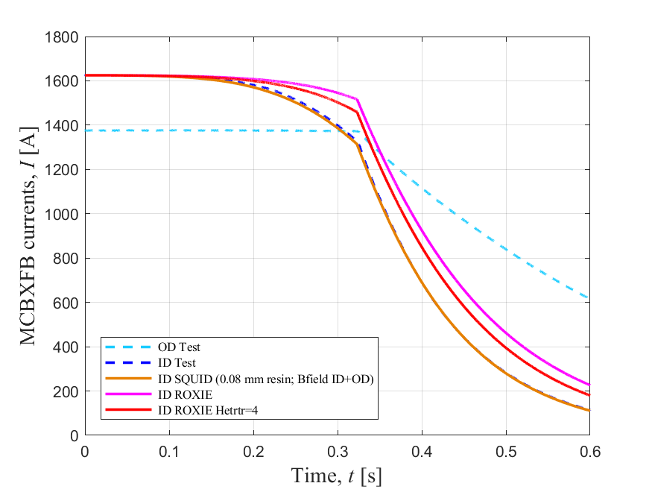
Q21: Quench in ID at 1625 A with dump resistor with 300 ms delay (August 2019)
Quench in the pole turn of the Inner Dipole at nominal current with OD at 1376 A.
t=0 at the initial quench. 13 ms for quench detection plus 10 ms for quench validation.
0.3 Ohm dump resistor with 300 ms delay from validated quench.
Measured RRR=140.
Used SQUID and ROXIE models corrected with April data. SQUID with 0.08 mm resin thicknes, ROXIE without correction factors.
SQUID predicts very good the discharge.
ROXIE for higher currents and quench in the pole turn is much more conservative than in the previous case studied. The impact of the combined field would accelerate the discharge, but still at least a correction factor of HETRTR=4 is needed (see impact of combined magnetic field in Annex).
SQUID corrected model is considered realistic while ROXIE model with HETRTR=4 still should be conservative.

Slide 7
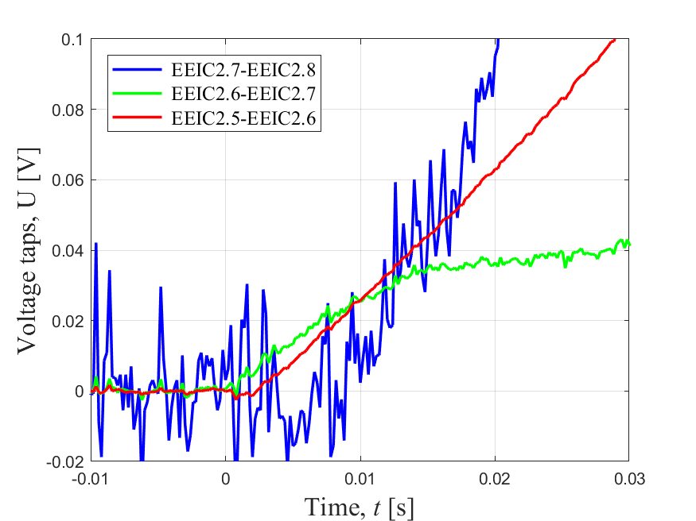
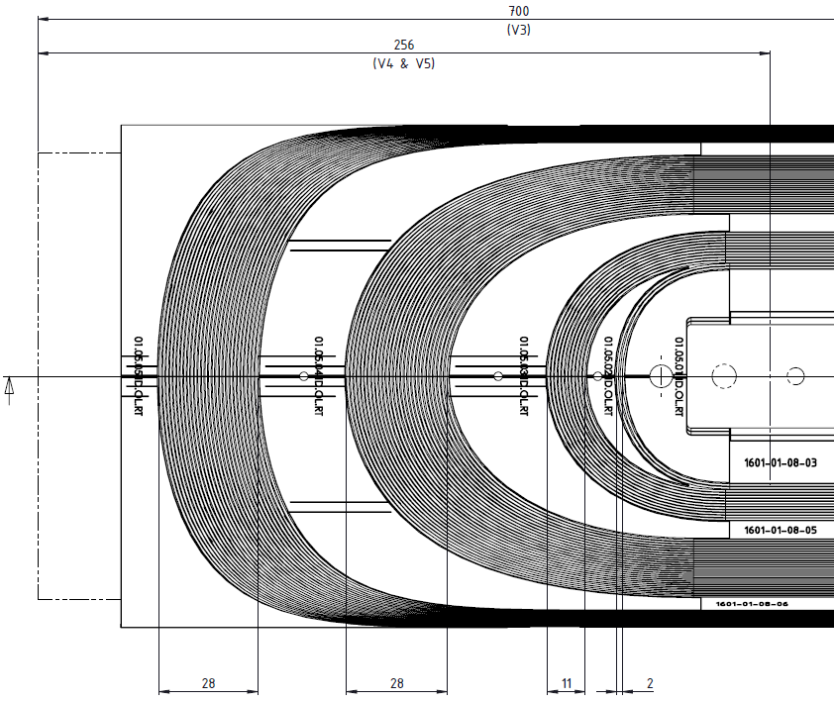
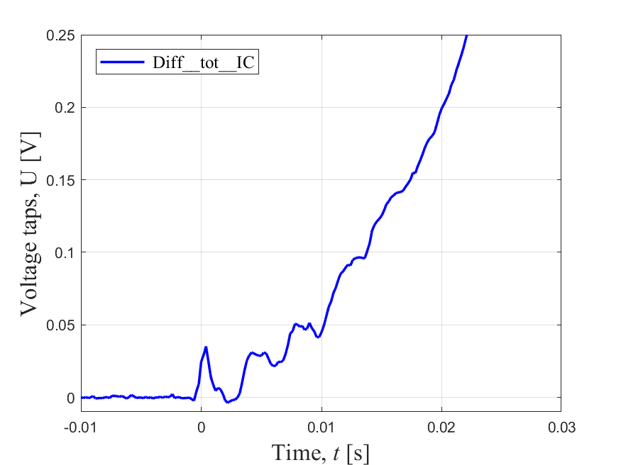
Q21: Quench in ID at 1625 A. Quench propagation velocity
Longitudinal quench propagation velocity calculated with the voltage taps information plus geometry (assuming velocity from quench to EEIC2.6 equals velocity to EEIC2.7): 12.6 m/s. SQUID: 7.4 m/s.
9 ms
Quench in the coil end pole turn.
2 ms
Quench
EEIC2.6
Turn-to-turn propagation time
EEIC2.7
SQUID: 1.5 ms
The SQUID underestimation of the initial longitudinal quench velocity compensates the overestimation of the transversal velocity.
10 ms

Slide 8
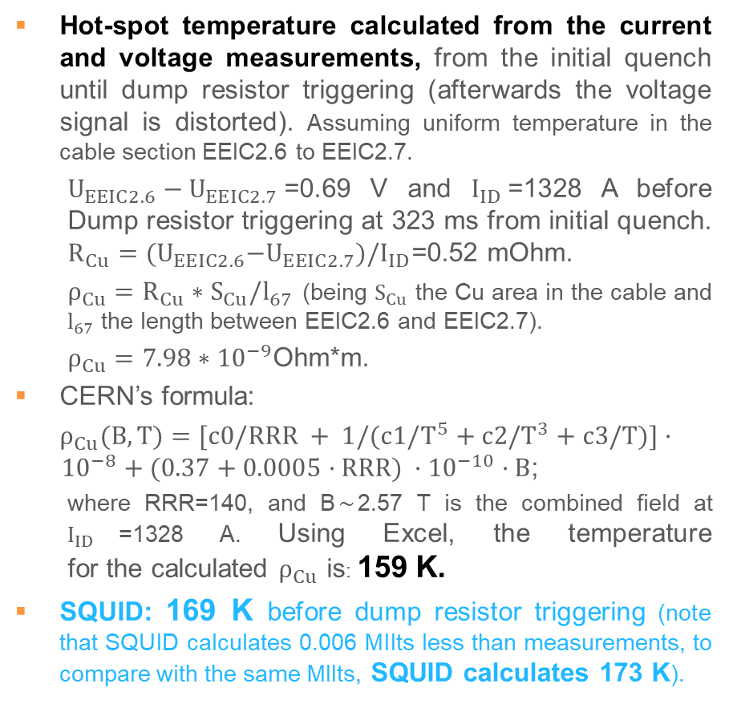
Q21: Quench in ID at 1625 A. Hot-spot temperature
Hot-spot temperature calculated from the current and voltage measurements, from the initial quench until dump resistor triggering (afterwards the voltage signal is distorted). Assuming uniform temperature in the cable section EEIC2.6 to EEIC2.7.
  $U_{EEIC2.6}−U_{EEIC2.7}$=0.69 V and $I_{ID}$=1328 A before Dump resistor triggering at 323 ms from initial quench. $R_{Cu}={(U}_{EEIC2.6}−U_{EEIC2.7})/I_{ID}$=0.52 mOhm.
  $ρ_{Cu}=R_{Cu}∗S_{Cu}/l_{67}$ (being $S_{Cu}$ the Cu area in the cable and $l_{67}$ the length between EEIC2.6 and EEIC2.7).
  $ρ_{Cu}=7.98∗{10}^{−9}$Ohm*m.
CERN’s formula:
$ρ_{Cu}(B, T)=[c0/RRR + 1/(c1/T^{5}+c2/T^{3}+c3/T)]·{ 10}^{−8} + (0.37+0.0005·RRR) ·{10}^{−10}·B$;
  where RRR=140, and B$\sim$2.57 T is the combined field at $I_{ID}$=1328 A. Using Excel, the temperature for the calculated $ρ_{Cu}$ is: 159 K.
SQUID: 169 K before dump resistor triggering (note that SQUID calculates 0.006 MIIts less than measurements, to compare with the same MIIts, SQUID calculates 173 K).
Quench
EEIC2.6
EEIC2.7
SQUID acceptably estimates the hot-spot temperature of the MCBXFB-ID, being conservative by ~8 %.

Slide 9
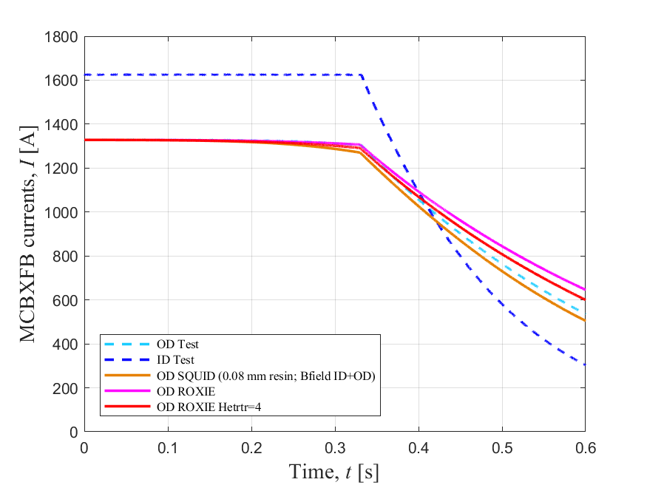
Q4: Quench in OD at 1328 A with dump resistor with 300 ms delay (August 2019)
Quench in the pole turn of the Outer Dipole at 1328 A with the Inner Dipole at nominal current, 1625 A.
t=0 at the initial quench. 20 ms for quench detection plus 10 ms for quench validation.
0.3 Ohm dump resistor with 300 ms delay from validated quench.
Measured RRR=140.
Used SQUID and ROXIE models corrected with April data. SQUID with 0.08 mm resin thickness, ROXIE without correction factors.
SQUID still seems to be slightly optimistic, but more delay of the dump resistor is needed for a proper comparison.

Slide 10
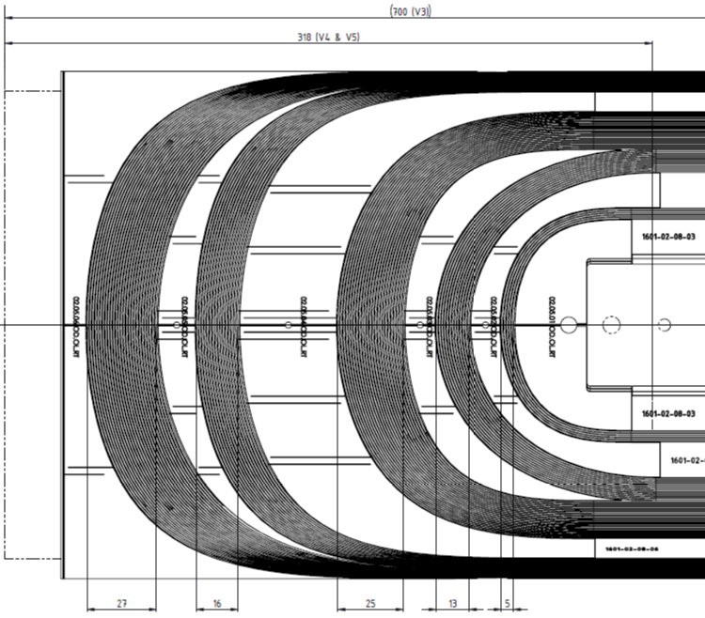
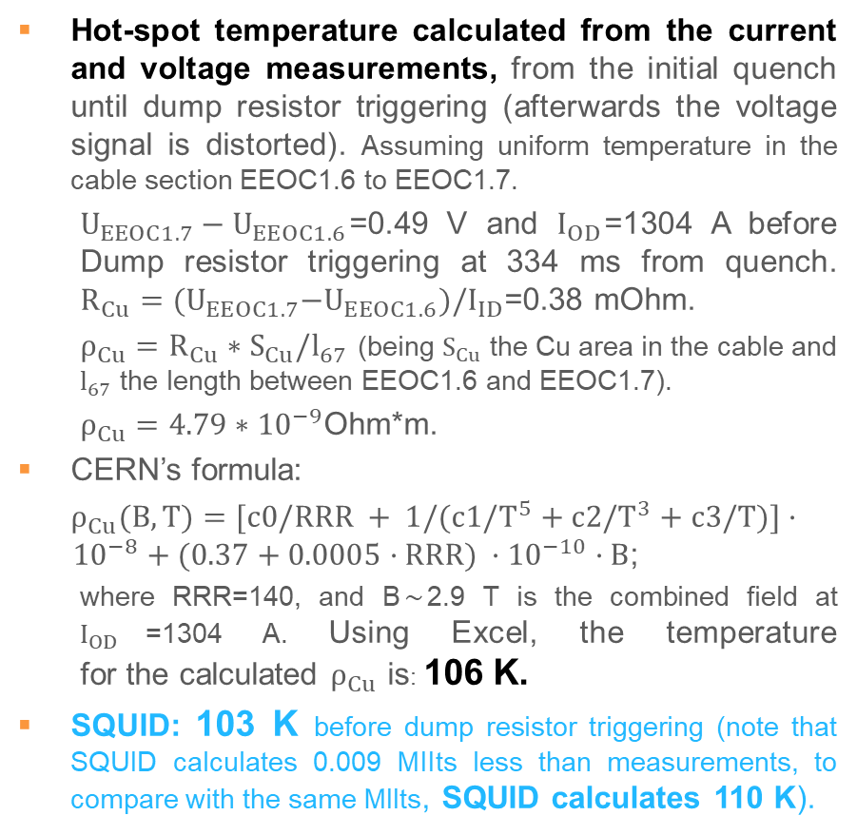
Q4: Quench in OD at 1328 A. Hot-spot temperature
Hot-spot temperature calculated from the current and voltage measurements, from the initial quench until dump resistor triggering (afterwards the voltage signal is distorted). Assuming uniform temperature in the cable section EEOC1.6 to EEOC1.7.
  $U_{EEOC1.7}−U_{EEOC1.6}$=0.49 V and $I_{OD}$=1304 A before Dump resistor triggering at 334 ms from quench. $R_{Cu}={(U}_{EEOC1.7}−U_{EEOC1.6})/I_{ID}$=0.38 mOhm.
  $ρ_{Cu}=R_{Cu}∗S_{Cu}/l_{67}$ (being $S_{Cu}$ the Cu area in the cable and $l_{67}$ the length between EEOC1.6 and EEOC1.7).
  $ρ_{Cu}=4.79∗{10}^{−9}$Ohm*m.
CERN’s formula:
$ρ_{Cu}(B, T)=[c0/RRR + 1/(c1/T^{5}+c2/T^{3}+c3/T)]·{ 10}^{−8} + (0.37+0.0005·RRR) ·{10}^{−10}·B$;
  where RRR=140, and B$\sim$2.9 T is the combined field at $I_{OD}$=1304 A. Using Excel, the temperature for the calculated $ρ_{Cu}$ is: 106 K.
SQUID: 103 K before dump resistor triggering (note that SQUID calculates 0.009 MIIts less than measurements, to compare with the same MIIts, SQUID calculates 110 K).
EEOC1.6
Quench
EEOC1.7
SQUID accurately estimates the hot-spot temperature of the MCBXFB-OD, being conservative by ~4 %.

Slide 11
Conclusions
Electro-thermal numerical models of the MCBXFB magnet for quench simulation were developed in SQUID and ROXIE.
The models predictions were compared to the MCBXFB1 measurements in April and again with the last measurements in August, for different quench scenarios.
The corrected SQUID model with the increased resin thickness from 0.002 mm to 0.08 m predicts very well the cases. SQUID is conservative in the hot-spot temperature calculation for given MIIts (see Annex T Vs. QL), while ROXIE is more conservative in MIIts for a given quench case.
We are still working on the models, trying to refine the predictions for higher currents.
More tests are ongoing with increased delays in the energy extraction.

Slide 12
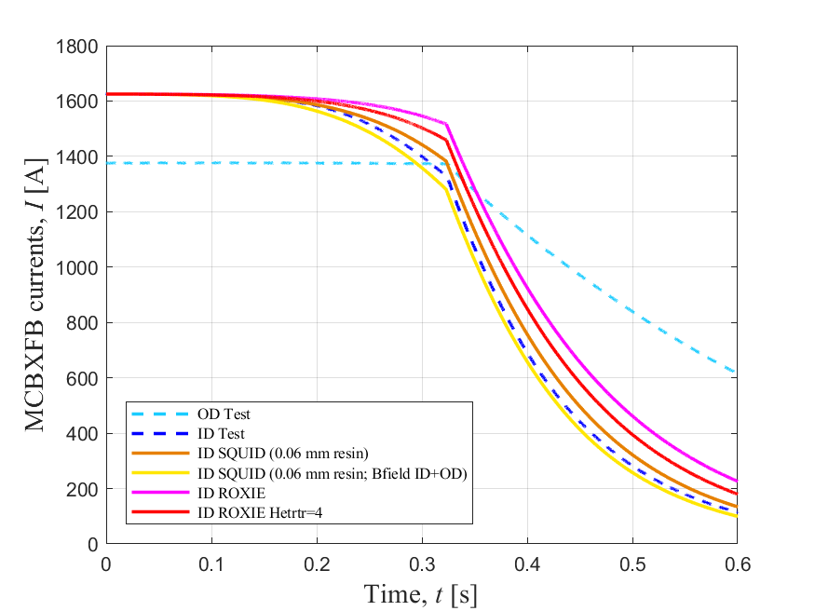
Annex: Impact of the combined magnetic field in Q21 (August 2019)
Quench in the pole turn of the Inner Dipole at nominal current, 1625 A, with OD at 1376 A.
t=0 at the initial quench. 13 ms for quench detection plus 10 ms for quench validation.
0.3 Ohm dump resistor with 300 ms delay from validated quench.
Measured RRR=140.
Used SQUID with 0.06 mm resin thickness.
The impact of the combined magnetic field in SQUID is comparable to the impact of a factor HETRTR=4 in ROXIE. Therefore, ROXIE with HETRTR=8 approximately would fit the measurements.

Slide 13
Annex: T Vs. QL comparison
Assumptions
The calculations from SM18 are done through an Excel sheet and the DIAdem code assuming RRR=200 and fixed magnetic field through the discharge. There are 6 models depending on the simplifications assumed: With and without cable insulation at 0 T magnetic field; with and without insulation at 2.4 T; and with and without insulation at 4 T.
2.4 T approximately corresponds to the peak magnetic field for nominal current of the independently powered dipoles. 4 T approximately corresponds to the peak magnetic field for combined powering at nominal current. Considering the cable insulation in the model should be realistic, while not considering it is a conservative assumption.
The calculations in SQUID and ROXIE assume as well RRR=200 for comparison. The cases studied assume the magnet (either the Inner Dipole or the Outer Dipole) discharged through free quench propagation only, without other active means of quench protection. The initial currents are 70%, 80 % of nominal current, nominal current and ultimate current.

Slide 14
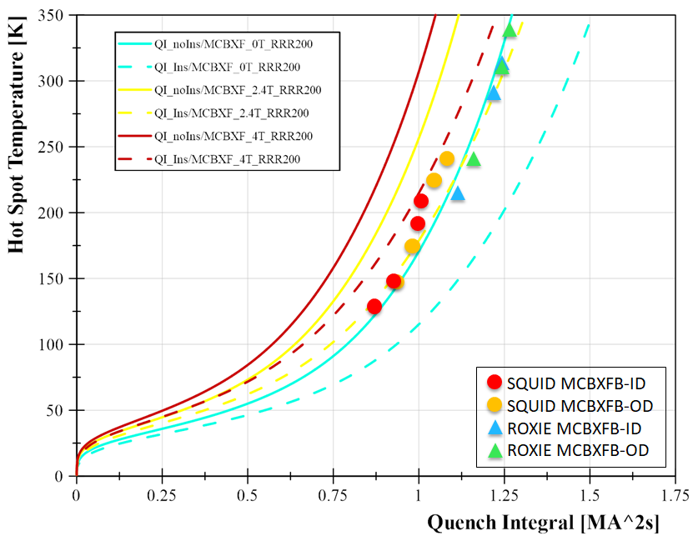
Annex: Temperature Vs. Quench Load

Slide 15
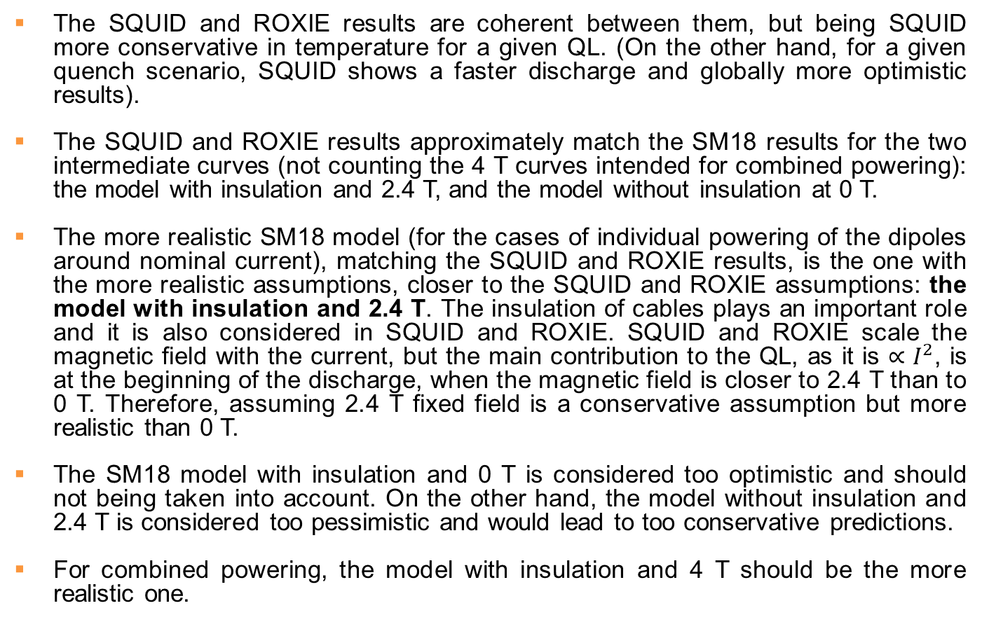
Annex: T Vs. QL Conclusions
The SQUID and ROXIE results are coherent between them, but being SQUID more conservative in temperature for a given QL. (On the other hand, for a given quench scenario, SQUID shows a faster discharge and globally more optimistic results).
The SQUID and ROXIE results approximately match the SM18 results for the two intermediate curves (not counting the 4 T curves intended for combined powering): the model with insulation and 2.4 T, and the model without insulation at 0 T.
The more realistic SM18 model (for the cases of individual powering of the dipoles around nominal current), matching the SQUID and ROXIE results, is the one with the more realistic assumptions, closer to the SQUID and ROXIE assumptions: the model with insulation and 2.4 T. The insulation of cables plays an important role and it is also considered in SQUID and ROXIE. SQUID and ROXIE scale the magnetic field with the current, but the main contribution to the QL, as it is ${∝I}^{2}$, is at the beginning of the discharge, when the magnetic field is closer to 2.4 T than to 0 T. Therefore, assuming 2.4 T fixed field is a conservative assumption but more realistic than 0 T.
The SM18 model with insulation and 0 T is considered too optimistic and should not being taken into account. On the other hand, the model without insulation and 2.4 T is considered too pessimistic and would lead to too conservative predictions.
For combined powering, the model with insulation and 4 T should be the more realistic one.

Slide 16
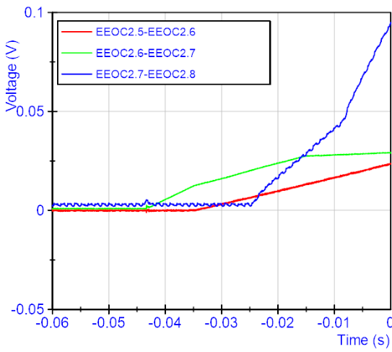
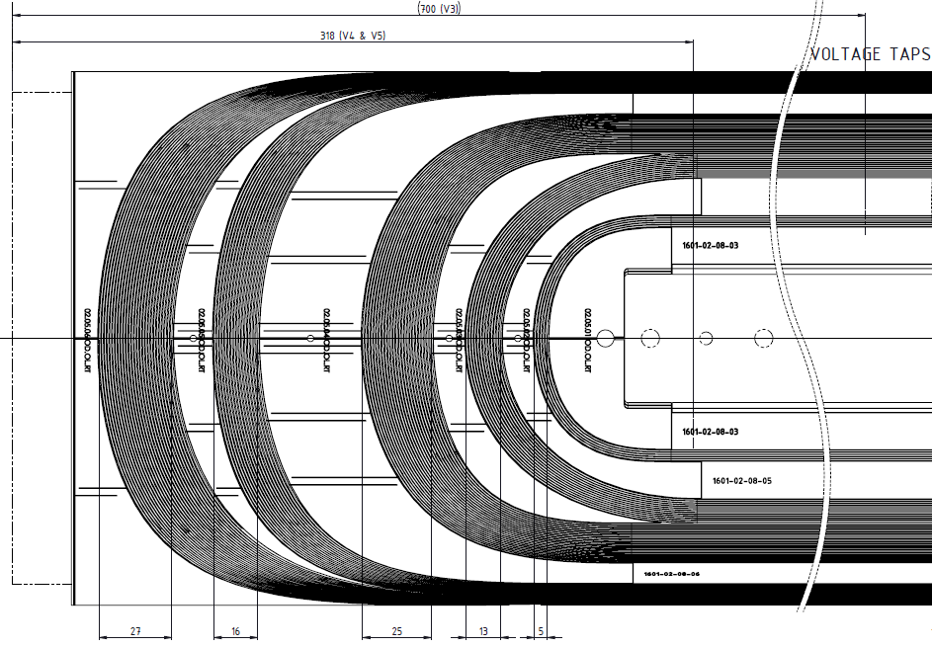
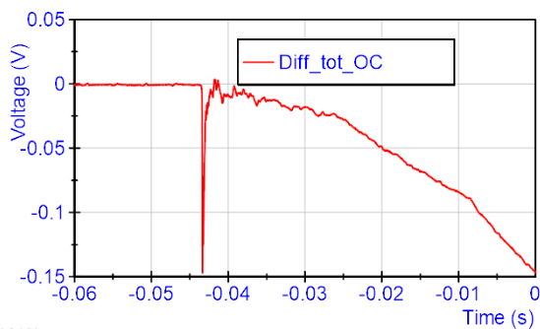
Annex: Quench in the Outer Dipole at 1165 A
Quench in the coil end pole turn of the Outer Dipole powered alone at 1165 A. 0.3 Ohm dump resistor with no delay.
EEOC2.6
9 ms
Quench
19 ms
EEOC2.7
Turn-to-turn propag. time
Longitudinal quench propagation velocity calculated with the voltage taps information plus geometry: 6.4 m/s.
SQUID: 2.7 m/s.
17 ms
18 ms
SQUID: 2 ms
ROXIE 2D: 12 ms

Slide 17
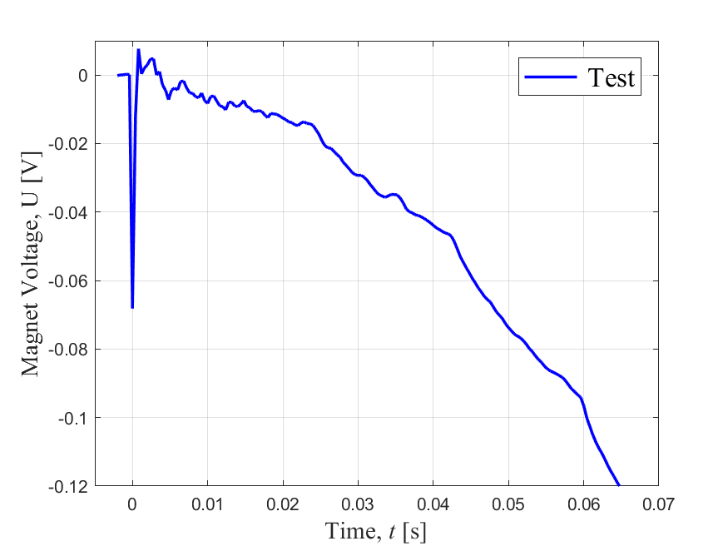
Annex: Quench with dump resistor with 900 ms delay
Quench in the Inner Dipole with both dipoles powered at 870 A.
t=0 at the initial quench. 60 ms for quench detection (100 mV) plus 10 ms for quench validation.
Turn-to-turn propagation time
22 ms
20 ms
18 ms
SQUID: 3 ms
ROXIE 2D: 26 ms

Slide 18
Annex: Conclusions for quench propagation velocity
Electro-thermal numerical models of the MCBXFB magnet for quench simulation were developed in SQUID and ROXIE with an estimated RRR=120.
SQUID and ROXIE predictions have been compared to the MCBXFB1 measurements for two tests with free quench propagation (dump resistor delays of 900 ms and 1000 ms).
SQUID overestimates the transversal quench propagation velocity while underestimates the longitudinal propagation. The current discharge is faster than measurements at the beginning of the discharge being the model slightly optimistic.
ROXIE’s model is more conservative, underestimating mainly the transversal quench propagation velocity. The current discharge is slower than measurements, MIIts are pessimistic.
The ROXIE model has been improved by introducing a correction factor of 2 in the transversal heat transfer coefficient in ROXIE.
The corrected models match the test current during the first 600 ms of the discharge, but their current decrease is slower afterwards. Therefore, the calculated results should be considered as conservative.
The reason for the faster measured discharge after 600 ms could be the quench back effect (Eddy currents), not accounted in the numerical models. However, a preliminary calculation with ROXIE shows that the impact of this effect is negligible.

