Slide 1
Designing the cross section of the MBXF prototype
Kento Suzuki
WP3 meeting, 04/09/2019

Slide 2
Contents
Review of design procedure for MBXFS2 and 3
Supplemental slides can be found at
https://indico.cern.ch/event/844249/contributions/3552239/attachments/1901676/3140152/20190725_CERN-KEK_meetingv2.pdf
Determination of the correction b₃
Coil deformation
Data– calc. discrepancy at nominal current
3D effect
Expected b3 integral of the prototype

Slide 3
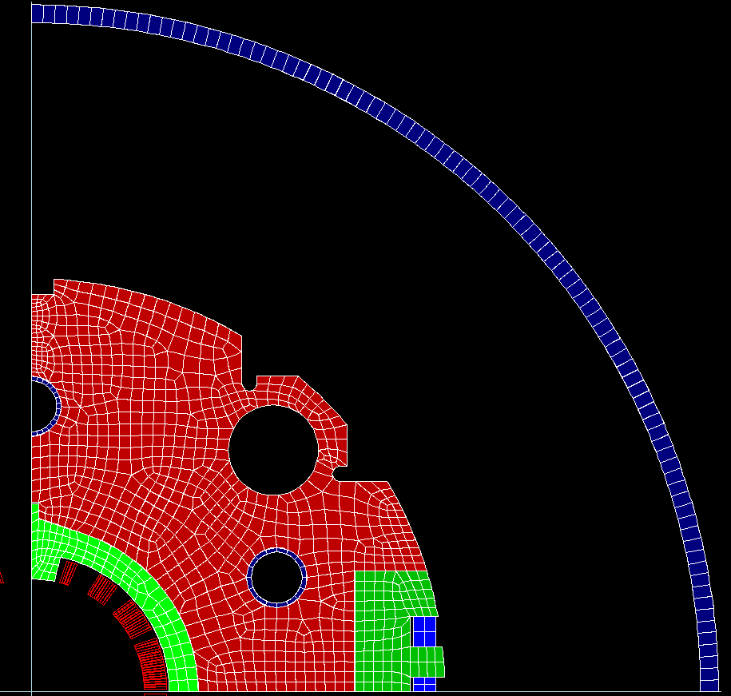
MBXF short models so far
MBXFS1 (80 MPa)
MBXFS2 (115 MPa)
MBXFS3 (115 MPa)
Cryostat
HX hole
HX Φ 60
HX Φ 61
Yoke
Collar
Coil blocks
Tested in 2016-2017
Tested in 2018
Under testing
ROXIE 2D input | MBXFS1 | MBXFS2 and 3
φ₁ (deg) | 1.026 | 1.135
φ ₂ (deg) | 27.852 | 27.872
φ₃ (deg) | 50.308 | 50.297
φ₄ (deg) | 70.635 | 70.699
α₁ (deg) | 0 | 0
α₂ (deg) | 26.000 | 26.000
α₃ (deg) | 52.351 | 52.421
α₄ (deg) | 68.002 | 68.002
Azimuthal insulation thickness (mm) | 0.135 | 0.130

Slide 4
MFM results for Model#2 and #3
RE
SS
~20 units
 | MBXFS2 | MBXFS3
 | After the cold test (warm, z=0) | After yoking (z=-321.5) | After shell weld. (z=-312.6)
b3 | 18.88 | 21.96 | 21.88
b5 | -1.96 | -2.31 | -2.57
We saw ~20 units offset in b₃ for both Model#2 and 3

Slide 5
M. Sugano, F2F meeting on 25/07/19
It was found that the wedge design in Model #2 and #3 was inadequate.
The detailed explanation can be found in
https://indico.cern.ch/event/844249/contributions/3552239/attachments/1901676/3140152/20190725_CERN-KEK_meetingv2.pdf
For MBXFP: azimuthal cable insulation thickness : 0.122 mm (GFRP E=31.5 GPa) in the ROXIE2D design
Ref.) 0.130 mm for Model #2 and #3

Slide 6
Secondary effect: coil deformation
M. Sugano and K. Suzuki, D1 technical meeting on 10/07/19
We have evidence that the coil is deviated from the perfect circular model

Slide 7
Designing MBXFP
Azimuthal cable insulation thickness : 0.122 mm (GFRP E=31.5 GPa)
ROXIE2D design optimization
at I=3 kA and T=1.9 K
OPERA3D calculation*
Verify integral b_{n} at I=12 kA
Correction on b₃ from :
Coil deformation
Data-calc. difference at 12 kA
3D effects
Correction to get final b₃:
- Coil deformation
- Data-calc. different at 12 kA
(*) 3D effects are already included

Slide 8
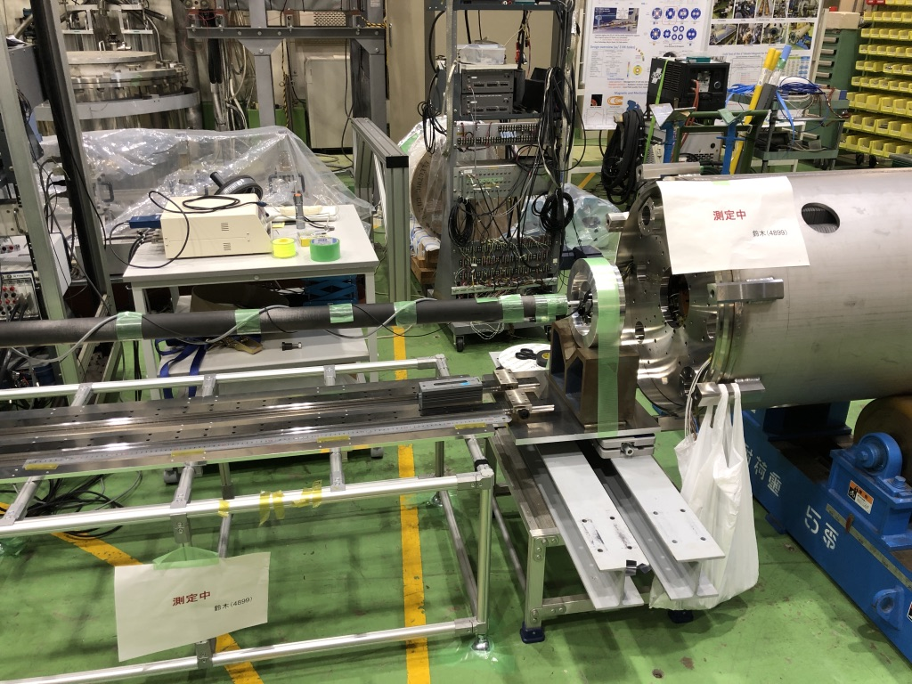
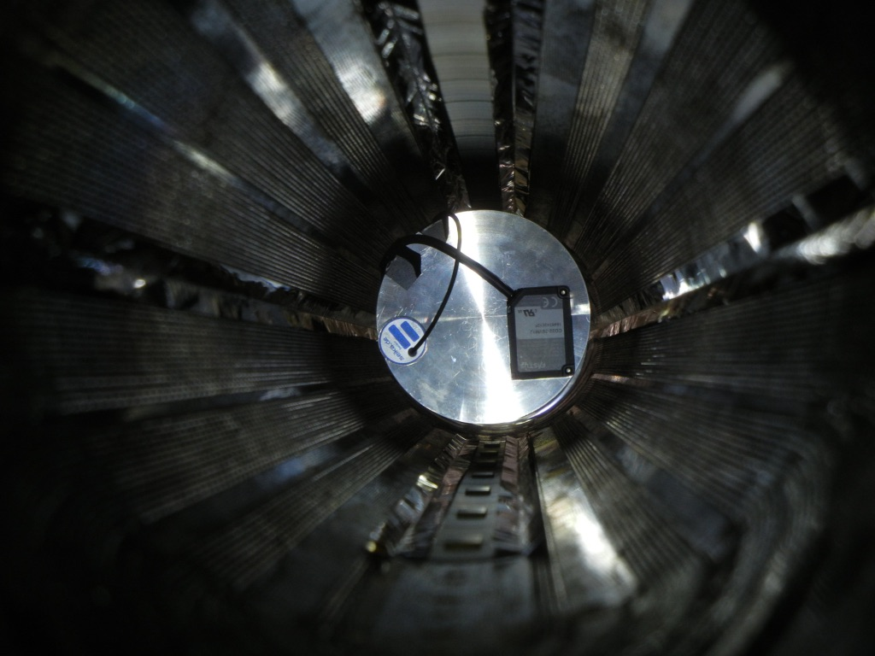
Measurement of the coil deformation
Rotary table
Stepping motor
CFRP pipe
XZ stage
Laser Displacement meter (LDM)
Reference
gauge (R=75)
Rotary table
MBXFS2
LDM
(CD22-35 )
Tilt sensor

Slide 9
Measured inner diameter of MBXFS2
CB4
Insulation
CB3
1
2
3
4
5
6
7
CB2
CB1
CB１
CB3
7
6
5
CB2
4
3
2
1
1
2
CB4 region is hidden by the insulation and could not be measured
→ Regions of CB1,2 and 3 are used in the analysis
3
4
5
6
7

Slide 10


Modeling coil inner surface
Polynomial:
Oval :
a=167 um
diameter (mm)
diameter (mm)
$χ^{2}$/ n.d.f = 2252/410
$χ^{2}$/ n.d.f = 956/193
angle (degree)
angle (degree)
 | MBXFS2, 1.9 K, I=3 kA, (ROXIE2D) |  |  |  | MBXFS2 Data at I=3 kA average up/down
 | Wrong wedge | Actual wedge | Actual wedge Oval: (a=167um) | Actual wedge Polynomial
b3 | 2.12 | 17.02 | 21.50 | 20.53 | 20.89
b5 | -3.18 | -3.12 | -4.05 | -3.16 | -1.95
b7 | 0.40 | -0.03 | -0.28 | -0.35 | -0.15
b9 | -0.27 | -0.13 | -0.21 | -0.25 | 0.08
+3.51

Slide 11
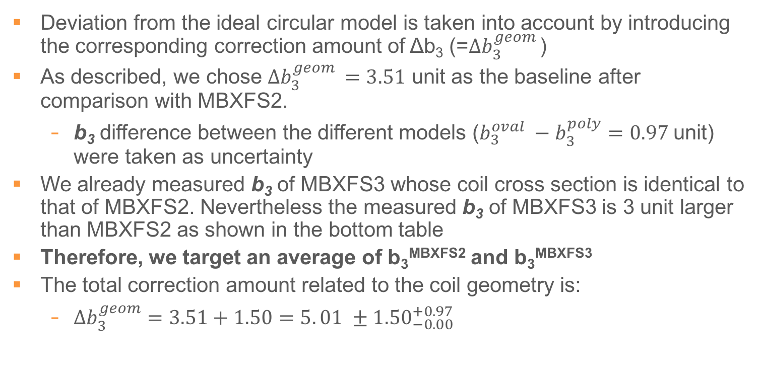
Determination of geometrical correction: Δb₃^{geom}
Deviation from the ideal circular model is taken into account by introducing the corresponding correction amount of Δb₃ (=$∆b_{3}^{geom }$)
As described, we chose $∆b_{3}^{geom }=3.51$ unit as the baseline after comparison with MBXFS2.
b₃ difference between the different models ($b_{3}^{oval} −b_{3}^{poly}=0.97$unit) were taken as uncertainty
We already measured b₃ of MBXFS3 whose coil cross section is identical to that of MBXFS2. Nevertheless the measured b₃ of MBXFS3 is 3 unit larger than MBXFS2 as shown in the bottom table
Therefore, we target an average of b₃^{MBXFS2} and b₃^{MBXFS3}
The total correction amount related to the coil geometry is:
${Δb}_{3}^{geom}=3.51+1.50=5. 01 ±{1.50}_{−0.00}^{+0.97}$
Average of Model#2 and 3
Production uncertainty
Coil model
uncertainty
Warm measurement
 | MBXFS2 (z=0) | MBXFS3 ( z=~-300)
 | After cold test | After yoking | After shell welding
b3 | 18.88 | 21.96 | 21.88
b5 | -1.96 | -2.31 | -2.57

Slide 12
Designing MBXFP
Azimuthal cable insulation thickness : 0.122 mm (GFRP E=31.5 GPa)
ROXIE2D design optimization
at I=3 kA and T=1.9 K
OPERA3D calculation*
Verify integral b_{n} at I=12 kA
Correction on b₃ from :
Coil deformation (Δb₃=+5.01)
Correction at I=12kA
3D effects
Correction to get final b₃:
- Coil deformation (Δb₃=+5.01)
- Correction at 12 kA
(*) 3D effects are already included

Slide 13
Correction at I=12 kA
Previous model
15.15 for data
13.13 for calc.
 | b3 at the center OEPRA fine model | b3 at the center Data (MBXFS2)
3kA (Geom) | 2.04 (I=3kA) | 20.89 (average of up/down)
12 kA | 15.17 | 36.04 (average of up/down)
12 kA – 3 kA | 13.13 | 15.15
Δb₃= +2.02
OPERA3D does not reproduce ‘b₃ increase’ (b₃^{12kA}-b₃^{3kA}) :
Iron saturation and cable displacement due to the Lorentz force
The data-calc. difference is simply assigned to the correction (2.02 unit)

Slide 14
3D effect: Transition from 2D to 3D at I=3kA
FQ at z=0 | ROXIE 2D w/o persistent current | OPERA 3D 7m simplified* yoke
 | 3kA | 3kA
b3 | 2.12 | 2.09
b5 | -3.18 | -3.24
b7 | 0.40 | 0.43
b9 | -0.27 | -0.29
b11 | 0.18 | 0.20
(*) Assume no difference in FQ for lower field current between simplified and fine yoke models
2D model predicts the 3D-geometrical FQ well
No correction is necessary for transition from b₃^{2D} to b₃^{3D}

Slide 15
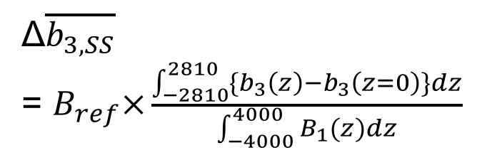
3D effect : b₃ profile along the beam axis
At I=12kA, b₃ in the straight part is affected by highly saturated yoke at the coil end even for 7m-long (MBXFS2-3 cross section model)
The following shape difference at nominal current operation is taken into account for the correction amount Δb₃
b₃ contribution from the coil-end region
due to highly saturated yoke at nominal current
Δ$\overline{b_{3,SS}}$
= $B_{ref}×\frac{\int_{−2810}^{2810}{{\{b}_{3}\left(z\right)−b_{3}\left(z=0\right)\}dz}}{\int_{−4000}^{4000}{B_{1}(z)dz}}$
12047 A
= 4.10 units
3000 A (no saturation)
SS

Slide 16
Summary of the correction to the b3 integral
OPERA3D prediction
OPERA3D prediction
RE
SS
LE
Numerator
Input from
ROXIE2D
Geometrical correction
Transition
from
2D to 3D
Correction at 12 kA
5.01 unit
2.02 unit
0 unit
4.10 unit
3D shape

Slide 17
Determination of correction b₃
Target: -4 unit

Slide 18
K. Suzuki, D1 technical meeting on 10/07/19

Slide 19
Optimization result : Δb₃=-4 unit
 | For prototype design (2D_v6.a)
 | Objectives | 3000 A | 12070 A
B1 (T) | - | 1.559041 | 5.569903
b3 | -4 | -3.99870 | -6.03259
b5 | -3 | -3.00004 | 0.36068
b7 | 0 | -0.00541 | -0.48401
b9 | 0 | -0.05577 | 0.37743
b11 | 0 | -0.09511 | -0.13606
 | MBXFS2 and 3 | Prototype (proposal)
φ1 | 1.1346 | 1.2957
φ2 | 27.8721 | 27.9748
φ3 | 50.2969 | 50.4723
φ4 | 70.6992 | 70.8718
α2 | 26.0000 | 27.2648
α3 | 52.4212 | 52.3461
α4 | 68.0015 | 69.0283
Azimuthal insulation thickness (mm) | 0.130 | 0.122

Slide 20
OPERA 3D model
7M model w/ CERN cryostat (perfect alignment)
Estimated BL: 35.005 Tm @ 12.07 kA

Slide 21
Field profile b₃

Slide 22
Designing MBXFP
Azimuthal cable insulation thickness : 0.122 mm (GFRP E=31.5 GPa)
ROXIE2D design optimization
at I=3 kA and T=1.9 K
OPERA3D calculation*
Verify integral b_{n} at I=12 kA
Correction on b₃ from :
Coil deformation (Δb₃=+5.01)
Correction at I=12kA (Δb₃=+2.02)
3D effects (Δb₃^{shape}=+4.01)
Correction to get final b₃:
Coil deformation (Δb₃=+5.01)
Correction at 12kA (Δb₃=+2.02)
(*) 3D effects are already included

Slide 23

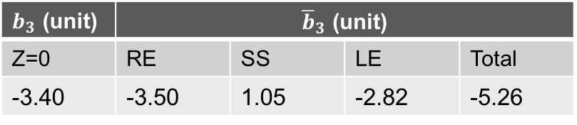
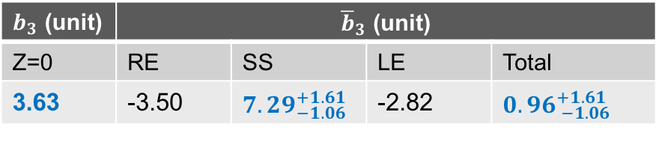
Final b₃ integral
Expected
final b_{3,SS}
( I = 12 kA )
( I = 12 kA )
$${5.01}_{−1.50}^{+1.80}$$
2.02
$b_{3}$ (unit) | ${\overline{b}}_{3}$ (unit)
Z=0 | RE | SS | LE | Total
-3.40 | -3.50 | 1.05 | -2.82 | -5.26
Before correction
After
correction
$b_{3}$ (unit) | ${\overline{b}}_{3}$ (unit)
Z=0 | RE | SS | LE | Total
3.63 | -3.50 | ${7.29}_{−1.06}^{+1.61}$ | -2.82 | ${0.96}_{ −1.06}^{+1.61}$
Final b₃ integral is expected to be within the requirement

Slide 24
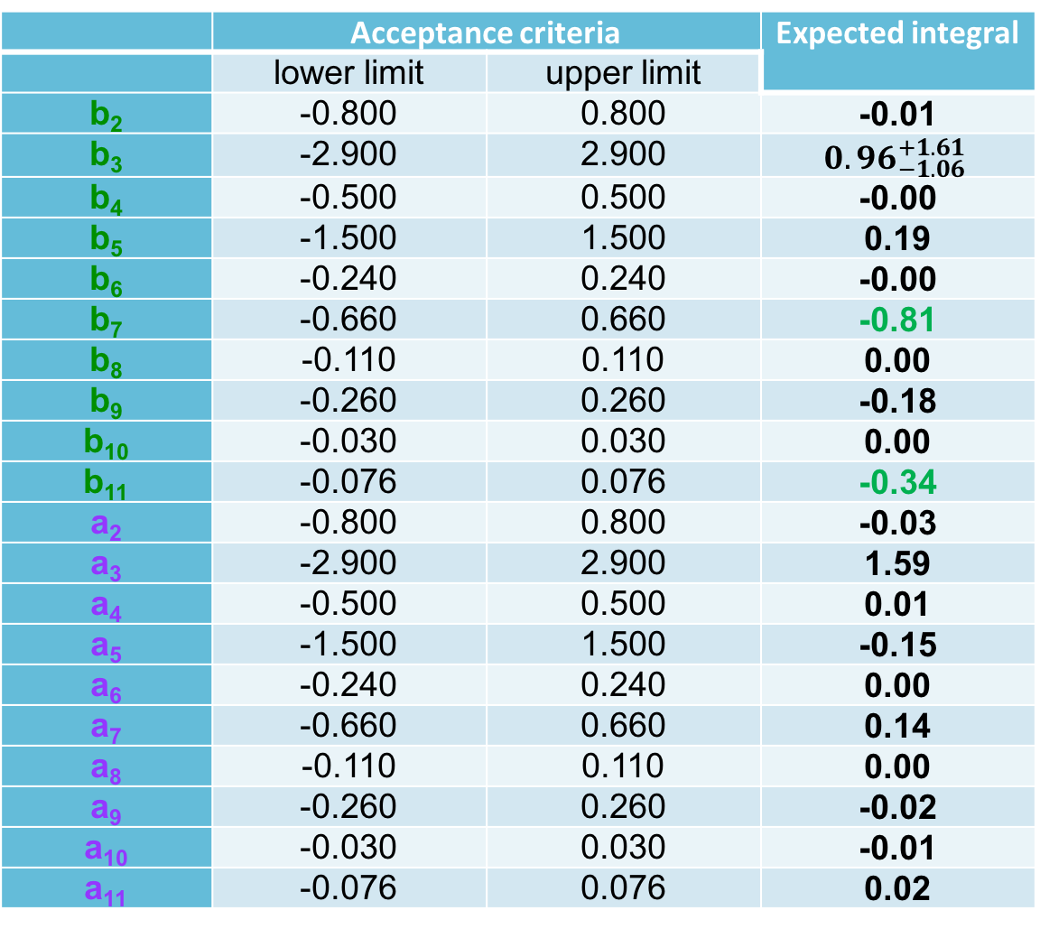
Expected integral for MBXFP
 | Acceptance criteria |  | Expected integral
 | lower limit | upper limit
b₂ | -0.800 | 0.800 | -0.01
b₃ | -2.900 | 2.900 | $${0.96}_{−1.06}^{+1.61}$$
b₄ | -0.500 | 0.500 | -0.00
b₅ | -1.500 | 1.500 | 0.19
b₆ | -0.240 | 0.240 | -0.00
b₇ | -0.660 | 0.660 | -0.81
b₈ | -0.110 | 0.110 | 0.00
b₉ | -0.260 | 0.260 | -0.18
b₁₀ | -0.030 | 0.030 | 0.00
b₁₁ | -0.076 | 0.076 | -0.34
a₂ | -0.800 | 0.800 | -0.03
a₃ | -2.900 | 2.900 | 1.59
a₄ | -0.500 | 0.500 | 0.01
a₅ | -1.500 | 1.500 | -0.15
a₆ | -0.240 | 0.240 | 0.00
a₇ | -0.660 | 0.660 | 0.14
a₈ | -0.110 | 0.110 | 0.00
a₉ | -0.260 | 0.260 | -0.02
a₁₀ | -0.030 | 0.030 | -0.01
a₁₁ | -0.076 | 0.076 | 0.02

Slide 25
Conclusion
Reviewed our design procedure found to be inadequate
Performed the measurement of coil deformation to define a correction amount of b3
Further corrections were considered for designing the cross section of the prototype
Evaluated field quality with the new cross section, and resultant b₃ is confirmed to be within 2.9 units

Slide 27
Summary of the field integral
 |  | OPERA Fine Yoke
 |  | RE | SS | LE | Total | z=0
ver.6.1.0 12070 A | B1 | 1.778 Tm | 31.456 Tm | 1.771 Tm | 35.005 Tm | 5.577 T
 | b3 | -3.50 units | 7.29 units | -2.83 units | 0.96 units | 3.63 units
 | b5 | -0.24 | 0.19 | 0.24 | 0.19 | -0.18
 | b7 | -0.31 | -0.41 | -0.10 | -0.81 | 0.05
 | b9 | -0.28 | 0.29 | -0.19 | -0.18 | 0.11
 | b11 | -0.13 | -0.12 | -0.09 | -0.34 | 0.18

Slide 28
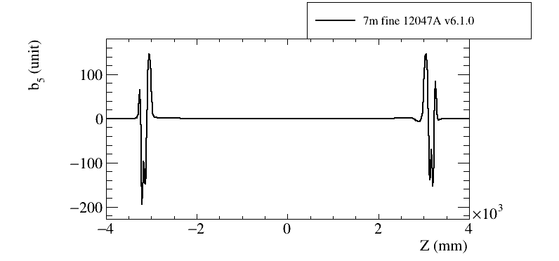
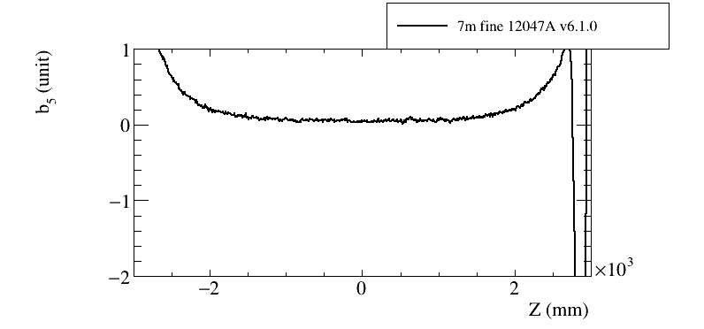
Field profile – b₅

Slide 29
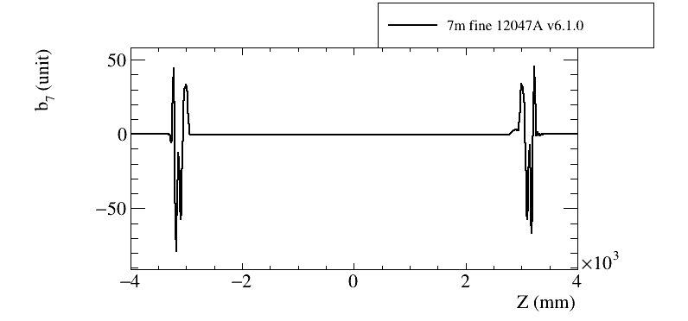
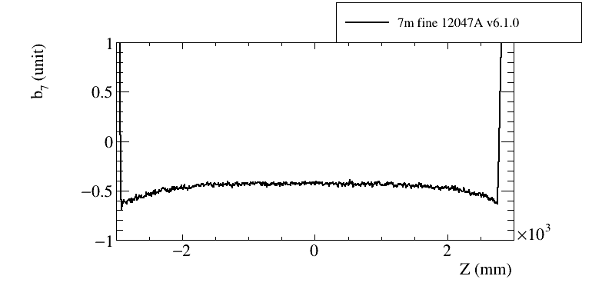
Field profile – b₇

Slide 30
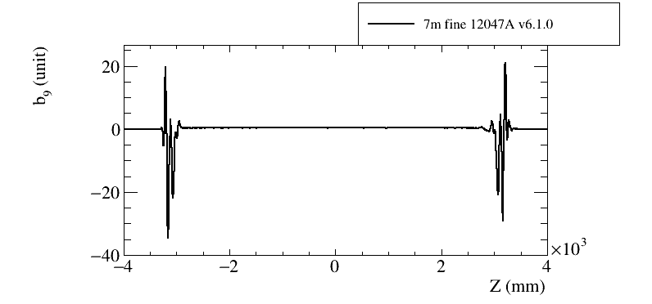
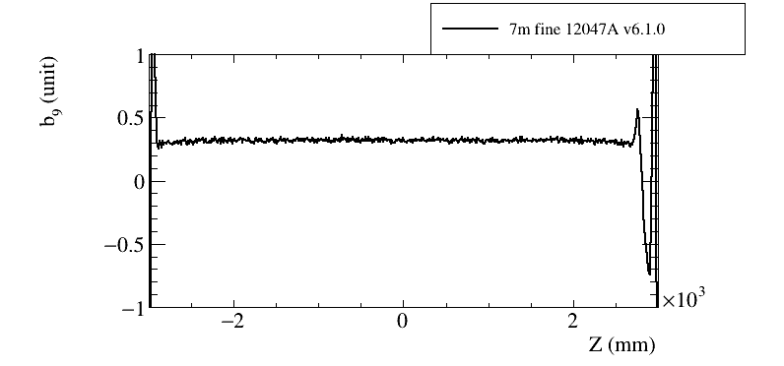
Field profile – b₉

Slide 31
M. Sugano, F2F meeting on 25/07/19
for GFRP E=27GPa

Slide 32
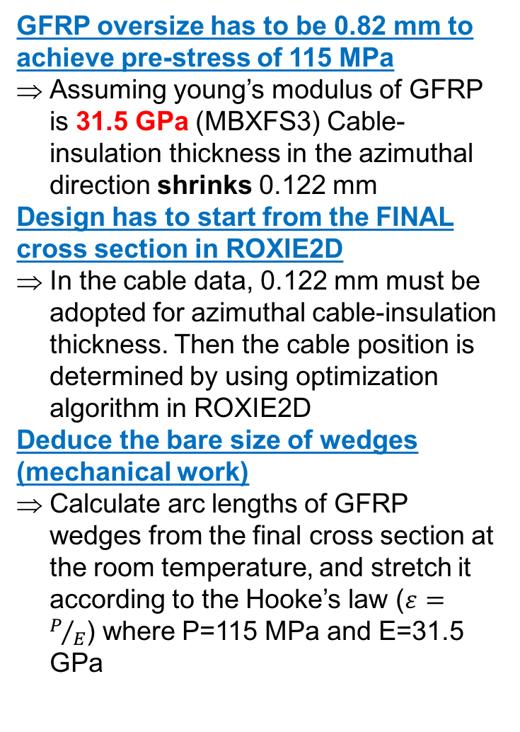
Procedure of designing the MBXFP cross section
GFRP oversize has to be 0.82 mm to achieve pre-stress of 115 MPa
Assuming young’s modulus of GFRP is 31.5 GPa (MBXFS3) Cable-insulation thickness in the azimuthal direction shrinks 0.122 mm
Design has to start from the FINAL cross section in ROXIE2D
In the cable data, 0.122 mm must be adopted for azimuthal cable-insulation thickness. Then the cable position is determined by using optimization algorithm in ROXIE2D
Deduce the bare size of wedges (mechanical work)
Calculate arc lengths of GFRP wedges from the final cross section at the room temperature, and stretch it according to the Hooke’s law ($ε=P/E$) where P=115 MPa and E=31.5 GPa
0.155 at 0 MPa
Bare size
0.122 /0.123
at 115 MPa
Rutherford cable
In this way, eventually we will get the target coil cross section

Slide 33
Measurement of the coil inner surface
Coil inner surface was measured using an laser displacement meter (LDM)
The LDM is fixed to the rotary table, and placed inside the magnet
As the table rotates we can measure distance to the coil inner at each angle step
Coil
y
LDM
Emitter axis
x

Slide 34
d(θ) measurement for MBXFS2
RE
LE
Z
-14
LDM was positioned to z=-14 ( the magnet center is at z=0)
Measurement procedure:
Rotation angle step was set to 0.18 degree
Took an average of 1000 samples at each angle
29 rotations in total

Slide 35
Setup
Reference
gauge (R=75)
Rotary table
MBXFS2
LDM
(CD22-35 )
Tilt sensor
Measurement was performed in this summer.
A reference gauge (R=75) is put in front of the magnet to ensure an effect from inclination of LDM, which might result in overestimation of the oval size
Tilt sensor is also attached to the rotary table as well as LDM, which is used to monitor the inclination of the table throughout the measurement

Slide 36
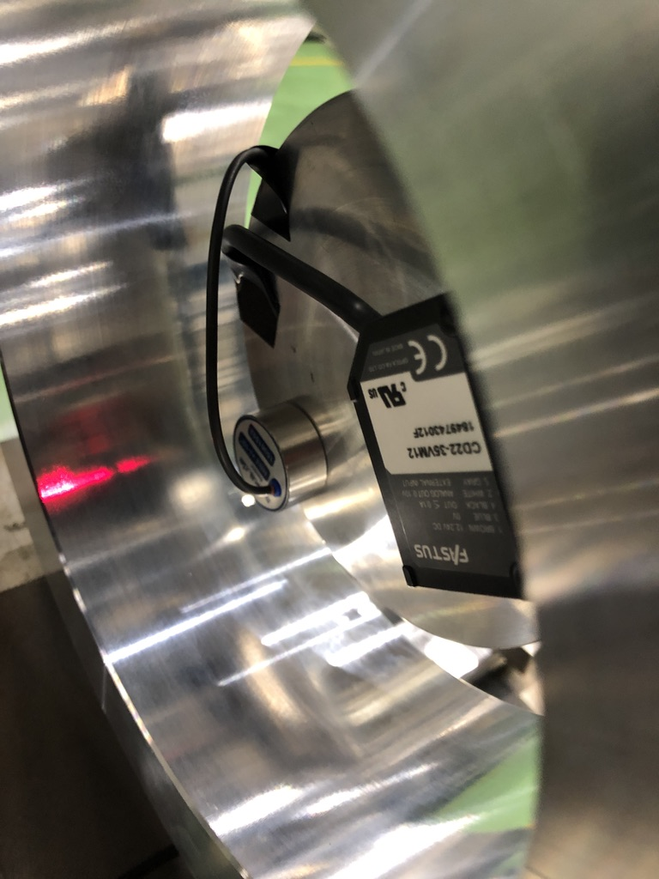
Analysis method
To eliminate an effect from ‘off-center’ of the LDM, the coil inner diameter is reconstructed as follow:
Performed an analysis validation using the reference gauge (R=75) and reconstructed d(θ) from the measured r(θ)
Oval size a is derived by a fit of d(θ) using a cos function
From the fitting we evaluated the measured oval a is less than 10 um, and confirmed validity of the analysis
Reference gauge (R=75)
Sinusoidal curve due to ‘off-center’ of LDM
Fit function:
r(θ)
Reconstruct d(θ)
d₀=149.12 mm
a=-8.97 um
d(θ)

Slide 37


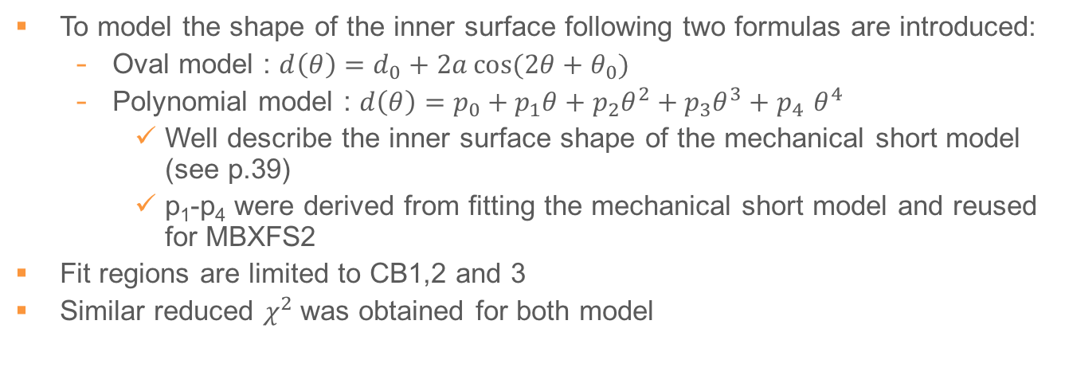
Modeling coil inner surface
diameter (mm)
diameter (mm)
a=167 um
$χ^{2}$/ n.d.f = 2252/410
angle (degree)
$χ^{2}$/ n.d.f = 956/193
angle (degree)
To model the shape of the inner surface following two formulas are introduced:
Oval model : $d\left(θ\right)=d_{0}+2a\cos{(2θ+θ_{0})}$
Polynomial model : $d\left(θ\right)=p_{0}+p_{1}θ+p_{2}θ^{2}+p_{3}θ^{3}+p_{4 }θ^{4}$
Well describe the inner surface shape of the mechanical short model (see p.39)
p₁-p₄ were derived from fitting the mechanical short model and reused for MBXFS2
Fit regions are limited to CB1,2 and 3
Similar reduced $χ^{2}$was obtained for both model

Slide 38
ROXIE2D prediction
Define position for each cable
Implement the two models (oval and poly.) into ROXIE2D and calculate the corresponding multipoles
As shown in the table, we got a good agreement with the measured b3 when poly. model was used
Baseline is to use the polynomial model
Δb₃ = +3.51
Difference between b₃^{oval} and b₃^{poly} is taken as uncertainty in modeling the coil inner shape
 | MBXFS2, 1.9 K, I=3 kA, phi_R and alpha_R are set to 0
 | original | modified xsec | modified xsec w/ oval (a=167um) | modified xsec w/ poly | MBXFS2 data average up/down
b3 | 2.12 | 17.02 | 21.50 | 20.53 | 20.89
b5 | -3.18 | -3.12 | -4.05 | -3.16 | -1.95
b7 | 0.40 | -0.03 | -0.28 | -0.35 | -0.15
b9 | -0.27 | -0.13 | -0.21 | -0.25 | 0.08
Design variables: Φ_{R}=α_{R}=0
Cable insulation thickness : 0.123 mm

Slide 39
Fitting to the inner diameter of the mechanical short model
Polynomial function
f=Σpi x θ^{i} (i=0-4)
Diameter (mm)
Angle (degree)

