Slide 1
Advances on Integration of Monolithic Silicon Sensors in Pixel Trackers
  Roberto Cardella
  ESR 9
  Sv. Petra Riedler (CERN)
  Sv. Heidi Sandaker (UiO)
  CERN EP-DT-DD

Slide 2
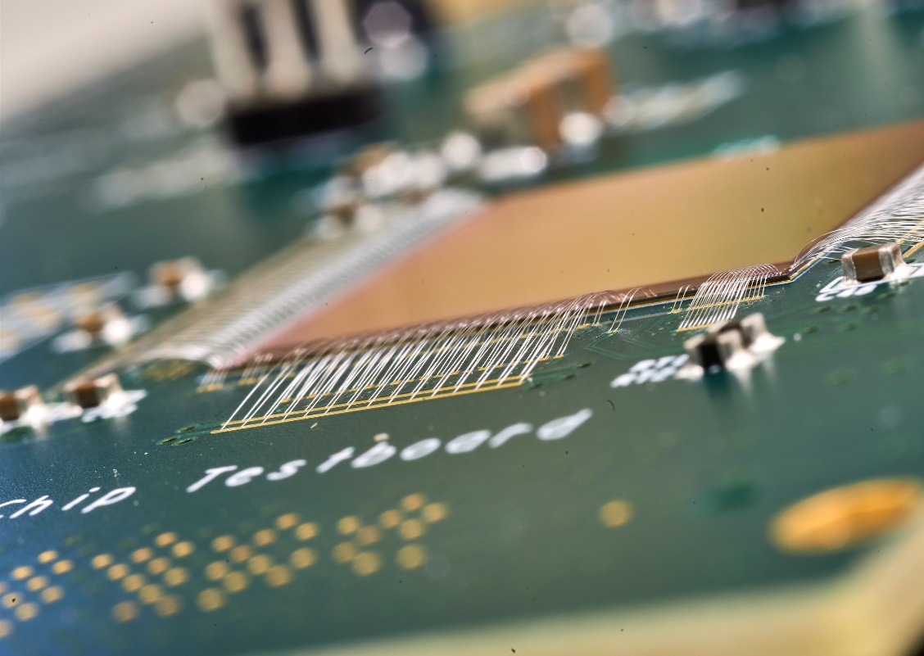
Outline
MALTA and MiniMALTA sensors
  From Assembly to Efficiency
  Rad Hardness studies
  Improvements and MiniMalta
A large area CMOS module
Chip To Chip Communication
Buried Microchannel in CMOS Devices
High Speed Data Transmission in Trackers
  LAPA testchip Results
Conclusions

Slide 3
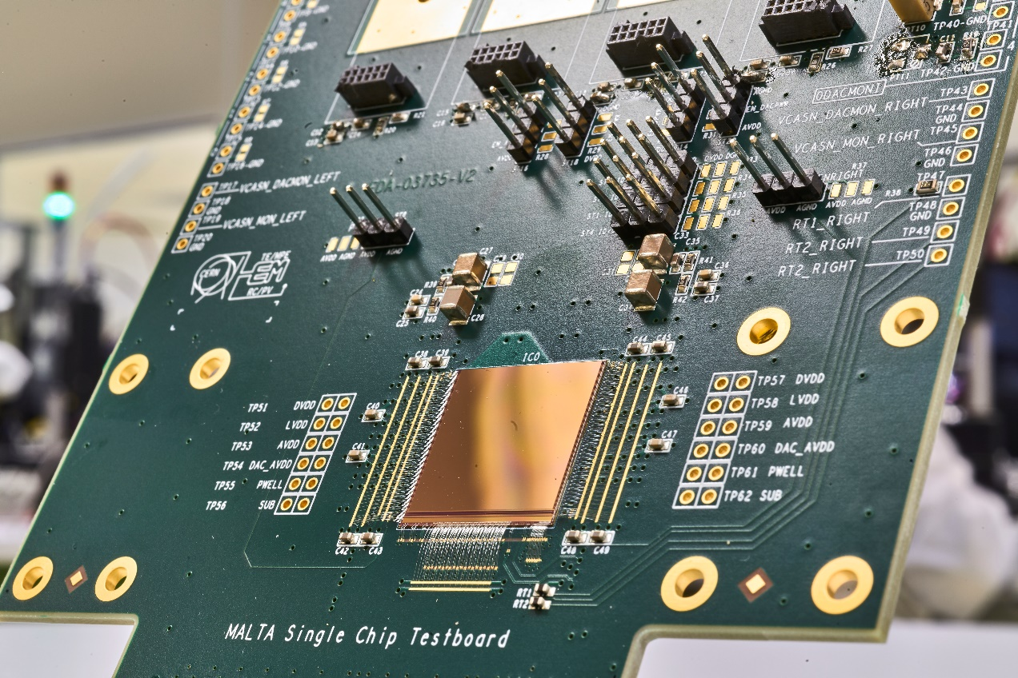
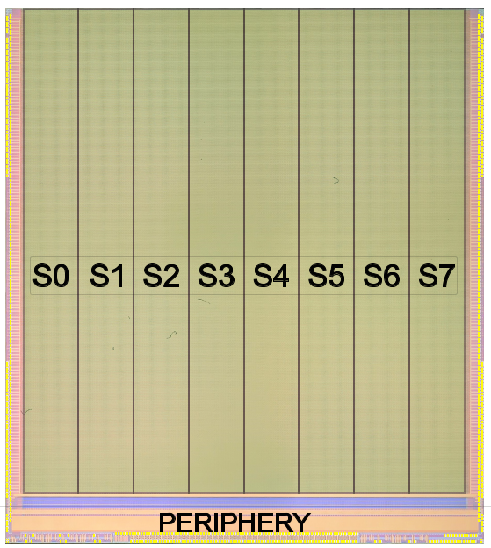
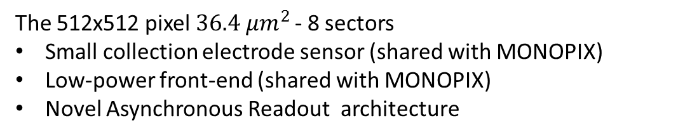
MALTA: Monolithic pixel detector from ALICE to ATLAS
The 512x512 pixel $36.4 μm^{2 }$- 8 sectors
Small collection electrode sensor (shared with MONOPIX)
Low-power front-end (shared with MONOPIX)
Novel Asynchronous Readout architecture
18.6 mm
For more details see presentation of I.Berdalovic and F.Piro
DACs for analogue biases
LVDS driver
3

Slide 4
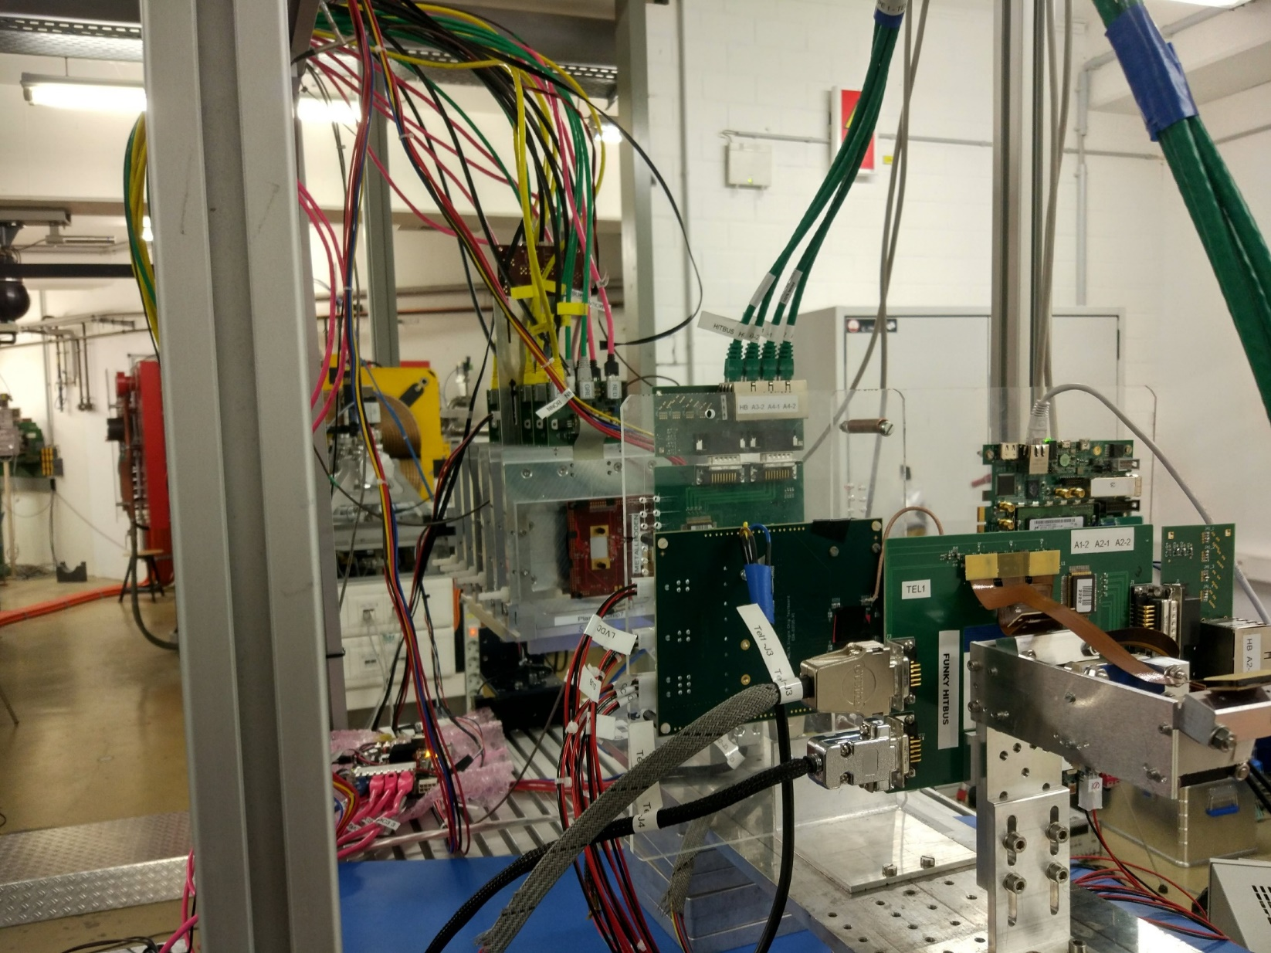
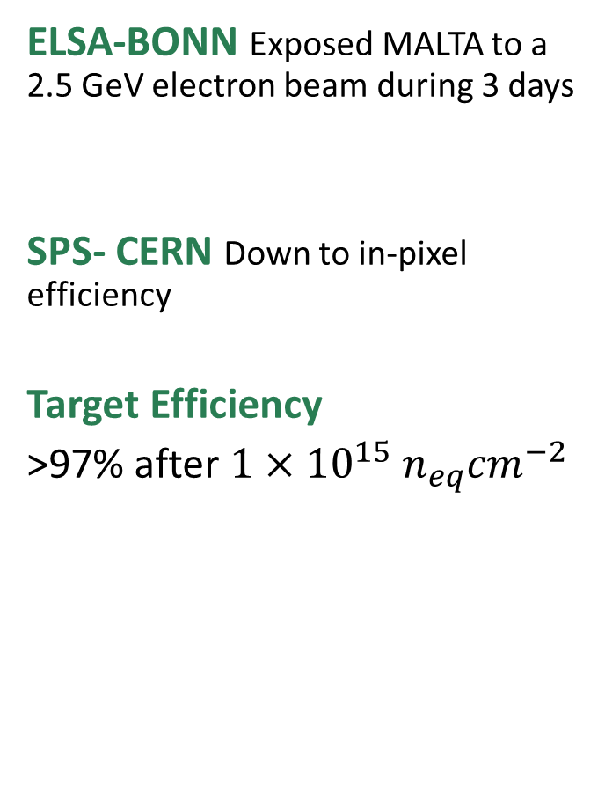
Collection Efficiency Characterization - MALTA
ELSA-BONN Exposed MALTA to a 2.5 GeV electron beam during 3 days
SPS- CERN Down to in-pixel efficiency
Target Efficiency
>97% after $1×{10}^{15}{ n}_{eq}{cm}^{−2}$

Slide 5
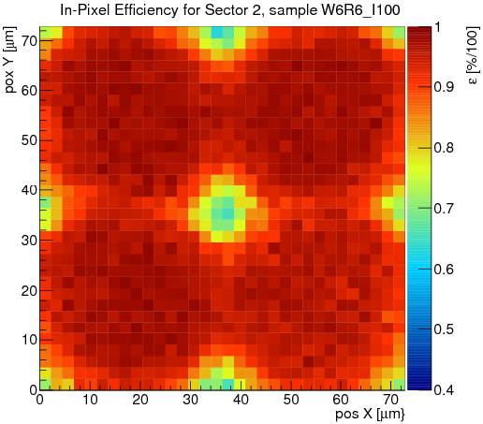
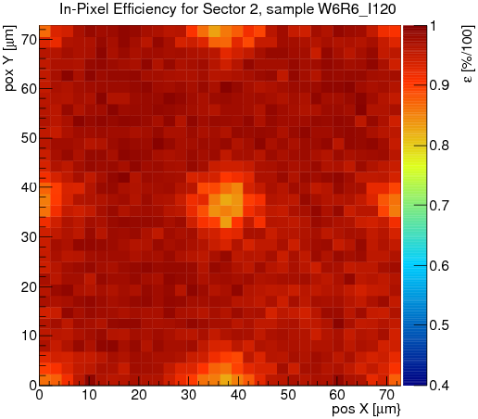
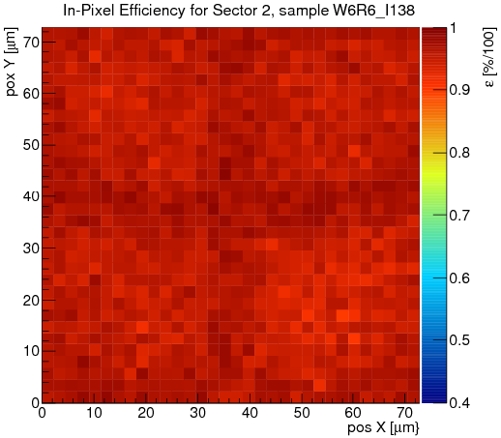
Collection Efficiency Characterization - MALTA
3
3
3
Unirradiated: lowering the threshold gives full efficiency
Decreasing threshold from ~600 e⁻ to ~250 e⁻ (unirrad.)
3
3
3
Cannot go lower with threshold because of RTS noise and masking issue
See I.Berdalovic presentation
Notes:
60Mhit/s badwidth

Slide 6
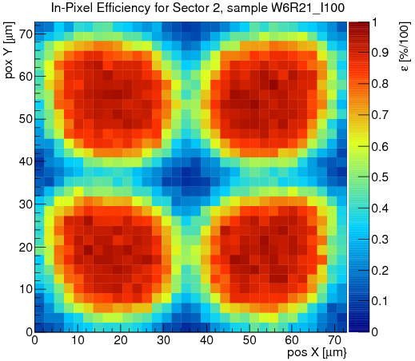
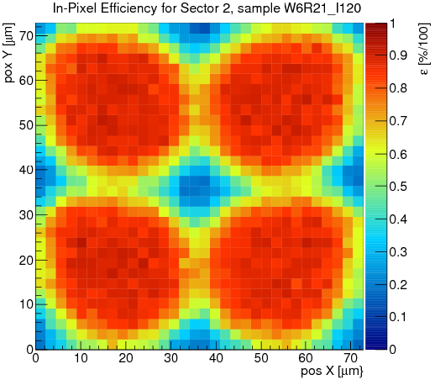
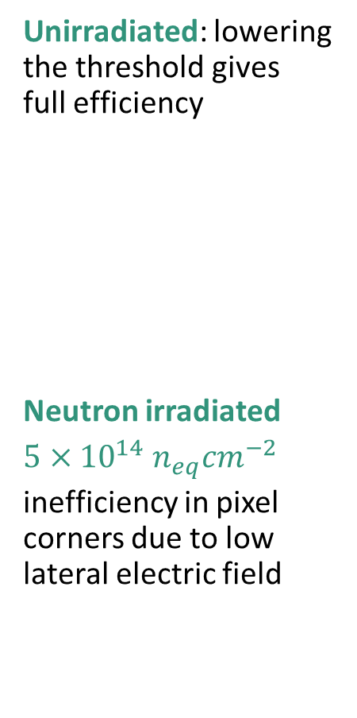
Collection Efficiency Characterization - MALTA
3
3
3
Unirradiated: lowering the threshold gives full efficiency
Neutron irradiated
inefficiency in pixel corners due to low lateral electric field
Decreasing threshold from ~600 e⁻ to ~250 e⁻ (unirrad.)/350 e⁻ (irrad.)
3
3
3
Could not reach lower threshold
(RTS + MASKING ISSUE)
Notes:
60Mhit/s badwidth

Slide 7
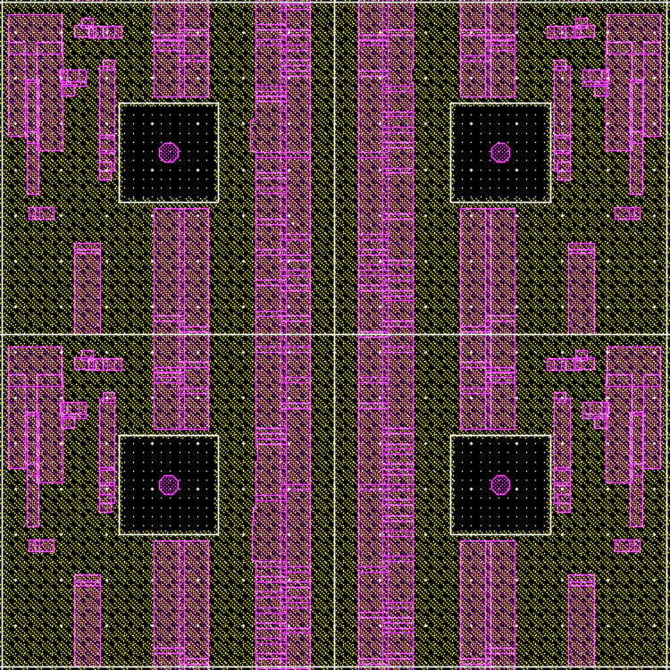
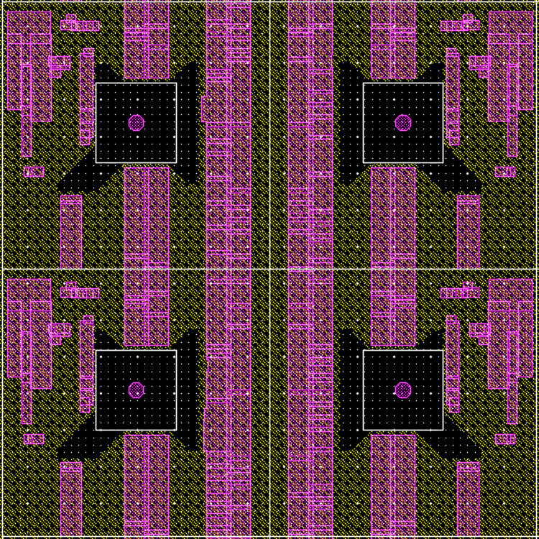
Efficiency vs. deep p-well coverage

Slide 8
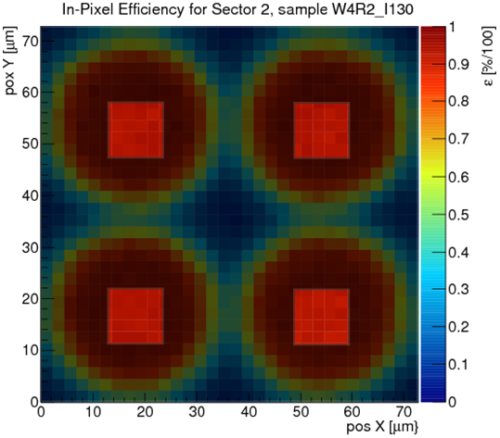
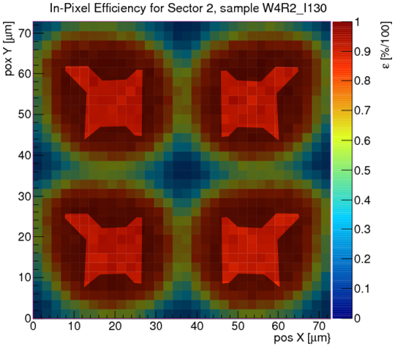
Efficiency vs. deep p-well coverage
Deep p-well only needed under n-wells of PMOS transistors
In-pixel efficiency can be correlated to deep p-well coverage around the collection electrode
Removed deep p-well results in higher overall efficiency due to higher lateral electric field

Slide 9
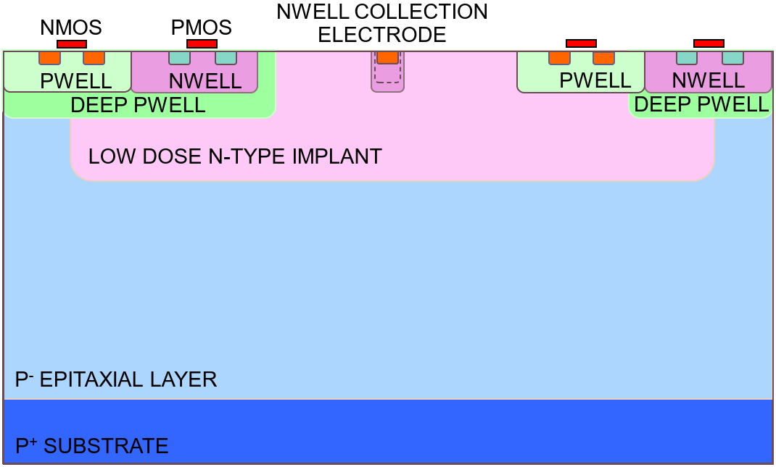
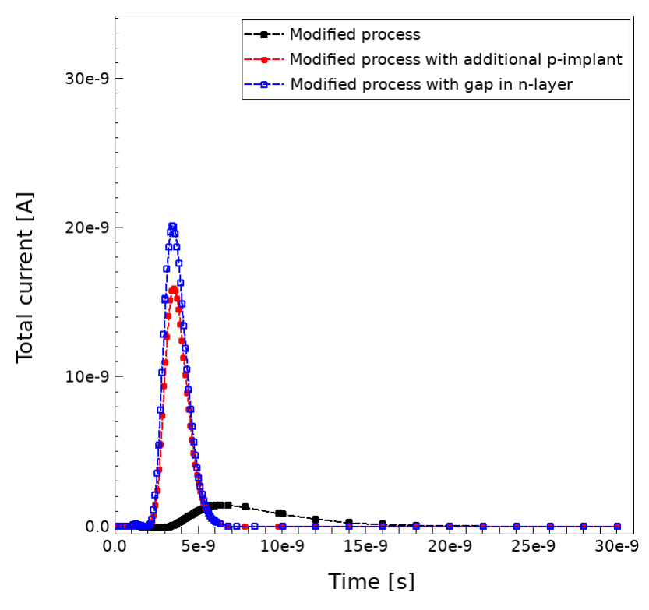
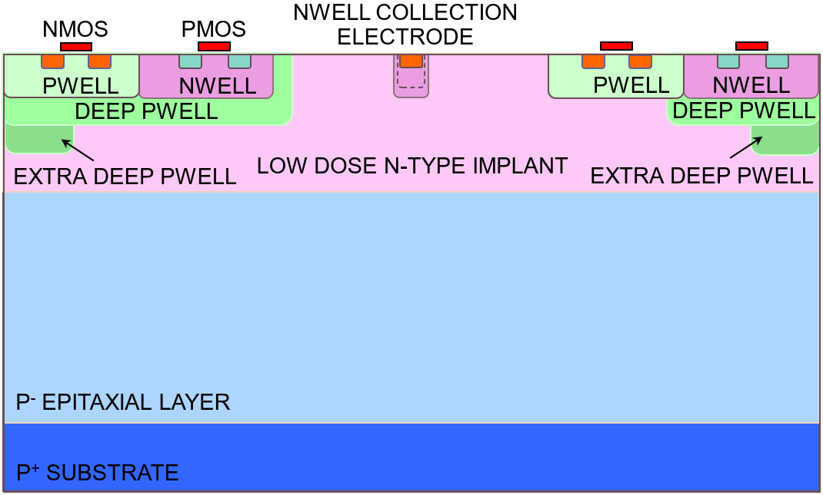
Pixel design improvements
Additional “extra-deep p-well” layer
Already known by TowerJazz: no process R&D needed
Gap in the n- layer
requires only a change of the existing mask for the n-layer
After irradiation simulated current pulse
Magdalena Munker

Slide 10
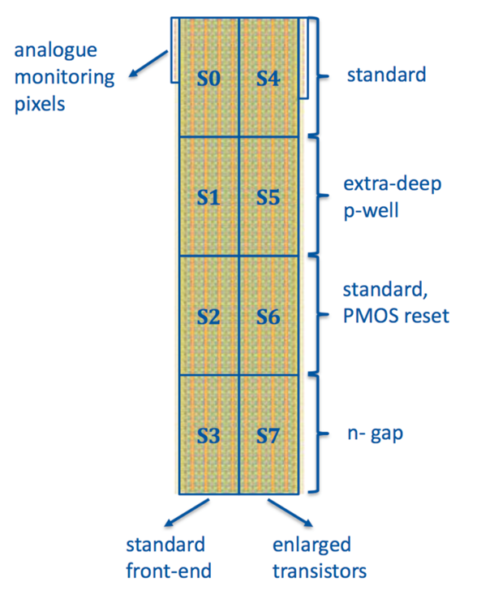
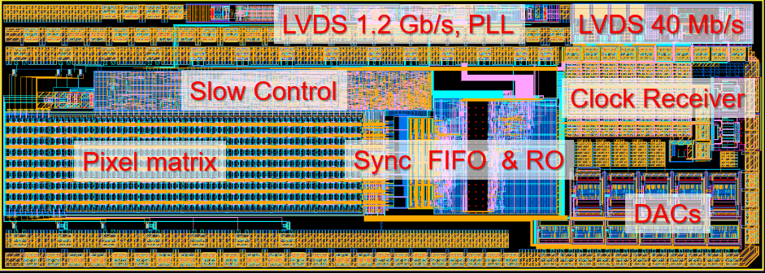
Mini MALTA pixel matrix
Pixel size: 36.4 μm x 36.4 μm
64x16 pixel matrix includes 8 sectors with splits on analogue front-end design, reset mechanism and process
MiniMALTA with synchronization
and fixes for improved charge collection

Slide 11
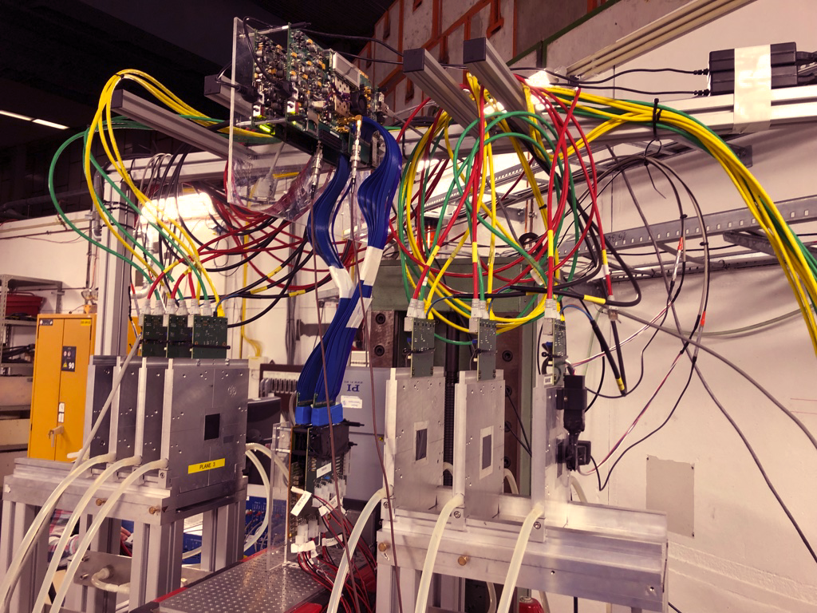
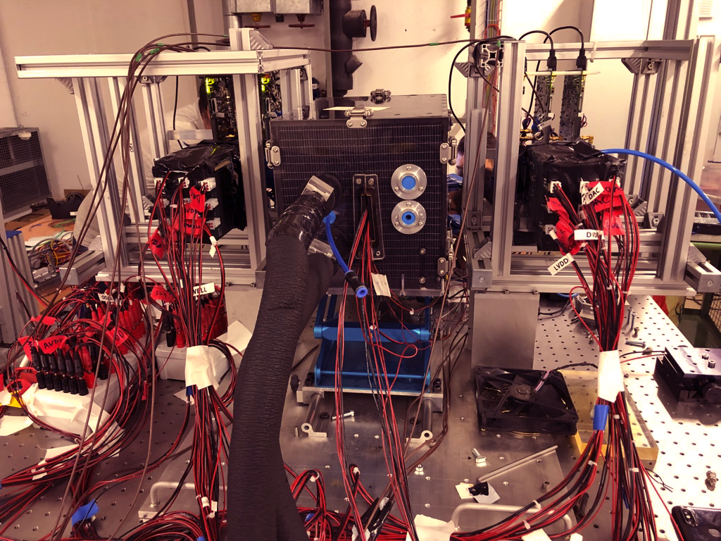
Testbeam campaigns
EUDAQ DURANTA telescope in DESY ^{MALTA telescope in ELSA}

Slide 12
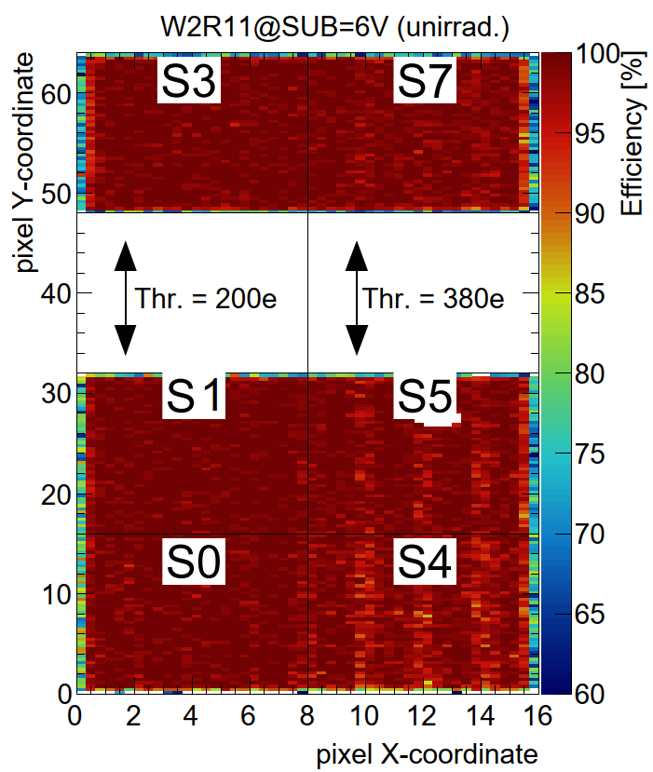
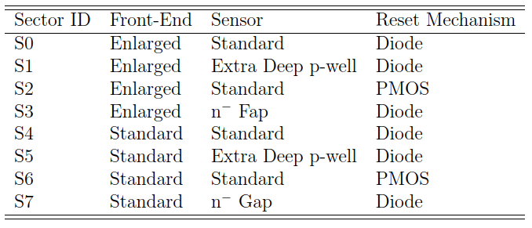
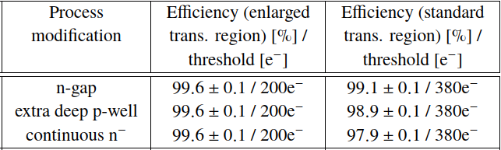
Mini MALTA Collection Efficiency
Before Irradiation

Slide 13
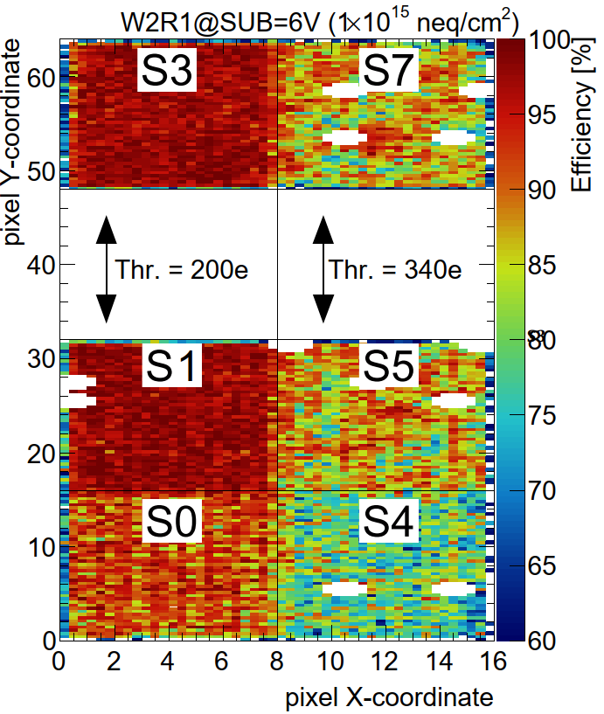
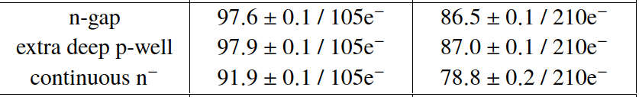

Mini MALTA Collection Efficiency
Neutron Irradiated
$$1×{10}^{15}n_{eq}{cm}^{−2}$$

Slide 14
Mini MALTA Collection Efficiency
Neutron Irradiated
$$1×{10}^{15}n_{eq}{cm}^{−2}$$
Matching ATLAS ITk requirements!

Slide 15
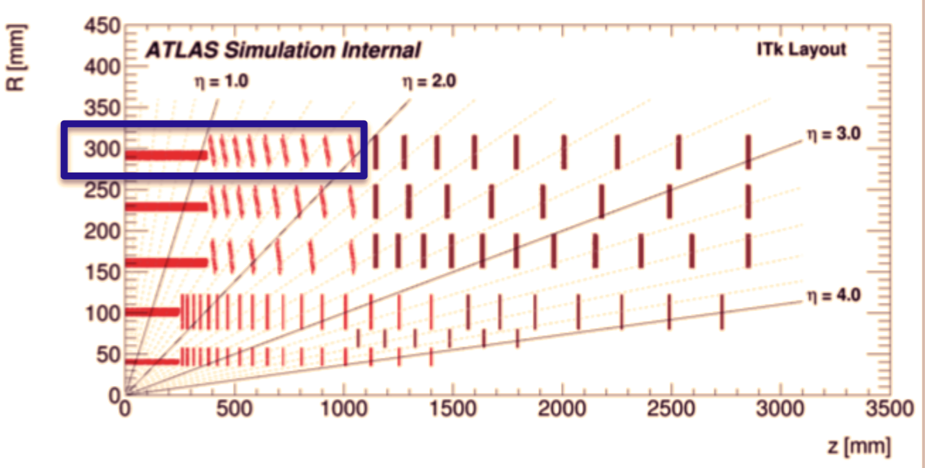
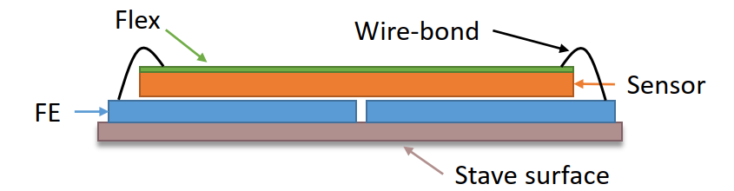
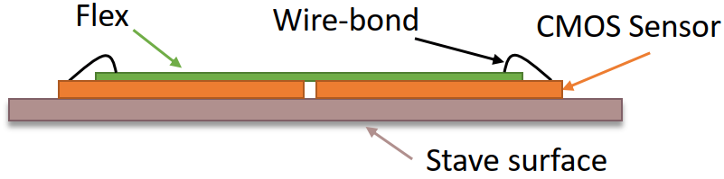


CMOS development for the ATLAS ITk
Outermost layer of ITk Pixel Barrel
    2016 quad modules
    3m² (~45% of outer barrel layers)
Monolithic CMOS sensors were considered as option for the outermost layer
    Saves bump bonding for ~45% of outer barrel system
    Substantial cost reduction and reduced module assembly time
    Requires “Drop-In” module compatibility to hybrid module
Hybrid Module
Monolithic Module
Notes:
The outermost layer of he Itk pixel barrel covers an area of 3 square meters, around 45 % of the all barrel. The cost of assembly of the sensor modules is quite relevant in the case of Hbrid pixels. For this reason some R&D are on going to study the possibility of using Monolitics pixels, with a compatible drop in solution for the outermost layer, reducing cost and assembly time.

Slide 16
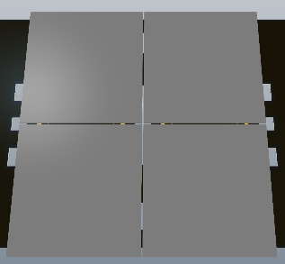
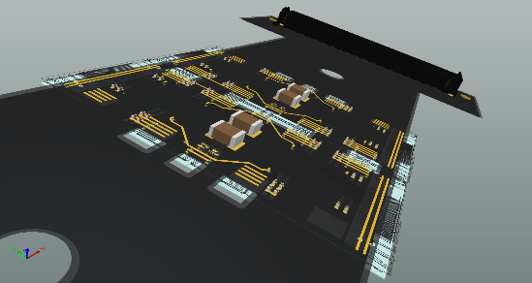
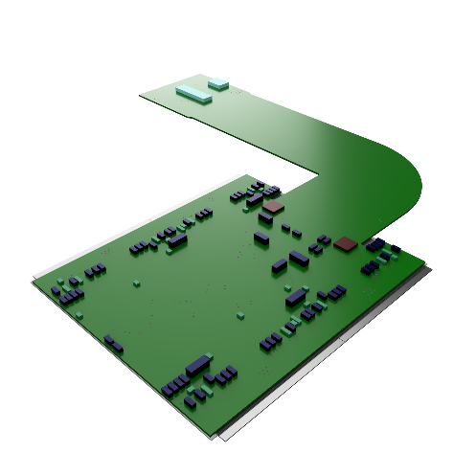
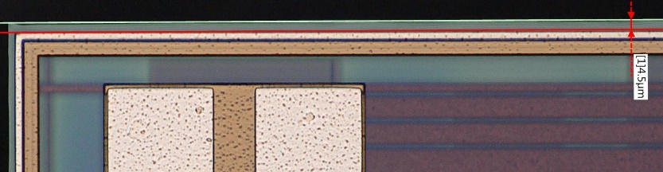
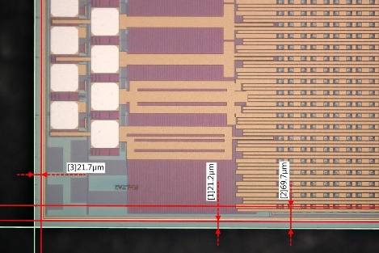
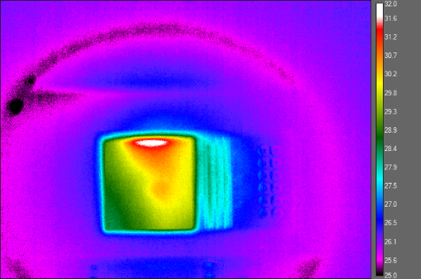
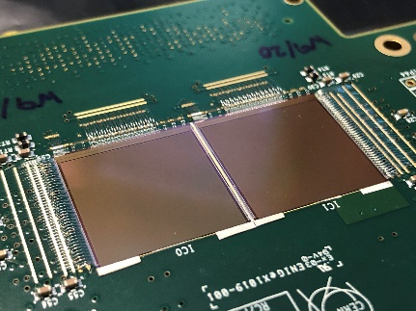
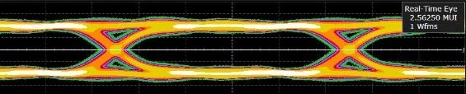
Integrating a CMOS Module in a Tracker
Module Design
Dead Area Minimization
Sensor cooling
Data Transmission
Notes:
The outermost layer of he Itk pixel barrel covers an area of 3 square meters, around 45 % of the all barrel. The cost of assembly of the sensor modules is quite relevant in the case of Hbrid pixels. For this reason some R&D are on going to study the possibility of using Monolitics pixels, with a compatible drop in solution for the outermost layer, reducing cost and assembly time.

Slide 17
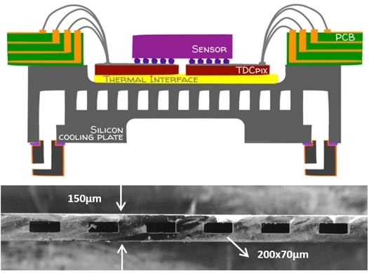
Sensor Cooling in HEP
NA62 Hybrid with Silicon Cooling Plate
Pixels operated at -30 ˚C to avoid thermal runaway
Critical Parameters
Good thermal conductivity
Low thermal expansion mismatch between parts
Integration with mechanics
Embedding the channels in the sensor!
Could improve all the three parameters
Buried Channels Technology (BCT)
  J. Bronuzzi, R. Callegari, R. Cardella, C. Lipp, A. Mapelli, P. Riedler
Notes:
The outermost layer of he Itk pixel barrel covers an area of 3 square meters, around 45 % of the all barrel. The cost of assembly of the sensor modules is quite relevant in the case of Hbrid pixels. For this reason some R&D are on going to study the possibility of using Monolitics pixels, with a compatible drop in solution for the outermost layer, reducing cost and assembly time.

Slide 18
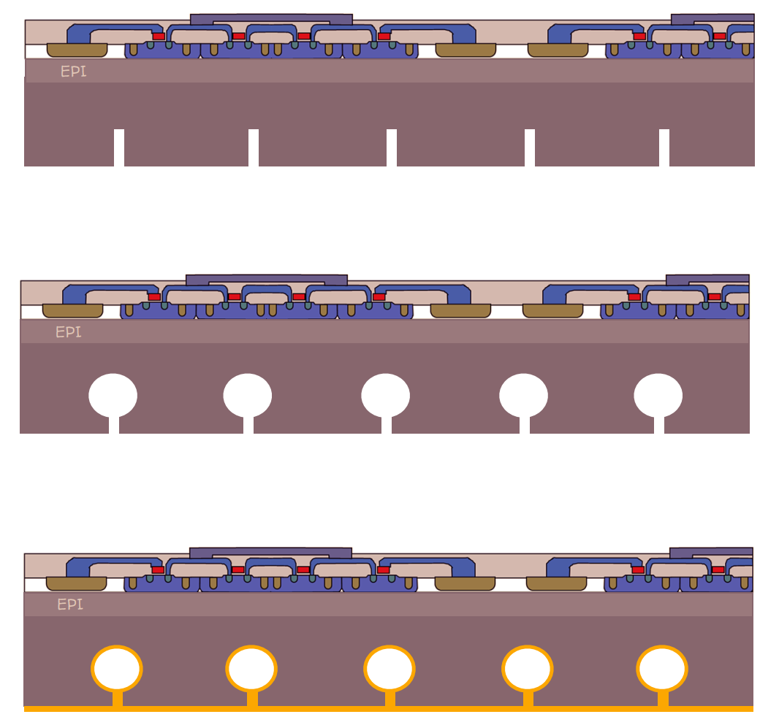
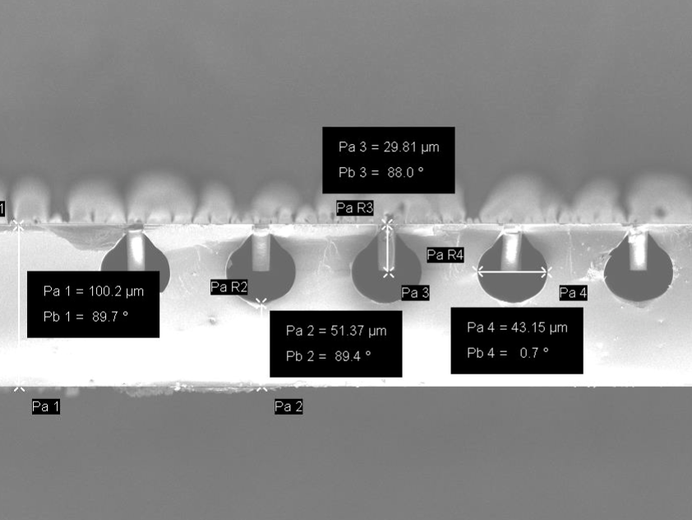
BCT Process
Processed at the CMI – EPFL, Lausanne
100 µm
DRIE of 30 µm deep trenches (3 x 10 µm)
50 µm
XeF₂ etching of microchannels (diam. 40 µm)
25 µm
Trenches filled with Parylene (5 µm)

Slide 19
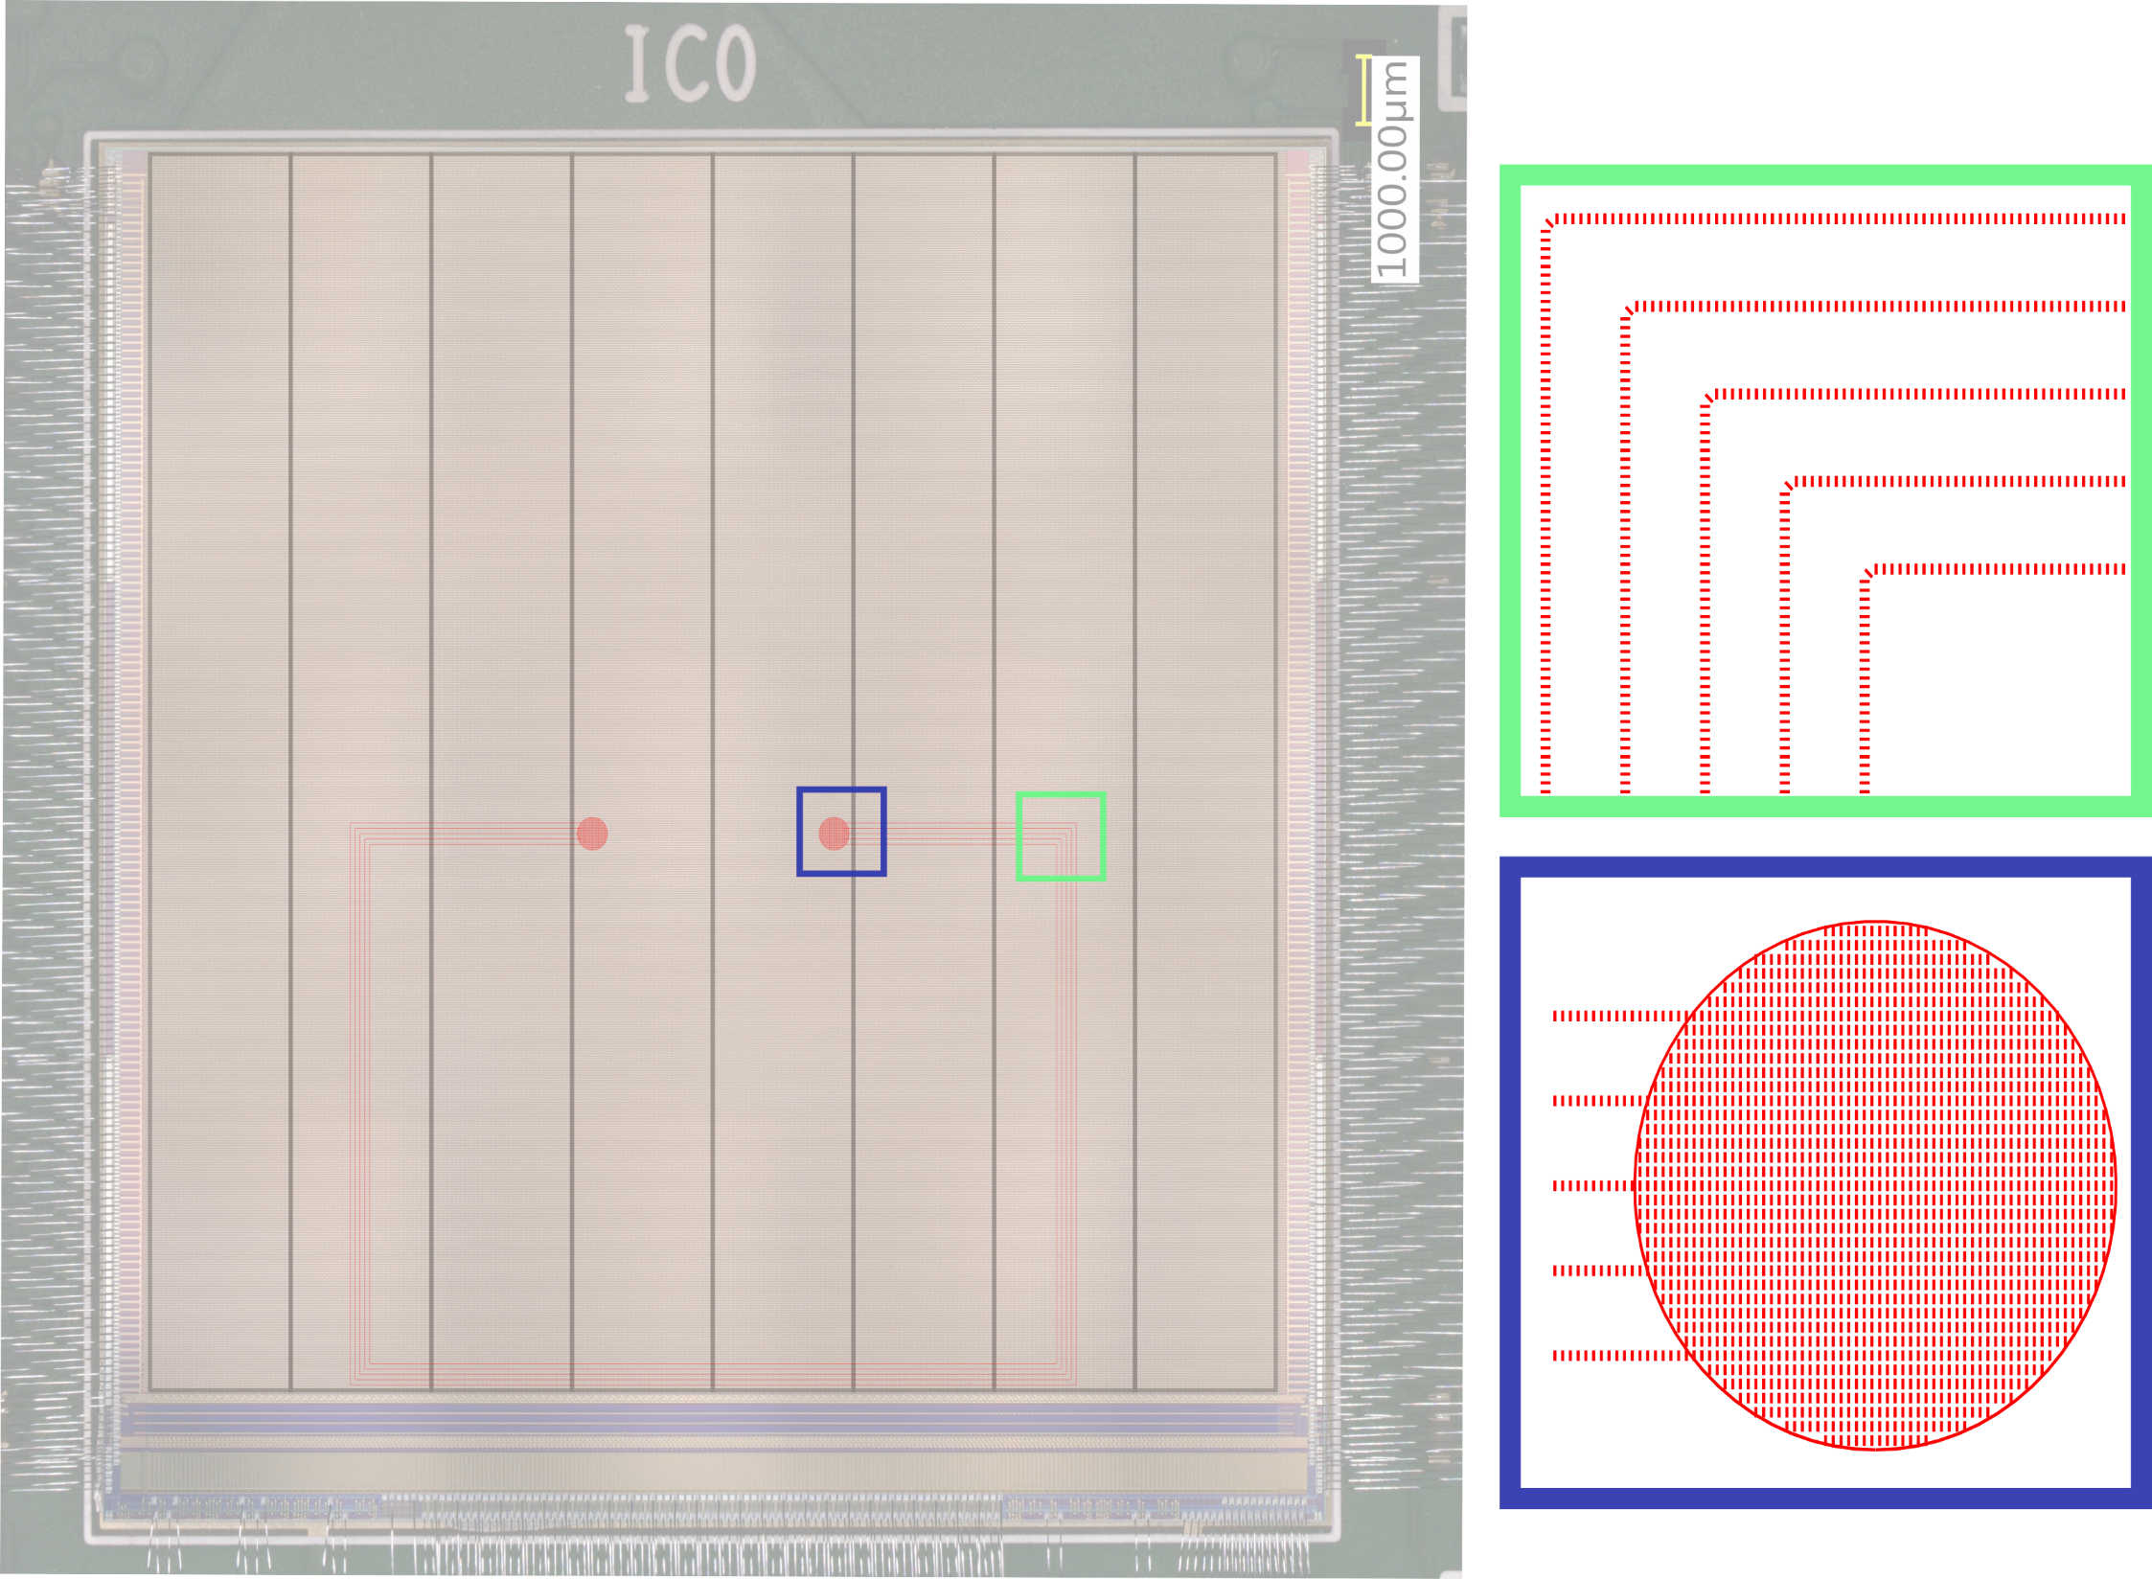
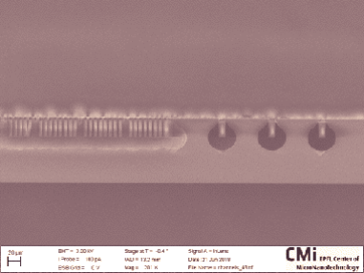
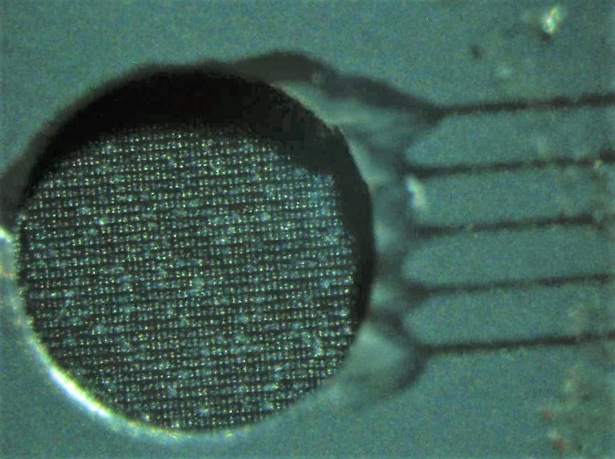
MALTA with BCT

Slide 20
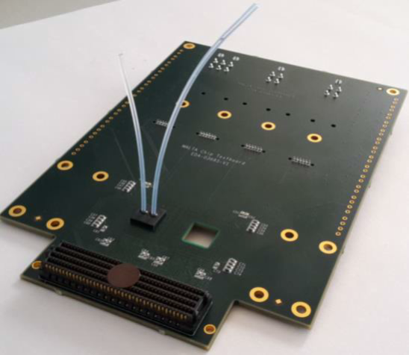
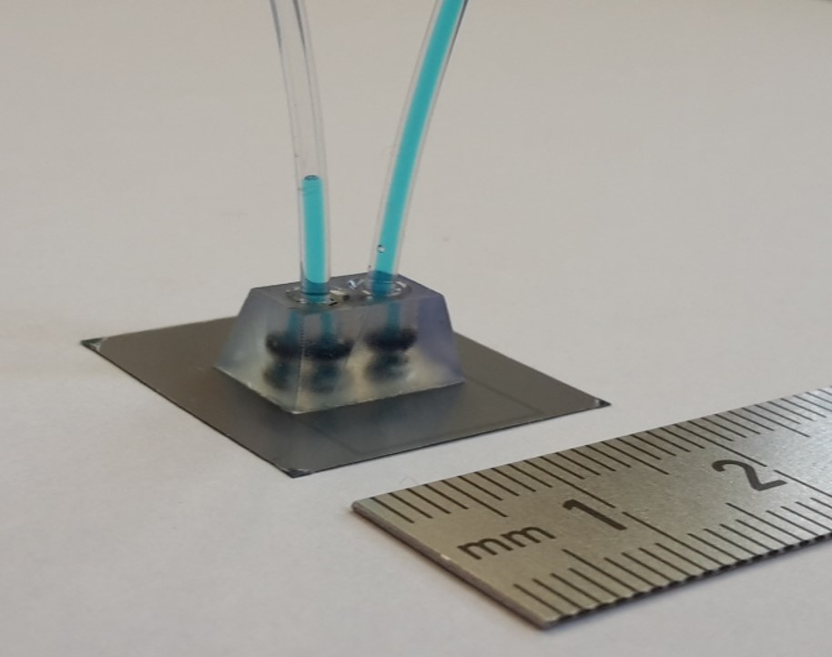
MALTA with BCT

Slide 21
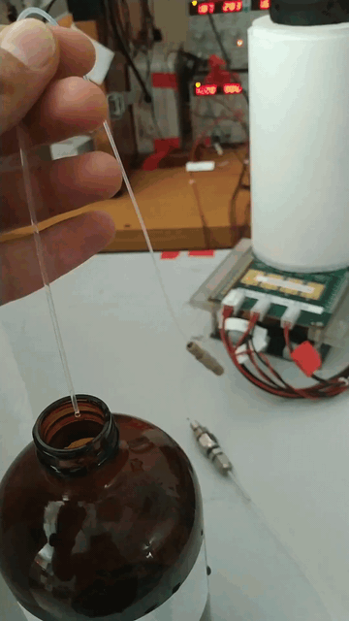
MALTA with BCT

Slide 22
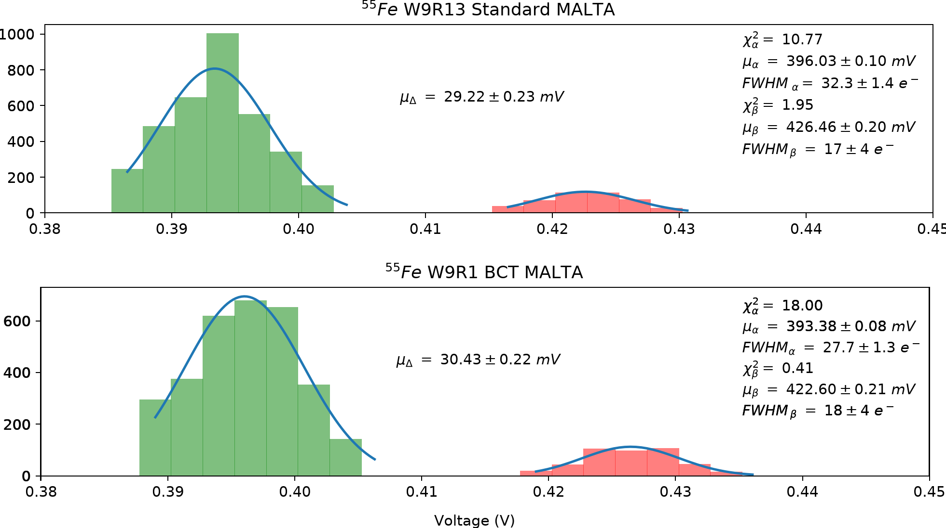
MALTA with BCT – Functional Test
⁵⁵Fe source scan
  Peaks fit comparable
  Distance of the peaks within the gain dispersion of MALTA

Slide 23
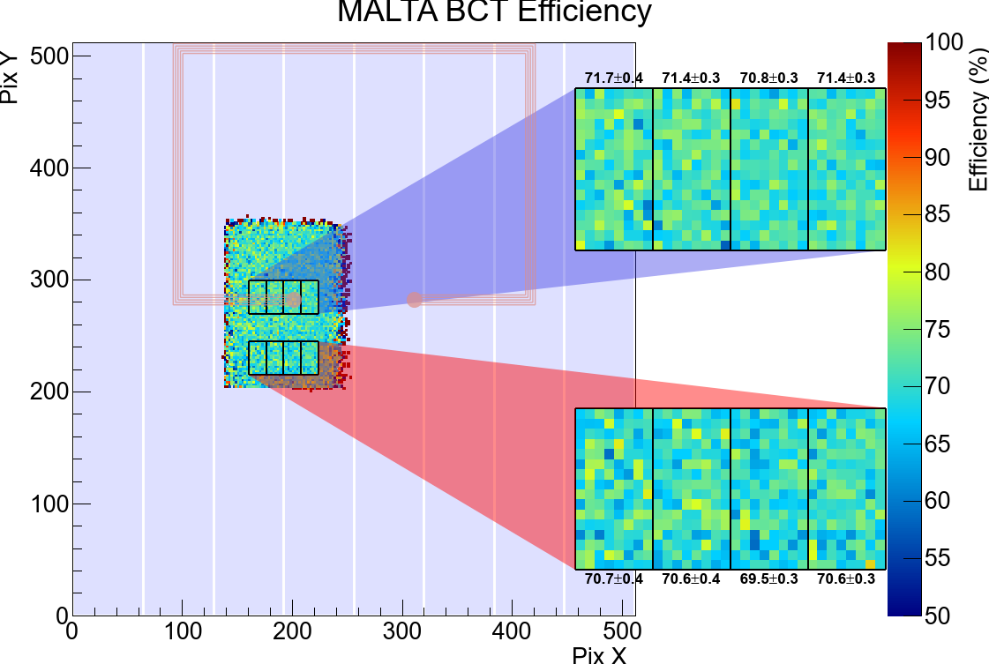
MALTA with BCT – Functional Test
⁵⁵Fe source scan
  Peaks fit comparable
  Distance of the peaks within the gain dispersion of MALTA
Collection Efficiency
  Readout issue reduced the efficiency of ALL detectors to ~70%
  Comparable efficiency for the different ROIs

Slide 24
MALTA with BCT – Functional Test
⁵⁵Fe source scan
  Peaks fit comparable
  Distance of the peaks within the gain dispersion of MALTA
Collection Efficiency
  Readout issue reduced the efficiency of ALL detectors to ~70%
  Comparable efficiency for the different ROIs
BCT process does not change the device performance!

Slide 25

BCT Thermal Test - No Cooling
Hot area about 29˚C

Slide 26

5ml/min -> 10 ml/min
Hot area from 29˚C to 24˚C, using “fresh” water

Slide 27

Data Transmission from Module
Several solutions to transmit data from a module to the readout
Master/Slaves configuration:
Avoid large number of output connections
Could simplify flex design
Only one sensor transmits data over a long distance
DATA
Merged Output
Data

Slide 28


Chip 2 Chip Communication
Wirebond connection
Flip chip connection
MALTA can transmit power and data asynchronously to a neighboring chip (via CMOS pad), merging the data of multiple pixel matrix in just one parallel output
Connection between neighboring chips using flip chip
Better for assembling
Allow additional electronics in the flipchip

Slide 29
MALTA Chip to Chip Data Transmission
Wirebond connection
Flip chip connection
Can save Power and Reduce the Material Budget!
MALTA can transmit power and data asynchronously to a neighboring chip (via CMOS pad), merging the data of multiple pixel matrix in just one parallel output
Connection between neighboring chips using flip chip
Better for assembling
Allow additional electronics in the flipchip

Slide 30

MALTA Chip2Chip data transmission
MALTA_C W7R22
MALTA_C W7R23

Slide 31


MALTA Chip to Chip Data Transmission
⁹⁰Sr source
Compatible results in both directions
MALTA_C W7R22
MALTA_C W7R23

Slide 32



LAPA: pseudo-LVDS for the ATLAS Pixel Apparatus
5Gb/s
240 µm
280 X 240µm² (2 pad pixel pitch)
Tunable DC current (7x 0.8mA )
Modular capacitive coupled pre-emphasis: 16 blocks driving 25fF each.
Vcm feedback control at 0.8V.
External 100 Ω differential termination
40 drivers integrated in MALTA (up to 2Gb/s)
Dedicated testchip
280 µm

Slide 33



LAPA Receiver
5Gb/s
320 X 240 {2 pad pixel pitch) µm²
Internal selectable 100 Ω termination resistor

Slide 34


LAPA eye diagram measurement
5Gb/s
1.28Gb/s (ITk specification)
Jitter_{p-p}= 71ps
Jitter_{p-p}= 38ps

Slide 35


LAPA @1.28 Gbit/s on FLEX ITk prototype
Flex for data transmission out of the ITk system (length~5m)

Slide 36

Conclusions
The small collection electrode shows a collection efficiency >97% after neutron irradiation to$1×{10}^{15}n_{eq}{cm}^{−2}$.
The first version of the sensor (MALTA), suffers from degraded efficiency in the pixel corners after irradiation.
Two process modifications have been developed using technology simulations, promising to improve the sensor radiation-hardness.
The two new versions of the pixel have been implemented in the MiniMALTA sensor, which confirmed the results of the simulations, achieving the target radiation hardness, matching the ATLAS ITk outermost layer requirements. However, the collaboration has chosen to use Hybrid Pixel as baseline solution for the detector upgrade.
Several R&D towards the integration of CMOS pixel sensors have been carried on.
A CMOS compatible microchannel fabrication process, has been successfully performed with the MALTA sensor. The sensor test demonstrate that the chip performance are not degraded after processing. The preliminary cooling tests demonstrate that this approach could be use in future applications.
The data transmission in the tracker has been addressed with the development of a chip to chip communication schema and the design of a 5Gb\s low-power LVDS driver and receiver (LAPA). Both are promising to reduce power consumption, hence the overall material budget.
Studies on a CMOS module have been performed, aiming to define the constrains for the future CMOS sensor design, and minimize the dead area.

Slide 37







My Year
Guiding in ATLAS cavern
ELSA- TESTBEAM
PIXEL2019 Taipei
University of Glasgow
IMEC - COURSE
Exam @ UiO

Slide 38
My Year
Guiding in ATLAS cavern
ELSA- TESTBEAM
PIXEL2019 Taipei
Thank you for the attention
University of Glasgow
IMEC - COURSE
Exam @ UiO

Slide 39

LAPA H-BRIDGE
7 HBRIDGE blocks of 0.8mA - max: total 6mA

Slide 40


LAPA-PRE-EMPHASIS
16 BLOCKS driving 25fF coupled with the output pad

Slide 41

Pre Emphasis Simulations
Simulations of the LVDS OUTPUT

Slide 42

LAPA Single Channel Schema
LVDS_RX_EN
LAPA_CMOS_DRIVER_SEL<X>
CMOS_IN<X>
CMOS_OUT<X>
LVDS_RX_EN
LAPA_CMOS_DRIVER_SEL<X>
LVDS_IN_P<X>
LVDS_OUT_P<X>
TR_EN
LVDS_IN_N<X>
LVDS_OUT_N<X>

Slide 43

LAPA TESTCHIP SIMULATION
2.5GHz LVDS IN – LVDS OUT. 100Ω termination. 1pF load. Simulated jitter=45ps

Slide 44
LAPA
Preliminary power consumption
Expected static power consumption
Static | Current [mA] | Power [mW]
5 Hbridge | 4 | 7.2
7 Hbridge | 5.2 | 10
Measurements on test chip
Static+Dynamic 1.28Gb/s | Current [mA] | Power [mW]
5 Hbridge | 6 | 10.8
7 Hbridge | 8 | 14.4

Slide 45

First signs of life from MALTA
ANALOG pixel output
MALTA (not the one under test)
Digital signal from read-out

Slide 46
First signs of life from MALTA
Happy Designers
ANALOG pixel output
MALTA (not the one under test)
Digital signal from read-out

