Slide 1
Radiation To Electronics (R2E)
Extended Seminar
Preparation of 2010 Workshop
CERN
February 9th
M. Brugger for the R2E Study Group
!!! Many Thanks To Everybody !!!

Slide 2
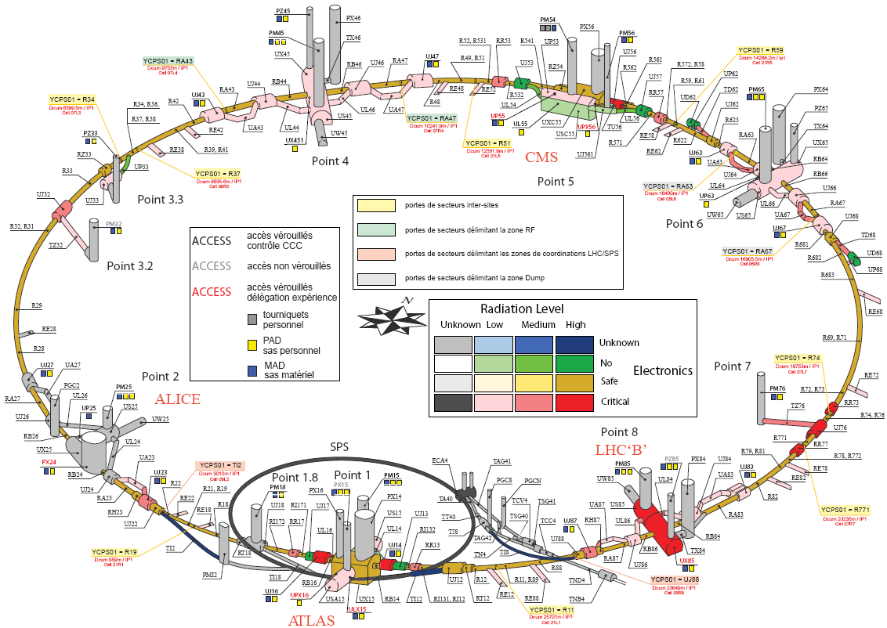
Critical Area Overview
Collimation Area
(high losses possible at an early stage)
High-Luminosity Experiments
(UJs, RRs, possibly UPS)
LHC Tunnel Electronics
LHCb: reaches early significant
radiation levels
Injection & Adjacent Areas:
losses on collimators and dumps on TED

Slide 3
The Challenge
(Problem)
About 30 critical areas
(radiation level 100-100000 more than at surface)
100s of racks concerned
Each containing several electronics cards
(partly full computers)
Each of them again containing at least
tens of components
Many (Most) of them being commercial ones
Failure Cross-sections unknown
Failure consequences not always clear
Radiation levels will evolve over time
Mitigation options are costly, both in time and money
Optimization critical
It’s big…
It’s difficult…
It’s impossible…
It’s getting worse…
It’s important…
“We started yesterday … and should finish by tomorrow…”

Slide 4
The ‘Logical’ Approach
Operational Assumptions / Scenarios
Radiation Levels (critical areas versus time)
Electronics (designed, COTS)
Expected Sensitivity, Failure Cross-Section and Failure Rates
Failure Consequences
Early Monitoring (what can we learn to optimize)
Mitigation options
  shielding (simple + complex)
  relocation
  rad-toldesign
  civil engineering options
  SCL
How to compare the various options
  costs (high uncertainties) + time (not better)
  remaining risk or not
  sustainability and other long-term advantages
  how to fit in operational planning
What is critical when?
What can we learn early?
What can we do about it?
What’s possible and how to optimize?
After the Workshop!

Slide 5
Documentation & Reports
besides R2E meetings, minutes and presentations @ LMC, Chamonix Workshops,…
R2E Website: www.cern.ch/r2e
Document Database & Questionnaires (linked through above):
www.cern.ch/info-r2e-documents
Area Overview of Radiation Levels (see link)
Equipment Inventory (working document, see link)
Mitigation Options (working document, see link)
Memorandum for possible temporary move betatron cleaning to IR3
UJ76 Relocation (see ECR)
R2E Status Report @ Chamonix (see paper)
RR73/77 Shielding Improvement (see ECR)
Mid/Long-Term Action Plan (see report)
R2E Memorandum for Short-Term Resources
Power-Converter Summary (see internal report)
Point-8 Iteration Summary (see final draft)
Point-1/5 Iteration Summary (in preparation)
Online Mitigation Project Tracking (see link)
R2E Radiation School (see program and summary), …

Slide 6
Workshop Input Requirements
Preparation of the follow-up workshop in April/May
Detailed review of R2E mitigation options
Input requirements:
  Equipment
  Radiation Levels
  Mitigation Options
  Planning,…
This seminar builds the basis and defines a list of requirements, then to be distributed to and iterated with you…
You will be responsible for a summary during the workshop
Look for slides with a red title bar

Slide 7
Review Of
Radiation Levels and Some Updates

Slide 8
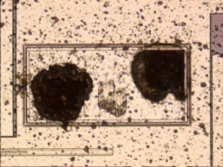
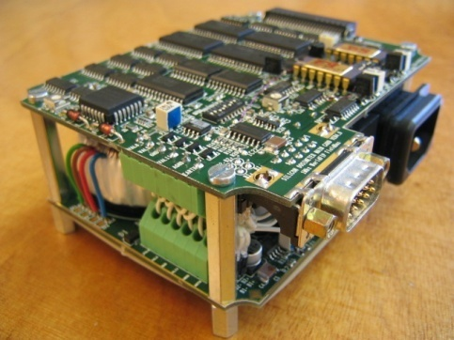
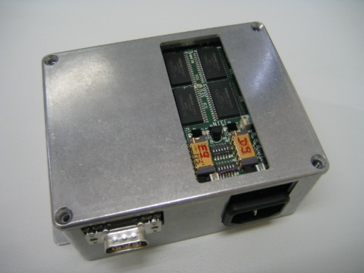
Radiation Physics/Effects/Monitoring
radiation damage in semiconductors
nuclear cascade
Single Events
h > 20 MeV
Effect in
the Device
Radiation Field
h, e,.. > 100 KeV
Displacement
Dose
EM cascade
Radiation Monitor
SEU counter
Measurement
Radfet
PIN Diodes

Slide 9
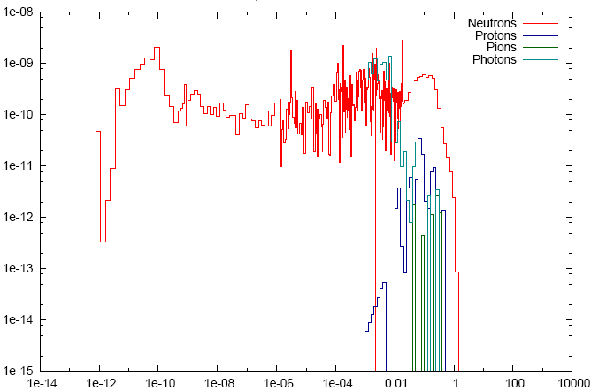
Reality Is Complicated (e.g., UJ76)
The “Failure/
Detector Response”
&
a Little More
Fluence Lethargy / ΦdE/E
??? How high does it go ???
Energy / GeV

Slide 10
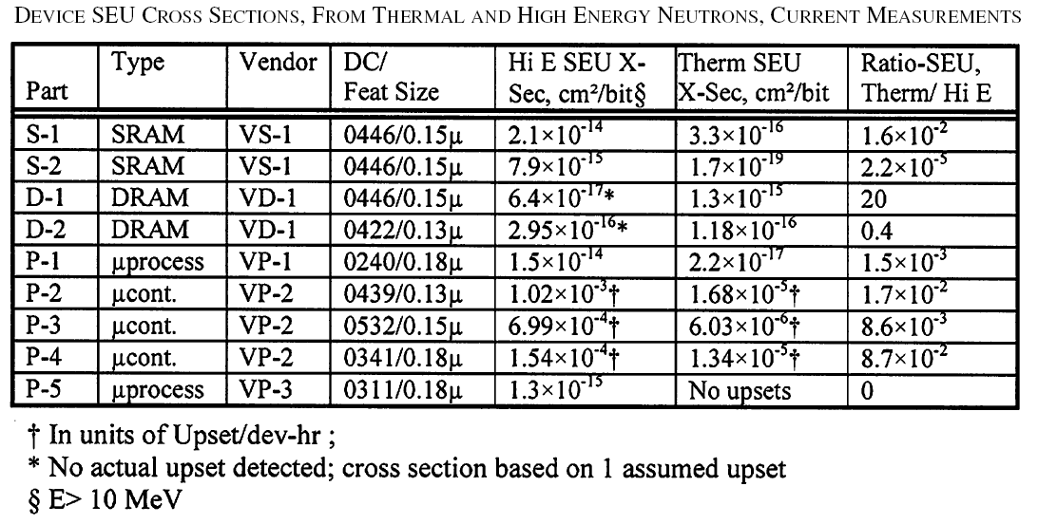
The Risk of Low-Energy Neutrons
Having a look in literature
Sensitivity ranges over four order of magnitudes
  Some: similar or larger xSection
  Others: a factor of 10-100 or further below
How does is compare to our particle energy spectra?
IEEE Trans. on Nucl. Sci., Vol 5, p. 3587-3595

Slide 11
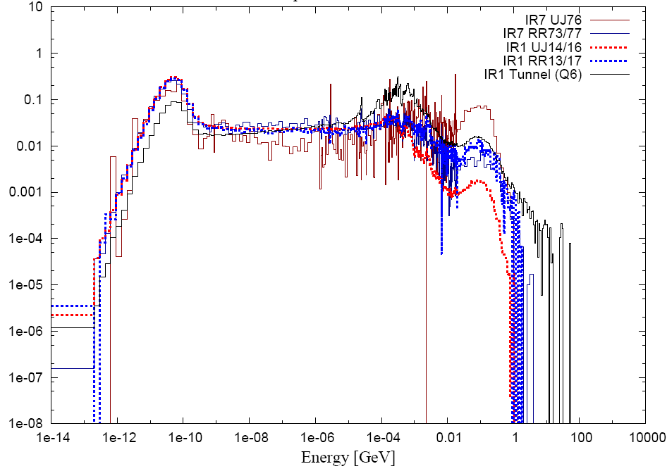
What’s about the Critical Areas
Thermal-Neutron Φ
divided by
High-Energy Hadron Φ
R-Factor
RR13/17: ~ 10-20
RR73/77: ~ 30-60
UJ76: ~ 1-3
UJ56: ~ 1-3
UJ14/16: ~ 1-200
Various ‘typical’ Spectra
© K. Roed et al.

Slide 12
The Risk of Low-Energy Neutrons
The Risk of low-energy neutrons can’t be excluded
  after shielding and with similar cross-sections dominant
  significant contribution even with a cross-section of a factor of 10-100 less
Important criteria for shielding and relocation approaches
Only preliminarily studied so far (main concern to reduce the high-energy hadron fluence – still helps for low energy neutrons)
Different shielding strategies (Boron, …)
Risk:
  important for old components possibly containing borated glass
  also not to be excluded for new COTS, etc…

Slide 13
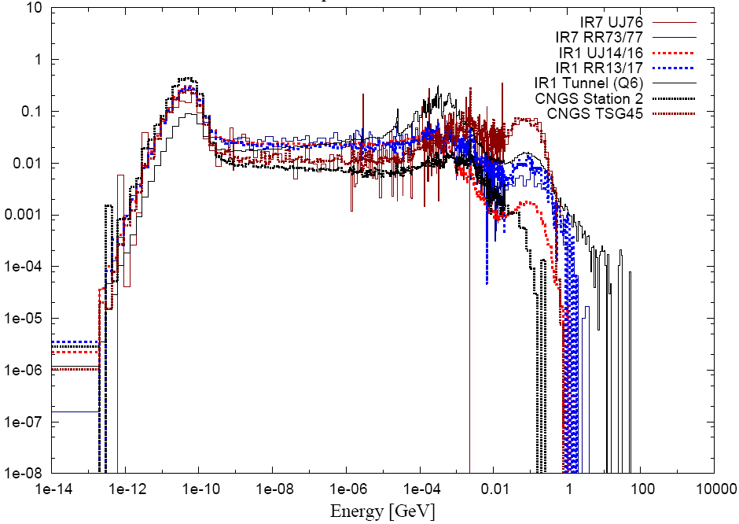
And Testing at CNGS?
© K. Roed et al.
CNGS line-of-sight <-> UJ76

Slide 14
Some Examples of FLUKA Calculations

Slide 15
Calculations Overview
Dedicated R2E calculations were performed for:
  Point 7 (UJ76, RR73/77, TZ76)
  Point 3 (UP/UJ33)
  Point 1 (UJ14/16, RR13/17, UPS14/16)
  Point 5 (UJ56, RR57, UPS56)
  Point 8 (UJ84, RA83/UA83)
  ARC/DS
Simplified calculations were performed for:
  Point 6 (TCDQ and scaling towards UA)
  TI8 Injection test on collimator
Existing calculations were reviewed:
  Point 8 (UX/US85)
  Point 2, 8 (TI2/8, UJ22/23/88/87, UA23/87) … only rough scaling possible
  RE32/38
  ARC/DS
  Point 1/5 RRs
  Point 4 (UX45)
Some Examples

Slide 16
Normalisation & Scaling
Direct losses (collimation, TCDQ,…)
  total losses depend on beam intensity, as well as on machine performance and stability and required aperture settings
  already in early operation one could possibly "locally" reach levels close to ½ nominal
  high uncertainty in distribution of losses which can locally raise radiation levels (e.g., TCLA <-> RR77)
Beam-Beam (UJs in IR1, IR5,…)
  luminosity dependent
  Failures will occur at constant rate as long as luminosity remains the same
  Integrated (e.g., over a year) luminosity allows to estimate the number of expected failures
Beam-Gas (REs, UJ32,…)
  depend directly on beam-gas densities, the respective gas composition as well as the actual beam intensity
  Changes over operational time/intensity and within the machine

Slide 17
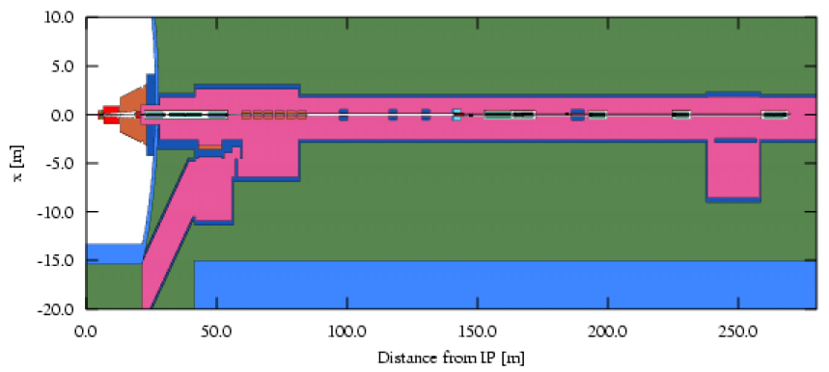
IR1: UJs, RRs and ULs
LHC Point 1, right side;
FLUKA implementation of the ATLAS cavern, the LHC tunnel up to the RR17 with UJ16, UJ17 and UL16 service tunnels;
© A. Mereghetti et al.

Slide 18
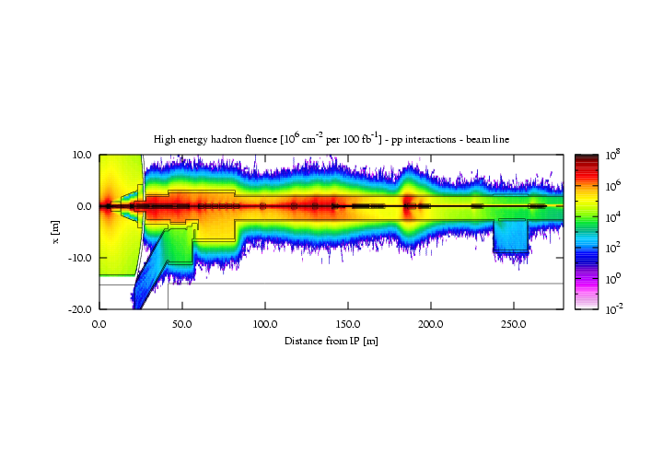
Beam-Beam collisions
High energy hadron fluence [units of 10⁶ cm⁻² per 100 fb⁻¹]
© A. Mereghetti et al.
Hot spots: Triplet, TCL5.R1.B1;
RR: Consistent with earlier estimates Baishev et al.
UL: long distance to UJ required (+shielding)

Slide 19
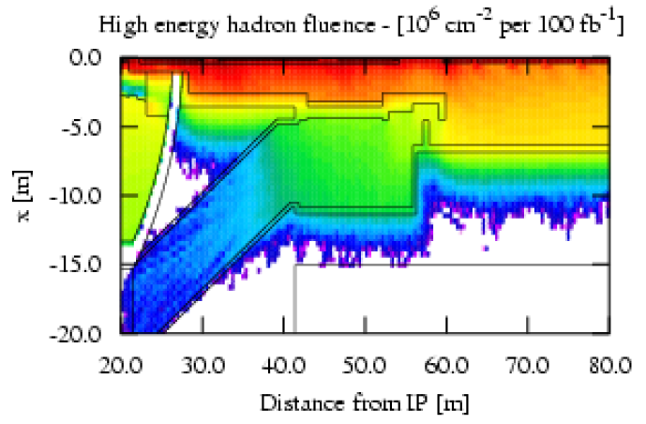
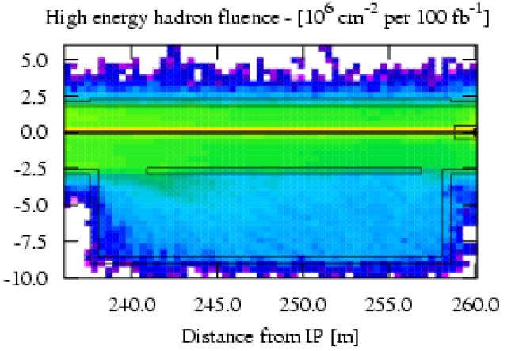
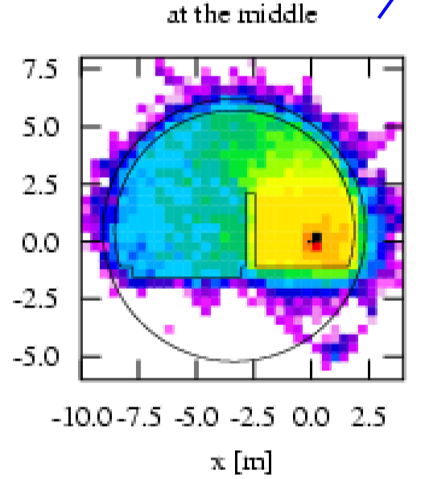
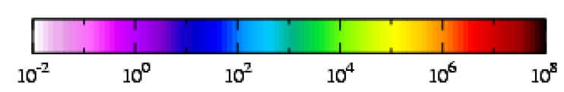
IR1: UJs, RRs and ULs
© A. Mereghetti et al.
UJ: 10⁹ – 10¹⁰ cm⁻²y⁻¹
RR: 10⁸ – 10⁹ cm⁻²y⁻¹
UL: 10⁷ – 10⁹ cm⁻²y⁻¹

Slide 20
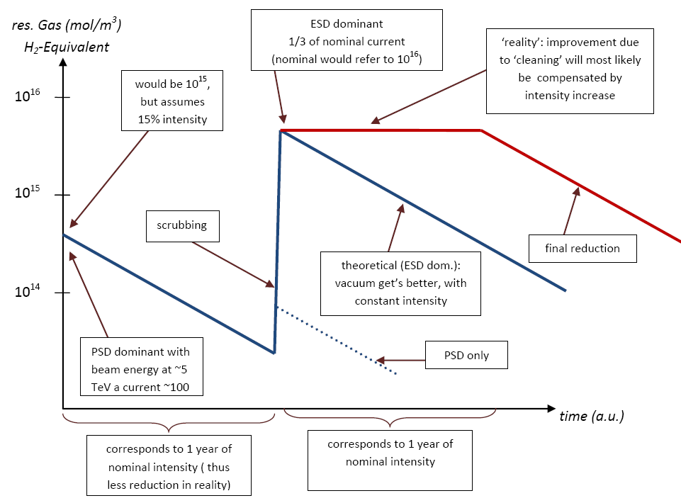
Tunnel: DS/ARC
Beam-Gas calculation assumptions:
  residual gas density: 10¹⁵ mol/m³ (H₂-equivalent)
  beam 1 only, results scaled by a factor of two
  sampling as from D3
  up to MBC13 (~250m)
  scoring dose in air
Normalisation:
  1 nominal LHC year
    10⁷s and 3.64x10¹⁸p/s
  76mbarn cross-section
  [H₂]
© V. Baglin

Slide 21
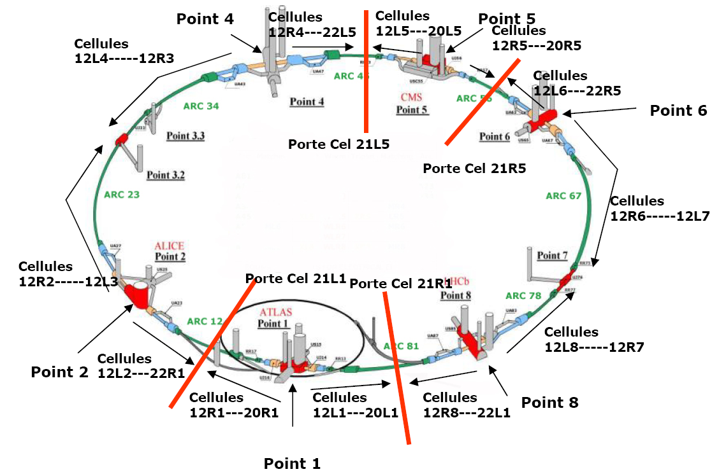
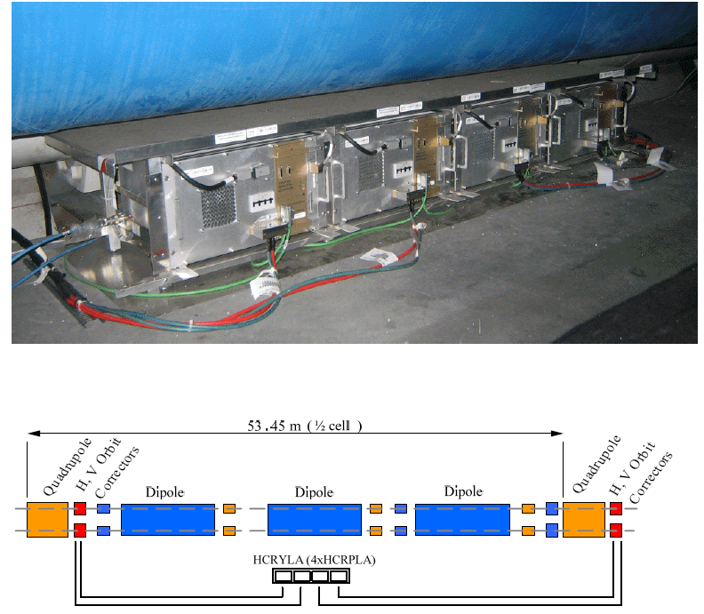
Tunnel: DS/ARC
© Y. Thurel

Slide 22
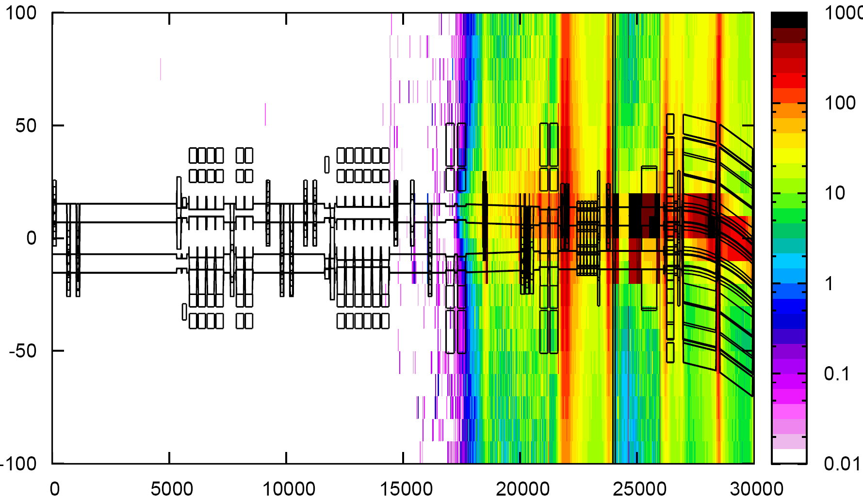
Tunnel: DS/ARC
IR7 FLUKA geometry extending from the LSS up to MBC13 (here not shown)
D3
D4
Q7
MB8
Gy / nominal LHC year
horizontal distance from IP / cm
Distance from IP / cm

Slide 23
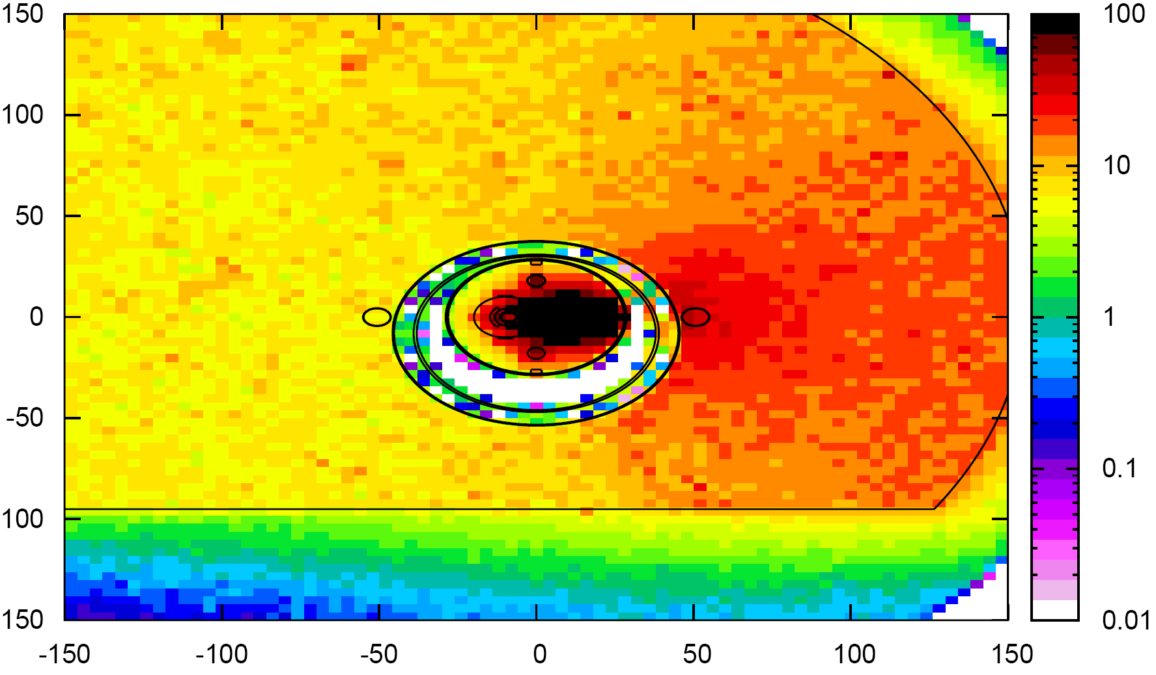
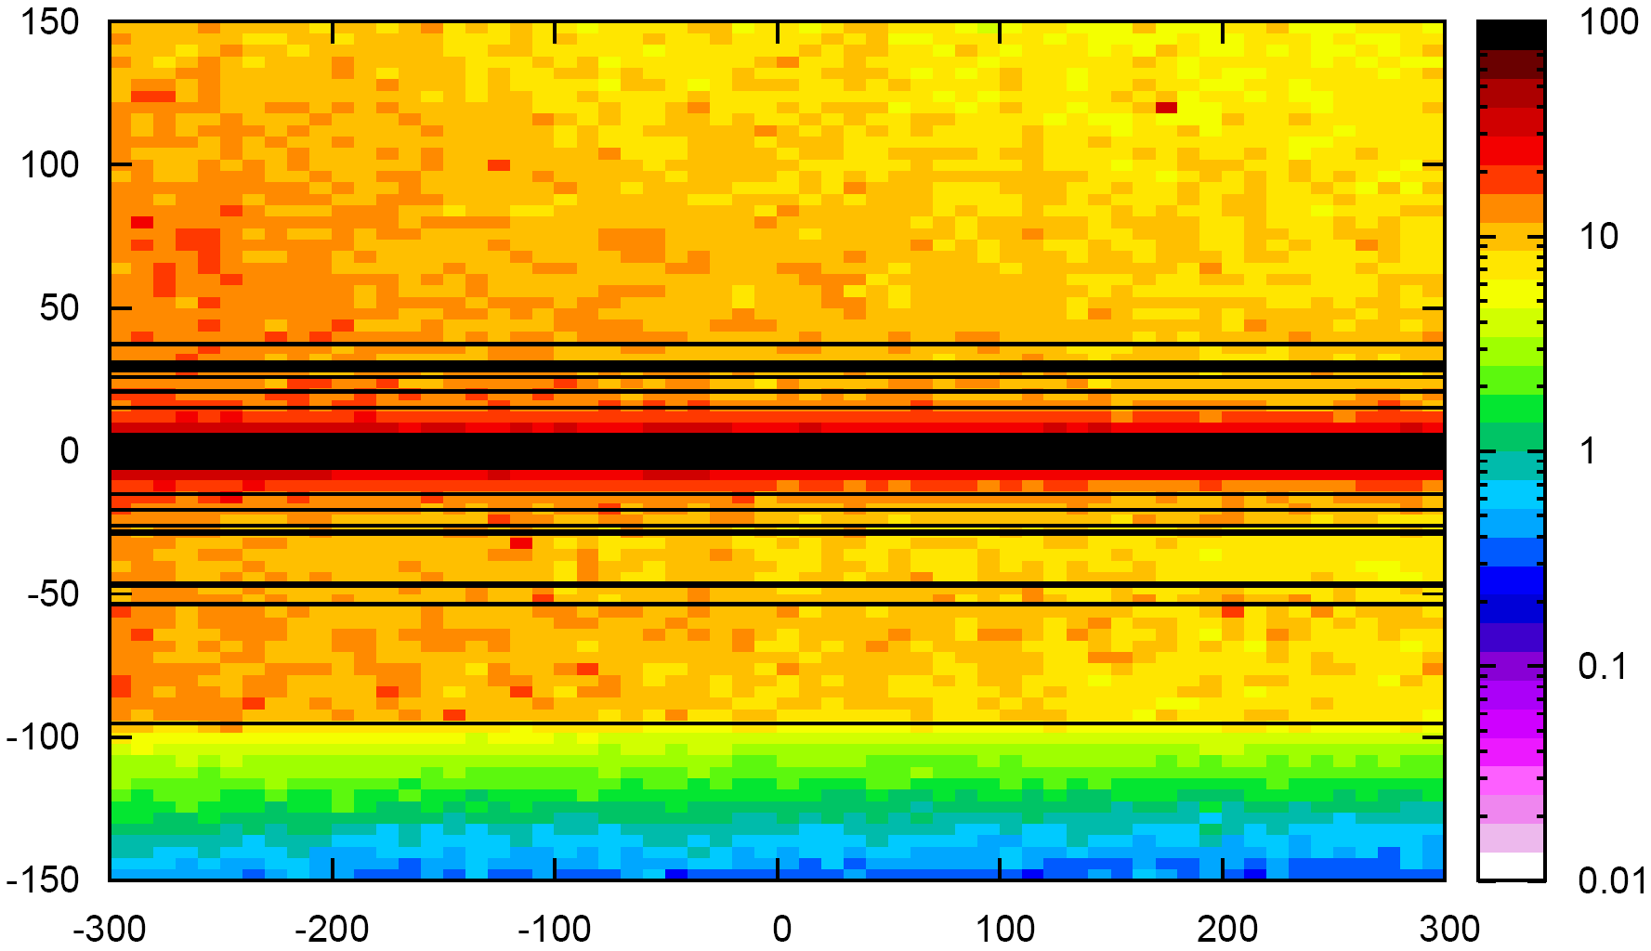
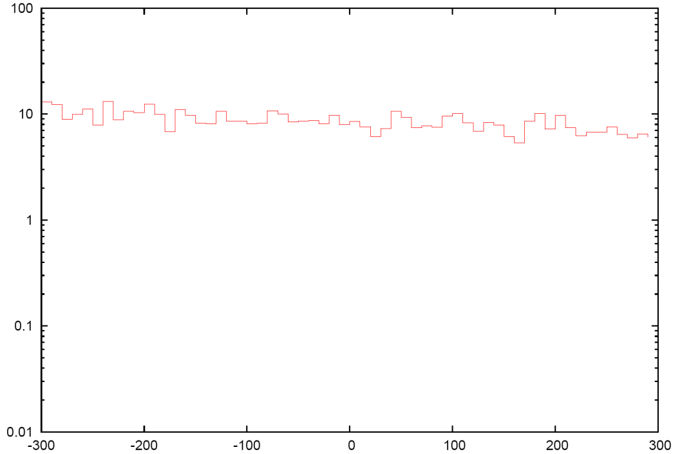
Tunnel: DS/ARC
MBB8
Gy/year
Gy/year
Avg
Avg
Average: 8.6 Gy (2.7%)

Slide 24
Tunnel: DS/ARC
Magnet | Dose/Gy/y | Error / %
MQ 7: | 26.3 | 6.3%
MQ 8: | 37.0 | 8.7%
MBA 8: | 13.9 | 2.0%
MBB 8: | 8.6 | 2.7%
MQ 9: | 32.9 | 6.3%
MBA 9: | 7.1 | 2.5%
MBB 9: | 6.7 | 2.3%
MQ 10: | 34.2 | 5.5%
MBA 10: | 6.9 | 2.1%
MBB 10: | 6.2 | 2.4%
MQ 11: | 14.4 | 4.8%
MBA 11: | 6.8 | 3.4%
MBB 11: | 6.3 | 3.5%
MQ 12: | 2.8 | 12.0%
MBA 12: | 6.1 | 2.8%
MBB 12: | 1.4 | 6.7%
MBC 12: | 0.4 | 10.1%
MQ 13: | 3.5 | 10.3%
MBA 13: | 0.4 | 7.9%
MBB 13: | 0.3 | 12.2%
MBC 13: | 0.2 | 10.2%
Summary Table:
Doses highest in change from LSS to bent region
Peaks where
matching is done
(Q8, Q11)
MBB12 worst case
for Power-Converters
>=MBB13: <=1Gy/y
-> what comes from the LSS?

Slide 25
Tunnel: DS/ARC
Beam-Gas Only as before
Thanks to R. Assmann et al.
Magnet | Dose/Gy/y | Error / %
MQ 7: | 26.3 | 6.3%
MQ 8: | 37.0 | 8.7%
MBA 8: | 13.9 | 2.0%
MBB 8: | 8.6 | 2.7%
MQ 9: | 32.9 | 6.3%
MBA 9: | 7.1 | 2.5%
MBB 9: | 6.7 | 2.3%
MQ 10: | 34.2 | 5.5%
MBA 10: | 6.9 | 2.1%
MBB 10: | 6.2 | 2.4%
MQ 11: | 14.4 | 4.8%
MBA 11: | 6.8 | 3.4%
MBB 11: | 6.3 | 3.5%
MQ 12: | 2.8 | 12.0%
MBA 12: | 6.1 | 2.8%
MBB 12: | 1.4 | 6.7%
MBC 12: | 0.4 | 10.1%
MQ 13: | 3.5 | 10.3%
MBA 13: | 0.4 | 7.9%
MBB 13: | 0.3 | 12.2%
MBC 13: | 0.2 | 10.2%
Scaled with…
Collimation Loss IR7 [Gy/y] | All Magnets at Quench [Gy/y]
bad statistics | 926.2
417.2 | 497.7
bad statistics | 277.2
5.3 | 69.4
501.9 | 418.2
348.2 | 181.0
258.3 | 84.7
349.6 | 447.6
20.2 | 264.9
7.5 | 78.4
2913.6 | 1100.3
321.5 | 173.9
110.1 | 74.1
scoring problem | 632.2
43.2 | 252.1
1.7 | 45.8
bad statistics | 64.7
30.2 | 527.7
bad statistics | 60.0
bad statistics | 43.0
bad statistics | 54.1
Collimation
  horizontal Loss
  limited statistics
Quench
  1mW/cm3
!!!
only a quick
and rough
estimation
!!!

Slide 26
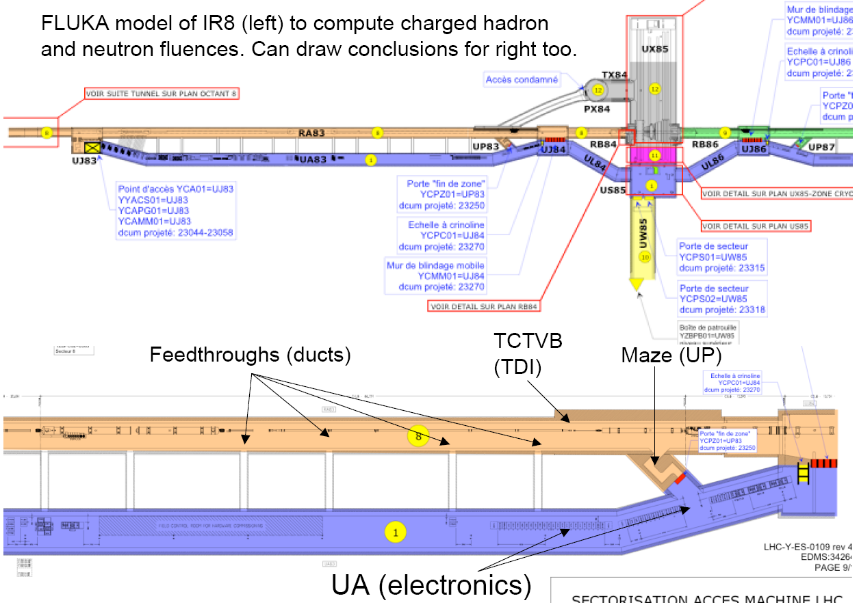
IR8: UJ84/86 – UA83/87

Slide 27
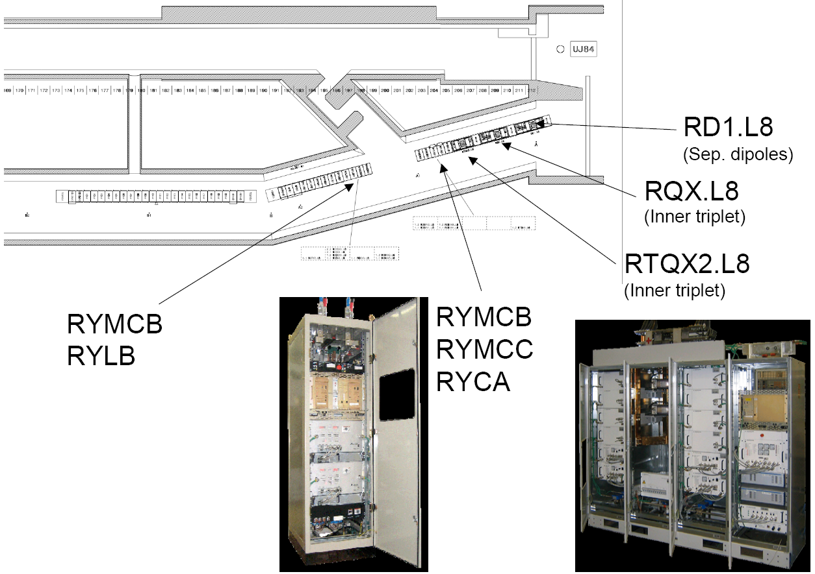
IR8: UJ84/86 – UA83/87

Slide 28
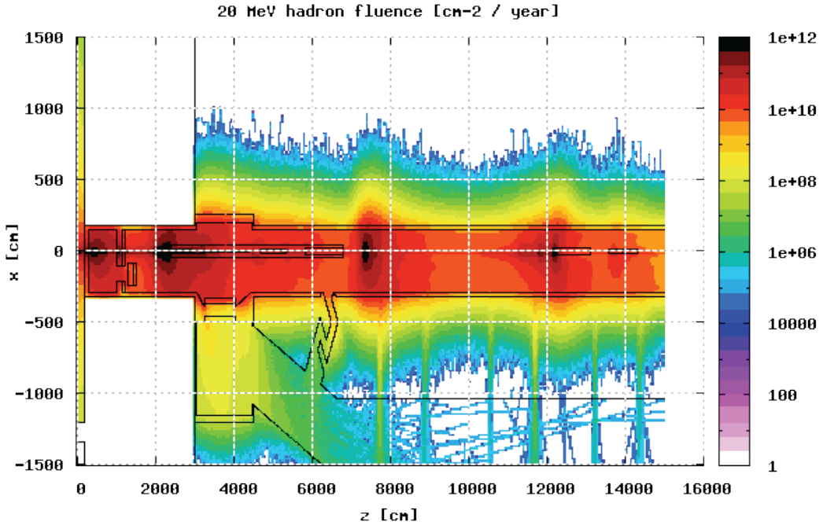
IR8: UJ84/86 – UA83/87
Normalized assuming 10⁷ coll/s (conservative)
– Tunnel : Typically 10¹¹ cm⁻² / year
– Entrance of maze : 10¹⁰ cm⁻² / year
– Exit of maze : ~10⁷ cm⁻² / year
– Entrance of ducts 1 and 2 : 5x10¹⁰ cm⁻² / year
– Exit of ducts 1 and 2 : ~10⁷ cm⁻² / year
– UJ/UA electronics: 10⁷ cm⁻² / year
– Through shielding plug in UJ: 10⁸-10⁹ cm⁻² / year
© R. Appleby et al.

Slide 29
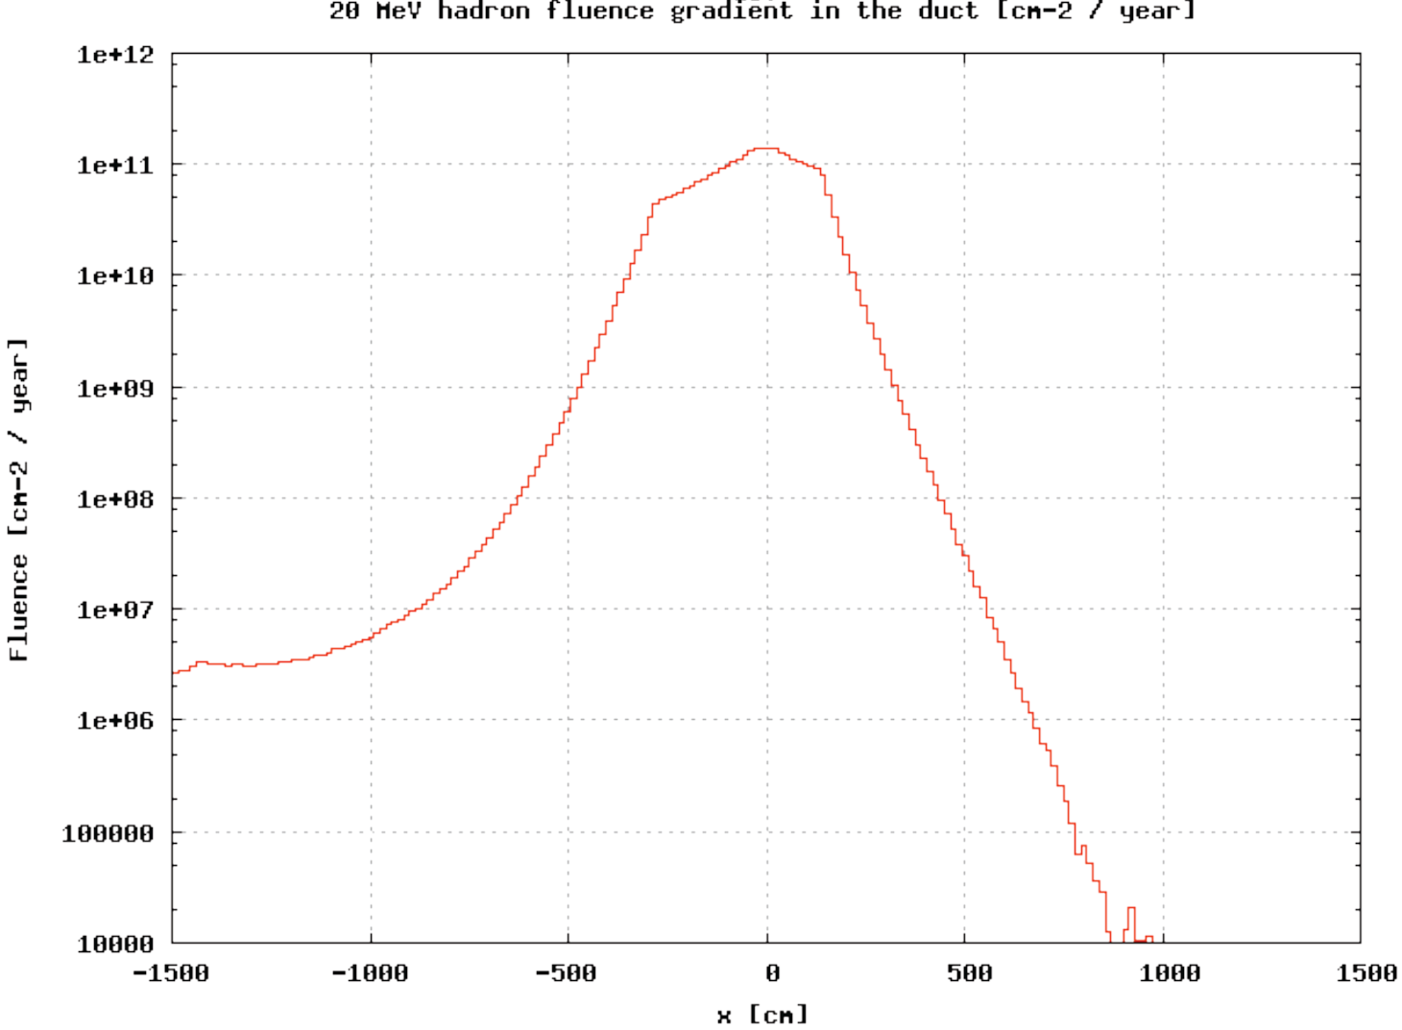
IR8: UJ84/86 – UA83/87
Streaming Through Ducts:
© R. Appleby et al.
Ducts between
RAs and UAs
Attenuation: 10³ - 10⁴

Slide 30
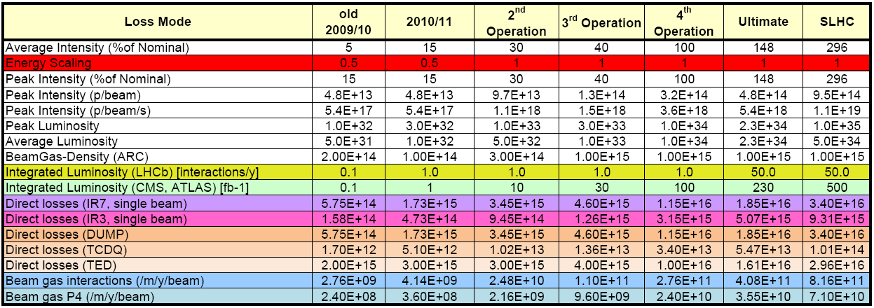
Scaling With LHC - Operation
Good idea for 2009/10
Defined goal for 2010/11
General problem when putting ‘years’
(longer operational period, etc…)
Below table as currently used and easy update possible
© M. Lamont

Slide 31
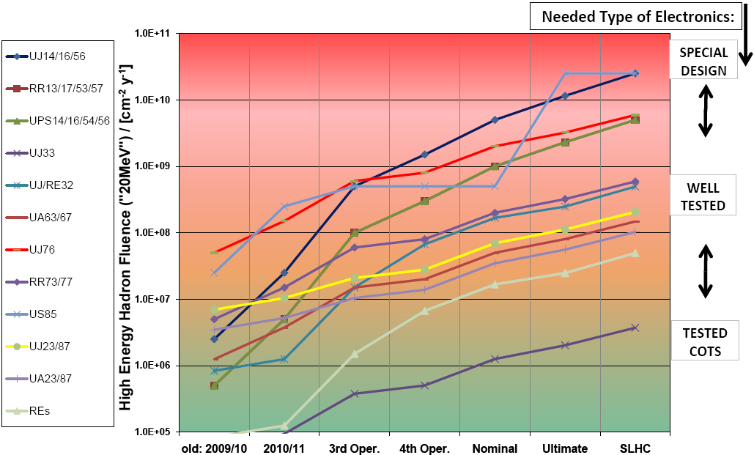
Summary Of Areas
See also: Direct Link

Slide 32
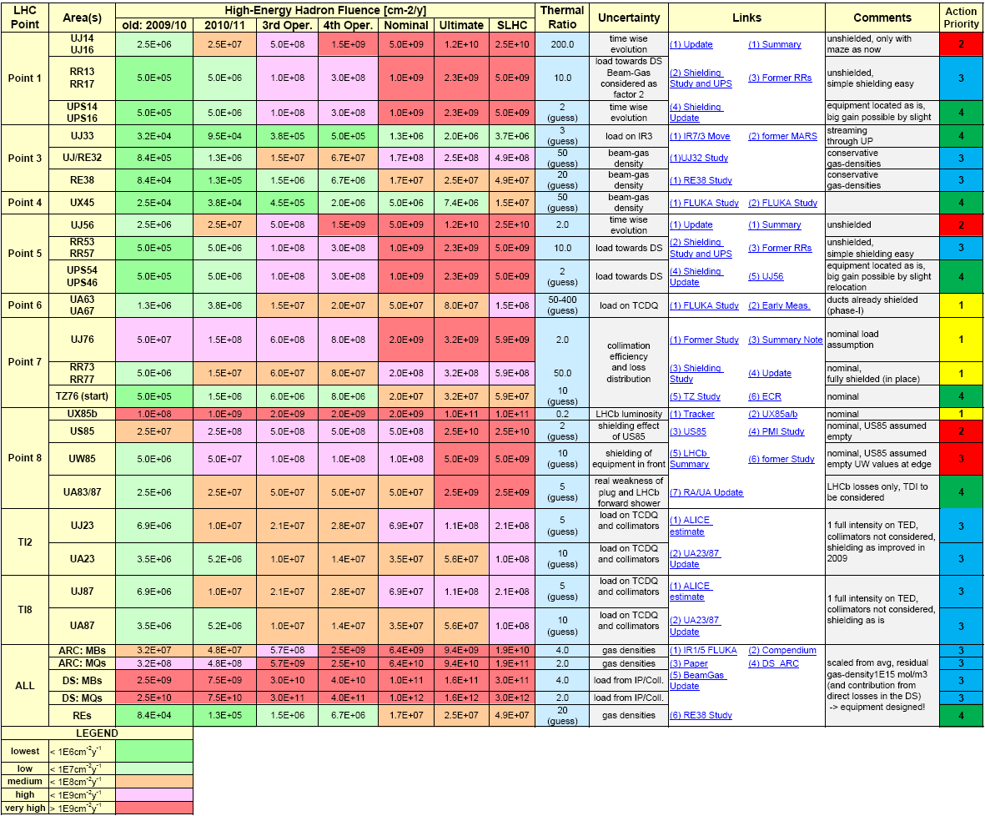
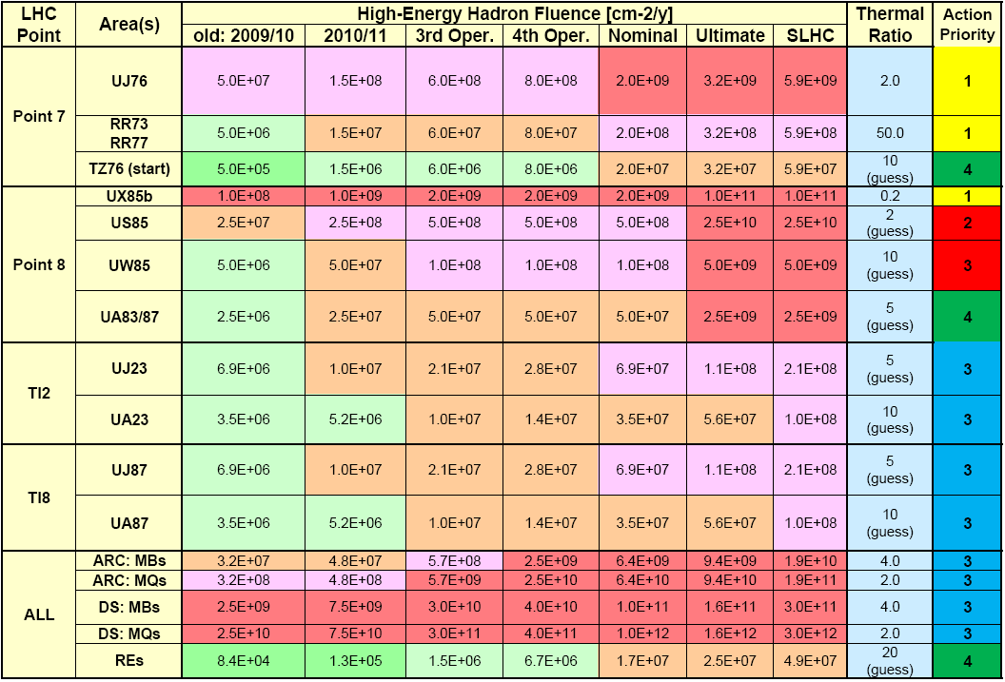
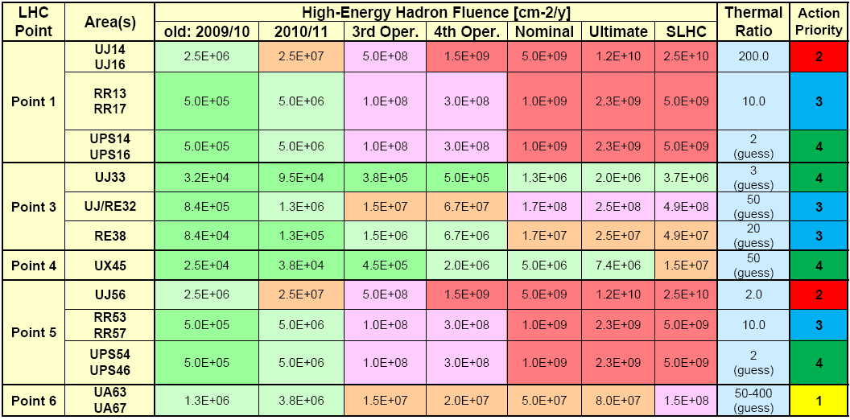
Summary Of Areas – See Direct Link

Slide 33
Workshop Input Requirements
General:
  Thermal neutron problem
    can one better quantify the thermal neutron contribution in the various areas
    possibly combined with early measurements?
  Operational Scenarios 2010 and beyond
    do we need a further refinement?
Calculation Requirements:
  Correct scaling between 7TeV and 3.5TeV operation
    generic calculation to be possibly compared to one dedicated case
  Missing calculations:
    Phase-II collimation impact
    RR shielding at P1/5
    TI2/8 Shielding

Slide 34
Equipment in
Critical Areas

Slide 35
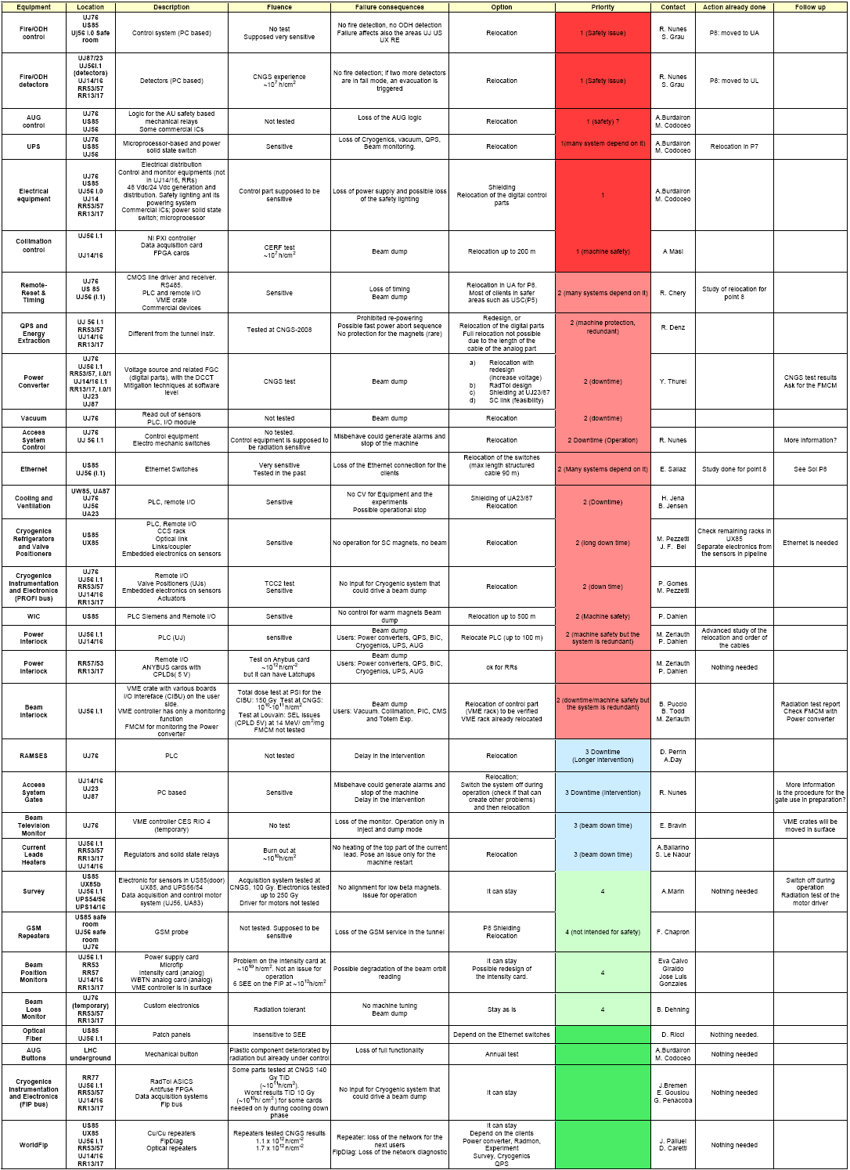
Equipment Inventory (see link)
Evaluation of the risk:
Personnel and Machine safety
(Priority 1)
Long downtime (Priority 2)
Beam quality degradation
(Priority 3)
Monitoring or no immediate impact on the machine (Priority 4)
  Equipment radiation hardness
Investigate solutions to reduce risk
Assess interdependencies between systems
  How :
Information from equipment owners via on-line survey (see link)
© G. Spiezia
Priorities are assigned not only
taking into account the failure
consequences, but also the area
and possible knowledge about
radiation sensitivity

Slide 36
Equipment Test: UJ22
Equipment | Ethernet | ProfiBus | Power line | Others
Collimator control rack | X (3 outlets) |  | Remote reset System under test | 9 wires cable
Remote Reset Crate | X | X | As above | To be defined
PIC/WIC* | X | X | As above | 4 wires cable (NE4)
CV PLCs | X |  | To be defined | To be defined
Fire Detectors* |  |  | To be defined | To be defined
*To be confirmed
*To be confirmed
To follow next week (.5day slot on Tuesday)
Ethernet availability
ProfiBus connection
Independent power supply for each user with a brake-circuit
Cabling and installation of Test-Station
To follow up for next technical stop
Documentation of tests, access,…
Monitoring system for each user
Cabling (profibus, ethernet, power line, NE4, NE9) from UJ23 to the radiation area (~30-50 meters)
Installation/Test of Equipment

Slide 37
CNGS requests for 2010
© D. Kramer
Cryogenics
  TSG45, Two crates like in 2009
  1MHz SUBD + 2xNE48
  New cards ready for the April/May run
Power Convertors TE/EPC
  TSG45, The same installation size as in 2009
  NE48 only
  PS etc ready 2nd half of May or June
QPS
  TSG46
  1MHz miniSUBD
  Later in the year (prototype boards for IP1,5)
Continuation/Extension of UJ22 tests
That’s all? Upcoming RadWG to collect further needs!

Slide 38
Radiation Sensitivity – Another Way?
© J. Troska, F. Faccio
What if?
  One asks the question:
  “What is the expected SEE sensitivity of the following equipment?”
What is required:
  List of equipment, Inventory
  Some idea of most sensitive parts
  Ideally some components (and description)
Approach
  Independent review of expected equipment sensitivity by asking the question to a set of ‘experts’
  After receiving a first collection of answers, building an average and then re-iteration (up/down approach)
  Getting a best possible conclusion
  Then to be compared with the result of old/new measurements

Slide 39
What is a ‘safe’ limit in terms of high-energy hadron fluence?

Slide 40
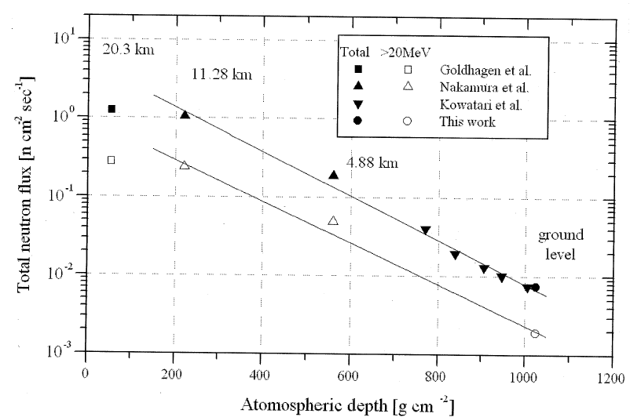
Can one Define a ‘Limit’
10⁷ cm⁻²y⁻¹ as an annual ‘limit’:
ground level: some 10⁵, thus roughly a factor of 10 more where problems start?
CNGS experience
(PLC and Fire Detector failures at ~10⁷)
Valve controllers
(failure actually already below 10⁷)
Risks always remains
(cross section, fluence, number of devices)
  possible to predict/measure in case of full component/system control
  estimate perhaps possible when analysing some components
∼3 x 10⁵ cm⁻² y⁻¹
∼1 x 10⁵ cm⁻² y⁻¹
© Nakamura et al.: Terrestrial Neutron-Induced Soft Errors in Advanced Memory Devices

Slide 41
Workshop Input Requirements
Equipment Inventory
  Equipment Owners
    Verify/Complete collected/provided information
Equipment Radiation Tests
  from existing tests + alternative approach
    PIC/WIC, PLCs,… (@ CNGS, TCC2,…) + PH/ESE experience
  TI2: UJ22
    Collimation Control, Remote Reset, PIC/WIC (tbc.),
    CV, Fire-Detection (tbc.)
    Support from planning
  CNGS
    Cryo, PCs, QPS, Continuation of UJ22, + ???
    Additional Needs to be defined soon
Do we need an additional facility, test location?
  Equipment owners need to define their needs
  (long-term strategy!)

Slide 42
Monitoring
&
Benchmark

Slide 43
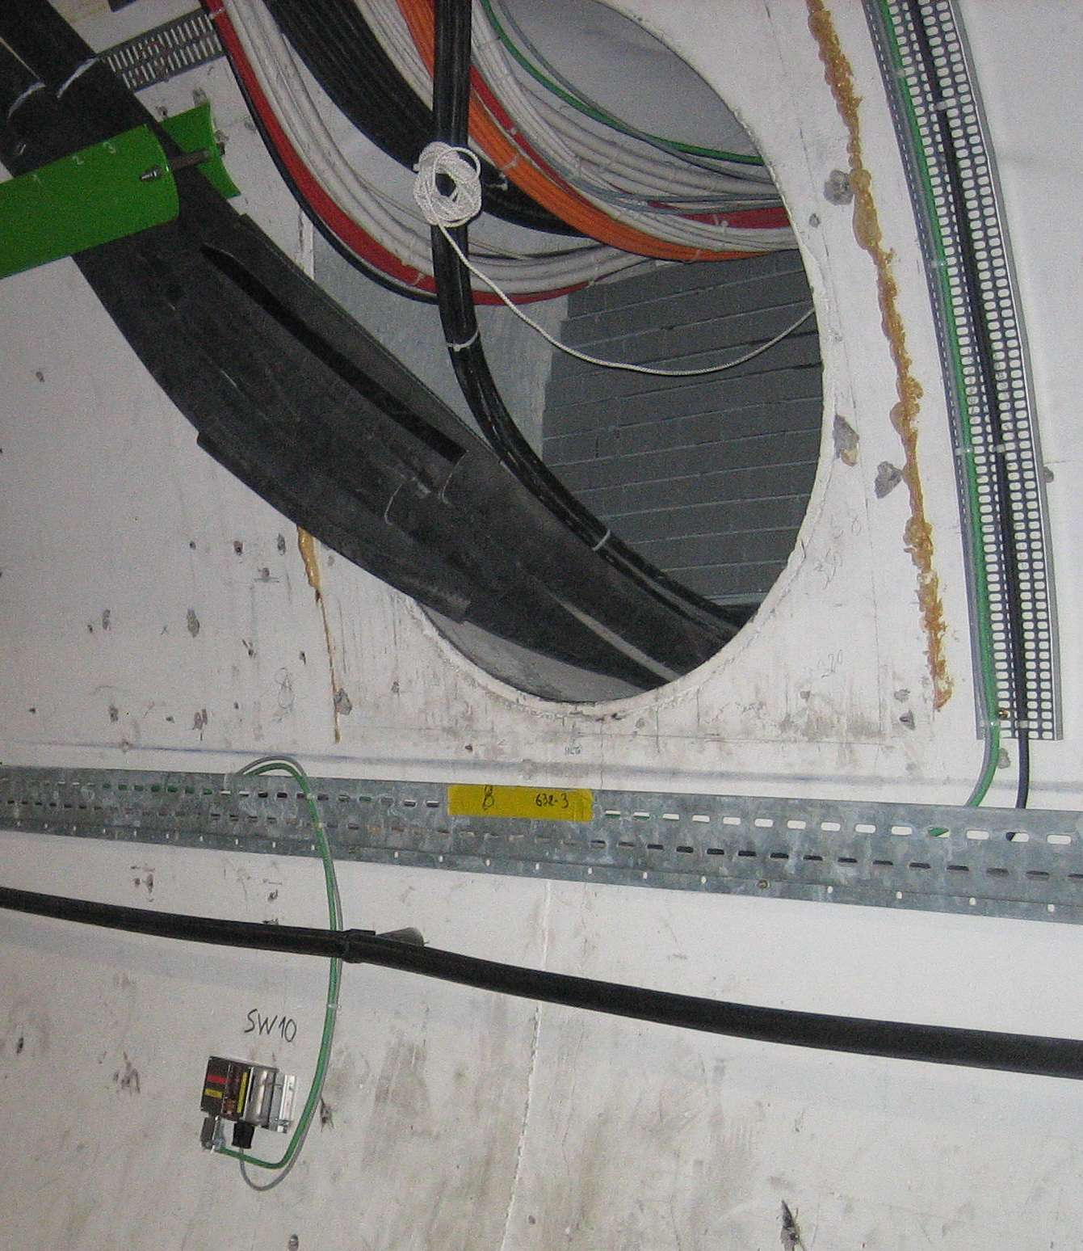
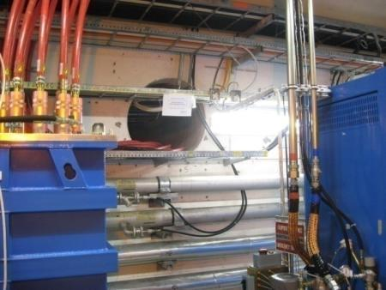
Monitoring Improvements
RadMon Improvements
  Refined Calibration (benchmarks, dedicated tests,…)
  Relocation of detectors to optimize early
  measurements
  The LHC Radiation Environment
  Change of Voltage Settings
  New RadMon Developments (e.g., Battery Driven,…)
  Inventory & Additional Monitoring
  Through Point-Iterations monitor locations were checked & documented -> visualisation tool suggested
  (to be developed)
  more than 200 TLD detectors placed
  in critical areas (collaboration with SC/RP)
  will allow for an early analysis at even
  low-intensities
  we will start collecting them late-summer

Slide 44
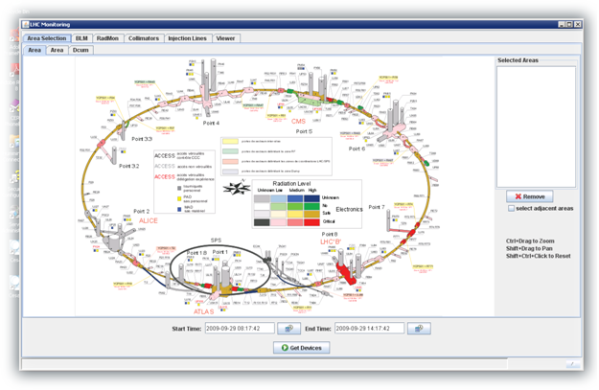
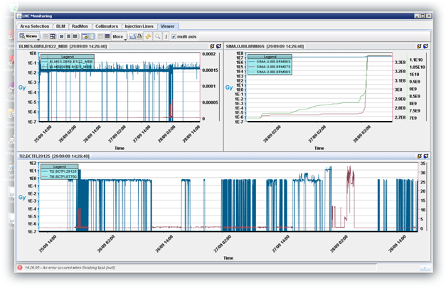
Combined Monitoring Tool (link)
© M. Pinheiro
Monitor selection through
areas (graphical, list,
beam element, DCUM,…)
Easy navigation trough
critical areas
Numerous monitor types at
the same time
  BLMs, RadMons, BCTs,
  RAMSES (in work)
  Collimator settings
Combined Viewer to check
correlations
Still under development
  PLEASE TEST IT
Final Beta-Version ready

Slide 45
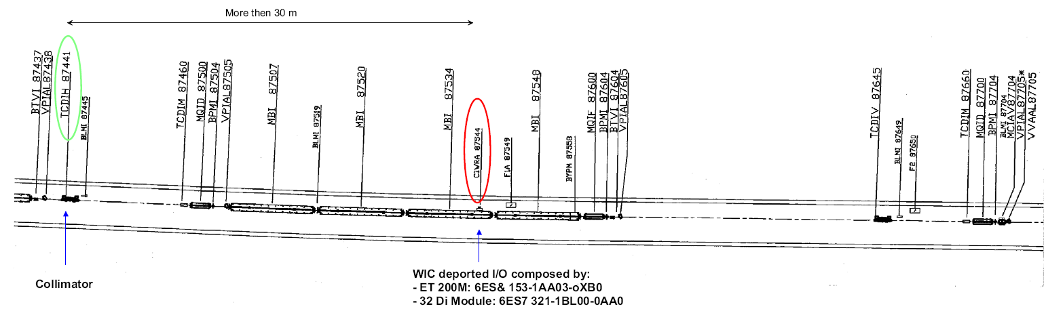
WIC Failure during TI8 Injection Test
WIC failure observed in June (stopped CNGS and LHC Injection)
Immediate analysis of available measurement data
FLUKA simulations: respective radiation levels (10⁸-10⁹cm⁻²)
Detailed review of WIC layout and available test measurements
Analysis confirmed that the failure was very unlikely
During the additional TI2/8 test about 4x10¹³ protons were ‘dumped’ on the upstream collimator -> no WIC failure observed
still: …WIC-crate to be relocated when time

Slide 46
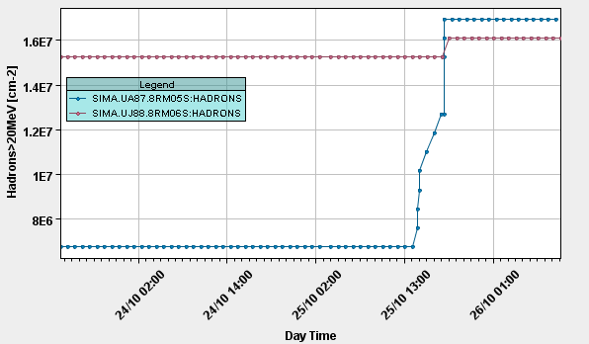
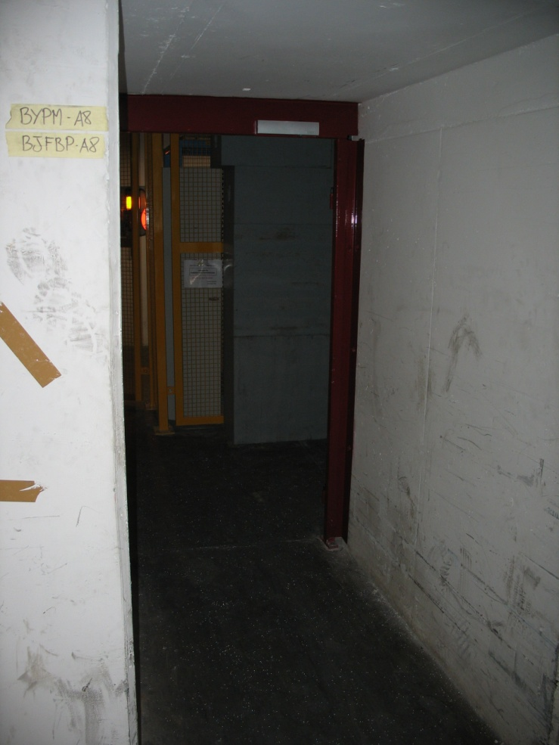
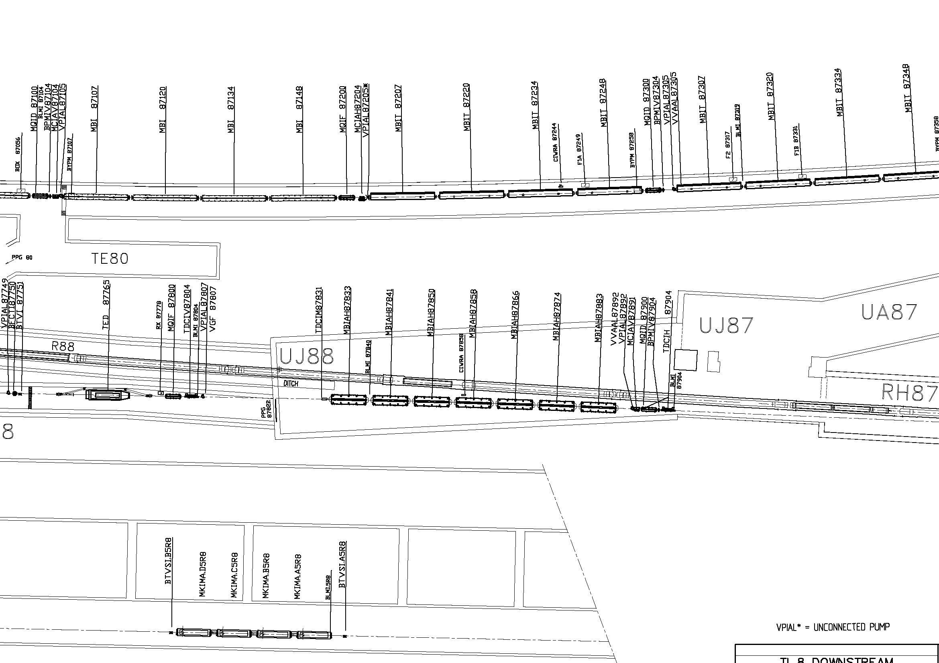
UJ87: setup of TCDIH.87904
Blue – inside UJ87 (3V)
Red – on the new shielding in UJ88 (5V)
Radiation directly from the Collimator TCDIH 87904 (Setup)

Slide 47
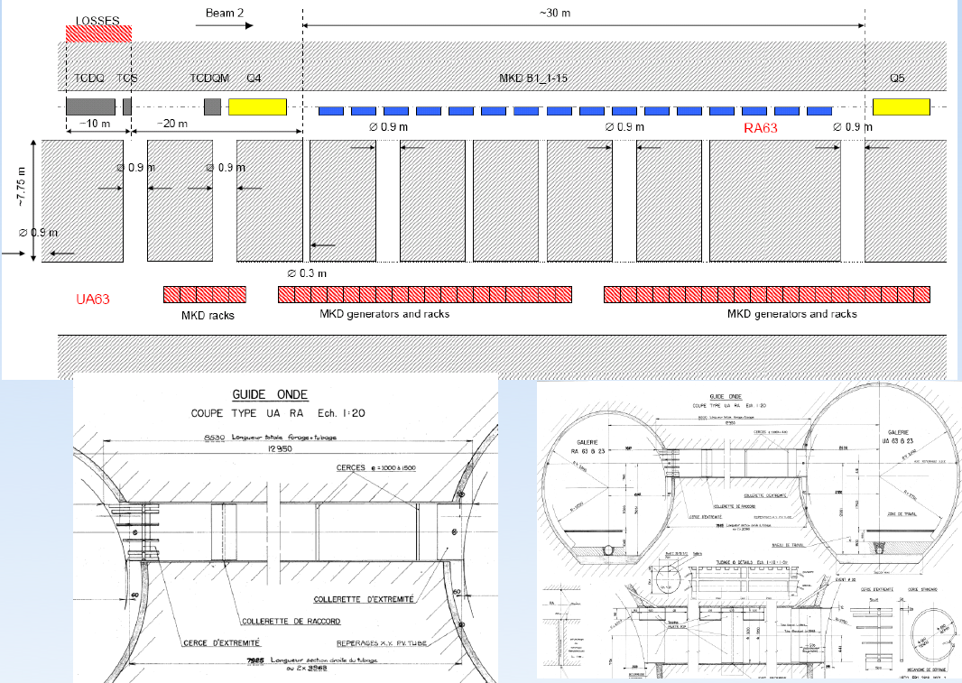
TCDQ Losses 07-09.11.2009

Slide 48
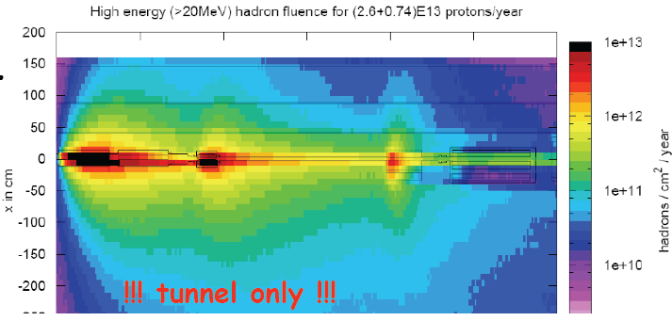
TCDQ Losses 07-09.11.2009
~3x10¹⁰ cm⁻² high-E hadrons for 7TeV and 2.6x10¹³
rough scaling: ~2x10⁹ cm⁻² at 450GeV
this results in ~4x10⁵ per 5x10⁹ shot
We had about 50 (full) shots on the TCDQ -> ~2x10⁷ expected
5.6x10⁷ measured at the tunnel location (~30counts!)
In the UA, the monitor is set to 3V (factor of 10 more sensitive) -> nothing measured -> confirms the expected attenuation factor of ~1000
Thanks Brennan!

Slide 49
Early Measurements
Out of Practice…
Measurements: “Everybody believes in them…
  except the person who did the measurement…”
Simulations: “Nobody believes in them…
  except the person who performed them…”
Recommendations: “Everybody argues…
  including the person who is giving them … “
Conclusion: …
  it takes time…

Slide 50
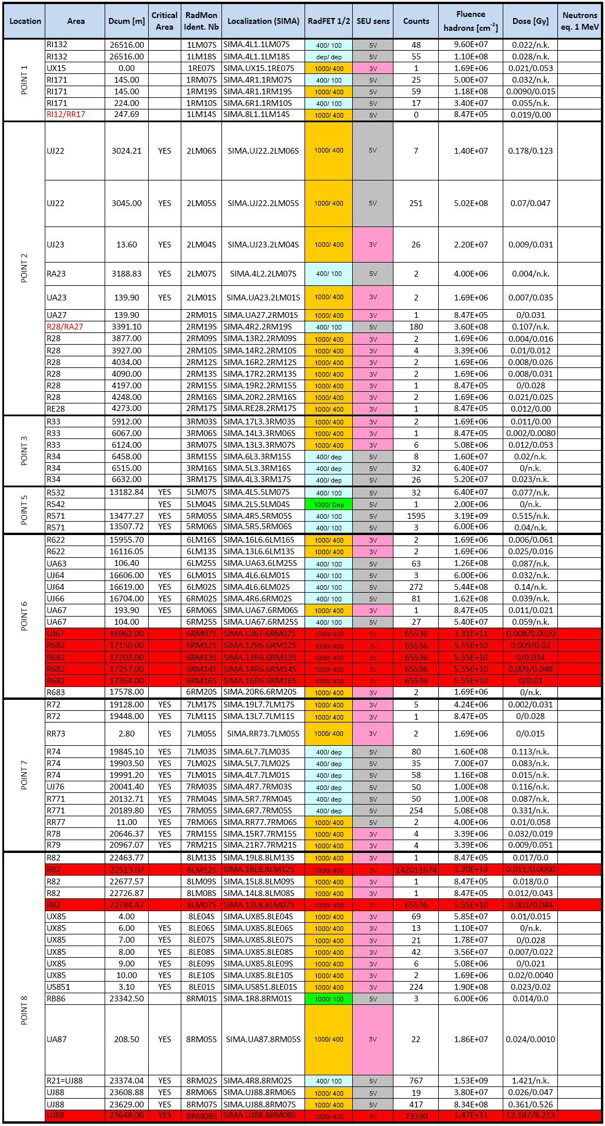
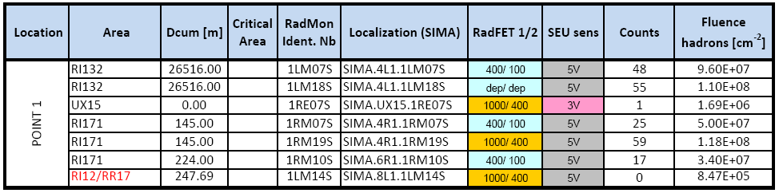
Early Monitoring - Important Analysis
a long table -> don’t try reading
© E. Lebbos
Continuous analysis of monitor readings helps verifying simulation predictions as well as identifying additional weak-points (in case)
A draft table of possible loss-cases (intended losses for R2E purposes) was developed and is in iteration with operation (R. Assmann, B. Goddard)
Coming months will be particularly important and time and effort is required for a dedicated R2E analysis
one example (first part only…)
3V

Slide 51
Workshop Input Requirements
Dedicated R2E losses and analysis
  Pre-defined list of locations available
  (see link) and iteration needed
  Operations Team
  R2E & RadMon Team
  Measurement Plan to be setup
Monitoring
  Additional monitoring to be considered?
    e.g., mobile IG5 chambers, MediPix
  Combined Monitoring Tool
    Final Release Version
Feedback
  Results to be integrated in estimate
  of expected radiation levels

Slide 52
Mitigation Options
EARLY
RELOCATION
RELOCATION
SHIELDING
RAD-TOL DESIGN
CIVIL ENGINEERING
OTHER

Slide 53



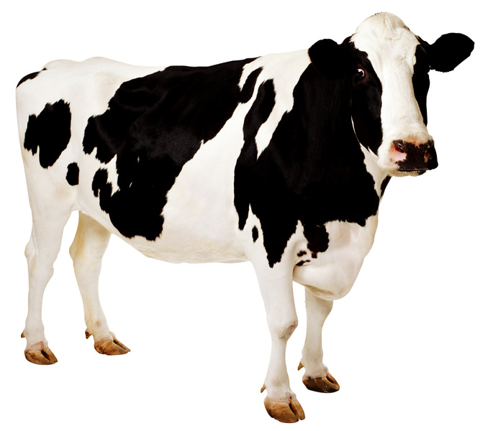

The Perfect Solution
We keep on looking …

Slide 54
“Easy Options”

Slide 55
Some Easy Parts
Access-Gates in UJ14/16/23/87
  Can be switched off during operation
  Procedure with OP in preparation
  contact: L. Ponce, R. Nunes
Equipment which can remain (partly) in place
  QPS (further development possible)
  BPM (mostly ok)
  BLM (VME crate already removed)
  Some cryogenics control (partly the same as in tunnel)
  Details in Equipment-Summary (G. Spiezia, see link) and Chamonix talks from D. Kramer and T. Wijnands

Slide 56
Workshop Input Requirements
Procedures:
  Are they put in place?
    e.g., access gates in critical areas
    shielding after access (see example later)
Equipment Remaining
  is the list complete?
  further details/constraints to be added
  can (other) equipment be split (e.g., control part and rest), so that only a part of the equipment has to be relocated?

Slide 57
“Rad-Tol Design”

Slide 58
Radiation Tolerant Design
Remote-Valve-Controllers in US85
  Solution known from other areas
  Order to be started – Installation in 2010/11/12?
Power-Converters (120/600A)
  Details in Chamonix talk from Y. Thurel (see link)
New FIP Development
  Details in Chamonix talk from J. Serrano (see link)
Common Developments
  Possible working group with PH-ESE for common development of FPGA or micro-processors?
    e.g., generic field-bus, or acquisition module for temperature, pressure, low precision voltage measurement etc…

Slide 59
Workshop Input Requirements
Equipment Replacement:
  Remote valve controllers
    preparations to start the order, so to be ready in case time-window opens for installation
Radiation Tolerant Development:
  Power-Converters
    PC-Day to be organised prior the workshop
    refinement of estimates concerning development time, test requirements, costs and constraints
  FIP
    decision on implementation option
    planning (time, costs)
  new developments in cooperation with PH/ESE
    common radiation tolerant I/O
    radiation hard components to be used for various groups

Slide 60
Shielding

Slide 61
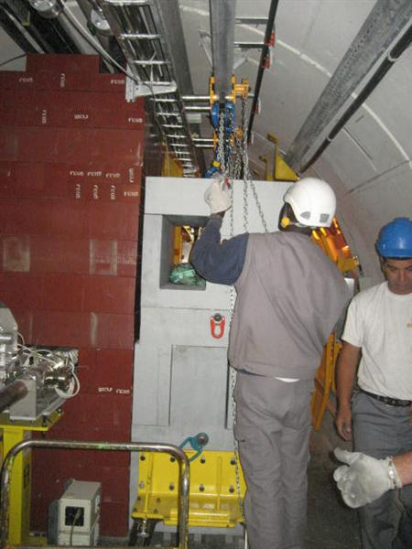
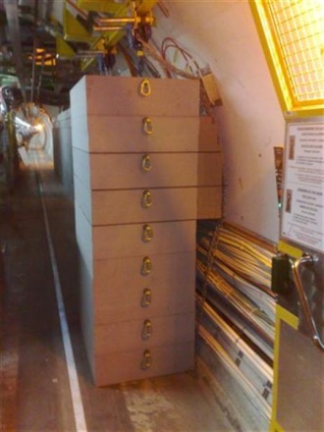
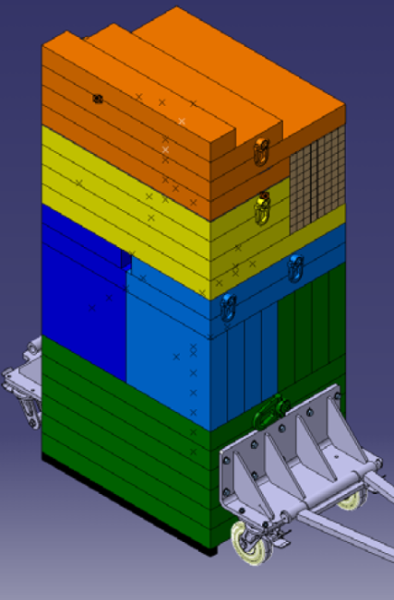
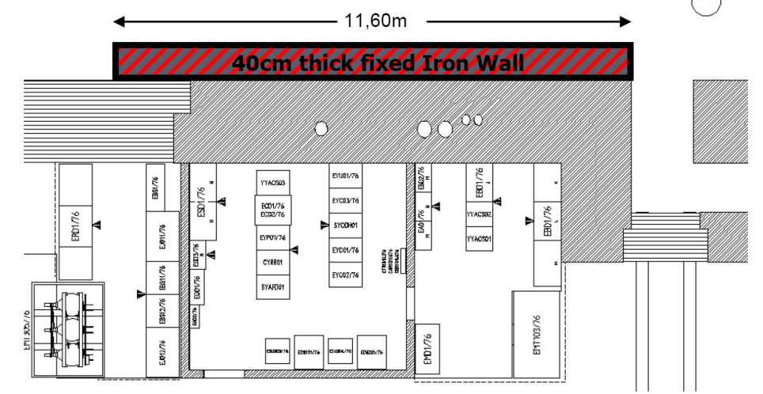
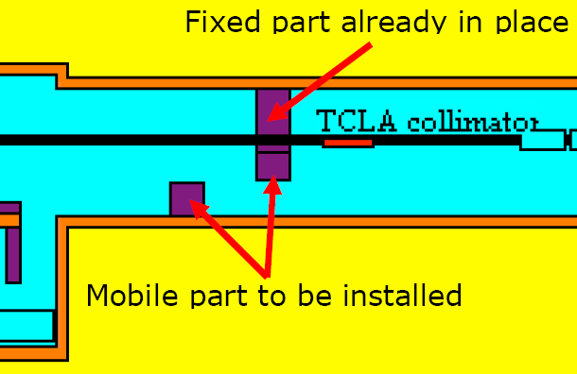

RR73/77and UJ76 Shielding
RR73/77
UJ76 Safe Room Shielding

Slide 62





UJ87/88 – UJ23/22 – Shielding
Additional penetration
in plug
Holes will be filled
- Shielding installed before LHC-re-start
- Analysis confirms the expected improvement
- ~Factor of 10 less radiation (high-energy hadron fluence)
- Relaxed situation for this years operation
- Long-Term solution will require further measurements
- Possible issue with low-energy neutrons
Shielding wall will be install parallel
to this wall + 90deg leg (L-shape)
Location of the future shielding

Slide 63

UJ14/16 Shielding Options
Updated FLUKA Calculations for Various (Theoretical) Shielding Layouts
To Compare: Unshielded Case (as installed now) … at least theoretically
PCs: 5x10⁹cm⁻²y⁻¹
© R. Versaci et al.

Slide 64



UJ14/16 Shielding Options
Correct …
!!! Wrong Way !!!

Slide 65


UJ14/16 Shielding Options
Reason for Shielding Limitation:
streaming and scattering from the top
© R. Versaci et al.

Slide 66




An Example: US85 Safe-Room Shielding
© M. Lazzaroni et al.

Slide 67


UJ14/16 Shielding Options
© R. Versaci et al.
Improving the Weak-Points
heavy shielding (further optimization possible)
PCs: 1-2x10⁸cm⁻²y⁻¹

Slide 68


UJ56 Shielding Option
R562
UJ56
VERS UJ56
F. DELSAUX
1500
ENVIRON 18 M
HT LIBRE 2600 mm
CHICANE
VERS UJ57

Slide 69


UJ56 Shielding Option
BLINDAGE UJ56
COMPLEMENT
BRIQUETTES ACIER
HAUTEUR 600mm
MONORAIL
300mm
RAIL DE MANUTENTION
DES BLOCS DE BLINDAGE
MUR FIXE ACIER
HAUTEUR 2000mm
300mm
xz view
400mm
BLINDAGE ACIER
DEMONTABLE
EP. 400mm
HAUTEUR 2000mm
800mm
F. DELSAUX

Slide 70


UJ56 Shielding Option
Assuming 1 year of operation at nominal luminosity (100 fb⁻¹)
Shielding Effectiveness:
- Ground floor: ~10
- First floor: ~2
xz view
Upstream weak-point could be improved, so could be the maze … BUT
© R. Versaci et al.

Slide 71


UJ56 Shielding Option
Assuming 1 year of operation at nominal luminosity (100 fb⁻¹)
w/o shielding
Shielding Effectiveness:
- Ground floor: ~10
- First floor: ~2
with shielding
1st Floor-Shielding can hardly be improved
-> First Floor Critical
© R. Versaci et al.

Slide 72
UJ14/16/56 - Conclusion
‘Smart-Shielding’ in UJ14/16 can lead to significant improvement -> not a final solution, but also important in order to possibly use parts of the UL
  staged implementation possible
  detailed integration study to be launched as soon as possible
  further optimization required (currently about 60m³ iron and 40m³ concrete)
UJ56-shielding is only effective at the lower-floor
  useful either for protection of safe-room equipment
  or in case reshuffling with power converters has to be considered
  cost estimate available: ~500kCHF
  no other option in place…

Slide 73
Other Areas – Where Shielding is an Option
UJ76: Safe-Room shielding could be slightly improved
  safe-room equipment remains at risk
UJ/UA/23/87: already improved, further steps possible
  combined simulation/integration study required
RR/13/17/53/57
  shielding similar to RR73/77 possible
  more complex shielding could be envisaged (see existing conceptual ECR)
UA63/67
  ducts already shielded
  additional rods could be added if required
UJ32 (RE32)
  in case monitoring shows that beam-gas is a long-term issue
UJ84/86 – UA83/87
  Downstream loss from LHCb, possible TDI contribution, and weakened plug

Slide 74
Workshop Input Requirements
Integration Studies:
  Shielding of RRs at P1/5
    what can be done, constraints, etc…
  Shielding of UJ14/16
    complex shielding and possible final integration
  Shielding of UJ56
    final integration and possible preparation requirements
  Shielding of UJ/UA/23/87
    how to improve, long-term solution
  Shielding constraints from Safety
    accessibility of areas
    RP constraints

Slide 75
Relocation

Slide 76
Early Relocations
Fire/ODH Control Racks
  Relocation already performed in UX/US85
  UJ76, UJ56 pending
  Possible impact on safety
  To be scheduled for next shutdown or earlier?
Fire Detectors
  Possible impact on safety chain (not a safety issue)
  Most areas affected
  For long distances tests ongoing
  To be scheduled for next shutdown or earlier?
Other Equipment
  Scenarios studied (partly prepared for)
    BIC, PIC, WIC
    Timing/Remote-Reset

Slide 77
Complete Relocation: e.g., US/UW85
Good News / Bad News
  Solution exists / Expensive and Time Consuming
Most of the Equipment has to be relocated
  Cryogenics, WIC, Timing, Remote-Reset, UPS, Access Control, Network, AUG control, Electrical Distribution (Control), GSM, Fire/ODH (already done)
Detailed Study (A.L. Perrot + Equipment Owners)
  Cost and Time estimate available (~1MCHF, Long-Shutdown)
  Cabling needs to be prepared early
  (4-6 month lead time)
  2-3 month of work to prepare for
  possible relocation
  (report in final draft version)
Planning/Coordination/Follow-Up
required soon

Slide 78

UJ14/16 – Upgrade Study
© Y. Muttoni, S. Maridor

Slide 79


New equipment in US15
© Y. Muttoni, S. Maridor
D1 cold
Cryogenic link
Electrical link

Slide 80

UJ56 – Upgrade Study
© Y. Muttoni,
S. Maridor

Slide 81
Other Areas – Where Relocation is an Option
UJ76: preparations in place
  change possible if required to house RR equipment
  decision required soon
UJ14/16: possibility in US15 and UL
  first studies for upgrade – not trivial
  to be studied further
UJ56: option in UP/USC-bypass
  first studies for upgrade – not trivial
  PM56 is most probably not an option
RRs
  RR73/77: possible to relocate equipment into TZ (see above), but requires significant TZ-layout changes
  others: not possible

Slide 82
Workshop Input Requirements
Equipment Relocation:
  Cryogenics at P8
    preparations to start order
  Fire/ODH Control Rack and Detectors
    risk analysis of detector failure
    detailed planning of relocation options/constraints
    cost/time estimate
  Equipment in the RRs
    re-iteration with G. Spiezia to verify constraints for equpiment other than power-converters
  UJ76 Relocation
    implication in case RRs have to be considered
    safe-room: what to do
    (can it be ‘integrated in the TZ)
    preparation and planning

Slide 83
Workshop Input Requirements
Equipment Relocation:
  US85 Relocation
    final integration and planning + preparation
  UW85 Relocation
    detailed comparison of options
  Options at P1/5 (Upgrade, etc…)
    refined integration study
    UJs
    RRs (equipment other than PCs)?
  Relocation constraints from CV
    cooling requirements
  Relocation constraints from Safety
    accessibility of areas
    RP constraints

Slide 84
Civil Engineering

Slide 85

Locally Enlarging Areas
Considered as hardly feasible with equipment in place…
“Yvon wondering about
the magnet transport
zone”

Slide 86

RR Shafts & Caverns (P1 and P5)
New Shaft ∅5m
Existing
LHC tunnel
Existing RR
New Access ∅3m
Existing
LHC tunnel
New cavern ∅7m

Slide 87
RR Shafts & Caverns (P1 and P5)
Constraints:
Large Costs (~10MCHF each)
Important lead time required (~4 years)
Known Solution:
Solves issue at RR13/17/53/57
Allows for work during operation
Relocation could be optimized during one shut-down
No issue with cable lengths
In Addition – See Talk(s) from S. Weisz:
Accidental Helium-Release
Opens further doors for LHC Upgrade-Scenarios
  could this also solve UJ56 ??? (UA extension)

Slide 88
Workshop Input Requirements
Civil Engineering:
  Local Enlargements
    can we really exclude them
  RR shafts and caverns
    split in what can be started with low costs (to be ideally started soon) and when a go-decision is needed and for what delay
  UA extension
    impact on planning & costs
    can an option be kept for later

Slide 89
Other Options

Slide 90
IR7: Betatron-Cleaning in IR3
© R. Assmann et al.
Studied in the “early R2E days”
Allows relocating the losses from IR7 to IR3
(up to a certain beam intensity)
Impact studied
  tracking studies
  FLUKA studies radiation load in IR3 (UJ33, superconducting link, warm magnets,…)
Results/Proposal summarized in memorandum
(see link)
Proposal studied as temporary solution
To be possibly reworked looking towards current collimation status and planned/possible upgrades

Slide 91

IR7: Phase-II Collimation as Absorbers
Proposed by R. Assmann
Installing Phase-II Collimators to act as shielding
Openings of collimators – various options
studied with FLUKA:
  +1 sigma of Phase-I
  +13 sigma
Different scenarios studied
  Beam-1 and Beam-2
  All-Phase-II collimators in Place
  Only most contributing (to UJ76 radiation levels)
Effective for Beam-1 (up to a factor of 6 in reduction)
Less effective (layout reasons) for Beam-2
(only a factor of ~2)

Slide 92
Superconducting Links
R&D Work is being carried out at CERN for the development of HTS links on two fronts
(A. Ballarino):
Development of semi-flexible MgB₂ link for the powering of the Triplets for the upgrade phase-1 (up to 100 m length, ∼ 120 kA in multiple circuits,
EDMS N. 1046267) ;
FP 7 European collaboration for the development of gas- cooled HTS links operating at higher temperatures and suitable also for vertical transfer of current.
‘Immediate’ option for power converters at Point-7 ?
(similar to SCL at Point-3, DSLC-length of ~450m)

Slide 93
Workshop Input Requirements
Collimation:
  unbalanced load towards critical collimators
    (TCS close to UJ, TCLAs for RRs)
  possible change of collimator load during operation
    is there a margin?
  IR7/3 ‘relocation’
    is there a long-term solution?
  Phase-II collimation
    how much do we really gain?
Super Conducting Links:
  new developments (planning & options)
    semi-flexible link
    vertical link
  classical link as in IR3 (constraints & planning)

Slide 94
How To Compare

Slide 95
How To Compare the various ‘Options’
Current planning summarized in ‘working table’, constantly updated (see link)
Taking into account:
  Area Priority
  Possible Mitigation Option
Comparing:
  Radiation Levels (before and after)
  Cost + Uncertainty
  Required Lead- and Installation-Time
  Long-term Sustainability
Next: grouping of options by operational period
A veeeery long table….

Slide 96

How To Compare
safety warning: don’t try reading
Further Analysis necessary
Details required to fully
compare various options
Estimates require further input on
time estimates (lead-, installation-
and commissioning-time), as well as
costs
Detailed planning required towards
operational scenarios
Based on its result a phased
proposal is to be prepared for
the management

Slide 97
Workshop Input Requirements
Planning & Optimization:
  Comparison of mitigation options
    global schedule in comparison with various operation options
    detailed planning for mitigation phase-I (what would be currently expected for the next long shutdown)
  How to fit with possible Upgrade requirements
  Required resources among departments and groups
R2E Mitigation Project:
  Budget and spending profile
    for the various planning as studied above
  Project Proposal

Slide 98
Conclusions
Radiation levels currently based on simulations, early measurements will have to improve this
Local shielding supposed to improve the situation, even if not a solution in the long term for most areas – gaining time
Relocation options foresee all sensitive equipment
  safety issues: Fire/ODH rack in P5/7, fire detectors general
  when final locations are identified, early relocations possible
  final relocation campaigns shall be done ideally for complete areas only
Alternative mitigation options:
  for areas where other solutions will be hard to find – their integration shall foresee also future requirements
First decisions required soon …

Slide 99
Conclusions
Review of radiation levels important for the coming years
Early operation will be an important input – work needed now!
Detailed analysis of mitigation options
Important inter-departmental effort to get as far as possible
Stringent time constraints, it will not be enough to do things ‘sequentially’ (i.e., first observe and then react)
  Parallel work required (we already started in this direction)
Required resources will significantly increase
Continued support required from various key contributors
(Planning and Integration, Equipment Owners, Point-Owners, FLUKA Team, RadMon Team, RP, RadWG,…)
Follow-Up Workshop scheduled to prepare final proposal
  Homework for all is defined – THANKS A LOT

Slide 100
Workshop Input Requirements
Workshop Organisation:
  Your help and contribution is essential
  As already listed in this seminar, the list of required information/studies and input will be distributed
  Intermediate iterations will be organised through the R2E Study Group
  Please don’t hesitate in contacting us in case of questions
  A Doodle Poll has been set up to find the best possible date for the workshop:
    http://www.doodle.com/zw3yrh37mu4dbybq

Slide 101

Your Support Is Essential…
  Many Thanks to Everybody
EN/MEF, EN/HE, EN/EL, BE/OP, DG/PRJ, EN/STI, DGS/RP, EN/CV, GS/SEM, BE/ABP, TE/ABT , TE/MSC,
EN/GMS, TE/EPC, FP/PI,
BE/ASR, GS/ASE, PH/ESE,…

Slide 102
Backup

Slide 103

Mitigation Project Tracking Tool
toggle between
finished and
ongoing projects
list of projects
acquire status
report
check to have
all comments
- The tool is functional and used in R2E
- 2nd version to be uploaded soon

Slide 104

Order Of Iron Shielding Blocks
order approved and purchase started
supply of 1000 cast iron or steel
blocks (800mmx400mmx400mm)
the total mass of all blocks is
about 925 tonnes.
delivery is foreseen in
two batches, one half in about 3 months, the second half to be completed about 3 months later
storage place identified

