Slide 1

Theoretical Issues in
Neutrino Physics
2019.09.20-21
고에너지 물리학 미래전략 회의
Sin Kyu Kang
(Seoul Tech)

Slide 2
Outline
Current status of neutrino oscillations
Theoretical Issues
- Origin of neutrino mixing matrix
- Origin of neutrino masses
- New Physics in Neutrino Oscillations
Prospect
Conclusion

Slide 3



Current status of neutrino oscillations
Two big discoveries over past two decades :
- Neutrinos are massive
- Leptons mix
They have been achieved by
the observation of neutrino oscillations
( lots of sources: the sun, atmospheric, reactors and accelerators)

Slide 4
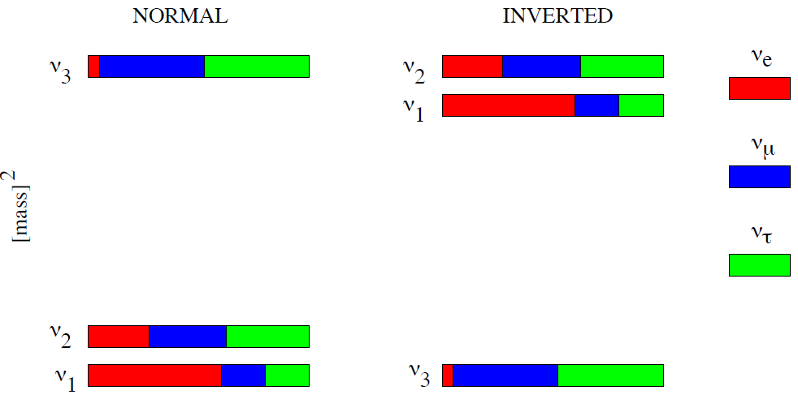
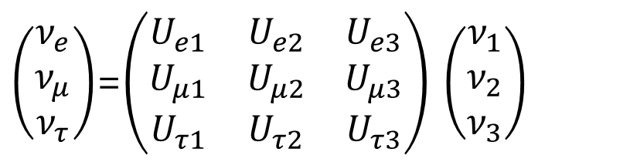
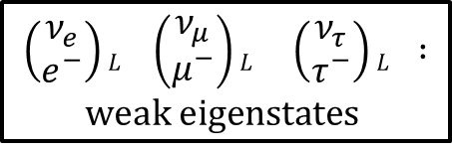
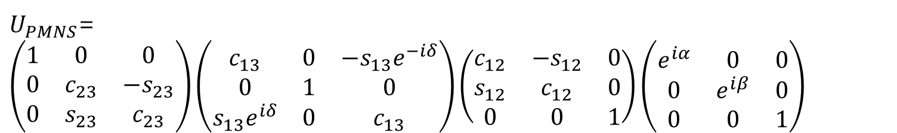
3-flavor paradigm
$$\left(\begin{matrix}ν_{e} \\ e^{−}\end{matrix}\right)L \left(\begin{matrix}ν_{μ} \\ μ^{−}\end{matrix}\right)L \left(\begin{matrix}ν_{τ} \\ τ^{−}\end{matrix}\right)L :$$
$$weak eigenstates$$
$\left(\begin{matrix}ν_{e} \\ ν_{μ} \\ ν_{τ}\end{matrix}\right)$=$\left(\begin{matrix}U_{e1} & U_{e2} & U_{e3} \\ U_{μ1} & U_{μ2} & U_{μ3} \\ U_{τ1} & U_{τ2} & U_{τ3}\end{matrix}\right)$ $\left(\begin{matrix}ν_{1} \\ ν_{2} \\ ν_{3}\end{matrix}\right)$
mass
eigenstates
- Specific parameterization of lepton mixing matrix
$U_{PMNS}$=$\left(\begin{matrix}1 & 0 & 0 \\ 0 & c_{23} & {−s}_{23} \\ 0 & s_{23} & c_{23}\end{matrix}\right)\left(\begin{matrix}c_{13} & 0 & {−s}_{13}e^{−iδ} \\ 0 & 1 & 0 \\ s_{13}e^{iδ} & 0 & c_{13}\end{matrix}\right)\left(\begin{matrix}c_{12} & {−s}_{12} & 0 \\ s_{12} & c_{12} & 0 \\ 0 & 0 & 1\end{matrix}\right)\left(\begin{matrix}e^{iα} & 0 & 0 \\ 0 & e^{iβ} & 0 \\ 0 & 0 & 1\end{matrix}\right)$

Slide 5
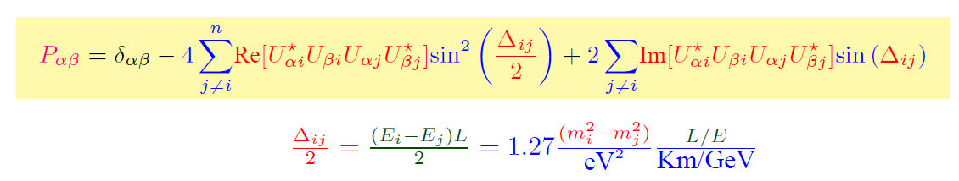


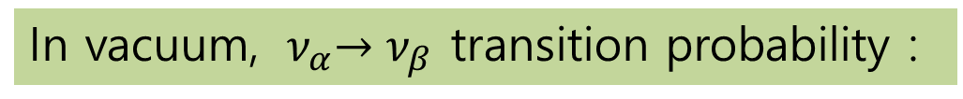
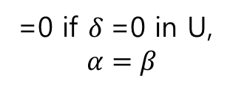
How do we probe neutrino mixing ?
➔ neutrino oscillation
=0 if $δ$=0 in U,
$α=β$
In vacuum, ${ ν}_{α}→ν_{β}$ transition probability :
From ν oscillation exps. we can determine
-
- $θ_{12} , θ_{23} , θ_{13}$
- $δ$
$$∆m_{21}^{2} ,∆m_{31}^{2}$$

Slide 6
How precisely determined?

Slide 7
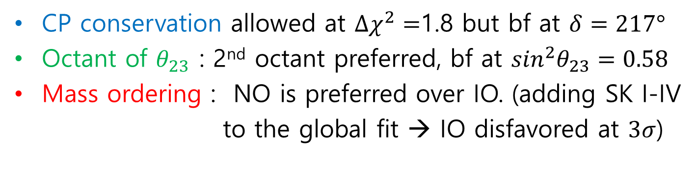
Not-so-well measured
CP conservation allowed at $Δχ^{2}=$1.8 but bf at $δ=217°$
Octant of $θ_{23}$ : 2nd octant preferred, bf at $\sin^{2}θ_{23}=0.58$
Mass ordering : NO is preferred over IO. (adding SK I-IV
to the global fit → IO disfavored at $3σ$)

Slide 8
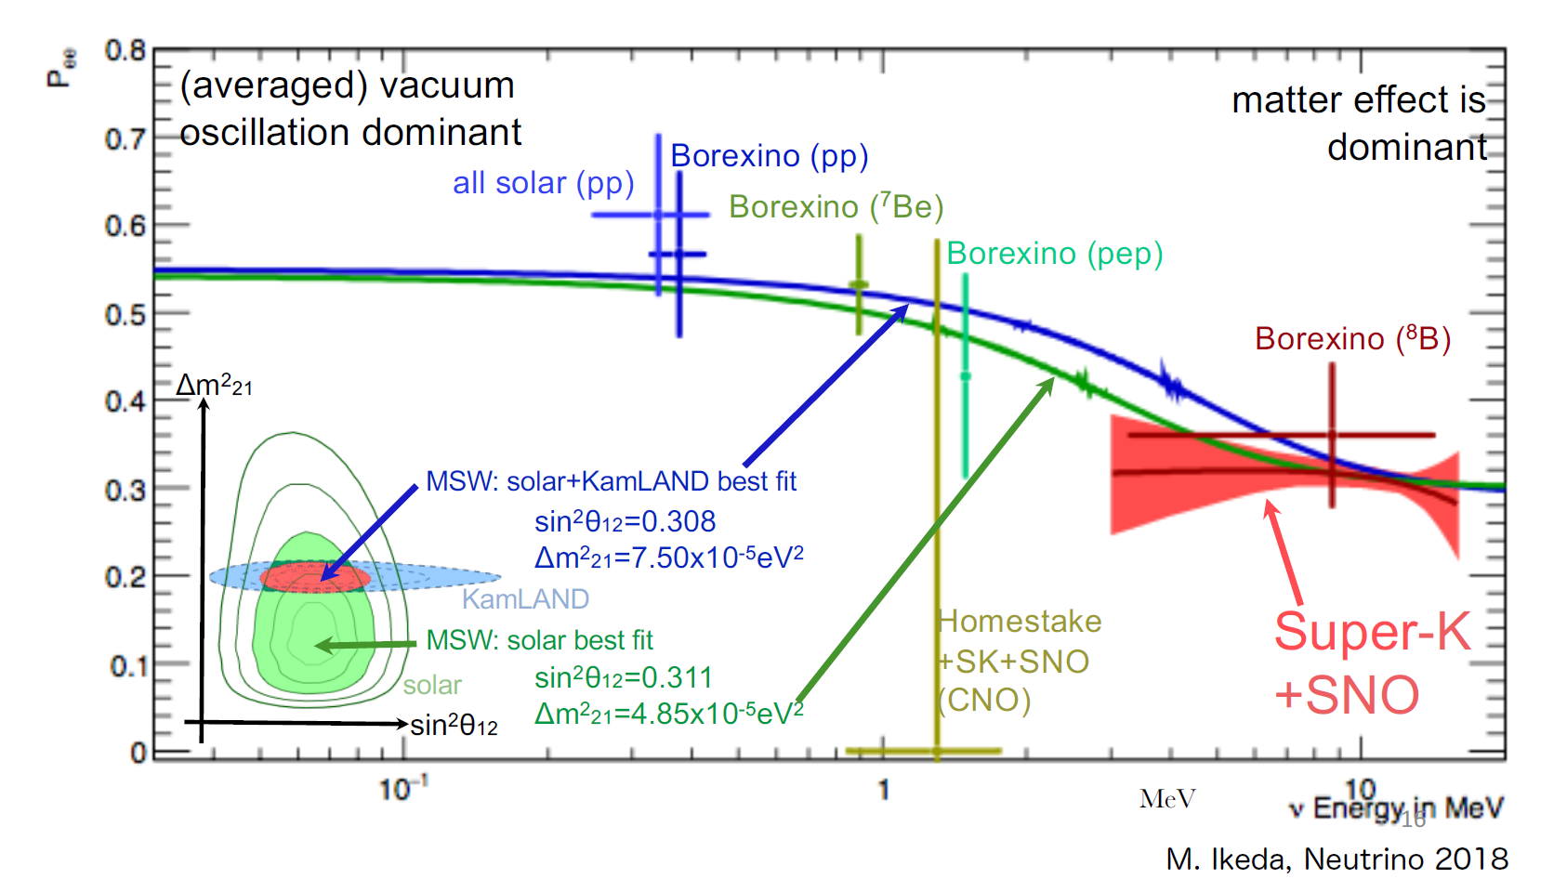
MSW matter effect
(Minakata, Pena-garay, 2012)
Low E
High E
BOREXINO (Barbara Caccianiga 2019)

Slide 9
Precision Measurements
(de Salas, Forero, Temes, Tortola, Valle, PLB782 , 1708.01186)

Slide 10
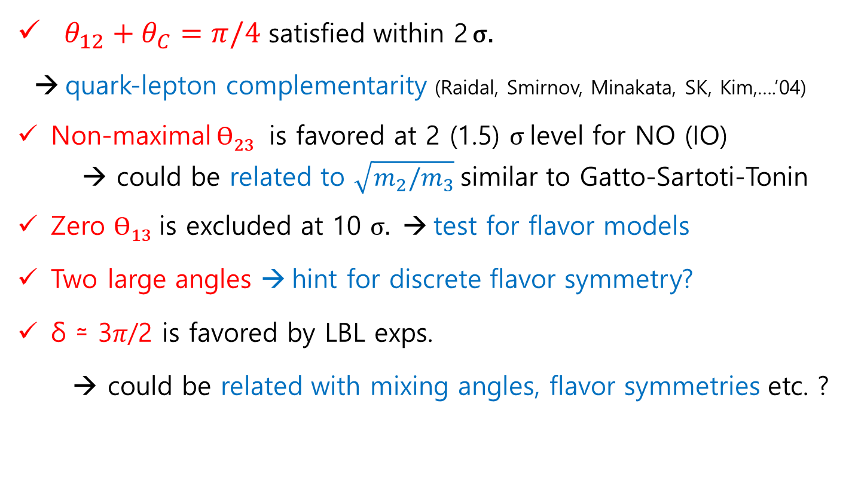
Implications of global fit:
$θ_{12}+θ_{C}=π/4$ satisfied within 2 σ.
→ quark-lepton complementarity (Raidal, Smirnov, Minakata, SK, Kim,….’04)
Non-maximal Ɵ₂₃ is favored at 2 (1.5) σ level for NO (IO)
→ could be related to $\sqrt{m_{2}/m_{3}}$similar to Gatto-Sartoti-Tonin
Zero Ɵ₁₃ is excluded at 10 σ. → test for flavor models
Two large angles → hint for discrete flavor symmetry?
δ ≃ 3𝜋/2 is favored by LBL exps.
→ could be related with mixing angles, flavor symmetries etc. ?

Slide 11
Theoretical Issues
Origins of neutrino mixing & CP violation
- flavor symmetry
- predictions
Origins of tiny neutrino mass
- seesaw variants
- radiative generation
New physics in neutrino oscillation

Slide 12


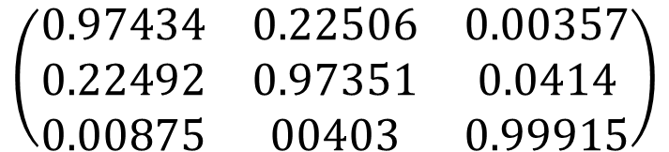
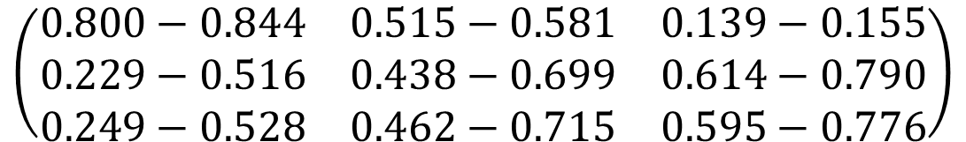
I. Origin of mixing pattern
From fit to neutrino data in 3-neutrino paradigm
$$\left(\begin{matrix}0.800−0.844 & 0.515−0.581 & 0.139−0.155 \\ 0.229−0.516 & 0.438−0.699 & 0.614−0.790 \\ 0.249−0.528 & 0.462−0.715 & 0.595−0.776\end{matrix}\right)$$
${|U}_{PMNS}|$=
Looks different from quark mixing matrix !!
$$\left(\begin{matrix}0.97434 & 0.22506 & 0.00357 \\ 0.22492 & 0.97351 & 0.0414 \\ 0.00875 & 00403 & 0.99915\end{matrix}\right)$$
$${|V}_{CKM}|=$$
PDG(2016)

Slide 13

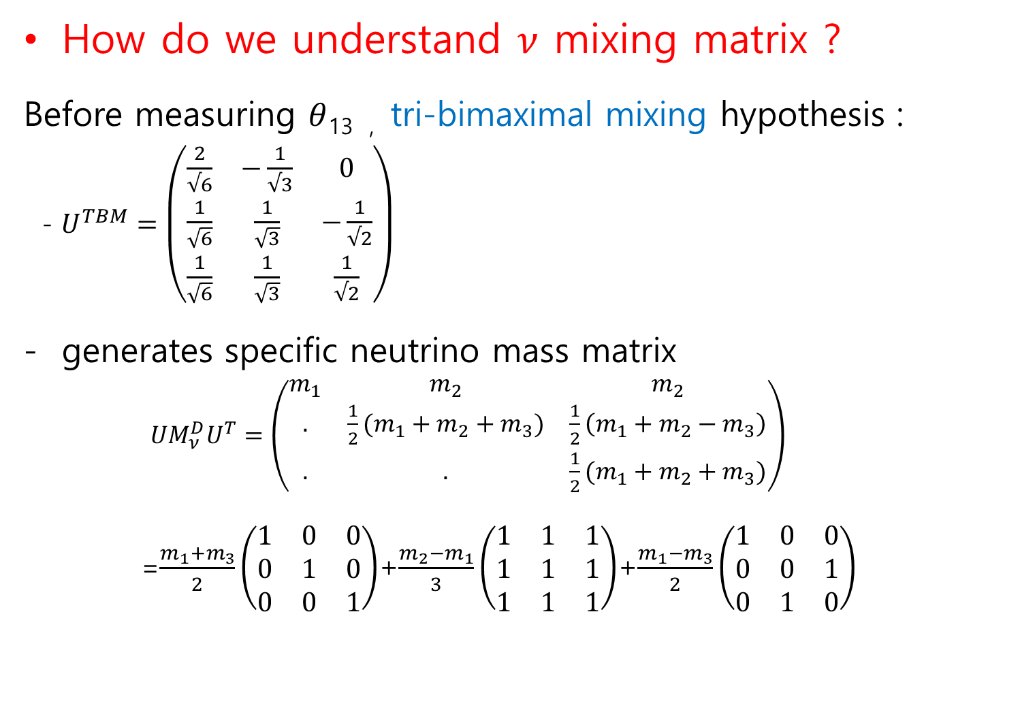
How do we understand $ν$ mixing matrix ?
Before measuring $θ$_{13 ,} tri-bimaximal mixing hypothesis :
- $U^{TBM}=\left(\begin{matrix}\frac{2}{√6} & −\frac{1}{√3} & 0 \\ \frac{1}{\sqrt{6}} & \frac{1}{\sqrt{3}} & −\frac{1}{√2} \\ \frac{1}{\sqrt{6}} & \frac{1}{\sqrt{3}} & \frac{1}{√2}\end{matrix}\right)$
generates specific neutrino mass matrix
$UM_{ν}^{D}U^{T}=\left(\begin{matrix}m_{1} & m_{2} & m_{2} \\ . & \frac{1}{2}(m_{1}+m_{2}+m_{3}) & \frac{1}{2}\left(m_{1}+m_{2}−m_{3}\right) \\ . & . & \frac{1}{2}(m_{1}+m_{2}+m_{3})\end{matrix}\right)$
=$\frac{m_{1}+m_{3}}{2}\left(\begin{matrix}1 & 0 & 0 \\ 0 & 1 & 0 \\ 0 & 0 & 1\end{matrix}\right)$+$\frac{m_{2}−m_{1}}{3}\left(\begin{matrix}1 & 1 & 1 \\ 1 & 1 & 1 \\ 1 & 1 & 1\end{matrix}\right)$+$\frac{m_{1}−m_{3}}{2}\left(\begin{matrix}1 & 0 & 0 \\ 0 & 0 & 1 \\ 0 & 1 & 0\end{matrix}\right)$
Harrison & Perkins & Scott (2002)
A₄ symmetric
- Integer matrix elements suggest non-Abelian discrete symmetry

Slide 14
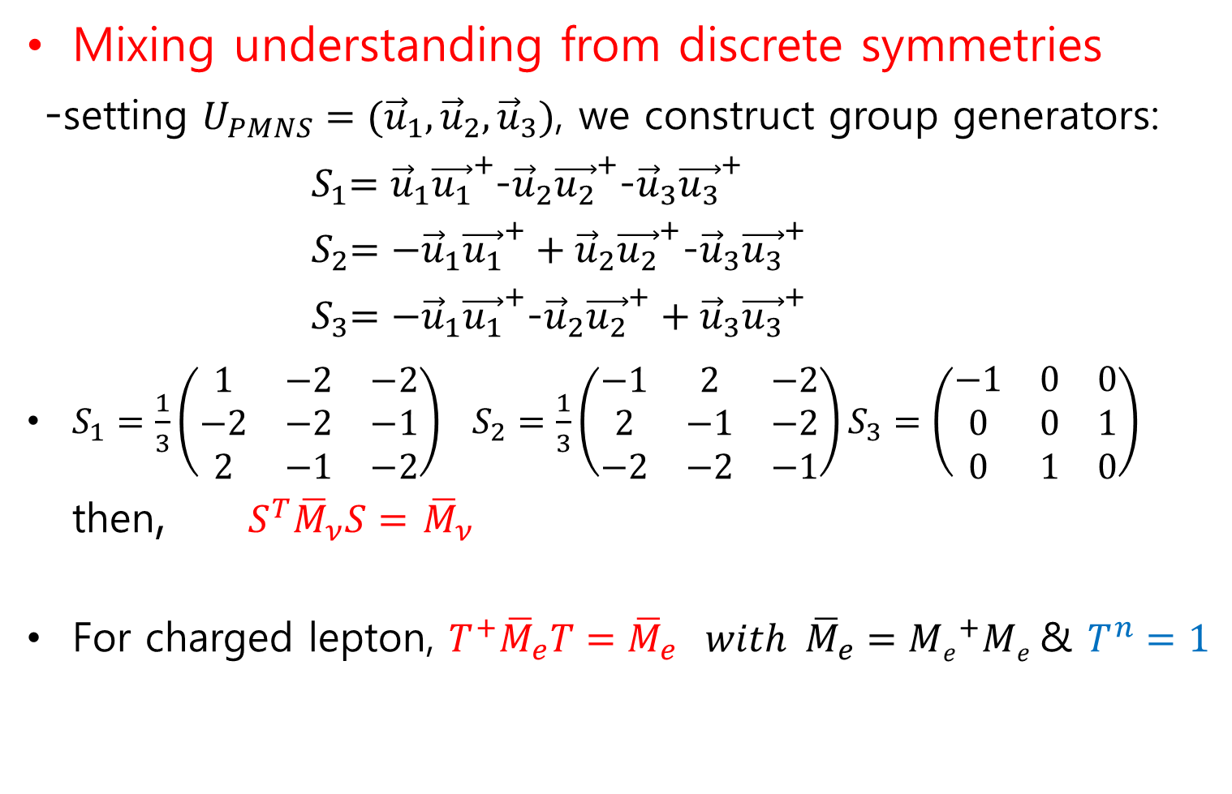
Mixing understanding from discrete symmetries
-setting $U_{PMNS}=({\vec{u}}_{1}, {\vec{u}}_{2}, {\vec{u}}_{3})$, we construct group generators:
${ S}_{1}={\vec{u}}_{1}{\vec{u_{1}}}^{+}$-${\vec{u}}_{2}{\vec{u_{2}}}^{+}$-${\vec{u}}_{3}{\vec{u_{3}}}^{+}$
${ S}_{2}={−\vec{u}}_{1}{\vec{u_{1}}}^{+}+{\vec{u}}_{2}{\vec{u_{2}}}^{+}$-${\vec{u}}_{3}{\vec{u_{3}}}^{+}$
${ S}_{3}={−\vec{u}}_{1}{\vec{u_{1}}}^{+}$-${\vec{u}}_{2}{\vec{u_{2}}}^{+}+{\vec{u}}_{3}{\vec{u_{3}}}^{+}$
$S_{1}=\frac{1}{3}\left(\begin{matrix}1 & −2 & −2 \\ −2 & −2 & −1 \\ 2 & −1 & −2\end{matrix}\right) S_{2}=\frac{1}{3}\left(\begin{matrix}−1 & 2 & −2 \\ 2 & −1 & −2 \\ −2 & −2 & −1\end{matrix}\right)S_{3}=\left(\begin{matrix}−1 & 0 & 0 \\ 0 & 0 & 1 \\ 0 & 1 & 0\end{matrix}\right)$ then, ${{ S}^{T}\overline{M}}_{ν}S=$ ${\overline{M}}_{ν}$
For charged lepton, $T^{+}{\overline{M}}_{e}T={\overline{M}}_{e} with {\overline{M}}_{e}={Me}^{+}Me$ & $T^{n}=1$
(CSLam’06 )
C.S.Lam, PRD98(2008)
arXiv:0809.1185
$\left\{S,T\right\}$ forms a discrete group (flavor symmetry)
(Mixing matrices diagonalize $M_{ν}$ and ${\overline{M}}_{e}$ also diagonalize S and T)

Slide 15
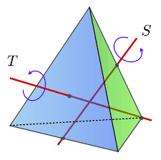


Simplest group with a triplet representation: A₄
A₄ has subgroups: three Z₂, four Z₃, one Z₂×Z₂
A₄ is spontaneously
broken to subgroups:
Neutrino sector preserves,
Z₂×Z_{2:}
Charged lepton sector preserves,
Z₃:
G(A₄)
$Z_{3}$
$$Z_{2}×Z_{2}$$
arXiv: 1402.4271 King, Merle, Morisi,
Simizu, Tanimoto

Slide 16
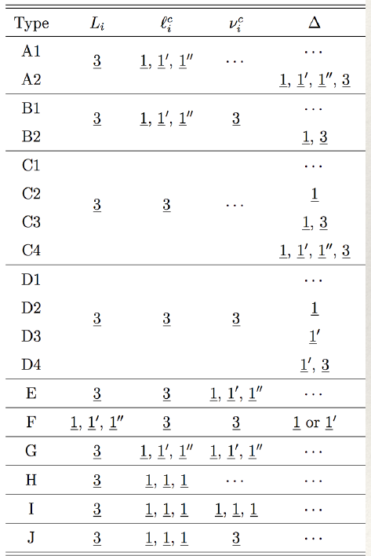
Many discrete groups reproducing TBM mixing
(Altarelli, Feruglio, 1002.0211)
Each group has many models!
(Barry, Rodejohann, PRD81(2010)

Slide 17
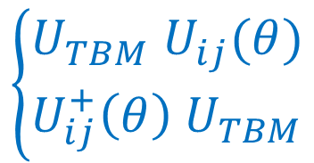
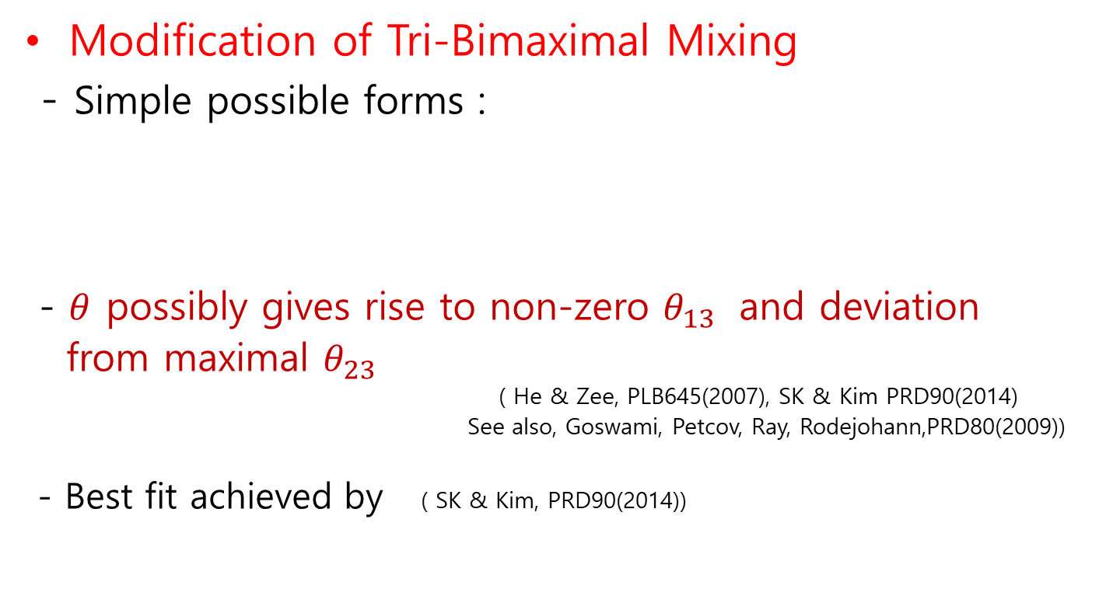
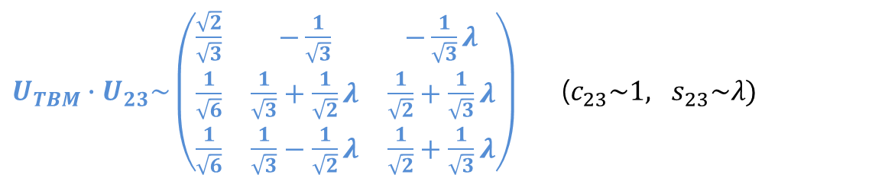
Modification of Tri-Bimaximal Mixing
- Simple possible forms :
- $θ$ possibly gives rise to non-zero $θ_{13}$ and deviation
from maximal $θ_{23}$
( He & Zee, PLB645(2007), SK & Kim PRD90(2014)
See also, Goswami, Petcov, Ray, Rodejohann,PRD80(2009))
- Best fit achieved by ( SK & Kim, PRD90(2014))
$$\left\{\begin{matrix}U_{TBM} U_{ij}(θ) \\ U_{ij}^{+}\left(θ\right) U_{TBM}\end{matrix}\right.$$
$U_{TBM}∙U_{23}\sim \left(\begin{matrix}\frac{\sqrt{2}}{\sqrt{3}} & −\frac{1}{\sqrt{3}} & −\frac{1}{\sqrt{3}}λ \\ \frac{1}{\sqrt{6}} & \frac{1}{\sqrt{3}}+\frac{1}{\sqrt{2}}λ & \frac{1}{\sqrt{2}}+\frac{1}{\sqrt{3}}λ \\ \frac{1}{\sqrt{6}} & \frac{1}{\sqrt{3}}−\frac{1}{\sqrt{2}}λ & \frac{1}{\sqrt{2}}+\frac{1}{\sqrt{3}}λ\end{matrix}\right)$($c_{23}\sim 1, s_{23}\sim λ)$

Slide 18

unchanged
$U^{TBM}∙U_{12}=\left(\begin{matrix}∎ & ∎ & 0 \\ ∎ & ∎ & −\frac{1}{\sqrt{2}} \\ ∎ & ∎ & \frac{1}{\sqrt{2}}\end{matrix}\right) U^{TBM}∙U_{13}=\left(\begin{matrix}∎ & −\frac{1}{√3} & ∎ \\ ∎ & \frac{1}{√3} & ∎ \\ ∎ & \frac{1}{√3} & ∎\end{matrix}\right)$
$U^{TBM}∙U_{23}=\left(\begin{matrix}\frac{√2}{√3} & ∎ & ∎ \\ \frac{1}{√6} & ∎ & ∎ \\ \frac{1}{√6} & ∎ & ∎\end{matrix}\right)$
Unchanged columns may reflect the remnants of flavor symmetry → residual symmetry

Slide 19
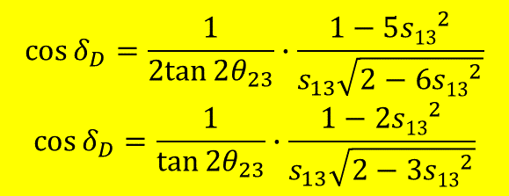

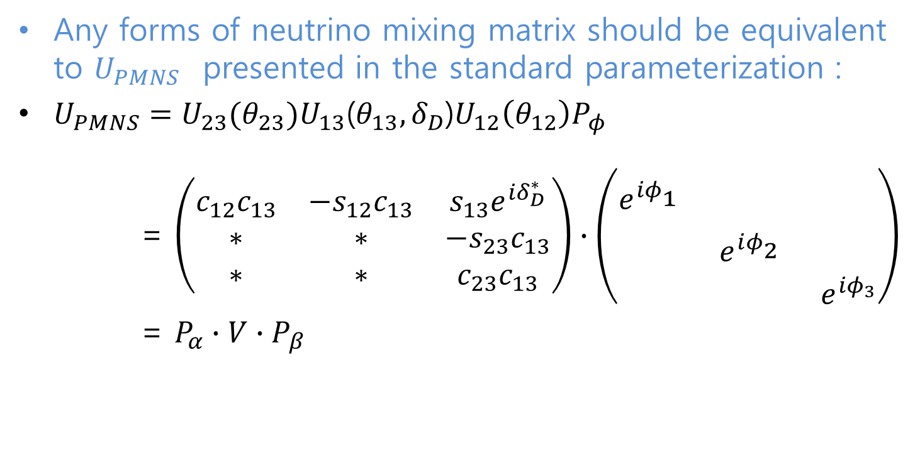

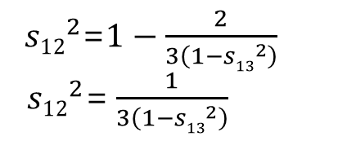
Predictions of CP phase
Any forms of neutrino mixing matrix should be equivalent to $U_{PMNS}$ presented in the standard parameterization :
$U_{PMNS}=U_{23}(θ_{23})U_{13}$($θ_{13}, δ_{D}$)$U_{12}\left(θ_{12}\right)P_{φ}$
= $\left(\begin{matrix}c_{12}c_{13} & −s_{12}c_{13} & s_{13}e^{iδ_{D}^{∗}} \\ ∗ & ∗ & −s_{23}c_{13} \\ ∗ & ∗ & c_{23}c_{13}\end{matrix}\right)∙\left(\begin{matrix}e^{iφ_{1}^{}} & & \\ & e^{iφ_{2}^{}} & \\ & & e^{iφ_{3}}\end{matrix}\right)$
= $P_{α}∙V∙P_{β}$
$, V=U^{TBM}$ $∙U_{23(13)}\left(θ,ξ\right)$
$$V_{ij}e^{i(α_{i}+β_{j})}=(U_{PMNS})_{ij}$$
Predictions : (SK & CSKim, PRD90(2014), SK & Tanimoto, PRD91(2015) )
${s12}_{}^{2}$=$1−\frac{2}{3\left(1−{s13}^{2}\right)}$
${ s12}_{}^{2}$=$\frac{1}{3\left(1−{s13}^{2}\right)}$
$$\cos{δ_{D}=\frac{1}{2tan{2θ_{23}}}∙\frac{1−5{s13}_{}^{2}}{s_{13}\sqrt{2−6{s13}_{}^{2}}}}$$
$$\cos{δ_{D}=\frac{1}{\tan{2θ_{23}}}∙\frac{1−2{s13}_{}^{2}}{s_{13}\sqrt{2−3{s13}_{}^{2}}}}$$

Slide 20

The relations can be obtained from A4 model
(SK & Tanimoto, PRD91 (2015))
.
Alternatively,
$$δ_{D}$$
(Cheng, Chulia, Ding, Srivastava, Valle)

Slide 21
A₄ model easily realizes non-vanishing θ₁₃ & CPV
Ahn, SK, PRD86 (2012)
Ahn, SK, CSKim, PRD87 (2013)
SK, Shimizu, Takagi,Shunya Takahashi,Tanimoto, PTEP(2018)
Additional Matrix
Both normal and inverted mass hierarchies are possible.
Tri-maximal mixing: TM2

Slide 22
A₄ model easily realizes non-vanishing θ₁₃ & CPV
Ahn, SK, PRD86 (2012)
Ahn, SK, CSKim, PRD87 (2013)
SK, Shimizu, Takagi,Shunya Takahashi,Tanimoto, PTEP(2018)

Slide 23
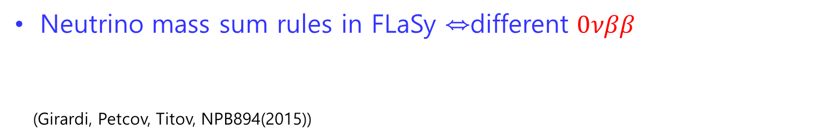

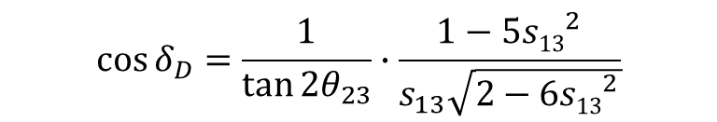
How to test Flavor Symmetry
UV theories giving rise to flavor symmetry in lepton sector
contains new scalars→ probe of signal be test of FlaSy.
Mixing angle sum rules:
Example:
${s12}_{}^{2}$=$1−\frac{2}{3\left(1−{s13}^{2}\right)}$
Neutrino mass sum rules in FLaSy ⇔different $0νββ$
(Girardi, Petcov, Titov, NPB894(2015))
Prediction of CP phase
$$\cos{δ_{D}=\frac{1}{\tan{2θ_{23}}}∙\frac{1−5{s13}_{}^{2}}{s_{13}\sqrt{2−6{s13}_{}^{2}}}}$$
(e.g.)

Slide 24
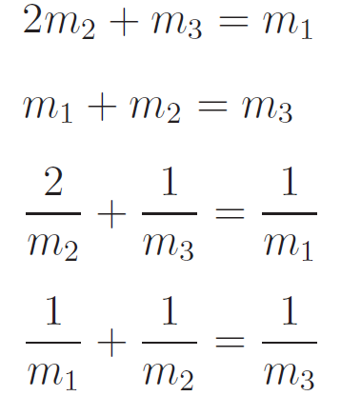
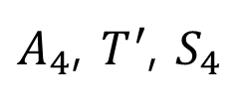

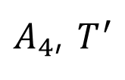
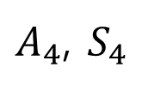
Neutrino mass sum rules
(King, Merle,Morisi, Shimizu,
Tanimoto, New J. Phys. 2014)
$A_{4}$, $T^{′}$, $S_{4}$
$A_{4}$, $S_{4}$
$A_{4}$, $T^{′}$
$S_{4}$

Slide 25
Neutrino mass sum rules
Restrictions on |m_{ee}| by mass sum rules
King, Merle, Stuart, JHEP2013
King, Merle,Morisi, Shimizu, Tanimoto, New J. Phys. 2014

Slide 26
II. Origin of Neutrino Mass
Why neutrinos are massless in SM ?
- no right-handed neutrinos
- only SU(2) doublet Higgs scalars
- prohibiting non-renormalizable terms
How can neutrinos have mass ?
-breaking those restrictions

Slide 27
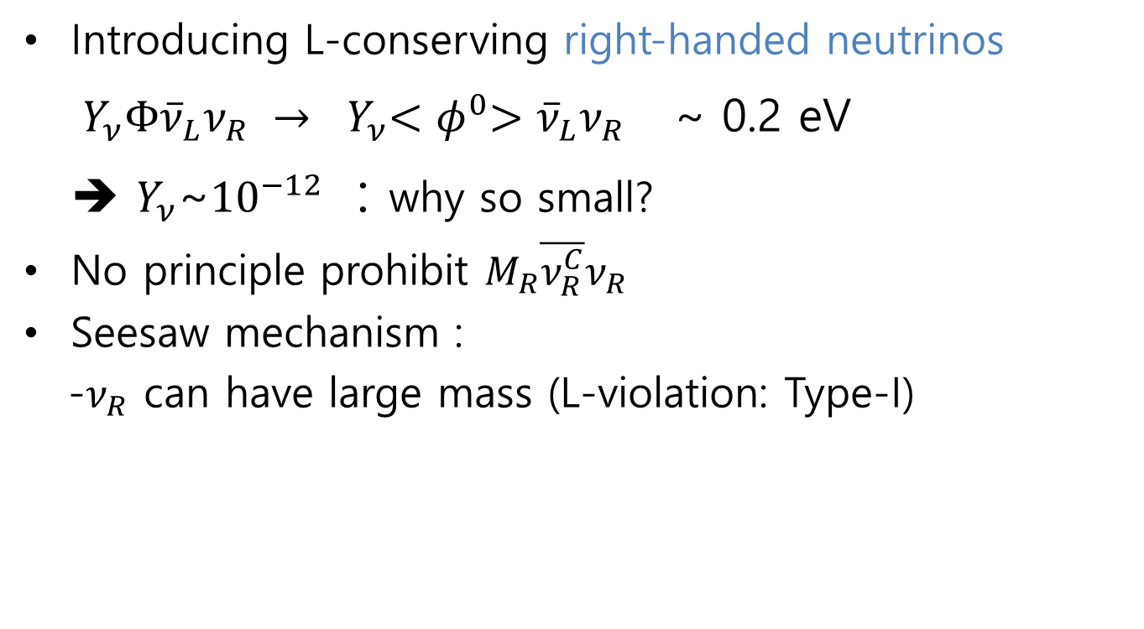
_{Seesaw Origins}
Type-I Seesaw
Introducing L-conserving right-handed neutrinos
$Y_{ν}Φ{\overline{ν}}_{L}ν_{R} →$ ${ Y}_{ν}{<φ}^{0}>{\overline{ν}}_{L}ν_{R}$ ~ 0.2 eV
➔ $Y_{ν}$~${10}^{−12}$ : why so small?
No principle prohibit $M_{R}\overline{ν_{R}^{C}}ν_{R}$
Seesaw mechanism :
-$ν_{R}$ can have large mass (L-violation: Type-I)
(Minkowski ‘77 Gellman
Ramond Slansky ‘80
Glashow, Yanagida ‘79
Mohapatra Senjanovic ‘80
Lazarides Shafi Weterrich ‘81
Schechter-Valle ‘80 & ’82)

Slide 28
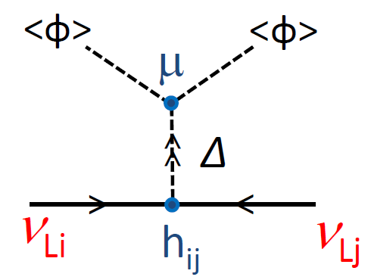
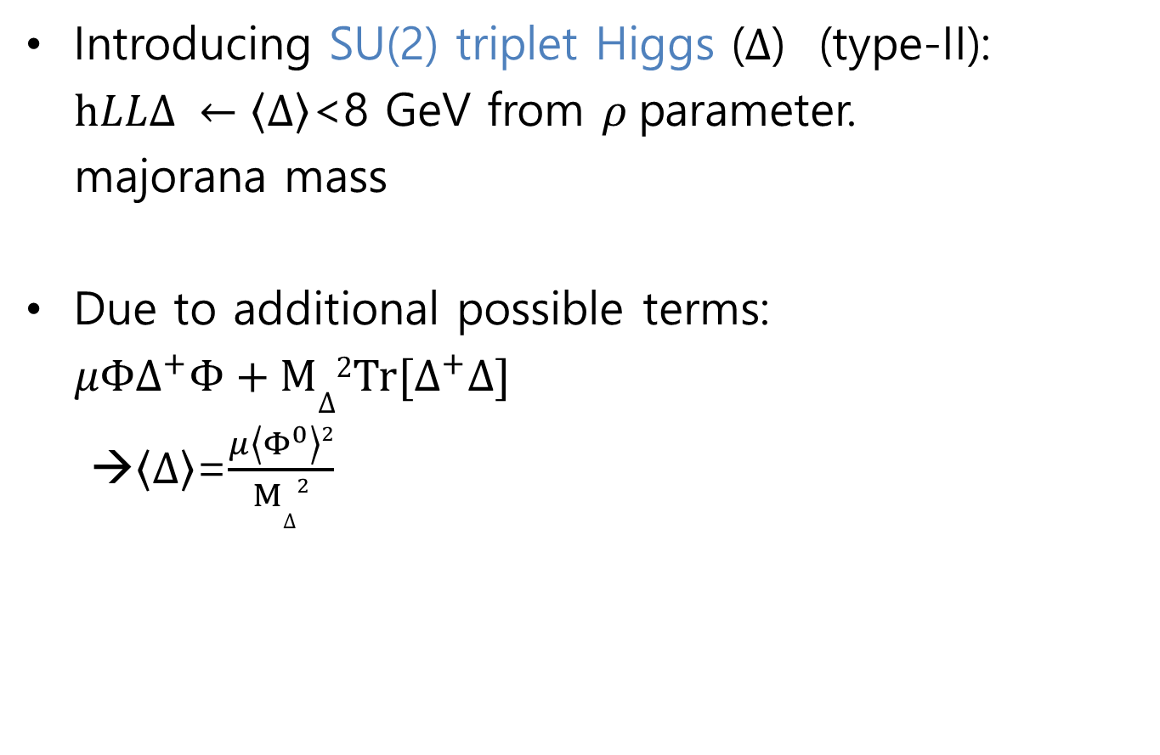
Type-II Seesaw
Introducing SU(2) triplet Higgs ($Δ$) (type-II):
$hLLΔ ←\left\langle ∆\right\rangle$<8 GeV from $ρ$parameter.
majorana mass
Due to additional possible terms:
$μΦ∆^{+}Φ+M∆2Tr[∆^{+}∆]$
→$\left\langle ∆\right\rangle$=$\frac{μ\left\langle Φ^{0}\right\rangle 2}{M∆2}$
(Magg, Wetterich; Lazarides, Shafi;
Mohapatra, Senjanovic; Schechter, Valle)

Slide 29
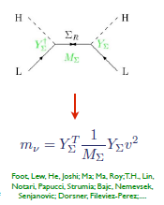
Type-III Seesaw
Introducing SU(2) triplet fermions

Slide 30
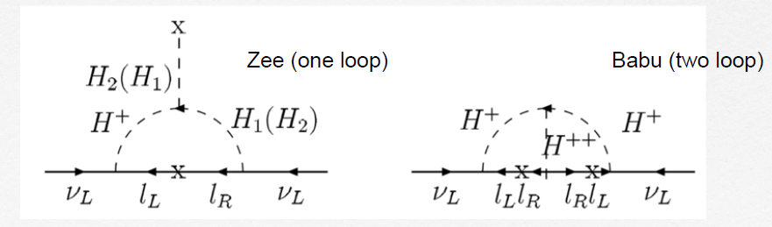

Non-renormalizable term
$\frac{λ}{M}LLΦΦ$ → $\frac{λ}{M}\left\langle φ^{0}\right\rangle 2$ same as type-I seesaw
Radiative generation of neutrino masses
talk by Ramond Volkas

Slide 31
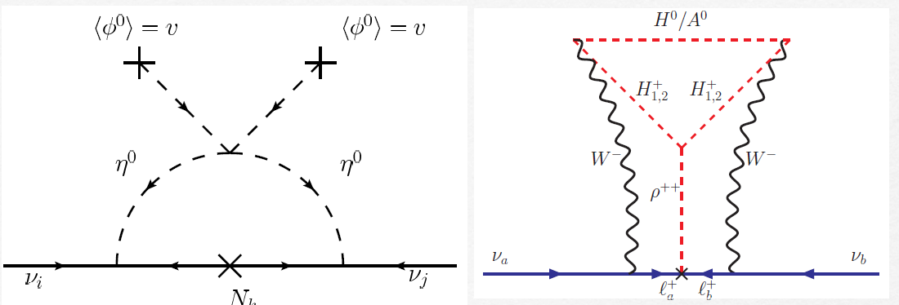
Scotogenic (Ma) Cocktail (Gustafusson etal.)
R-parity violating SUSY model

Slide 32
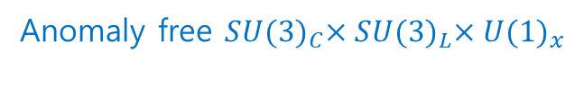
Seesaw for Dirac Neutrino
Type-I Seesaw
Type-II Seesaw (Valle,Vaquera-Araujo, PLB755(2016),
Addazi et al PLB759 (2016))
Chulia, Srivastava, Valle, PLB761 (2016),
Chulia, Ma, Srivastava, Valle ,PLB767 (2017)
Anomaly free $SU{(3)}_{C}×SU{(3)}_{L}×{U(1)}_{x}$

Slide 33
Seesaw for Dirac Neutrino
Type-II Seesaw
Type-III Seesaw
Bonilla, Valle, PLB762(2016)
Reig et al., PRD94(2016)
Chulia, Srivastava, Valle, PLB781(2018)
Neutrino mass generation in type-III Dirac seesaw
There can be d=5 op. leading to tiny Dirac mass.

Slide 34
Inverse seesaw
Inverse seesaw
Mohapatra, PRL56(1986)
Mohapatra, Valle, PRD34(1986)
Radiative Inverse seesaw
Carcamo Hernandez et al JHEP 1902 (2019)

Slide 35
Scotogenic inverse seesaw
Inverse seesaw+1-loop (A. Das et al, 1704.02078)
Dirac Inverse seesaw (Borah, Karmakar, PLB780(2018))
arXiv:1907.07728

Slide 36
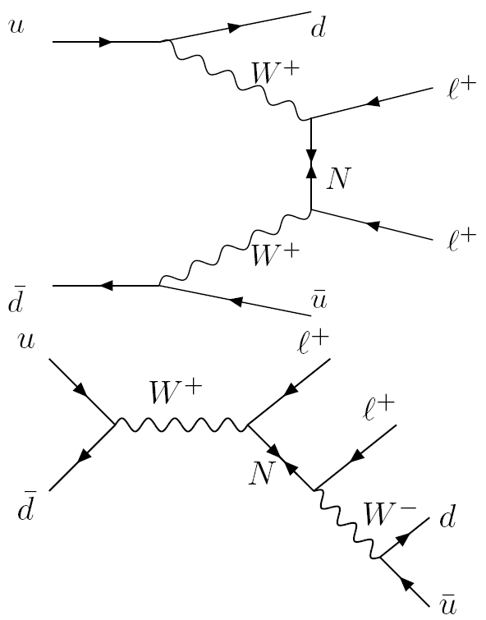
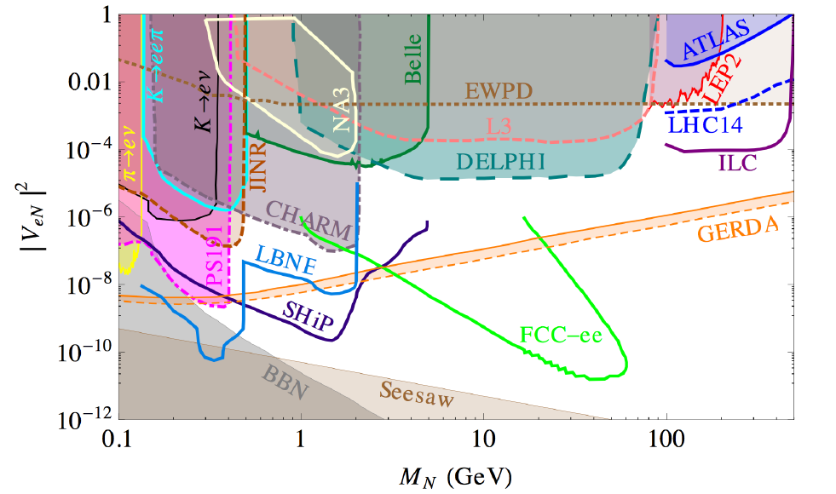
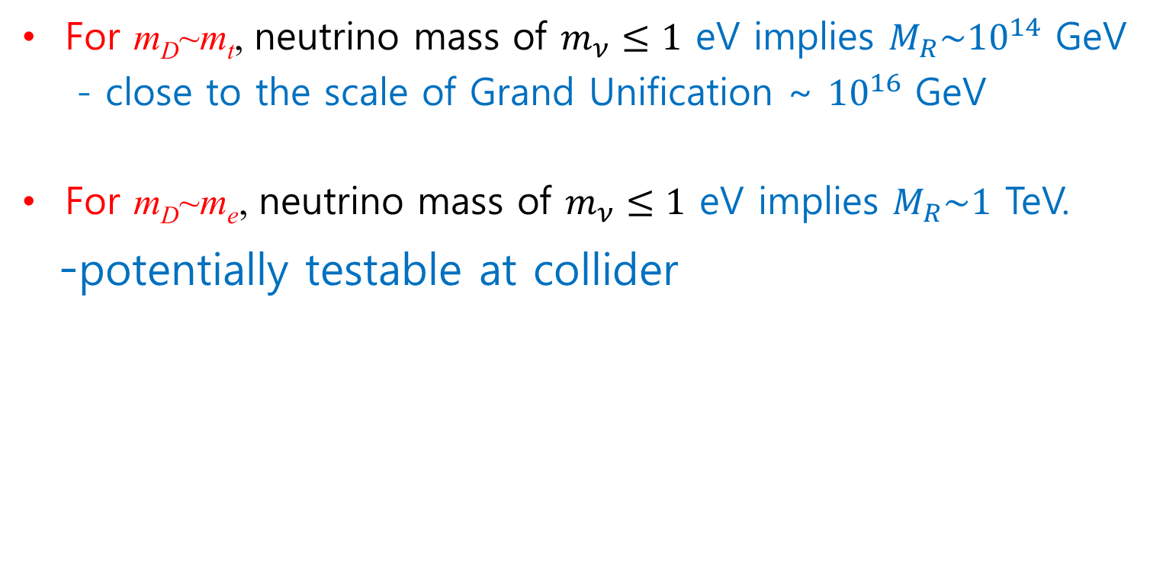
What is the Seesaw scale ?
For m_{D}~m_{t}, neutrino mass of $m_{ν}≤1$ eV implies $M_{R}\sim {10}^{14}$ GeV
- close to the scale of Grand Unification ~ ${10}^{16}$ GeV
For m_{D}~m_{e}, neutrino mass of $m_{ν}≤1$ eV implies $M_{R}\sim 1$ TeV.
-potentially testable at collider
Deppisch, Dev, Pilaftsis, 1502.06541

Slide 37
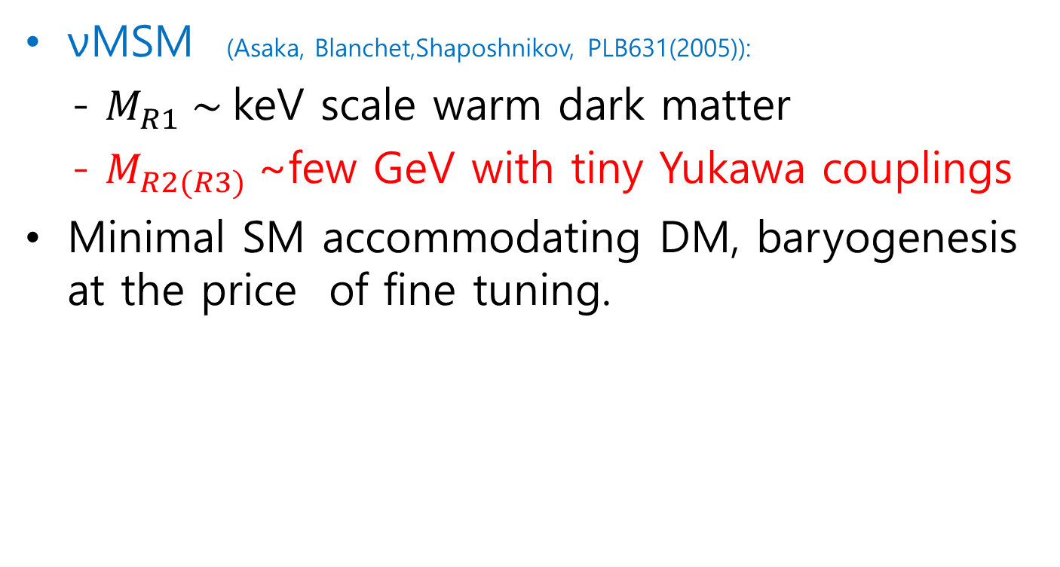
What is the Seesaw scale ?
νMSM (Asaka, Blanchet,Shaposhnikov, PLB631(2005)):
- $M_{R1} \sim$keV scale warm dark matter
- $M_{R2(R3)}$~few GeV with tiny Yukawa couplings
Minimal SM accommodating DM, baryogenesis at the price of fine tuning.

Slide 38
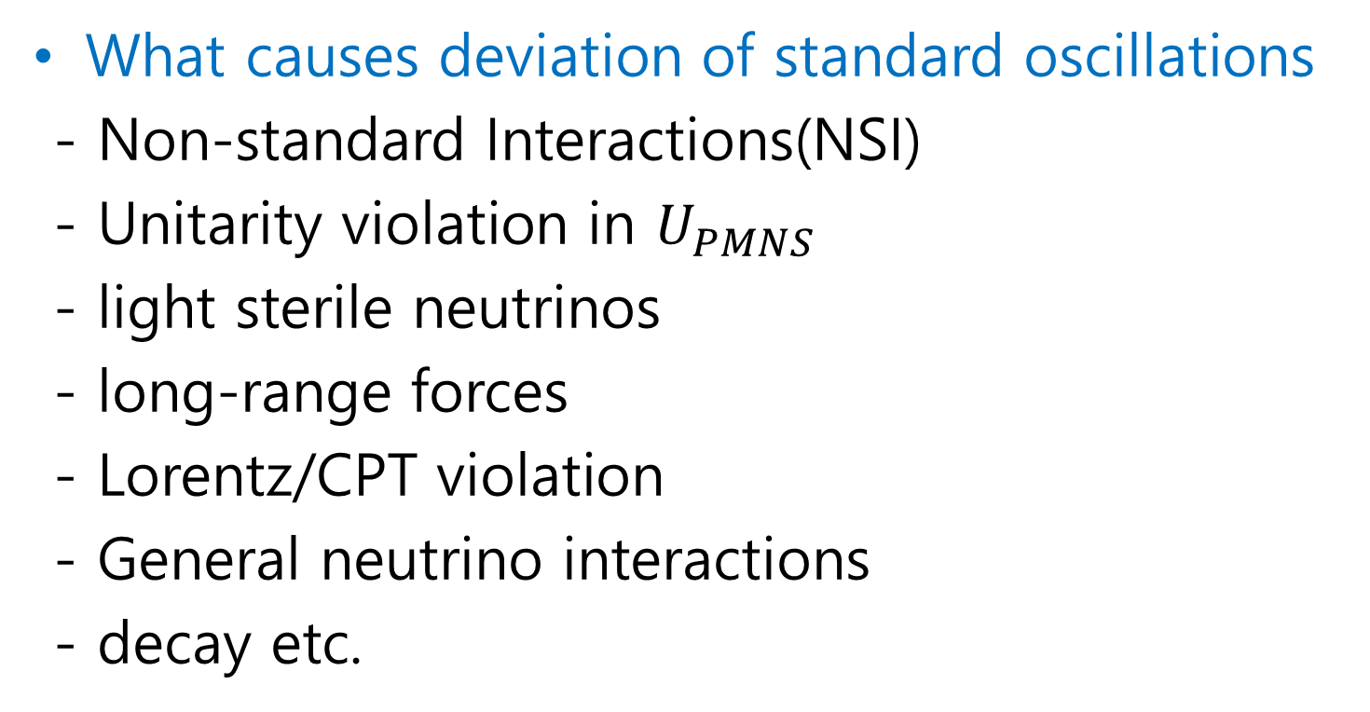
III.New Physics in ν Oscillation
What causes deviation of standard oscillations
- Non-standard Interactions(NSI)
- Unitarity violation in $U_{PMNS}$
- light sterile neutrinos
- long-range forces
- Lorentz/CPT violation
- General neutrino interactions
- decay etc.

Slide 39

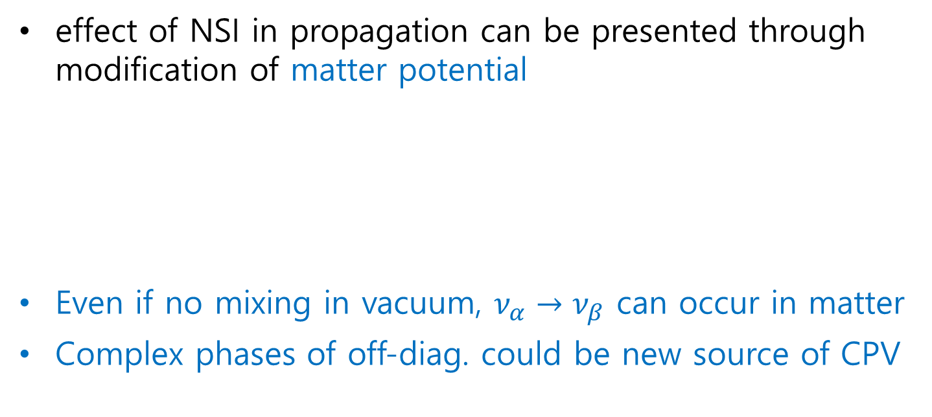
NSI
Existence of NSI indicates new physics beyond the SM
effect of NSI in propagation can be presented through modification of matter potential
Even if no mixing in vacuum, $ν_{α}→ν_{β}$ can occur in matter
Complex phases of off-diag. could be new source of CPV
$$ε_{αβ}^{f}=ε_{αβ}^{fL}+ε_{αβ}^{fR}$$

Slide 40
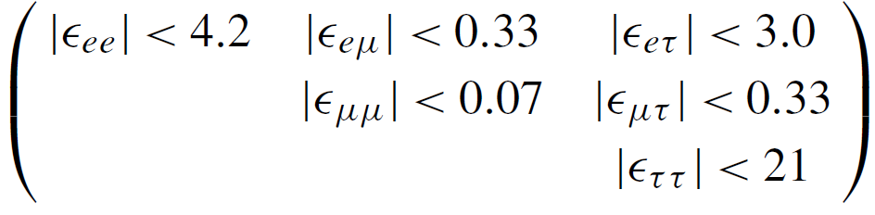
Current conservative model independent bounds
Deepthi, Goswami, Nath, PLB936 (2018)
NSI may affect neutrinos at the production point as well as detection point.
To see those effects, we use different parameters ;
(ex) for production,

Slide 41
Results from global fit to solar data and KamLAND
(Esteban et al., 1805.04530)

Slide 42
NSI
NSI can prevent determination of CP violation
Masud, Mehta, PRD94(2016)

Slide 43
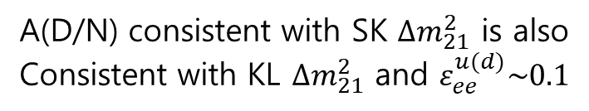

NSI
$2σ$ tension for $Δm_{21}^{2}$ could be due to NSI
Liao, Marfatia, Whisnant, 1704.04711
A(D/N) consistent with SK $∆m_{21}^{2}$ is also
Consistent with KL $∆m_{21}^{2}$ and $ε_{ee}^{u(d)}\sim 0.1$
(JUNO and HyperK would reject no NSI-solution by 7σ)

Slide 44
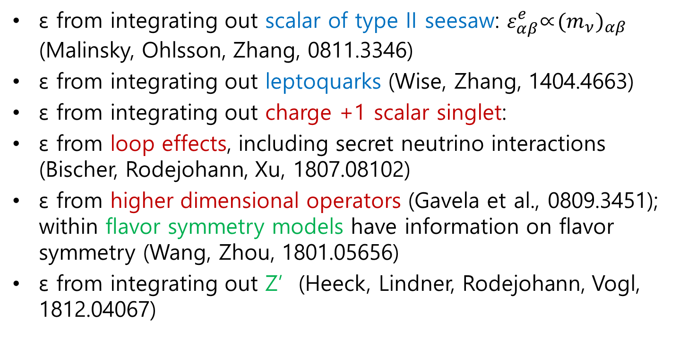
Origin of NSI
ε from integrating out scalar of type II seesaw: $ε_{αβ}^{e}$∝${(m_{ν})}_{αβ}$ (Malinsky, Ohlsson, Zhang, 0811.3346)
ε from integrating out leptoquarks (Wise, Zhang, 1404.4663)
ε from integrating out charge +1 scalar singlet:
ε from loop effects, including secret neutrino interactions (Bischer, Rodejohann, Xu, 1807.08102)
ε from higher dimensional operators (Gavela et al., 0809.3451); within ﬂavor symmetry models have information on ﬂavor symmetry (Wang, Zhou, 1801.05656)
ε from integrating out Z’ (Heeck, Lindner, Rodejohann, Vogl, 1812.04067)

Slide 45
Non-unitarity
Source of non-unitary : sterile neutrino, effective op… (minimal unitarity violation: Antusch et al, 2006)
Parametrization (Z. Xing, PLB 2008, Escrihuela et al. PRD92(2015))
Constraints from experimental data: ν oscillations, W & Z decays, rare lepton-flavor-violating decays, lepton universality tests, ……
Sensitivity to CPV in LBL exps. can be affected by the presence of non-unitarity.

Slide 46
Escrihuela, Forero, Miranda, Tortola, Valle, New.J.Phys.19(2017)

Slide 47
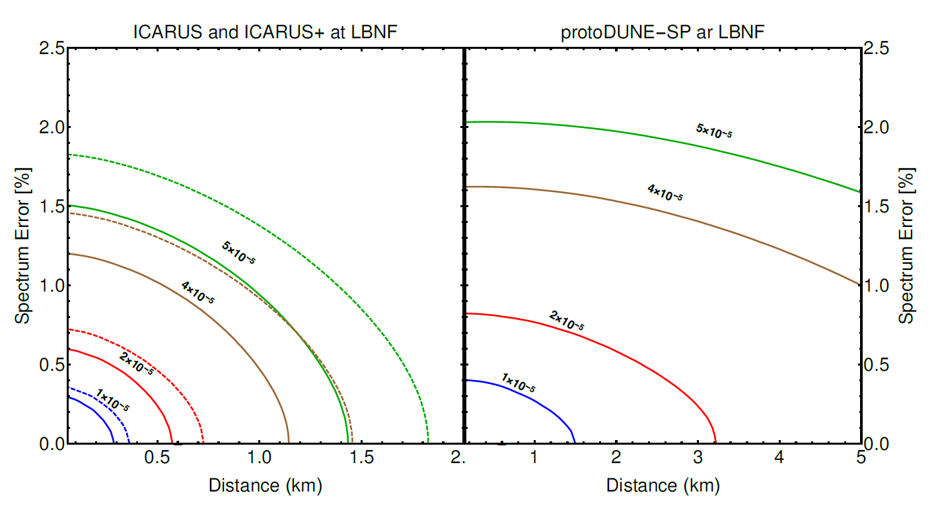




Non-unitarity predicts “zero-distance effect”
$$P\left(ν_{μ}→ν_{e}\right)=α_{11}{\left|α_{21}\right|}^{2}$$
Thus, at very short distances from the neutrino source, # of detected electron neutrinos, $N_{e}$, is given by
$N_{e}=φ_{ν_{e}}^{0}$+${\left|α_{21}\right|}^{2}φ_{ν_{μ}}^{0}$
Capabilities of SBL as well as LBL as a probe of the unitarity of lepton mixing :(Miranda et al. PRD97(2018); Escrihuela et al ,New.J.Phys.19(2017)
$${|α_{21}|}^{2}$$

Slide 50
Prospects
Precisely measuring PMNS mixing angles
→ test of neutrino models with flavor symmetry
→ some hint for grand unification or Q-L symmetry
Determining mass ordering
→ implication on neutrinoless double beta decay
→ test of some of neutrino mass model
Observing CP violation
→ implication on baryogenesis
→ hint for Q-L symmetry or grand unification
Search for new physics beyond the SM
Measuring neutrino mass scale
Neutrino properties : Dirac vs. Majorana
Search for sterile neutrinos
light sterile → neutrino oscillation, low energy experiments
heavy sterile → collider experiments

Slide 51
Conclusion
Lots of progress in neutrino physics in the past years
→ PMNS parameters approach CKM precision
Still lots to learn about neutrino
→ mass ordering, CP violation, Majorana or Dirac etc.
Lots of theoretical idea proposed to understand our universe via neutrino
→ More idea will emerge in future
Lots of experimental programs and proposals exist
→ New era of neutrino physics

Slide 53


Minimal Seesaw (type-I)
2 RH neutrinos : Frampton, Glashow, Yanagida, PLB548(2002),
Endoh, SK, Kaneko, Morozumi, Tanimoto, PRL89(2002)
Littlest Seesaw : Dirac texture zero & 2 RH $ν$
(S.F. King, JHEP1307(2013))
Littlest Seesaw from $S_{4}$ (Chen, Ding, King, Li : 1906.1141)

