Slide 1


Update on MCBXFBP1 performance for WP2
E. Todesco, J. C. Perez, F. Toral
CERN 10th September 2019

Slide 2
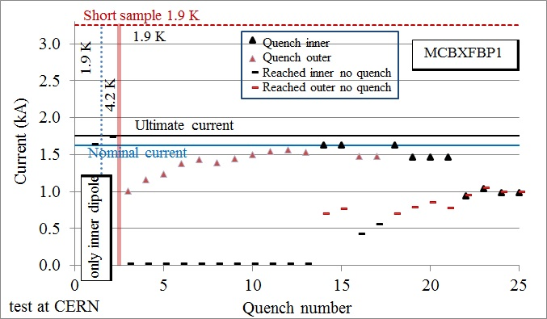
NESTED CORRECTOR
In first two powering, magnet reached ultimate current in each direction
But it was blocked at about 50% of the torque
Training of MCBXFBP1 (G. Willering, F Toral, J. C. Perez, et al.)

Slide 3
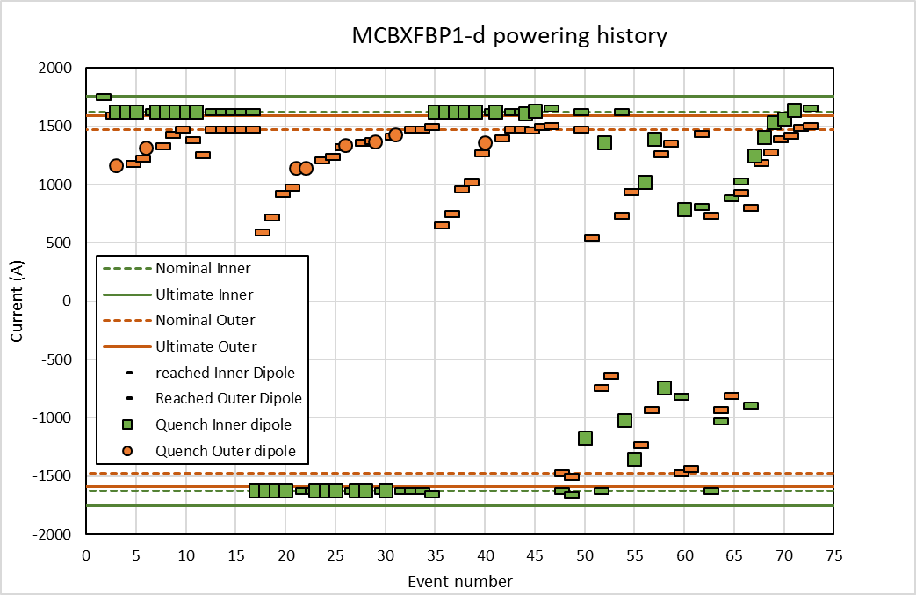
NESTED CORRECTOR
With the third assembly the issue has been understood
  Improved shmming of the coil ends
Nominal current (plus 2%) in both planes reached simultaneously with limited training
Training of MCBXFBP1 (G. Willering, F Toral, J. C. Perez, et al.)

Slide 4
NESTED CORRECTOR
We still have one issue
  When the torque sign is changed, some retraining is needed to go above 30% of the torque
  The present prototype can operate safely in this region …

Slide 5
NESTED CORRECTOR
We still have one issue
  When the torque sign is changed, some retraining is needed to go above 30% of the torque
  Or, after <10 quenches, in the region with the opposite torque

Slide 6
NESTED CORRECTOR
We will have a second prototype to check reproducibility and verify if the situation can be improved
  We wish to know if the present limitation is a showstopper for the operation

