Slide 1
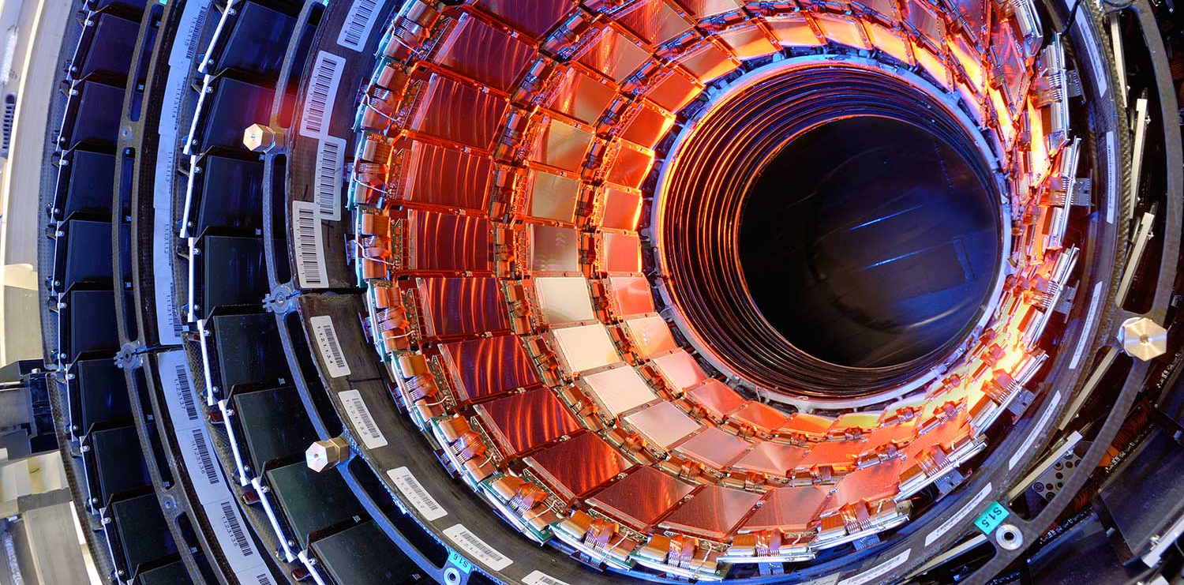



ATTRACT: Quick Reference Guide
Pablo G. Tello, meeting, January 23-24 Aalto, Finland
ATTRACT Project Administrative Office

Slide 2
What is ATTRACT?
It is an initiative with the purpose of creating a sustainable breakthrough innovation ecosystem in Europe focused on detection and imaging technologies for boosting fundamental research, industrial applications and social innovation.
Notes:
1) The Project – Overall scope of ATTRACT, importance of detection and imaging technologies to enable innovation, access to Project Work Plan and deliveries.
2) ATTRACT Call – All information for the call, examples of challenges to tackle, documentation, and link to submission platform
– Also Speed Networking service. 32 MATCHES already!
3) Consortium – PARTNERS visibility (link to website)
4) Committees – All ATTRACT committees and short bios.
5) News and events – Latest news, events and also MEDIA ROOM for journalists

Slide 3












Business, Entrepreneurship & Innovation Experts
Research
Infrastructures
Public Investment
Who is steering the initiative?
Industry
Notes:
Second:
Incorporate in the value chain the necessary actors for that:
Value generators: Research Infrastructures and their research communities.
Value captors: Industry, Business and Innovators and Private Investors.
Risk absorption: Public funding.

Slide 4
How ATTRACT deplyoment is envisioned?
Phase 1
Running until November 2020
170 R&D&I projects out of 1200 received in an open call have been selected by an Independent Scientific Committee (IC).
Funded with 100kE each.
Phase 2
(2021-2024)
“X” number of projects out of the 170 will be selected by the IC.
Each one will be funded in a scalable manner.
Phase 3
(2021-2027)
Repetition of phases 1 and 2 in several rounds for establishing a pan-European innovation ecosystem.
Running for 1 year started in May 2019.
The will run for 2 years.
Horizon Europe
MAXI-ATTRACT
(full deployment)
Horizon 2020
Mini-ATTRACT
(pilot)
Notes:
1) The Project – Overall scope of ATTRACT, importance of detection and imaging technologies to enable innovation, access to Project Work Plan and deliveries.
2) ATTRACT Call – All information for the call, examples of challenges to tackle, documentation, and link to submission platform
– Also Speed Networking service. 32 MATCHES already!
3) Consortium – PARTNERS visibility (link to website)
4) Committees – All ATTRACT committees and short bios.
5) News and events – Latest news, events and also MEDIA ROOM for journalists

Slide 5

What is the status of phase 1?
Running according to plan.
All of you are kindly invited to the ATTRACT Final Conference in Brussels.
Visit our website for much more information https://attract-eu.com/
Notes:
1) The Project – Overall scope of ATTRACT, importance of detection and imaging technologies to enable innovation, access to Project Work Plan and deliveries.
2) ATTRACT Call – All information for the call, examples of challenges to tackle, documentation, and link to submission platform
– Also Speed Networking service. 32 MATCHES already!
3) Consortium – PARTNERS visibility (link to website)
4) Committees – All ATTRACT committees and short bios.
5) News and events – Latest news, events and also MEDIA ROOM for journalists

Slide 6
What is the status of phase 2?
The ATTRACT Consortium is preparing the submission to the call: INFRAINNOV-03-2020: Co-Innovation platform for research infrastructure technologies.
The deadline for submission is March 17th 2020.
Notification of funding from the EC and invitation to the ATTRACT Consortium for Grant Agreement negotiation expected by August 2020.
Optimistic starting date for the ATTRACT phase 2 project: January 2021 (it will depend on the duration of the point above).
Notes:
1) The Project – Overall scope of ATTRACT, importance of detection and imaging technologies to enable innovation, access to Project Work Plan and deliveries.
2) ATTRACT Call – All information for the call, examples of challenges to tackle, documentation, and link to submission platform
– Also Speed Networking service. 32 MATCHES already!
3) Consortium – PARTNERS visibility (link to website)
4) Committees – All ATTRACT committees and short bios.
5) News and events – Latest news, events and also MEDIA ROOM for journalists

Slide 7
What ATTRACT has to do with MSc students?
Phase 1
Running until November 2020
Running of a pilot experience with 100 students.
Aalto DF and ESADE are the coordinators of this activity happening at their premises.
Phase 2
(2021-2024)
Scalability of phase 1 student projects up to 400 students.
Phase 3
(2021-2027)
This is going to be huge!!!
Design Thinking methodology.
Students are inspired with the technology of the projects for prototyping social innovation solutions.
Notes:
1) The Project – Overall scope of ATTRACT, importance of detection and imaging technologies to enable innovation, access to Project Work Plan and deliveries.
2) ATTRACT Call – All information for the call, examples of challenges to tackle, documentation, and link to submission platform
– Also Speed Networking service. 32 MATCHES already!
3) Consortium – PARTNERS visibility (link to website)
4) Committees – All ATTRACT committees and short bios.
5) News and events – Latest news, events and also MEDIA ROOM for journalists

Slide 8
How student pilots happened/are happening in phase 1 (summary of key steps)?
Step 1
Aalto and ESADE sent a request to all projects asking for volunteers to inspire students.
Step 2
Aalto and ESADE made a selection of the most suitable projects to run the pilot (e.g. technology more prone for social innovation and understandable for MSc students).
Step 3
Aalto and ESADE are running the experience with recruited students from their network and fully documenting process and results.
CERN as administrative coordinator of the ATTRACT phase 1 project is responsible for the reimbursement of the activities according to EC rules.
Notes:
1) The Project – Overall scope of ATTRACT, importance of detection and imaging technologies to enable innovation, access to Project Work Plan and deliveries.
2) ATTRACT Call – All information for the call, examples of challenges to tackle, documentation, and link to submission platform
– Also Speed Networking service. 32 MATCHES already!
3) Consortium – PARTNERS visibility (link to website)
4) Committees – All ATTRACT committees and short bios.
5) News and events – Latest news, events and also MEDIA ROOM for journalists

Slide 9
How the student projects will happen in phase 2 logistically?
Aalto will be the coordinator of the Work package implementing this activity.
CERN (as ATTRACT phase 2 administrative coordinator) will ensure that the administration works well according to the H2020 rules.
ESADE and Aalto facilities will be used for running the student projects.
IdeaSquare at CERN as well (see next slides).
The student projects are expected to happen during 2022-2023 since first the ATTRACT phase 2 call for projects needs to be launched, the proposals received, the evaluation and selection by the IC done and the contractual formalities of the R&D&I projects with the ATTRACT consortium finalized.
Notes:
1) The Project – Overall scope of ATTRACT, importance of detection and imaging technologies to enable innovation, access to Project Work Plan and deliveries.
2) ATTRACT Call – All information for the call, examples of challenges to tackle, documentation, and link to submission platform
– Also Speed Networking service. 32 MATCHES already!
3) Consortium – PARTNERS visibility (link to website)
4) Committees – All ATTRACT committees and short bios.
5) News and events – Latest news, events and also MEDIA ROOM for journalists

Slide 10
How could you get involved? (1)
Propose yourself as a volunteer for running a round of student project and liaise with Aalto for the preparatory work.
You could decide to:
    Option 1: Run the round in your facilities.
    Option 2: Liaise with Aalto, ESADE and/or CERN IdeaSquare for running it together (easier from the admin point of view; see next slides).
Notes:
1) The Project – Overall scope of ATTRACT, importance of detection and imaging technologies to enable innovation, access to Project Work Plan and deliveries.
2) ATTRACT Call – All information for the call, examples of challenges to tackle, documentation, and link to submission platform
– Also Speed Networking service. 32 MATCHES already!
3) Consortium – PARTNERS visibility (link to website)
4) Committees – All ATTRACT committees and short bios.
5) News and events – Latest news, events and also MEDIA ROOM for journalists

Slide 11
How could you get involved? (2)
If you decide for option 1 then a contractual arrangement between the ATTRACT Consortium and your institution should be put in place for you to get the cost formally reimbursed according to H2020 rules.
If you decide for option 2 then there is no need for this contractual arrangement since the activity is happening at the premises of one of the ATTRACT consortium members.
Notes:
1) The Project – Overall scope of ATTRACT, importance of detection and imaging technologies to enable innovation, access to Project Work Plan and deliveries.
2) ATTRACT Call – All information for the call, examples of challenges to tackle, documentation, and link to submission platform
– Also Speed Networking service. 32 MATCHES already!
3) Consortium – PARTNERS visibility (link to website)
4) Committees – All ATTRACT committees and short bios.
5) News and events – Latest news, events and also MEDIA ROOM for journalists

Slide 12
What costs can be covered?
Each student project round must be considered as a lump sum voucher.
This voucher will be covering:
      Student associated costs during the round (i.e. travelling, accommodation).
      Prototyping materials.
      Hours of the teachers.
All costs MUST BE justified with receipts. Otherwise you will not get reimbursed and must be classified as what the EC knows as eligible costs in any H2020 project.
This is an additional consideration that makes option 1 more straightforward.
Notes:
1) The Project – Overall scope of ATTRACT, importance of detection and imaging technologies to enable innovation, access to Project Work Plan and deliveries.
2) ATTRACT Call – All information for the call, examples of challenges to tackle, documentation, and link to submission platform
– Also Speed Networking service. 32 MATCHES already!
3) Consortium – PARTNERS visibility (link to website)
4) Committees – All ATTRACT committees and short bios.
5) News and events – Latest news, events and also MEDIA ROOM for journalists

Slide 13
What happens if I am not entitled to get funding in H2020?
You can still run a student project round.
But it needs to happen at IdeaSquare at CERN.
The EC allows funding students from countries normally not entitled to be so in H2020 given the international status of CERN.
We will NOT be able to fund the hours of the teachers.
Thus, funding will only cover students costs and prototyping materials.
Notes:
1) The Project – Overall scope of ATTRACT, importance of detection and imaging technologies to enable innovation, access to Project Work Plan and deliveries.
2) ATTRACT Call – All information for the call, examples of challenges to tackle, documentation, and link to submission platform
– Also Speed Networking service. 32 MATCHES already!
3) Consortium – PARTNERS visibility (link to website)
4) Committees – All ATTRACT committees and short bios.
5) News and events – Latest news, events and also MEDIA ROOM for journalists

Slide 14
Final remarks
We (the ATTRACT Consortium) only will know about fine details on how the admin will run regarding student projects rounds during the Grant Agreement negotiations with the EC.
Some unforeseen issues will need to be solved in collaboration with the EC on the go (ATTRACT is an innovative way of doing things also for them but we have built a solid and very good relationship with the EC in phase 1).
Notes:
1) The Project – Overall scope of ATTRACT, importance of detection and imaging technologies to enable innovation, access to Project Work Plan and deliveries.
2) ATTRACT Call – All information for the call, examples of challenges to tackle, documentation, and link to submission platform
– Also Speed Networking service. 32 MATCHES already!
3) Consortium – PARTNERS visibility (link to website)
4) Committees – All ATTRACT committees and short bios.
5) News and events – Latest news, events and also MEDIA ROOM for journalists

Slide 15

Thanks and Questions

