Slide 1
Technology path towards future colliders
Caterina Biscari
ALBA Synchrotron
ECFA-EPS Joint Session

Slide 2

Input to this talk mainly from Granada Symposium
Thanks to all those who submitted inputs, plus speakers, plus participants
Inputs to the Strategy on accelerators
e+e- colliders
hh colliders
ep colliders
FCC
Gamma factories
Plasma acceleration
Muon colliders
Beyond colliders
Technological developments
Questions on Accelerator Science and Technology
What is the best implementation for a Higgs factory?
Choice and challenges for accelerator technology: linear vs. circular?
Path towards the highest energies: how to achieve the ultimate performance (including new acceleration techniques)?
How to achieve proper complementarity for the high intensity frontier vs. the high-energy frontier?
Energy management in the age of high-power accelerators?
Disclaimer
Only main technologies
will be mentioned

Slide 3
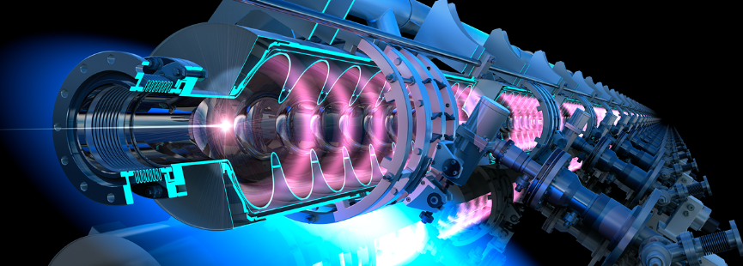
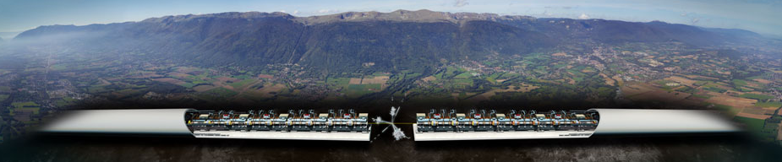
Linear colliders technology highlights
rf cavities
nanobeam

Slide 4
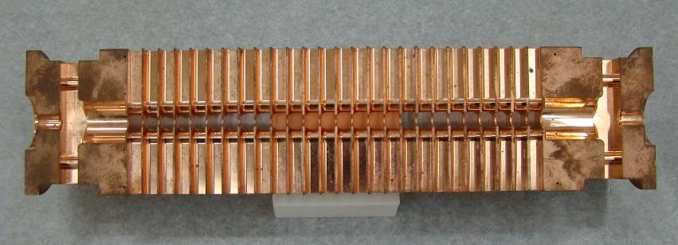

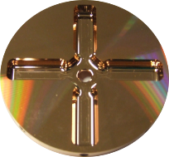
Features of Normal conducting and Superconducting RF
Courtesy: W. Wuensch
Normal conducting (CLIC) | Superconducting (ILC)
Gradient: 72 to 100 MV/m - Higher energy reach, shorter facility | Gradient: 31.5 to 35 (to 45) MV/m, - Higher efficiency, steady state beam power from RF input
RF Frequency: 12 GHz - High efficiency RF peak power - Precision alignment & stabilization to compensate wakefields | RF Frequency: 1.3 GHz - Large aperture gives low wakefields
Q₀: order < 10⁵, - Resistive copper wall losses compensated by strong beam loading – 40% steady state rf-to-beam efficiency | Q₀: order 10¹⁰, - High Q - losses at cryogenic temperatures
Pulse structure: 180 ns / 50 Hz | Pulse structure: 700 µs / 5 Hz
Fabrication: - driven by micron-level mechanical tolerances | Fabrication - driven by material (purity) & clean-room type chemistry
- High-efficiency RF peak power production through long-pulse, low freq. klystrons and two-beam scheme | - High-efficiency RF also from long-pulse, low-frequency klystrons

Slide 5
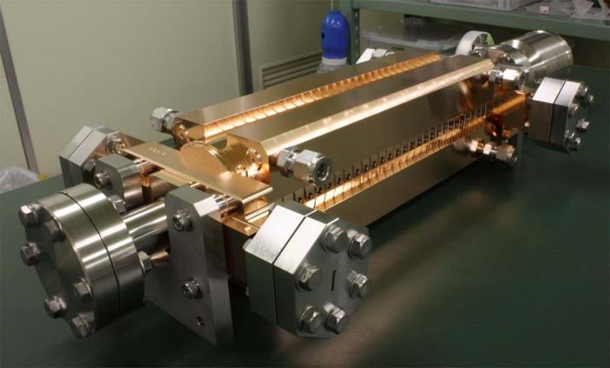
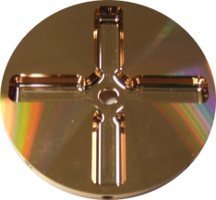
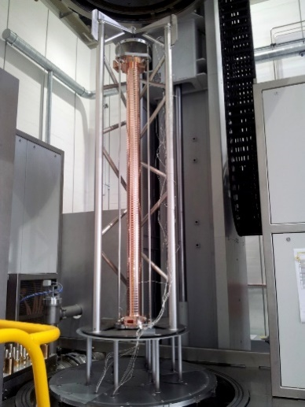
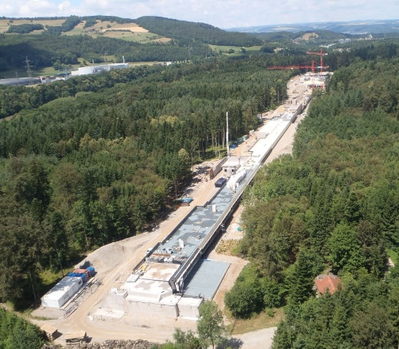
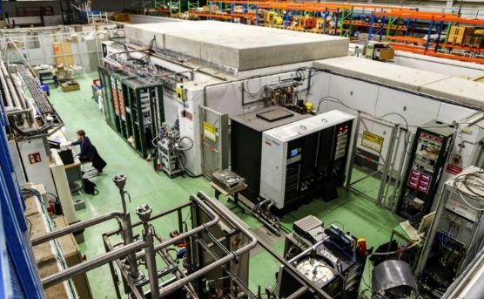
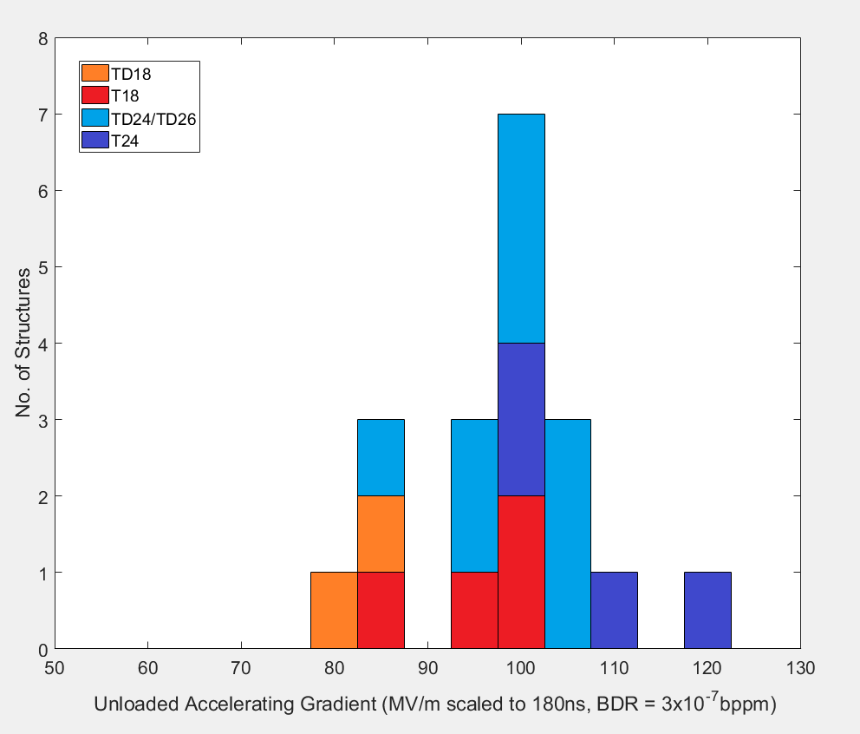
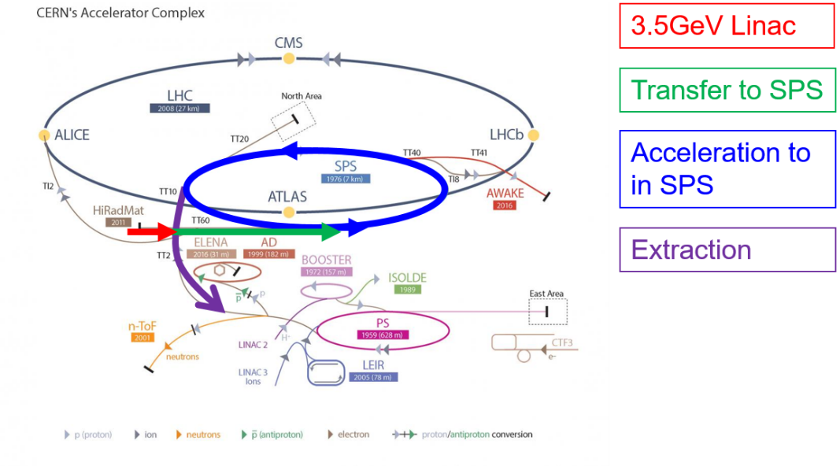
Normal Conducting Linac Technology Landscape
Courtesy: W. Wuensch
Components:
Laboratory with commercial
Accelerating structures
pulse compressors
alignment
Stabilization, etc.
Full commercial supply
X-band klystrons
solid state modulator,
C-band (6 GHz),
low-emittance
GeV-range facilities
Operational:
SACLA
SwissXFEL (8 GeV)
Systems Facilities:
(100 MeV-range)
XBoxes at CERN
(NEXTEF KEK)
Frascati
NLCTA SLAC
Linearizers at Electra, PSI, Shanghai and Daresbury
Test stand at Tsinghua
Deflectors at SLAC, Shanghai, PSI and Trieste
NLCTA
SmartLight
FLASH
X-band (12 GHz)
GeV-range facilities
Planning:
EuPraxia
e-SPS
CompactLight
CLIC
~ 100 (+/-20) MV/m
A. Yamamoto, 190513bb

Slide 6



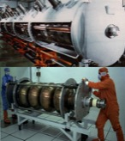


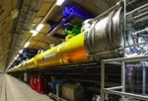

Advances in SRF Technology for Accelerators
Progress (1988~)
TRISTAN
LEP-II
HERA
CEBAF
CESR
KEKB
BES
cERL
In Operation: → # cavities
SNS: 1 GeV
CEBAF 12 GeV → 80
ISAC-II, ARIEL
Super-KEKB
Eu-XFEL → 800
Under Construction:
LCLS=II → 300
FRIB → 340
PIP-II → 115
ESS→ 150
Shine → 600
To be realized:
HL-LHC-Crab → 20
EIC
ILC-250 → 8,000
FCC
CEPC/SPPS
1980
2000
2020
> 2,000 SRF cavities realized, in last 10 years !

Slide 7
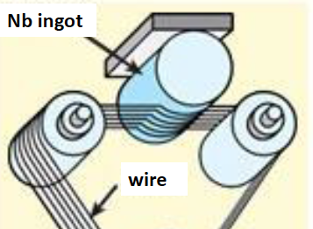
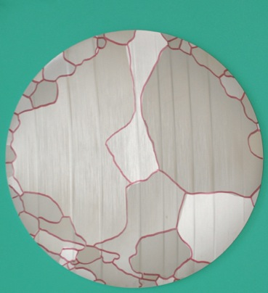
Challenges in SRF Cavity Technology
Bulk-Nb:
  High-G and -Q optimization
    Low-T treatment w/ or w/o N-infusion.
  Large-Grain (LG) directly sliced from ingot
    For possible less contamination and cost-reduction
Thin-film Coating
  Nb thin-film coating on Cu-base cavity structure
    Important for lower frequency and/or low-beta application.
    A New approach to realize flatter Q-slope (higher-Q)
    High Power Impulse Magnetron Sputtering (HiPIMS) ,
    instead of
    DC Magnetron Sputtering (DCMS)
  Nb₃Sn / MgB₂ film coating on Nb or Cu
    To reach much higher G, with higher B_{c} (B_{sh})
A. Yamamoto, 190513bb

Slide 8
RF technology
Accelerator Technologies are ready to go forward for lepton colliders (ILC, CLIC, FCC-ee, CEPC), focusing on the Higgs Factory construction to begin in > ~5 years.
SRF accelerating technology is well matured for the realization including cooperation with industry.
Continuing R&D effort for higher performance is very important for future project upgrades.
  Nb-bulk, 40 – 50 MV/m: ~ 5 years for single-cell R&D and the following 5 – 10 years for 9cell cavities statistics to be integrated. Ready for the upgrade, 10 ~ 15 years.
FEL communities develop NC + SC rf cavities
Operating (SwissFEL, EuXFEL,…)
in construction (LCLS,…)
in design stage
And so do ERL (PERLE,..)

Slide 9
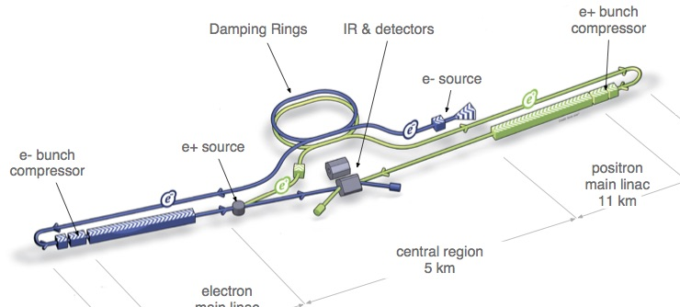
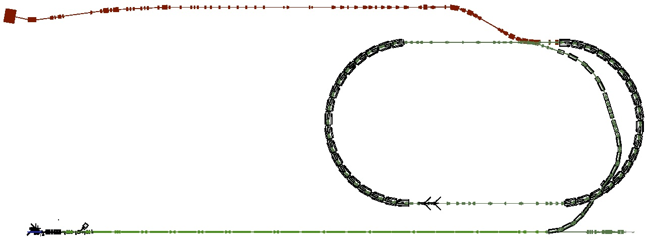













ATF/ATF2: Accelerator Test Facility
Courtesy: N. Terunuma
Develop nano-beam technology for ILC/CLIC
Goal: Realize small beam-size and theStabilize beam position
ILC
Advances in light sources
(diffraction limited storage rings)
Demonstrated by MaxIV
In progress at ESRF, Sirius, APS, ALS,….
FF: Nano beam-size
 | B Energy [GeV] | Vertical Size
ILC-250 | 125 | 7.7 nm
CLIC-380 | 190 | 2.9 nm
ATF2 (achieved) | 1.3 | 41 nm (-->8 nm eq. at ILC)
Damping Ring (140m)
Low emittance e- beam
1.3 GeV S-band e- LINAC (~70m)

Slide 10
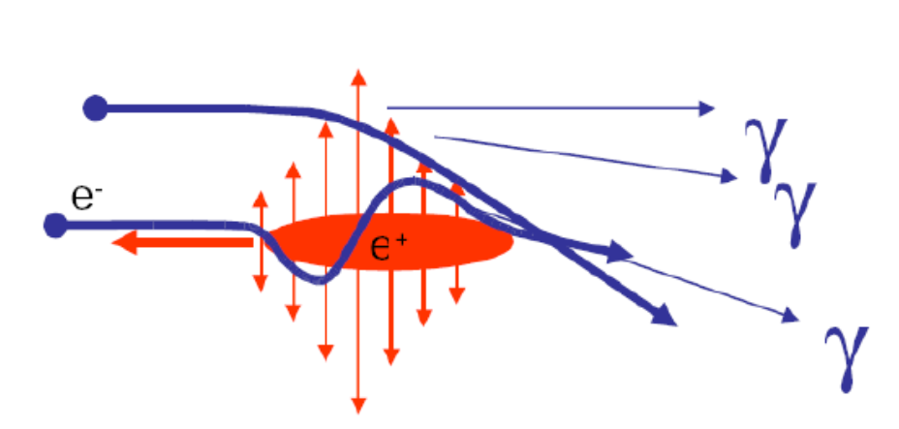

Challenges of Linear Colliders Higgs Factories
~10³⁴
Luminosity Spectrum
(Physics)
Beam Current
(RF power limited, beam stability)
Beam Quality
(Many systems)
beamstrahlung
Record small DR emittances
0.1 μm BPMs
IP beam sizes
ILC 8nm/500nm
CLIC 3nm/150nm
Challenging e+ production (two schemes)
CLIC high-current drive beam bunched at 12 GHz
(klystrons + 1.4 BCHF)
δE/E ~1.5% in ILC
Grows with E: 40% of CLIC lumi 1% off

Slide 11
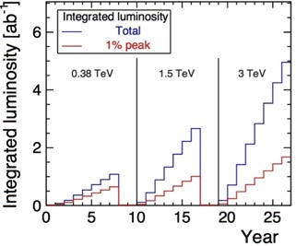
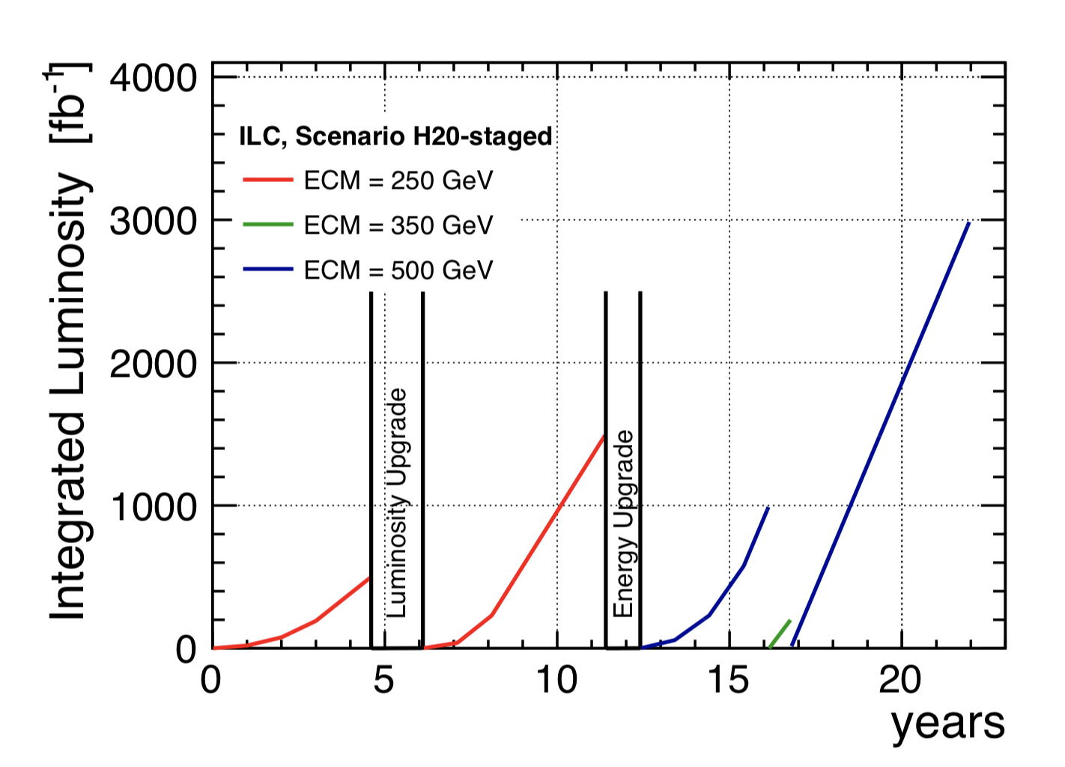
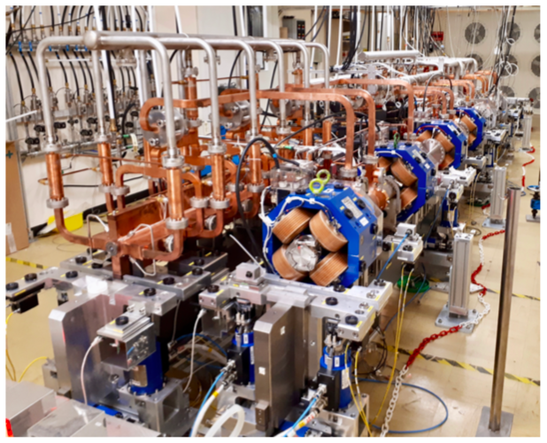
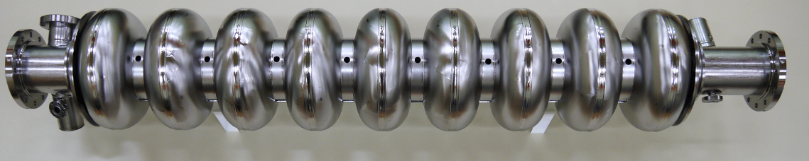
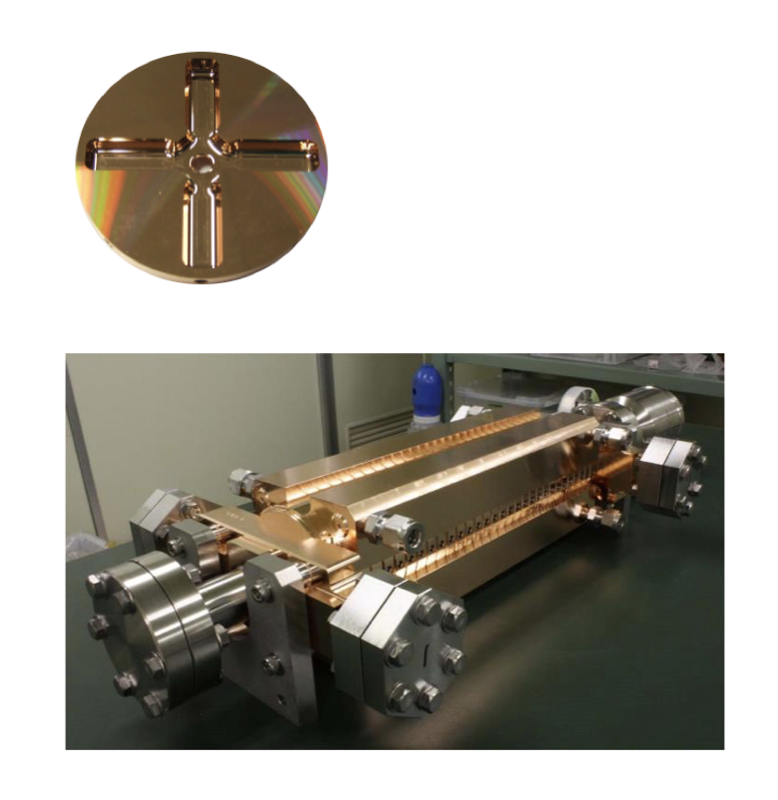
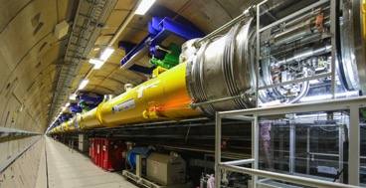
Overview of CLIC and ILC parameters
CLIC illustrations | CLIC parameters | ILC parameters | ILC illustrations
 | E: 380, 1500, 3000 GeV (L: 11-50 km) Lum: 1.5-5.9 10³⁴ ⁻² cm-2 s-1 * Prep. phase 2020-2025 Constr.+comm. 7y, ready before 2035 Cost: CLIC-380: 5.9 BCHF, Upgrades: deltas of 5 and 7 BCHF Power: ~ 170 MW – 580 MW** | E: 250, 500, 1000 GeV (L: 20-40 km) Lum: 1.35 (2.7) – 1.8(3.6) 10³⁴ cm-2 s-1* Prep. phase 2020-2023(4) Constr.+comm. 9-10y, ready before 2035 Cost: ILC-250: 4.9-5.3 BILCU, ILC-500: 8 BILCU (2012 $) Power: ~ 130 – 300 MW
CLIC y: 75% of 180 days | NCRF X-band now established and industrially available, used in small systems and being introduced in larger ones, relevant reference experience with C-band for larger systems (Swissfel). | SCRF in extensive use in several FELs with parameters close to ILC parameters, the primary one being the E-XFEL at DESY. Technology optimization underway, linking to evolving SCRF R&D for grad. and Q. | ILC y: 75% of 240 days
 | Nanobeam addressed in design & specifications, benchmarked simulations, low emittance ring progress, extensive prototype and method development (for alignment, stabilization, instrumentation, algorithms and feedback systems, system and facility tests : FACET, light-sources, FELs, ATF2) Extensive prototyping of all parts of these accelerators, for lab-test, use/test in test-facilities, light-sources or FELs (magnets, instrumentation, controls, vacuum, etc)
 | CERN hosted international project (follow LHC model) | Japan hosted international project, initial ideas about European capabilities available (link)
Staged approach to higher energies
* Doubling by increasing frequency (to be) studied, ** Power at 1.5 and 3 TeV not updated from CDR 2012

Slide 12
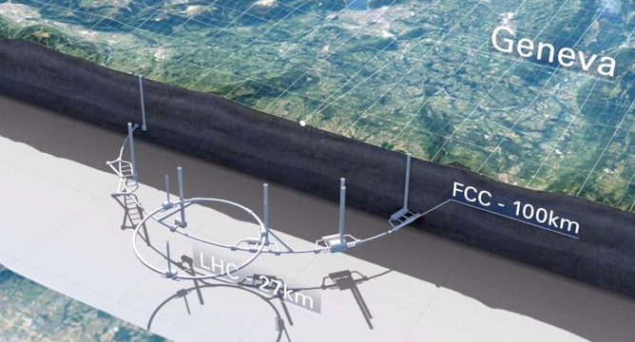
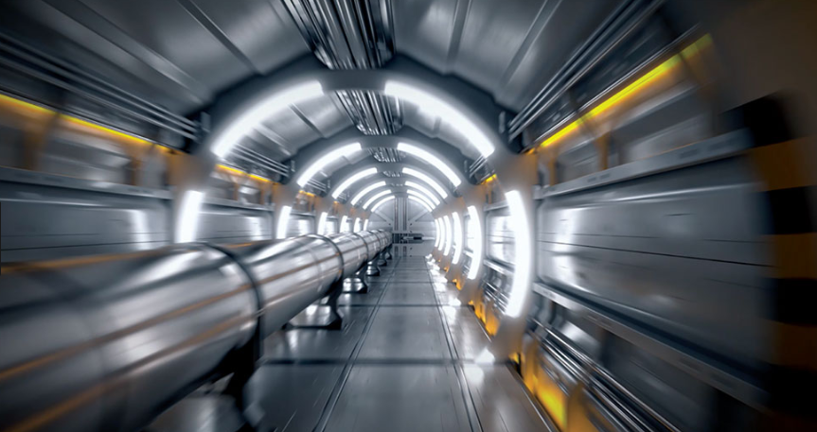
Circular colliders technology highlights
Size
Synchrotron radiation
High field magnets

Slide 13
Proton or lepton collisions
14 TeV lepton collisions
Are comparable to 100 TeV proton collisions
D. Schulte

Slide 14
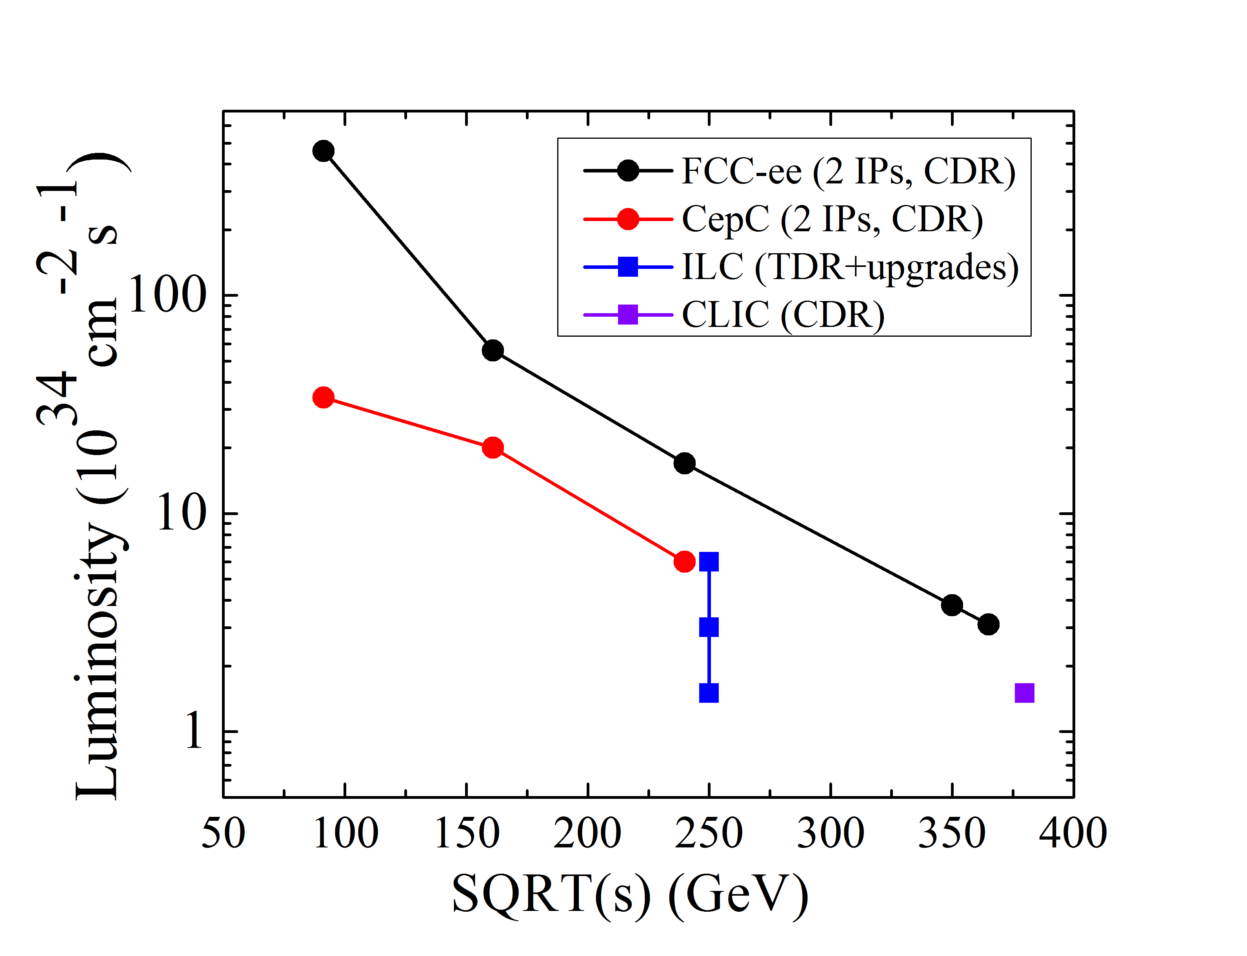
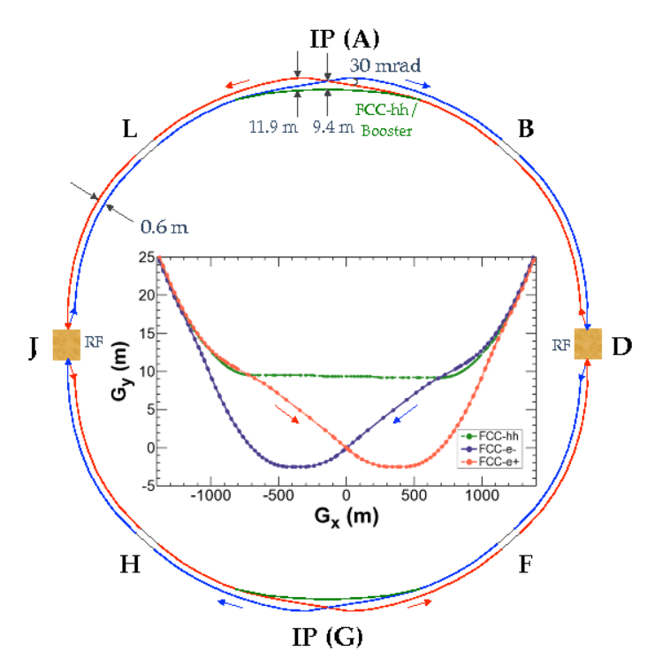
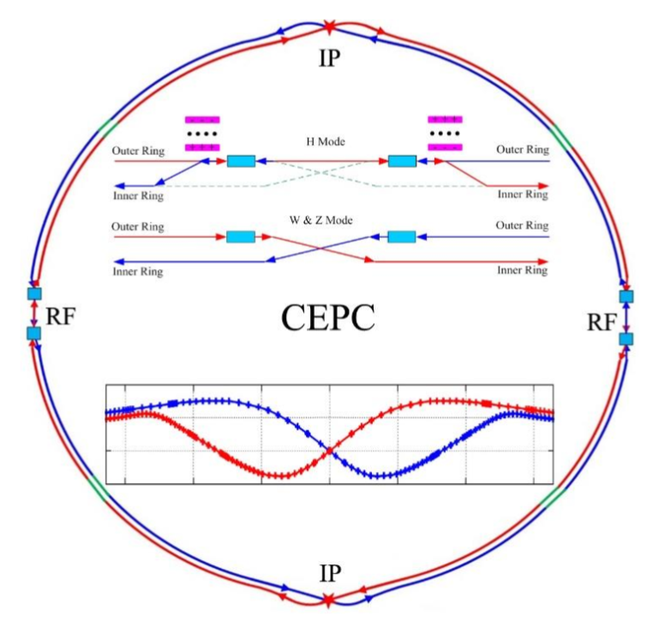
e+ e- colliders
Synchrotron radiation power, mitigated by long tunnel (100 km)
Limit set to 100 MW @ FCC-ee (60 MW @ CepC) by limiting the current => L decreases as E increases
new beam-beam instability; short beam lifetime => large acceptance
High efficient RF sources:
  Klystron 400/800 MHz η from 65% to >85%
High efficiency SRF cavities:
  10-20 MV/m and high Q₀; Nb-on-Cu, Nb₃Sn
Crab-waist collision scheme:
  Super KEK-B nanobeams experience will help
Energy Storage and Release R&D:
  Magnet energy re-use > 20,000 cycles
Efficient Use of Excavated Materials:
  10 million cu.m. out of 100 km tunnel
  Shiltsev

Slide 15
Luminosity Challenge (e+ e-)
Luminosity cannot be fully demonstrated before the project implementation
Luminosity is a feature of the facility not the individual technologies
Have to rely on experiences, theory and simulation and foresee margins
FCC-ee and CEPC are based on experience from LEP, DAPHNE, KEKB, PEP II, superKEKB, …
Gives confidence that we understand performance challenges
New beam physics occurs in the designs,
  e.g. beamstrahlung is unique feature of FCC-ee and CEPC
    Identified and anticipated in the design, should be able to trust simulations
The technologies required are improved versions of those from other facilities
Linear colliders are based on experiences from SLC, FELs, light sources, …
Gives confidence that we understand the performance challenges
Gives us confidence that we can do better than SLC
Still performance goal more ambitious, e.g. beam size of nm scale
  Creates additional challenges and requires additional technologies, e.g. stabilization
A part of the technologies are improved versions of those from other facilities
Some had to be purpose-developed for linear colliders

Slide 16
Maturity (e+e-)
CEPC and FCC-ee, LHeC
  Do not see a feasibility issue with technologies or overall design
  But more hardware development and studies essential to ensure that the performance goal can be fully met
    E.g. high power klystrons, strong-strong beam-beam studies with lattice with field errors, …
ILC and CLIC
  Do not see a feasibility issue with technology or overall design
  Cutting edge technologies developed for linear colliders
    ILC technology already used at large scale
    CLIC technology in the process of industrialization
  More hardware development and studies required to ensure that the performance goal can be full met
    e.g. undulator-based positron source, BDS tuning, …
Do not anticipate obstacle to commit to either CEPC, FCC-ee, ILC or CLIC
  But a review is required of the chosen candidate(s)
  More effort required before any of the projects can start construction

Slide 17
pp colliders (+ ion-p, e-p)

Slide 18
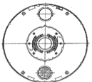
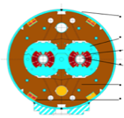
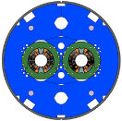


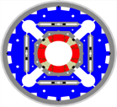
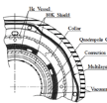
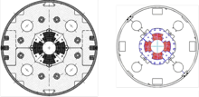
Advances in SC Magnets for Accelerators
Past:
ISR-IR
Tevatron (Fermilab)
TRISTAN-IR (KEK)
HERA (DESY)
Nuclotron (JINR)
LEP-IR (CERN)
KEKB-IR (KEK)
Present:
RHIC (BNL)
LHC (CERN)
SRC (RIKEN) …..
Under Construction
FAIR (GSI) …......
HL-LHC (CERN)
NICA (JINR)
Future:
EIC (e-Ion)
FCC-hh / HE-LHC
SppC
SC-Cyclotron
Fast-cycleShnchr.
1980
2000
2020
Tevatron-D. HERA-D. RHIC-D. LHC.D (NbTi) HL-LHC 11T-D (Nb₃Sn)
Dipole
ISR-IRQ, LEP-IRQ TRISTAN/KEKB-IRQ LHCC-IRQ (NbTI) HL-LHC-IRQ (Nb₃Sn)
IR Quadrupole

Slide 19
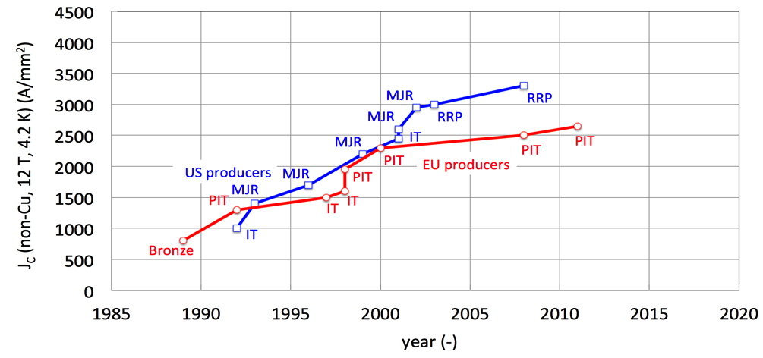
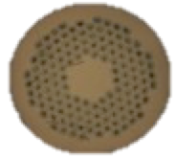






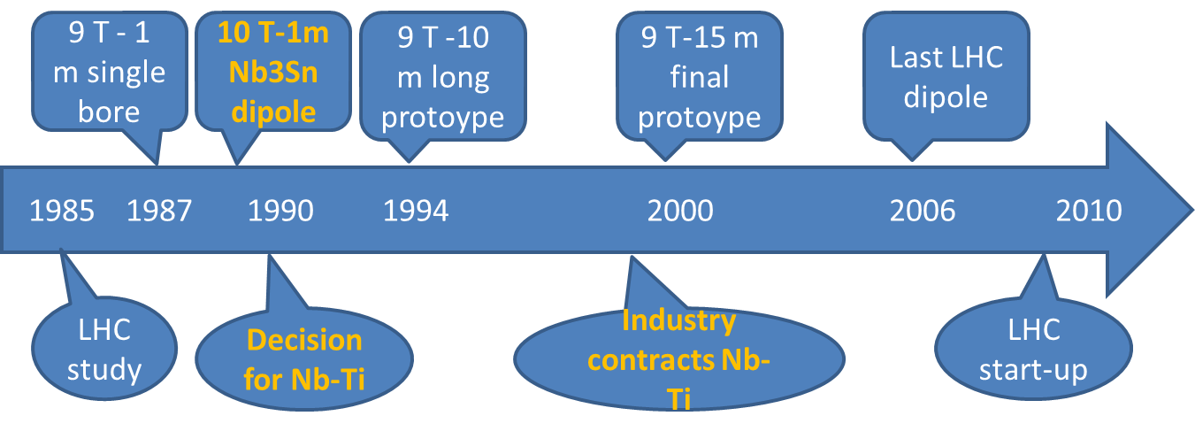
Nb₃Sn Conductor development for Accelerators (1998 ~ )
Courtesy, G. de Rijk
HL-LHC
ITER
FCC specs
HL-LHC specs
CARE-NED
EuCARD
US-CDP
FCC
After 10 years of development, the US and EU development produced the Nb₃Sn conductor for HILUMI
A. Yamamoto

Slide 20
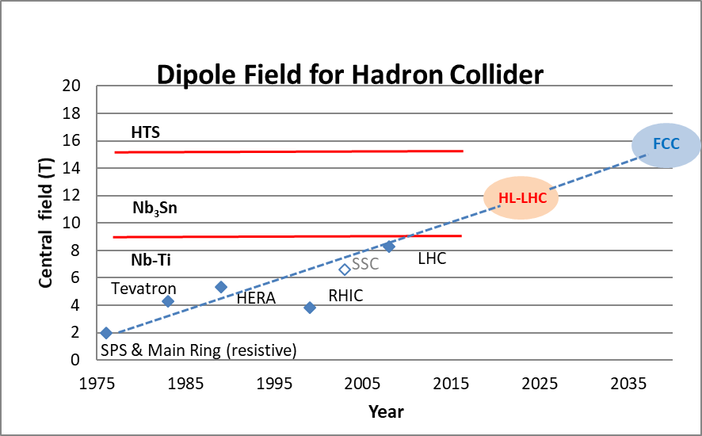
High field magnet development
HTS
In LHC, 14 T dipoles give 23.5 TeV
But timeline is NOT the same
12 T Nb₃Sn dipoles HiLumi technology in LHC: 21 TeV c.o.m.
LHC1.5
Energy tripler 100km
7 T Nb-Ti dipole (low cost LHC, 4.2 K):
44 TeV c.o.m. (100 km)
2040

Slide 21
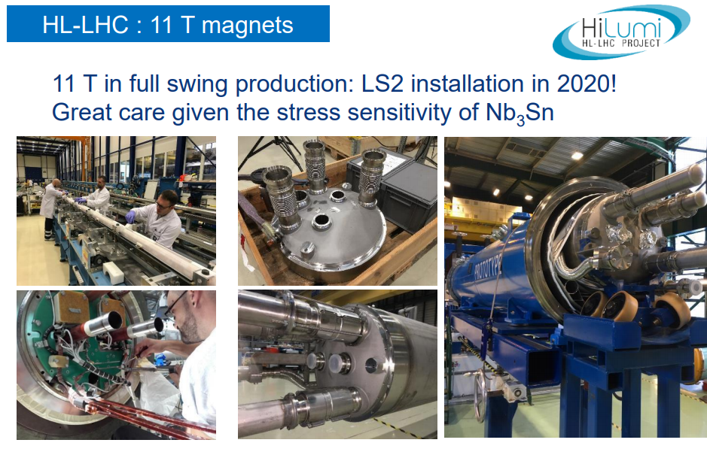
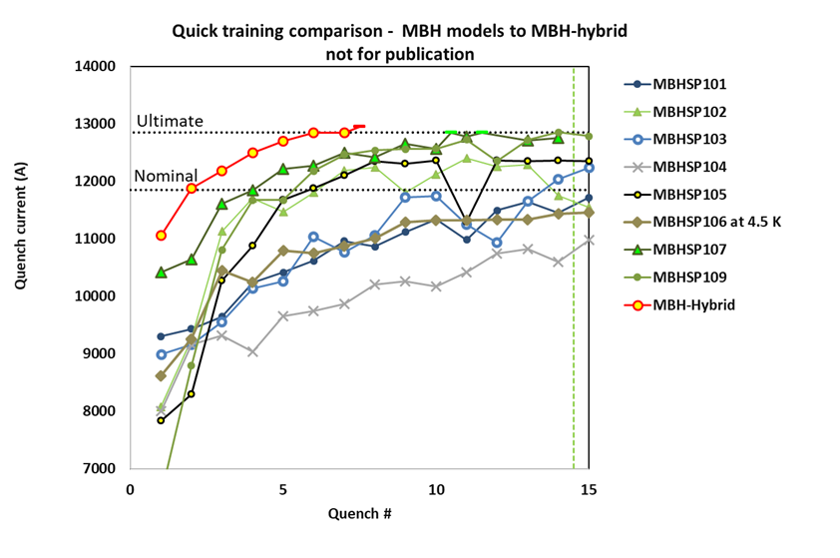
The 1st Series, 5.5 m long Dipole, powered as a single aperture in the initial test: Reached
  Bc = 11.2 T (at nominal current)
    I-nominal, after 1 quench,
  Bc = 12.1 T (at ultimate current)
    I-ultimate) after 6 quenches.
Bordry
+ Nb₃Sn Quadrupole (MQXF) at IR
US: 4.5 m Prototype:
Completed and tested
CERN: 1-m short Models:
Successfully demonstrated the performance
CERN: 7 m Prototype under development
+MgB₂ 18.5 kA Superconducting Link Demonstrated

Slide 22
s.c. magnet technology
Nb₃Sn superconducting magnet technology for hadron colliders, still requires step-by-step development to reach 14, 15, and 16 T.
It would require the following time-line (in my personal view):
  Nb₃Sn, 12~14 T: 5~10 years for short-model R&D, and the following 5~10 years for prototype/pre-series with industry. It will result in 10 – 20 yrs for the construction to start,
  Nb₃Sn, 14~16 T: 10-15 years for short-model R&D, and the following 10 ~ 15 years for protype/pre-series with industry. It will result in 20 – 30 yrs for the construction to start, (consistently to the FCC-integral time line).
  NbTi , 8~9 T: proven by LHC and Nb₃Sn, 10 ~ 11 T being demonstrated. It may be feasible for the construction to begin in > ~ 5 years.
Continuing R&D effort for high-field magnet, present to future, should be critically important, to realize highest energy frontier hadron accelerators in future.
Intensify HTS accelerator magnet development

Slide 23
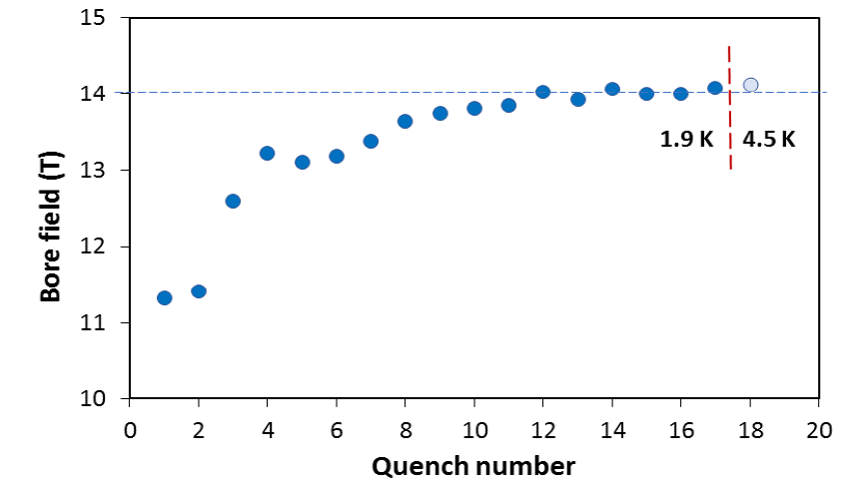
14 T magnet tested at FNAL!
84% on the laodline at 1.9 K
92% on the loadline at 4.2 K
60-mm aperture
4-layer graded coil
15 T dipole demonstrator
Staged approach: In first step pre-stressed for 14 T (as planned for the first stage)
Second test foreseen in fall 2019 with additional pre-stress for 15 T

Slide 24
14 T magnet tested at FNAL!
The difference between a 14 T and a 16 T magnet is very large, in terms of quantity of conductor needed, number of coils, and complexity of the construction. Though, on paper, a 16 T magnet is possible and is costing about twice the cost of a LHC magnet for twice the field. Achieving such a construction on a large series may be extremely difficult. A two layer design with a target field in the range of 12 T to 14 T is considered by the magnet community present during the FCC week as ‘consensus’ for a collider in the next decades
The design work has shown that all the considered options have a potential for FCC. This has motivated the decision of exploring experimentally all options to answer the outstanding questions of which design meets best the requirements, which margin field level (~12-14 T) should be selected
In the last three years, the FCC Conductor Development Program coordinated by CERN has succeeded in engaging the Japanese (Jastec and Furukawa via the KEK coordination), the Russian (TVEL) and the Korean (KAT) companies in developing for the first time very high-performance Nb₃Sn wire. Critical current densities of up to about 1250 A/mm² at 16 T have been achieved, and kilometers length of wire have been produced in industry and delivered to CERN for first cabling trials
In the US, the FCC current density target (1500 A/mm² at 16 T) has been achieved! Industrialization and cost reduction has yet to come

Slide 25
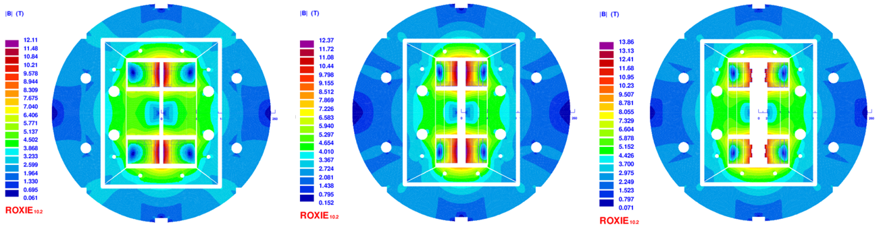
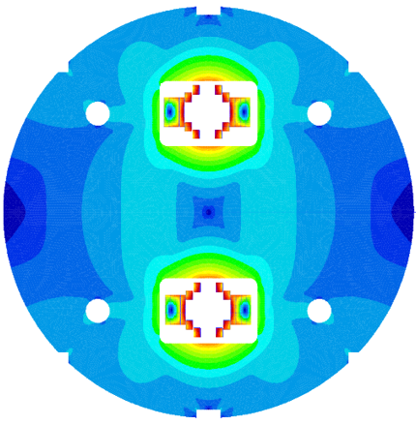
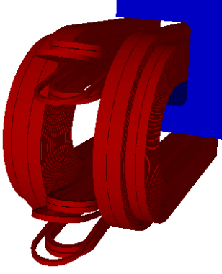
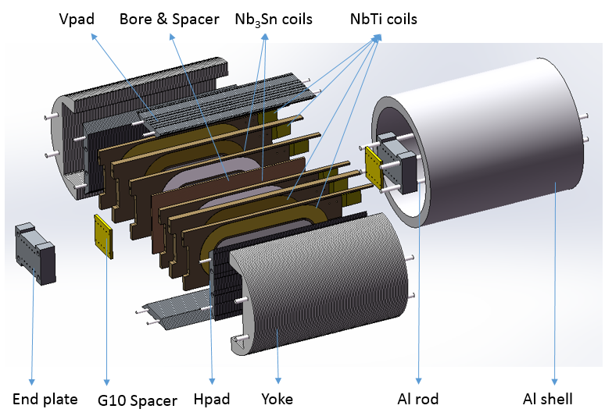
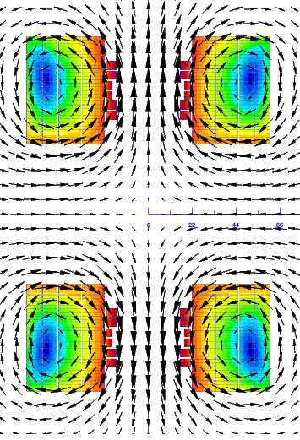
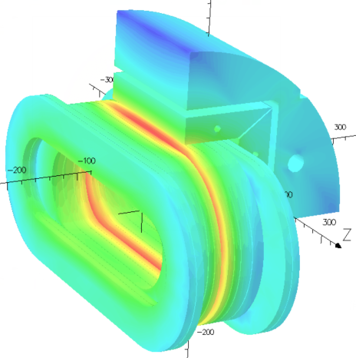
R&D of 12T Twin-aperture Dipole Magnet
R&D Roadmap for the next 10~15 years
NbTi+Nb₃Sn, 2*ф10 aperture
Nb₃Sn+HTS, 2*ф20 aperture
All HTS, 2*ф40 aperture
Magnetic flux distribution
3d coil layout
3D magnetic field distribution
Components and assembly

Slide 26
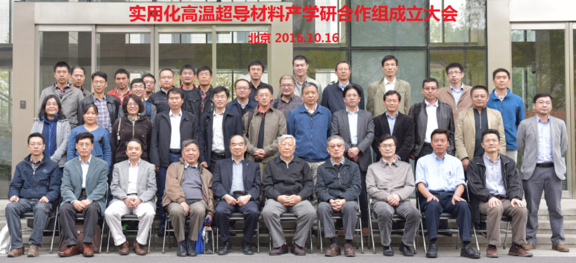
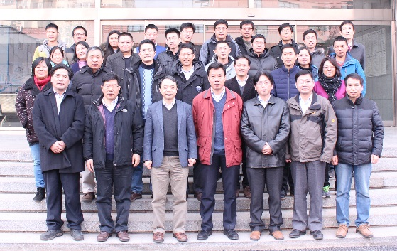






Domestic Collaboration for HTS R&D
Qingjin XU
“Applied High Temperature Superconductor Collaboration (AHTSC)” formed in Oct. 2016.
Including 18 institutions and companies in China. Regular meeting every 3 months.
Goal：
1) To increase the J_{c} of iron-based superconductor (IBS) by 10 times, reduce the cost to 20 Rmb/kAm @ 12T & 4.2K, and realize the industrialization of the conductor;
2) To reduce the cost of ReBCO and Bi-2212 conductors to 20 Rmb/kAm @ 12T & 4.2K;
3) Realization and Industrialization of IBS magnets and SRF cavities.
Working groups：1) Fundamental sciences study; 2) IBS conductor R&D; 3) ReBCO conductor R&D; 4) Bi-2212 conductor R&D; 5) Performance evaluation; 6) Magnet and SRF technology.

Slide 27


HTS in Europe
C. Senatore, FCC week

Slide 28













Beam vacuum systems:
HTS coated conductors for FCC-hh beam screen impedance reduction
3 x improvement at 8 GHz compared to copper, expected 20 x improvement at 1 GHz (f^{3/2})
All experiments on samples, supported by theoretical modelling, indicate that the Coated Conductors solution attains FCC-hh performance goals (impedance reduction in high magnetic field) and accelerator compatibility (e-cloud, SR radiation tolerance…)
Ready to undertake scaling-up to
real-scale proof-of-concept device
REBCO coated conductors are layered structures on a flexible metallic substrate
Soldering of REBCO tapes on the vacuum chamber
Dielectric Resonator
Synchrotron irradiation @ ALBA: no Tc degradation, neither permanent nor transient under photon flux

Slide 29
Energy Recovery Linacs
ERL: technology for possible applications in HEP, low energy and industrial areas
- Joint 802 MHz cavity development [LHeC+FCC]
- Very preliminary ideas on FCC-ee design with ERL technique: [extension to higher energy, less SR power, higher lumi > WW]
Llatas, Litvinenko, Roser FCC Brussels
LHeC: 1 TeV ep collider with 10³⁴ luminosity: P/10! Dump at injection.
Possible injector to FCC-ee in recirculating mode [O.Bruening]
Existing test facilities
PERLE BINP, CERN, Daresbury, Liverpool, Jlab, Orsay+. Could be 6 GeV injector to FCC-ee →
ERLs in: Berlin, BINP, Cornell, Daresbury, Darmstadt, Jlab, KEK, Mainz..
High current and E ~ 1GeV: low energy physics [1000 x L(ELI)!, lithography, photofission
From M.Klein,

Slide 30
Technical Challenges in Energy-Frontier Colliders proposed
 |  | Ref. | E (CM) [TeV] | Luminosity [1E34] | AC- Power [MW] | Cost-estimate Value* [Billion] | B [T] | E: [MV/m] (GHz) | Major Challenges in Technology
 | FCC-NbTi | (to be filled) | ~ 100 | < 30 |  |  | ~ 6 |  | ...Find the people who want to do it
CC hh | FCC-hh | CDR | ~ 100 | < 30 | 580 | 24 or +17 (aft. ee) [BCHF] | ~ 16 |  | High-field SC magnet (SCM) - Nb3Sn: Jc and Mechanical stress Energy management
 | SPPC | (to be filled) | 75 – 120 | TBD | TBD | TBD | 12 - 24 |  | High-field SCM - IBS: Jcc and mech. stress Energy management
CC ee | FCC-ee | CDR | 0.18 - 0.37 | 460 – 31 | 260 – 350 | 10.5 +1.1 [BCHF] |  | 10 – 20 (0.4 - 0.8) | High-Q SRF cavity at < GHz, Nb Thin-film Coating Synchrotron Radiation constraint Energy efficiency (RF efficiency)
 | CEPC | CDR | 0.046 - 0.24 (0.37) | 32~ 5 | 150 – 270 | 5 [B$] |  | 20 – (40) (0.65) | High-Q SRF cavity at < GHz, LG Nb-bulk/Thin-film Synchrotron Radiation constraint High-precision Low-field magnet
LC ee | ILC | TDR update | 0.25 ( -1) | 1.35 (– 4.9) | 129 (– 300) | 4.8- 5.3 (for 0.25 TeV) [BILCU] |  | 31.5 – (45) (1.3) | High-G and high-Q SRF cavity at GHz, Nb-bulk Higher-G for future upgrade Nano-beam stability, e+ source, beam dump
 | CLIC | CDR | 0.38 (- 3) | 1.5 (- 6) | 160 (- 580) | 5.9 (for 0.38 TeV) [BCHF] |  | 72 – 100 (12) | Large-scale production of Acc. Structure Two-beam acceleration in a prototype scale Precise alignment and stabilization. timing
*Cost estimates are commonly for ”Value” (material) only.

Slide 31
Technical Challenges in Energy-Frontier Colliders proposed
 |  | Ref. | E (CM) [TeV] | Luminosity [1E34] | AC- Power [MW] | Cost-estimate Value* [Billion] | B [T] | E: [MV/m] (GHz) | Major Challenges in Technology
 | FCC-NbTi | (to be filled) | ~ 100 | < 30 |  |  | ~ 6 |  | ...Find the people who want to do it
CC hh | FCC-hh | CDR | ~ 100 | < 30 | 580 | 24 or +17 (aft. ee) [BCHF] | ~ 16 |  | High-field SC magnet (SCM) - Nb3Sn: Jc and Mechanical stress Energy management
 | SPPC | (to be filled) | 75 – 120 | TBD | TBD | TBD | 12 - 24 |  | High-field SCM - IBS: Jcc and mech. stress Energy management
CC ee | FCC-ee | CDR | 0.18 - 0.37 | 460 – 31 | 260 – 350 | 10.5 +1.1 [BCHF] |  | 10 – 20 (0.4 - 0.8) | High-Q SRF cavity at < GHz, Nb Thin-film Coating Synchrotron Radiation constraint Energy efficiency (RF efficiency)
 | CEPC | CDR | 0.046 - 0.24 (0.37) | 32~ 5 | 150 – 270 | 5 [B$] |  | 20 – (40) (0.65) | High-Q SRF cavity at < GHz, LG Nb-bulk/Thin-film Synchrotron Radiation constraint High-precision Low-field magnet
LC ee | ILC | TDR update | 0.25 ( -1) | 1.35 (– 4.9) | 129 (– 300) | 4.8- 5.3 (for 0.25 TeV) [BILCU] |  | 31.5 – (45) (1.3) | High-G and high-Q SRF cavity at GHz, Nb-bulk Higher-G for future upgrade Nano-beam stability, e+ source, beam dump
 | CLIC | CDR | 0.38 (- 3) | 1.5 (- 6) | 160 (- 580) | 5.9 (for 0.38 TeV) [BCHF] |  | 72 – 100 (12) | Large-scale production of Acc. Structure Two-beam acceleration in a prototype scale Precise alignment and stabilization. timing
Major Technical Challenges:
Hadron Colliders:
High-field magnet
Energy management
Lepton Colliders:
SRF cavity: High-Q and -G (to prepare for upgrade)
NRF acc. Struct.: large scale, alignment, tolerance, timing
Energy management
*Cost estimates are commonly for ”Value” (material) only.

Slide 32


Advanced technologies
Muon collider
Plasma acceleration
Credit: Frank Tsung, UCLA

Slide 33
Proton-driven Muon Collider Concept
Muon-based technology represents a unique opportunity for the future of high energy physics research: the multi-TeV energy domain exploration.
Short, intense proton bunches to produce hadronic showers
Pions decay into muons that can be captured
Muon are captured, bunched and then cooled
Acceleration to collision energy
Collision
Two schemes for μ production
Proton (like in the figure)
Positrons, still requiring consolidation

Slide 34
Answers to the Key Questions (D. Schulte)
Can muon colliders at this moment be considered for the next project?
  Enormous progress in the proton driven scheme and new ideas emerged on positron one
  But at this moment not mature enough for a CDR, need a careful design study
  done with a coordinate international effort
Is it worthwhile to do muon collider R&D?
  Yes, it promises the potential to go to very high energy
  It may be the best option for very high lepton collider energies, beyond 3 TeV
  It has strong synergies with other projects, e.g. magnet and RF development
  Has synergies with other physics experiments
  Should not miss this opportunity?
What needs to be done?
  Muon production and cooling is key => A new test facility is required.
    Seek/exploit synergy with physics exploitation of test facility (e.g. nuSTORM)
  A conceptual design of the collider has to be made
  Many components need R&D, e.g. fast ramping magnets, background in the detector
  Site-dependent studies to understand if existing infrastructure can be used
    limitations of existing tunnels, e.g. radiation issues
    optimum use of existing accelerators, e.g. as proton source
  R&D in a strongly coordinated global effort

Slide 35
Proposed tentative timeline
CDRs
TDRs
Technically limited
DETECTOR
R&D detectors
Prototypes
Large Proto/Slice test
MDI & detector simulations
1
2
3
4
5
6
7
8
9
10
11
12
13
14
15
16
17
Years?
Design
Baseline design
Design optimisation
Project preparation
Approve
Test Facility
Design
Construct
Exploit
Exploit
MACHINE
Technologies
Design / models
Prototypes / t. f. comp.
Prototypes / pre-series
Ready to decide on test facility
Cost scale known
Ready to commit
to collider
Cost know
Ready to construct

Slide 36

Plasma acceleration based colliders
Drive beams
Lasers: ~40 J/pulse
Electrons: 30 J/bunch
Protons: SPS 19kJ/pulse, LHC 300kJ/bunch
Witness beams
Electrons: 10¹⁰ particles @ 1 TeV ~few kJ
Key achievements in last 15 years in plasma based acceleration using lasers, electron and proton drivers
Focus is now on high brightness beams, tunability, reproducibility, reliability, and high average power
The road to colliders passes through applications that need compact accelerators (Early HEP applications, FELs, Thomson scattering sources, medical applications, injection into next generation storage rings … )
Many key challenges remain as detailed in community developed, consensus based roadmaps (ALEGRO, AWAKE, Eupraxia, US roadmap,…)
Strategic investments are needed:
Personnel – advanced accelerators attract large numbers of students and postdocs
Existing facilities (with upgrades) and a few new ones (High average power, high repetition rate operation studies; fully dedicated to addressing the challenges towards a TDR for a plasma based collider)
High performance computing methods and tools

Slide 37

ALEGRO
Current initiatives of coordinated programs:
EuPRAXIA, ALEGRO, AWAKE.
EuPRAXIA
Advanced LinEar collider study GROup, ALEGRO: formed at initiative of the ICFA ANA panel in 2017.
Horizon 2020 EU design study funded in 2015.
Deliverable: Conceptual Design Report by Oct 2019
The EuPRAXIA Strategy for Accelerator Innovation:
The accelerator and application demonstration facility EuPRAXIA is the required intermediate step between proof of principle and production facility.
Mission of the ALEGRO community:
Foster and trigger Advanced Linear Collider related activities for applications of high-energy physics.
Provide a framework to amplify international coordination, broaden the community, involving accelerator labs/institutes
Identify topics requiring intensive R&D and facilities.
Goal:
Long-term design of a e⁺/e⁻/gamma collider with up to 30 TeV: the Advanced Linear International Collider (ALIC)
Construction of dedicated Advanced and Novel Accelerators (ANA) facilities are needed over the next 5 to 10 years in order to reliably deliver high-quality, multi-GeV electron beams from a small number of stages.
  Today: Existing facilities explore different advanced and novel accelerator concepts and are proof-of-principle experiments.

Slide 38

ALEGRO delivered a document detailing the international roadmap and strategy of Advanced Novel Accelerators (ANAs).

Slide 39
Status of Today and Goals for Collider Application
 | Current | Goal
Charge (nC) | 0.1 | 1
Energy (GeV) | 9 | 10
Energy spread (%) | 2 | 0.1
Emittance (um) | >50-100 (PWFA), 0.1 (LFWA) | <10⁻¹
Staging | single, two | multiple
Efficiency (%) | 20 | 40
Rep Rate (Hz) | 1-10 | 10³⁻⁴
Acc. Distance (m)/stage | 1 | 1-5
Positron acceleration | acceleration | emittance preservation
Proton drivers | SSM, acceleration | Emittance control
Plasma cell (p-driver) | 10 m | 100s m
Simulations | days | Improvements by 10⁷
Achieved Individually
and
NOT
simultaneously

Slide 40
Energy Efficiency
Energy efficiency is not an option, it is a must!
Energy efficiency and energy management must be addressed.
Investing in dedicated R&D to improve energy efficiency pays off in terms of savings and societal return through development of technologies which serve the society at large.
District heating, energy storage, magnet design, RF power generation, cryogenics, SRF cavity technology, beam energy recovery are areas where energy efficiency can significantly be improved.
Higher-temperature high-gradient Nb/Cu accelerating cavities and highly-efficient RF power sources developed in the frame of the FCC-ee R&D programme will find numerous other applications; could improve the sustainability and performance for accelerators of nearly all types and sizes around the world.
The resource-saving strategy includes studies to avoid water cooling wherever possible and developing schemes to supply waste heat to nearby consumers. A pilot program at LHC is on-going.
The detailed technical design of the FCChh will also investigate energy recovery opportunities within the accelerator infrastructure, for example, by working with industrial partners on either storing heat for later use or its conversion into mechanical or electrical energy.

Slide 41
Example: He consumption @FCC-hh
Nelium (Neon+ Helium) for cooling down to 40 + He for going to 1.9K
The most power-hungry element @ FCC-hh is the cryogenic refrigeration system needed to cool the 16 T superconducting magnets down to 1.9 K.
With respect to an LHC-class system, which would for an FCC-hh collider consume 290 MW of electrical power, the nelium technology and temperature choices lead to a reduction by 50 MW or 17% in the baseline configuration. Slowly ramping up the field of the magnets and with constant power substantially reduces the power demand, for all main dipoles from 270 MW for a constant-voltage ramp of 20 minutes to 100 MW for a constant-power ramp of 30 minutes.
The external peak power demand during the ramp phase can be reduced further by recovering the energy stored in the superconducting magnets at the end of a cycle (50 MWh for the main dipoles), to buffer it locally, and to reuse it during the subsequent ramp-up. Losses in electricity transmission will be reduced by cooperating with industry to bring medium voltage DC distribution systems to market grade so that they can power the accelerator subsystems.
R&D on High efficiency klystrons to go from 65% to 80% in power conversion efficiency (with LC communities)
SC thin-film coating technology for operating high-gradient RF cavities at higher temperature, lowering the electricity need.
Yearly energy consumption forecast of 4 TWh, compared to 1.4 TWh expected for the HL-LHC.

Slide 42





Figure of merit for proposed lepton colliders
Disclaimers:
This is not the only possible figure of merit
The presented numbers have different levels of confidence/optimism; they are still subject to optimisations
$$∝{\sqrt{s}}^{−4}$$
$$ℒ/{P_{WP}} \left[\frac{{10}^{34}cm^{−2}s^{−1}}{100 MW}\right]$$
(2 IPs)
FCC-ee
MC
ILC
${360}/{\left(nb MWh\right)}$
CLIC
$$∝{\sqrt{s}}^{2}$$
$$\sqrt{s} \left[TeV\right]$$
Numbers for baseline proposals
electricity cost ~200 euro per Higgs boson (F. Zimmerman)

Slide 43



Proposed HEP Projects and Grid Power Consumption
 | ECM [TeV] | L / IP [10³⁴cm⁻²s⁻¹] | P_{Grid} [MW] | power driving effects
FCC-ee (Z) | 0.091 | 230 | 259 | SR Power: 50MW/beam
FCC-ee (t) | 0.365 | 1.5 | 359 | SR power: 50MW/beam
FCC-hh | 100 | 30 | 580 | SR power: 2.4MW/beam @ 50K, cryogenics
ILC | 1 | 4.9 | 300 | beam power: 13.6 MW/beam, cryogenics
CLIC | 3 | 5.9 | 582 | beam power: 14 MW/beam
muon coll. | 6 | 12 | 270 | mu decay, 1.6MW/drive beam, cycling magnets, but scaling advantages, least developed
→ need more R&D towards efficient concepts & technology, and energy management
Notes:
Here is a number of collider proposals. They are all optimized for fantastic luminosity, but they consume enormous amounts of power as well. Unfortunately all have good physics reasons why the consumption is so high to achieve the required luminosity.
Mitigating the large power consumption is a topic that is in my interest for a long time, and this be quite important for a public acceptance of such a project.

Slide 44
Comparisons
‘Traditional-technologies’ colliders
Project | Type | Energy [TeV] | Int. Lumi. [a⁻¹] | Oper. Time [y] | Power [MW] | Cost
ILC | ee | 0.25 | 2 | 11 | 129 (upgr. 150-200) | 4.8-5.3 GILCU + upgrade
 |  | 0.5 | 4 | 10 | 163 (204) | 7.98 GILCU
 |  | 1.0 |  |  | 300 | ?
CLIC | ee | 0.38 | 1 | 8 | 168 | 5.9 GCHF
 |  | 1.5 | 2.5 | 7 | (370) | +5.1 GCHF
 |  | 3 | 5 | 8 | (590) | +7.3 GCHF
CEPC | ee | 0.091+0.16 | 16+2.6 |  | 149 | 5 G$
 |  | 0.24 | 5.6 | 7 | 266
FCC-ee | ee | 0.091+0.16 | 15+10 | 4+1 | 259 | 10.5 GCHF
 |  | 0.24 | 5 | 3 | 282
 |  | 0.365 (+0.35) | 1.5 (+0.2) | 4 (+1) | 340 | +1.1 GCHF
LHeC | ep | 60 / 7000 | 1 | 12 | (+100) | 1.75 GCHF
FCC-hh | pp | 100 | 30 | 25 | 580 (550) | 17 GCHF (+7 GCHF)
FCC-NbTi | pp | 37.5 | 10 | 20 | 240 | 14 GCHF (including tunnel)
HE-LHC | pp | 27 | 20 | 20 |  | 7.2 GCHF
new

Slide 45
Personal (A. Yamamoto) View on Relative Timelines
Timeline | ~ 5 | ~ 10 | ~ 10 |  |  | ~ 15 |  | ~ 20 |  | ~ 25 | ~ 30 | ~ 35
Lepton Colliders
SRF-LC/CC | Proto/pre-series | Construction | Construction |  |  |  |  | Operation |  |  | Upgrade
NRF—LC | Proto/pre-series | Construction | Construction | Construction |  |  |  | Operation |  |  | Upgrade
Hadron Collider (CC)
8~(11)T NbTi /(Nb3Sn) | Proto/pre-series |  | Construction |  |  |  |  | Physics Experiment | Operation |  |  | Upgrade | Upgrade
12~14T Nb₃Sn | Short-model R&D |  |  |  | Proto/Pre-series |  |  |  | Construction | Construction to Physics Experiment | Operation
14~16T Nb₃Sn | Short-model R&D |  |  |  |  |  | Prototype/Pre-series |  |  |  | Construction | Construction
14T Nb₃Sn magnets ready for a collider following
HL-LHC ?
Note: LHC experience: NbTi (10 T) R&D started in 1980’s --> (8.3 T) Production started in late 1990’s, in ~ 15 years

Slide 46
Ursula Bassler @ Granada

Slide 47
Special thanks to
Akira Yamamoto, Frank Zimmerman, Philip Burrows, Vladimir Shiltsev, Mike Seidel, Erk Jensen, Lucio Rossi, Daniel Schulte, Wim Leemans, Edda Gschwendtner, Mike Lamont, Michael Benedikt, Steinar Stapnes, Ursula Bassler, Fredry Bordry, Max Klein, plus many others
and
Lenny Rivkin

Slide 48
Back up slides

Slide 49


Slide 50

e+e- colliders
Ours is a very dynamic field!
(Luminosity upgrades for ILC, CLIC)
Proposed dates from projects
Would expect that technically required time to start construction is O(5-10 years) for prototyping etc.
Project | Start construction | Start Physics (Higgs)
CEPC | 2022 | 2030
ILC | 2024 | 2033
CLIC | 2026 | 2035
FCC-ee | 2029 | 2039 (2044)
LHeC | 2023 | 2031

Slide 51
FCC integrated project technical schedule
1
2
3
4
5
6
7
8
9
10
11
12
13
14
15
16
17
18
15 years operation
34
35
36
37
38
39
40
41
42
43
~ 25 years operation
70
LHC run 3
LS 3
LHC run 4
LS4
LHC run 5
LS5
LHC run 6
Project preparation &
administrative processes
Funding & governance strategy
Permis-sions
Update
Permission,
Funding
Geological investigations, infrastructure detailed design and tendering preparation
Tunnel, site and technical infrastructure construction
FCC-ee dismantling, CE & infrastructure adaptations FCC-hh
FCC-ee accelerator R&D and technical design
FCC-ee accelerator construction, installation, commissioning
FCC-hh accelerator R&D and technical design
FCC-hh accelerator construction, installation, commissioning
Detector R&D and
concept development
FCC-ee detector technical design,
collaborations
FCC-ee detector
construction, installation, commissioning
FCC-hh detector R&D,
technical design
FCC-hh detector
construction, installation, commissioning
Superconducting wire and high-field magnet R&D
SC wire and 16 T magnet R&D, model magnets, prototypes, preseries
16 T dipole magnet
series production
FCC integrated project is fully aligned with HL-LHC exploitation and provides for seamless continuation of HEP in Europe with highest performance EW factory followed by highest energy hadron collider.

Slide 52

ESG request for parameters of a
lower-energy hadron collider
https://indico.cern.ch/event/727555/contributions/3447469/attachments/1867359/3071163/190624_Overview_of_the_FCC_Study_ap.pdf
parameter | FCC-hh |  | FCC-hh-6T | HE-LHC | HL-LHC | LHC
collision energy cms [TeV] | 100 |  | 37.5 | 27 | 14 | 14
dipole field [T] | 16 |  | 6 | 16 | 8.33 | 8.33
beam current [A] | 0.5 |  | 0.6 | 1.1 | 1.1 | 0.58
synchr. rad. power/ring [kW] | 2400 |  | 57 | 101 | 7.3 | 3.6
peak luminosity [10³⁴ cm⁻²s⁻¹] | 5 | 30 | 10 (lev.) | 16 | 5 (lev.) | 1
events/bunch crossing | 170 | 1000 | ~300 | 460 | 132 | 27
stored energy/beam [GJ] | 8.4 |  | 3.75 | 1.4 | 0.7 | 0.36
NbTi technology from LHC, magnet with single-layer coil providing 6 T at 1.9 K:
  Corresponding beam energy 18.75 TeV or 37.5 TeV c.m.
  Significant reduction of synchrotron radiation wrt FCC-hh (factor 50) and corresponding cryogenic system requirements.
Luminosity goal 10 ab⁻¹ over 20 years or 0.5 ab⁻¹ annual luminosity:
  Beam current 0.6 A or 20% higher than for FCC-hh, 1.2E11 ppb (FCC-hh: 1.0 ppb).
  Stored beam energy 3.75 GJ vs 8.4 GJ for FCC-hh.
Analysis of physics potential, technology requirements and cost ongoing.

Slide 53

Proposed Schedules and Evolution

