Slide 1
Introduction
John Gordon, STFC
GDB meeting @Amsterdam March 24th 2010

Slide 2
Since the Previous Meeting
LHC OPN, London, 8-9 March
ISGC, Taipei, 7-12 March
OGF28, München, 14-19 March

Slide 3

GDB meetings in 2010
Second Wednesday of each month
Rooms booked for first six months
March 24, Amsterdam
  LHCb T1 Jamboree 22-23,
  MB Face to face on 23rd.
  See EGI.eu Headquarters ??
Pre-GDB rooms booked, May, June, July, August, October
Other offers to host a meeting?
January 13
February 10
March 24
May 12
June 9
July 14
August 11
September 8
October 13
November 10
December 8

Slide 4
Pre-GDB meetings
    None currently planned
    Tier1 (or all site) Best Practices
    Storage
    More ideas please.

Slide 5
Forthcoming Events
EGEE User Forum, Uppsala, 12-16 April,
HEPiX Spring Meeting, Lisboa, 19-23 April
WLCG Workshop, London, 7-9 July
EGI Conference, Amsterdam,13-17 September
CHEP 10, Taipei, 17-22 October
HEPiX Fall Meeting, Cornell, tbd

Slide 6
GDB Issues
MU Pilot Jobs, SCAS, gLExec
CREAM
SL5
  Enough resources for experiments
  Latest software releases SL5 only
Virtualisation
  WG meeting at HEPiX in April
Installed capacity
Security

Slide 7
Main Topics Today
Pilot Jobs – SCAS/glexec.
Operational Security
Middleware
Argus
Technical Forum – Pilot Jobs
OSG News

Slide 8
Installed Capacity
Please look at Sanity Checks run by Nagios on all sites.
  They show possible misconfigurations
Only the site can say whether the real resource data is correct.
Hope to produce monthly reports soon
  Do you want to look bad in them?

Slide 9
EGI
Foundation created
Council of ?? exists
Executive Committee elected chaired by Per Oster, chairman of council
Interviews for EGI.eu posts this month
NGI Operations Transitional Meeting 1-2 March
EGI-Inspire in negotiations with EC
  Unlikely to start in May
  Possibly backdated.

Slide 10
Storage
Access to storage has been repeatedly raised as the top issue by all experiments over a long period.
Time to review?
The Technical Forum plans a thread on support for various protocols
Revisit SRM
Wiki summary
Pre-GDB in May?
WLCG workshop in July.

Slide 11
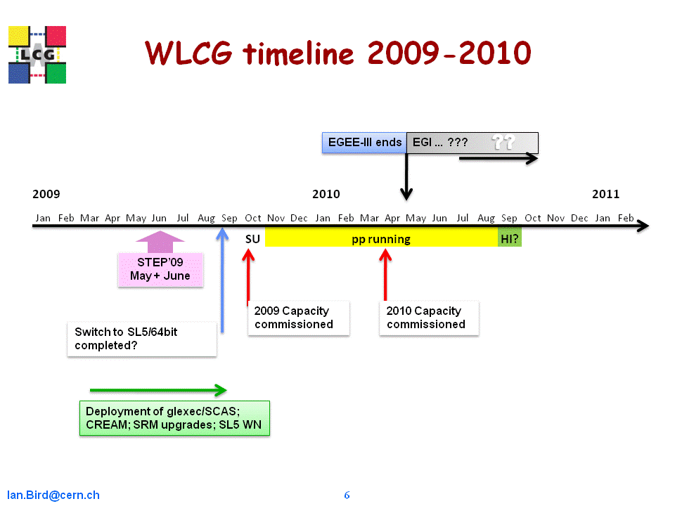
WLCG timeline 2010-2012
EGI
(SA3)
EGEE-III ends
EGI & NGIs
HEP – SSC
EMI
2010 |  |  |  |  |  |  |  |  |  |  |  | 2011 |  |  |  |  |  |  |  |  |  |  |  | 2012
Jan | Feb | Mar | Apr | May | Jun | Jul | Aug | Sep | Oct | Nov | Dec | Jan | Feb | Mar | Apr | May | Jun | Jul | Aug | Sep | Oct | Nov | Dec | Jan | Feb
 | SU | pp running |  |  |  |  |  |  |  | HI |  |  | SU | pp running |  |  |  |  |  |  |  | HI
⬧
2010 Capacity commissioned
2011 Capacity commissioned

Slide 12
Resource Requests
Agree preliminary requirements for 2011,12 at LHCC review in February
At MB yesterday experiments presented revised requirements for 2010-2012 based on revised models and running schedule.
Will be presented to RRB in April.

