Slide 1
CROHEP meeting
Vuko Brigljević
Institute Ruđer Bošković, Zagreb
Mirko Planinić
University of Zagreb – PMF
Ivica Puljak
University of Split - FESB
Institute Ruđer Bošković, Zagreb
9 December 2019

Slide 2
Goal of the meeting
Inform the community about the CERN membership
Exchange information about
Activities of research groups
We wanted to cover all the activities, but not all colleagues were available
There is still some space in agenda
Ongoing and future projects
Other initiatives
Meet colleagues
Discuss and conclude
Very good news: language = English
39 registered participants, 105 invited

Slide 3
Agenda
9⁰⁰ – 10³⁰ Introduction session
CERN, IPPOG, group activities
10³⁰ – 11⁰⁰ Coffee break
10⁰⁰ – 12³⁰ Morning session
Group activities
12³⁰ – 14⁰⁰ Lunch
Catering
14⁰⁰ – 15³⁰ Afternoon session
Group activities
15³⁰ – 16⁰⁰ Coffee break
16⁰⁰ – 17⁰⁰ Discussion and conclusions

Slide 4
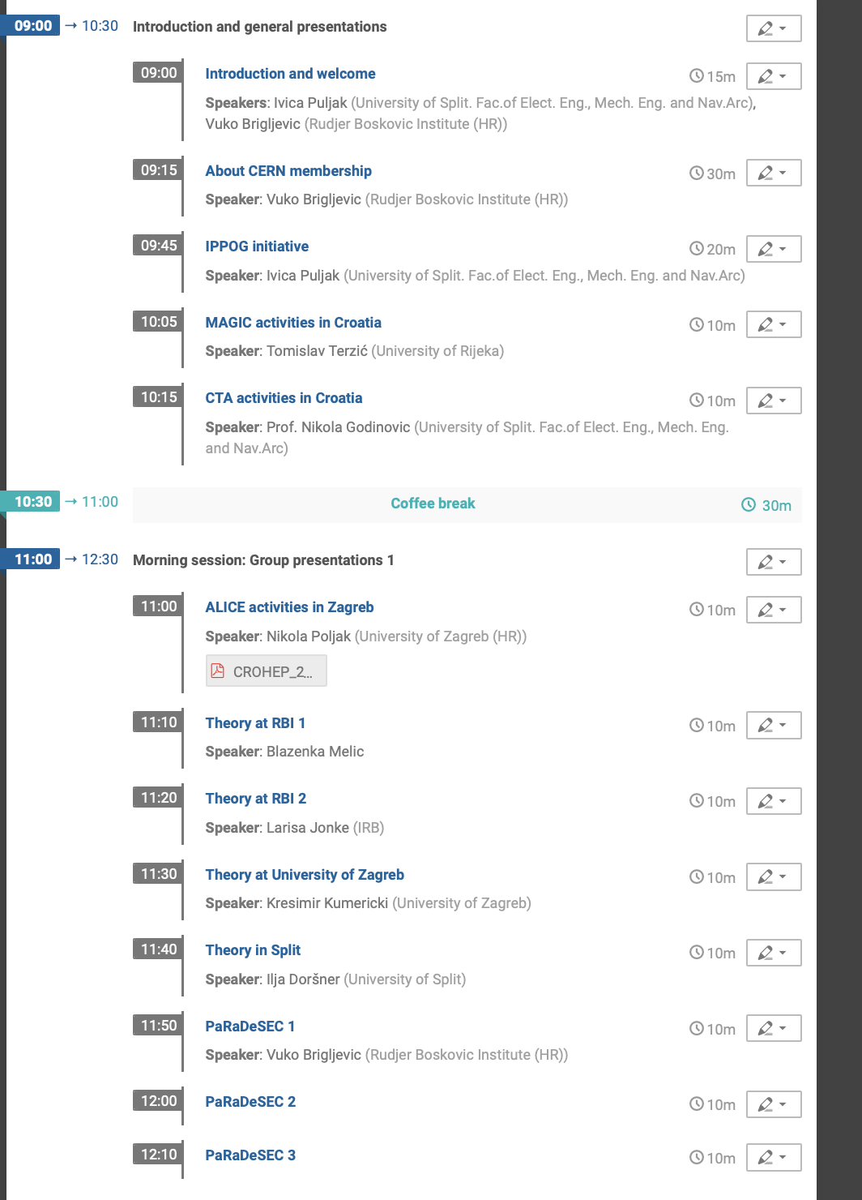
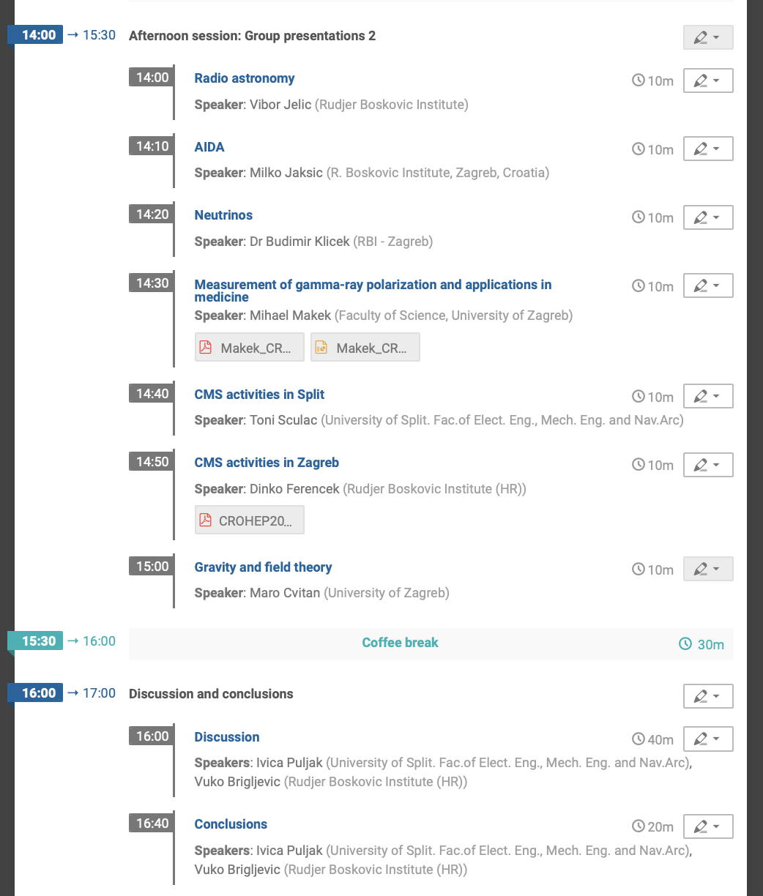
Agenda

Slide 5

A big thank to
Sponsor of travels, coffee breaks and lunch
Thanks a lot!

