Slide 1

RBI accelerator facility;
Ion beam characterization of radiation detectors;
Detectors for HEP & AIDA-2020 project
Unique infrastructure for competitive research !
4 H2020 projects:
PARADESEC
EuroFusion (dual beams)
AIDA-2020 (IBIC technique)
RADIATE
Milko Jakšić, Stjepko Fazinić
Laboratory for Ion Beam Interactions,
Division of experimental physics
Ruđer Bošković Institute, Zagreb, Croatia

Slide 2
Staff, Laboratory for ion beam interactions:
Scientists (5): Milko Jakšić, Stjepko Fazinić, Iva Bogdanović Radović,
Tonči Tadić, Zdravko Siketić
Postdocs (4+1): Iva Božičević, Georgios Provatas, Matea Krmpotić, Mauricio Rodriguez
Professional associates (3): Donny Domagoj Cosic, Milan Vićentijević, Fares Boussahoul
Doctoral students (4+1): Marko Barac, Andreo Crnjac, Marko Brajković, Toni Dunatov
Technicians (4): Željko Periša, Damir Španja, Andro Kovačić, Zvonko Kolar
Former staff:
Marin Vukšić, Natko Skukan, Ivana Zamboni, Ivan Sudić, Veljko Grilj, Željko Pastuović, Mladen Bogovac, Nikola Marković,...

Slide 3






Users:
Beam time (on target):
IAEA/RBI
agreement
New Tandetron
accelerator
SPIRIT
FP7
AIDA
2020
RADIATE
H2020

Slide 4
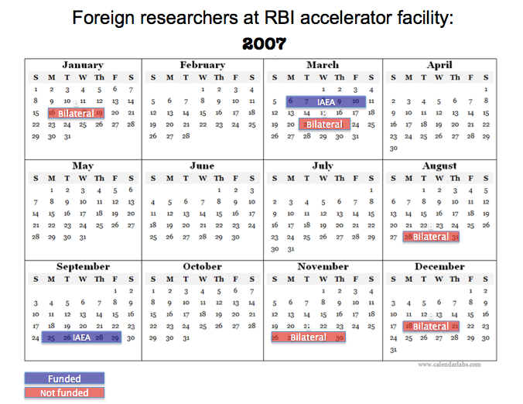
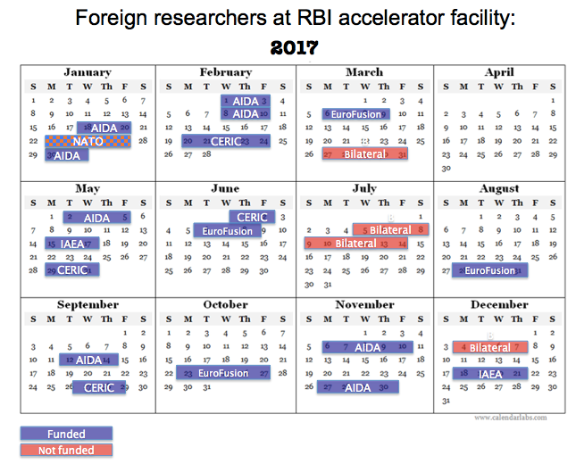
Foreign users of facility:

Slide 5
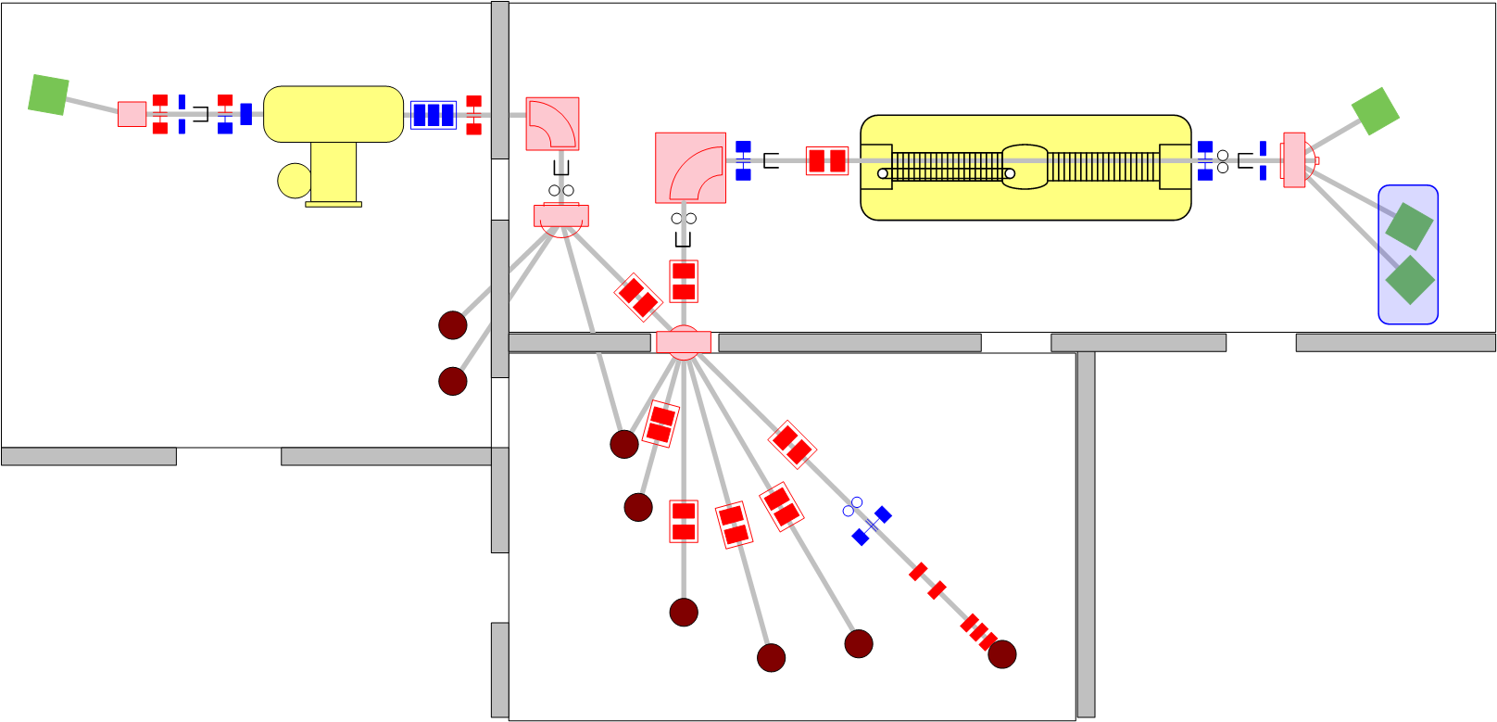
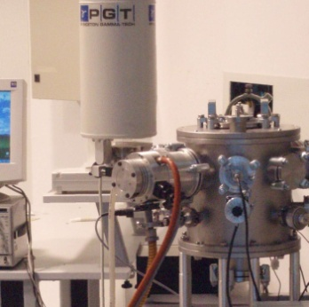
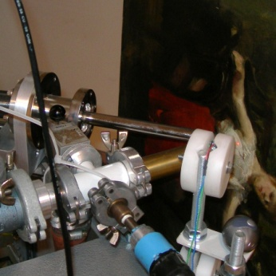
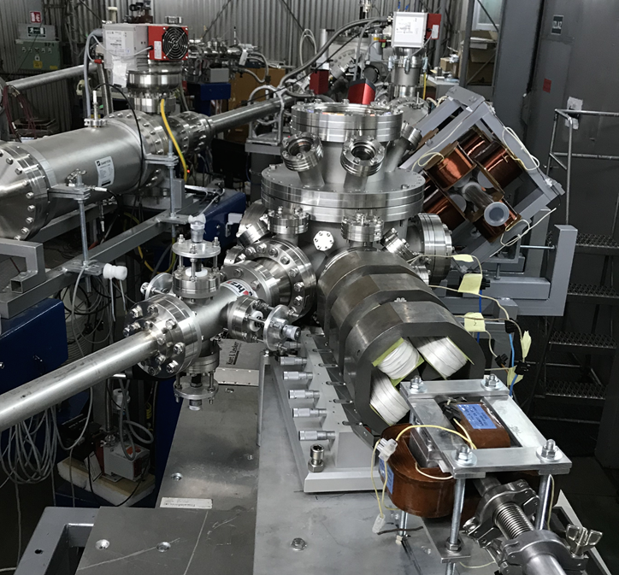
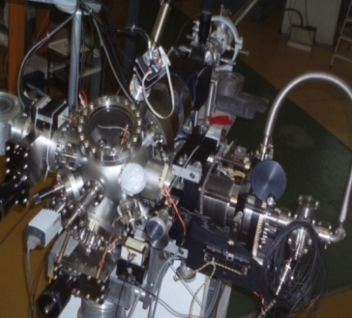
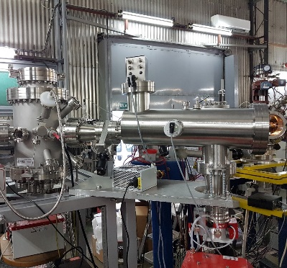
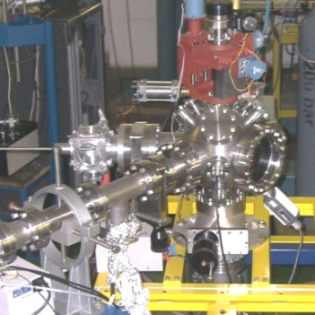
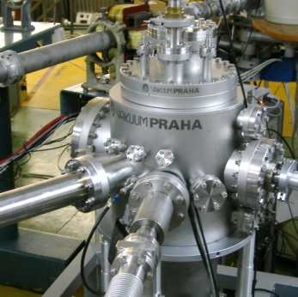
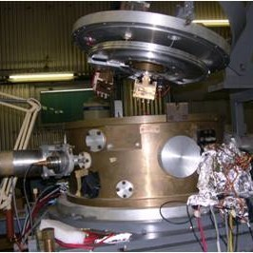
1.0 MV HVE Tandetron accelerator
6.0 MV EN Tandem Van de Graaff accelerator
PIXE/RBS
All LIBI end stations were constructed at RBI !
In-air PIXE
Dual µ-beam
Ion microprobe
Capillary MeV TOF-SIMS
TOF-ERDA
Channeling
Nuclear reactions
Dual beam,DiFu

Slide 6
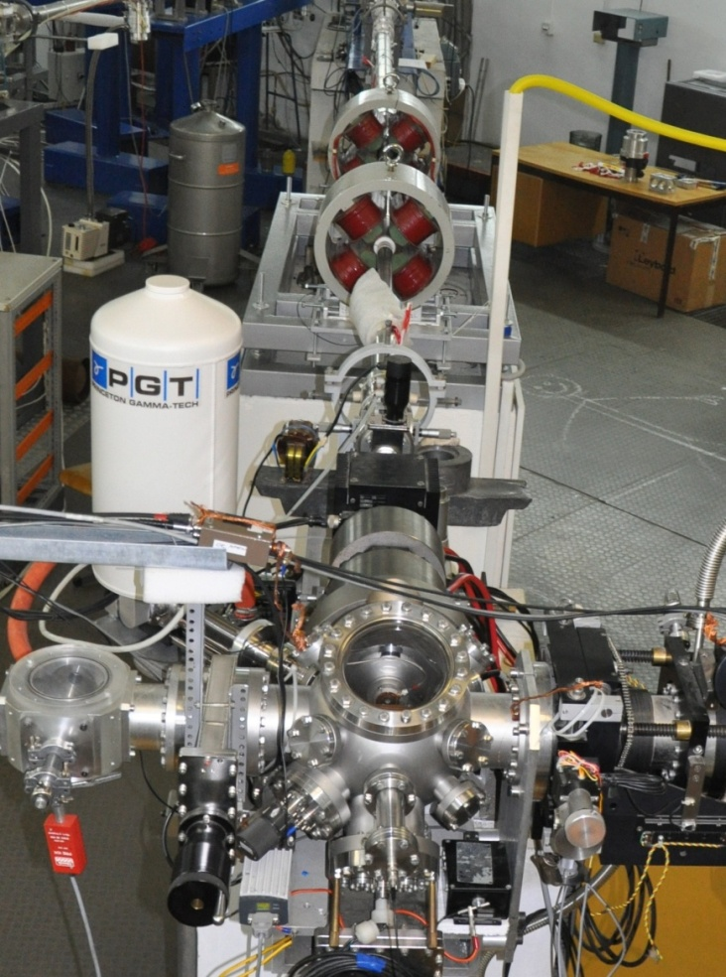
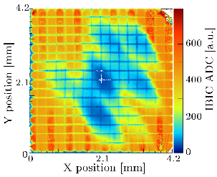
Ion microprobe – ideal radiation source !
❶ IONS
- p, α, Li, C, O,..
❹ ION POSITION
- focusing and scanning
RANGE (E)
- from 1 to 500 μm
ION RATE
- Currents 1 - 10⁹ p/s

Slide 7
Ion microprobe – ideal radiation source !
(for detector testing !)
Semiconductor detectors for HEP; current trends:
Decrease in pixel size
Introduction of monolytic Si detectors (low cost, power)
Extreme radiation hardness (up to 10¹⁷/cm2 of 1 MeV neutrons)
Reduction of SE effects
MeV ion microbeam & IBIC:
Lateral 0.5 μm; longitudinal up to 500 μm
Same ions can induce damage and can be used as a probe
No changes in leakage current es small parts are irradiated
Can work in air
Can localize origin of SE effects

Slide 8
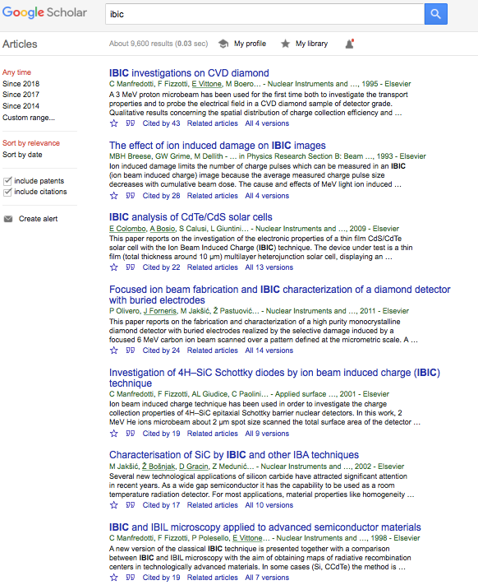
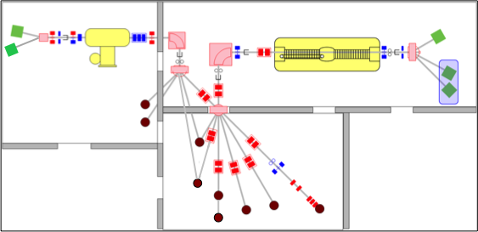
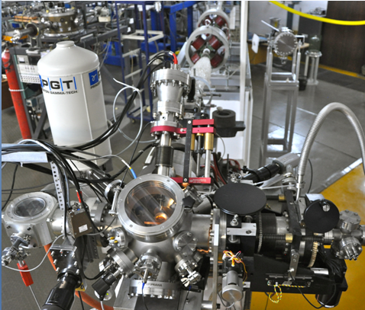
Ion Beam Induced Charge technique techniques: IBIC
IBIC: 8/10 first in Google Scholar done at RBI

Slide 9
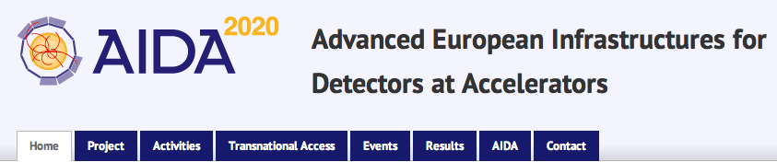
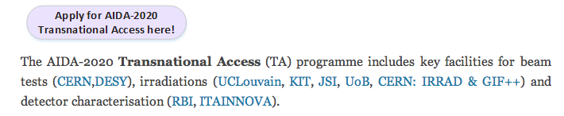
WP12. Detector Characterisation Facilities
WP12.1.: RBI Accelerator facility, PI Stjepko Fazinić

Slide 10
18 AIDA experiments at RBI (2015-2019)
partial list:
  AIDA-2020-RBI-2015-1, Systematic study of radiation damage in scCVD diamond material irradiated with relativistic Au beams, Jerzy Pietraszko, GSI Darmstadt, HADES, Germany (26-30.10.2015.)
  AIDA-2020-RBI-2015-3, Investigation of channeling depth profiles of high energy carbon and silicon ions implanted in diamond and SiC crystals for detector characterization, Michael Kokkoris, National Technical University of Athens, Greece (23-27.11.2015.)
  AIDA-2020-RBI-2015-2, Diamond Membranes for Radioisotope Batteries BATDiαm, Michal Pomorski, CEA, LIST, France (15-19.2.2016.)
  AIDA-2020-RBI-2015-4, 3D diamond, Alexander Oh, University of Manchester, UK (11-15.4.2016.)
  AIDA-2020-RBI-2016-1, IBIC characterization of single crystal diamond based Shottky diodes for microdosimetry application, Claudio Verona, ‘Tor Vergata’ University, Italy (24-28.10.2016).
  AIDA-2020-RBI-2016-2, Microbeam tests of silicon telescope for clynical dosimetry, G. Magrin, Austron, Austria (18-20.1. and 9-10.2.2017.)
  AIDA-2020-RBI-2016-3, Investigation of channeling depth profiles of high energy carbon and silicon ions implanted in SiC /Si crystals for detector characterization, University of Athens, Greece (30.1.-3.2. 2017.)
  AIDA-2020-RBI-2017-1: Diamond Membrane Microdosimeter, M. Pomorski, CEA, France (2-5.5.2017.)
  AIDA-2020-RBI-2017-4: Characterization of a large area CVDdiamond TimeofFlight detector with interdigitated electrodes for energyloss measurements of lowenergy ions in laserinduced plasmas , W. Cayzac, CMLA, ENS Paris, Saclay, France (6-10.11.2017)
  AIDA-2020-RBI-2017-5: Polycrystalline 3D Diamond IBIC and TRIBIC characterisation, A. Oh, Univ Manchester, UK (27.11.-2.12.2017).
  AIDA-2020-RBI-2017-3: Study of channeling depth profiles of high energy silicon ions implanted in diamond and silicon crystals at various fluences for detector characterization, S. Petrovic, Vinča, Serbia (12-16.2.2018).
  AIDA-2020-RBI-2017-2: Analysis of micrometer and millimeter-long graphite pillars buried in sc-CVD diamond , G. Conte, Roma Tre University, Rome, Italy (12-14.9.2017. and 20-21.3.2018)
  AIDA-2020-RBI-2018-1: Single event upsets in CMS pixel ROC, Wolfram Erdmann, PSI Switzerland (2.7.-6.7.2018).
  AIDA-2020-RBI-2019-1: IBIC of monolytic pixel detectors, Rogelio Pinto, University of Sevilla, Spain (19.8.-23.8.2019).

Slide 11
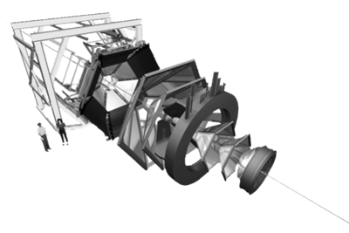
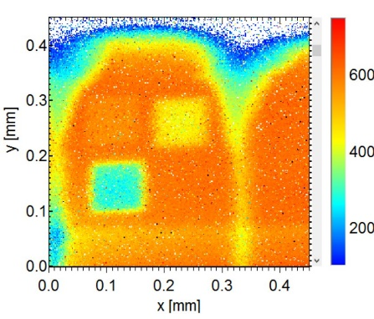
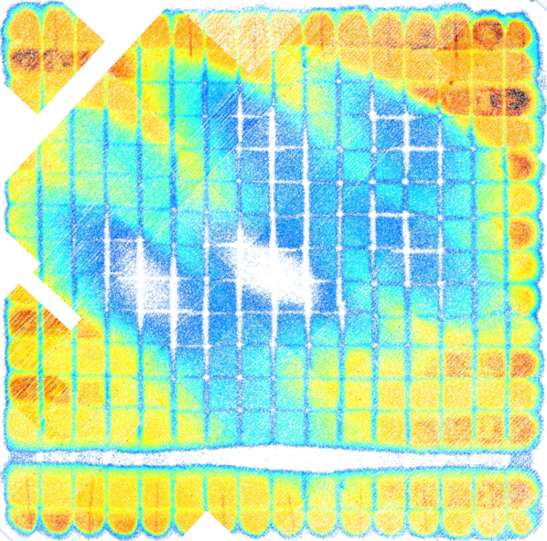
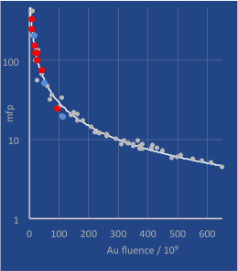
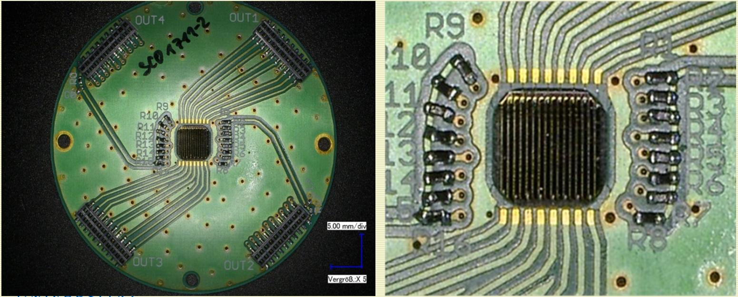
  AIDA-2020-RBI-2015-1
  Systematic study of radiation damage in scCVD diamond material irradiated with relativistic Au beams, Jerzy Pietraszko, GSI Darmstadt, HADES, Germany
HADES High Acceptance DiElectron Spectrometer:
START i VETO detectors are CVD diamond
Running conditions 10⁶ s⁻¹ Au ions of GeV energies
Number of traps:
Au / p_{4.5MeV} / p_{24GeV} = 1 / 30 / 2430

Slide 12
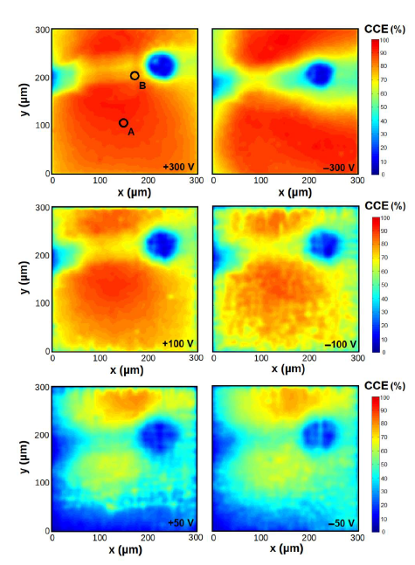
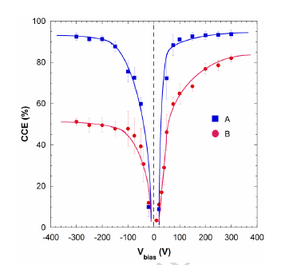
  AIDA-2020-RBI-2015-4 and
  AIDA-2020-RBI-2017-5
  3D diamond, Alexander Oh,
  University of Manchester, UK
  AIDA-2020-RBI-2017-2
  buried graphite pillars in CVD diamond, G. Conte, Roma Tre Univ and INFN, Italy
3D
PLANAR
p⁺
n⁺
p⁺
p⁺
50 μm
300 μm
-
-
-
-
-
-
-
-
-
+
-
+
+
+
+
+
+
+
+
+
Average CCE measured far away
and close (B) to the pillar
  CCE maps for different biases and geometries
IBIC map in case of front-side irradiation
at different bias voltages.

Slide 13
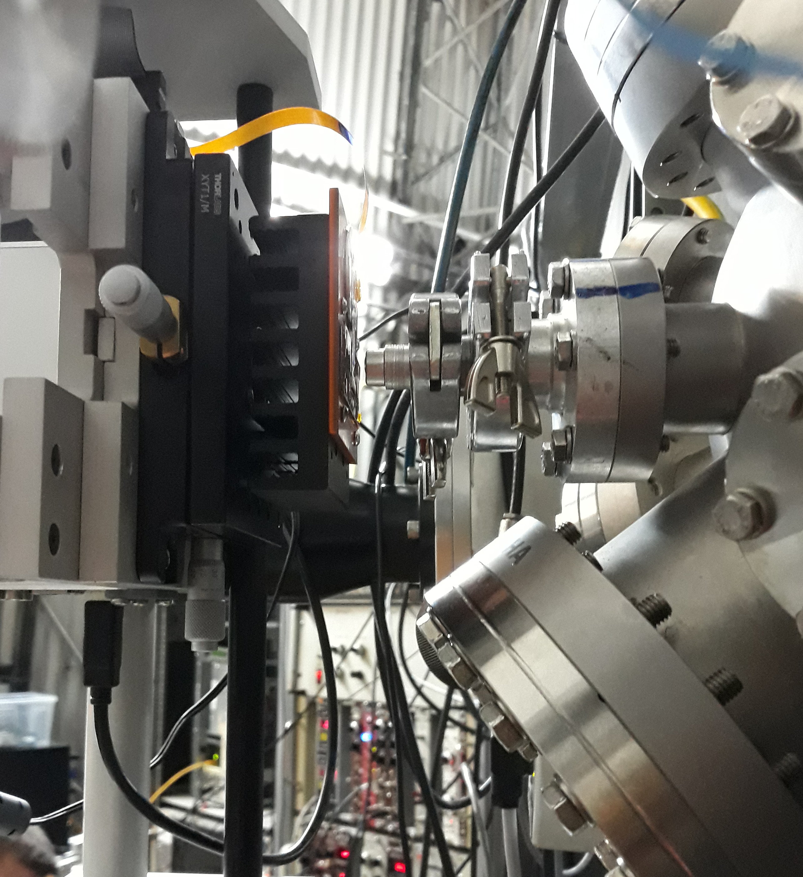
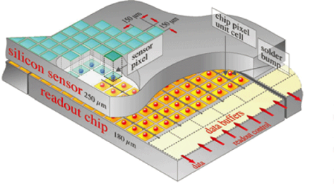
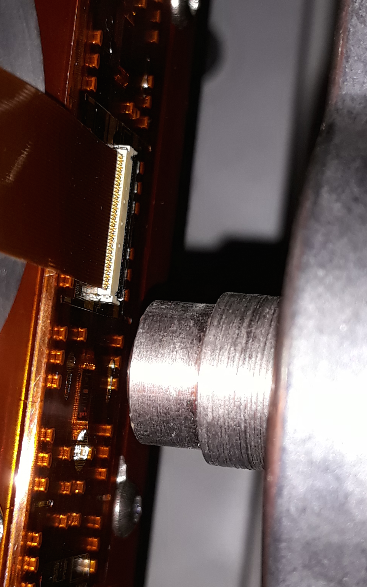
In air IBIC using protons and C ions
(Paradesec + AIDA)
  AIDA-2020-RBI-2018-1
  Single event effects in CMS pixel ROC
  W. Erdemann, PSI, Switzerland
The CMS (Compact Muon Solenoid) inner barrel pixel detector has integrated silicon pixels and readout chip (ROC), where occasional memory soft errors occur.
Total 48 million pixels in CMS
Minimum ionizing particles are supposed to be responsible for SEU in pixel readout chain (tested at PSI)
RBI tests:
New design – reduced SEU rate
Long range
6 MeV protons
(chip alignment)
Short range
heavy ions – 16 MeV C ions
(single event upsets)

Slide 14
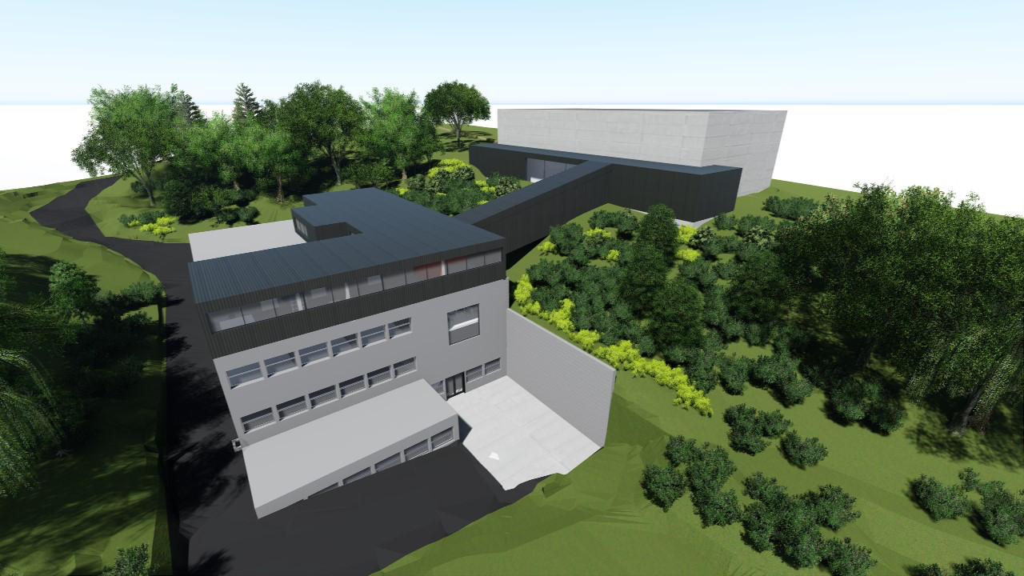
Overview of future upgrades
The O-ZIP project
CDSE (Center for detectors sensors and electronics) laboratories
New accelerator building

Slide 15
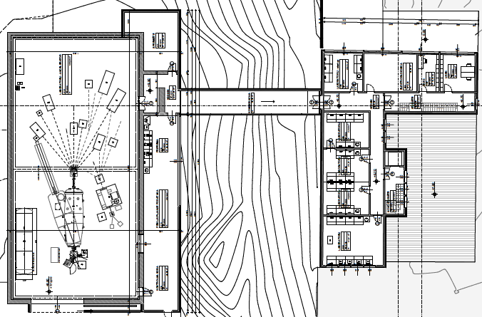
Overview of future upgrades
The O-ZIP project
Start-up lab
Electronic workshop
Device preparation area
Electrical & optical characterisation
X-ray & radioisotope testing
New accelerator building
CDSE/DEP laboratories

