Slide 1
GE2/1 chambers: design, prototypes, production readiness and production schedule
LUIGI BENUSSI
GEM WORKSHOP
September 24, 2019

Slide 2
Overview
GE2/1 Project Status
Updates since EDR
Integration tests with prototypes
Mechanical tests
Electronics Integration
Production overview
Production Readiness and Planning
Risk Management
Summary

Slide 3
GE2/1 Project Overview
GE2/1 station consists of 36 20º chambers
Same technical solution as for GE1/1
Two independent GE2/1 chambers will form on the YE1/1 disk a Super Chamber

Slide 4
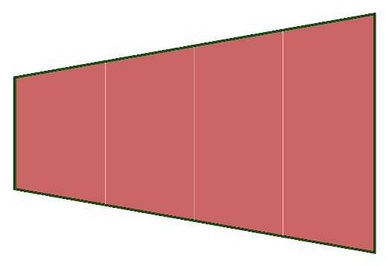
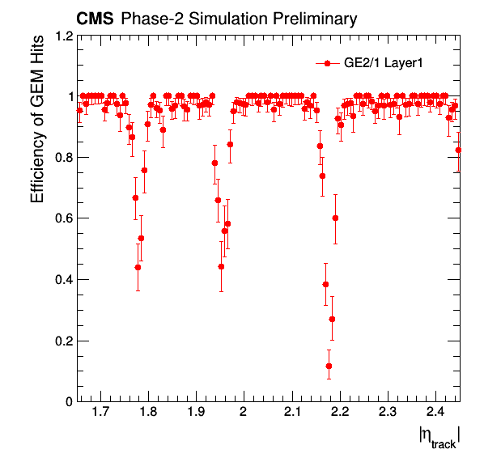
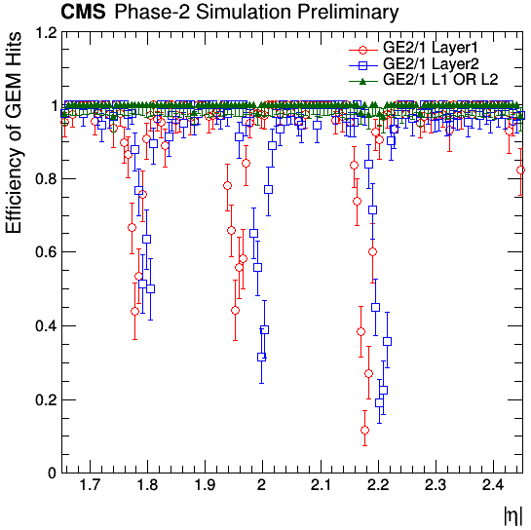
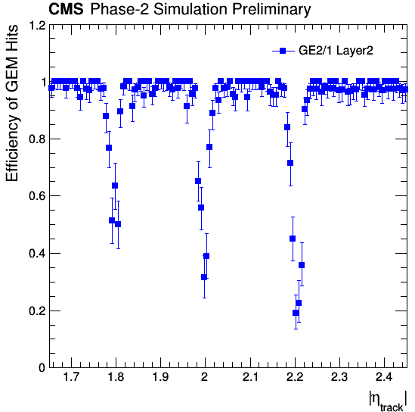
GE2/1 Chambers Layout
Front Chamber
Back Chamber
GE2/1 Superchamber
With a single layer, the average acceptance × efficiency would be reduced to 92% due to gaps.
To achieve maximum coverage, modules in front and back chambers will be staggered.
As a consequence, eight different types of modules will be
designed and produced.
Front Chamber
Back Chamber
M8
M4
longer
M8/M4
M7
M3
35.5 mm
M6
M2
M7/M3
M5
M1
35.5 mm
8 GE2/1 Triple-GEM Modules
M6/M2
35.5 mm
I.P.
M5/M1
shorter
Front Chamber Hit Efficiency
Super Chamber Hit Efficiency (OR)
Back Chamber Hit Efficiency

Slide 5
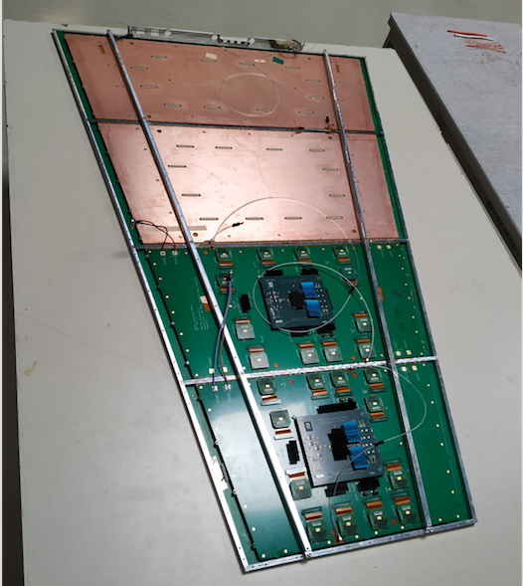
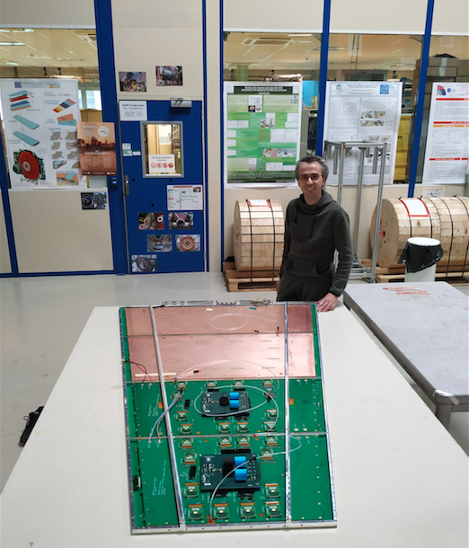
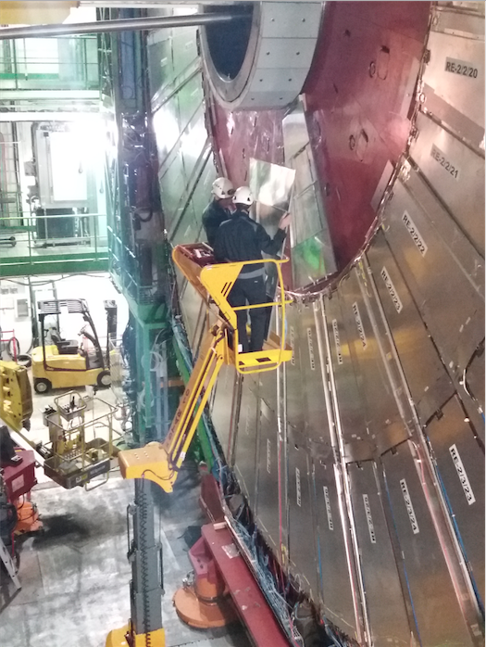
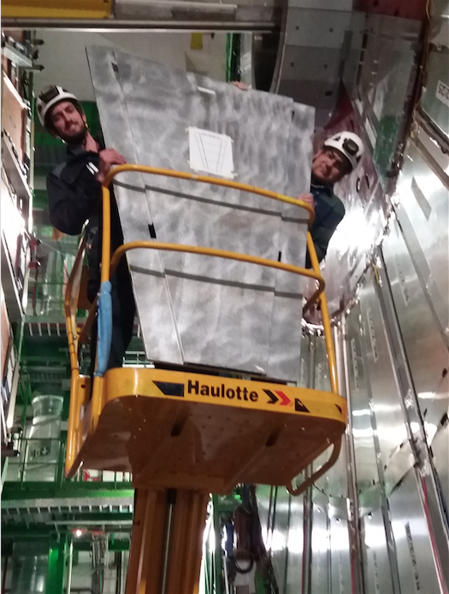
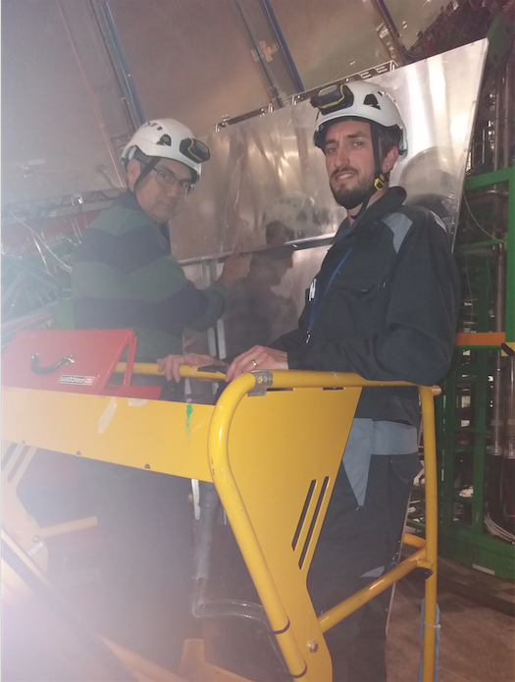
GE2/1 Mechanical test
Two GE2/1 chambers forming a Super Chamber fully assembled, tested and mechanically integrated
Mechanics for chamber installation validated in situ

Slide 6
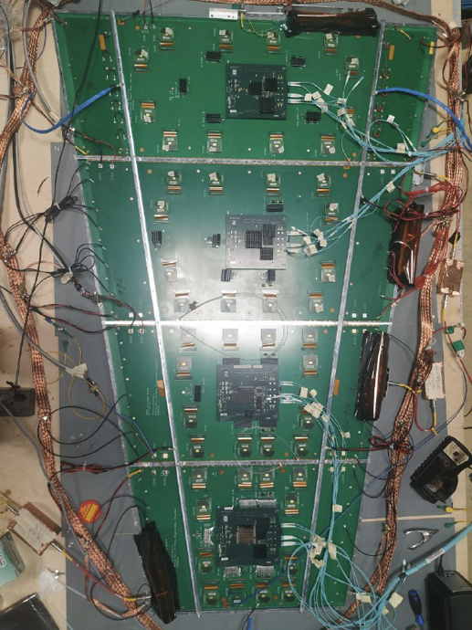
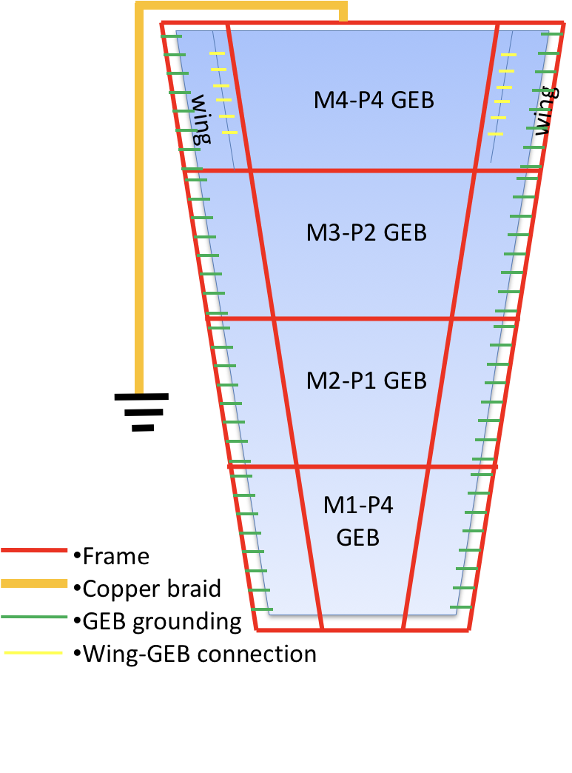
GE2/1 Electronics Integration
GE2/1 M1-M4 prototype modules with all mezzanine components are produced and integrated
Ultimate grounding scheme identified with the noise level under 0.6fC

Slide 7
GE2/1 R&D Steps to Completion
Complete GEB boards M6-M8
Timeline: by the end of 2019
Minor adjustments and optimization of OptoHybrid and select GEB boards to correct small mechanical issues
Validate packaged VFAT3 chips
Optimize VFAT3 chip protection and manufacture PlugIn Cards
PlugIn Cards design is almost ready, await for pinout confirmation from manufacturer
Integrate and test, including proof of principle with ATCA backend
ATCA backend ordered, estimated delivery: Nov. 2019

Slide 8
GE2/1 Production Readiness
Vendors
Central Site at CERN
Production Sites

Slide 9
GE2/1 Production Readiness
Vendors
Central Site at CERN
Production Sites
Components used in GE2/1 are almost identical to GE1/1
Vendors are already identified
Small mechanics and electrical components are produced by international companies (e.g. Bossard)
Minimal risk of failure or production delay
Drift and Readout boards: Micropack
Experience from GE1/1 Production: ~100% yield, in time delivery
Frames: Eltos
Experience from GE1/1 Production: >93% yield, in time delivery

Slide 10
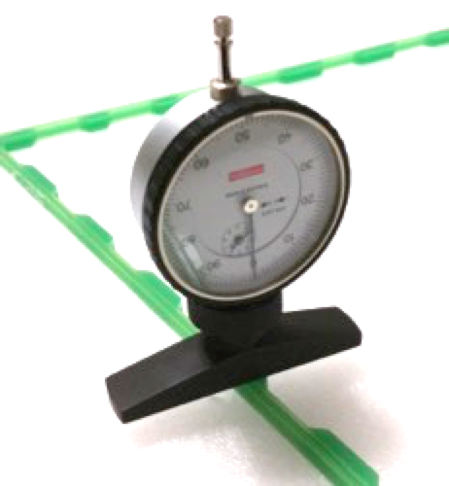
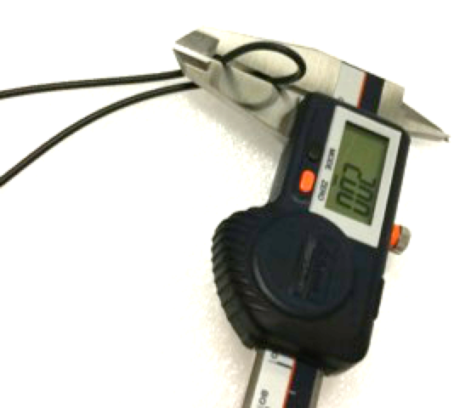
GE2/1 Production Readiness
Vendors
Central Site at CERN
Production Sites
Pre-production activities (central site at CERN)
Reception or materials
Initial inspection and acceptance test (approval/rejection of materials)
Optical inspections
Groove measurement on external frames
PCB bending measurements
RO board connectivity test
GEM QC2 fast and long tests at CERN
Material preparation
Coating of the internal/external frames (+ spacers)
Sorting of the O-rings
GEM foil packing
GE2/1 kit preparation
List of tasks is well defined
Manpower requirements and responsibilities are clear
Work plan is established with the production community

Slide 11
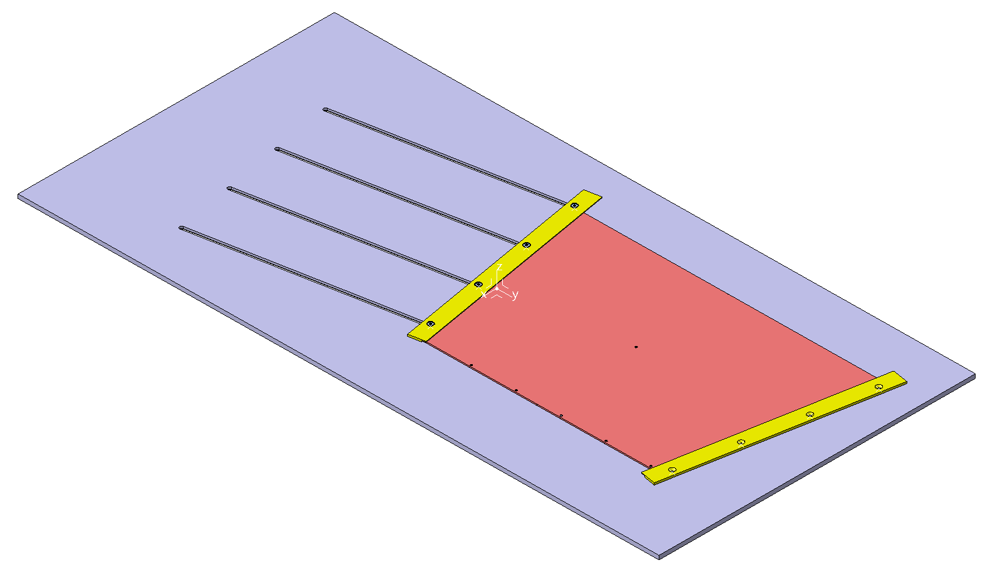
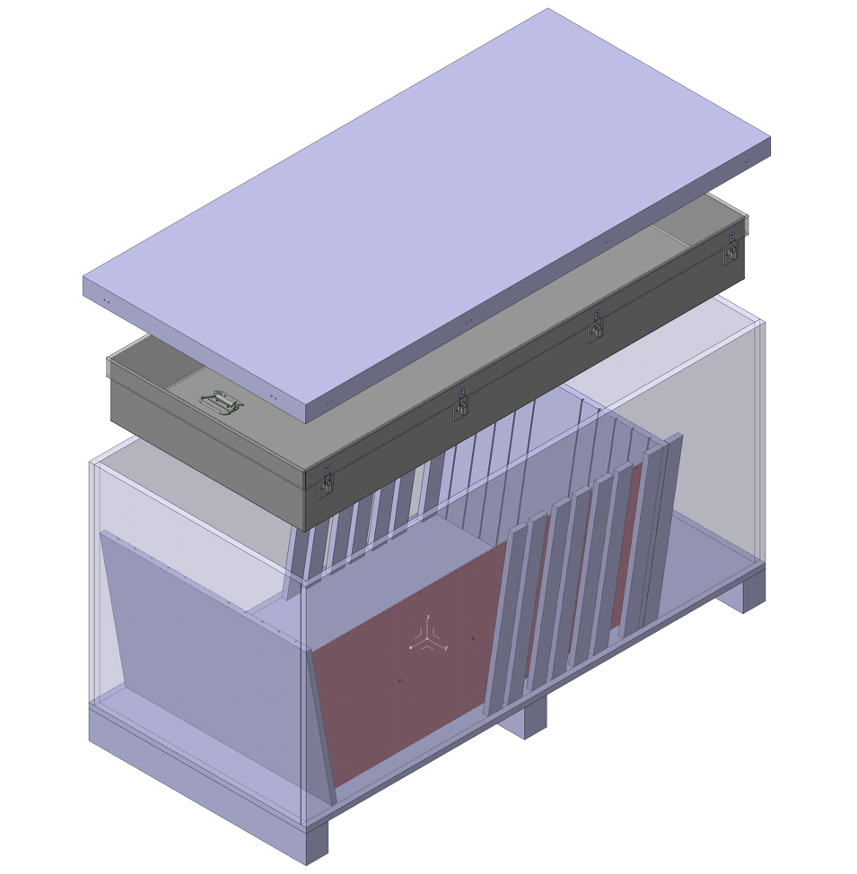
GE2/1 Production Readiness
Vendors
Central Site at CERN
Production Sites
Specific Tooling for GE2/1 Module Assembly
(adaptors and tools to make GE1/1 production sites compatible with the GE2/1 design)
Assembly Jig with Alignment Pins
Protective Plate
Grounding Plate
Fixation Bars
HV Clips for QC2
Adaptor PCB for QC4/QC5
Material Transport
Shipment Boxes
GE2/1 Assembly Jig
List of items is well defined
Design is 80% completed
Work plan is established with the production community
GE2/1 Shipment box

Slide 12
GE2/1 Production Readiness
Vendors
Production Sites
Central Site at CERN
Site | Nb of Production lines | Certified for GEM Production | Infrastructure ready and tested | Team | Comments
Belgium | 1 | YES | YES | 2 Physicists 3 Technicians | Produced 30 GE1/1 detectors
Germany | 1* | YES | YES | 4 Physicists | *QC only (no clean room) Tested 21 GE1/1 det.
Italy | 2 | YES | YES | 8 Physicists 8 Technicians +Students | Produced 26 GE1/1 detectors
India | 2 (+2 under approval) | YES (+2 on-going) | YES (+2 on-going) | 8 Physicists 5 Engineers/Tech + Students | Produced 17 GE1/1 detectors
Pakistan | 1 | YES | YES | 4 Physicists 8 Engineers/Tech | Produced 13 GE1/1 detectors
Sri-Lanka | 1 | YES | YES | 4 Physicists 1 Engineer + Students | Using CERN infrastructure and tooling
China | 1 | On-going | On-going | 3 Physicists 2 Engineer + Students | New site, QC Jamboree in progress
New sites

Slide 13
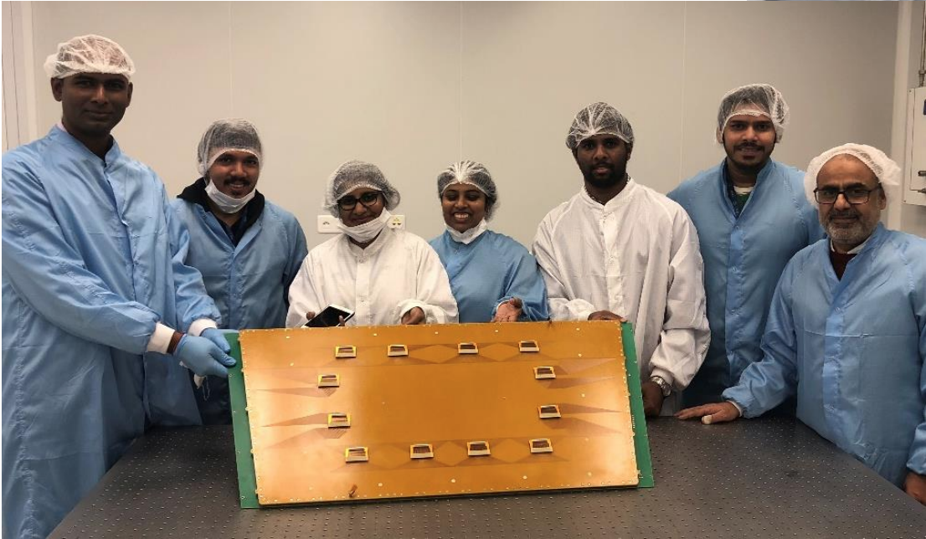
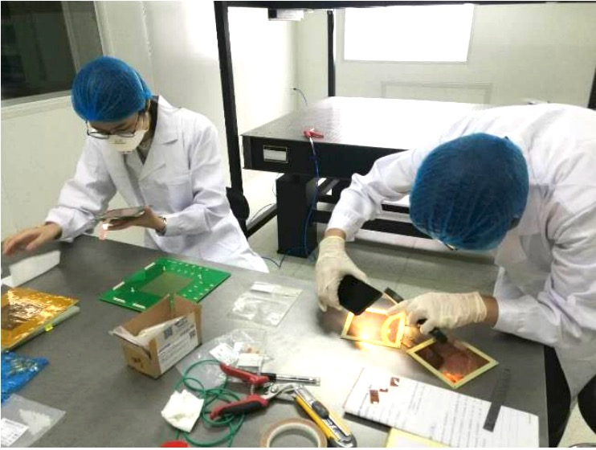
GE2/1 Production Readiness
Vendors
Production Sites
Central Site at CERN
Two New Production Sites for GE2/1
Sri-Lanka (UOC and UOR)
Strong team already involved in the GE1/1 production (test, operation and analysis)
Will use the CERN infrastructure to assemble and test GE2/1 modules
Participated in 6 training sessions
Approved for GE2/1 mass-production
China (PKU)
Strong group already experienced with gaseous detectors and small GEM chambers
Infrastructure 90% ready
1st stage of the QC Jamboree about to be completed (out of three stages)
Participated in CERN training
Full Approval is expected during Fall 2019
Sri-Lanka team at CERN
China PKU

Slide 14
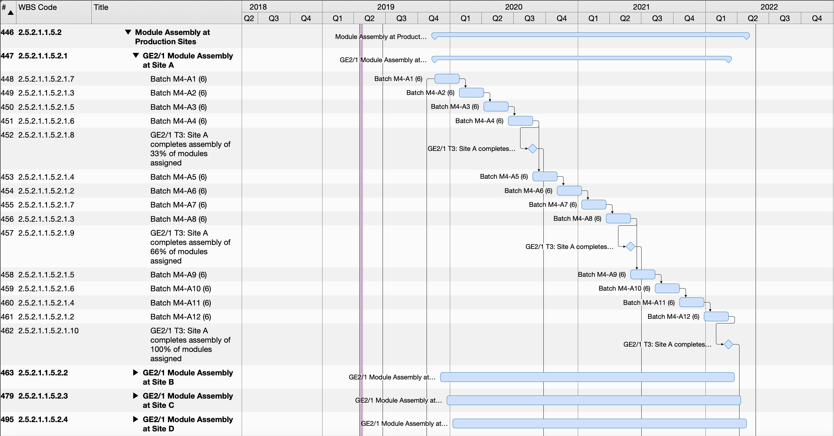
GE2/1 Production Planning
GE2/1 Module Production (TDR dates)
Baseline schedule with 4 production sites, each one assembling two types of modules
Production organized in batches of 6 modules every 10 weeks (including 1 week for shipping)
Start of the production in October 2019, end in April 2022 (662 working days)

Slide 15
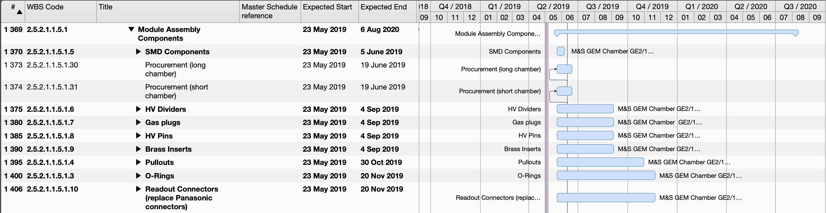
GE2/1 Production Schedules
Small Mechanics and Electrical Components

Slide 16
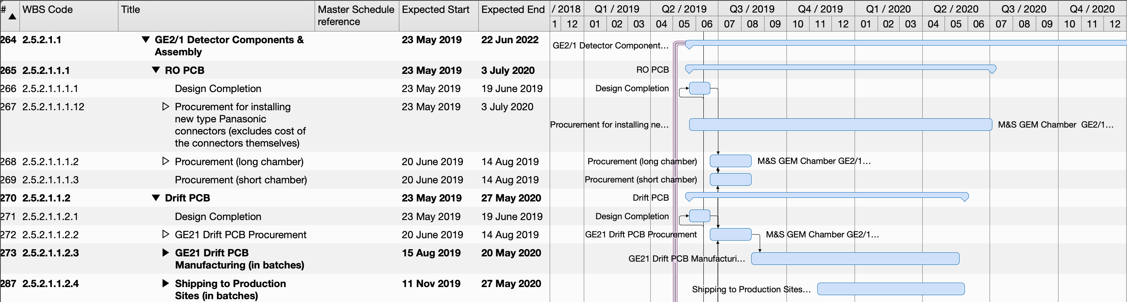
GE2/1 Production Schedules
PCBs: 304 Readout and Drift Boards

Slide 17
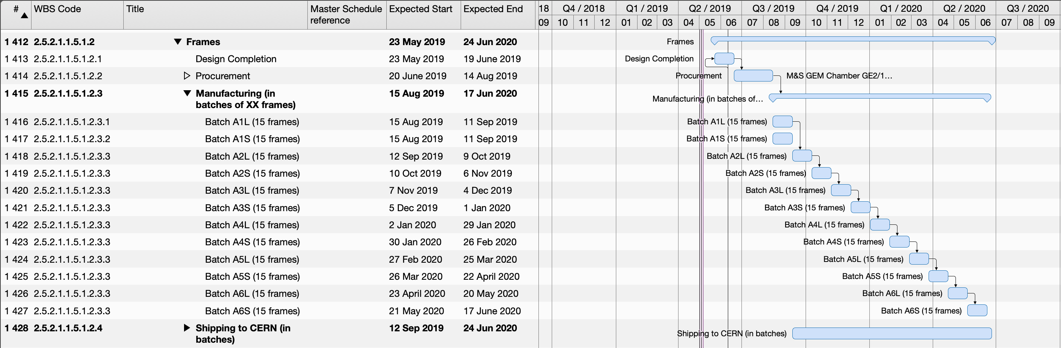
GE2/1 Production Schedules
Frames: 304 External/ 304 internal kits

Slide 18
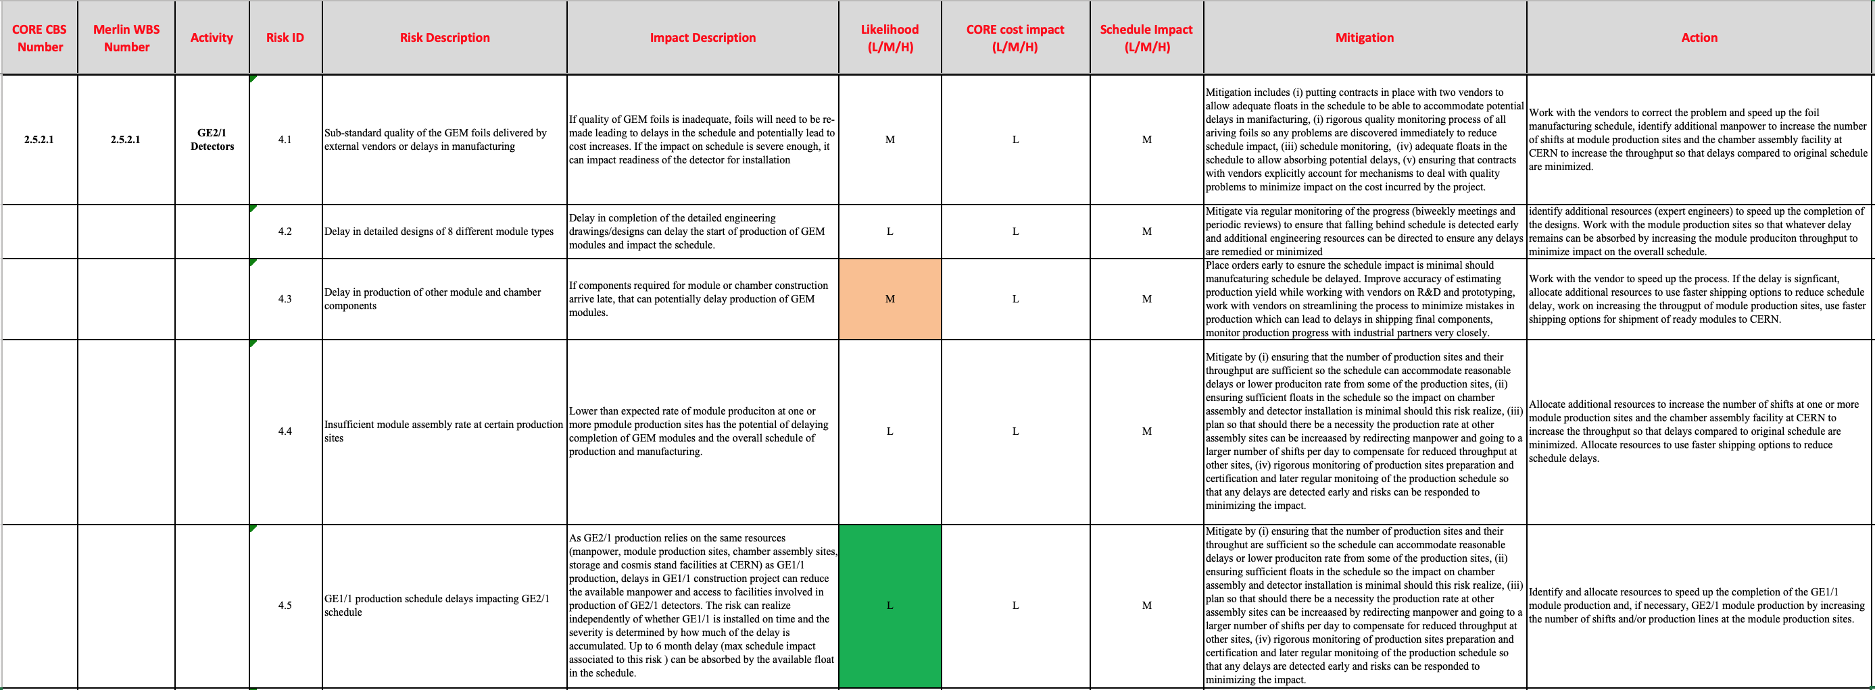
Risk Management
Case I: unavailability of detector components
Late delivery of components
Risk: medium
High rejection rate – components outside specifications
Risk: medium (GEM foils – new vendor)

Slide 19
Risk Management
Case II: failure at production sites
Assembly/test rate slower than expected
Risk: low (based on GE1/1 experience)
One or several sites not ready for mass-production
Risk: low (already 7 sites approved out of 4 needed)
Main risks are related to detector components but the GE1/1 experience gives good confidence and knowledge to anticipate possible delays

Slide 20
Risk Management
Layer 1
Layer 2
Sharing of the module production over 8 production sites
Each production line is assigned one type of GE2/1 modules
38 modules/line
Belgium and Sri-Lanka will produce extra 19 modules, each to be tested in Germany
M1
M5
M2
M6
Similar to GE1/1 size
M3
M7
M4
M8
Country | Nb of Prod. lines | Module types | Nb of Modules | Comments
Italy | 2 | M6 + M8 | 38 (M6) + 38 (M8)
Belgium | 1 | M3 +M1 | 38 (M3) + 19 (M1)
Germany | 1* | M1 | - | *QC only
India | 2 | M2 | 38 (M2)
China | 1 | M5 | 38 | To be approved
Sri-Lanka | 1 | M4 + M1 | 38 (M4) +19 (M1)
Pakistan | 1 | M7 | 38
Demonstrated capability to produce large size GE1/1 at high rate (~3 days per module)
Proximity of CERN experts and large infrastructure capacity

Slide 21
Summary
GE2/1 and RnD and prototyping progressing very fast
Change control performed for GE2/1 optical transceivers
We are back on track with schedule with a minimal delay
Given a new need-by date we have solid floating time
GE2/1 prototype is fully integrated and efficiency studies are ongoing
Production schedule is well established and production process is under control

Slide 22
Backup

Slide 23
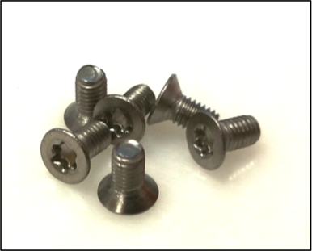
GE2/1 Production Schedules
Vendors
Central Site at CERN
Production Sites
Small Mechanics and Electrical Components

Slide 24
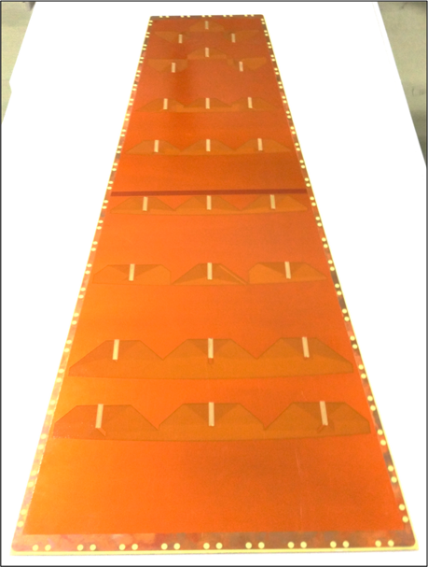
GE2/1 Production Schedules
Vendors
Central Site at CERN
Production Sites
PCBs: 304 Readout and Drift Boards

Slide 25
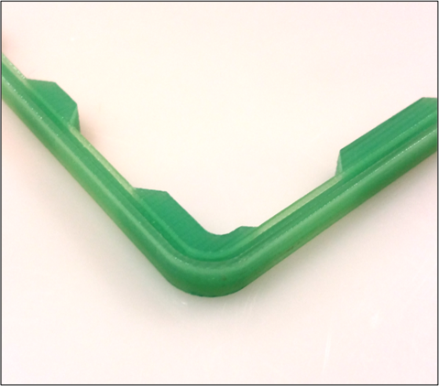
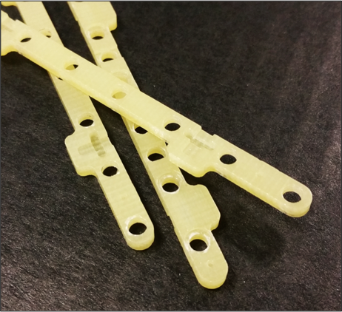
GE2/1 Production Schedules
Vendors
Central Site at CERN
Production Sites
Frames: 304 External/ 304 internal kits

Slide 26
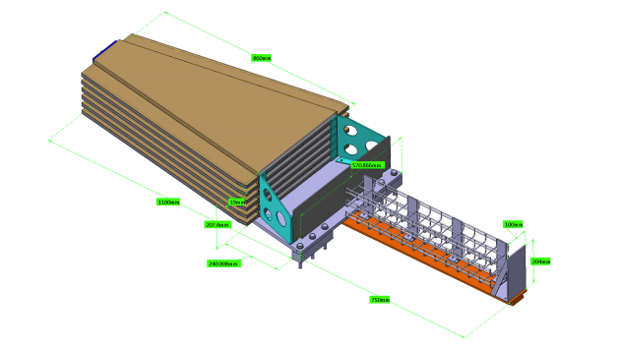
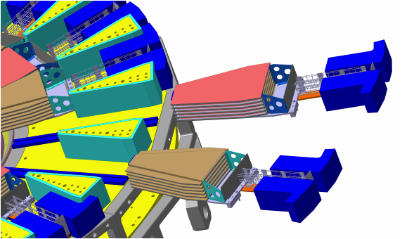
ME0 Design
Mechanical Design
HGCAL Envelope has been frozen
Space for ME0 stack insertion confirmed
HGCAL fixation points to HE back flange not yet finalized
May require special design of two stacks per Endcap at 3 and 9 o’clock
Discussion and studies on-going

Slide 27
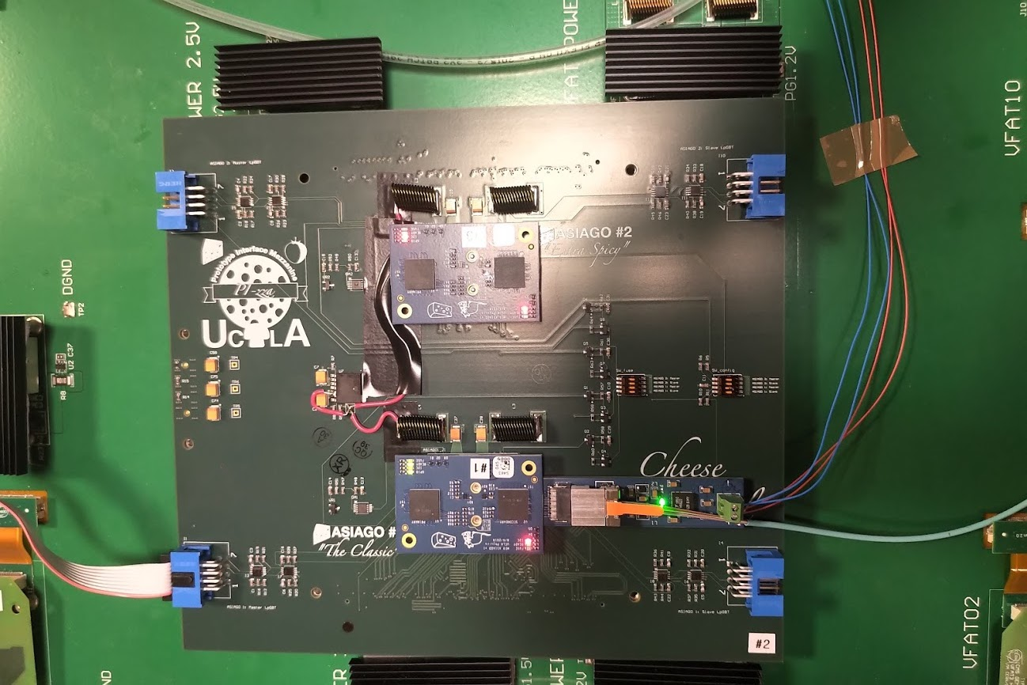
ME0 Design
Electronics Design
FPGA-less on-chamber electronics design is ready
Prototypes produced
ASIAGO (ME0 OptoHybrid board)
PIZZA (Special board to place ASIAGO over GE2/1 GEB)
Adapter for FireFly transceivers until Vlplus aren’t available
Integration started using GE2/1 detector
Communication between LpGBT and VFAT chips is established!

Slide 28
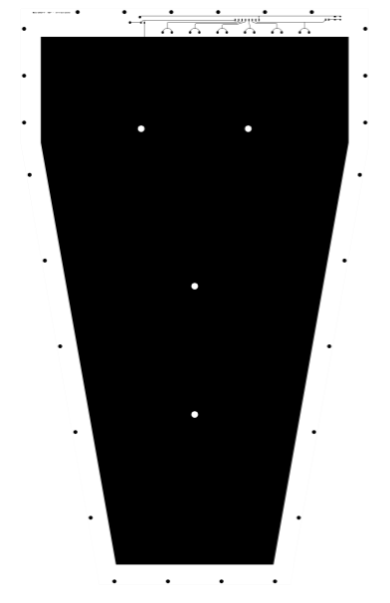
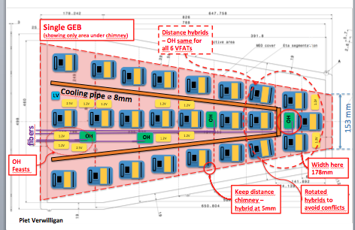
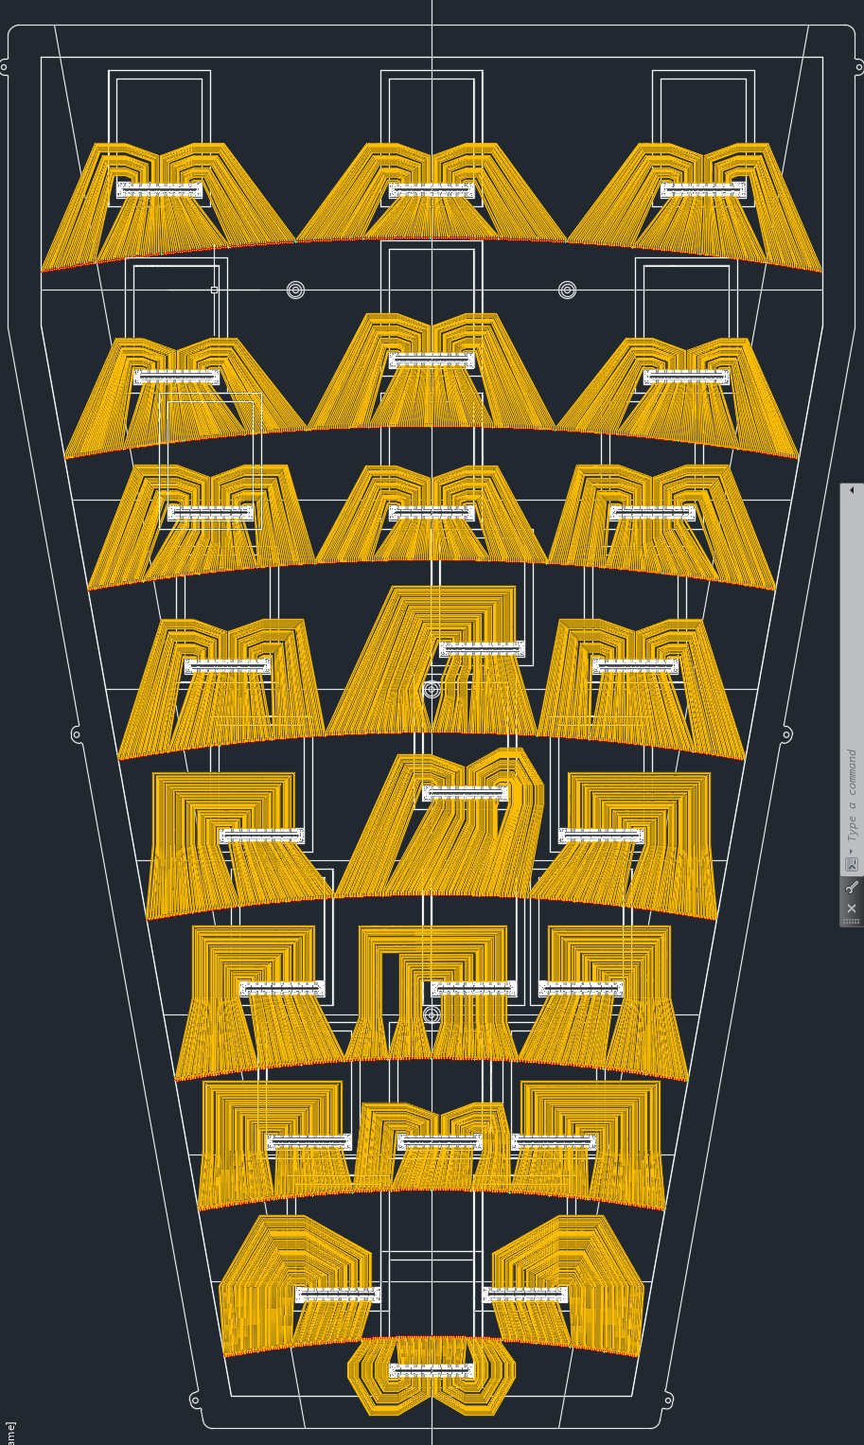
ME0 Detector Prototypes
Reduced space under the chamber cover
Foils with double face segmentation layout choosen
9 prototype modules production launched at CERN

Slide 29
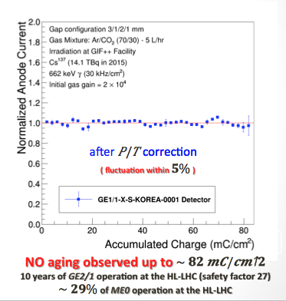
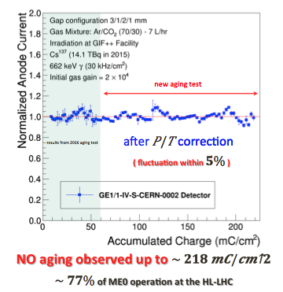
ME0 Aging Studies at GIF++
¹³⁷Cs Source
Chamber CERN GEM Foils
Chamber Korean GEM Foils
Total integrated Charge at GIF++ up to 22nd March: ~ 218 mC/cm²
Total integrated Charge at GIF++ up to 22nd March: ~ 82 mC/cm²

Slide 30
ME0 Milestones from TDR
Achieved
Achieved
Achieved
Achieved
Delayed till 14.01.2020
Up to the start of the construction project
Expect on-time
Expect on-time
Expect on-time
Expect on-time
Expect on-time
Projected on-time
Projected on-time
Projected on-time

Slide 31
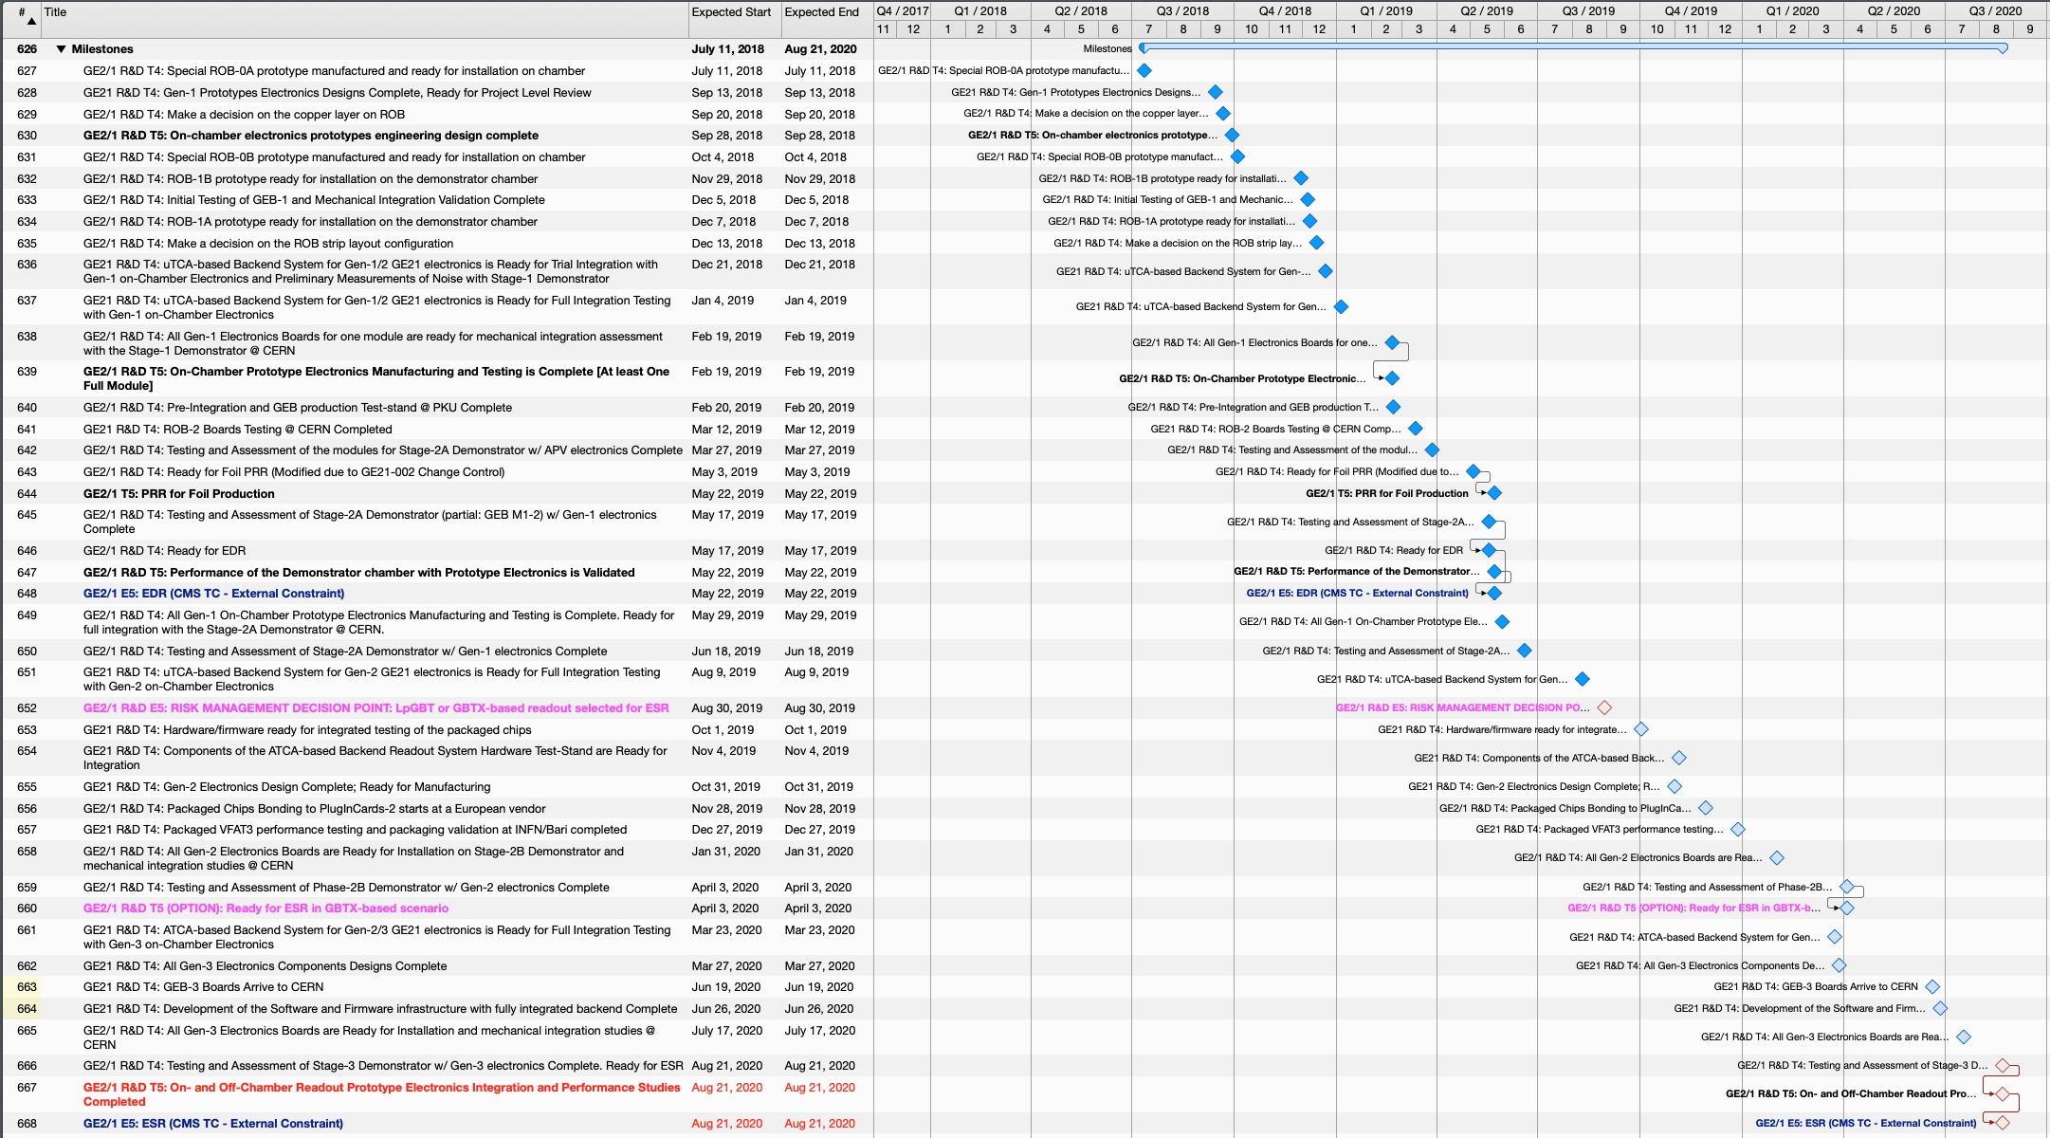
Electronics R&D Schedule
The “waterfall” plot for the updated R&D schedule
Ready for ESR (GBTX): Apr. 3 2020
Ready for ESR (LpGBT): Aug. 21 2020

