Slide 1
Preliminary results of accelerator systems reliability data
A. Apollonio, T. Cartier-Michaud,
Acknowledgements: M. Blumenschein, H. Trabelsi, J. Uythoven

Slide 2
Outlook
On the use of Risk Matrices:
  Definition of a risk matrix
  Understanding of probability
  Life expectancy of a system
  Operation vs Protection
  Already populated boxes
  (arbitrary) definition of bins
  (few) risk matrices examples
Estimation of failure distribution for barely failing components ➔ Uncertainty quantification

Slide 3
Definition of a risk matrix
LHC risk matrix |  | Recovery
 |  | ∞ | year | month | week | day | hours | minutes
 |  | S7 | S6 | S5 | S4 | S3 | S2 | S1
Frequency | 1 / hour
 | 1 / day
 | 1 / week
 | 1 / month
 | 1 / year
 | 1 / 10 years
 | 1 / 100 years
 | 1 / 1000 years

Slide 4
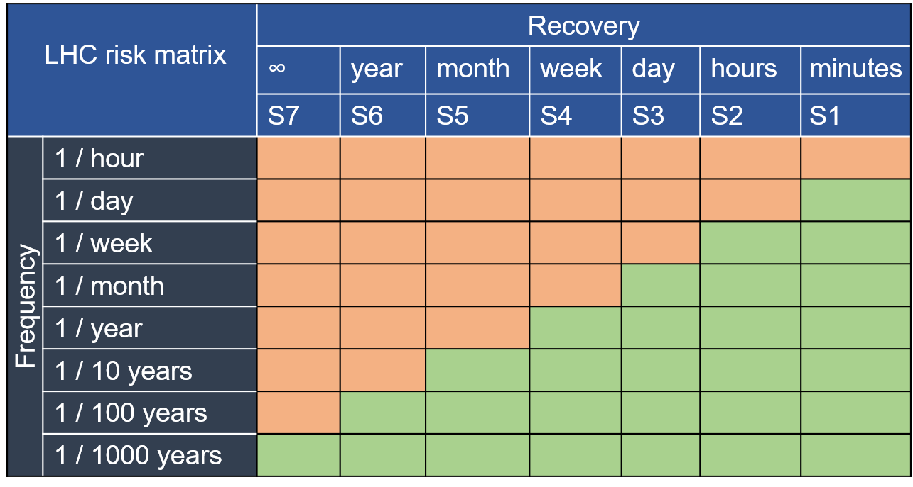
Definition of a risk matrix
Defining acceptable failures rate w.r.t. severity / recovery time:
Respecting this matrix implies
about 17% of “recovery time”
It does not directly translate into availability
Recovery implies turnaround
Type of stop | Total duration [days] | Percentage vs op
Minutes type | 250 days x 1/day x 15 minutes = 2.6 | 2.6/250 ~= 1%
Hours type | 36 weeks x 1/week x 5 hours = 7.5 | 7.5/250 ~= 3%
Day type | 8 months x 1/month x 2 days = 16 | 16/250 ~= 6%
Week type | 1 year x 1/year x 10 days = 10 | 10/250 ~= 4%
Month type | 1 year x 1/ 10 years x 45 days = 4.5 | 4.5/250 ~= 2 %
Year type | 1 years x 1/100 years x 250 days = 2.5 | 2.5/250 ~= 1%

Slide 5
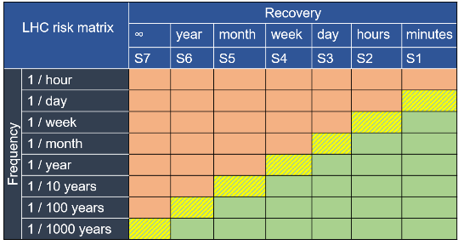
Understanding of probability
How to estimate in which box is a new system ?
Analytical computations
Simulation (AvailSim4: Monte Carlo, isograph, etc.)
Output of computations are probabilities of having a particular event (= recovery) for a given period (= frequency)
Difficult to compute
0% or 100% probability
Use of an intermediate box
10% probability of failing
Use of 1 box of margin
Maybe 2 boxes of margin in
case the box is already
populated

Slide 6

Understanding of probability
Probability to fail (or not to fail) in a given period
➔ Cumulative distribution function
$F_{X}\left(x\right)=P\left(X≤x\right)≤Target$
${ F}_{X}\left(2 hours\right)=P\left(X≤2 hours\right)≤10\%$
Probability that the failure X happens before 2 hours is less than or equal to 10 %

Slide 7
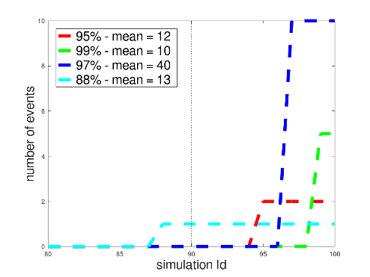
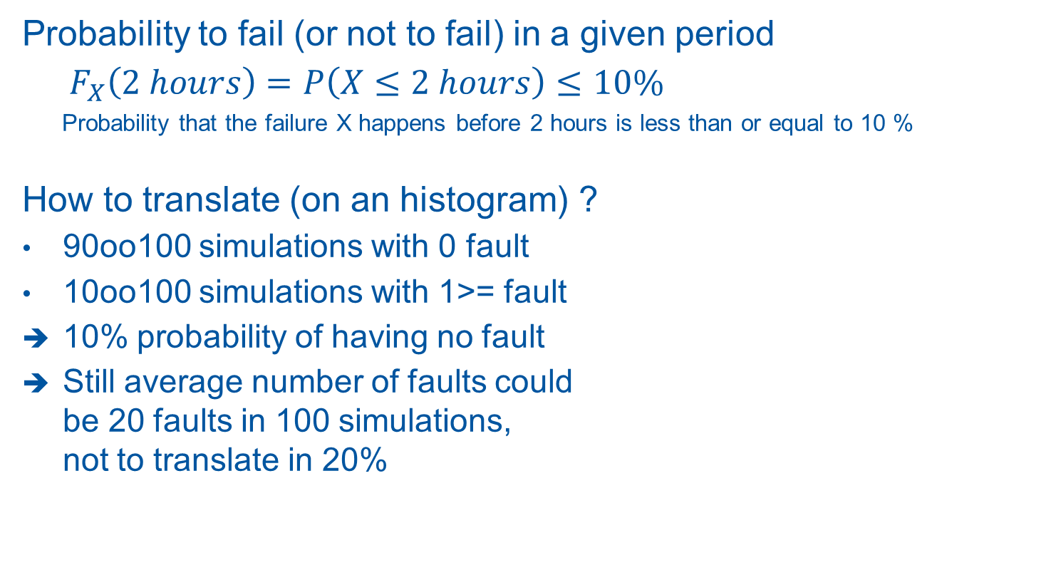
Understanding of probability
Probability to fail (or not to fail) in a given period
${ F}_{X}\left(2 hours\right)=P\left(X≤2 hours\right)≤10\%$
Probability that the failure X happens before 2 hours is less than or equal to 10 %
How to translate (on an histogram) ?
90oo100 simulations with 0 fault
10oo100 simulations with 1>= fault
10% probability of having no fault
Still average number of faults could
be 20 faults in 100 simulations,
not to translate in 20%

Slide 8
Life expectancy of a system
Frequencies inside risk matrices: 1/day to 1/1000 years
11T system : 14oo16 strips needed, MTTF of strip = 350y
AvailSim4 simulations of 11T on a period of
  20 years: almost no aging of strips
  Almost no spare needed
  1000 years: every strip would failed ~3 times
  Need for a significant number of spare magnets
  ➔ (number of spares for 1000y) / (50) >> (number of spare for 20 y)
  Frequency of a fault express using up to 1000 years in risk matrices
  ➔ Availability and Reliability should be computed on realistic life time to get proper aging effect

Slide 9
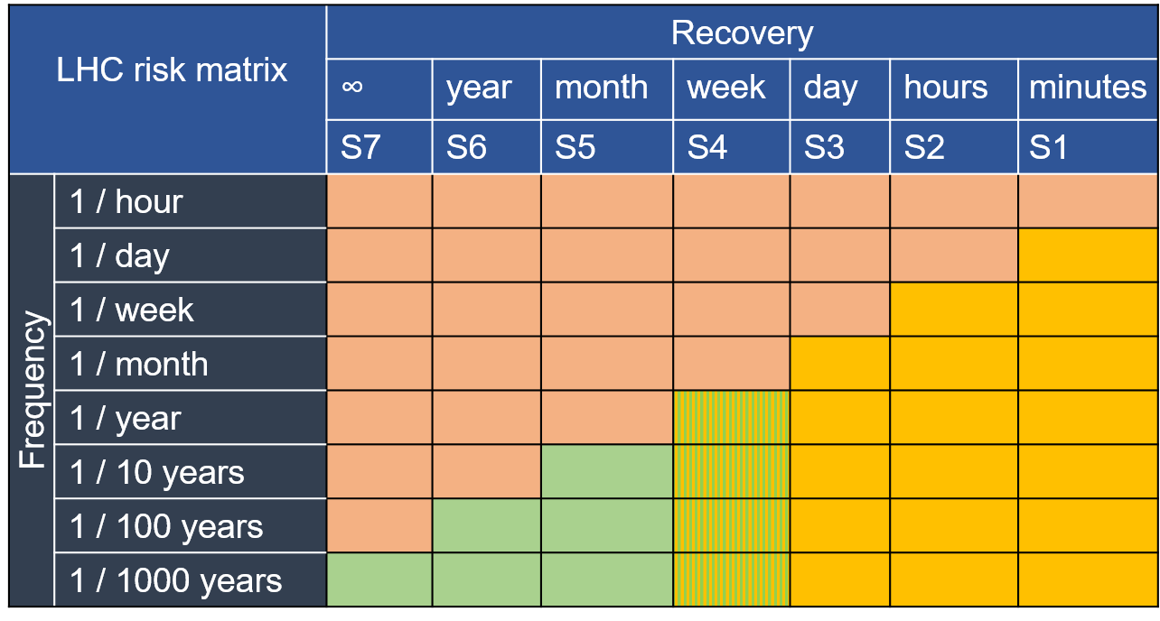
Operation & Protection
Operation range:
Frequency ~< 1/month
Available statistics
Possible predictions
(Isographe, AvailSim)
Protection range:
Frequency >~ 1/years
Not so much statistics yet
Difficult to predict
“ double or nothing”
Protection
Operation
Risk matric of LHC

Slide 10
Other possible risk matrix ?
Different distributions would be acceptable ?
LHC risk matrix |  | Recovery
 |  | ∞ | year | month | week | day | hours | minutes
 |  | S7 | S6 | S5 | S4 | S3 | S2 | S1
Frequency | 1 / hour
 | 1 / day
 | 1 / week
 | 1 / month
 | 1 / year
 | 1 / 10 years
 | 1 / 100 years
 | 1 / 1000 years

Slide 11
Already populated boxes
Use of AFT and excel – LHC data from 2015 to 2018
 | ≤ 45D | ≤ 14D | ≤ 24H | ≤ 5H | ≤ 15M
1/H | 0 | 0 | 0 | 0 | 0
1/D | 0 | 0 | 0 | 1 | 1
1/W | 0 | 0 | 1 | 1 | 1
1/M | 0 | 0 | 1 | 1 | 1
1/Y | 0 | 1 | 1 | 1 | 1
1/10Y | 0 | 1 | 1 | 1 | 1
1/100Y | 0 | 1 | 1 | 1 | 1
No statistics on long fault: protection range
Possible breaks in the demarcation

Slide 12
Already populated boxes / bins’ width
Use of AFT + excel – LHC data from 2015 to 2018
 | ≤ 2Wk | ≤ 48H | ≤ 24H | ≤ 12H | ≤5H | ≤ 1H | ≤ 15M | ≤ 5M | ≤ 1M | ≤ 5S
1/H | 0 | 0 | 0 | 0 | 0 | 0 | 0 | 0 | 0 | 0
1/D | 0 | 0 | 0 | 0 | 1 | 1 | 0 | 0 | 0 | 0
1/W | 0 | 0 | 0 | 1 | 1 | 1 | 1 | 1 | 1 | 0
1/M | 0 | 1 | 1 | 1 | 1 | 1 | 1 | 1 | 1 | 1
1/Y | 1 | 1 | 1 | 1 | 1 | 1 | 1 | 1 | 1 | 1
1/10Y | 1 | 1 | 1 | 1 | 1 | 1 | 1 | 1 | 1 | 1
1/100Y | 1 | 1 | 1 | 1 | 1 | 1 | 1 | 1 | 1 | 1
 | ≤ 45D | ≤ 14D | ≤ 24H | ≤ 5H | ≤ 15M
1/H | 0 | 0 | 0 | 0 | 0
1/D | 0 | 0 | 0 | 1 | 1
1/W | 0 | 0 | 1 | 1 | 1
1/M | 0 | 0 | 1 | 1 | 1
1/Y | 0 | 1 | 1 | 1 | 1
1/10Y | 0 | 1 | 1 | 1 | 1
1/100Y | 0 | 1 | 1 | 1 | 1
No statistics on long fault: protection range
Possible breaks in the demarcation
Possible over estimation if bins are too large

Slide 13
Bins’ width
Too many bins = complex tool ?
Not enough bins = over estimation of impact ?
How to define bin ?
  Faults which need access ? >= 3h
  Faults which break vacuum ?
  Faults which break cryo ?

Slide 14
(summary on) Risk matrices
Tool for quick estimation of reliability requirement
Probability of an event != average number of event
Risk matrices use frequencies up to 1/1000 years
➔ estimation of reliability / availability using realistic life
time to benefits from aging properties
Operation range vs Protection range
1 box of margin ?
Maybe 2 boxes of margin if already populated
Easy to produce risk matrices using AFT+excel
Arbitrary definition of bins = could be improved
Use of nomograms instead of matrices ?!

Slide 15
Prediction of availability and reliability
Risk matrices: tables used to estimate a reliability requirement wrt the severity of an event
AvailSim4:
Simulation tool using Monte Carlo approach
Statistics over a large number of simulations
“digital twin” of LHC, LINAC4, etc.
Inputs: architecture + failure behavior of cpt. (law + parameters)
Outputs:
Time series of events
Distribution function of reliability and availability
Analytical computations…

Slide 16
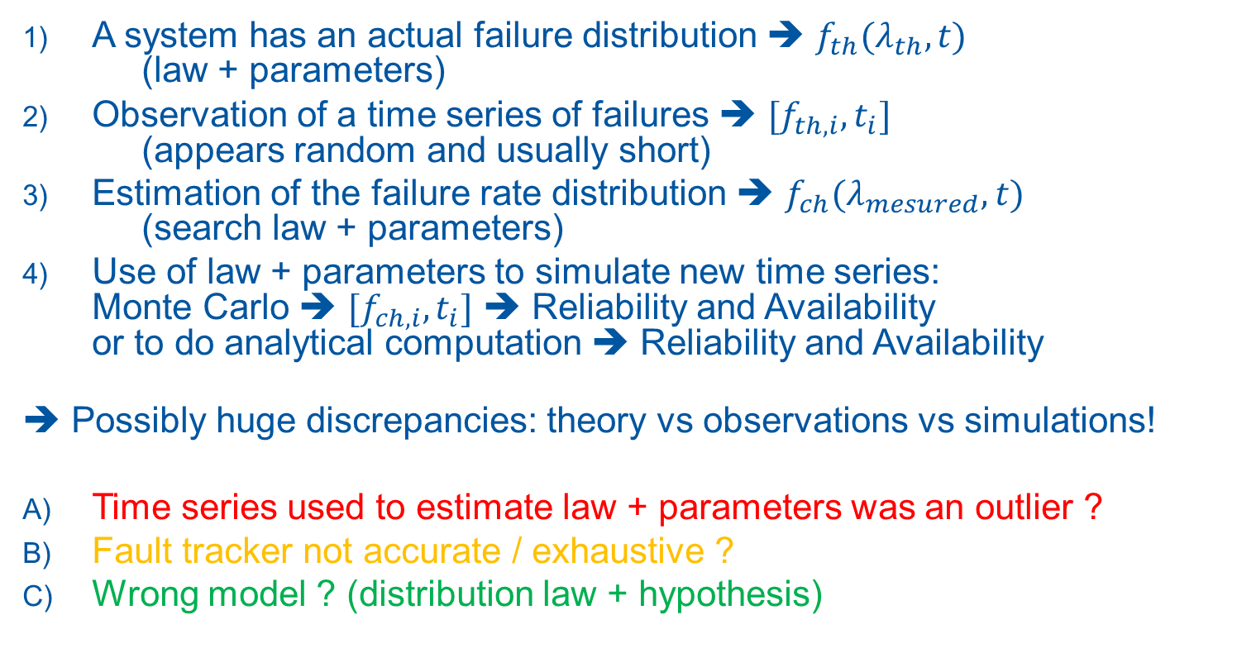
“Life” of the failure rate
A system has an actual failure distribution ➔ ${f_{th}(λ}_{th},t)$
(law + parameters)
Observation of a time series of failures ➔ ${[f}_{th,i},t_{i}]$
(appears random and usually short)
Estimation of the failure rate distribution ➔ ${f_{ch}(λ}_{mesured},t)$
(search law + parameters)
Use of law + parameters to simulate new time series:
Monte Carlo ➔ ${[f}_{ch,i},t_{i}]$ ➔ Reliability and Availability
or to do analytical computation ➔ Reliability and Availability
➔ Possibly huge discrepancies: theory vs observations vs simulations!
Time series used to estimate law + parameters was an outlier ?
Fault tracker not accurate / exhaustive ?
Wrong model ? (distribution law + hypothesis)

Slide 17
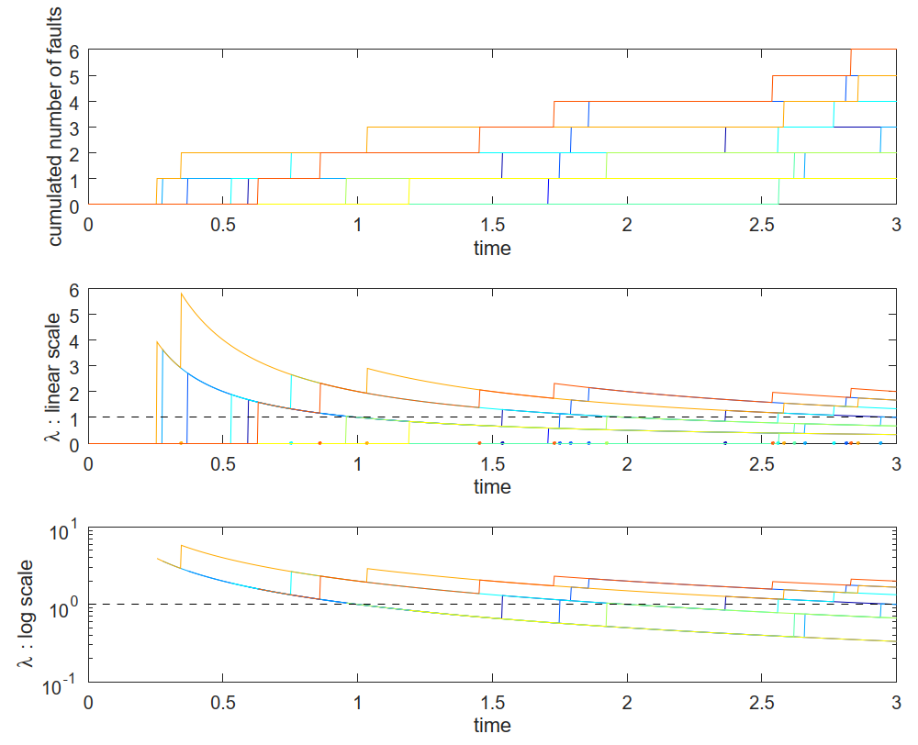
Measurement of failure rate
10 time series of event exponentially distributed
MTTF = 1

Slide 18
Measurement of failure rate
10 time series of event exponentially distributed
MTTF = 1
Failure rate with respect to the time of measurement

Slide 19
Measurement of failure rate
Typical range
of protection system
(few failures)
10 time series of event exponentially distributed
MTTF = 1
Failure rate with respect to the time of measurement
Typical range
for LHC top level
analysis by phase
Typical range
for LHC top level
analysis

Slide 20
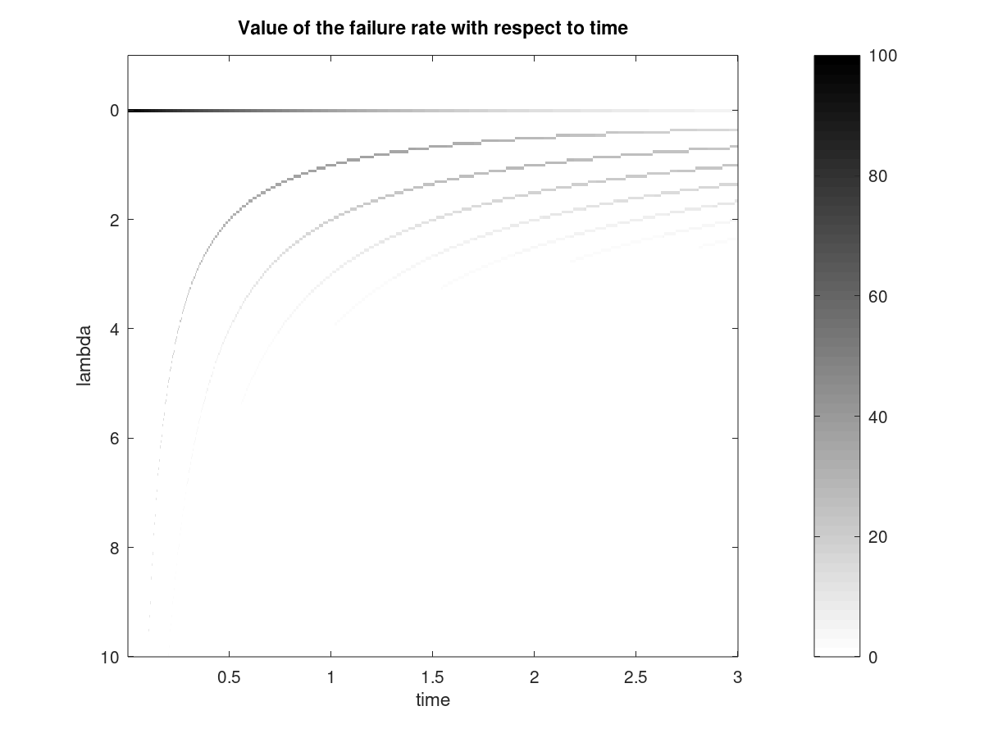

Measurement of failure rate
Probability of the values of the failure rate with respect to time
MTTF = 1

Slide 21
Measurement of failure rate
Probability of the values of the failure rate with respect to time
0 FAILURE
MTTF = 1
1 FAILURE
2 FAILURES

Slide 22
Measurement of failure rate
Probability of the values of the failure rate with respect to time
0 FAILURE
MTTF = 1
1 FAILURE
2 FAILURES
Typical range
For LHC top level
analysis by phase
Typical range
For LHC top level
analysis

Slide 23
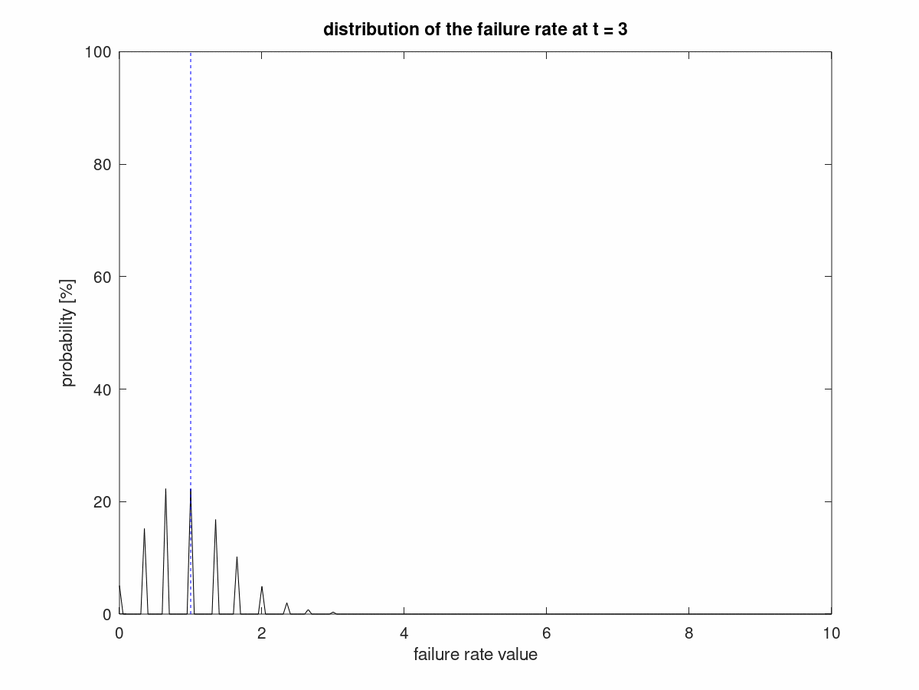

Measurement of failure rate
t = 3
Several discrete
possible values
MTTF = 1

Slide 24

Measurement of failure rate
MTTF = 1
t = 3
t = 100

Slide 25
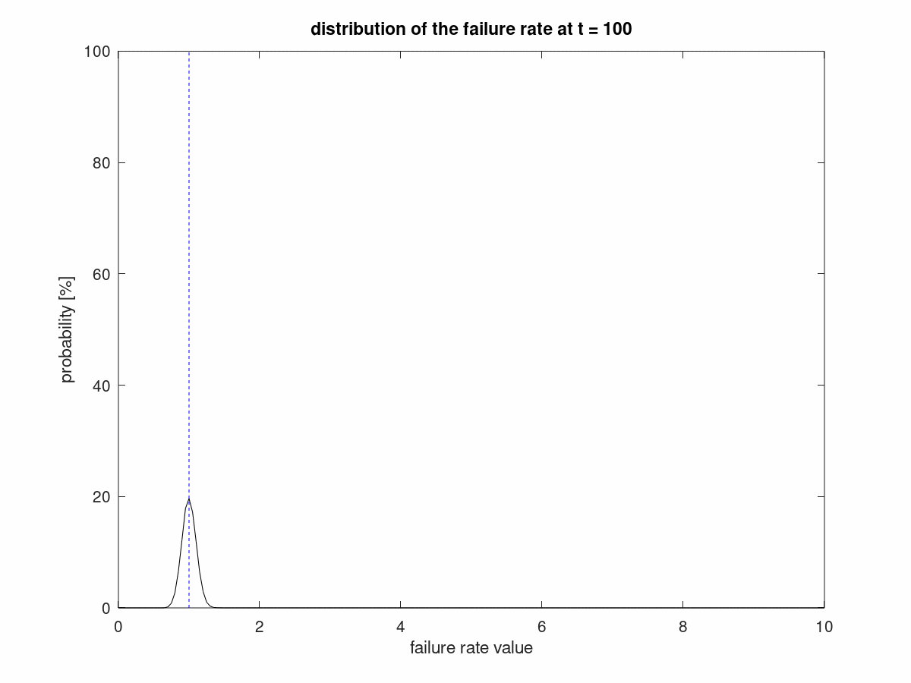
Measurement of failure rate
t = 100
“Narrower” distribution of possible failure rate
MTTF = 1

Slide 26
Measurement of failure rate
Probability of the values of the failure rate with respect to time
Most probable branch
MTTF = 1
Second most
probable branch
Typical range
For LHC top level
analysis by phase
Typical range
For LHC top level
analysis
t = 3

Slide 27
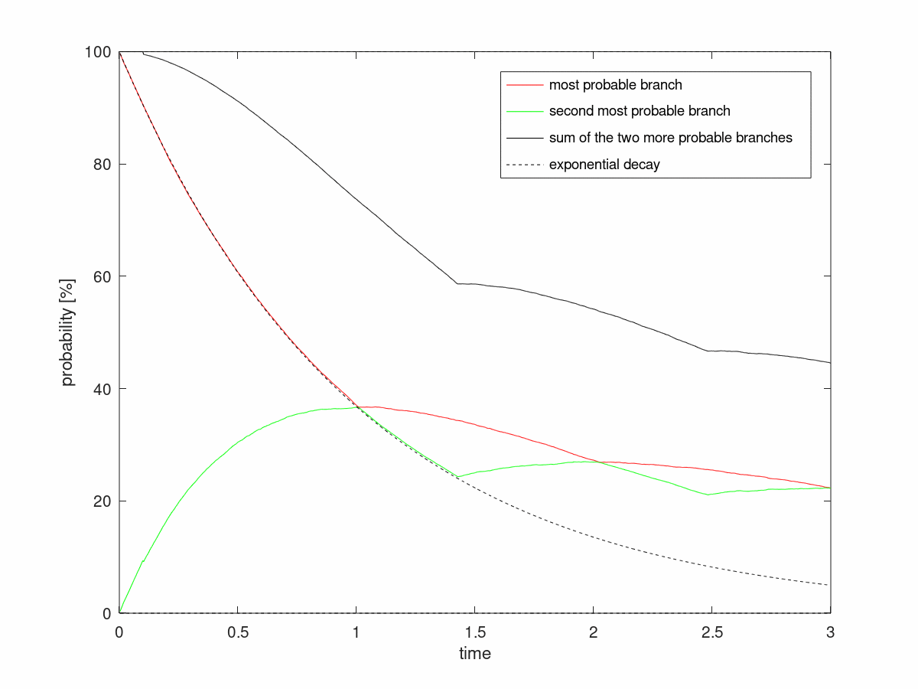
Measurement of failure rate

Slide 28
Measurement of failure rate
0 FAILURE
1 FAILURE
2 FAILURES

Slide 29
Measurement of failure rate
0 OR 1 FAILURE
1 OR 2 FAILURES
2 OR 3 FAILURES

Slide 30
What if we see NO failure?
mode = 0 ➔ more likely underestimation of MTTF
median = ln(2) = 0.7
mean = 1
Probability of having no failure:
Exponential decay
Over estimation
is unlikely

Slide 31
What if we see only 1 failure?
Probability of having 1 failure

Slide 32
Failure distribution for barely failing components
Discrete measurement of failure rate due to discrete number of fault ➔ artifact !
Search for a distribution law of faults
Search for a continuous distribution of
law’s parameter (~=failure rate)
Search for a range of law’s parameter to explore
Search for criteria validating results
WIP…

