Slide 1
LIU-PS EVM Status
Data extraction: 17 September 2019

Slide 2
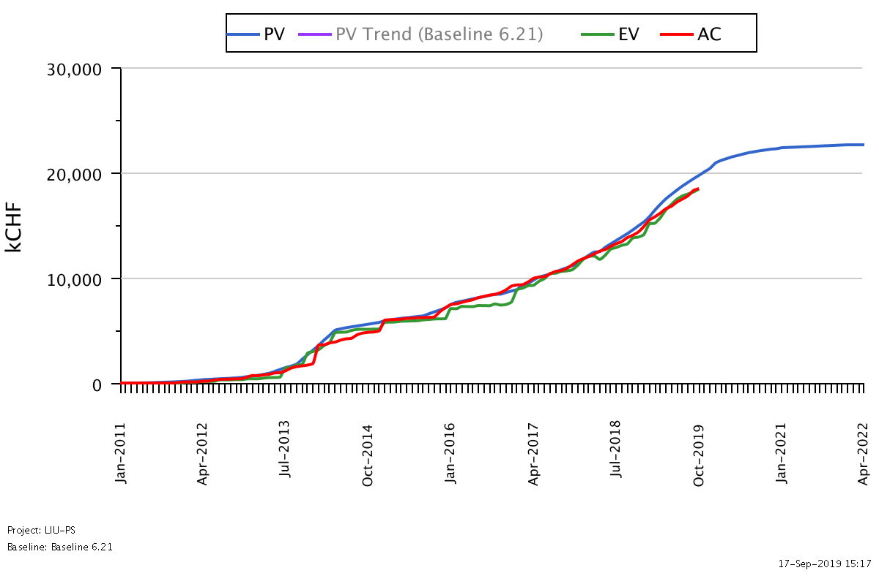
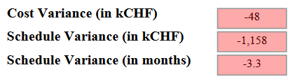
LIU-PS Dashboard
Was 3.5 on the 20.08.19
Reporting up-to-date for 63% of the workunits

Slide 3

LIU-PS Crosstab by Group

Slide 4
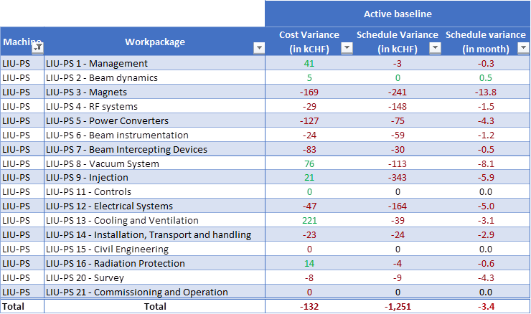
Schedule Variance by Workpackage
To be detailed for the CSR:
LIU-PS 9 Injection
LIU-PS 3 Magnets
LIU-PS 12 Electrical systems
LIU-PS 4 RF systems
LIU-PS 8 Vacuum systems

Slide 5
LIU-PS Crosstab by Group

Slide 6
Spare Slides

Slide 7
LIU-PS Crosstab – BE Department

Slide 8
LIU-PS Crosstab – EN Department

Slide 9
LIU-PS Crosstab – HSE Department

Slide 10
LIU-PS Crosstab – TE Department

