Slide 1
MEDical Isotopes Production Facility at ESS
(ESS-MEDIPF)
Yong Joong LEE (ESS)
September 19, 2019
PRISMAS-MAP (mediso-sepa) H2020 General meeting

Slide 2
Mission Statement: ESS-MEDIPF
Exploration of a potential to position ESS as a key research infrastructure providing a high flux proton and neutron sources for medical radioisotopes production, while not compromising the performance and availability of the facility’s main mission.

Slide 3
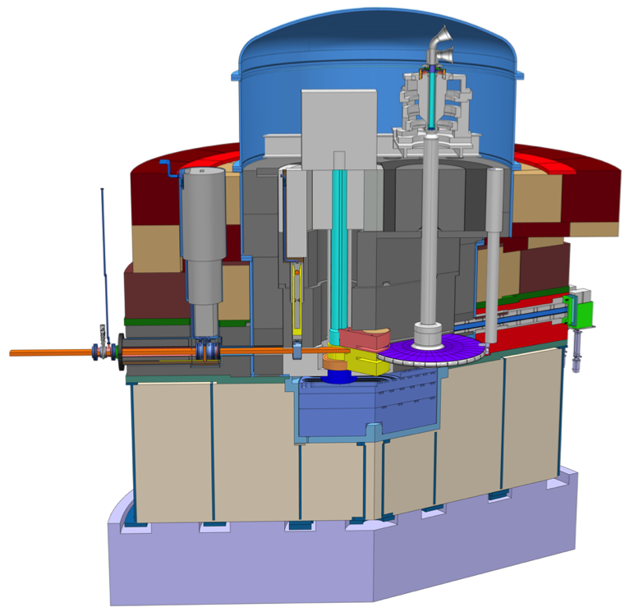
ESS Target Satation
Proton Beam Instrumentation
Target Wheel Drive Unit
Proton Beam Window (PBW)
Proton beam (2 GeV/5 MW)
Beam Extraction Unit
Moderator Reflector
Target Wheel

Slide 4
Radiation Environment
Thermal Neutrons:
  Max. available flux: ∼5∙10¹⁴ n/cm²/s
Protons: 2 GeV
  Available intensity: ∼1 𝞵A/cm²
Fast Neutrons:
  Max. available flux: ∼5∙10¹⁴ n/cm²/s

Slide 5
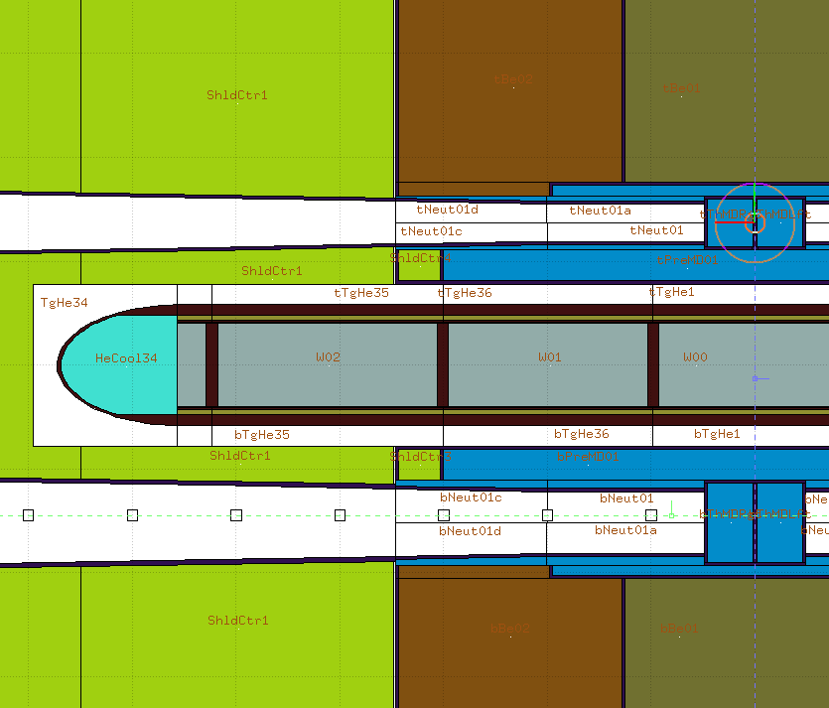
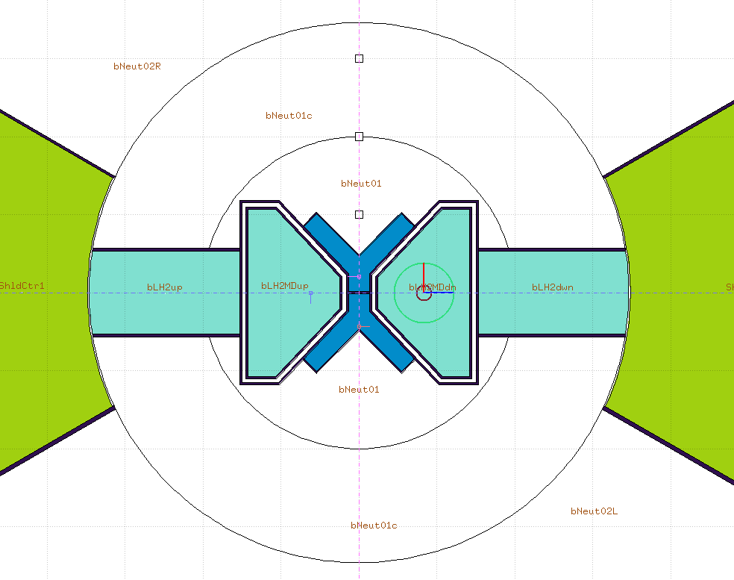
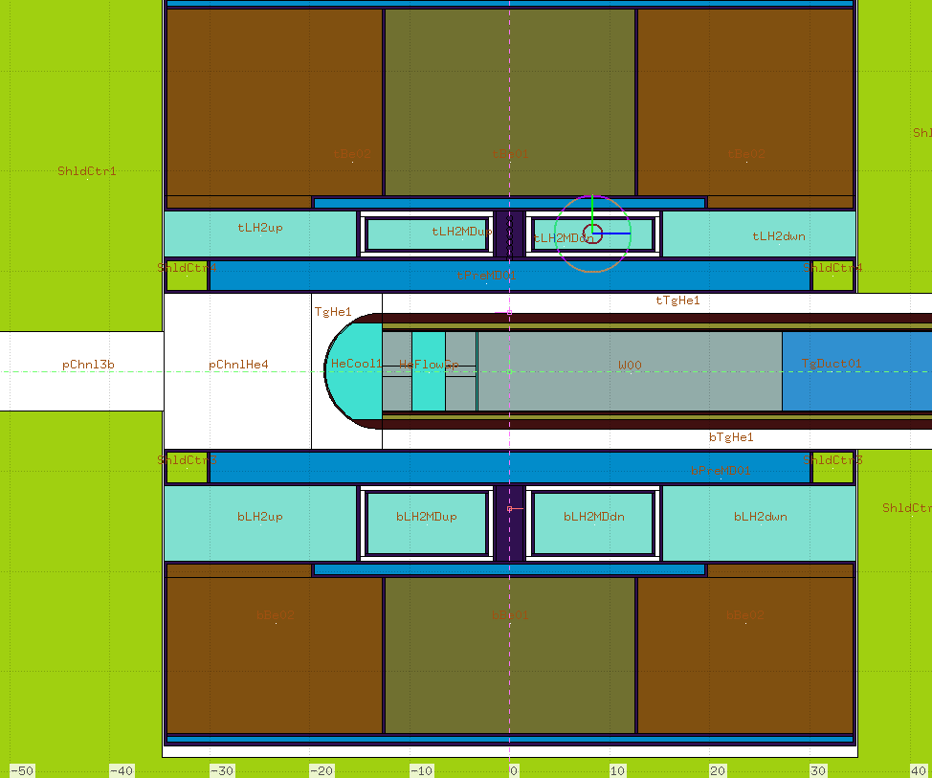
Potential Target Locations
Potential Location | Description | Potential Location | Description
A | In the vicinity of cold/thermal moderator | D | In the vicinity of the spallation target
B | In the water pre-moderator | E | Proton beam upstream
C | In the beryllium reflector | F | Used beam intercepting devices
E
D
B
A
A
C

Slide 6
Potential Access Point #1: Unused Beam Port E1
Isotopes production target uploading and unloading via unused beam port E1
Space for a hot cell for the radioactive target handling in the Experimental Hall
Requires design modification of Neutron Beam Port Plug

Slide 7
Potential Access Point #2: Moderator Twister Shaft
Isotopes production target uploading and unloading via Moderator-Reflector Plug
Space for a hot cell for the radioactive target handling on the High Bay
Requires design modification of Moderator-Reflector Plug
Picture courtesy by FZJ

Slide 8
Benchmark against research reactors: ILL/JHR
Potential Target Location | Source Partcles | normalised flux to ILL/JHR Max | Access Route | brightness reduction
A | Neutron: E < 1 eV | ≅ 0.1 | Beam Port E1 | < 0.5%
 | Neutron: E > 1 MeV | ≅ 0.1
 | Neutron: E > 10 MeV | > 10
B | Neutron: E < 1 eV | ≅ 0.5 | Twister | < 2.0%
 | Neutron: E > 1 MeV | ≅ 0.5
 | Neutron: E > 10 MeV | > 10
C | Neutron: E < 1 eV | ≅ 0.5 | Twister | < 0.5%
 | Neutron: E > 1 MeV | ≅ 0.1
 | Neutron: E > 10 MeV | > 10
D | Neutron: E < 1 eV | ≅ 0.1 | Twister | < 2.0%
 | Neutron: E > 1 MeV | ≅ 1.0
 | Neutron: E > 10 MeV | > 10
E | Proton: E ≅ 2 GeV | > 100 | Twister | < 0.1%
 | Neutron: E > 1 MeV | ≅ 0.5
 | Neutron: E > 10 MeV | > 10
F | Proton: E ≅ 2 GeV | > 100 | Active Cells | < 0.1%
 | Neutron: E > 1 MeV | ≅ 0.1
 | Neutron: E > 10 MeV | > 10

Slide 9
Benchmark against high power proton machines
Target Location | Source Particles | normalised flux to ISOLDE-MEDICIS | normalised flux to PSI-ERAWAST | brightness reduction
E | Proton: E < 2 GeV | ≅ 1 | -- | < 0.1%
F | Proton: E < 2 GeV | -- | ≅ 1 | < 0.1%

Slide 10
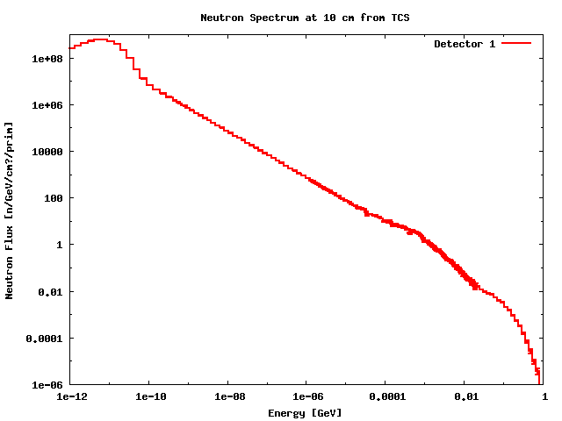
Case Study
Representative radiation intensity
  Thermal neutron flux: 10¹⁴ n/cm²/s
  Fast neutron flux (10 MeV < E < 20 MeV): 10¹³ n/cm²/s
  Proton intensity: 1 𝞵A/cm²
Reference isotopes yields after 1 week beamtime, for benchmarking:
Product | Target | Neutron Energy | Reaction Chain | E.o.B. yield [GBq/g]
Mo-99 | Mo-100 | 10 MeV < E < 20 MeV | Mo100(n,2n)Mo99 | 100
I-131 | Te-130 | E < 0.625 eV | Te130(n,g)Te131(β⁻)I131 | 100
Lu-177 | Yb-176 | E < 0.625 eV | Yb176(n,g)Yb177(β⁻)Lu177 | 1000
Ac-225 | Ra-226 | 5 MeV < E < 15 MeV | Ra226(n,2n)Ra225(β⁻)Ac225 | 10
Ac-225 | Th-232 | Proton: 2 GeV | Th232(p,x)Ra225(β⁻)Ac225 | 10

Slide 11
Way Forward
Identification of isotopes of high demands and target materials that ESS proton and neutron spectra at chosen target locations could be efficiently utilized
  ESS-MEDIPF intends to provide isotopes of high demands for research and clinical applications, which are otherwise not available in enough quantity
  Within the PRISMAS-MAP collaboration frame, the functional scope of the ESS-MEDIPF will be worked out in a way that it will become an important asset to the existing European research infrastructure
Identification of extraction methods for identified isotopes
  The neutrons have a large energy spectra from thermal to GeV, inducing a large radioisotopes inventories
  Renovative methods for extracting targeted isotopes should be studied within PRISMA MAPS collaboration frame.
Identification of target locations, conceptual design of the target station and handling concepts

Slide 12
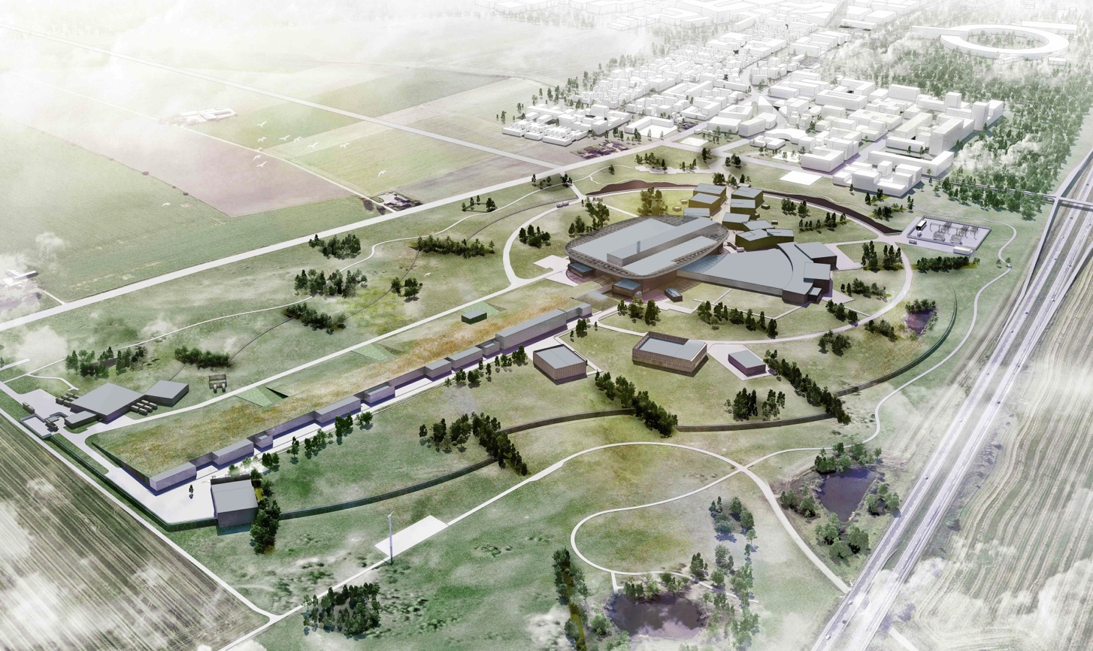
Thank you for your attention

