Slide 1



Energy Reconstruction of hadron showers with the CALICE SDHCAL prototype
I. Laktineh
For
CALICE SDHCAL groups
Gent, CIEMAT,GWNU, IP2I, LPC, SJTU, OMEGA
Calor 2022, University of Sussex

Slide 2
Outline
SDHCAL technological prototype
Short description
Energy reconstruction method
Improvement with PID techniques
Further improvements on energy reconstruction
Summary

Slide 3
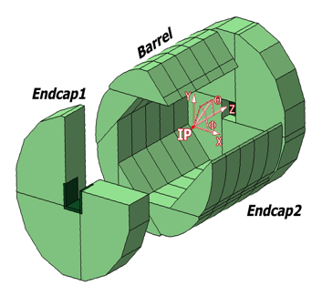
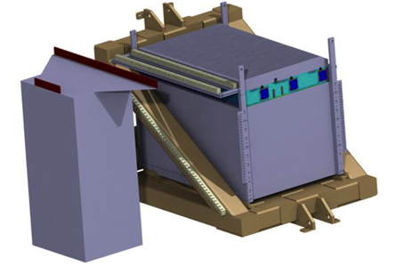
SDHCAL
The SDHCAL-GRPC is one of the two HCAL options based on PFA and
proposed for ILD of ILC/CEPC. Modules are made of 48/40 RPC chambers equipped with semi-digital, power-pulsed electronics readout and placed
in self-supporting mechanical structure to serve as absorber
as well.
The structure proposed for the SDHCAL :
is very compact with negligible dead zones
Eliminates projective cracks
Minimizes barrel / endcap separation
(services leaving from the outer radius)
SDHCAL Technological Prototype should
be as much as possible similar to the ILD module
and able to study hadronic showers
Challenges
-Homogeneity for large surfaces
-Thickness of only few mms
-Lateral segmentation of 1 cm X 1 cm
-Services from one side
-Embedded power-cycled electronics
-Self-supporting mechanical structure

Slide 4
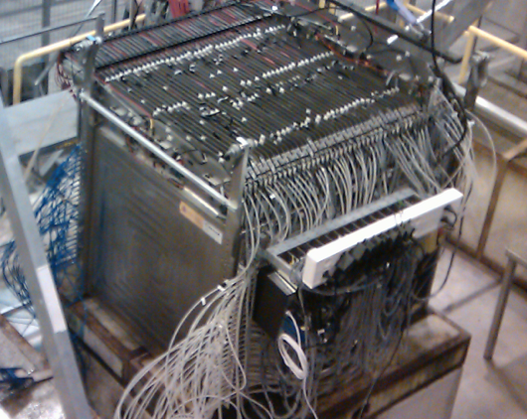
Published: JINST 10 (2015) P10039
48 layers (-6λ_{I})
1 cm X 1 cm granularity
3-threshold, 500000 channels
Power-Pulsed
Triggerless DAQ system
Self-supporting mechanical structure

Slide 5
SDHCAL prototype was exposed to beam particles
at CERN PS, SPS in 2012, 2015, 2017 and 2018
Electron rejection: shower starting after the fourth layer (6 radiation length)

Slide 6
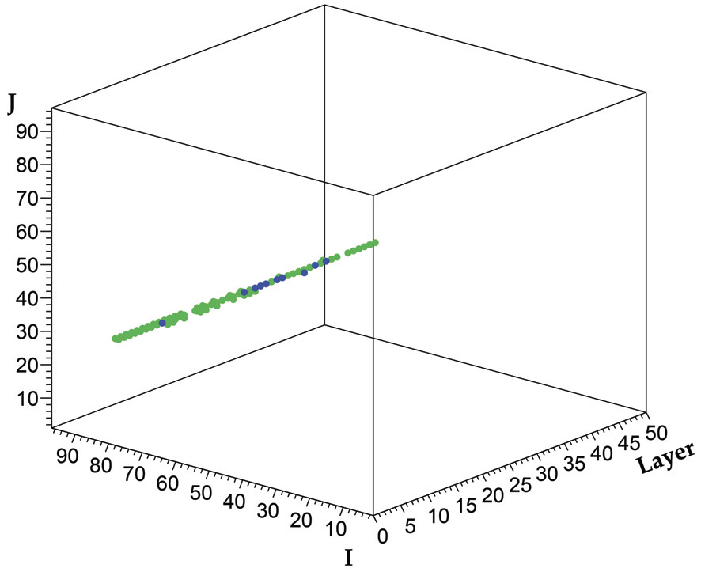
SDHCAL prototype was exposed to beam particles
at CERN PS, SPS in 2012, 2015, 2017 and 2018
Muon rejection: average number of hits/layer < 2

Slide 7
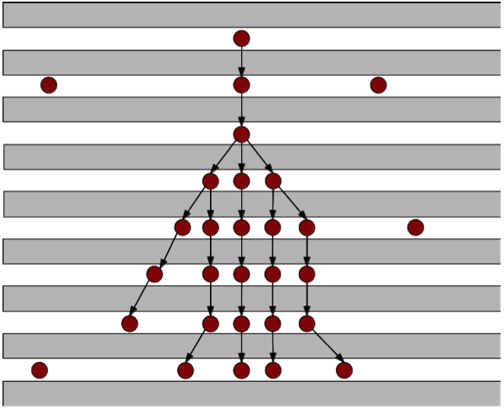
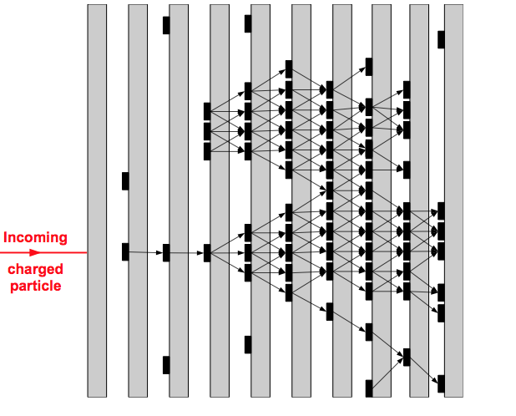
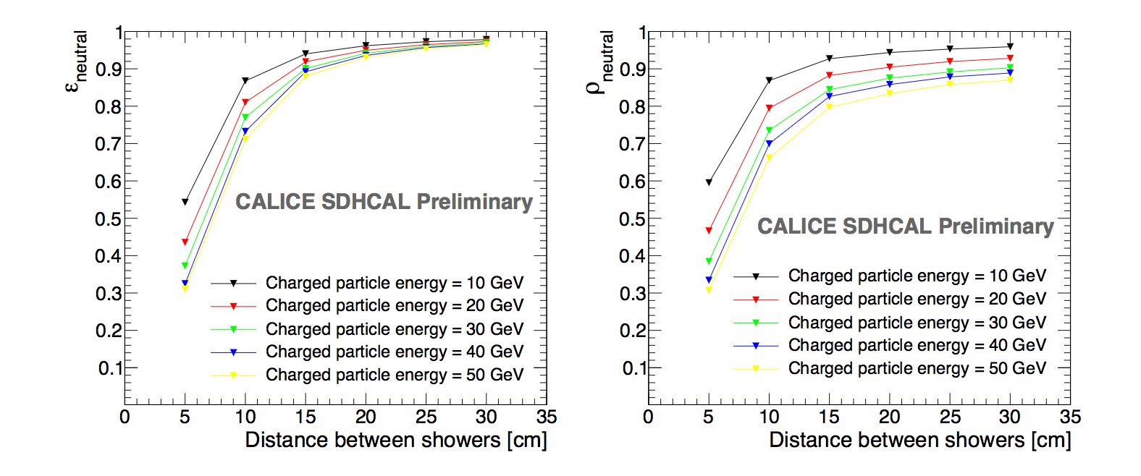
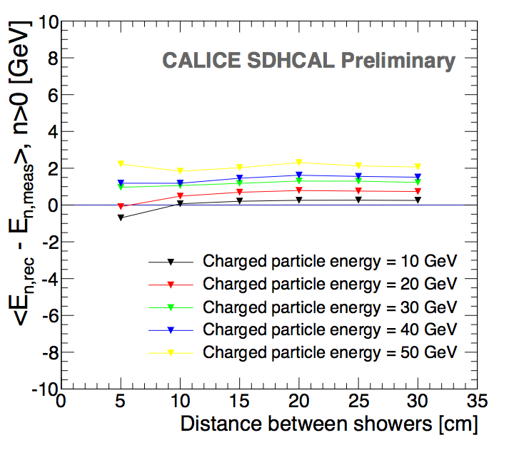
SDHCAL high granularity is conceived for PFA
It helps to optimize the connection of hits belonging to the same shower by using first the topology and then the energy information
ArborPFA algorithm*:
It connect hits and then their clusters using distance and orientation information
then correct using tracker information (momentum)
Efficiency
ΔE
Purity
1 neutral of 10 GeV
1 neutral of 10 GeV
1 neutral of 10 GeV
CALICE note CAN054

Slide 8
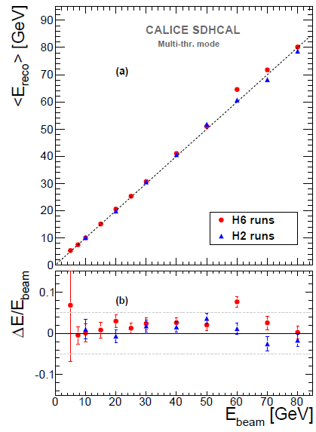
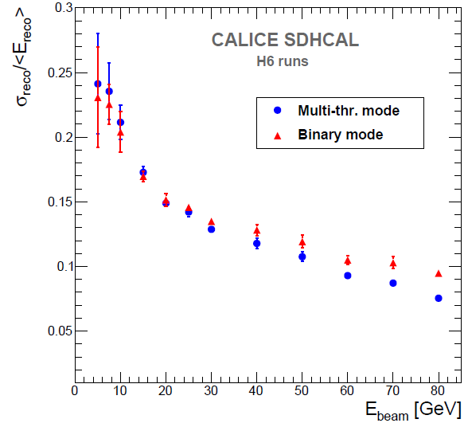
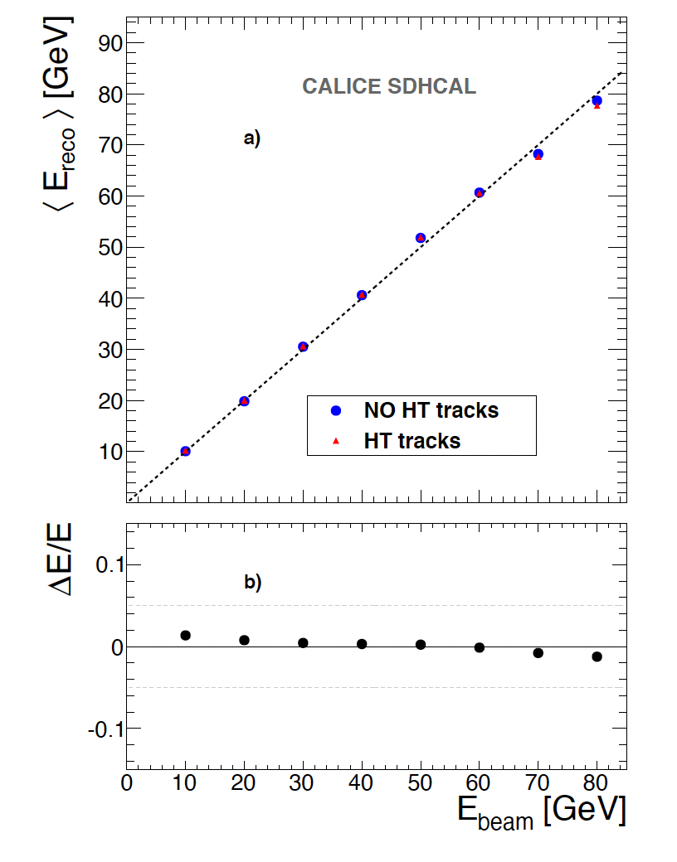
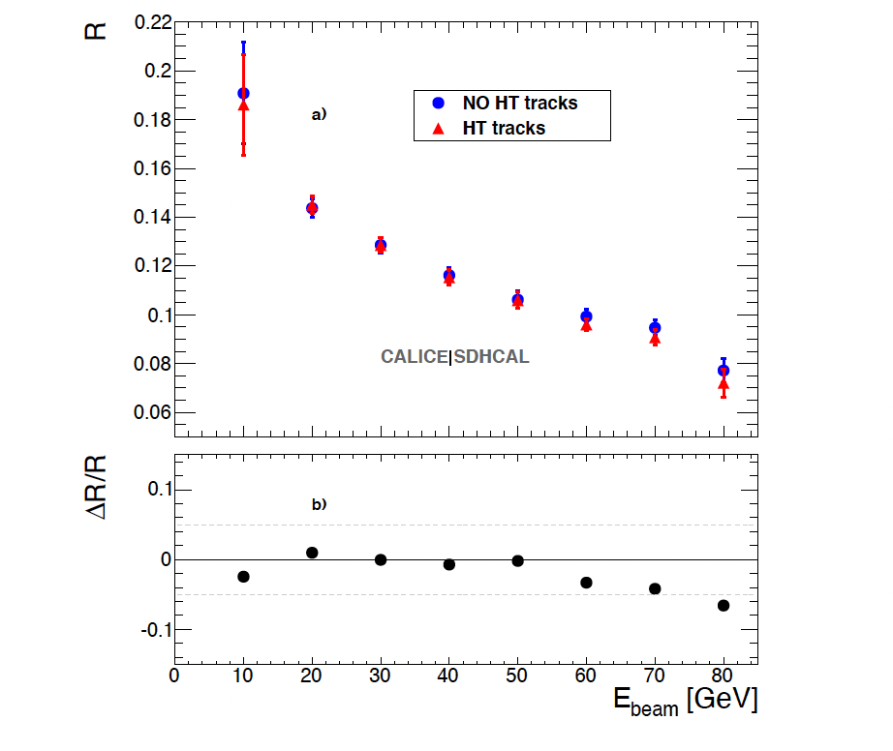
Energy reconstruction
N₁= Nb. of pads with first threshold <signal < second threshold
N₂ = Nb. of pads with second threshold <signal < third threshold
N₃ = Nb. of pads with signal> third threshold
E_{rec =} α (N_{tot}) N₁ + β (N_{tot}) N₂ + γ (N_{tot}) N₃
α , β , γ are quadratic functions of
They are computed by minimizing :
N_{tot} = N₁ + N₂ + N₃
χ²= (E_{beam}-E_{rec})²/E_{beam}
Hough-Transform
Track segments reconstruction using 3D-Hough Transform helps to apply different treatment to the hits of these segments.
JINST 11 (2016) P04001
E_{rec =} α (N_{tot}) N’₁ + β (N_{tot}) N’₂ + γ (N_{tot}) N’₃ + c N_{HT}
N_{tot} = N’₁ + N’₂ + N’₃+ N_{HT}
JINST 12 (2017) P05009

Slide 9
Energy reconstruction
Particle Identification
Due to the absence of Cerenkov detectors in front of the SDHCAL, the use of an electron selection (shower starting > d= 6 X_{I}) was rather powerful but led to an important loss of hadrons (d= 1 λ_{l}).
To reject electrons and muons without losing hadrons we use the excellent granularity of SDHCAL to discriminate the three species. Several discriminatory variables were selected:
1- First layer of the shower (begin)
2- Number of tracks in the shower (trackMultiplicity)
3- Ratio of shower layers over total fired layers (nSHowerLayer/Nlayers)
4- Shower density (density)
5- Shower radius (radius)
6- Maximum shower position (length)
7- Ratio of N₃/N_{tot}
8- Average number of clusters
….
BDT technique was used.
Simulated events of electrons, muons and pions were used for training/validation before to apply to data.
To avoid a possible bias due to discrepancy between data/simulation of electrons showers in the SDHCAL, pure electrons and muons data events were also used

Slide 10
JINST 15 (2020) P10009

Slide 11
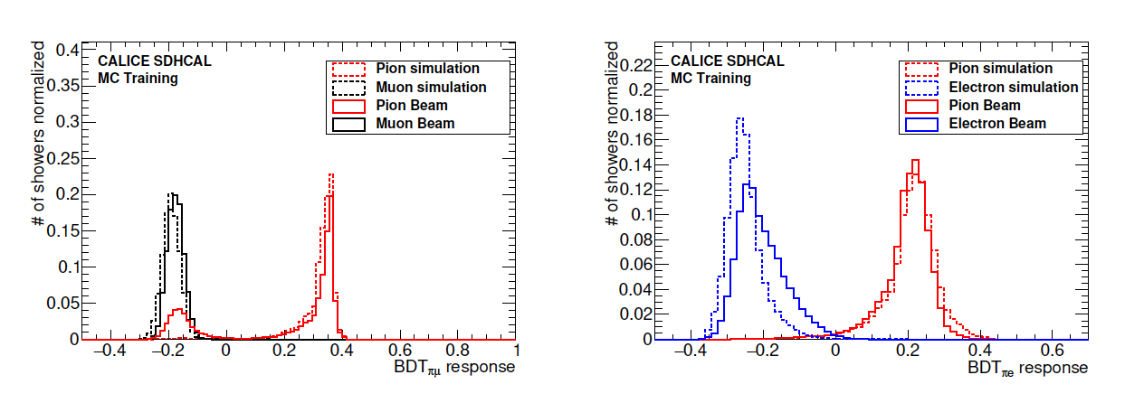
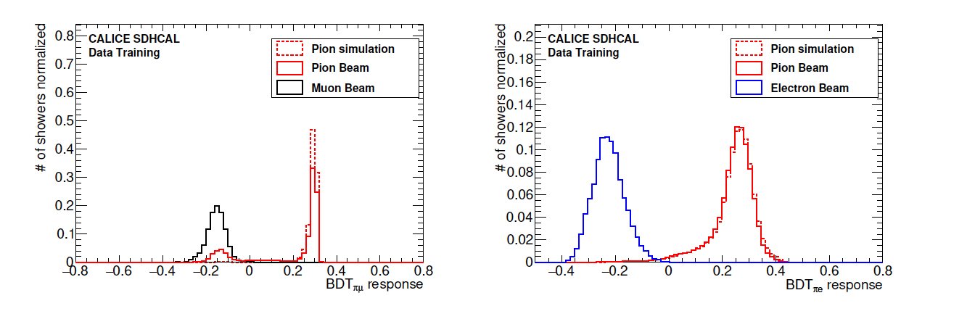
JINST 15 (2020) P10009
Electron and muon rejection > 99%

Slide 12
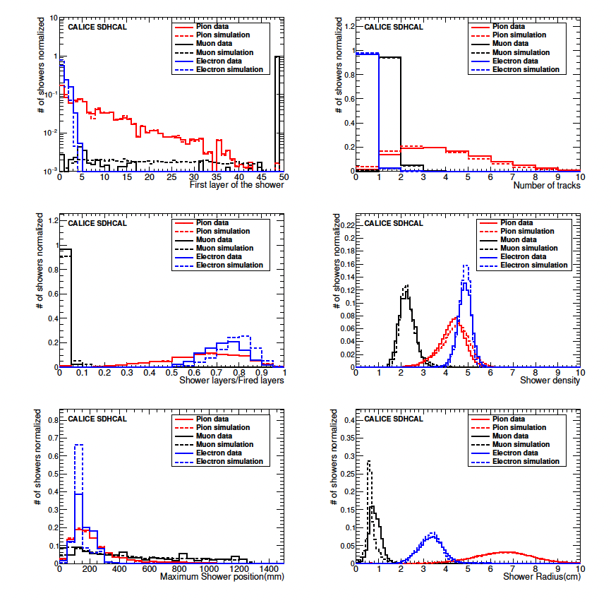
JINST 15 (2020) P10009
Excellent agreement between data and simulation of pion events.

Slide 13
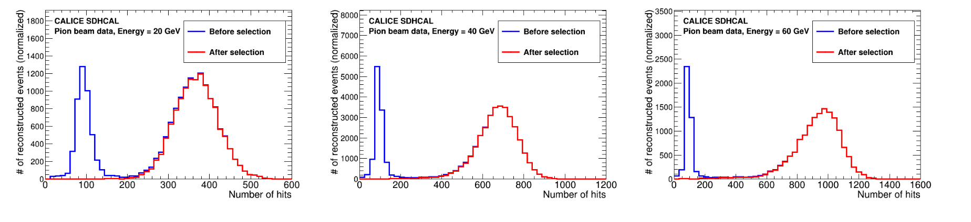
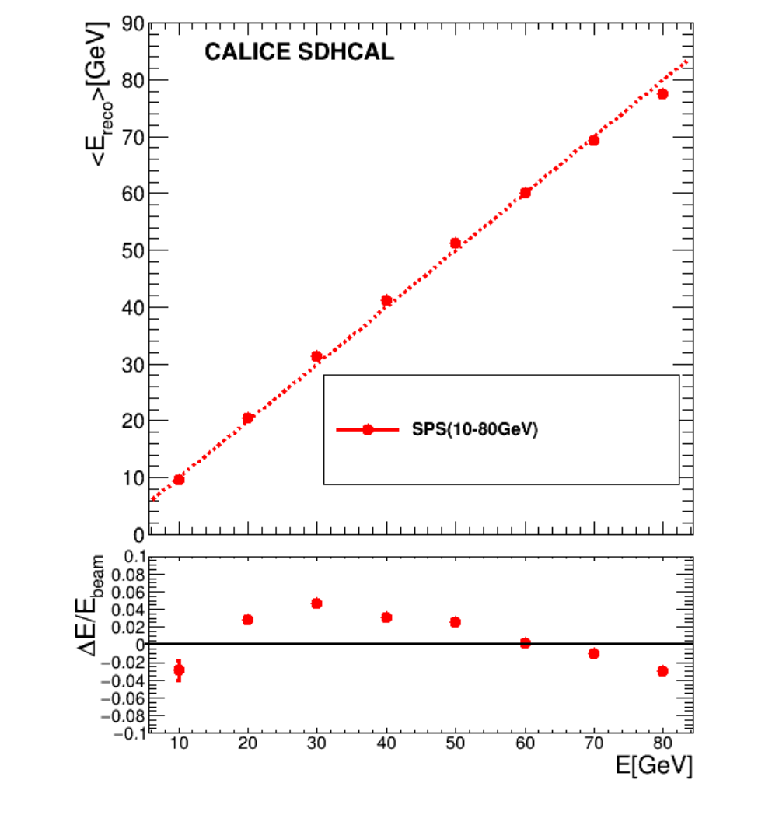
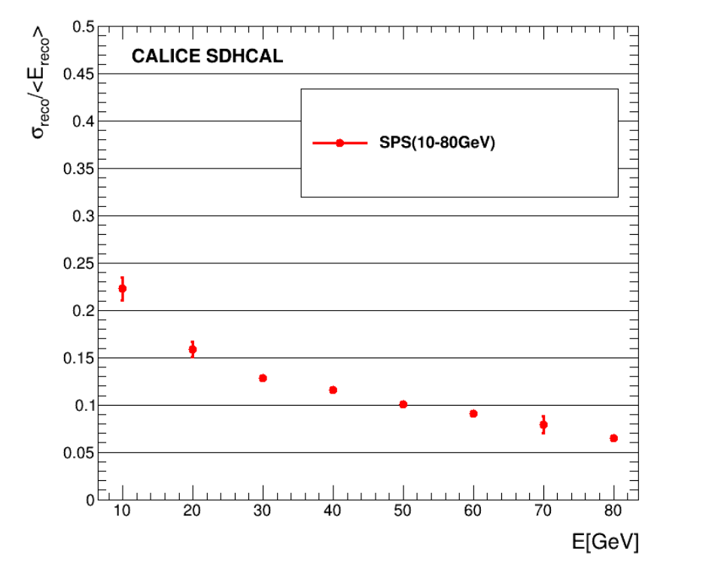
The BDT-based PID was first applied to the SPS 2015(10-80 GeV) samples
arXiv:2202.09684
Resolution
Linearity

Slide 14
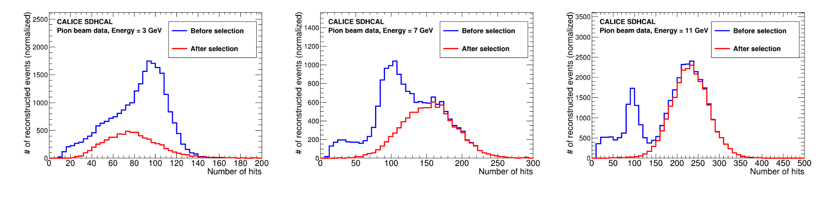
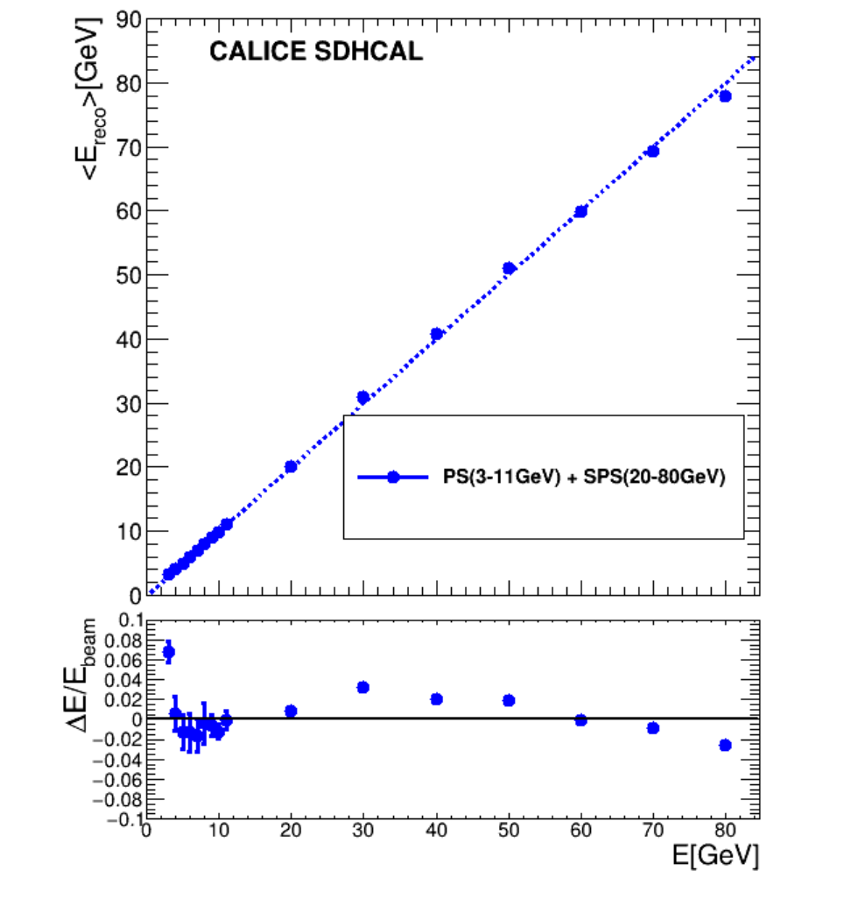
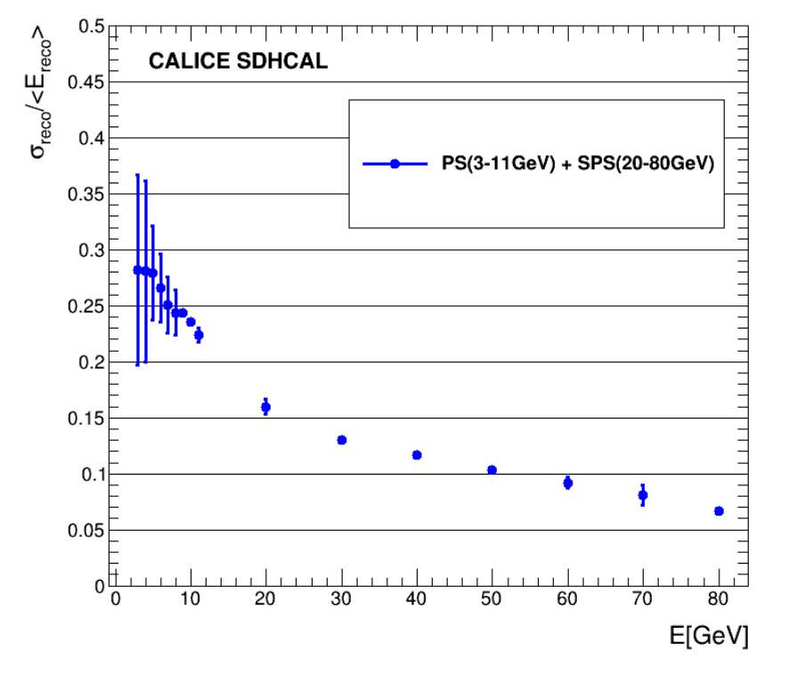
The BDT-based PID technique was also applied to the PS (3-12 GeV) samples
arXiv:2202.09684
Resolution
Linearity

Slide 15
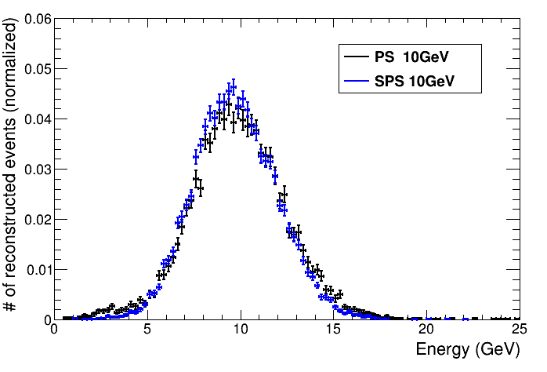
Comparison of reconstructed energy of 10 GeV PS ( no electron contamination) and 10 GeV SPS (after rejection of electron contamination)
arXiv:2202.09684

Slide 16
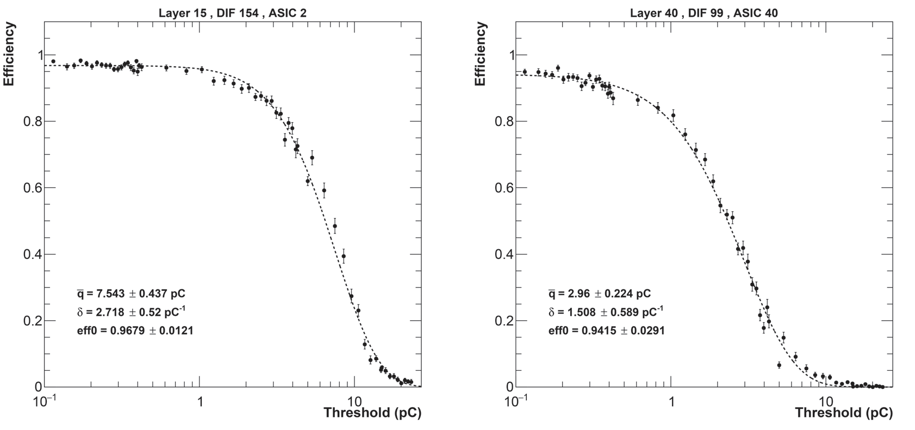
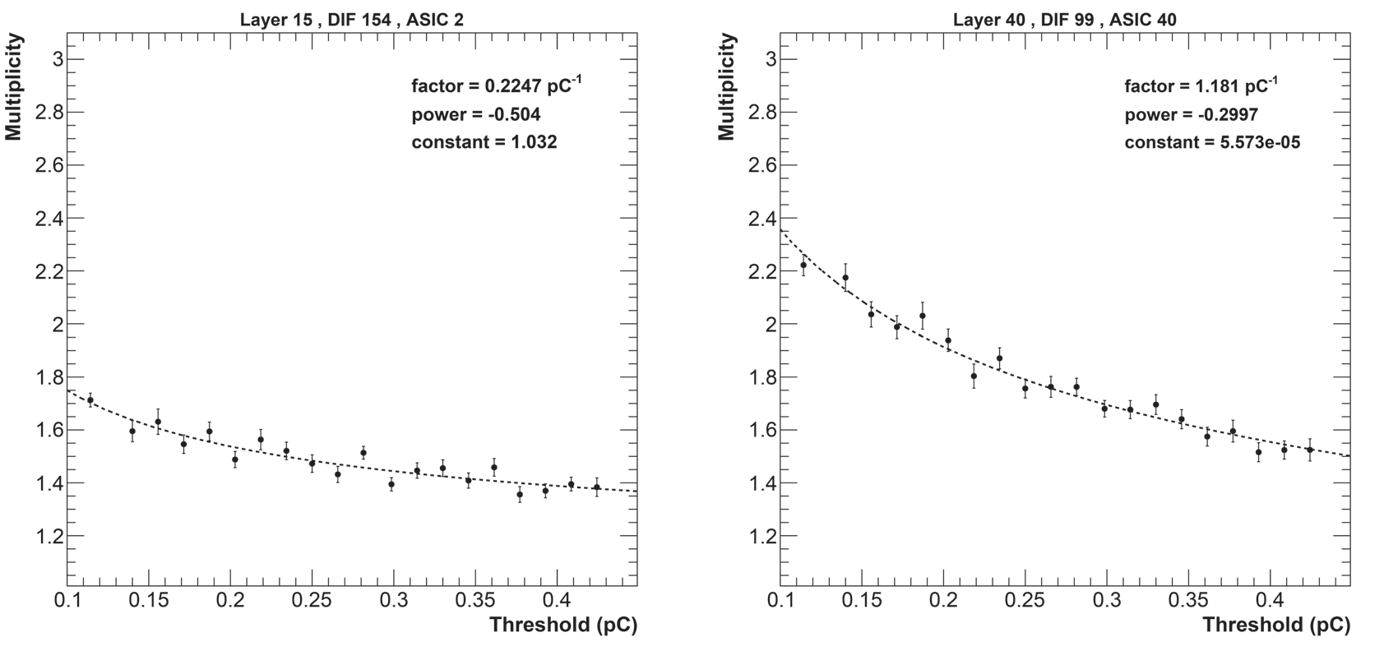
Further improvements on the energy reconstruction
Detector homogeneity
The homogeneity of the detector response is important to achieve better energy reconstruction
CALICE SDHCAL Preliminary
H2/2018
A new calibration method based on varying the thresholds rather than the electronic gain was found to be powerful. Muon runs with different thresholds Thr1: 0.1-0.42 pC, Thr2: 0.4-5, Thr3:4.7-24) and efficiency and multiplicity were measured for each value. The values of the three thresholds of each ASIC were fixed to obtain same multiplicity (first threshold) and the same efficiency for thr2 and thr3.
CALICE SDHCAL Preliminary
CALICE SDHCAL Preliminary
CALICE SDHCAL Preliminary
CALICE SDHCAL Preliminary

Slide 17
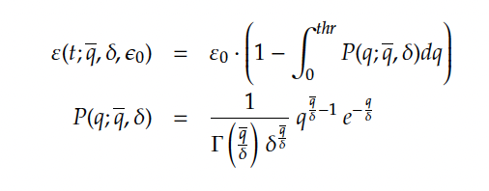

Further improvements on the energy reconstruction
Detector homogeneity
The homogeneity of the detector response is important to achieve better energy reconstruction
CALICE SDHCAL Preliminary
H2/2018
A new calibration method based on varying the thresholds rather than the electronic gain was found to be powerful. Muon runs with different thresholds Thr1: 0.1-0.42 pC, Thr2: 0.4-5, Thr3:4.7-24) and efficiency and multiplicity were measured for each value. The values of the three thresholds of each ASIC were fixed to obtain same multiplicity (first threshold) and the same efficiency for thr2 and thr3.

Slide 18
Further improvements on the energy reconstruction
Detector homogeneity
The homogeneity of the detector response is important to achieve better energy reconstruction
CALICE SDHCAL Preliminary
H2/2018
CALICE SDHCAL Preliminary
H2/2018

Slide 19
Further improvements on the energy reconstruction
Detector homogeneity
The homogeneity of the detector response is important to achieve better energy reconstruction
CALICE SDHCAL Preliminary
H2/2018
Before
After
1.4%
3.9%
We will apply the new method to the data to be collected in 2022

Slide 20
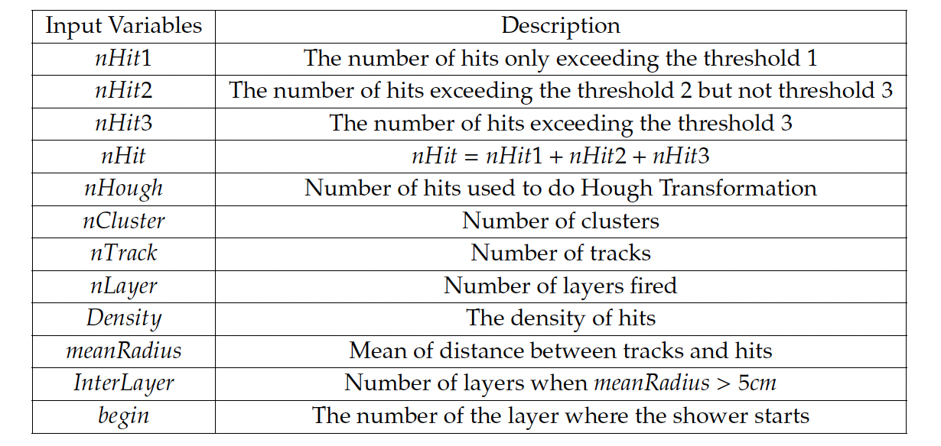
Further improvements on the energy reconstruction
Multi-Variate Techniques
Several MVT methods (NN and BDT) were used to exploit, in addition to N₁, N₂ and N₃, the hadronic shower shape information related to its energy thanks to the high granularity of the SDHCAL

Slide 21
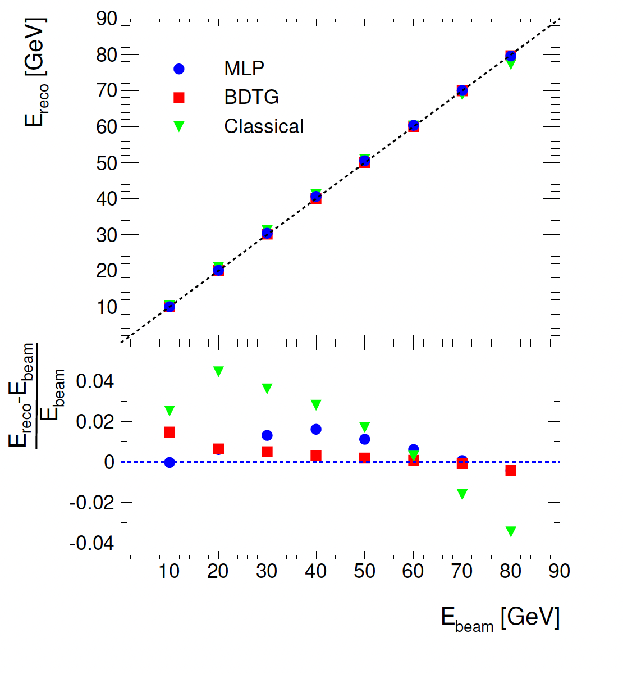
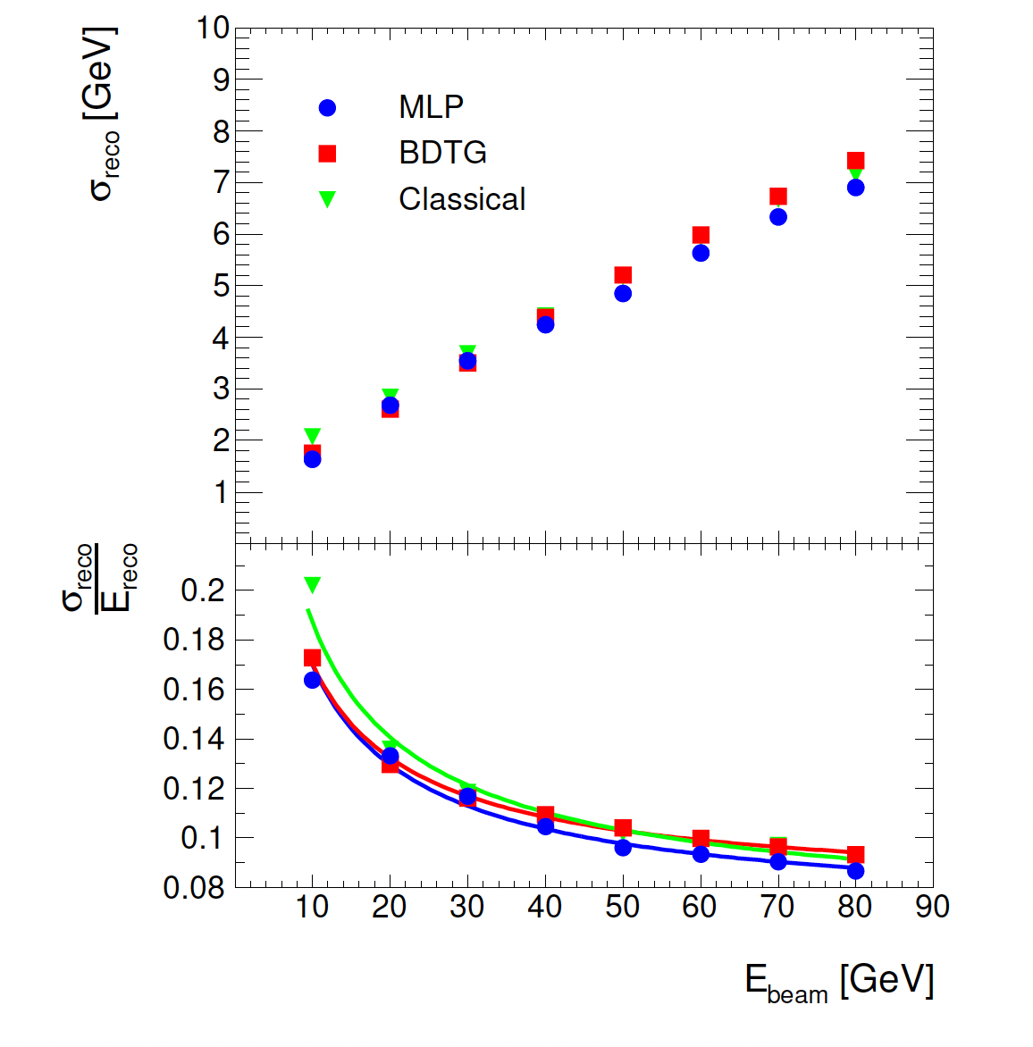
Further improvements on the energy reconstruction
Several MVT methods were used to exploit in addition to N₁, N₂ and N₃ the shape information that is related to the shower energy thanks to high granularity of SDHCAL. Simulated pion events within SDHCAL were used for this study.
Simulation
Simulation
MLP seems to perform better
JINST 14, 2019, P10033

Slide 22
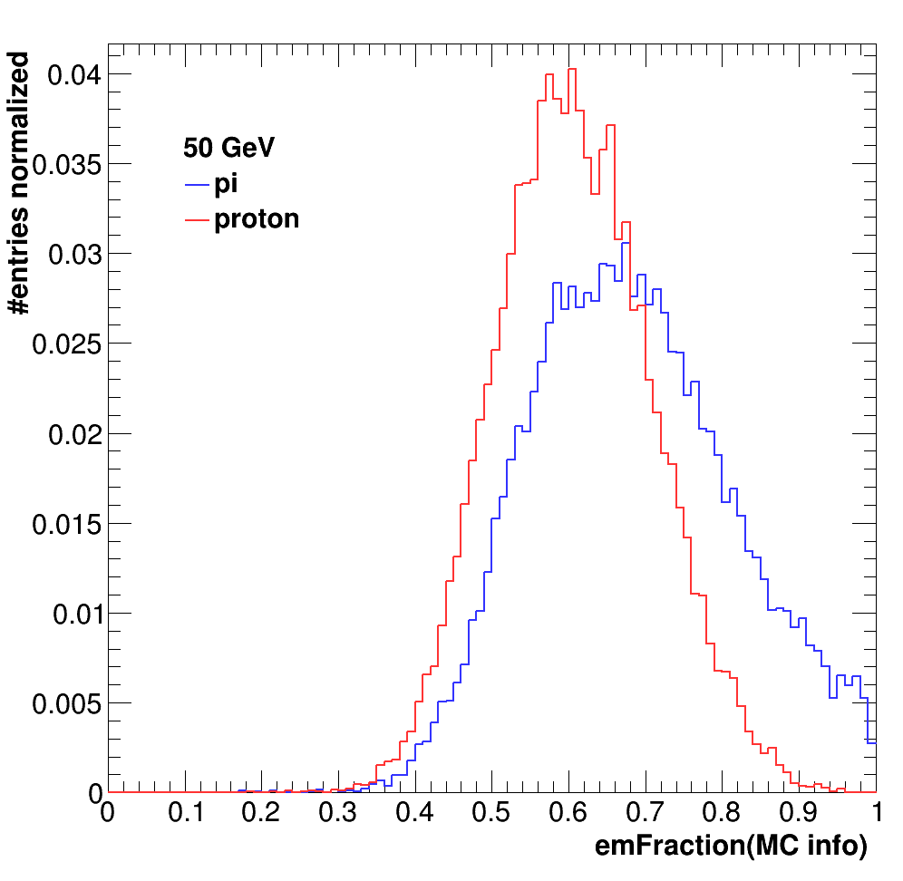
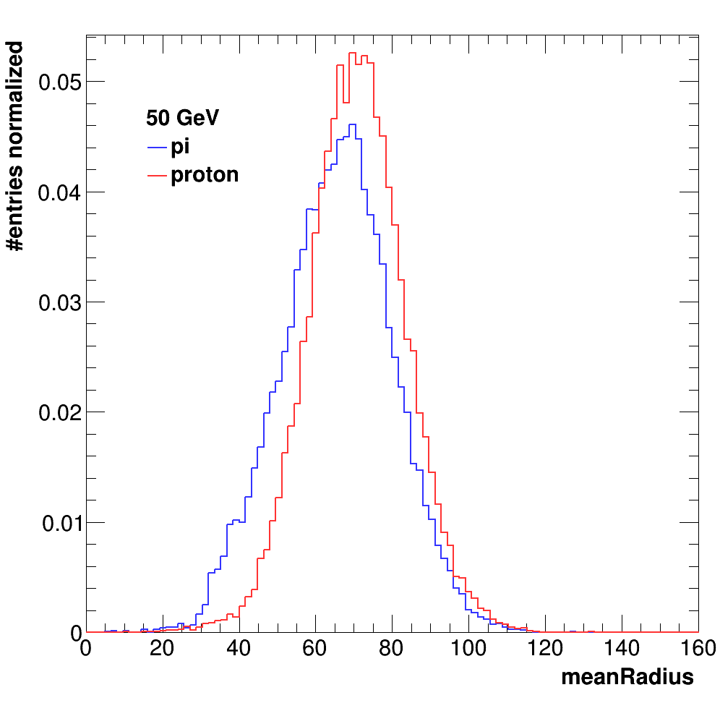
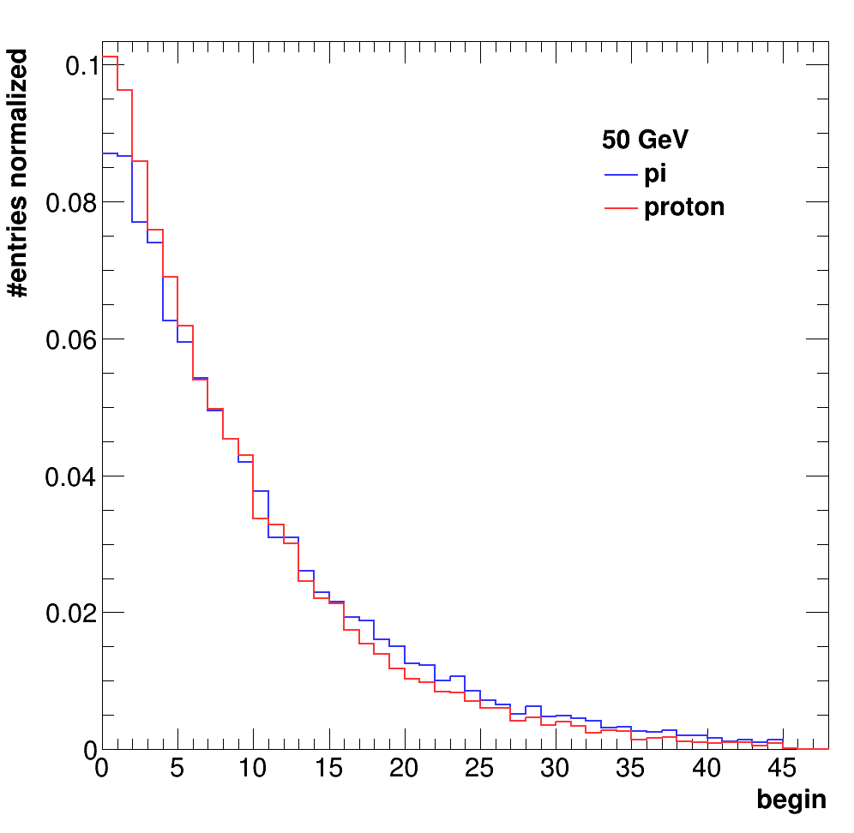
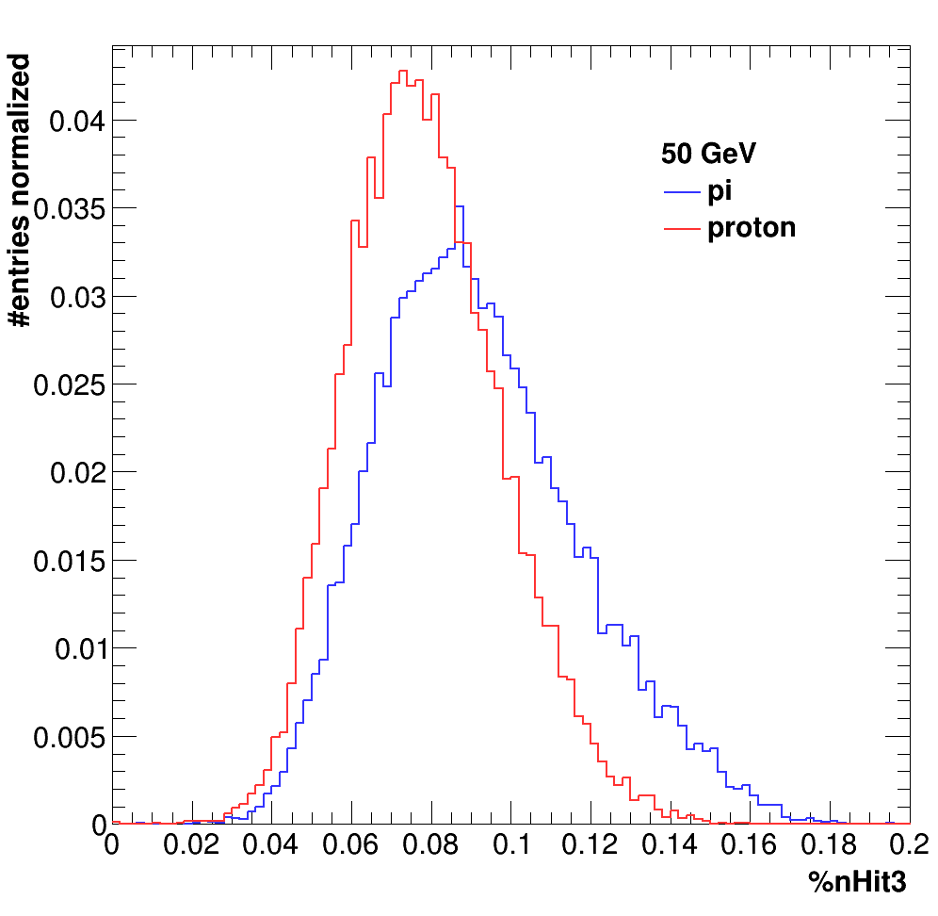
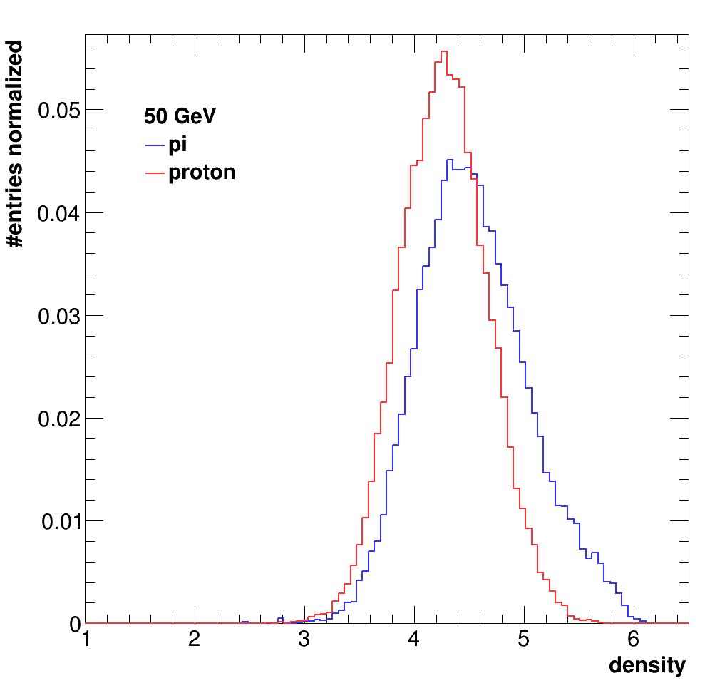
Further improvements on the energy reconstruction
Hadron identification
The energy reconstruction method was applied to hadron events.
No distinction was made between pions and protons or others.
Hadronic showers of pions and protons are not identical
Simulation
Better construction can be made if one can identify the nature f the hadron.
Simulation
Simulation
Simulation
Simulation
2022 beam test will be dedicated to study pion vs proton and kaon showers using Cerenkov detectors. Then BDT technique will be used to develop hadron PID and then energy construction algorithm with different (α, β, γ) parameters could be used.

Slide 23
Summary
SDHCAL concept with its high granularity provides an excellent tool not only to apply PFA by separating nearby showers but also to measure their energy.
Different techniques were used to measure hadronic shower energy
excellent linearity and very good resolution are obtained
The exploitation of the hadronic shower shape thanks to the high granularity is an excellent asset to identify particles and then better measure their energy.
In the future SDHCAL will exploit precise time information using MRPC. The time information will improve on energy reconstruction by separating delayed neutrons contribution and better estimating it.

Slide 24
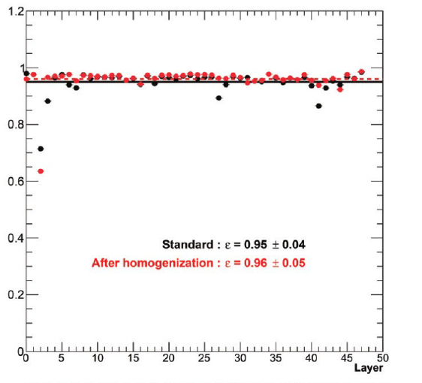

Slide 25
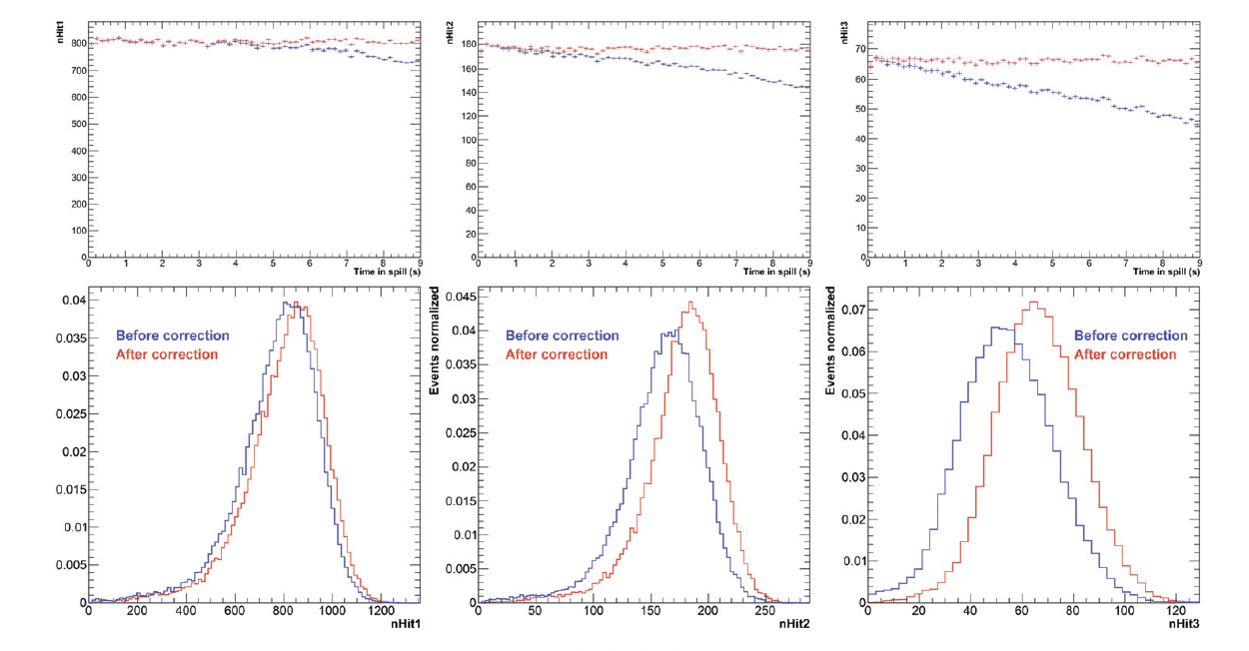
Time correction

Slide 26
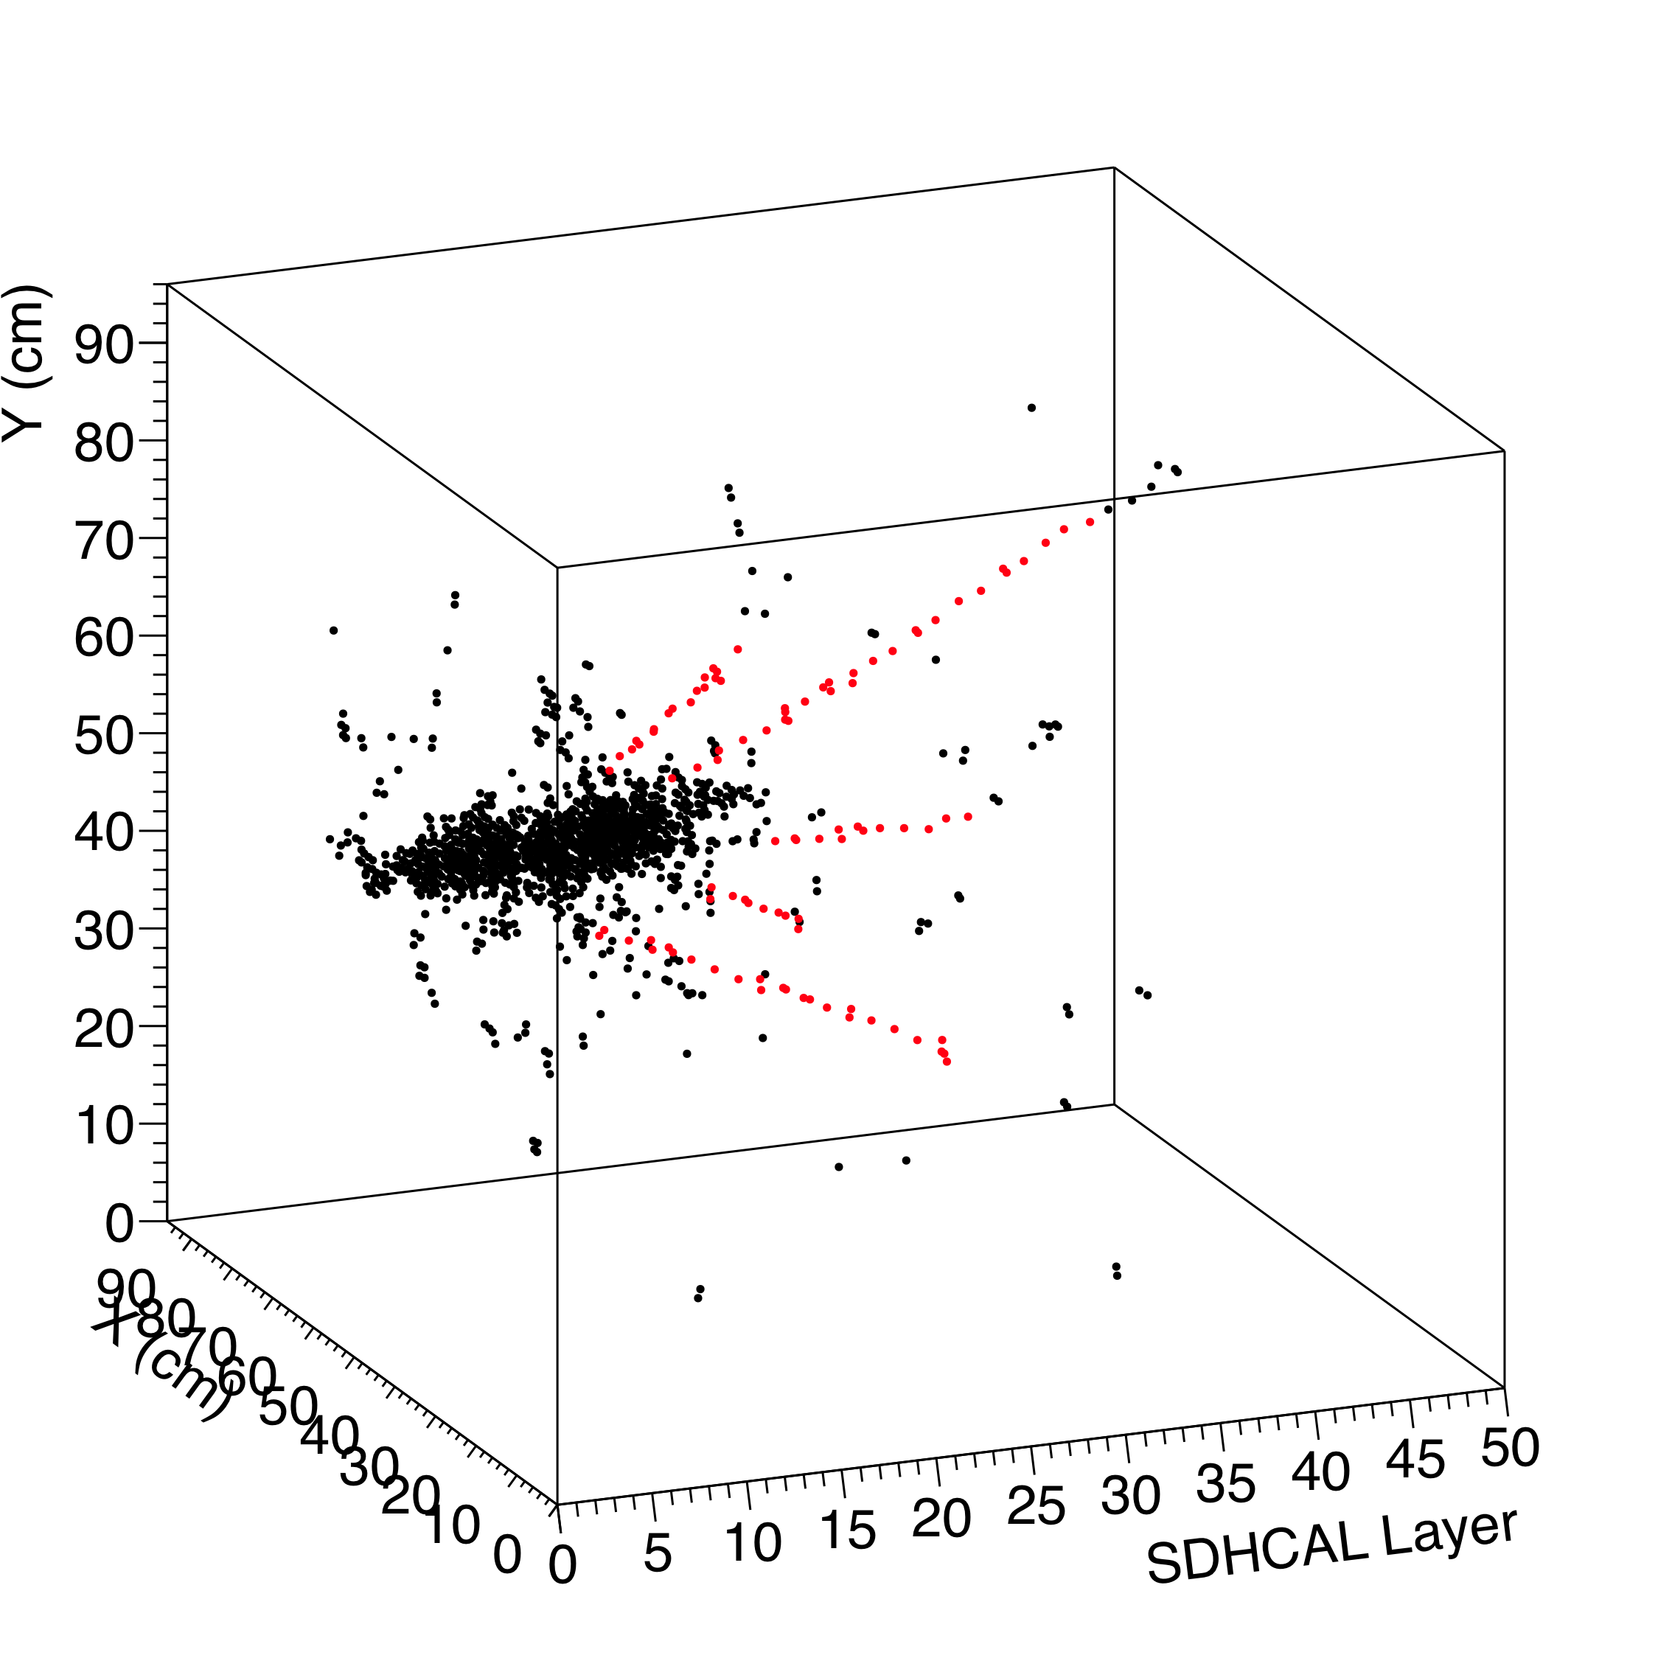
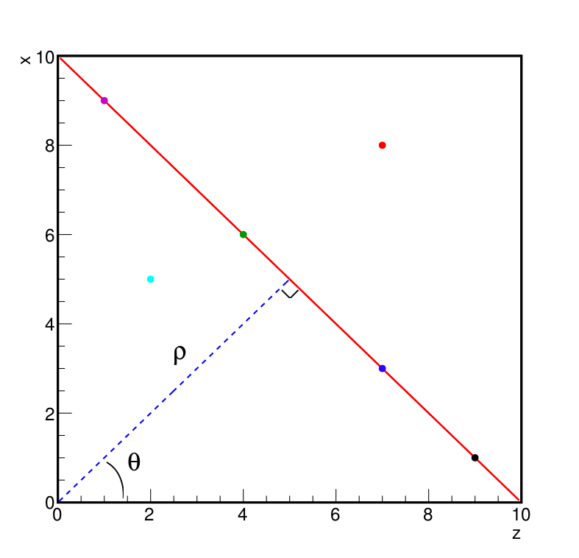
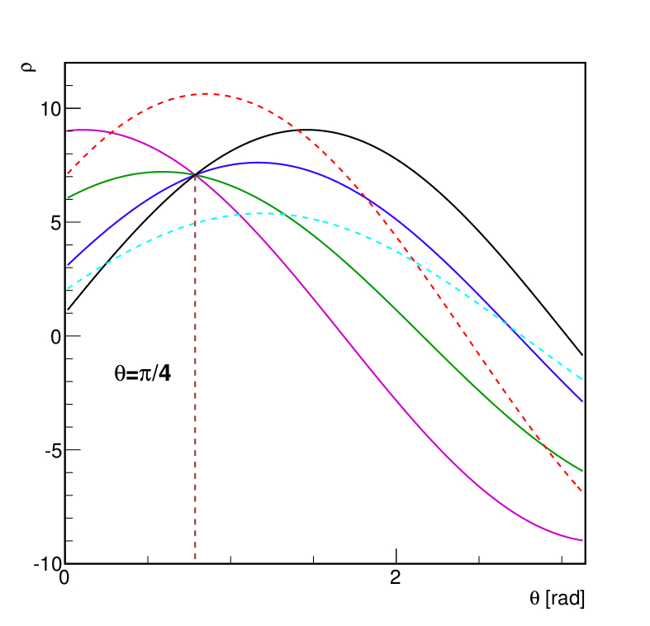
SDHCAL High-granularity impact
Hough Transform is an example to extract tracks within hadronic showers and to use them to control the calorimeter in situ
ρ_{xz} = z sin(θ) + x cos(θ)
Excellent agreement with efficiency/multiplicity results obtained with cosmic and beam-muons. Excellent agreement data/MC

Slide 27
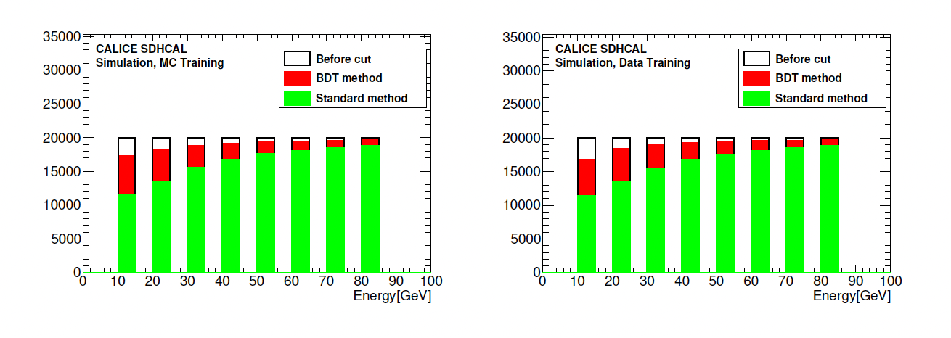

Slide 28
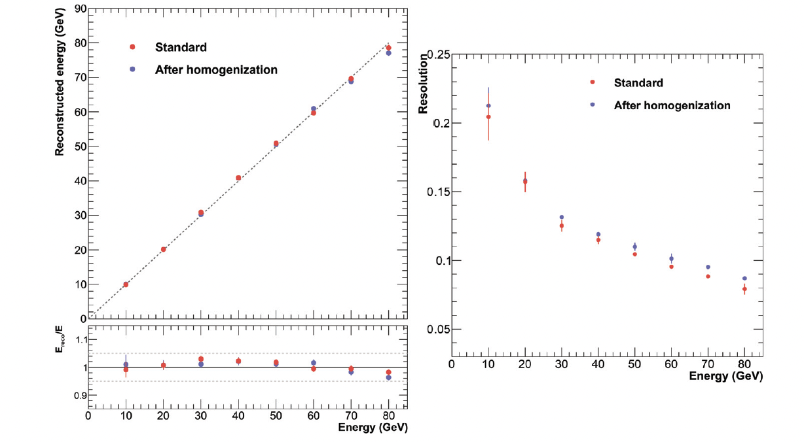

Slide 29
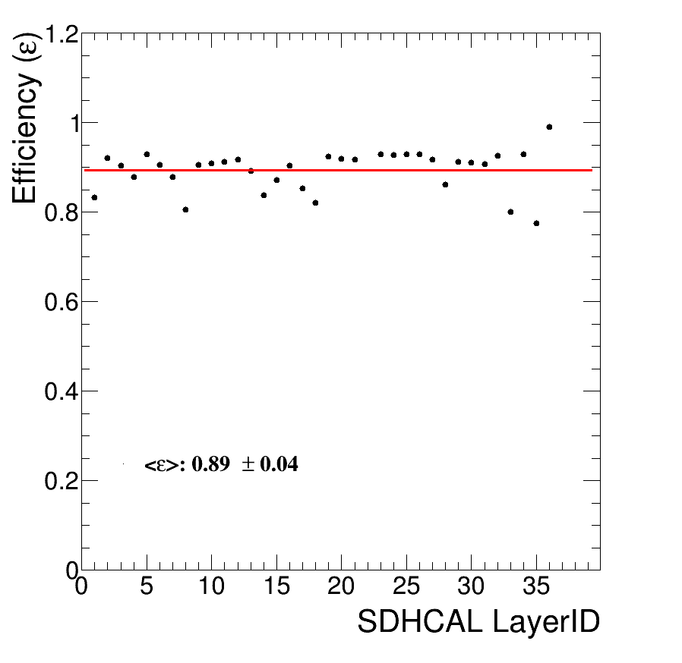

Slide 30
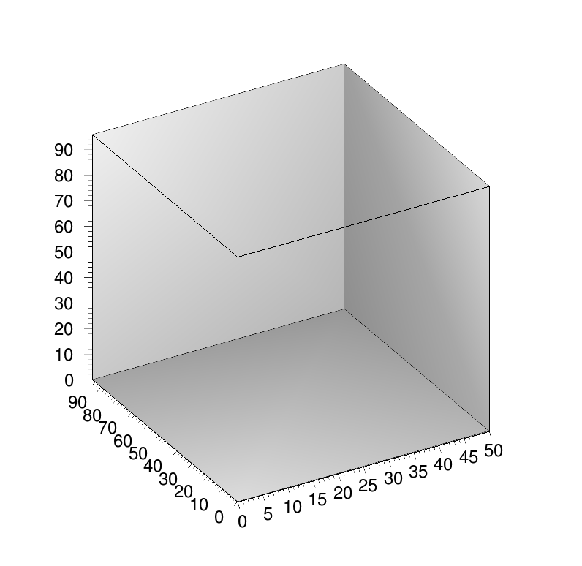
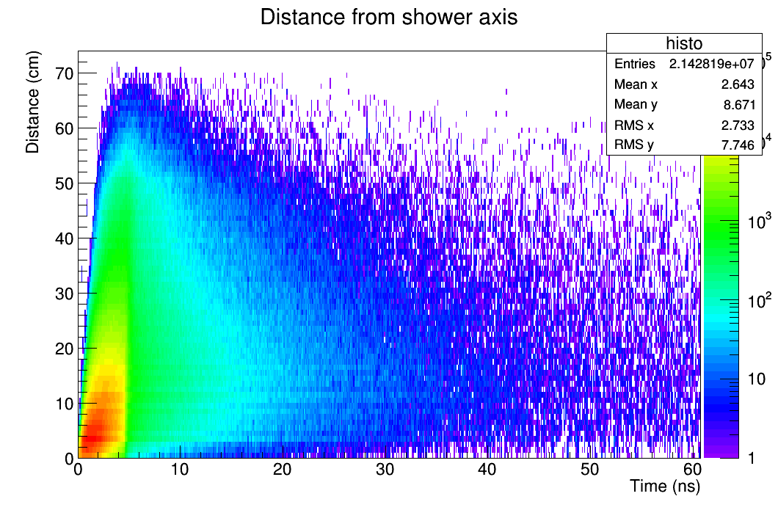
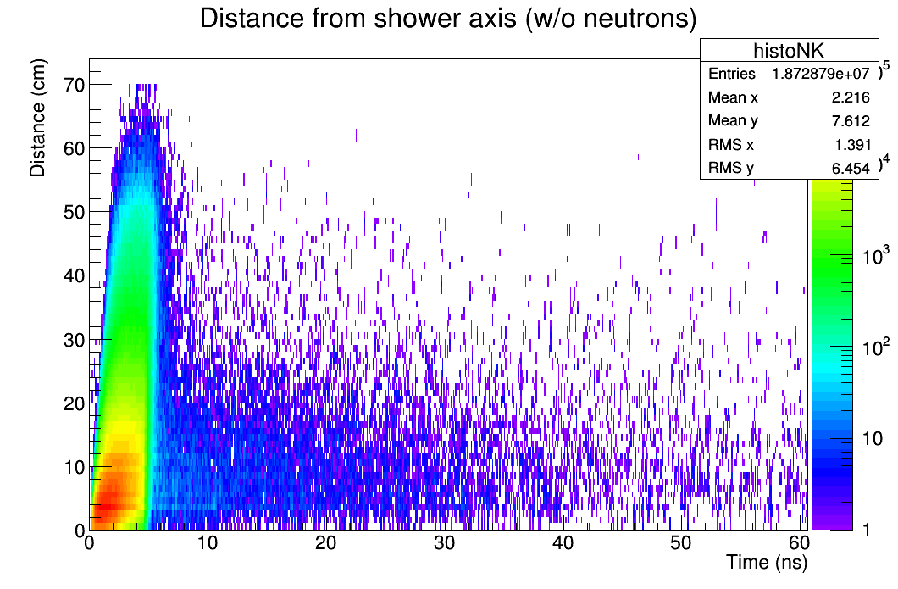
Timing could be an important factor to identify delayed neutrons and better reconstruct their energy

