Slide 1
Radiation damage studies for phenyl-based plastic scintillators
CALOR 2022 – 19th International Conference on Calorimetry
in Particle Physics
University of Sussex, Brighton, 16-20 May 2022
Alberto Belloni, Sarah Eno, Timothy Edberg, Christos Papageorgakis (UMD)
May 20, 2022
Preprint: arXiv:2203.15923
Submitted to NIMA for review.
Notes:
10 secs – Just say ”hello” and the title.

Slide 2
Overview
Plastic scintillators in HEP
Work principles
Mechanisms of radiation damage
Related work
Experimental methodology
Results
Conclusions
Notes:
30 secs – No further comments.

Slide 3
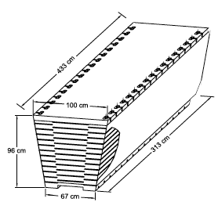
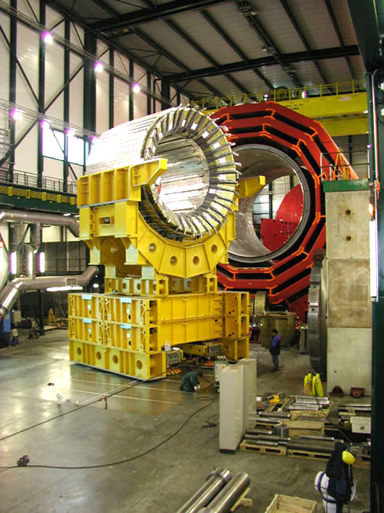
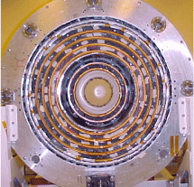
Plastic scintillators in HEP – past
Many experiments have used them in the past:
  CDF
    Hadronic Calorimeter
  DØ
    outer tracker (scintillating fiber)
    Preshower detector
Notes:
30 secs tops - Briefly go through this.

Slide 4
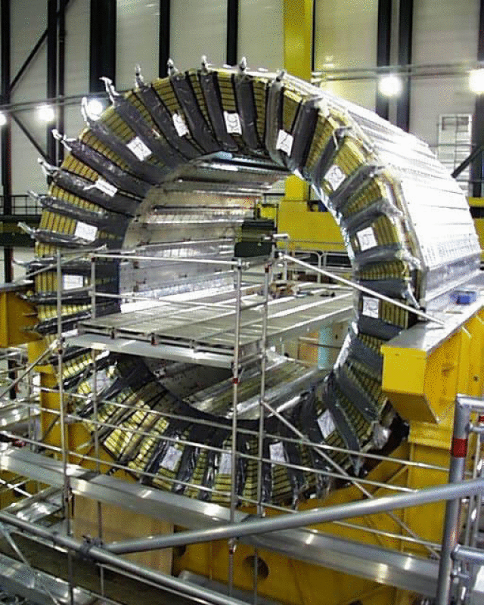
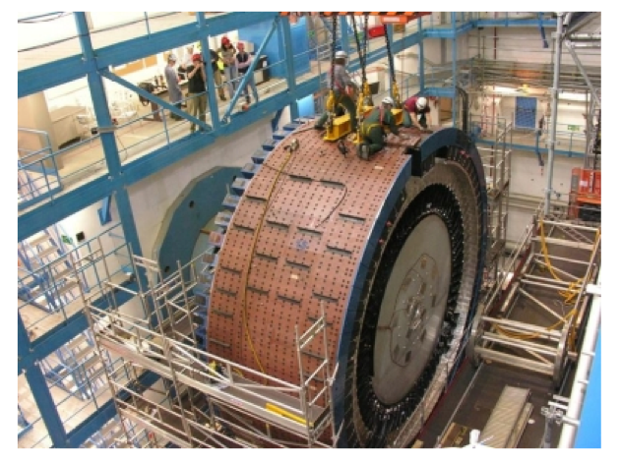
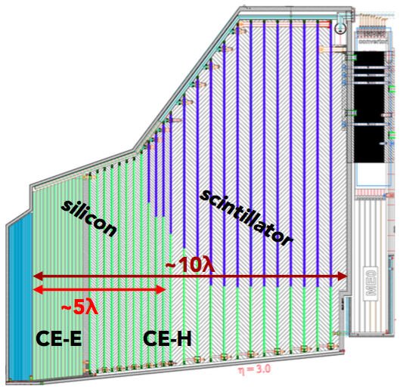
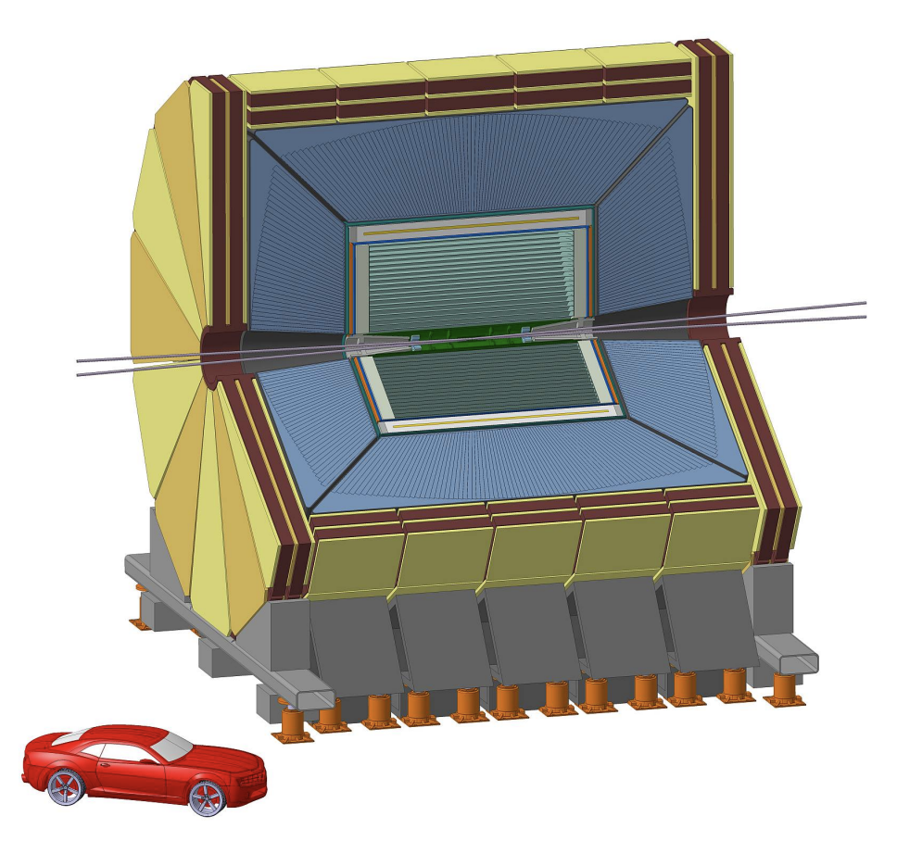
Plastic scintillators in HEP – today
Many experiments are using them or planning to use them:
  CMS
    HCAL
    HGCAL
  ATLAS
    TileCal
Future experiments considering their use:
  E.g., FCC-ee: the IDEA detector (in the form of scintillating fiber)
Notes:
30 secs tops - Briefly go through this.

Slide 5
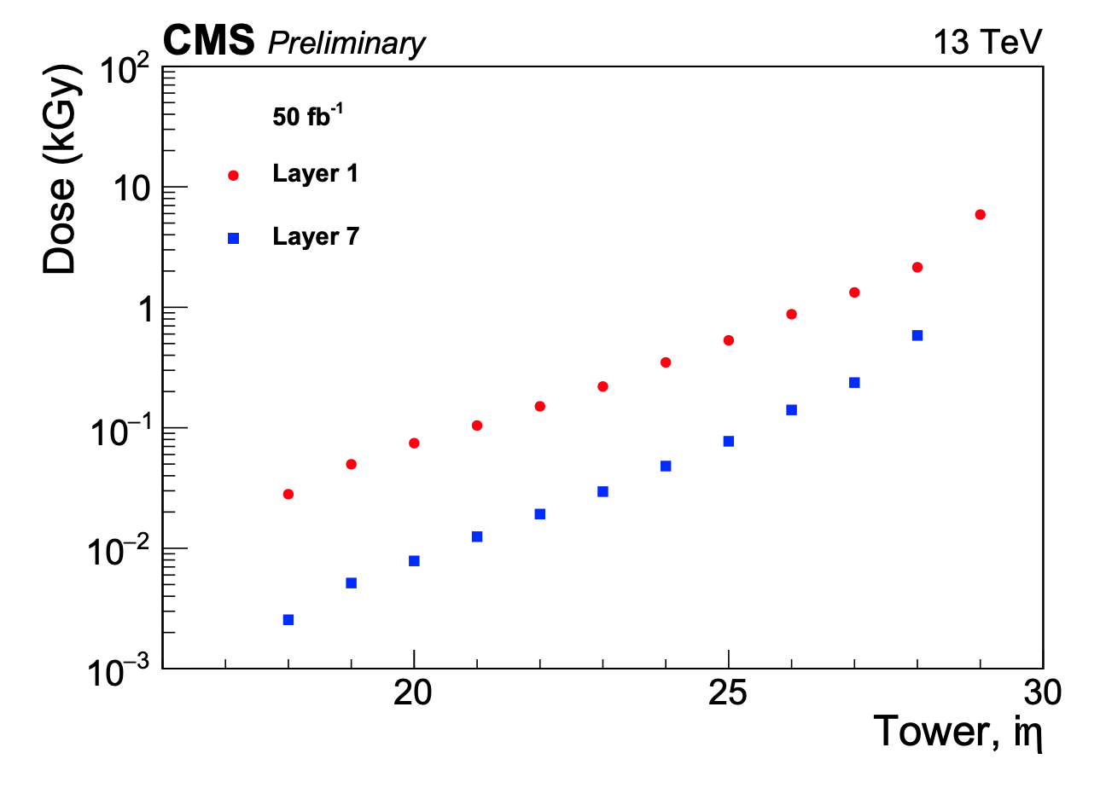
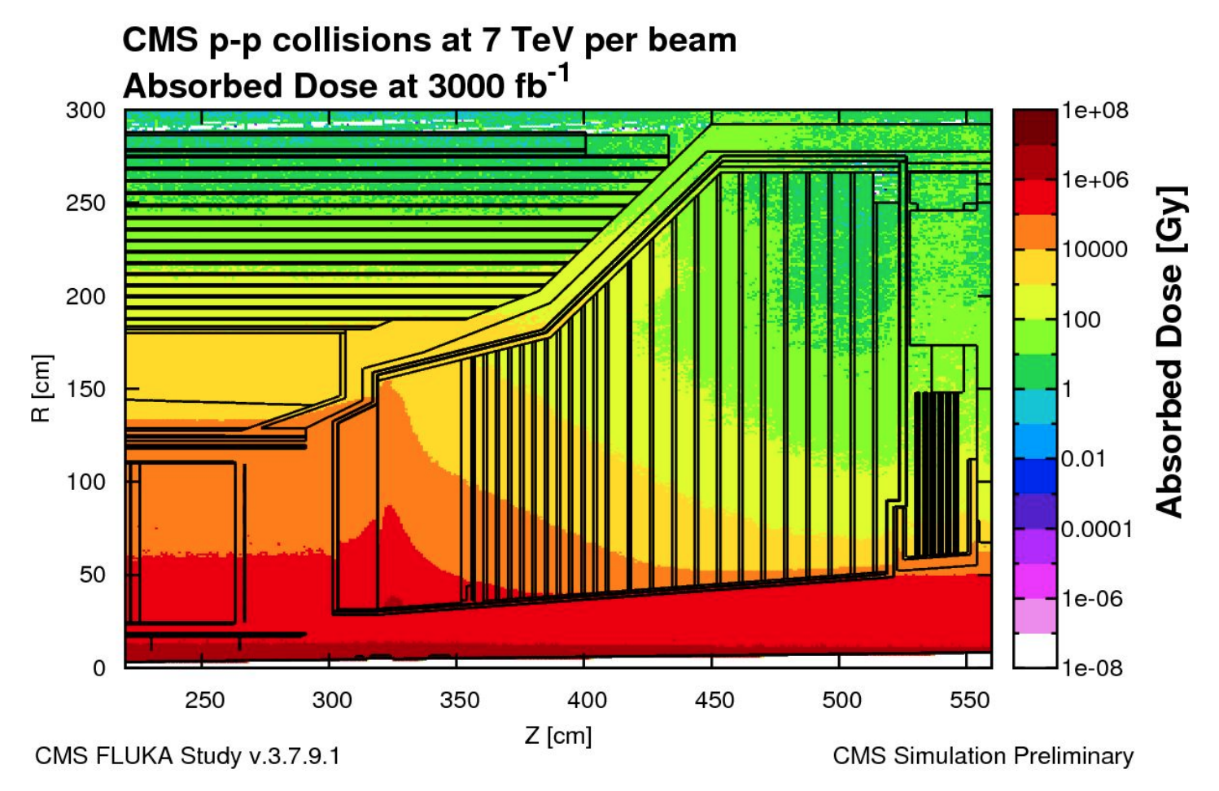
Importance of radiation hardness
Radiation tolerance has been important for applications with high particle fluxes.
(doses > 10³ Gy)
At CMS, during the 50 fb⁻¹ running at 13 TeV in 2017, the HE tiles received doses up to a few kGy. ^{[12]}
Typical dose rates from 10⁻³ to 1 Gy/h.
During the HL-LHC run, the HGCal detector’s scintillator is expected to absorb doses up to O(100 kGy). ^{[13]}
More details on Ted Koldberg’s talk yesterday
Notes:
45 secs – Compare past doses with expected in the future.

Slide 6
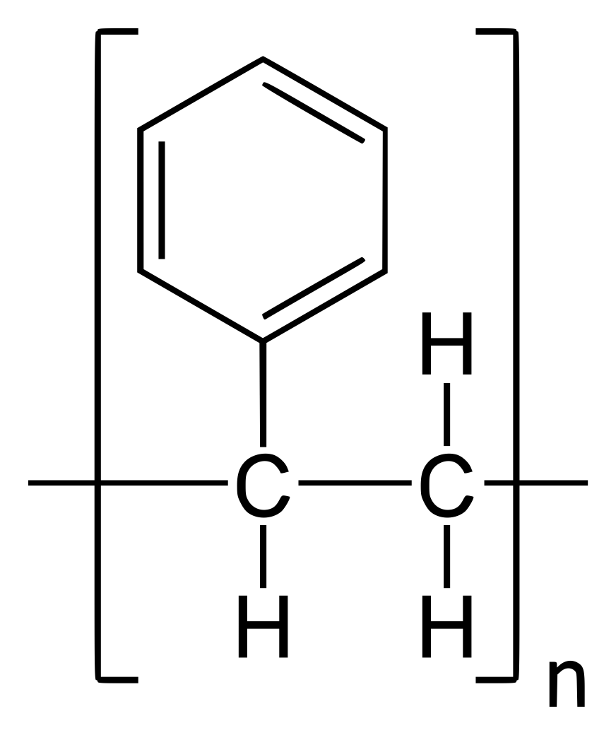
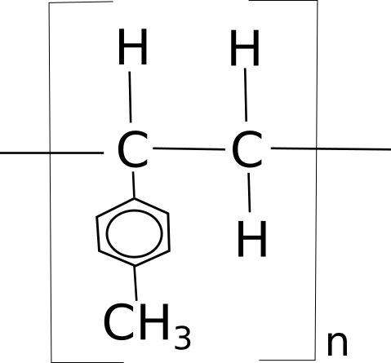
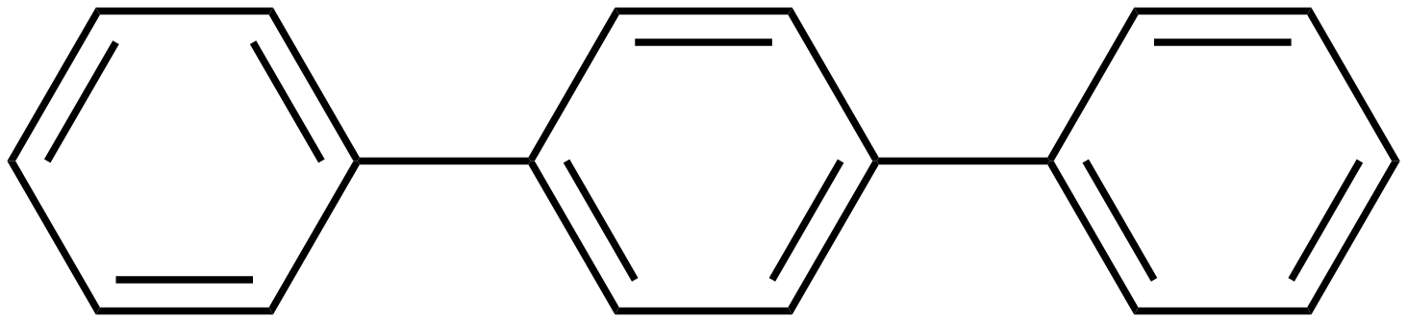
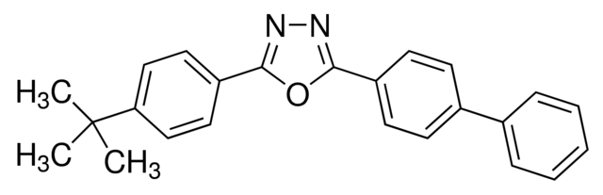
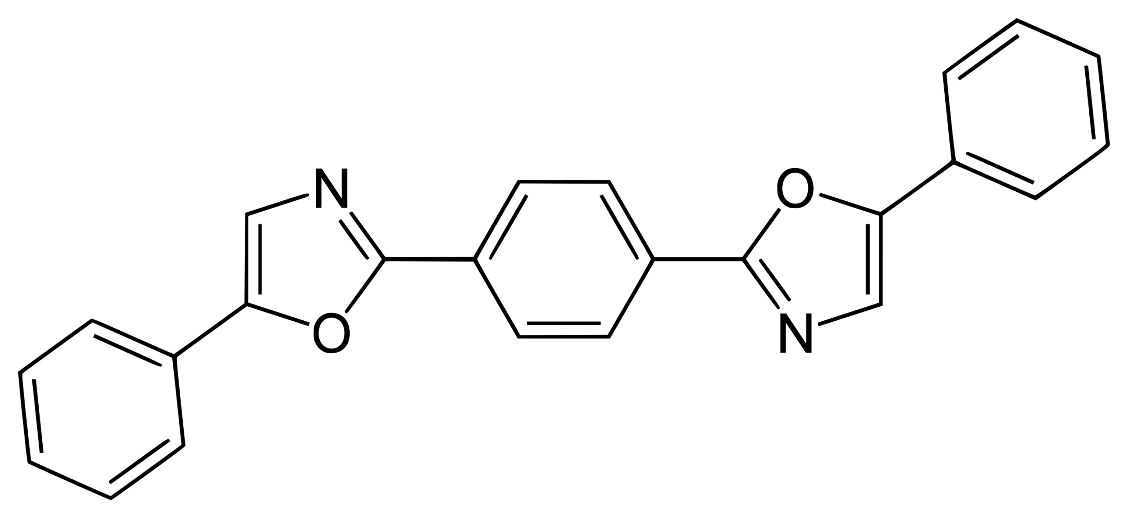
Plastic scintillators – structure
Plastic scintillators consist of:
  Substrate material: Common choices include:
  Dopants:
    Primary fluors, like:
    Secondary fluors, like:
polystyrene (PS)
polyvinyl toluene (PVT)
p-terphenyl (PTP)
BPBD
POPOP
Notes:
45 secs – Go through each bullet point.

Slide 7
Plastic scintillators – inner workings
The scintillation process for a particle that enters the scintillator follows these steps ^{[1, 2]}:
  The particle excites/ionizes the the electrons of the substrate.
  Energy transfer from substrate to primary fluor:
    Non-radiative transfer through the Förster mechanism.
    Radiative transfer
  Primary fluor emits photon.
  Secondary fluor absorbs photon from primary and reemits at different wavelength.
  Detection of secondary fluor emission with photodetector.
^{[3]}
Photodetector
primary dopant
secondary dopant
substrate excitation
radiative transfer
Förster transfer
Notes:
60 secs – Go through all 5 points.

Slide 8
Radiation damage
Mechanisms for radiation damage can be categorized as follows:
Decrease in the initial light production
  Fluor destruction
  Absorption of light between primary and secondary fluors.
  Suppression of Förster mechanism.
Formation of color centers^{[4]}
  Absorption of light emitted from the secondary fluor.
Photodetector
primary dopant
secondary dopant
substrate excitation
radiative transfer
Förster transfer
Notes:
60 secs – Go through all 2 & 4 points.

Slide 9
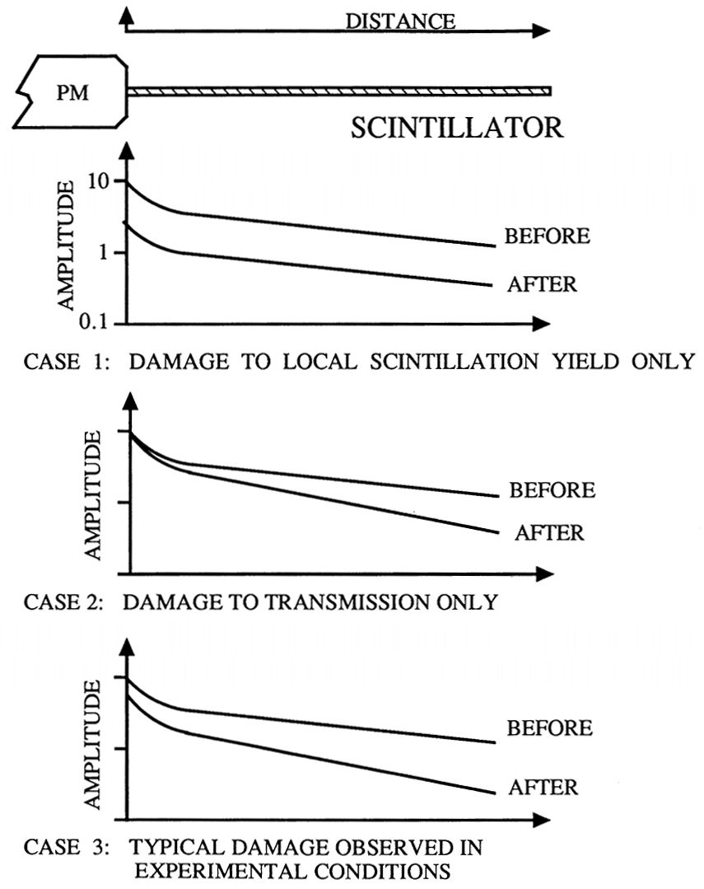
Radiation damage
DISTANCE
Mechanisms for radiation damage can be categorized as follows:
Decrease in the initial light production
  Fluor destruction
  Absorption of light between primary and secondary fluors.
  Suppression of Förster mechanism.
Formation of color centers^{[4]}
  Absorption of light emitted from the secondary fluor.
Differences:
  Color centers: dependence on thickness
  Initial LY decrease: independent of thickness
Figure taken from [1].
Notes:
15 secs – Briefly explain the new plot.
Color centers: dependent on sample thickness
Initial LY: independent of thickness.

Slide 10
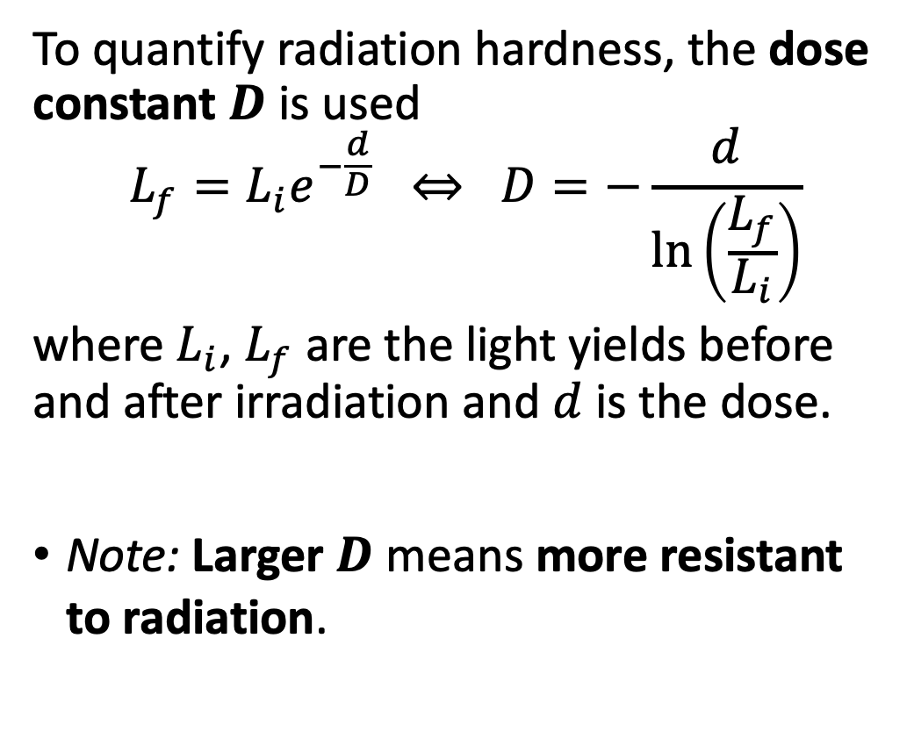
Dose constant
To quantify radiation hardness, the dose constant $D$ is used
$$L_{f}=L_{i}e^{−\frac{d}{D}} ⇔ D=−\frac{d}{\ln\left(\frac{L_{f}}{L_{i}}\right)}$$
where $L_{i}$, $L_{f}$ are the light yields before and after irradiation and $d$ is the dose.
Note: Larger $D$ means more resistant to radiation.
Exponential Fits
Notes:
30 secs – Make sure they understand how D is defined and behaves.

Slide 11
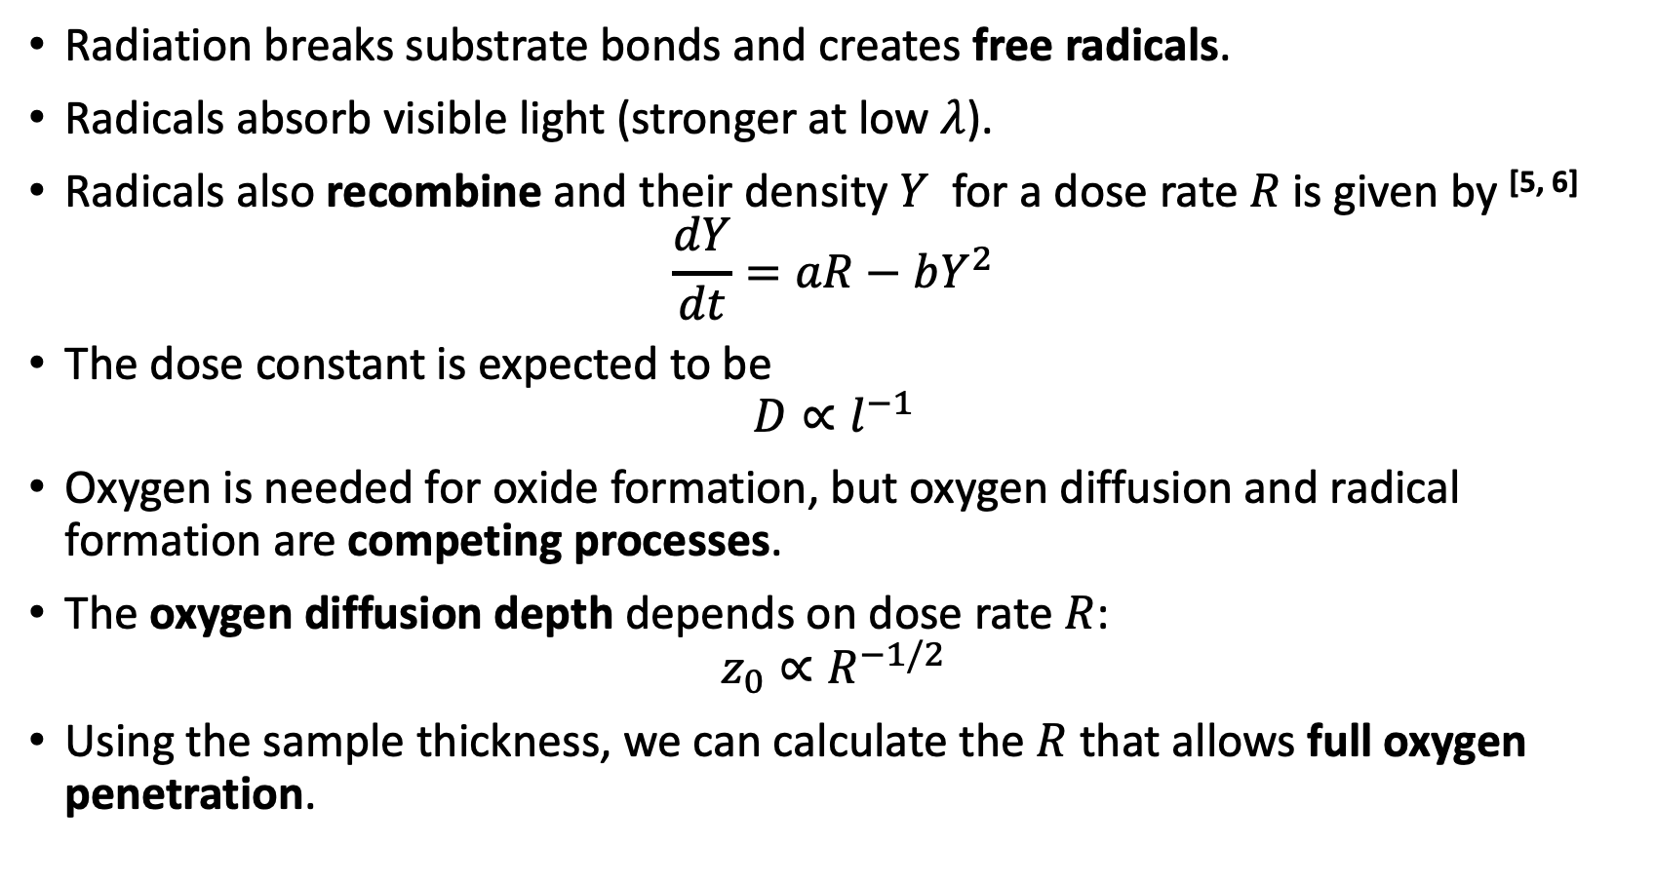
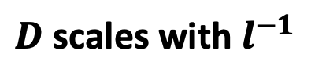
Dose rate dependence on damage
Radiation breaks substrate bonds and creates free radicals.
Radicals absorb visible light (stronger at low $λ$).
Radicals also recombine and their density $Y$ for a dose rate $R$is given by ^{[5, 6]}
$\frac{dY}{dt}=aR−bY^{2}$
The dose constant is expected to be
$D{∝l}^{−1}$
Oxygen is needed for oxide formation, but oxygen diffusion and radical formation are competing processes.
The oxygen diffusion depth depends on dose rate $R$:
$z_{0}∝R^{−1/2}$
Using the sample thickness, we can calculate the $R$ that allows full oxygen penetration.
Temporary damage
$D$ scales with $l^{−1}$
*symbols expanded and explained in backup slides
Notes:
90 secs – Dense slide. Need to go through all 7 of them.

Slide 12
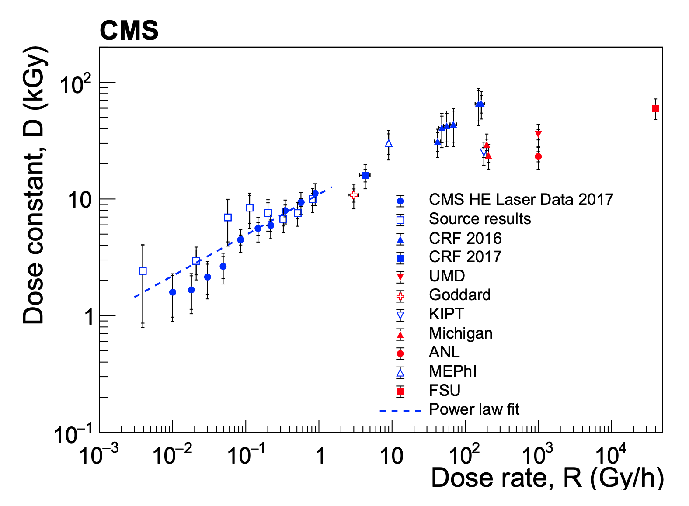
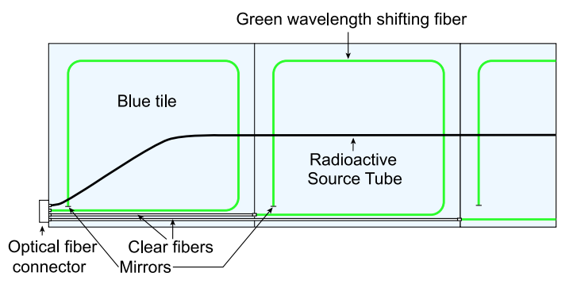
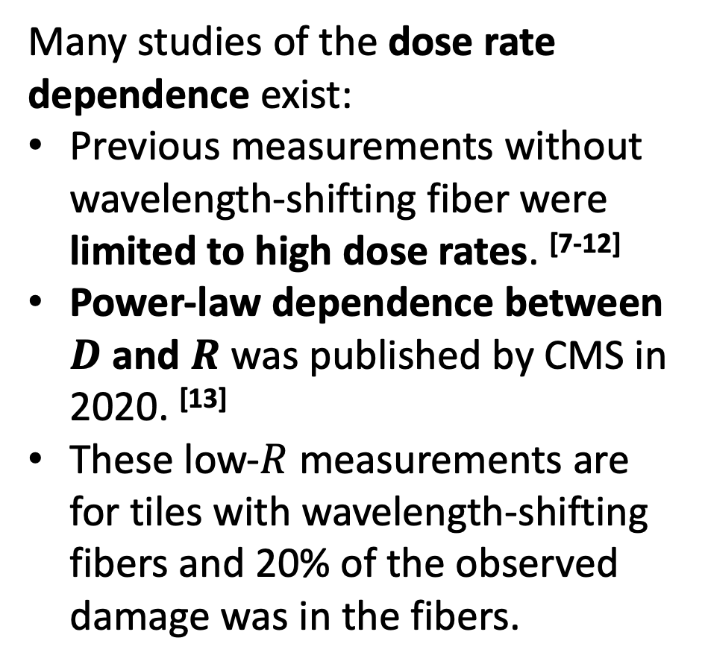
Related work
Many studies of the dose rate dependence exist:
Previous measurements without wavelength-shifting fiber were limited to high dose rates. ^{[7-12]}
Power-law dependence between $D$ and $R$ was published by CMS in 2020. ^{[13]}
These low-$R$ measurements are for tiles with wavelength-shifting fibers and 20% of the observed damage was in the fibers.
Notes:
45 secs – 3 points.
Biagtan: 140 Gy/hr
Wick: 30 Gy/hr
Anna Pla Dalmau: 300 Gy/hr
Giokaris:

Slide 13
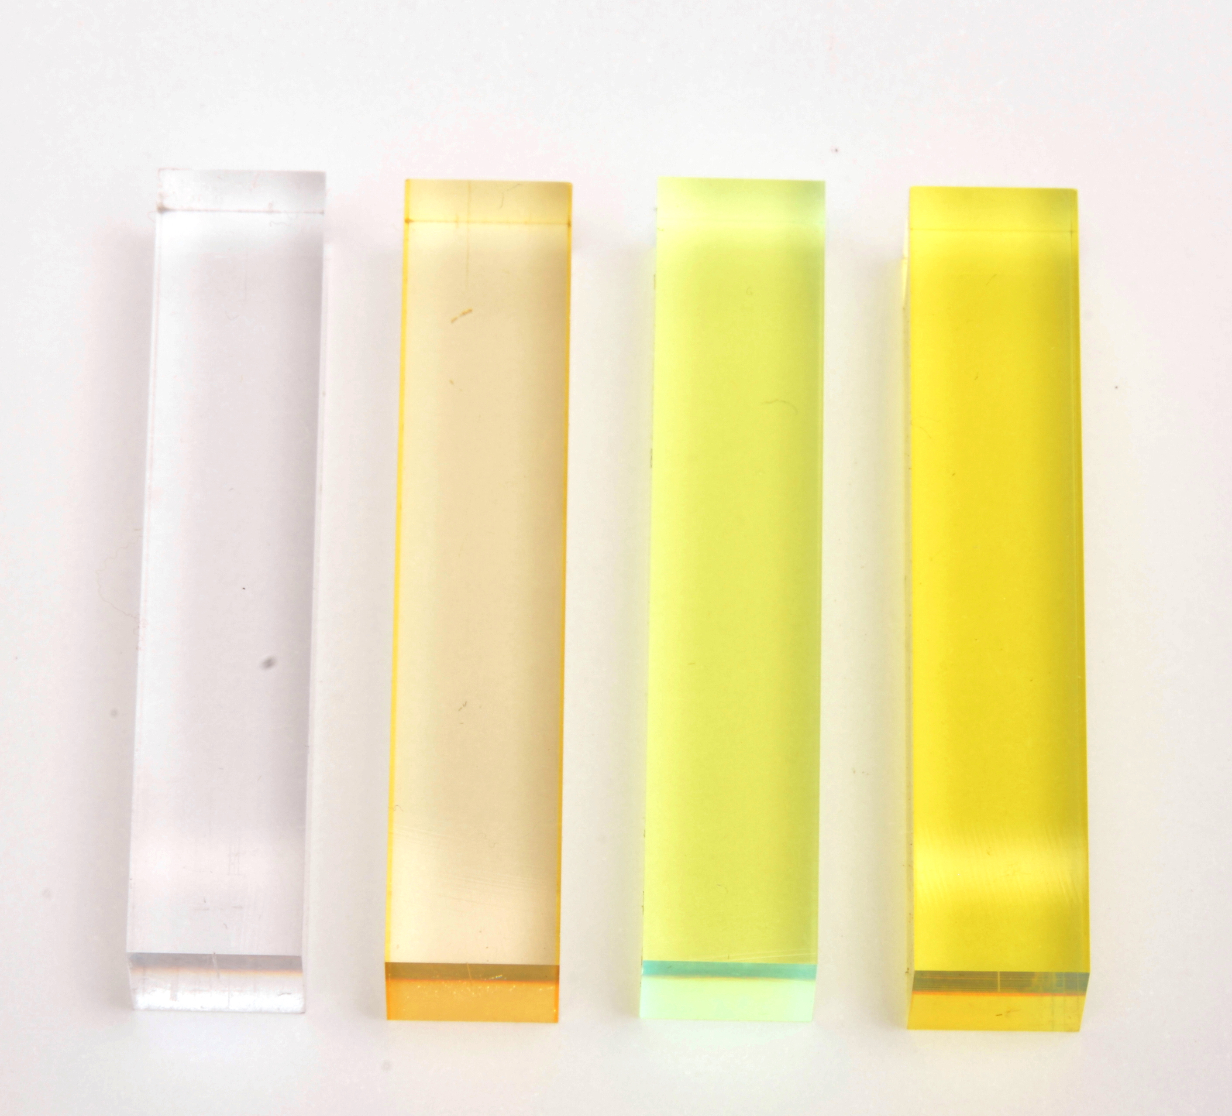
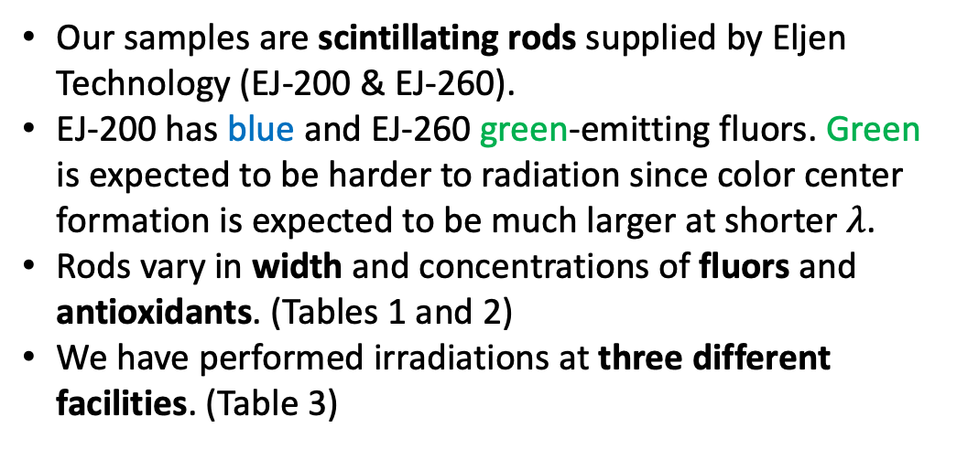
Methodology – Irradiations
Our samples are scintillating rods supplied by Eljen Technology (EJ-200 & EJ-260).
EJ-200 has blue and EJ-260 green-emitting fluors. Green is expected to be harder to radiation since color center formation is expected to be much larger at shorter $λ$.
Rods vary in width and concentrations of fluors and antioxidants. (Tables 1 and 2)
We have performed irradiations at three different facilities. (Table 3)
Table 1: 1x1x5 cm samples (units of nominal concentration) | Table 2: 1x1x5 cm samples (units of nominal concentration)
Scintillator type | Substrate | Primary fluor | Secondary fluor | Antioxidants
EJ200, EJ260 | PS | 1 | 1 | 0, 1, 2
 |  |  | 2 | 1
 |  | 2 | 1 | 1
 | PVT | 1 | 1 | 0, 1, 2
 |  |  | 2 | 1
 |  | 2 | 1 | 1
Table 3: Irradiations
Irradiation facility | Source | Dose (kGy) | Dose rate (Gy/hr)
GSFC REF | Gamma | 12.6 | 3.1
 |  | 42 | 9.8
NIST | Co-60 | 47 | 470
 |  | 70 | 83.4, 85.3
 |  |  | 744
 |  |  | 2570, 3900
GIF++ | Cs-137 | 13.2 | 2.2
EJ-200
EJ-260
Table 2: Variable width samples
Substrate | Width (cm) | Fluors/ Antioxidants
PS | 0.2, 0.4, 0.6, 0.8, 1.0 | Nominal concentrations
PVT | 0.2, 0.4, 0.6, 0.8, 1.0
Before irr.
After irr.
Notes:
60 secs – need to explain how and what we irradiate.

Slide 14

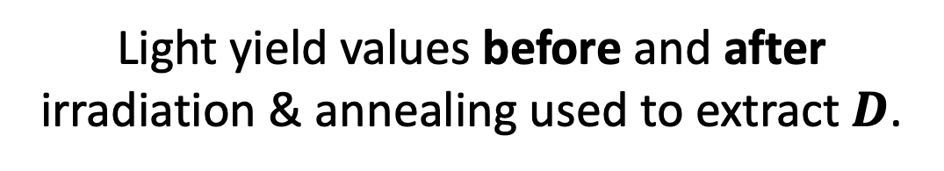
Methodology – Measuring $D$
Charge integration
over 100 ns
Tektronix TDS7104
oscilloscope
(²³⁹Pu)
Calibration measurements
(dark current, gain)
+
Fit peak of curve
Light yield values before and after irradiation & annealing used to extract $D$.
Notes:
45 secs – how we calculate D for a sample.

Slide 15
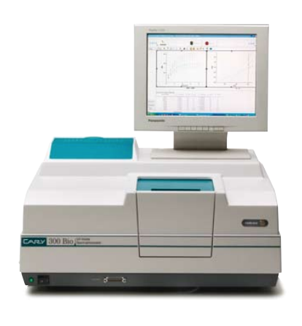
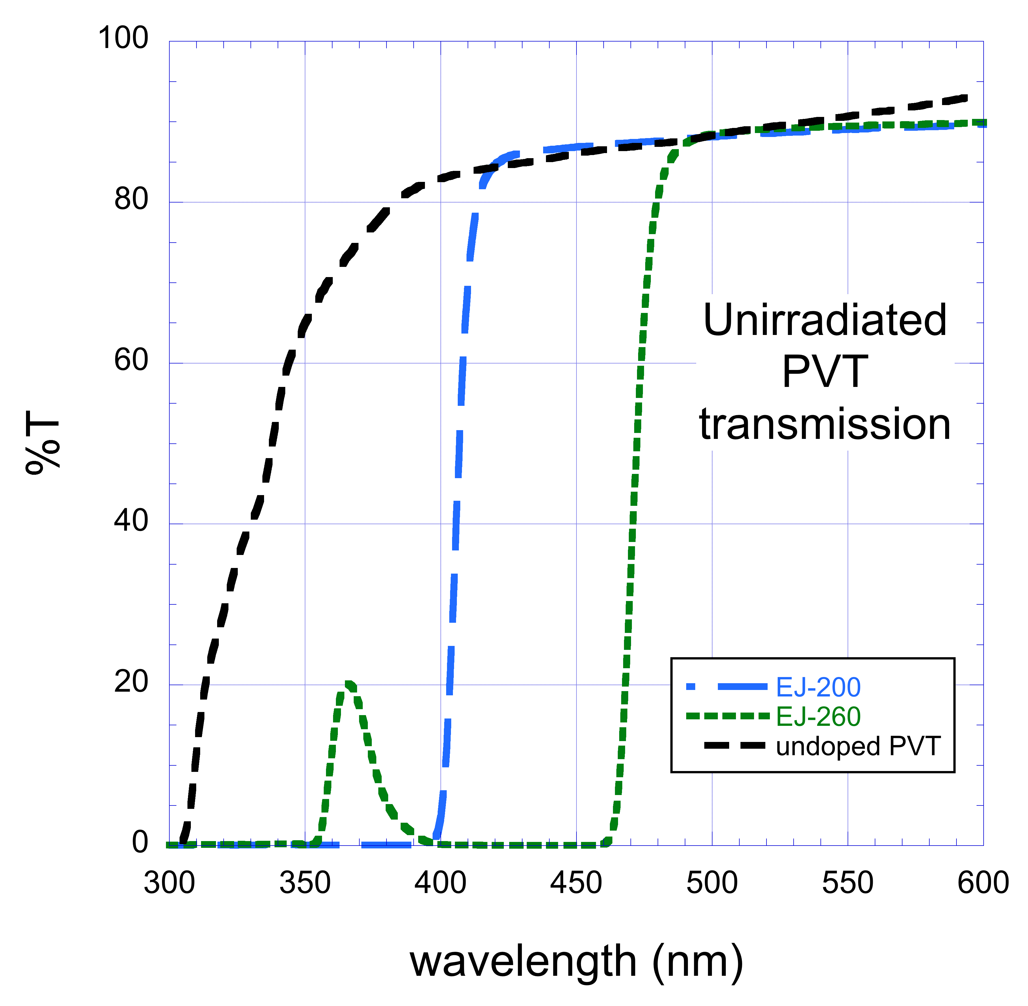

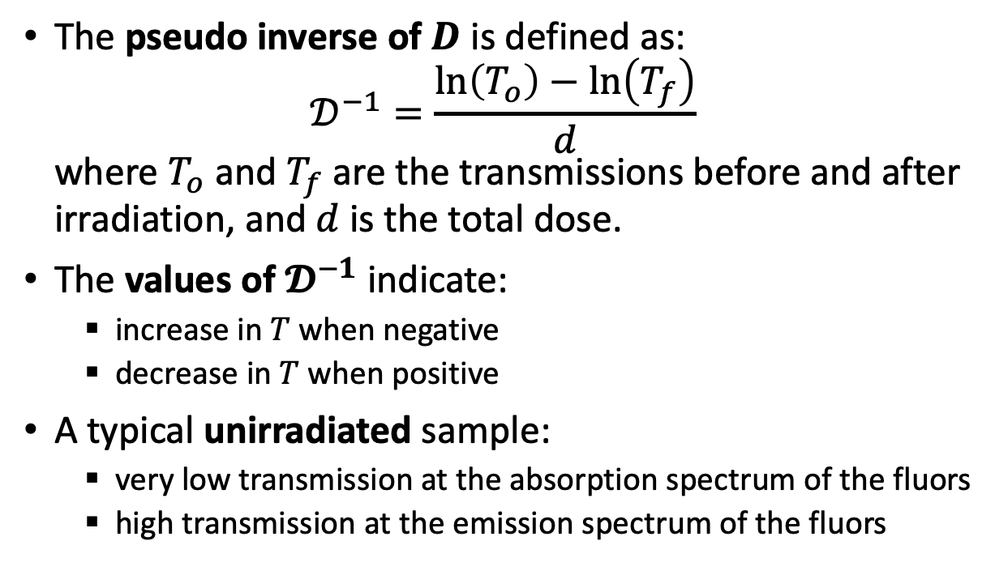
Methodology – Measuring $T$
Used a Varian Cary 300 spectrophotometer to measure transmission.
The pseudo inverse of $D$ is defined as:
$𝒟^{−1}=\frac{\ln\left(T_{o}\right)−\ln\left(T_{f}\right)}{d}$
where $T_{o}$ and $T_{f}$ are the transmissions before and after irradiation, and $d$ is the total dose.
The values of $𝓓^{−1}$ indicate:
  increase in $T$ when negative
  decrease in $T$ when positive
A typical unirradiated sample:
  very low transmission at the absorption spectrum of the fluors
  high transmission at the emission spectrum of the fluors
Notes:
60 secs – need to go through 4 & 4 points.
I don't know that you have to say this, but you should know why we defined D^-1 as we did.
If we paralleled the analogy to D, we would use D, not D^-1.
The reason for using D^-1 is that D would go to infinity whenever the T_i/T_f curve crosses 1.
D^-1 goes to zero in these cases, so it's better behaved.

Slide 16
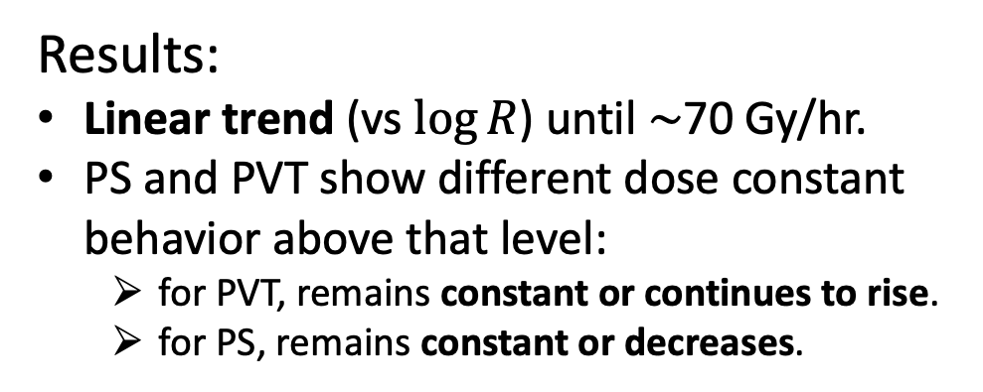
Results – PS vs PVT
About the comparison:
Comparing rods with PS and PVT substrates.
Both blue (EJ200) and green (EJ260) fluors are considered.
Fluors and antioxidants concentrations are nominal.
blue (EJ200)
Results:
Linear trend (vs $\log{R}$) until $\sim$70 Gy/hr.
PS and PVT show different dose constant behavior above that level:
  for PVT, remains constant or continues to rise.
  for PS, remains constant or decreases.
green (EJ260)
Depending on the fluor concentrations.
Notes:
45 secs – explanation & results.

Slide 17
Results – Fluor concentrations
PS
Varying fluor concentrations:
  1X1P: nominal primary and secondary
  1X2P: double primary and nominal secondary
  2X1P: nominal primary and double secondary
Some observations:
No significant effect observed until 70 Gy/hr.
Behavior above that amount depends on dopant concentrations.
Increasing the primary dopant concentration benefits PS samples.
No dependence observed for PVT within uncertainties.
PVT
Notes:
45 secs – explanation & results.

Slide 18
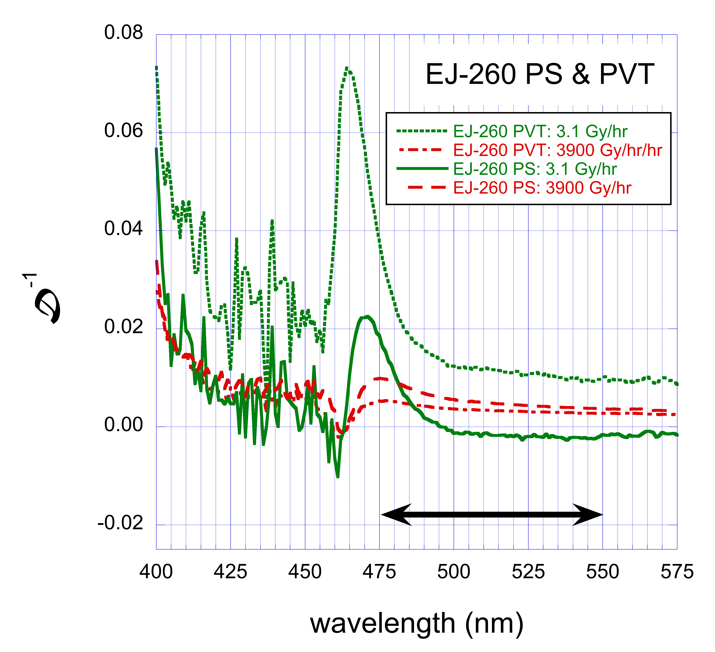
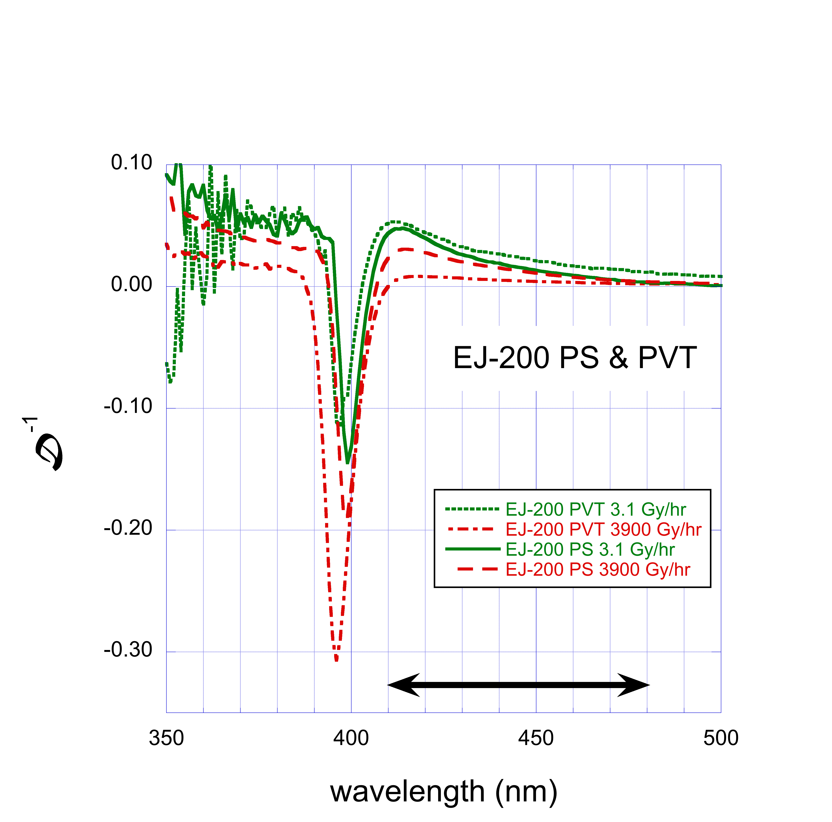
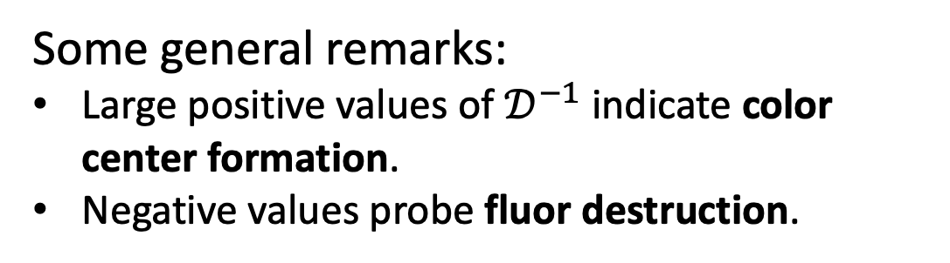
Results – Transmission
Some general remarks:
Large positive values of $𝒟^{−1}$ indicate color center formation.
Negative values probe fluor destruction.
Both are indicators of radiation damage.
Our observations show:
Radiation damage for both scintillator types.
Fluor destruction for the blue scintillator (EJ200).
Black arrows indicate the emission spectrum of the secondary.
Notes:
45 secs – explanation & results.

Slide 19
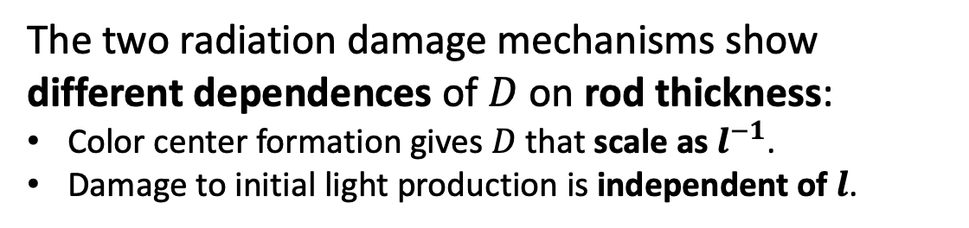
Results – Varying thickness
The two radiation damage mechanisms show different dependences of $D$ on rod thickness:
Color center formation gives $D$ that scale as $l^{−1}$.
Damage to initial light production is independent of $l$.
Results:
During the recovery period, the dose constant is strongly dependent on the sample thickness.
Indication that color centers (radicals!) form during irradiation but their number reduces after annealing.
Final dose constants do not depend strongly on thickness.
Dominant radiation damage mechanism is reduction in initial light production after annealing.
The maximum sample thickness (1 cm) is not large enough to make color centers dominant.
Note: For full oxygen penetration dose rates need to below 10 Gy/h, 4.4 Gy/h, 2.5 Gy/h, and 1.6 Gy/h for thicknesses 4, 6, 8, and 10 mm, respectively.
Notes:
60 secs – explanation & results.

Slide 20
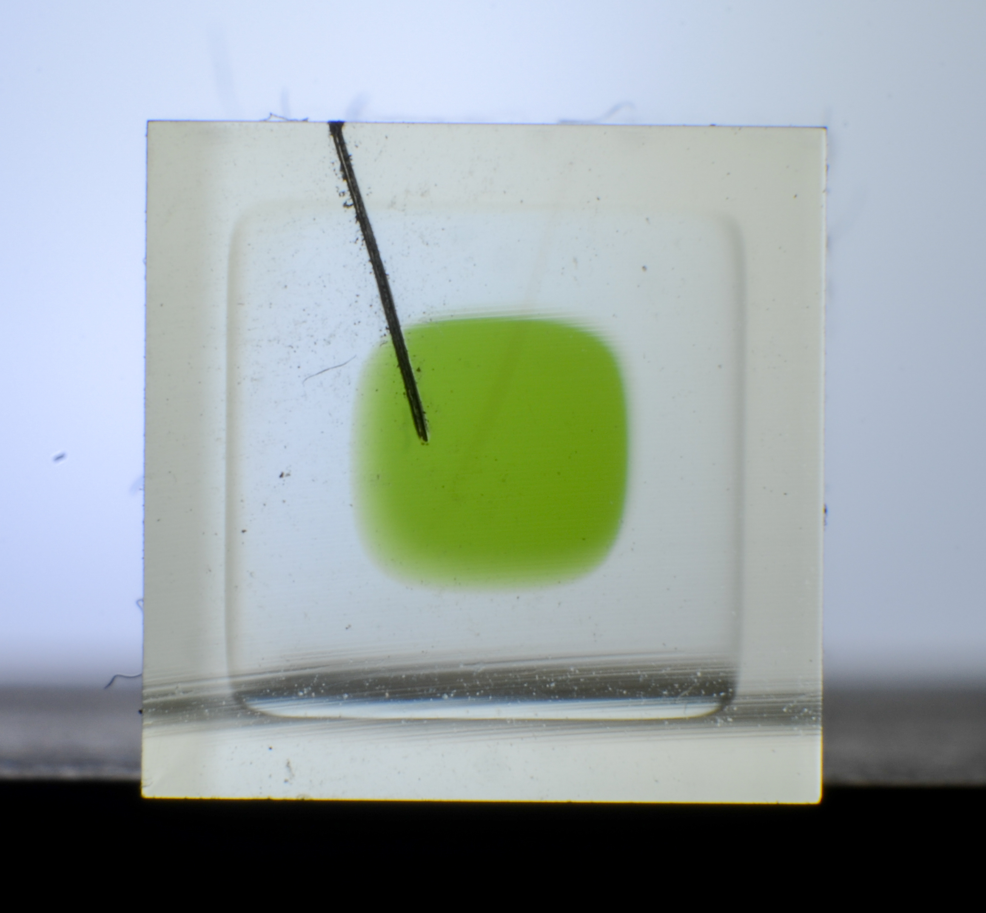
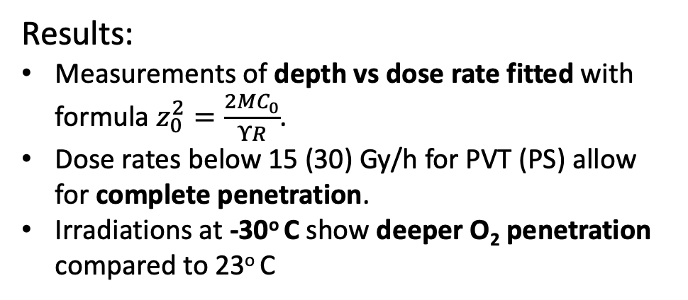
Oxygen penetration depth
Area with color centers during recovery
Scintillators acquire distinct optical features after irradiation. E.g., coloration, index change.
Index change boundary can be used to measure oxygen penetration depth.
Rod width
1 mm
Oxygen
penetration
depth
Results:
Measurements of depth vs dose rate fitted with formula $z_{0}^{2}=\frac{2MC_{0}}{ΥR}$.
Dose rates below 15 (30) Gy/h for PVT (PS) allow for complete penetration.
Irradiations at -30º C show deeper O₂ penetration compared to 23º C
3.5 mm vs 0.9 mm
operating temperature
for HGCAL

Slide 21
Conclusions
𝐷 increases linearly vs logR for dose rates up to 70 Gy/hr.
Above 70 Gy/hr:
  for PVT, it is constant or continues to rise
  for PS, it is constant or decreases
Results from varying thickness rods suggest that damage to the initial light output is dominant for thicknesses up to 1 cm.
Thicker samples will be more sensitive to color center absorption.
For the blue scintillator (EJ-200), the transmission measurements indicate damage to the fluors.
O₂ penetration depth measured using optical features. Deeper penetration at -30º C vs 23º C.
Depending on doping concentration.
Notes:
30 secs – 5 points.

Slide 22
References
C. Zorn, Plastic and liquid organic scintillators, in: F. Sauli (Ed.), Instrumentation in High Energy Physics, Advanced Series on Directions in High Energy Physics, Vol. 9, World Scientific, 1992, p. 218. doi:10.1142/9789814360333_0004.
J. B. Birks, The theory and practice of scintillation counting, Interna-tional Series of Monographs on Electronics and Instrumentation, Vol-ume 27, Pergamon Press, The Macmillan Company, New York, 1964. doi:10.1016/C2013-0-01791-4.
T. Förster, Zwischenmolekulare Energiewanderung und Fluoreszenz, Ann. Phys. 437 (1947) 55
Y. Kharzheev, Radiation Hardness of Scintillation Detectors Based on Organic Plastic Scintillators and Optical Fibers, Phys. Part. Nucl. 50 (1)(2019) 42–76. doi:10.1134/S1063779619010027.
Wise, K. Gillen, R. Clough, Quantitative model for the time development of diffusion-limited oxidation profiles, Polymer 38 (1997) 1929–1944.
K. Gillen, R. Clough, Rigorous experimental confirmation of a theoretical model for diffusion-limited oxidation, Polymer 38 (1992) 1929. doi:10.1016/0032-3861(92)90280-A.
E. Biagtan, E. Goldberg, R. Stephens, E. Valeroso, J. Harmon, Gamma dose and dose-rate effects on scintillator light output, Nucl. Instrum. Meth. 345B 108 (1996) 125. doi:10.1016/0168-583X(95)00874-8.
U. Holm, K. Wick, Radiation stability of plastic scintillators and wave-length shifters, IEEE Trans. Nucl. Sci. 36 (1989) 579. doi:10.1109/23.34504.

Slide 23
References
K. Wick, D. Paul, P. Schröder, V. Stieber, B. Bicken, Recovery and dose rate dependence of radiation damage in scintillators, wavelength shifters and light guides, Nucl. Instrum. Meth. B 61 (1991) 472. doi:10.1016/0168-583X(91)95325-8.
B. Bicken, U. Holm, T. Marckmann, K. Wick, M. Rohde, Recovery and permanent radiation damage of plastic scintillators at different dose rates, IEEE Trans. Nucl. Sci. 38 (1991) 188. doi:10.1109/23.289295.
A. D. Bross, A. Pla-Dalmau, Radiation damage of plastic scintillators, IEEE Trans. Nucl. Sci. 39 (1992) 1199. doi:10.1109/23.173178.
N. D. Giokaris, M. Contreras, A. Pla-Dalmau, J. Zimmerman, K. F. John-son, Study of dose-rate effects on the radiation damage of polymer-basedSCSN23, SCSN81, SCSN81+Y7, SCSN81+Y8 and 3HF scintillators, Radiat. Phys. Chem. 41 (1993) 315. doi:10.1016/0969-806X(93)90069-7.
CMS Collaboration, Measurements with silicon photomultipliers of dose-rate effects in the radiation damage of plastic scintillator tiles in the CMS hadron endcap calorimeter, Journal of Instrumentation 15 (06) (2020)P06009–P06009. doi:10.1088/1748-0221/15/06/p06009.
CMS Collaboration, The Phase-2 Upgrade of the CMS Endcap Calorimeter, 2017. https://cds.cern.ch/record/2293646

Slide 24
Backup

Slide 25
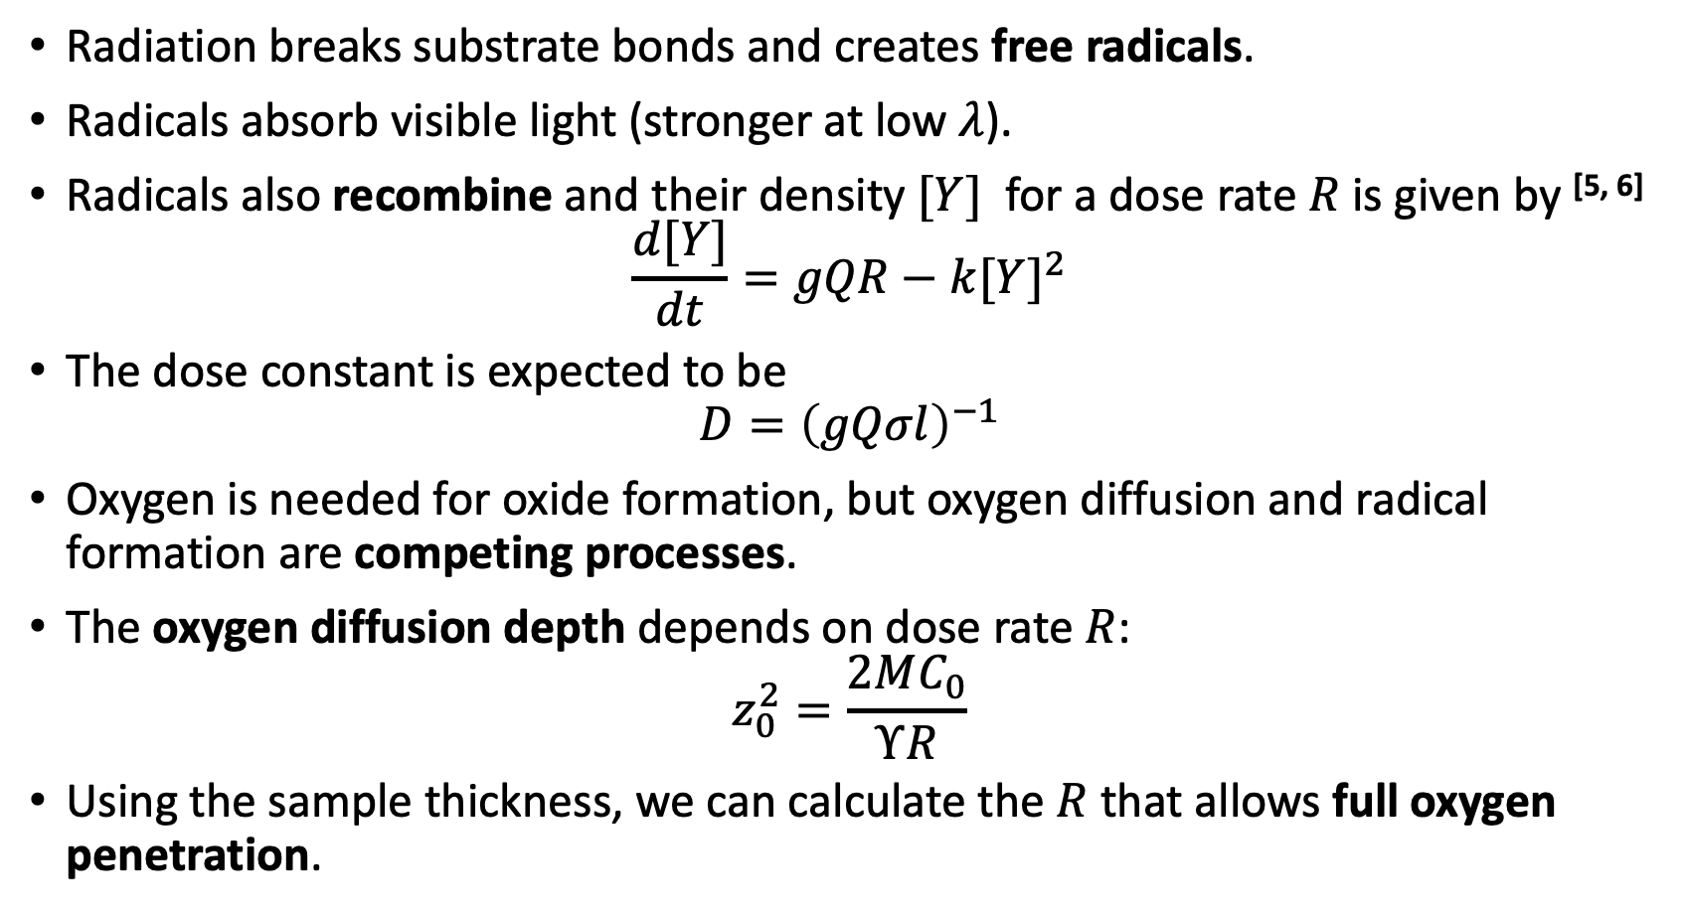
Dose rate dependence on damage
Radiation breaks substrate bonds and creates free radicals.
Radicals absorb visible light (stronger at low $λ$).
Radicals also recombine and their density $[Y]$ for a dose rate $R$is given by ^{[5, 6]}
$\frac{d[Y]}{dt}=gQR−k{[Y]}^{2}$
The dose constant is expected to be
$D={\left(gQσl\right)}^{−1}$
Oxygen is needed for oxide formation, but oxygen diffusion and radical formation are competing processes.
The oxygen diffusion depth depends on dose rate $R$:
$z_{0}^{2}=\frac{2MC_{0}}{ΥR}$
Using the sample thickness, we can calculate the $R$ that allows full oxygen penetration.
Temporary damage
$D$ scales with $l^{−1}$
*symbols explained in backup slides
Notes:
90 secs – Dense slide. Need to go through all 7 of them.

Slide 26
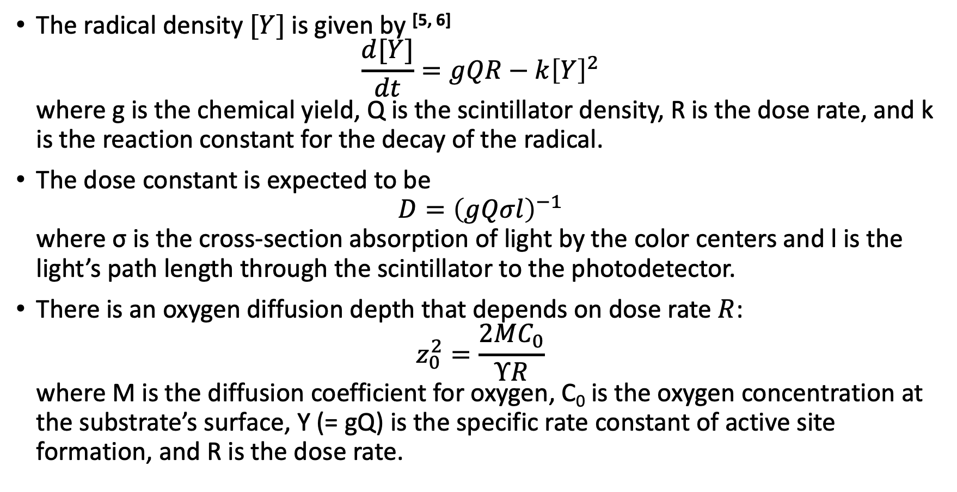
Dose rate dependence on damage
The radical density $[Y]$ is given by ^{[5, 6]}
$\frac{d[Y]}{dt}=gQR−k{\left[Y\right]}^{2}$
where g is the chemical yield, Q is the scintillator density, R is the dose rate, and k is the reaction constant for the decay of the radical.
The dose constant is expected to be
$D={\left(gQσl\right)}^{−1}$
where σ is the cross-section absorption of light by the color centers and l is the light’s path length through the scintillator to the photodetector.
There is an oxygen diffusion depth that depends on dose rate $R$:
$z_{0}^{2}=\frac{2MC_{0}}{ΥR}$
where M is the diffusion coefficient for oxygen, C₀ is the oxygen concentration at the substrate’s surface, Y (= gQ) is the specific rate constant of active site formation, and R is the dose rate.
*symbols explained in backup slides

Slide 27
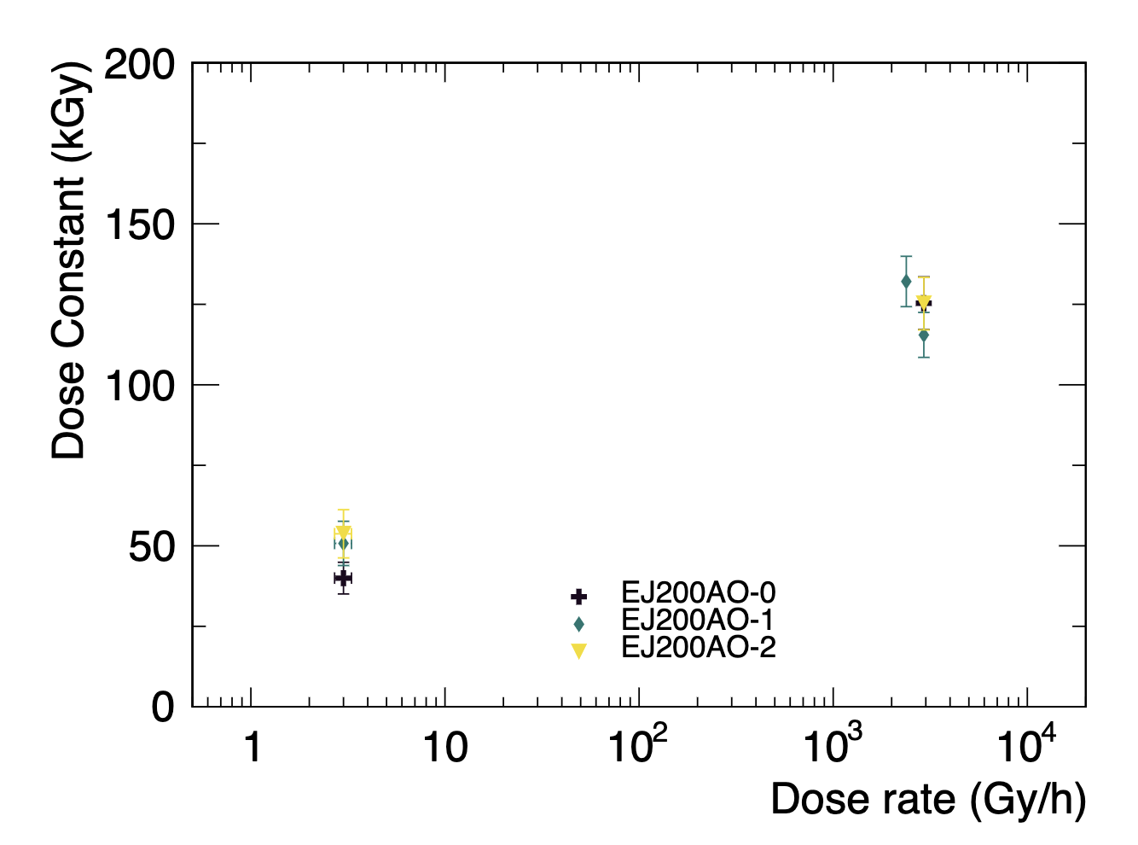
Antioxidants
Antioxidant concentrations:
  0.5 x nominal
  nominal
  2 x nominal
We do not see any significant effects of antioxidant concentration on radiation hardness.

