Slide 2
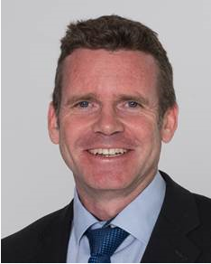
Bienvenue
Welcome
James PURVIS
Chef du département des ressources humaines
Head, Human Resources Department
Link to video on Indico
Notes:
Rocio
**************************

Slide 3

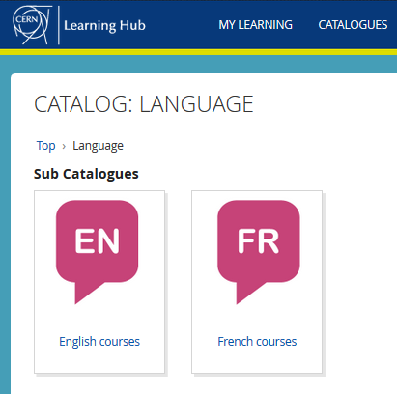

Logistics - language
Classroom courses
cern.ch/learninghub
Tandem
link
Find a partner
to practice speaking
each other’s language
Notes:
Au CERN, nous avons 2 langues officielles : l’anglais et le francais.
Qui maitrise bien ces 2 langues ?
Aujourd’hui, nous utiliserons principalement l’anglais, mais n’hesitez pas d’intervenir en francais si vous le souhaitez !
CERN has 2 official languages : English and French. Today, we will use mainly English, as from experience we know that not everyone understands French … yet !.
To learn English or French, there are classroom courses organised on the site, which are also open for spouses. You find the details on the CERN learning hub.
And you can also create the opportunities yourself with the tandem website. The aim of the website is to facilitate finding a partner (not to bike together but) to meet and learn by practicing on a voluntary basis each other’s language, not limited to English and French !

Slide 4

Logistics - slides
Available at any time
direct link : https://indico.cern.ch/category/10150/
Notes:
The slides are available on Indico, which is an event management software tool invented at CERN.
You will within 48 hours get an e-mail with the link, otherwise go to Indico and search by typing Welcome.

Slide 5
Programme of the morning
Welcome by James Purvis, Head HR Department
09.10 Quiz – CERN as organization
Coffee and croissants and networking
10.00 Quiz – daily life at CERN
10.25 Meet colleagues from your department
Transfer to department
11.00 Welcome in department (for BE : 14.00)
Notes:
Rocio
**************************
James Purvis, who can not be present but would like to give all newcomers a message. He has put it in a short video (which you can watch again on Indico if you want).

Slide 6



Many questions, answers are …
  Your departmental secretariat
  Your supervisor, your colleagues
  Specific question for personal situation?
  → Make appointment with the expert services
  Pension Fund, Health Insurance, Installation Service, Housing Service, Social Service, …
  HR Website > Welcome > my first week
Notes:
Erwin
************************
CERN is a big and complex organisation, with more than 60 years of history. Enough to have certain traditions, a certain way to do things, a certain culture.
You will certainly have many questions …
But where to find the answers ?
The departmental secretariat is an important info point about your rights and obligations, and it is close to you. You will meet them later today.
Your supervisor and colleagues will also be able to answer certain of your questions.
On the HR website, there is also the Welcome site with a dedicated section “My first week”
If you have specific questions related to you personal situation, there are expert services at your disposal. You’ll find their contact details on the Welcome pages.
We encourage you to make an appointment with them, why not do it later today ?
The quiz will also be an opportunity for you learn about the how and why of certain things.

Slide 7
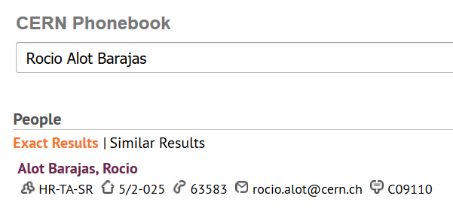
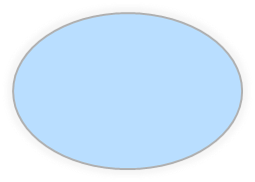

Building 5,
2nd floor
office 025
R = ground floor (rez de chaussee)
S = basement (sous-sol)
Notes:
In the CERN Phonebook, you can find out where people have their office.
For example, me/Rocio has her office in building 5, on the 2nd floor, and the office number is 25, on the side of the corridor with oneven numbers, and which are going up from 1 on one side of the building to the highest number on the other side of the building.

Slide 8
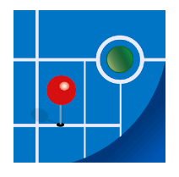
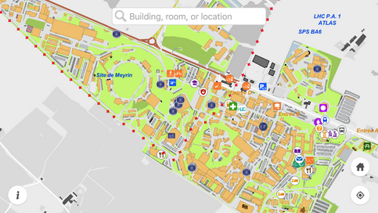
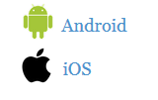
MapCERN
Notes:
Rocio
************************
The app is called MapCERN and is available for Android and iOS.
You can do a quick search, it covers all places at CERN and works offline.

Slide 9
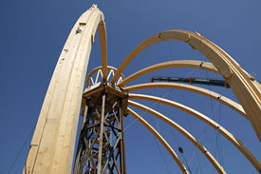
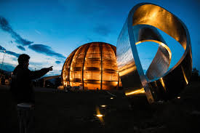
https://visit.cern/globe/history-globe
Notes:
Erwin
************************
The Globe is building with a history similar to the Eiffel tower.
Built for a national exhibition in Switzerland in 2002, which lasted 6 months, it was located near the lake of Neuchatel and called at that time the Palais de l’equilibre.
This name is however no longer used.
At the end of the exhibition, it was dismantled and the Swiss Governement offered to re-build it on the CERN site.
The building technique is quite unique : they start with top crown, which is on a temporary platform. Once all the beams are put in circle, the platform is dismantled : the crown holds everything together.
The shape of the building represents the planet Earth (outer layer to protect the building against Sun and other elements, just like the atmosphere does).
The Globe has become a landmark in the Geneva area.
If you want to know more about it, here is a link :
https://visit.cern/globe/history-globe

Slide 10

CERN as an international organization
Quiz – part 1
Notes:
Rocio
************************
Ready to start with the real quiz ?
We first have a few questions about CERN as an international organisation.

Slide 11






CERN MoP
> 17 200
Contractors
> 4 500
Employed MPE
> 3 300
Associated MPA
> 13 900
Staff
> 2 500
Fellows
> 800
Users
> 12 500
Associates
> 700
Students
> 700
Notes:
Erwin
************************
If you answered 2500, then you probably only took into account the staff members (click).
But on top of the staff, we also have more than 800 fellows (click).
The staff members and fellows together are the employed members of the personnel or MPE (click): CERN is their employer.
But besides these more than 3300 people, there are also many people who have a contract with CERN, although it is not an employment contract :
First of all, we have more than 12500 users (click) who are working in scientific collaborations
And also more than 700 associates
And more than 700 students
All together 14000 people who have a contract of association with CERN.
Both MPE and MPA are considered MoP, and you are a member of that big family of more than 17000 people.
Not all users are present at CERN every day. Note also that there is also personnel from contractors which can be working on the CERN site : there are more than 4500 such people with an active registration, and some of them come here every day while others come only for the duration of a specific intervention.

Slide 12
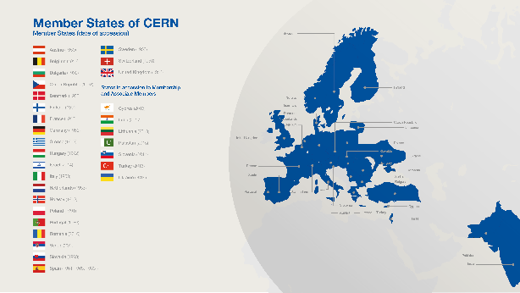
Revenues 2019
Member State contributions 92 %
Associate Member State contributions 2 %
Other (e.g. EU, knowledge transfer, …) 6 %
Principle =
proportional to Gross National Income
→ equal effort for every country
Notes:
Erwin
************************
The CERN member states are indeed providing 92 % of CERN’s budget. (click)
There are today 22 Member states – originally when CERN was founded, there were only 12 countries. (click)
In order to have a fair sharing of the cost, the contributions are calculated as a certain percentage of the National Income.
And were does the remaining 8% comes from ?
Well, CERN also has associated member states, who pay a reduced contribution compared to the members states. This amounts to 2% of the budget.
And the last 6% of the budget come a variety of sources : participation of the European Commission, income from knowledge transfer activities, donations to CERN, …)

Slide 13
Budget 2019
Official Currency : CHF
Units
1 kCHF = 1 000 CHF = 10³ = one thousand
1 MCHF = 1 000 000 CHF = 10⁶ = one million
1 260 MCHF = 1.26 * 10⁹ = 1.26 billion (1.26 milliard) CHF
Style guide
http://translation-council-support-group.web.cern.ch/en/content/style-guide
Notes:
Erwin
************************
CERN has a Medium term plan : The MTP describes CERN’s scientific and financial strategy for the next five years along with a longer-term view over ten years. This plan is updated annually and also includes a precise budget for the following year. This budget is voted by the Council in the year before. So E was not correct.
CERN has its seat in Geneva, Switzerland, only the Swiss franc is udes as its official currency. So you could disregard the answers C and who were expressed in other European currencies.
You will very often see kCHF and MCHF, so it is worth to explain it
The correct answer is B : 1250 million Swiss francs, which is 1.25 billion Swiss francs
4. We have at CERN a styleguide for how to write in CERN publications
http://translation-council-support-group.web.cern.ch/en/content/style-guide
Applied here :
Use space as 1000 separator (comma might be misleading)
Up to 4 figures : no space or comma

Slide 14
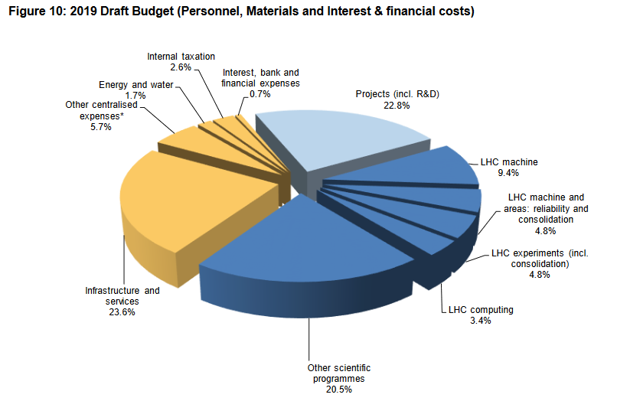
Scientific programme = 520 MCHF
Projects = 275 MCHF
Infrastructure & services = 474 MCHF
Notes:
Erwin
************************
How is the budget spent ?
Here you have a breakdown according to the nature of the spending :
The main expenditure goes to the dark blue part : CERN’s scientific programme, a bit more than 50% is for LHC, but CERN’s research programme is very diversified.
The projects, including R&D are separate, and represent more than 20% of the budget
More than 1/3 of the budget goes to maintaining the infrastructure and delivering services
In this breakdown, personnel and material are counted in each of the expenditure chapters.
You could also make a breakdown by how many CERN spends on Personnel and how much on Material (P+M)
It is almost 50-50. In fact it is slighty more on Personnel with 53%, and 47% for Materials.
M = 47 % (= 596 MCHF) – contractor’s personnel is included in M
P = 53% (= 673 MCHF)

Slide 15
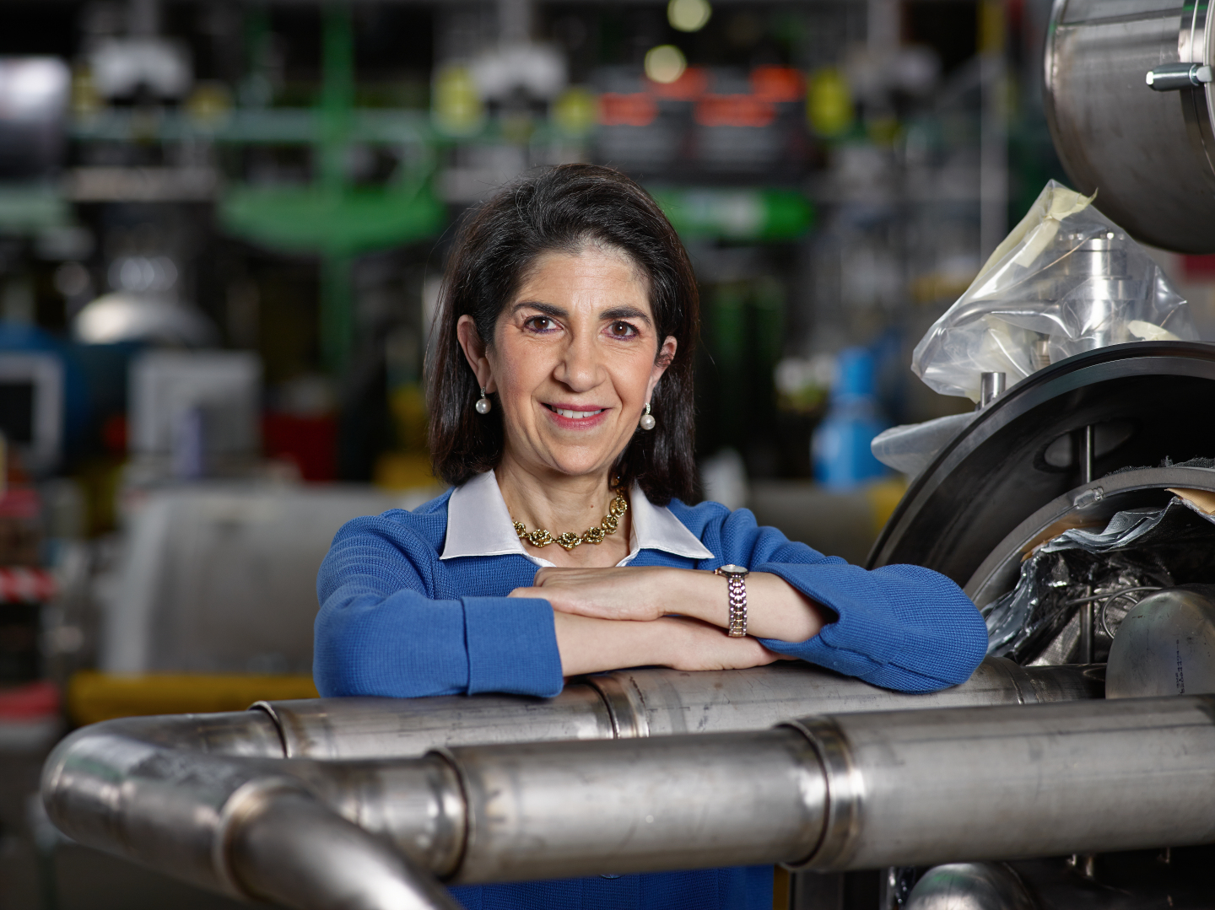
Link to biography
© CERN Photo, 2015
Notes:
Rocio
************************
https://press.cern/biographies/fabiola-gianotti-born-1960-Italian
Fabiola Gianotti is indeed CERN’s 1st female Director General, since 1st January 2016. Like all DG’s, she has a mandate of 5 years. In some exceptional cases in the past, this has been extended, but usually we have a new DG every 5 years.
From 2009 to 2013, she was spokesperson for the ATLAS experiment, and had the task of presenting the results on the search for the Higgs boson in a seminar at CERN on 4 July 2012. This discovery led to the Nobel prize for Higgs and Englert.
Gianotti has been awarded several prizes, but not the Nobel prize.
In 2013, she was included among the “Top 100 most influential women” by Forbes magazine, and today she continues to figure in their top 100 of Power Women.
https://www.forbes.com/profile/fabiola-gianotti/?list=power-women

Slide 16
Working at CERN when Nobel prize
1992 : Georges Charpak
1988 : Carlo Rubbia & Simon van der Meer
1984 : Jack Steinberger (with Lederman and Schwartz)
Working at CERN after Nobel prize
1952 : Felix Bloch
1976 : Sam Ting
Nobel prize thanks to discoveries at CERN
2013 : Peter Higgs & Francois Englert
Notes:
Erwin
************************
https://public-archive.web.cern.ch/public-archive/en/About/Nobels-en.html
https://www.nobelprize.org/nobel_prizes/facts/
3 prizes for people who were working at CERN when they received the Nobel prize
1992 : Georges Charpak
1988 : Carlo Rubbia & Simon van der Meer
1984 : Jack Steinberger (with Lederman and Schwartz)
+ 2 Nobel prize winners who worked at CERN
1952 : Felix Bloch, became CERN DG in 1954
1976 : Sam Ting, still works here at CERN on AMS (alpha magnetic spectrometer which is installed on ISS, the International Space Station)
+ 2 Nobel prize winners thanks to discoveries at CERN
2013 : Higgs and Englert

Slide 17
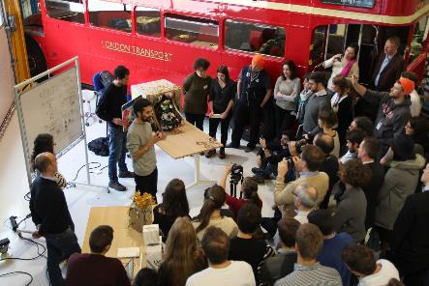
Daily life at CERN
Quiz part 2
Notes:
Rocio
************************
We have some questions for you, which will be helpful for your daily life at CERN.
Your daily life can be exciting – here you have a picture of an 96 hour contest in which students from different disciplines and countries worked in teams to prototype a robot showing human emotions. It is one of the activities organised by Ideasquare.

Slide 18
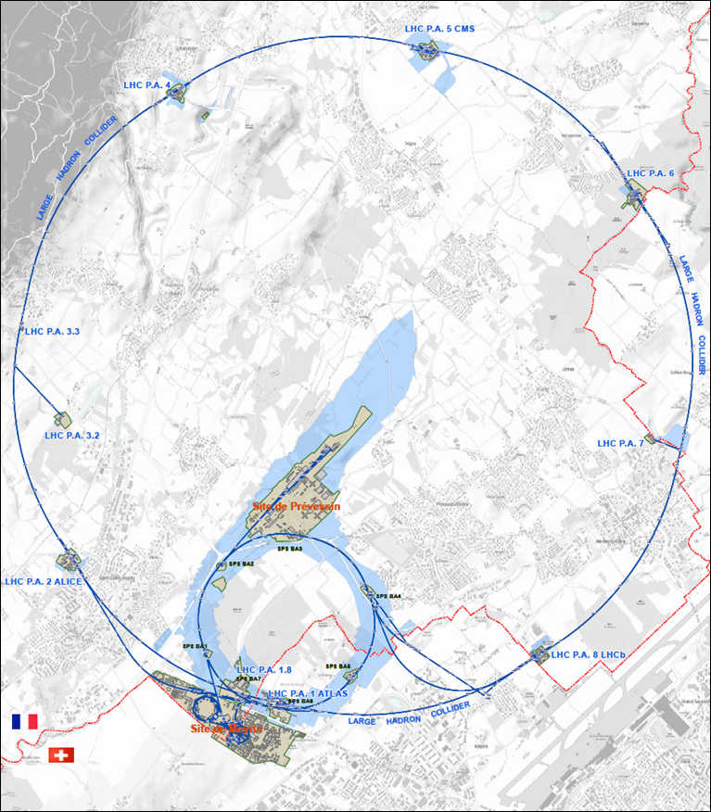




625 ha
515 ha
fenced : 220
110 ha
… 700+ buildings
accounting for
500.000 m²
6 180 parking spots
101 ha
green
spaces
30 km roads
Notes:
Erwin
************************
Source : https://indico.cern.ch/event/669690/contributions/2740056/attachments/1553507/2441980/Mobility_IoT.pptx
CERN is indeed composed of 2 major sites : Meyrin in Switzerland and Prevessin in France. But there are many more smaller CERN sites, especially in France.
CERN has all in all 625 hectares of land, of which 1/3 is fenced. The majority is on the French territory.
There are more than 700 buildings, for a variety of purposes and built in different periods in a variety of styles. Office space as well as parking space are sometimes difficult to find !
There are also 30 km of roads, and normal traffic rules applies. And there is control and sanctions : if you park your car on the footpath, the sidewalk, your car might be towed away.
There also green spaces, especially on the Prevessin site. Some people have the luck to see through their window deers coming out of the wood or a flock of sheep grazing in the prairie next to their office.

Slide 19
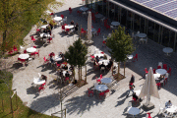
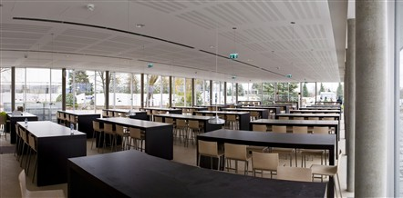
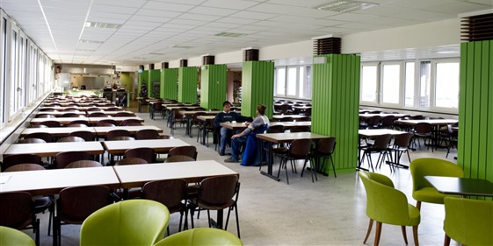
Restaurants
2 in Meyrin (resto 1 & 2)
1 in Prevessin (resto 3)
Cafeteria (snacks)
Building 13, 30, 40, 54, …
© CERN Photo
Meyrin, Restaurant 1
Prevessin, Restaurant 3
Notes:
Rocio
************************
There are 3 restaurants on the site. There are always several menus, including a vegetarian.
You can find menus and opening hours in the CERN directory.
There are also microwave ovens, when you heat the food you bring along yourself.
There are also some cafeterias, which often have a reduced offer, and shorter opening hours.

Slide 20

Meet new people during lunch!
https://lunchcollider.ch/
Notes:
Erwin
************************
If you want to meet new people during lunch, join lunchcollider.
Twice a week you can enrol via the website, and you will randomly assigned to have lunch with one or two other people.

Slide 21



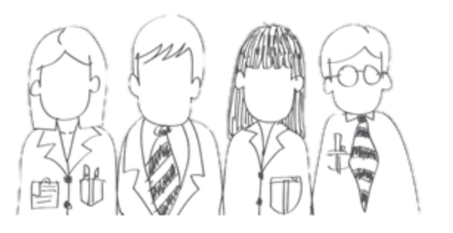
CERN Service Portal
Services
Service overview in a glance
Online forms
Report an incident, submit a request
Knowledge articles
Find your answer!
Feedback
Your feedback matters!
CERN Service Desk
Open
from 07:30 to 18:30
Work days
Geneva time
Phone: 77777 (+41 22 76 77777 from outside CERN)
By visiting: building 55 (entrance B)
Email: service-desk@cern.ch
https://cern.ch/service-portal
Notes:
Erwin
************************
Important at any time during your stay at CERN, and even before.
Who has already contacted the service desk ?
You want to report an incident or make a request, but you do not know which service to contact
Examples :
Heating of your office
Blocked computer account
Network connection issue
Water leak in the toilet
Search the CERN Service Portal, link available from CERN directory.
On line form or contact service desk

Slide 22
Accident on site – different cases
In all cases
Inform supervisor
In case of
Injury
Environmental hazard
Disruption traffic
3rd party involved
CERN Fire & Rescue 74444
(+ 41 22 767 44 44)
+
Internal accident report (EDH)
+
European Union Car Accident form
Notes:
Erwin
************************
The correct answer in all cases is to call your supervisor (D) and in some cases (C), the CERN Fire and rescue service, through the number 74444.
Why always your supervisor ?
Internal accident report :
- needs to be signed by your supervisor, so for that reason he must be informed immediately.
- also used to report near-misses -> can be used to avoid further accidents
In certain cases, the CERN Fire and rescue need to be called.
We recommend to add the full number in your mobile phone
+41 22 767 44 44, so you can also call them if you are not connected to the CERN telephone network.
https://admin-eguide.web.cern.ch/node/352
2.2.1 Accident on the CERN site
In the event of injury, disruption to the flow of traffic or involvement of a third party:
The CERN Fire Brigade will go to the scene of the accident, take the appropriate measures required by the circumstances and draw up a call-out report.
The local Gendarmerie/Police will intervene only if so requested by CERN (Relations with the Host States Service or CERN Fire Brigade).
The driver(s) of the vehicle(s) (or, if not possible, the Fire Brigade) must complete a European car accident form (a blue form known as the "Constat européen d'accident automobile"), which must be signed by the parties involved. A copy of page 1 of the form must be sent to the Legal Service and to the CERN's Insurance Manager. If the injured party is a member of the personnel or a family member who is a member of the CERN Health Insurance Scheme, the procedure set out in paragraph 3 must also be followed.
In all other cases, and if the vehicle suffers material damage:
The member of the personnel must draw up a report to which he must attach, where possible, a statement by a witness (the European car accident form may be used). This report (or a copy of the European car accident form) must be sent to the CERN's Insurance Manager together with a statement by the Head of Department or his designated representative, certifying that the journey was made on official duty, or a copy of the official travel form if applicable.

Slide 23
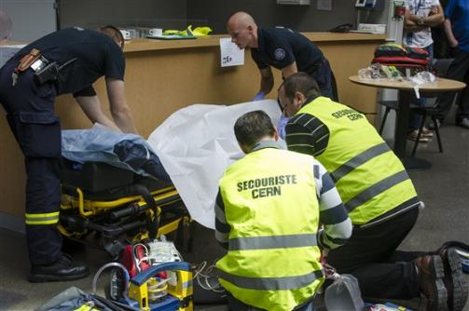
CERN Fire and Rescue Service
assisted by local First Aiders
Find out who
are closest to
your office / usual work places
© CERN Photo
Notes:
Rocio
************************
CERN’s Fire and Rescue Service is a team of more than 50 qualified fire-fighters and paramedics. They are available 24h/day, all year long.
They are assisted by more than 800 First Aiders, who are trained volunteers.

Slide 24
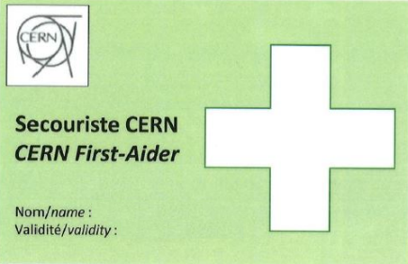
First Aider door sticker
Your safety contacts : http://safety.cern.ch/FirstAid.html
Notes:
Rocio
************************
You can find the first aiders in your building in this link.
And you also spot the green stickers on the doors, indicating that there is a qualified CERN first-aider in that office

Slide 25
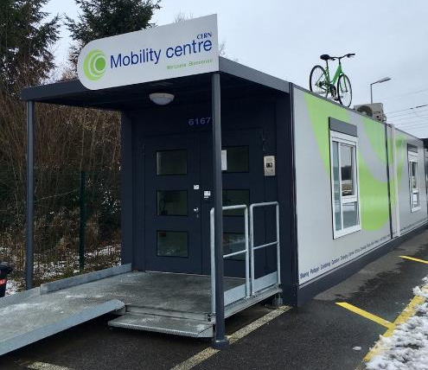
CERN Mobility Centre
Located next to the Globe at end of parking
https://smb-dep.web.cern.ch/en/Mobility
© CERN Photo
Notes:
Erwin
************************
http://cds.cern.ch/record/2141046/files/MAX_6386.jpg?subformat=icon-640
Other pictures : https://foursquare.com/v/cern-mobility-centre/58762eb4ae975678e2aa5061?openPhotoId=5876303ee9233e34875ae97d
The CERN mobility Centre was inaugurated in 2016 by Martin Steinacher, Director of Finance and Human Resources and Luis Miralles, Head of the Site Management and Buildings department. It is situated an the side of the Globe parking.
https://cern.service-now.com/service-portal/customer-service.do?name=passenger-mobility

Slide 26


Defends all personnel
on a collective and on an individual basis
Become member : Website
Network of people who work(ed) at CERN
Become member : Website
Notes:
Rocio
************************
The Staff association defends your rights, they organize regularly public meetings to inform you. The also have a website, and you can become a member by paying a fee.
CERN Alumni is an initiative launched in 2017.
It brings together people who have worked at CERN and those who work today at CERN. As such, you can be a member as from today. Membership is free.

Slide 27
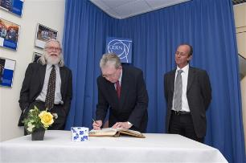
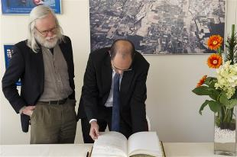
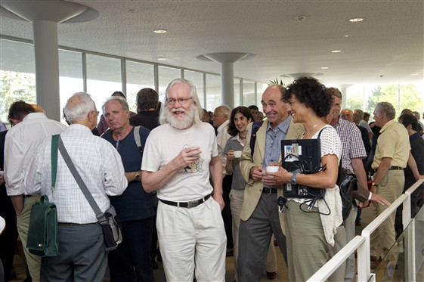
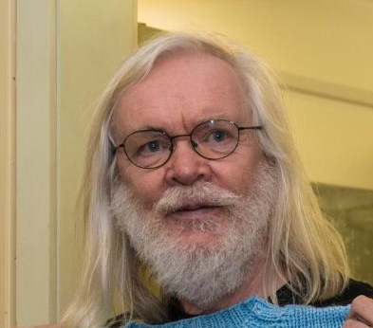
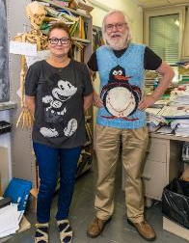
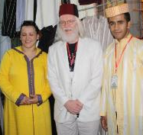
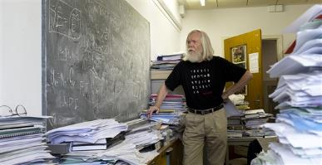
© CERN Photo
Notes:
Erwin
************************
This is John Ellis, a British theoretical physicist.
Employed by CERN, he has been department head of the Theory department, and an advocate for geographical enlargement of CERN.
You can see him
At an official ceremony to sign an agreement, dressed business formal, in a suit and tie
In his office, amongst his papers, casual with pants and a black T-shirt
At another official ceremony, smart casual or business casual, with a shirt and jacket, but no tie
At a Physics School in Morocco, in local traditional clothes, including the fez
Again in his office, with a Finnish teacher who knitted him a pullover with his famous penguin diagram
In 2011, at the coffee break of the colloquium in honor for his 65th birthday
Conclusion:
CERN is very casual
CERN is very tolerant
Recommendations :
Dress according to the situation
Nothing offending other people – T-shirts with text/images

Slide 28

Code of Conduct
Notes:
Rocio
************************

Slide 29




Gates | Days
Meyrin A | Mon-Fri | 6-22 |  | 7-19
Porte Jura Bldg 33 |  | 24/24
Meyrin B (Main entrance) |  | 24/24
Meyrin C | Mon-Fri | 6-22 |  | 7-19
Meyrin D (goods only) | Mon-Fri |  |  |  | 08-12 13-16
Meyrin E | Mon-Fri | In : 7-9.30 Out : 16.30-20
Intersites tunnel (restrictions) | Mon-Fri |  |  | 7-18
Prevessin Main entrance |  | 24/24
Prevessin Route du Maroc |  | 24/24
Prevessin Moulin des Ponts |  | 24/24
Notes:
Erwin
************************
There are 7 gates at the Meyrin site, and 3 gates at the Prevessin site.
The Main gates in Meyrin and Prevessin are open 24 hours a day, for pedestrians, bikes and motorized vehicles.
In Meyrin, on top of the main gate, there are 4 other gates for pedestrians, with are open only on workdays and for certain periods. 3 of them are also open for bycicles. With a car, you can get in on workdays during certain hours through 3 other gates.
Meyrin 2 gates with restrictions : entrance D is for goods only, and the intersites tunnel can only be used with a car and being on duty. It can not be used to get to your workplace nor to go home.

Slide 30
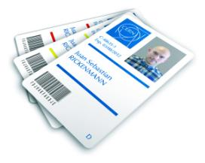
CERN access card
Visitors badge
Validity :
2 working days
CERN access card
Building 55
Working days
from 7:30 to 17:30, non stop
Also
vehicle registration
biometrics registration
Notes:
If you hurry to get your CERN access card, you might find yourself queuing.
Avoid
Mondays
1st working day of the month
7:30 to 9

Slide 31
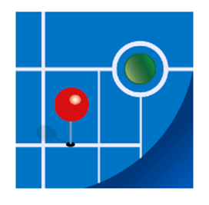

Recommended to do
Download CERN map on your smartphone
Enter full number Fire and rescue service in your phone
Find out who are closest first-aiders
+ 41 22 76 74444
Notes:
Erwin
************************

Slide 32
Next steps
  Guided CERN tour
  Open for your family
  Enrol on a voluntary basis
  Quarterly session
  For staff, fellows, doctoral students and users
  Need to enrol
Notes:
Erwin
************************

Slide 33
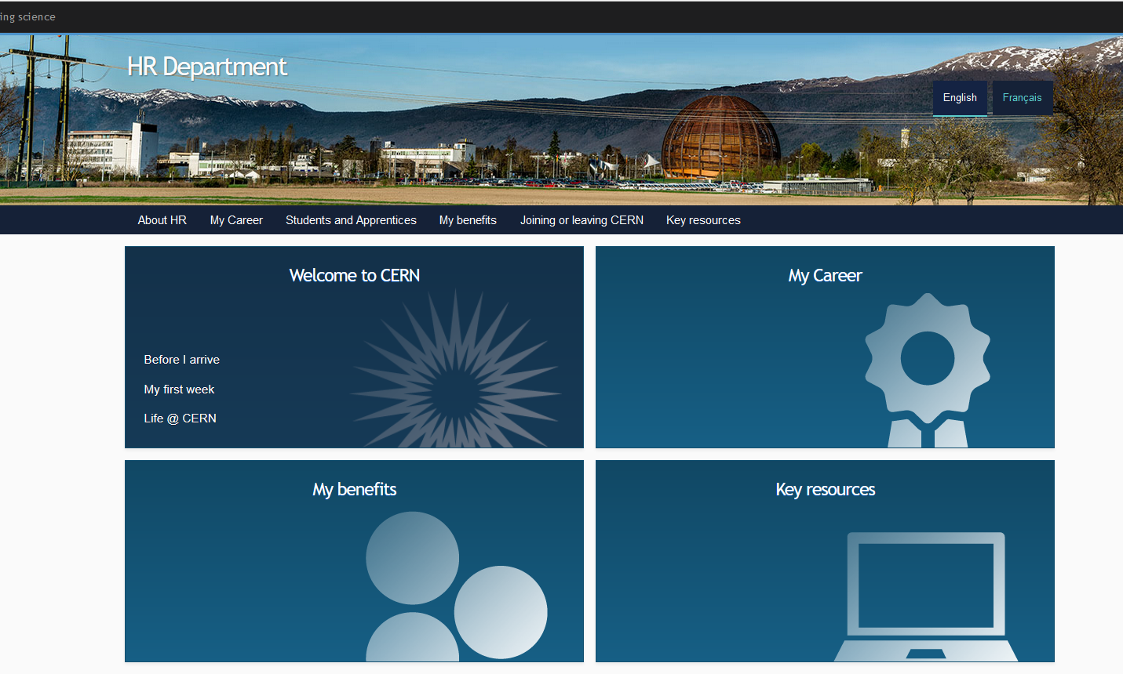
Newcomers website
https://hr-dep.web.cern.ch/
Notes:
Rocio
************************
On the HR website, you will find the Welcome to CERN pages.
You have already looked at the pages “Before I arrive”, but there is more information for you to discover now under “My first week” and later on under “life@CERN”

Slide 34

Next steps
Slides
  Specific question ?
  → Make appointment with the expert services
  Pension Fund, Health Insurance, Installation Service, Housing Service, Social Service, …
Notes:
Erwin
************************

Slide 35
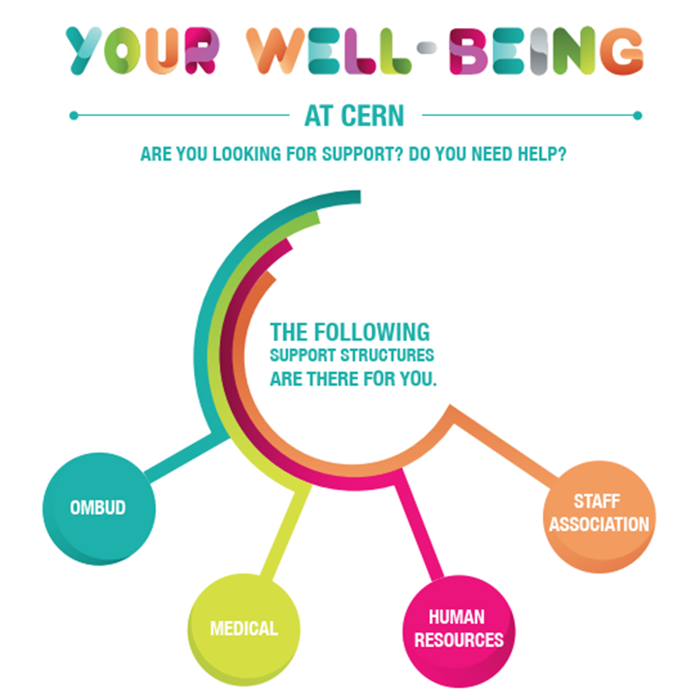

Work well, feel well
cern.ch/hr/wwfw
Notes:
Erwin
************************
ARE YOU LOOKING FOR SUPPORT ? DO YOU NEED HELP?
THE FOLLOWING SUPPORT STRUCTURES ARE THERE FOR YOU.
The Ombud (Tel. 73566, Bldg. 500/1-004): listening, guidance, mediation
The Medical service (Tel. 73802 or 73186, Bldg. 57): a doctor, nurses and a psychologist : medical and psychological care for health-related issues and stress symptoms
Human resources: HR Advisors, HR Programme Coordinators, social workers (Tel. 79866 or 74701, Bldg 5 & 33): listening, advice, guidance, mediation
Social Service also for support for non-work related issues (family, …)
Staff Association (CAPA, SA delegates - tel. 72819, Bldg. 64/R-010): listening, advice, support
More information on the work well, feel well page.

Slide 36
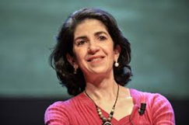
Directorate Services
Health, Safety and Environment
Accelerator and Technology
Beams
Technology
Finance and Human Resources
International Relations
Research and Computing
Engineering
Finance and Administrative Processes
Industry, Procurement and Knowledge Transfer
Human Resources
Site Management and Buildings
Experimental Physics
Theoretical Physics
Information Technology
Sector
Department
Unit
Notes:
Erwin
************************
At the head of the organisation, there is the Director General, Fabiola Gianotti.
She is assisted by 4 directors, which each are responsible for a sector :
Accelerator and technology
Finance and Human Resources
International Relations
Research and Computing
Within each sector, except for International relations, there are departments.
Within departments, there are groups, which might be split into sections.
There are also units, which are directly attached to the DG : Directorate services and Health, Safety and Environment.
They all have acronyms.

Slide 37
DG
HSE
ATS
BE
TE
FHR
IR
RCS
EN
FAP
IPT
HR
SMB
EP
TH
IT
Notes:
Erwin
************************
If you’re in doubt about which their department you belong to, come and ask Marie or myself.
For each of the units/departments, there is a flag, with a different color.

Slide 38

Notes:
All the best with

