Slide 1


Moving Out of Academia To …
Laure Esteveny , Head of CERN Alumni Relations, IR
11 October 2019

Slide 2
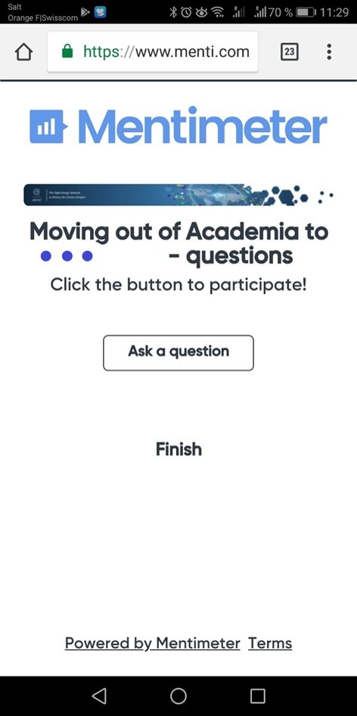
Ask questions on menti.com
Discussion code is 10 75 28
Vote for the burning questions!

Slide 3


15:30

Slide 4


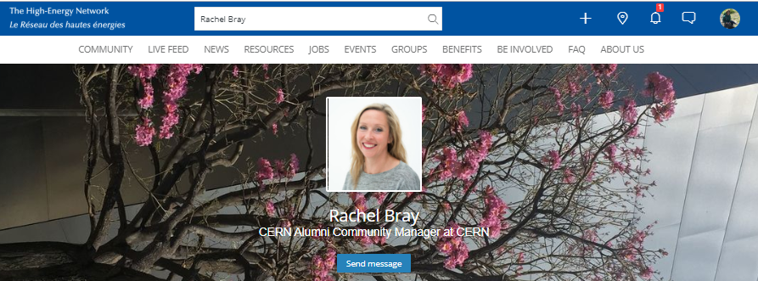

Slide 5
Make the most of the event!
Join at https://alumni.cern
or email alumni.relations@cern.ch

