Slide 1




OPTIMIZING THE SIGNAL OF ODDERON
T. Csörgő^{1,2} , T. Novák², R. Pasechnik ³, A. Ster ¹ and I. Szanyi ^{1,4}
¹ Wigner RCP, Budapest, Hungary
² MATE KRC, Gyöngyös, Hungary
³ University of Lund, Lund, Sweden
⁴ Eötvös University, Budapest, Hungary
Statistically Significant Observations of Odderon
Model independent results:
Significance ≥ 6.26 σ
Model dependent results:
Significance ≥ 7.08 σ
D0-TOTEM results:
Significance ≥ t 5.2 σ
New: Model independently
Optimal Significance ≥ 6.36 σ
Domain of validity
Sliding window, closing doors
Summary

Slide 2
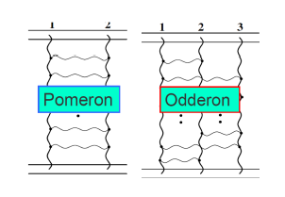
Odderon: 48 years old scientific puzzle
Odderon: L. Lukaszuk, B. Nicolescu,
Lett. Nuovo Cim. 8, 405 (1973)
At CERN LHC’s TeV energy scale:
Odderon is an odd component of elastic scattering:
Changes sign for crossing
2

Slide 3
Odderon: origin of its name
Odderon name coined in 1975:
D. Joynson, E. Leader, B. Nicolescu, C. Lopez
Nuovo Cim. 30A, 345 (1975)
3

Slide 4
Odderon: well established in QCD
Odderon proposed in Regge phenomenology:
L. Lukaszuk, B. Nicolescu, Lett. Nuovo Cim. 8, 405 (1973)
Three Gluon Integral Equation and Odd c Singlet Regge Singularities in QCD
J. Kwiecinski, M. Praszalowicz, Phys.Lett.B 94 (1980) 413-416
A new Odderon intercept from QCD:
R. A. Janik, J. Wosiek, Phys. Rev. Lett. 82 (1999) 1092
Odderon in QCD:
J. Bartels, L.N. Lipatov, G. P. Vacca: Phys. Lett. B (2000) 178
Odderon in QCD with running coupling:
J. Bartels, C. Contreras, G. P. Vacca, JHEP 04 (2020) 183
For an excellent theory intro/review, see Yu. Kovchegov’s
CTEQ Webinar, April 28, 2021
http://youtu.be/yHBO3zcB3V4
4

Slide 5
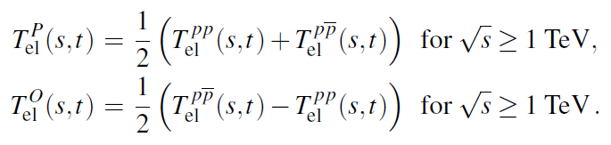
Odderon Search and symmetry violation in elastic collisions
Two simple consequences:
5

Slide 6

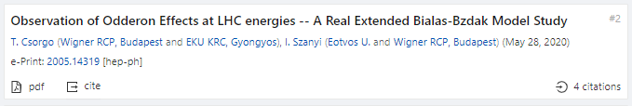

Observations of Odderon with > 5 σ
Eur. Phys. J. C (2021) 81: 180
https://doi.org/10.1140/epjc/s10052-021-08867-6
Eur. Phys. J. C (2021) 81:611
https://doi.org/10.1140/epjc/s10052-021-09381-5
Phys. Rev. Lett. (2021) in press
Accepted for a publication
6

Slide 7
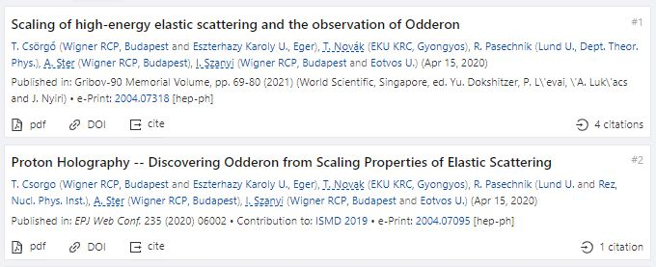
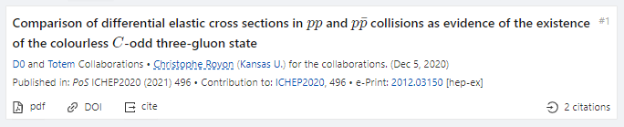
Three Odderon Proceedings with > 5 σ
Gribov’90 Memorial Volume, pp. 69-80 (2021)
https://doi.org/10.1142/9789811238406_0012
EPJ Web Conf. 235 (2020) 06002, proc. ISMD 2019
https://doi.org/10.1051/epjconf/202023506002
PoS ICHEP 2020 (2021)
https://doi.org/10.22323/1.390.0496
7

Slide 8


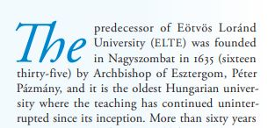
Three Oldest Hungarian Universities
University of Pécs: 1367
University of Debrecen: 1538
(S,C) structure evident,
S: statement, valid if
C: condition is satisfied
See talk of R. Dardashti at ISMD21
8
Eötvös Loránd University: 1635

Slide 9
Model independent results since ISMD’19
Eur. Phys. J. C (2021) 81: 180
https://doi.org/10.1140/epjc/s10052-021-08867-6
H(x) = 1/(B σ_{el}) dσ/dt vs x = - B t
x = - B t = - B₀(s) t
9
S: Model independent Odderon significance ≥ 6.26 σ
C1: All D0 and TOTEM published data at 1.96, 2.76 and 7.0 TeV
C2: domain of validity is still determined model dependently.

Slide 10
Model independent results since ISMD’19
Gribov’90 Memorial Volume, pp. 69-80 (2021)
https://doi.org/10.1142/9789811238406_0012
S: Model independent Odderon significance ≥ 6.26 σ
C1: All D0 and TOTEM published data at 1.96, 2.76 and 7.0 TeV
C2: domain of validity is still determined model dependently.
10
H(x,s₁)/H(x,s₂) nearly 1 for pp with small violations. Peak for pbarp over pp.
Model independent Odderon significance 6.26 σ
Small violations under theoretical controll (next slide).
New result presented in this talk: domain of validity model independently

Slide 11
Model dependent evidence for Odderon
Eur. Phys. J. C (2021) 81:611
https://doi.org/10.1140/epjc/s10052-021-09381-5
S: Model independent Odderon significance ≥ 7.08 σ
C1: All D0 and TOTEM published data at 1.96, 2.76 and 7.0 TeV,
C2: domain of validity extended to both pp and pbarp
But limited to 0.372 ≤ −t ≤ 1.2 GeV² and 0.546 ≤ sqrt(s) ≤ 7 (8) TeV
11
Model dependent, Real Extended Bialas-Bzdak theory results,
Odderon significance ≥ 7.08 σ, a Glauber model for p = (q,d)

Slide 12
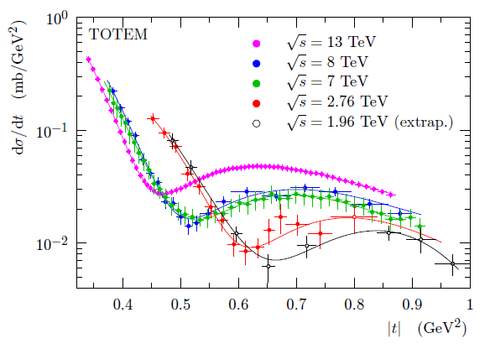
Evidence for Odderon, new D0-TOTEM
Phys. Rev. Lett. (2021) in press
Accepted for a publication
12
S: Odderon significance ≥ 5.2 σ,
C1: if combined with 13 TeV σ_{tot} and ρ₀
C2: if new pp data at 13, 8 TeV and 1 new point at 2.76 TeV is added,
C3: if only 8 out of the 17 D0 points is used
12

Slide 13
Model independent result
H(x|pp)
s-independent:
2.76 – 7(8) TeV
H(x|pp, 7 TeV)
≠
H(x|pantip,
1.96 TeV)
Odderon,
IF scaling holds
in pp down to
1.96 TeV
6.26 σ
Odderon effect
13
Energy range: tested both model independently and with modelling.
Modelling is useful, but model independent tests more important!

Slide 14
Is H(x,s) = H(x) at 1.96 TeV?
S IGNAL
MODEL DEPENDENTLY: Yes
1.96 TeV
Highest energy where p+antip data are available
H(x) scaling limit:
in the Bialas-Bzdak model
Fits pbarp data up to largest -t
(red line, dashed line: pp)
Pull plots:
(data-fit)/error
(data-fit)/fit
t_{max}(1.96 TeV, pp) > 1.2 GeV²
→ x_{max}(1.96 TeV, pp) > 20
14

Slide 15
SLIDING WINDOW for 5 σ
Model independent results:
only datapoints,
without s-dependent extrapolations !
Where is the signal of Odderon from?
All possible sliding windows,
where the significance is at least 5 σ

Slide 16
SLIDING WINDOWS
7 TeV data shifted
by ε_{B7,TeV} to minimize χ²
Type A errors are shown only
Both swing and dip regions important!
2020 → 2O2O

Slide 17
CLOSING DOORS/GATES
7 TeV data shifted
by ε_{B7,TeV} to minimize χ²
Type A errors are shown only
Both swing and dip regions important!
2020 → 2O2O

Slide 18
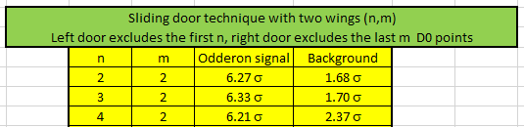
RESULTS FOR CLOSING GATES
Two sliding gates of size n and size m:
(n,m): Leaving out the first n and last m D0 point
New MODEL INDEPENT RESULT:
Optimized Odderon signal is 6.33 σ
New MODEL INDEPENT RESULT 2:
Best window: leaving out first 3 and last 2 D0 point
New MODEL INDEPENT RESULT 3:
Best background: pp and pbarp agree within 1.7 σ

Slide 19
Summary: At least 6.36 σ Odderon
An at least 6.36 σ Odderon effect
Odderon first discovered in three papers
2 published
1 accepted for publication, but
under three different conditions
(S,C) structure evident,
S: statement, valid if
C: condition is satisfied
See talk of R. Dardashti at ISMD21
19

Slide 20
OBSERVATION OF ODDERON
2020 → 2O2O
THANK YOU FOR YOUR ATTENTION

Slide 21

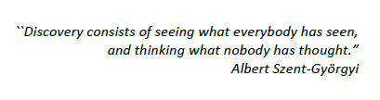


ODE TO ODDERON → OBERON

Slide 22
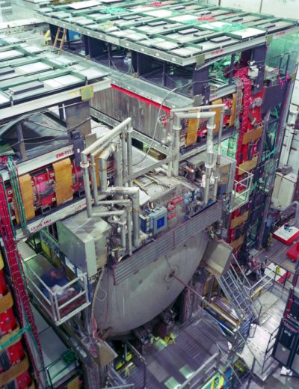
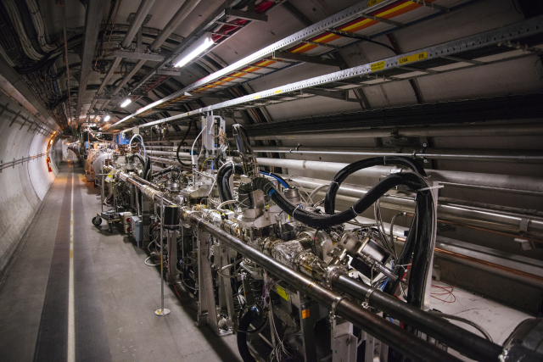
BACKUP SLIDES

Slide 23
Asymmetry parameter for C-violation
A(x|pbarp,s₁|pp,s₂)
does NOT vanish
for a C-symmetry violation AND
A(x|pp,s₁|pp,s₂)
vanishes if
H(x) scaling valid
23
Energy range: HAS to be tested carefully

Slide 24
Main result of A
A(x|pp,s₁|pp,s₂) ~ 0
vanishes if
H(x) scaling valid
A(x|pbarp,s₁|pp,s₂) ≠ 0
does NOT vanish
if Odderon term is present
24
Scaling violations: under theoretical control:
Model calculations by solid line, see e-Print: 2005.14319 [hep-ph]

Slide 25
Essentially, Odderon
p+p → p+p
(RGB) + (RGB) → (GBR) + (GBR)
-
p+p → p+p
(RGB) + (RBG) → (BRG) + (BGR)
25
p₁
p₃
g₃
g₁
g₂
O = (g₁, g₂, g₃)
p₂
p₄

Slide 26
Formalism: elastic scattering
26
Basic problem: dσ/dt measures an amplitude, modulus squared.
How to achieve amplitude level reconstruction? Phase info lost…

Slide 27
Formalism in b space
27
Impact parameter or b space:
elastic scattering interferes with propagation w/o collisions: Genuine quantum physics.
Complex opacity function Ω(s,b) (eikonal, from unitarity)
0 ≤ P(s,b) ≤ 1 : inelastic scattering has a probabilistic interpretation

Slide 28
Odderon search: a possible strategy
Known trivial s-dependences in
σ_{tot}(s), σ_{el}(s), B(s), ρ(s)
Try to scale this out
Data collapsing (scaling)
Look for scaling violations
In the TeV energy range:
Odderon is equivalent with
a crossing-odd component
Look for violations of C-symmetry
28

Slide 29
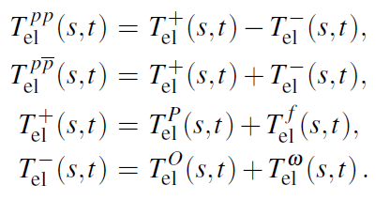
Looking for Crossing-Odd(eron) effects
Three simple consequences:
29
Odderon differential cross-section from pp and ppbar collisions, Reggeized Philips-Barger:
A. Ster, L. Jenkovszky, T. Cs., arxiv:1501.03860, Phys.Rev.D 91 (2015) 7, 074018

Slide 30



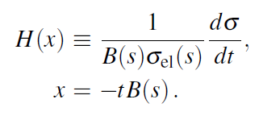
Scaling in the diffractive cone region
Advantages:
1) H(x) = exp(-x) in the cone
2) Start from a place that you know
3) Measurable both for pp and pbarp
30

Slide 31
Test of the H(x) scaling at ISR
31
H(x) = exp(-x) in the cone
Works better than expected, even in the bump/tail region!

Slide 32
Derivation of H(x) scaling for all x
Advantages:
H(x) ≠ exp(-x) arbitrary positive def. in the dip-bump region
Measurable both for pp and p-antip. Normalized as H(0) = 1.
32

