Slide 1


The QCD Equation of State in Small Systems
W. A. Horowitz
University of Cape Town
July 13, 2021
Mogliacci, Kolbé, WAH, PRD102 (2020) [1807.07871]
Kitazawa, Mogliacci, Kolbé, WAH, PRD99 (2019) [1904.00241]
WAH and Rothkopf, in progress

Slide 2
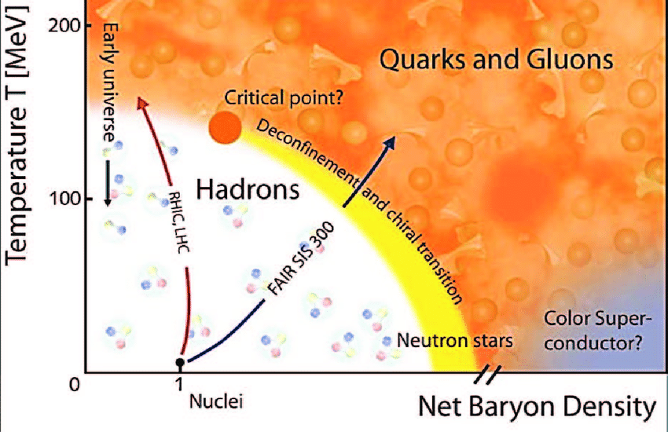
Why HI Collisions?
Quantify non-trivial, emergent many-body phenomena of non-Abelian QFT

Slide 3
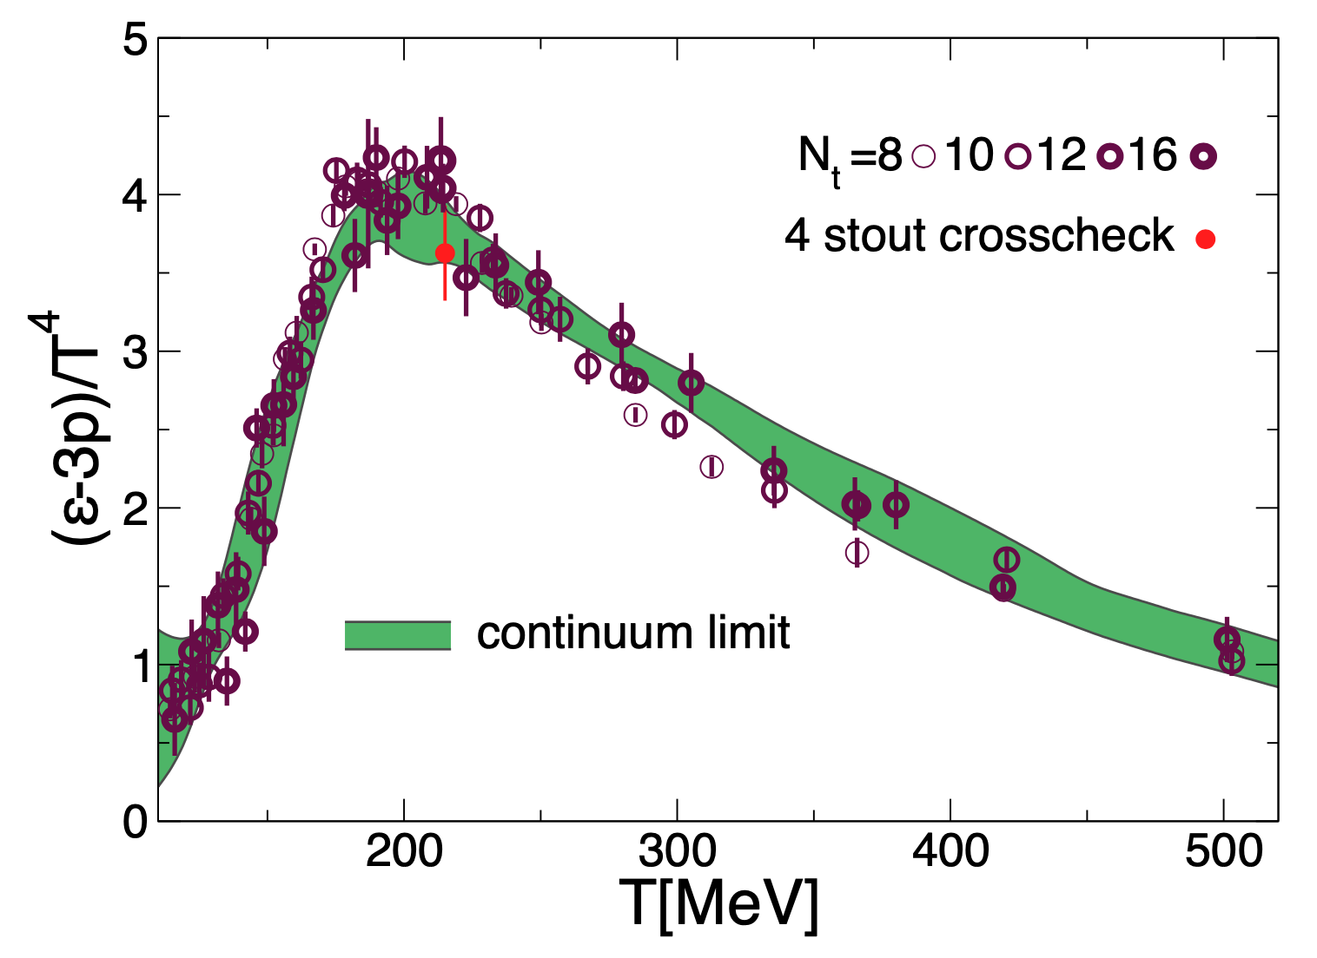
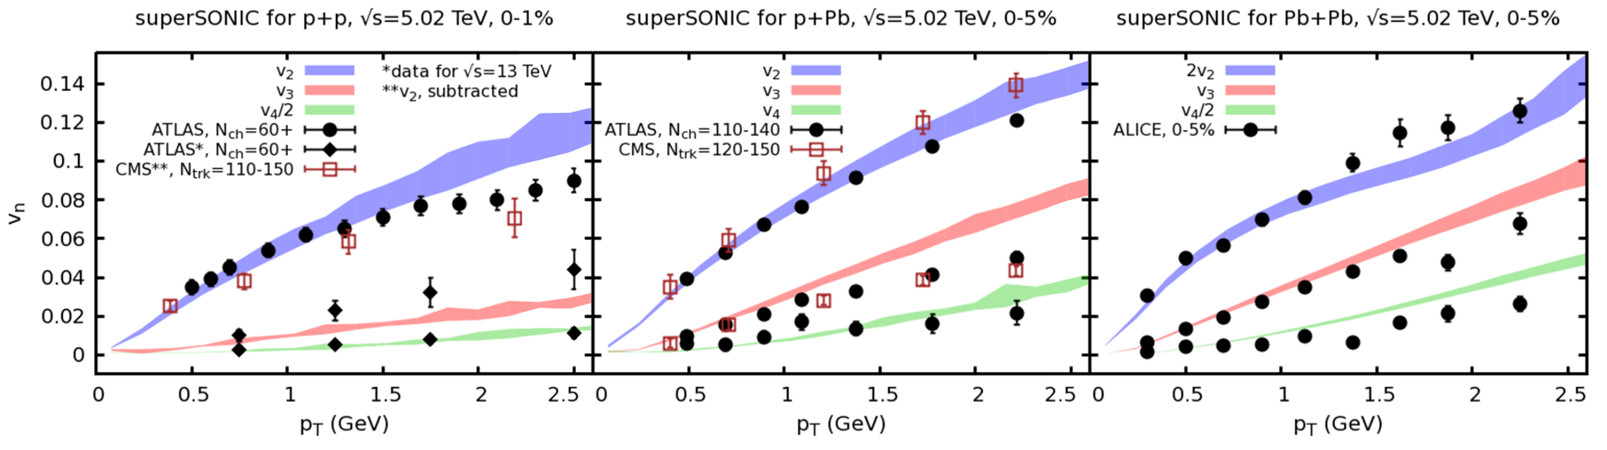
Hydro + HI Probes QCD/QGP
Input
Borsanyi et al.,
PLB730 (2014)
=>
Output
Weller and Romatschke, PLB774 (2017)

Slide 4
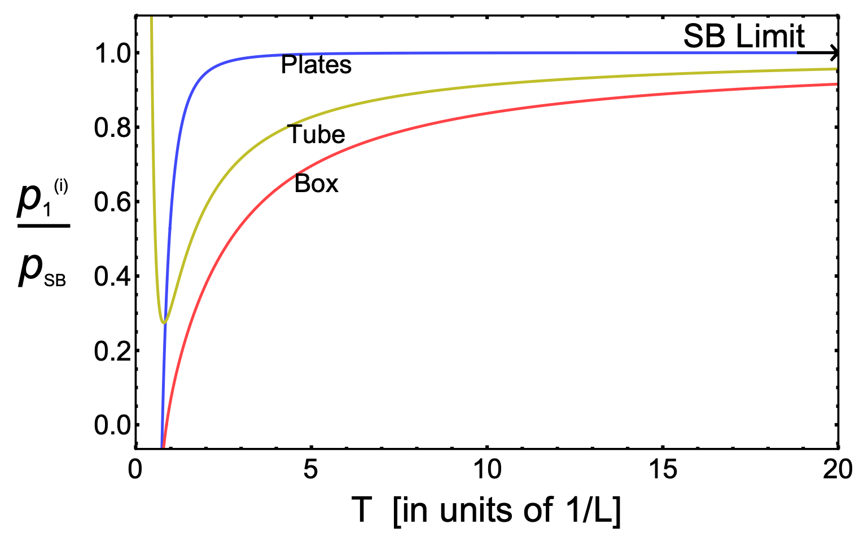
Does Finite Size Affect Thermodyn.?
Test using free scalar field theory
  p decreases significantly as T decreases for fixed L, converging to T = 0 Casimir effect
~10% effect at 400 MeV
for ~1 fm system
Mogliacci, Kolbé, and WAH, PRD102 (2020)
See also I Ghisoiu MSc thesis

Slide 5
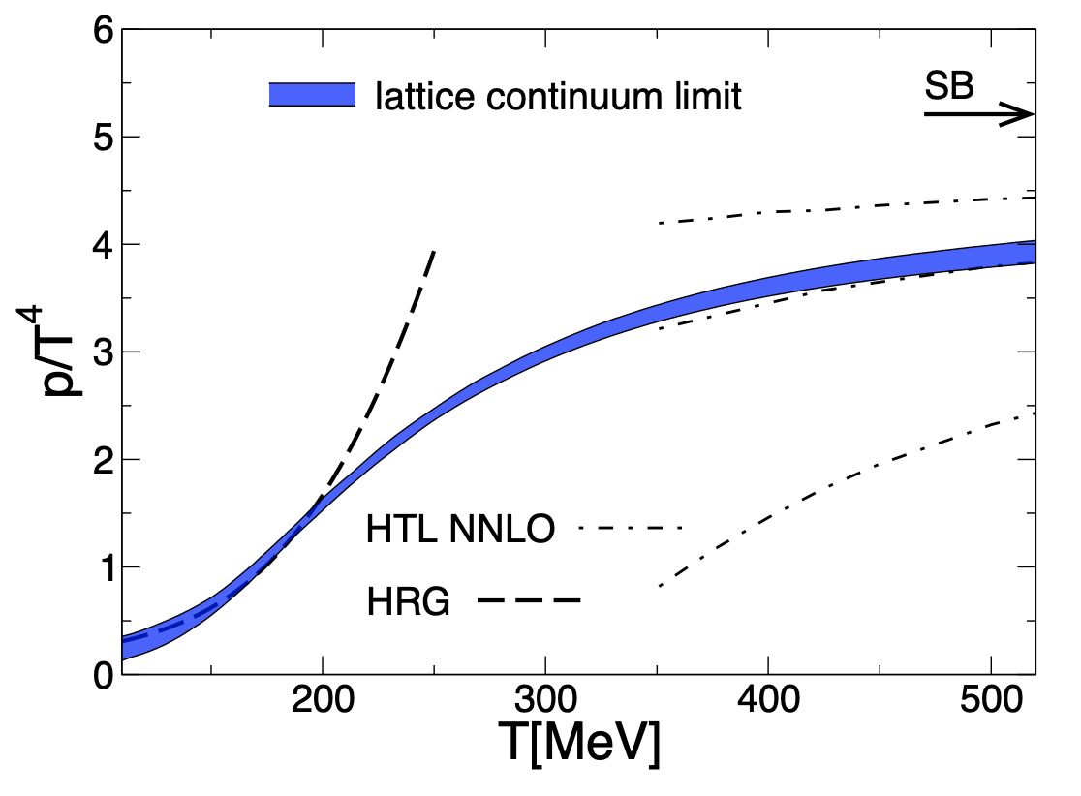
Does Finite Size Affect Thermodyn.?
Provocative qualitative T dependence:
Mogliacci, Kolbé, and WAH, PRD102 (2020)
Borsanyi et al., PLB730 (2014)
Notes:
Finite system size effects mimic some of the non-perturbative, phase transition reduction in pressure seen on lattice

Slide 6
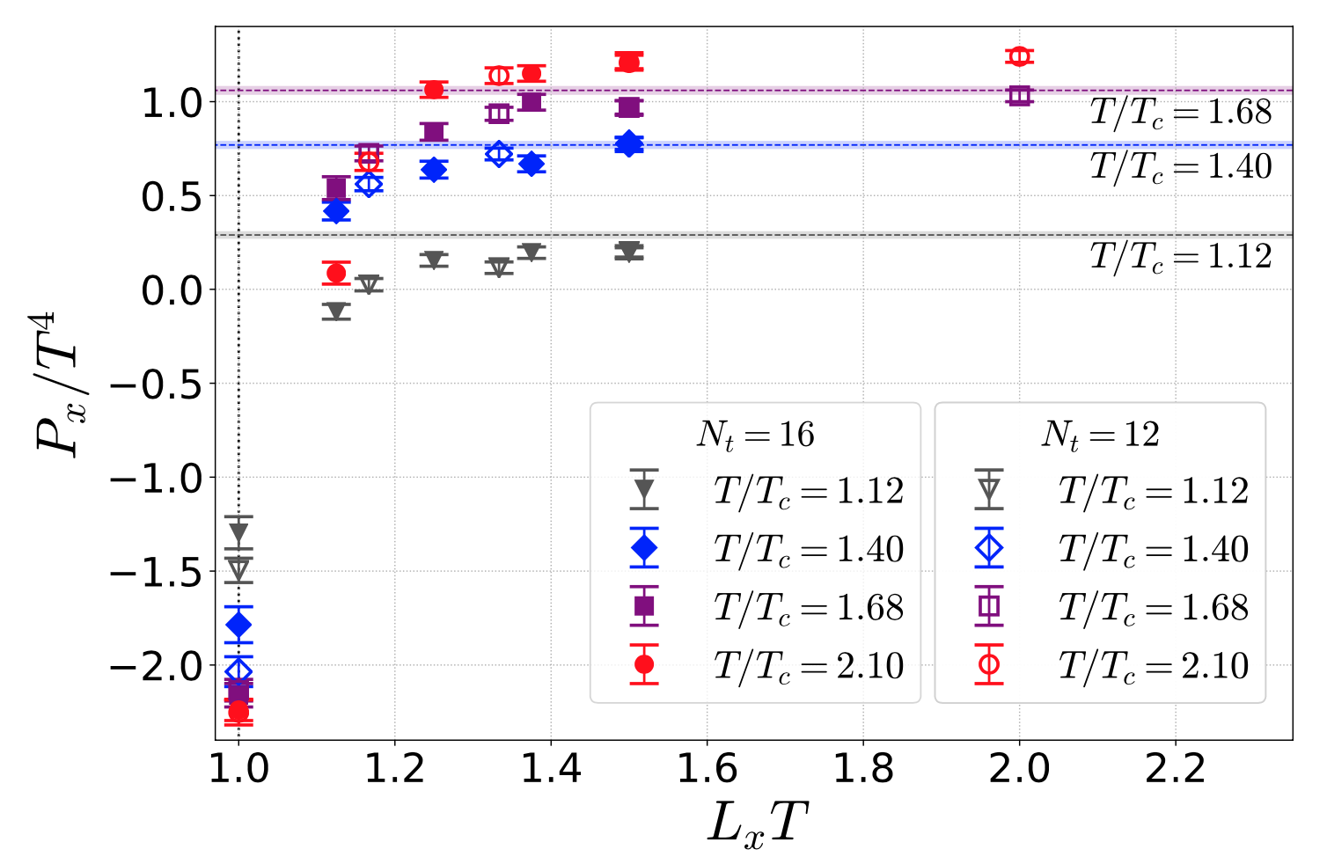
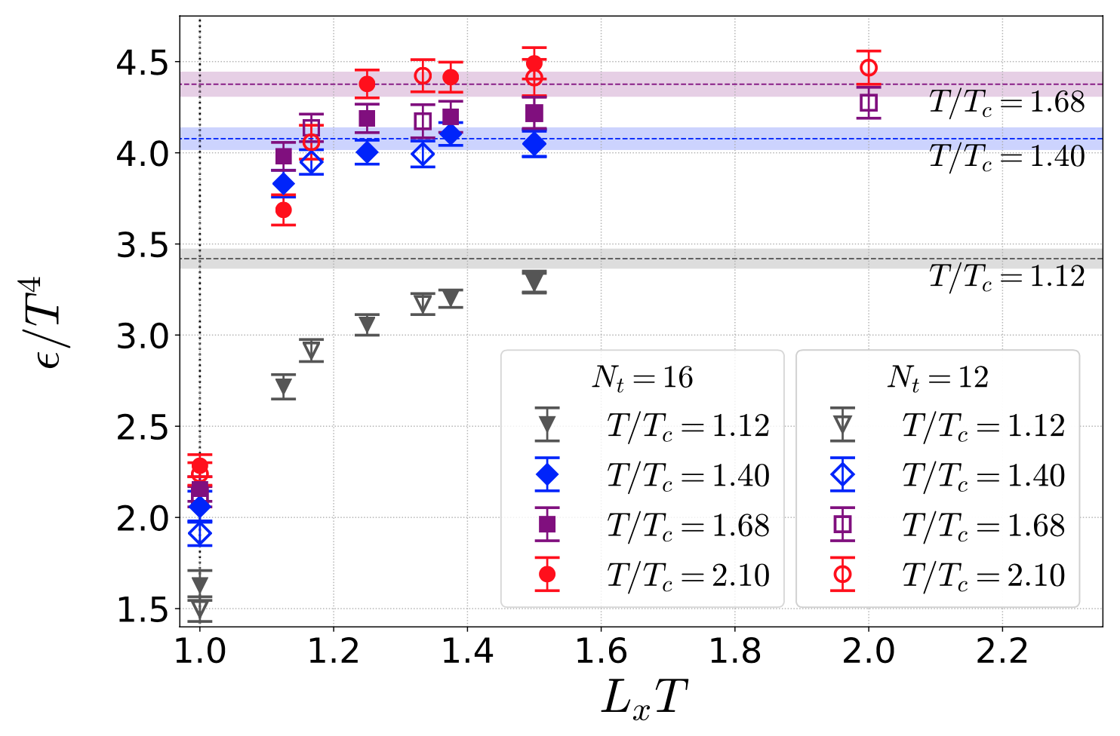
FS Effects in Quenched QCD
Kitazawa, Mogliacci, Kolbé, and WAH, PRD99 (2019)
Full lattice simulations of p, e follow analytic scalar/Casimir expectations

Slide 7
FS Effects in Quenched QCD
Thermodynamic quantities on anisotropic lattice with periodic boundary conditions
  Reduction of p, e with T*L qualitatively similar to free, massless scalar theory
Kitazawa, Mogliacci, Kolbé, and WAH, PRD99 (2019)

Slide 8
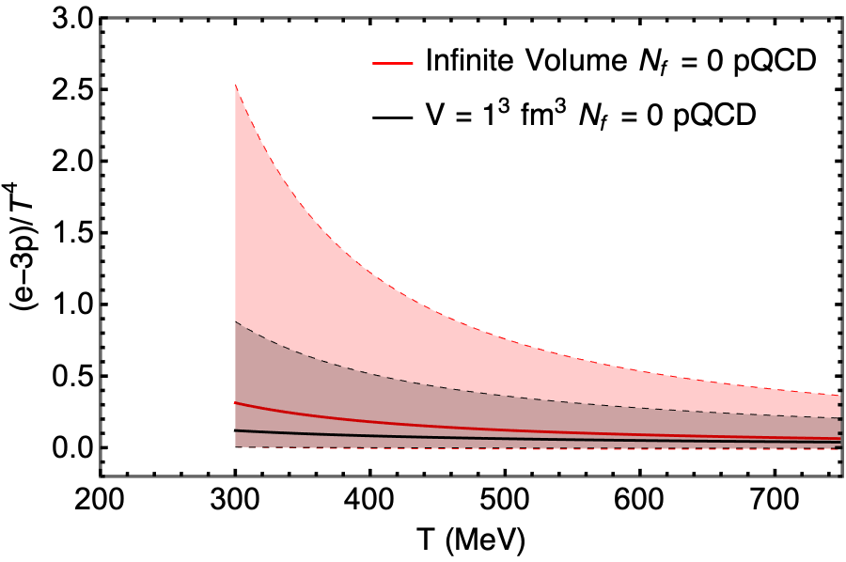
FS Effects on Trace Anomaly
Analytic expectations
  Scalar running coupling decreased by FS
  Use form of scalar FS correction in SU(3)
  Δ decreases with decreased system size
WAH and Rothkopf, in progress

Slide 9
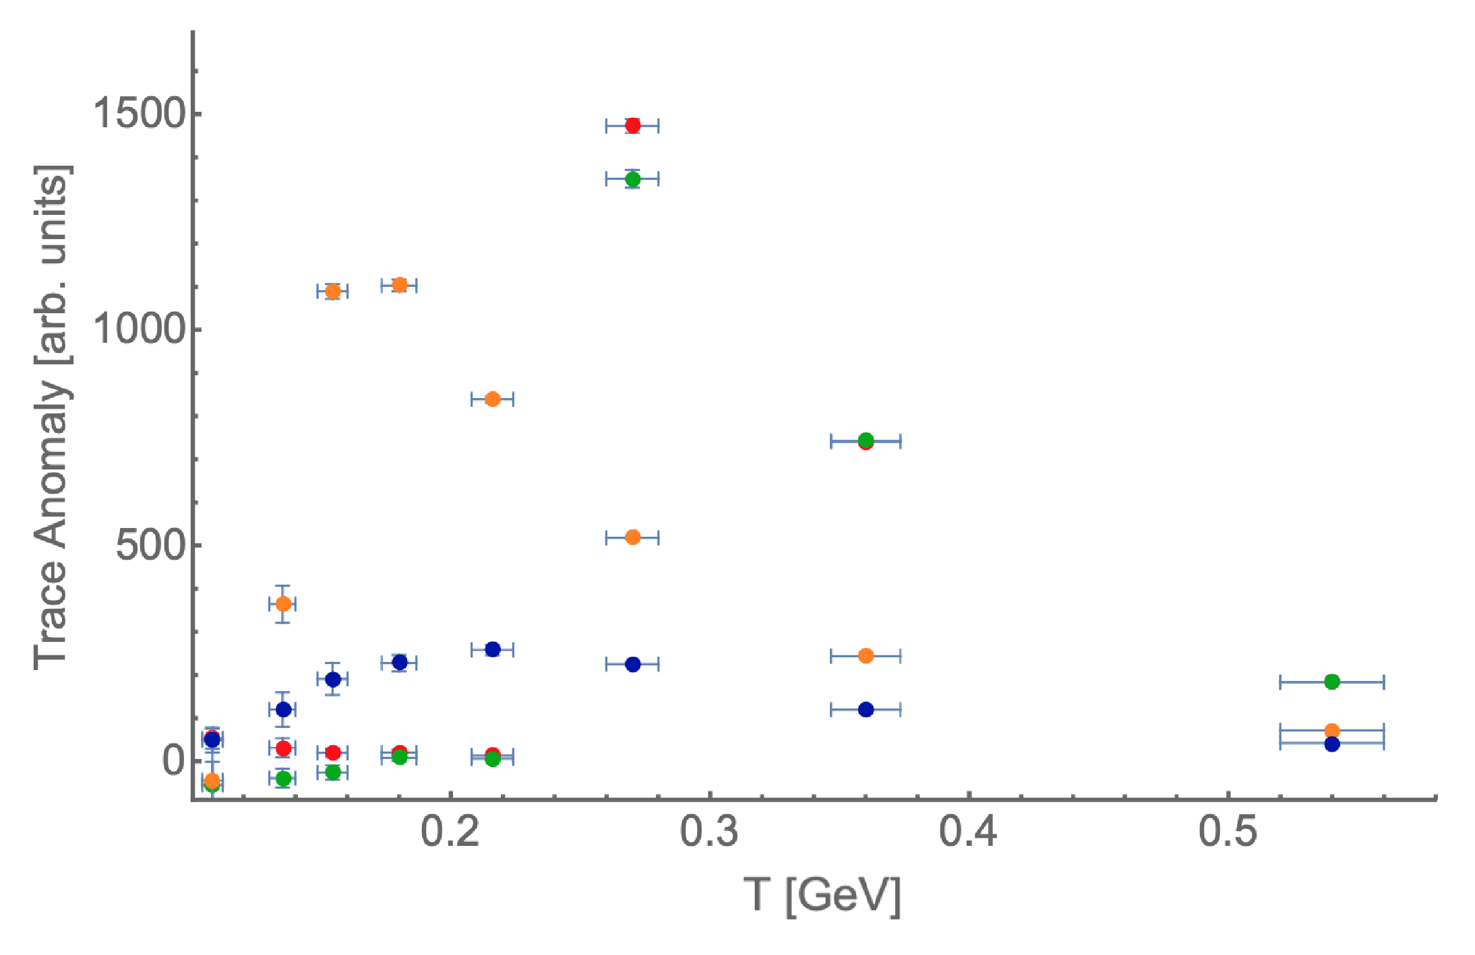
FS Effects on Δ in Lattice
Quenched QCD
Periodic BCs
PRELIMINARY
WAH and Rothkopf, in progress
Decreasing system size:
  decreases Δ
  washes out phase transition
Notes:
Nx = 24 (red), 16 (green), 8 (orange), 4 (blue). T varied by changing Nt

Slide 10
Conclusions
Finite size effects can be large for thermodynamics in QFT’s
  Appear to be phenomenologically relevant for pp collisions up to peripheral AA
  Likely impact extraction of QCD EoS from data
Future work:
  Explicitly compute finite size effects in running QCD coupling
  Refine current lattice calculations with periodic BCs
  Implement more realistic Dirichlet BCs on lattice
  Maintaining gauge invariance a challenge

