Slide 1

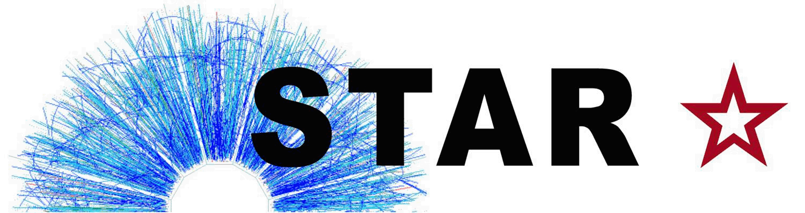

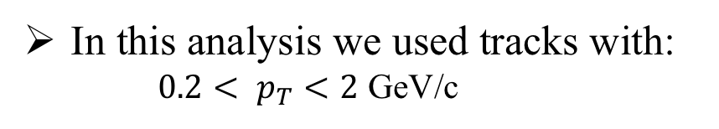
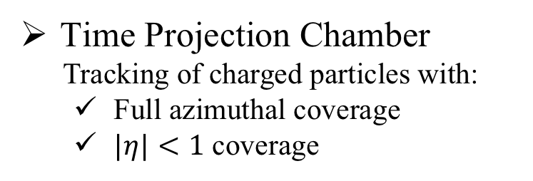
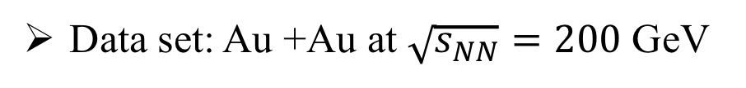
Investigations of the longitudinal broadening of two-particle transverse momentum correlations from STAR
Niseem Magdy Abdelrahman (For The STAR Collaboration)
University of Illinois at Chicago
niseemm@gmail.com
Data set: Au +Au at $\sqrt{s_{NN}}=200$ GeV
Time Projection Chamber
Tracking of charged particles with:
  Full azimuthal coverage
  $|η|<1$ coverage
In this analysis we used tracks with:
  ${0.2< p}_{T}<2$ GeV/c

Slide 2
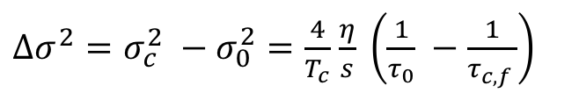
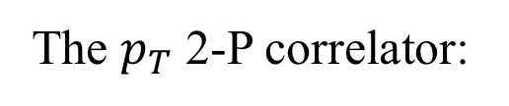
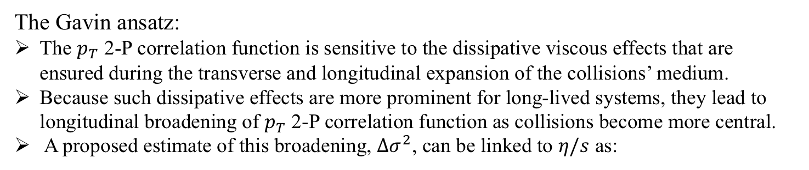
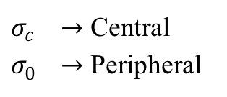
Motivation:
$σ_{c}^{} →$ Central
$σ_{0}^{} →$ Peripheral
S. Gavin and M. Abdel-Aziz
Phys.Rev.Lett. 97 (2006) 162302
The Gavin ansatz:
The $p_{T}$ 2-P correlation function is sensitive to the dissipative viscous effects that are ensured during the transverse and longitudinal expansion of the collisions’ medium.
Because such dissipative effects are more prominent for long-lived systems, they lead to longitudinal broadening of $p_{T}$ 2-P correlation function as collisions become more central.
A proposed estimate of this broadening, $Δσ^{2}$, can be linked to $η/s$ as:
Cartoon
$Δσ^{2}=σ_{c}^{2} −σ_{0}^{2}=\frac{4}{T_{c}}$ $\frac{η}{s} \left(\frac{1}{τ_{0}} −\frac{1}{τ_{c,f }}\right)$
The $p_{T}$ 2-P correlator:
STAR Collaboration
PLB 704 (2011) 467–473
$r_{1,2}$ is a number correlation, it will be unity when the particle pairs are independent
The $r_{1,2}$ correlations can be impacted by the centrality definition
Excluding the POI from the collision centrality definition, helps reduce the possible self-correlations.
N. Magdy and R. Lacey
arXiv: 2101.01555
Niseem Magdy ISMD-2021

Slide 3

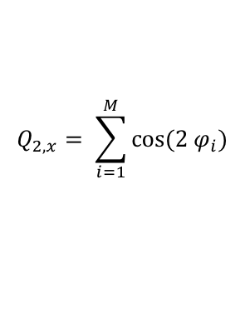
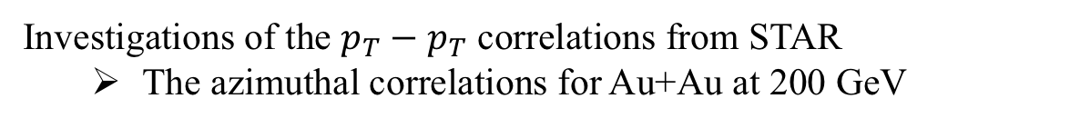






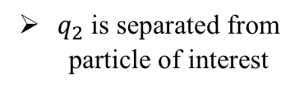


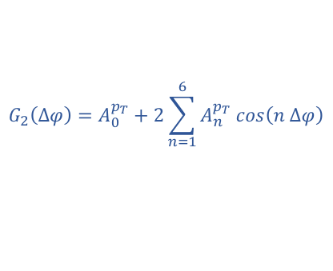




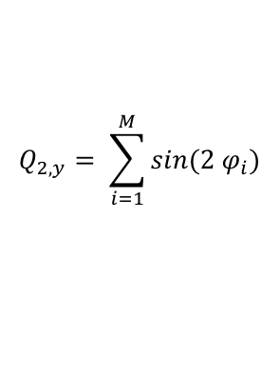

Investigations of the $p_{T}−p_{T}$ correlations from STAR
  The azimuthal correlations for Au+Au at 200 GeV
$$G_{2}\left(∆φ\right)=A_{0}^{p_{T}}+2\sum_{n=1}^{6}{A_{n}^{p_{T}} cos\left(n ∆φ\right)}$$
$$a_{n}^{p_{T}}= \sqrt{A_{n}^{p_{T}}}$$
STAR Preliminary
$$\left|∆η\right|>1.0$$
$$(GeV/c)$$
STAR Preliminary
$$Au+Au 200 GeV$$
STAR Preliminary
$${\left(GeV/c\right)}^{2}$$
The extracted $a_{2}^{p_{T}}$:
Decrease with harmonic order
Models do not describe the data
$q_{2}$ is separated from particle of interest
$$\left|η\right|<0.3$$
Event shape dependent
$$η<−0.5$$
$$η>0.5$$
$$q_{2}$$
$$Q_{2,x}= \sum_{i=1}^{M}{cos⁡(2 φ_{i})}$$
STAR Preliminary
$$(GeV/c)$$
$$Q_{2,y}= \sum_{i=1}^{M}{sin(2 φ_{i})}$$
STAR Preliminary
STAR Preliminary
$$\left|Q_{2}\right|= \sqrt{Q_{2,x}^{2}+Q_{2,y}^{2}}$$
$$q_{2}=\frac{\left|Q_{2}\right|}{\sqrt{M}}$$
 | Slope
$$a_{2}^{p_{T}}$$ | 8.60e-05 +/- 1.0e-05
Niseem Magdy ISMD-2021

Slide 4


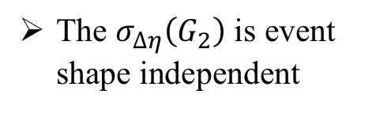
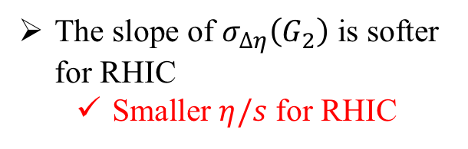
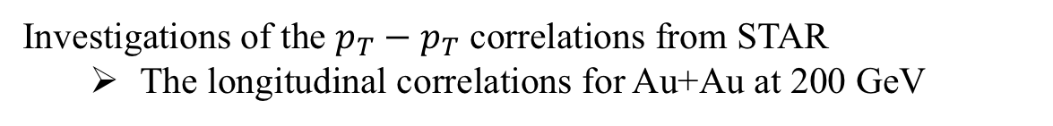
Investigations of the $p_{T}−p_{T}$ correlations from STAR
  The longitudinal correlations for Au+Au at 200 GeV
$$σ_{∆η}\left(G_{2}\right)=RMS[G_{2}\left(∆η\right)]$$
$${\left(GeV/c\right)}^{2}$$
STAR Preliminary
STAR Preliminary
The slope of $σ_{∆η}\left(G_{2}\right)$ is softer for RHIC
  Smaller $η/s$ for RHIC
P. Alba et al.
PRC 98, 034909 (2018)
 | Slope
LHC | 0.0412 +/- 0.0036
RHIC | 0.0120 +/- 0.0007
STAR Preliminary
STAR Preliminary
The $σ_{∆η}\left(G_{2}\right)$ is event shape independent
ALICE Collaboration
PLB 804 (2020) 135375
 | Slope
Total | 0.0120 +/- 0.0007
10 % | 0.0119 +/- 0.0009
90 % | 0.0110 +/- 0.0012
Niseem Magdy ISMD-2021

Slide 5

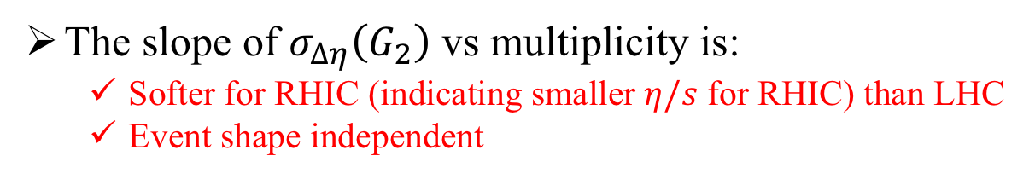
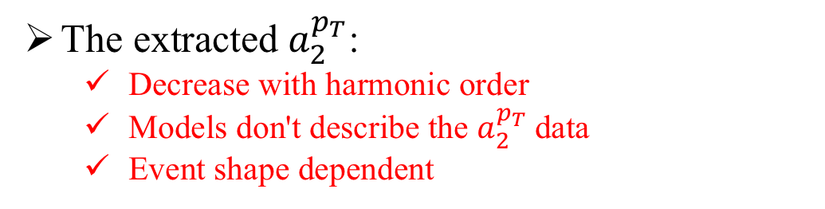
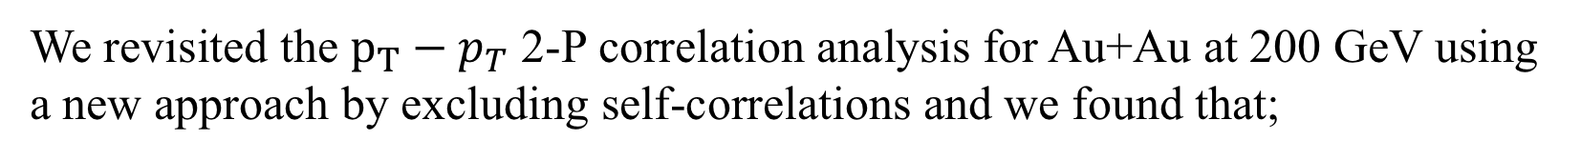
Investigations of the $p_{T}−p_{T}$ correlations from STAR
  Conclusions
We revisited the ${p_{T}−p}_{T}$ 2-P correlation analysis for Au+Au at 200 GeV using a new approach by excluding self-correlations and we found that;
The extracted $a_{2}^{p_{T}}$:
  Decrease with harmonic order
  Models don't describe the $a_{2}^{p_{T}}$data
  Event shape dependent
ALICE Collaboration
PLB 804 (2020) 135375
V. Gonzalez et al.
Eur.Phys.J.C 81 5, 465 (2021)
N. Magdy and R. Lacey
arXiv: 2101.01555
N. Magdy et al.
arXiv: 2105.07912
S. Gavin and M. Abdel-Aziz
Phys.Rev.Lett. 97 (2006) 162302
Sean Gavin et al.
PRC 94 (2016) 2, 024921
M. Sharma et al.
PRC 84 (2011) 054915
STAR Collaboration
PLB 704 (2011) 467–473
The slope of $σ_{∆η}\left(G_{2}\right)$ vs multiplicity is:
  Softer for RHIC (indicating smaller $η/s$ for RHIC) than LHC
  Event shape independent
These comparisons are reflecting the efficacy of the 𝐺2(Δ𝜂,Δ𝜑) correlator to differentiate among theoretical models as well as to constrain the 𝜂/𝑠.
Thank You
Niseem Magdy ISMD-2021

Slide 6
Thank You

Slide 7
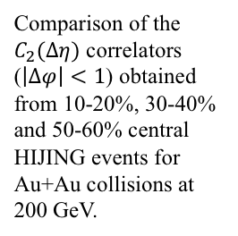

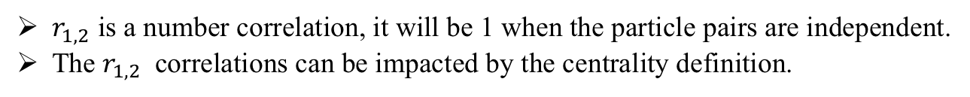
N. Magdy and R. Lacey
arXiv: 2101.01555
The $p_{T}$ 2-P correlator is given as:
The first term can be given as:
$r_{1,2}$ is a number correlation, it will be 1 when the particle pairs are independent.
The $r_{1,2}$ correlations can be impacted by the centrality definition.
Comparison of the $C_{2}(Δη)$ correlators ($\left|Δφ\right|<1$) obtained from 10-20%, 30-40% and 50-60% central HIJING events for Au+Au collisions at 200 GeV.
N. Magdy and R. Lacey
e-Print: 2101.01555
Set-A: with centrality defined using all charged particles in an event,
Set-B: with centrality defined using random sampling of charged particles in an event
Set-C: with centrality defined using the impact parameter distribution.
Excluding the POI from the collision centrality definition, serves to reduce the possible self-correlations.

Slide 8
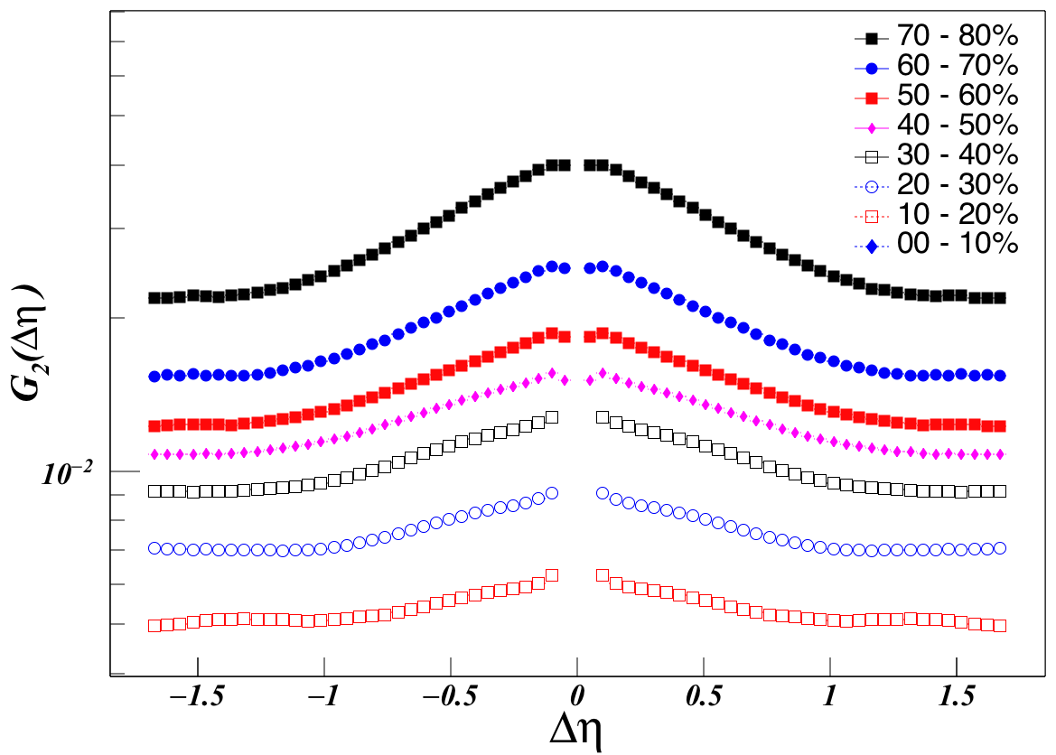



$$\left|φ\right|<1.0$$
$$Au+Au 200 GeV$$
STAR Preliminary
$${\left(GeV/c\right)}^{2}$$

