Slide 1
Getting ready for the next
Strips BCP
G. Sciolla

Slide 2
What is already in P6 and what should be added
P6 will close soon and we do not want to be the last people in line
  Mistake may happen when in a hurry
Instead of putting every single change in one single BCP, safer to split it into 2
  First one targets next Tue
Several changes have already been implemented in P6
  In my slides today I will review some of what has been implemented/approved recently

Slide 3
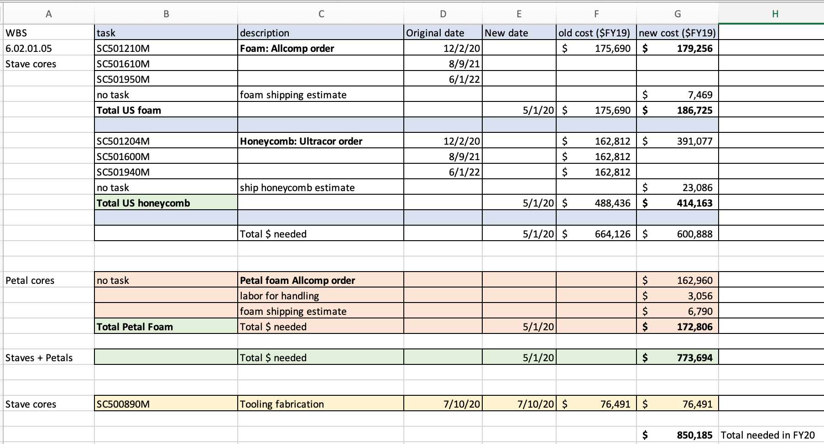
Recent Changes in P6 – Cores
Foam and Honeycomb orders through Yale for Production ALMOST ready to go
CD3 task

Slide 4
Cores: foam and honeycomb – To do
Preliminary OK from Jon
Waiting for D. Francis’ confirmation for Petal’s portion of the order
  Expected by Wed/Thu
Implementation in P6 by the end of the week (GS and Carrie)
→ Chuck is ready to transfer funds and Jeff will order

Slide 5
Payments to CERN – HV/LV PSs for SR1
Introduced new task in the Payments to CERN:
RE170050M, Material Payment for HV/LV Power Supplies for SR1 testing
Cost: 11,554 CHF which corresponds to about 11,900 US$.
Date: May 11th
Predecessor: RE320650M
Successor: RE170040
This is not a CD3A item because these items will not be included in the final detectors
Already got invoice from CERN → Chuck will pay as soon as it is in P6

Slide 6
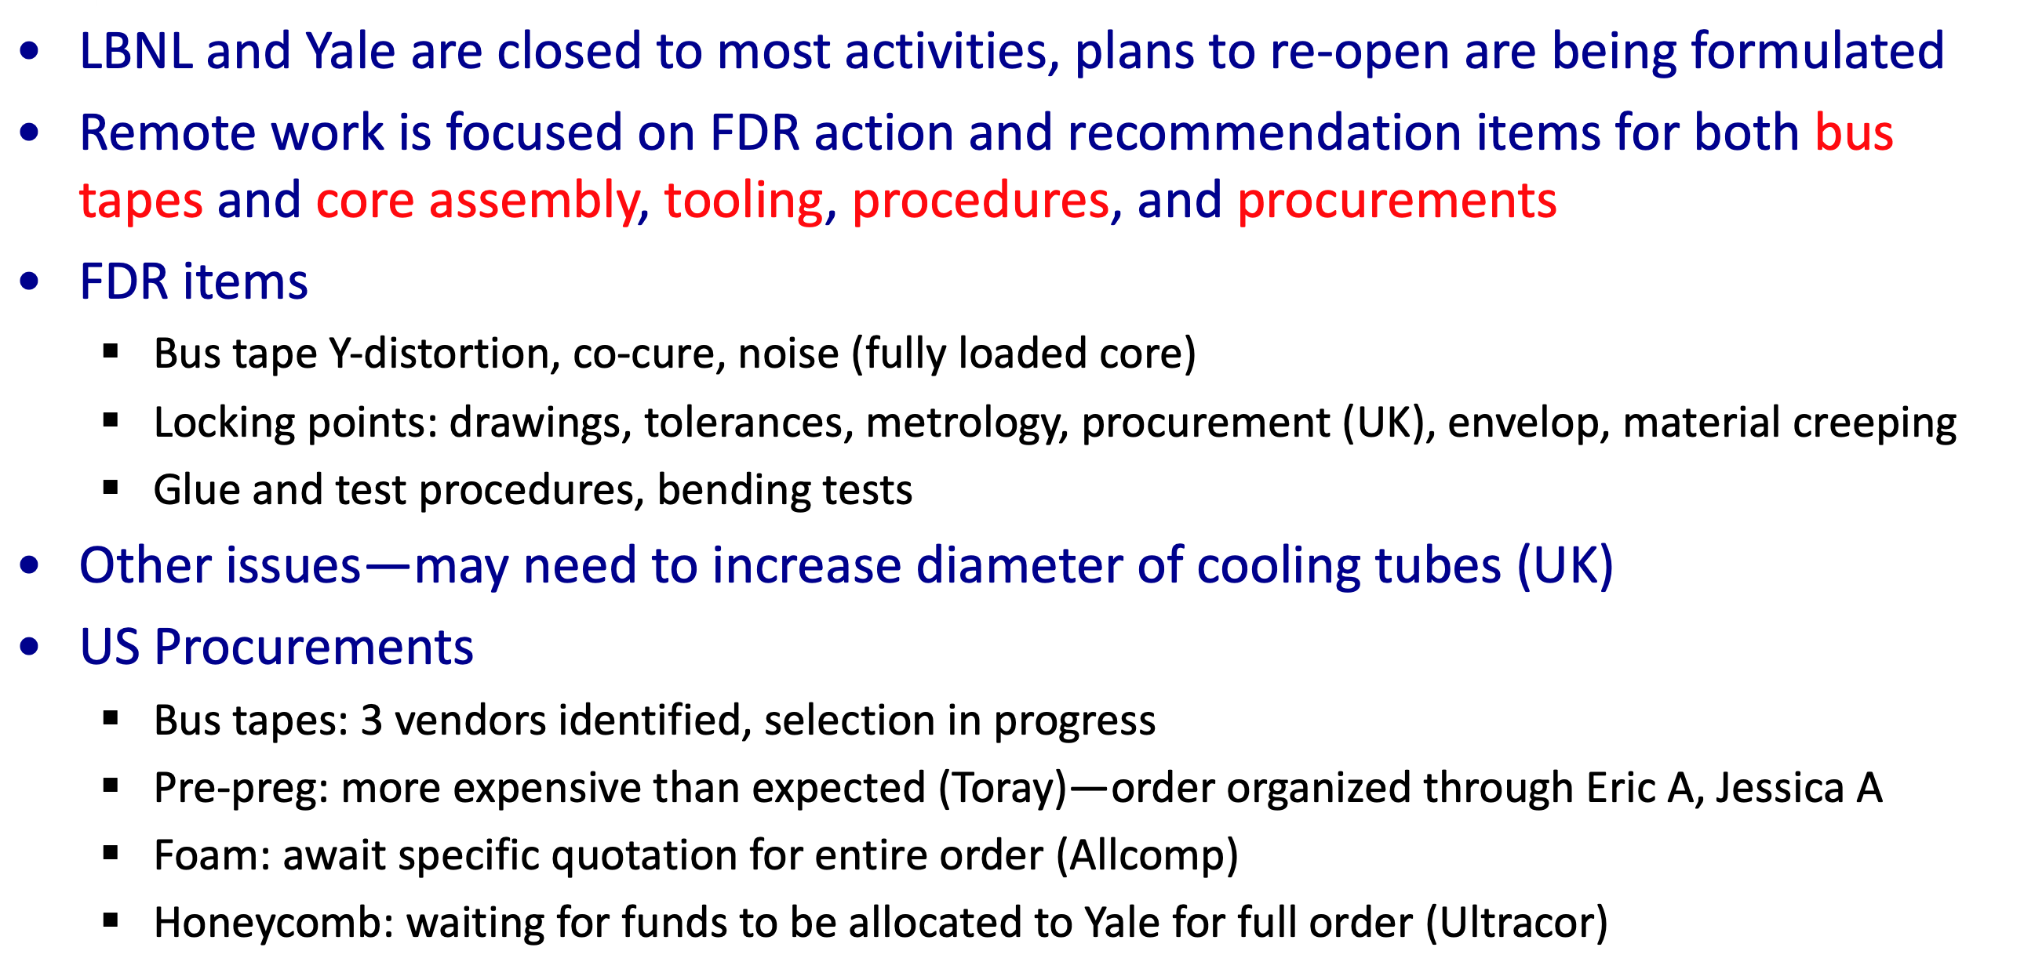
News from L3s – Cores (Jeff)
Slide from Jeff

Slide 7
RE (Evelyn)

Slide 8
Modules (Gabriella)
Main activity in Modules is restructuring Materials for PP3 and Production
  Problem: each site has material implemented in its own way
    BNL: attached to 1/3 batches
    Others: 1 payment/year
    Amounts almost the same in production (not in PP3) and not well justified
  Need improvement to be able to defend in CD2
  Had meeting with L4s; requested new quotes
    None received yet, but now AUW is over…
  Already implemented in P6:
    homogeneous material in Production for all 3 sites (old #s still in place, but the skeleton is ready)
  To do:
    Update #s based on new quotes from L4s (when?)
    Extend this more uniform implementation to PP3
    Revise description of hybrids and some other items (test frames, etc)

Slide 9
Modules
UCSC Change Rate:
  Implemented by Penka in an Administrative BCP (BCP-36 in Doc-db)
Mistake found and fixed in UCSC budget for FY20
  Re-did calculations with Penka, and realized that UCSC received less than they were supposed to this FY
  Mistake was rectified in P6 last week (will be included in next Strips BCP)
    Already OK-ed by PO
Sensor – additional cost for shipping from Japan
  Good news. Vitaliy received Pre-production sensors and could confirm that he did not have to pay import tax. Only customs/handing fees/duties.
  Extrapolating to the entire production: 44 shipments, 1/month → +38k$
  We will have to include them somehow in the next BCP

Slide 10
Stave Assembly (Alessandro)

Slide 11
Questions/Comments
Carl: already approved new order of bus tapes (for 15-20k$)
  Is it already in P6?
HVMux: recent email from Carl points points toward having invoice from CERN in a few weeks. We know the total:
  Let’s update entry in P6 before next BCP
Toray: pre-preg --

Slide 12
All Recent and Pending BCPs (as of 4/10/2020)
WBS | task | description | Original date | New date | old cost | new cost | diifference | 2020 BCP's | comments
Cores
6.02.01.02 | SC200510M | CF purchase | 9/8/2020 | 4/8/2021 | $49,779 | $40,132 | -$9,647 | -$9,647 | question of UK bound portion and wastage estimate, was 590 sqm total@$303/sqm
 | SC200720M | CF purchase | 12/20/2020 | 7/20/2021 | $51,359 | $68,001 | $16,642 | $16,642 | new amount is 861 sqm at $303/sqm
 | SC201000M | CF purchase | 5/10/2021 | 10/12/2021 | $40,691 | $100,062 | $59,371 | $59,371 | JA is negotiating with Toray
 | SC201210M | CF purchase | 9/20/2021 | 5/10/2022 | $40,691 | $123,422 | $82,731 | $82,731 | JA is negotiating with Toray
 |  | CF shipping
 |  | New Allcomp order |  | 4/1/2020 | $182,520 | $180,000 | -$2,520 | -$2,520
 |  | foam shipping
6.02.01.05 | SC200474M | Bus tape | 8/19/2020 | 1/15/2021 | $32,781 | $65,562 | $32,781 | $32,781 | estimate fom 1 vendor
 | SC200475M | Bus tape | 8/20/2020 | 1/18/2021 | $444,729 | $889,458 | $444,729 | $444,729 | estimate fom 1 vendor
 | SC200485M | Bus tape | 10/1/2021 | 10/1/2021 | $192,443 | $384,886 | $192,443 | $192,443 | estimate fom 1 vendor
 | new | Bus tape additional test | 8/1/2019 |  | $0 | $20,000 | $20,000 |  | part of 2nd source study
 | new | Bus tape 2nd vendor test | 8/1/2019 |  | $0 | $8,000 | $8,000 |  | part of 2nd source study
 | new | Bus tape post Feb FDR tests |  | 4/1/2020 |  | $39,000 | $39,000 | $39,000
Electronics
6.02.07 | RE140400M | HV Mux | 1/17/2020 |  | $895,000 | $552,000 | -$343,000 | -$343,000 | new pricing from Panasonic
 | RE310390M | ABC Prod | 7/8/2020 | 9/15/2020 | $853,000 | $1,083,404 | $230,404 | $230,404 | new from Paul 1/22/20 | $436,917
 | RE310335M | ABC Pre |  | 2/1/2020 | $170,889 | $190,577 | $19,688 | $19,688 | new from Paul 1/22/21
 | RE321030M | HCC/AMAC Prod | 8/1/2019 | 10/30/2020 | $473,000 | $570,874 | $97,874 | $97,874 | new from Paul 1/22/22
 | RE329650M | HCC/AMAC Pre |  | 5/1/2020 | $332,679 | $421,630 | $88,951 | $88,951 | new from Paul 1/22/23
 | new | Common irrad cost |  |  | $0 | $41,000 | $41,000 |  | late request from international ATLAS
 | new | irrad pre pro die |  | 9/1/2020 | $0 | $41,000 | $41,000 | $41,000 | new request
 | new | BCP025 |  |  | $0 | $405,187 | $405,187
 | RE261411M | Yale coils | FY20 | 1/15/2020 | $108,765 | $81,381 | -$27,384 | -$27,384 | coils cheaper, add China tariff, US=67%
Modules |  |  | FY20
6.02.04.01 | new | Smart Scope BNL | FY20 |  | $0 | $83,000 | $83,000 |  | Required for site qualification from international ATLAS
 | new | Pull tester BNL |  |  | $0 | $43,000 | $43,000 |  | Required for site qualification from international ATLAS
6.02.04.04 | new | Sensor test stand UCSC |  |  | $0 | $25,000 | $25,000 |  | late requirement from international ATLAS
 | new | mechanical sensors | pre prod | now | $0 | $18,000 | $18,000 |  | CERN surprise! Who ordered that?
 | new | Santa Cruz rate change | prod | duration | $0 | $300,000 | $300,000 |  | estimate but they have the data now
 | new | fixed monthly staff costs |  |  |  | $100,000 | $100,000 |  | cannot properly assess without a current scrubbing report, and explicit plan
 | new | US costs on sensor import |  | duration | $0 | $50,000 | $50,000 | $50,000 | VF, research ongoing
Stave Assy |  |  | 5/21-12/21 |  |  |  | $0
6.02.05.01 | new | temporary EOS risk realized* |  | 1/2021 | $0 | $50,000 | $50,000 | $50,000 | cost for temp EOS cards
 | new | labor for the temp EOS effort |  |  | $0 | $100,000 | $100,000 | $100,000 | labor 6 mo Tech, too high?
total |  |  |  |  |  |  | $2,206,250 | $1,163,063 | $462,087
Yellow background = CD3a items
* but was not in CD-3a
near term items
Needs resolution
Status?
Ready to be implemented?
Status?
Done, not sure if it is in P6
Already done
Mentioned earlier
International schedule now available

