Slide 1


ARIES QPR Update
Stewart Leith, Michael Vogel
Authors would like to acknowledge the support provided by European Union’s ARIES collaboration H2020 Research and Innovation Programme under Grant Agreement no. 730871.

Slide 2
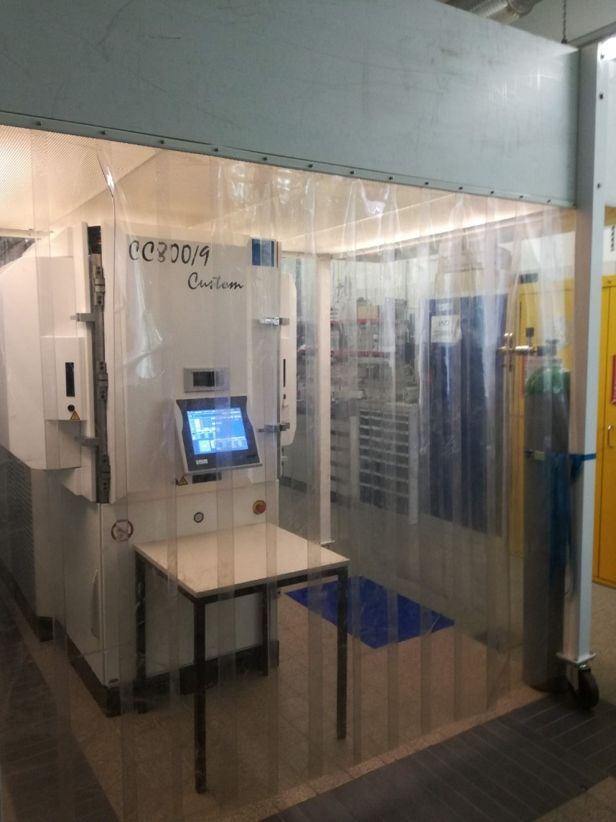
Preparation for QPR
Flow cell installed around machine. Reduce particulate and create laminar flow
Area inside flow cell cleaned prior to deposition
QPR sample handled inside flow cell
Clean suits worn during mounting and dismounting of QPR sample
Copper surface showed evidence of pitting and machining on the surface prior to deposition

Slide 3
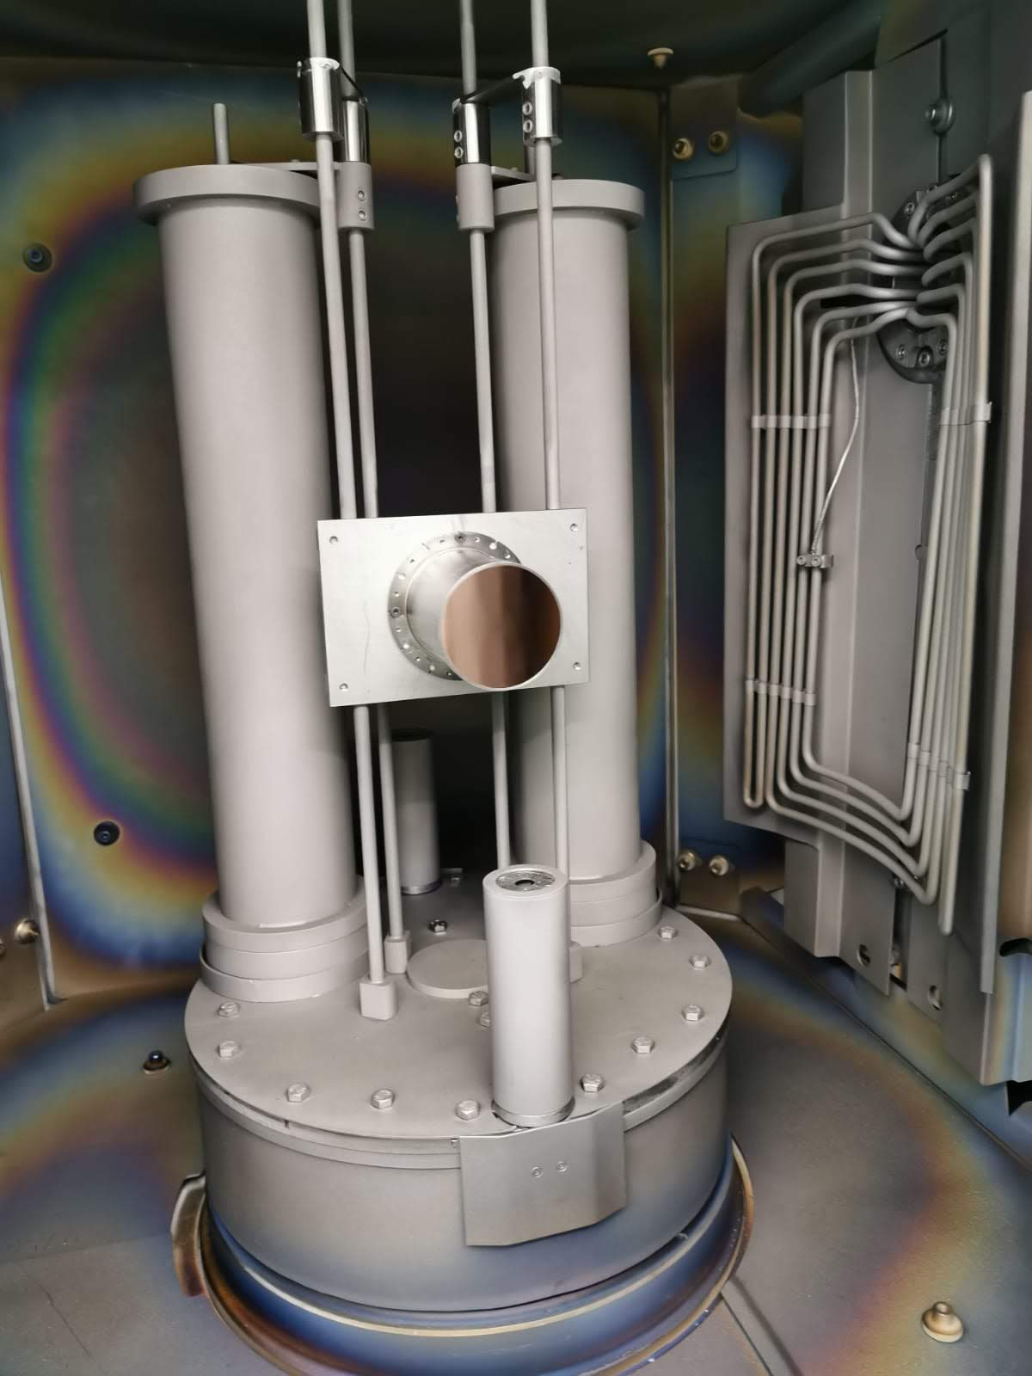
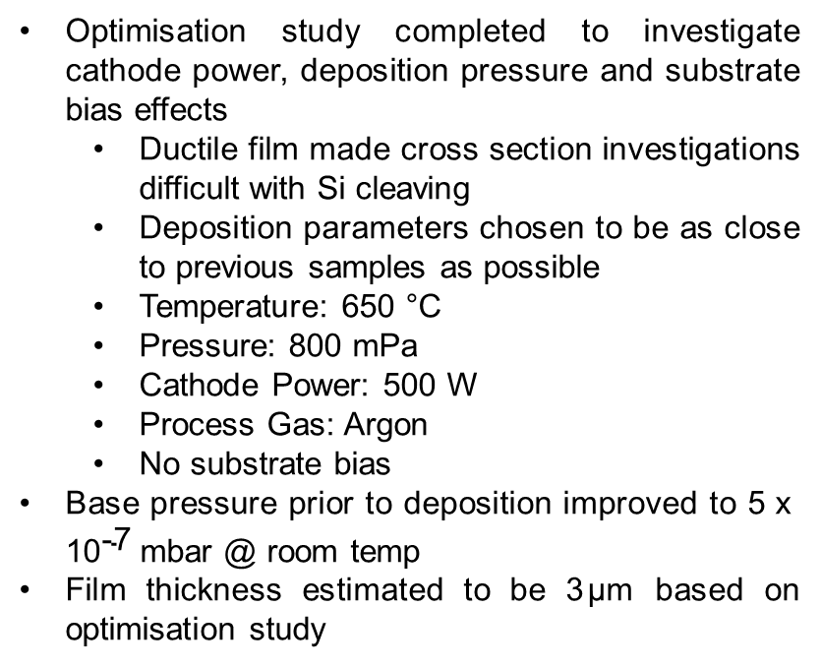
Deposition Parameters
Optimisation study completed to investigate cathode power, deposition pressure and substrate bias effects
  Ductile film made cross section investigations difficult with Si cleaving
  Deposition parameters chosen to be as close to previous samples as possible
  Temperature: 650 °C
  Pressure: 800 mPa
  Cathode Power: 500 W
  Process Gas: Argon
  No substrate bias
Base pressure prior to deposition improved to $\text{5} \text{x} {\text{1}\text{0}}^{\text{−7}}$mbar @ room temp
Film thickness estimated to be 3$\text{μm}$ based on optimisation study

Slide 4
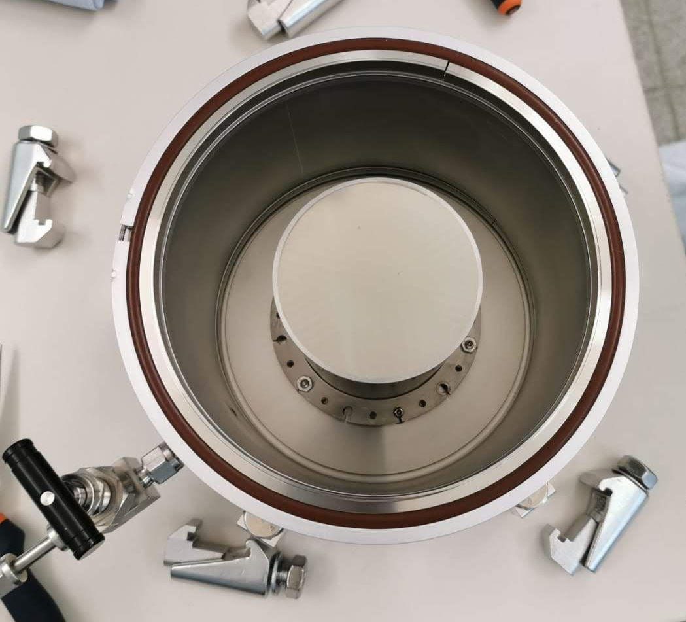
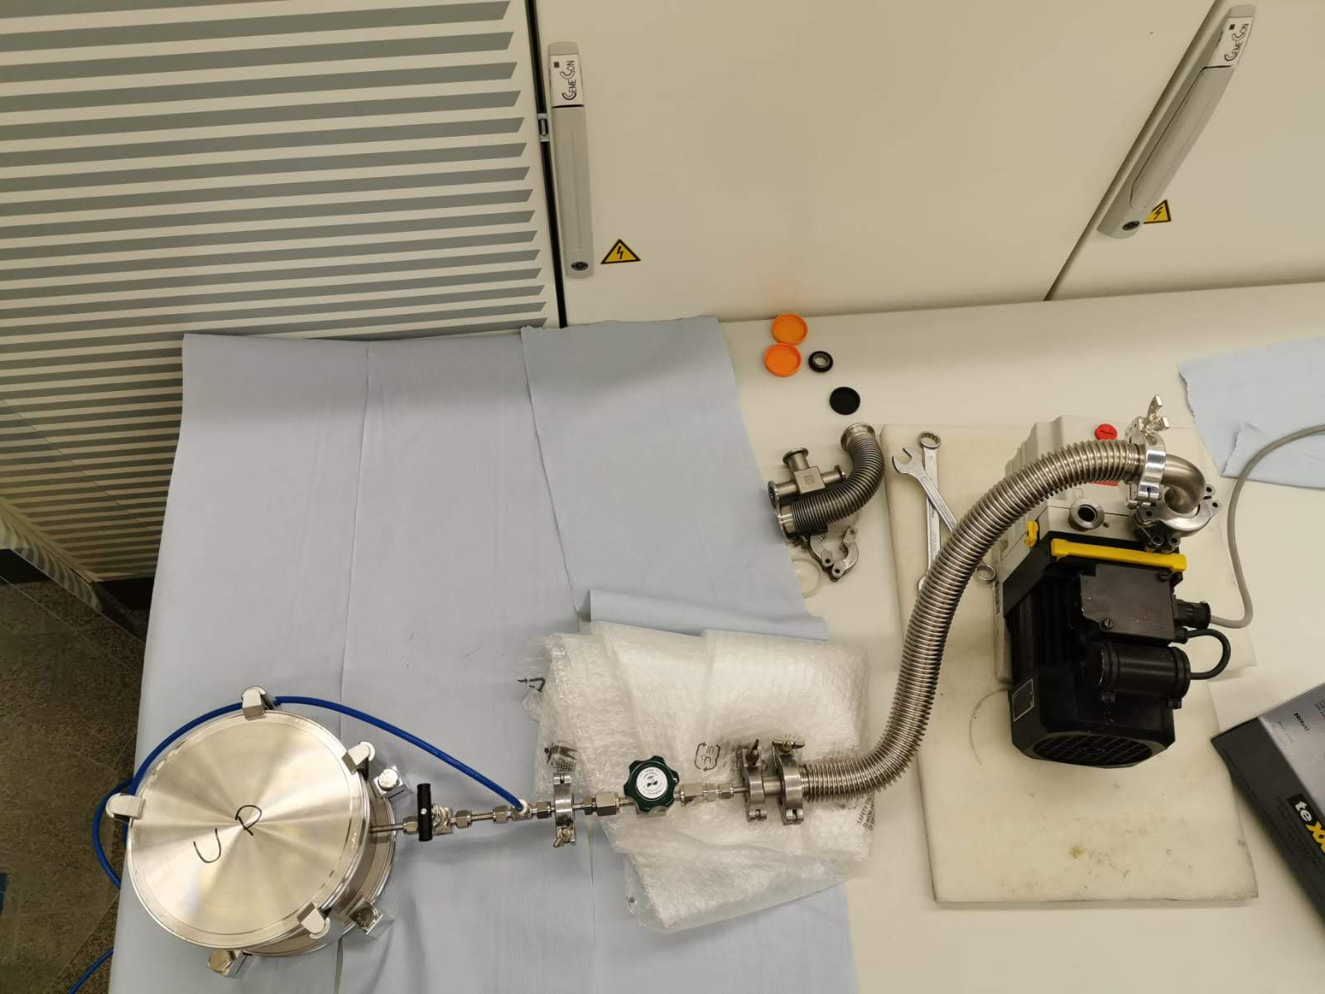
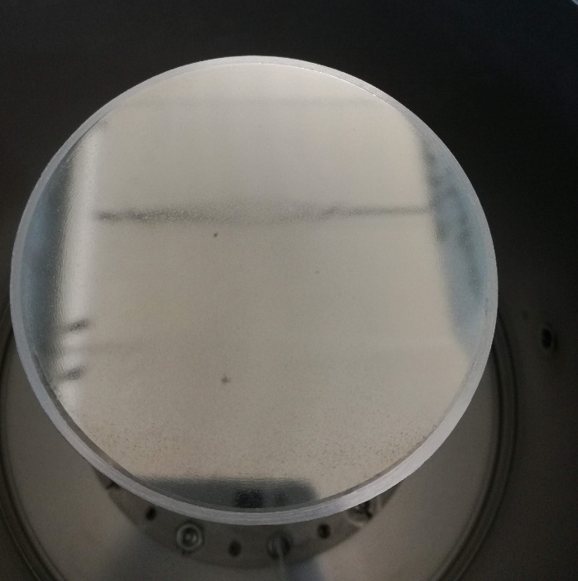
Results
QPR sample placed in holder and inspected inside flow cell
Niobium thin film showed evidence of the pitting seen on copper surface.
A handful of star marks found on the surface of the film. Two prominent. Possible localised different orientation
Sample holder pumped down and backfilled with Argon for delivery
QPR sampled delivered to HZB for characterisation
Four clamps broken during fixing – bent bolts. Replaced

