Slide 1


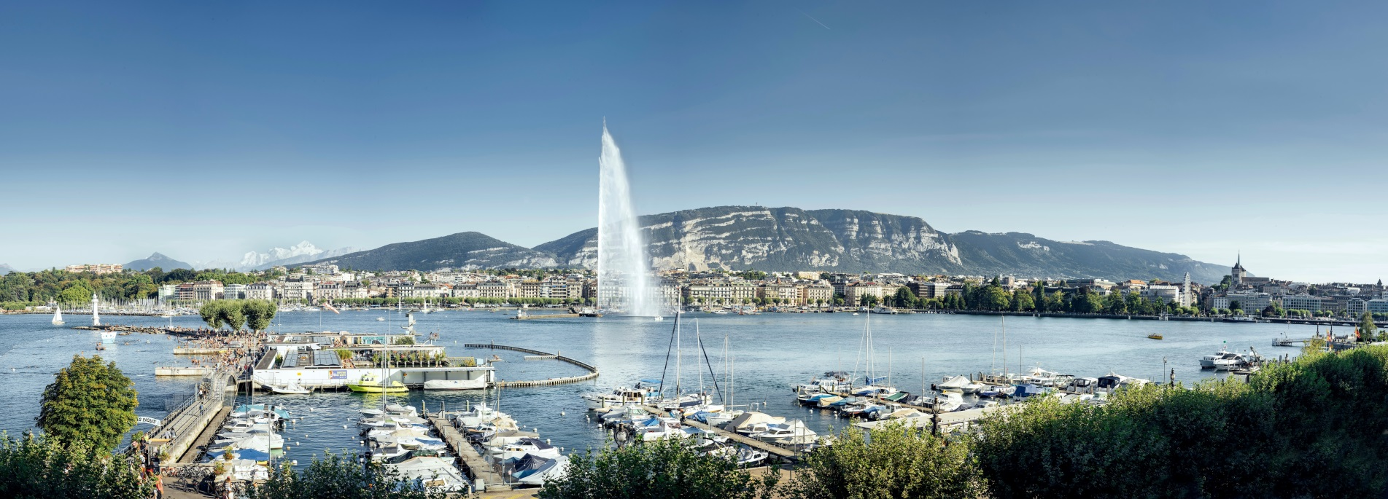
International Geneva Welcome Centre
www.cagi.ch
@CagiGeneva

Slide 2
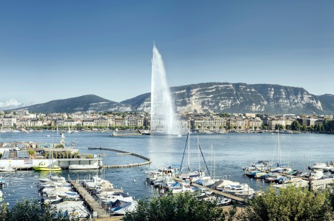
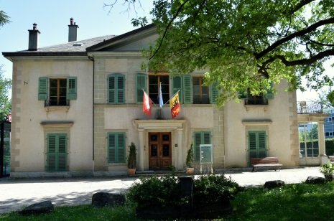
A non-profit organisation, founded in 1996 by the Swiss Confederation and the Republic and canton of Geneva
The 'one stop shop' facilitating the settlement and integration of employees of International Geneva and their family members.
Assisting NGOs and supporting delegates attending conferences in Geneva.
Thanks to the support of public and private entities, CAGI’s services are free of charge.
Who are we?
Contact
 +41 22 546 14 00
welcome.cagi@etat.ge.ch

Slide 3




































Founding members
Associate members
Sympathising members

Slide 4
1. Newcomers Network Service
The Newcomers Network Programme for Internationals and their families facilitates integration into Geneva and its region :
• Welcome call
• Lunchtime-conferences (health, education, housing etc.)
• Excursions and events to discover Geneva and the Lemanic region
• Insiders' Geneva
• Language Exchange Programme
Contact
 +41 22 546 14 26
network.cagi@etat.ge.ch

Slide 5
2. Housing Service
• Support finding accommodation through an online housing platform
• VIP Service for Permanent Representatives, Heads of IOs and their Deputies
• Settling-in & departure support, proofreading of rental contracts and tenancy law advice
• Support Permanent Missions and NGOs in their search for office space
Contact
 +41 22 546 14 17
immo.cagi@etat.ge.ch

Slide 6
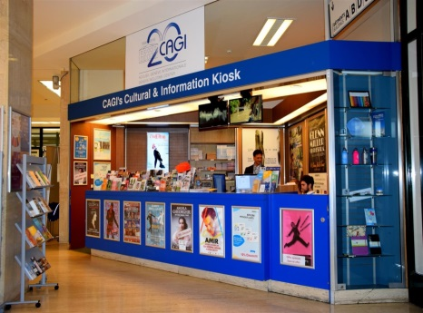
3. Communications & Events Service
Cultural Kiosk at UNOG
Organization of social events, open to all,
facilitating gatherings between Internationals
and the local community.
The Cultural Kiosk :
The only point of sale (also on-line), in the heart of the Palais des Nations, for a variety of events at preferential rates
Informs Internationals on the cultural and tourist
offers in Switzerland.
Contact
 +41 22 546 14 07
 event.cagi@etat.ge.ch
Cultural Kiosk
 +41 22 917 11 11
info@kiosqueonu.ch

Slide 7
WEEKLY EMAIL
For internal circulation among staff members
---------------------------------------------------------------------------------------------------------------------------------------------------------------------------------
Flash news du CAGI
New housing offer intended primarily for employees of International Geneva.
From now you can buy tickets remotely at the Cultural Kiosk!
Contact us by mail info@kiosqueonu.ch or phone 022 917 11 11.
Summer opening hours: 10am to 3pm
---------------------------------------------------------------------------------------------------------------------------------------------------------------------------------
Check out our cultural Agenda!
---------------------------------------------------------------------------------------------------------------------------------------------------------------------------------
Summer edition: week #9
Current offers (at preferential rates)
Chaplin's World museum
Yatouland's aquatic park for kids
CGN's lake cruises
SIG's carafe and flask
Pathé Cinema
Swiss Vapeur Parc's real steam trains open air museum
Ariana's museum of ceramic and glass
Fondation Baur, museum of Far Eastern Art
Vitam's aquatic park
Geneva City Pass
Hike, tourism, wakeboard and more
Free hike on the Salève every Sunday with l'AGAS!
Discover Jura & Three-Lakes region with its absinthe, Pinot Noir, Creux du Van and more!
Fan of wakeboard, kneeboard or water ski? Try the TNA Cable Park (F)!
Family
À Western City les petits comme les grands renouent avec les cowboys et les indiens.

Slide 8
4. NGO Service
Assistance and support to International nongovernmental organisations (INGO), whether already based in, or interested in establishing an office in Geneva :
• Information on the local conditions for INGO activities
• Interface between INGO and public authorities
• Practical services aimed at facilating day-to-day operations
Contact
 +41 22 546 14 10
ong.cagi@etat.ge.ch

Slide 9
5. How to help spouses / Partners (new focus)
• Meeting with multinationals
• CAGI's NGO Recruitment Platform www.cagi.ch/en/ngo
• International Dual Career Network: www.idcn.info
• Association découvrir – assists qualified migrant women:
www.associationdecouvrir.ch
• Fellowship programmes (f.ex. GCSP)

Slide 10

6. New products
Informing employees of IG and their family members before their arrrival:
4 topics of major concern: housing, transport, health and education
Short movies : www.cagi.ch/practical-geneva
Brochure
How to reach incoming employees of International Geneva? – with your help

Slide 11



