Slide 1

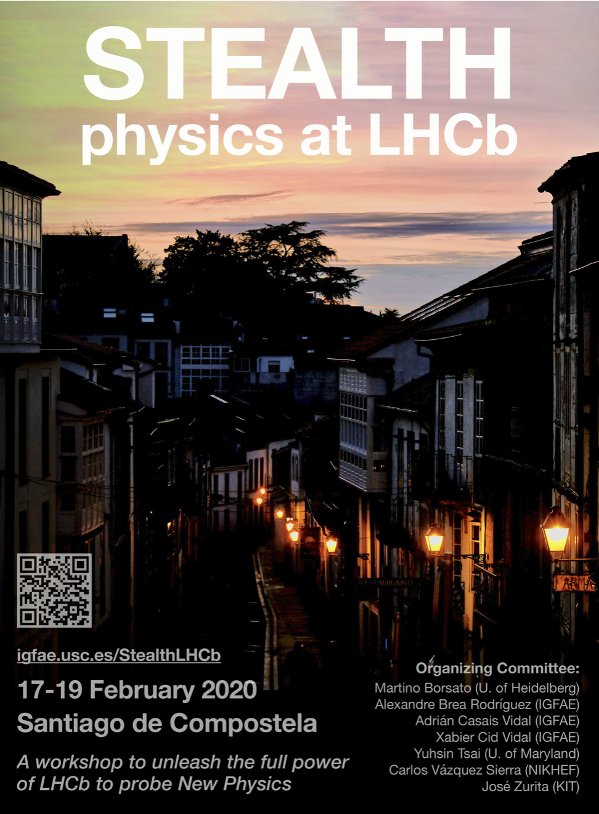

Direct Searches for New Physics
Who are LHCb’s Main Rivals?
Albert De Roeck
CERN, Geneva, Switzerland
Antwerp University Belgium
UC-Davis California USA
NTU, Singapore
19th February 2020

Slide 2
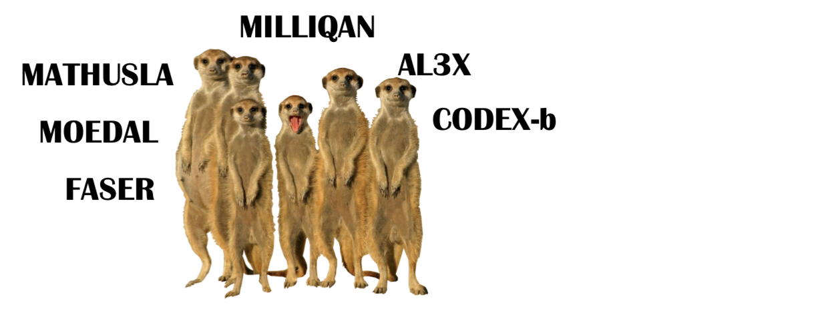

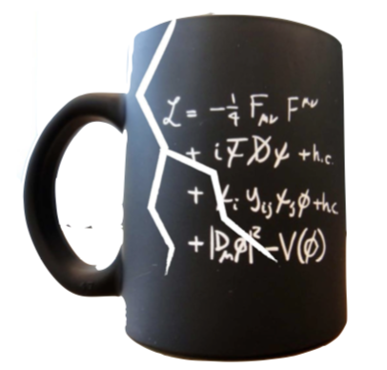
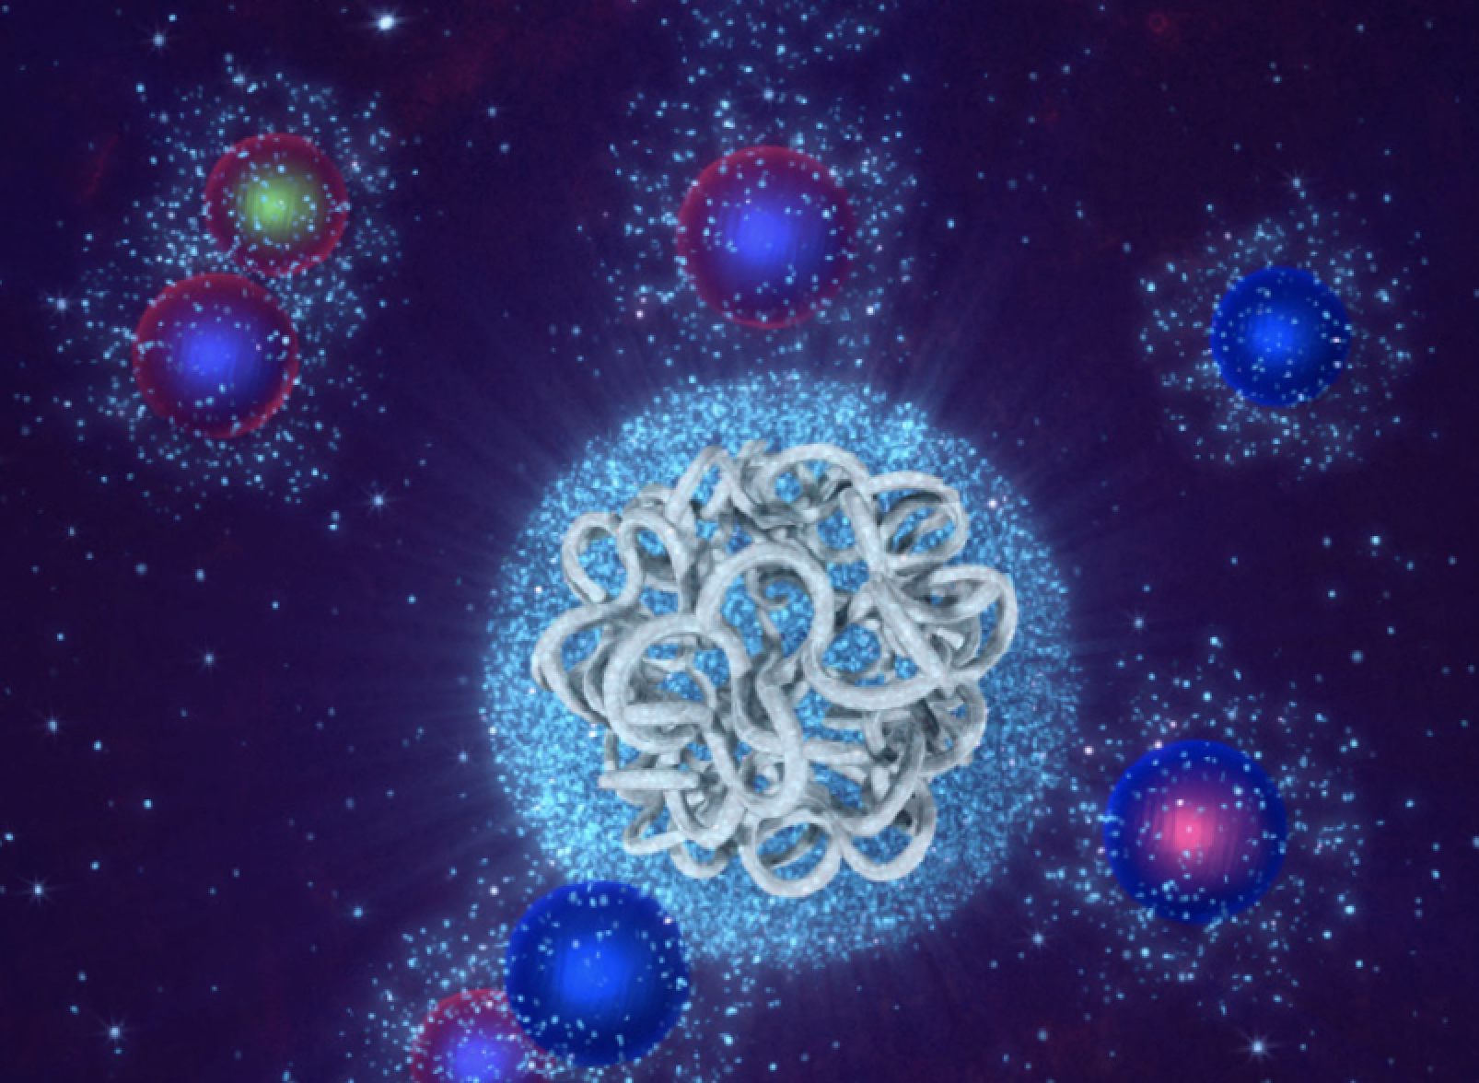
Outline
+…
Introduction
Upcoming upgrades of the LHC
experiments (ATLAS/CMS)
Dedicated new experiments @
the LHC!
Physics beyond collider:
fixed target program
New/current neutrino
experiments
Summary & Outlook
•Personal selection of topics.
•Will mostly consider LLPs.

Slide 3

Who are LHCb’s Main Rivals?
Present other LHC experiments
  ATLAS, CMS, MoEDAL(+)
New proposals/ideas for LHC experiments
  FASER, MilliQan, MATHUSLA, MAPP, CODEX-b, AL3X, ANIBUS and recently XSEN, FASER-Nu, SND@LHC
Fixed target/BDF experiments eg at CERN
  See Physics Beyond Collider-2018 study
Neutrino experiments present/future
  SBN, NOVA, T2K, and in future DUNE/T2HK, (ESS-Nu)
Belle II (50 ab⁻¹ in 2027, but not this talk)

Slide 4

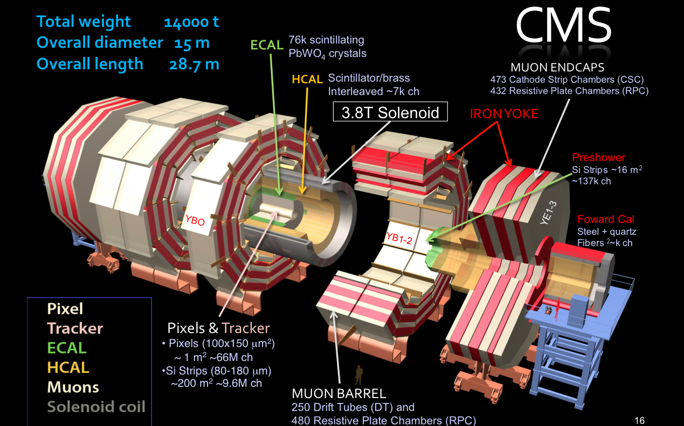
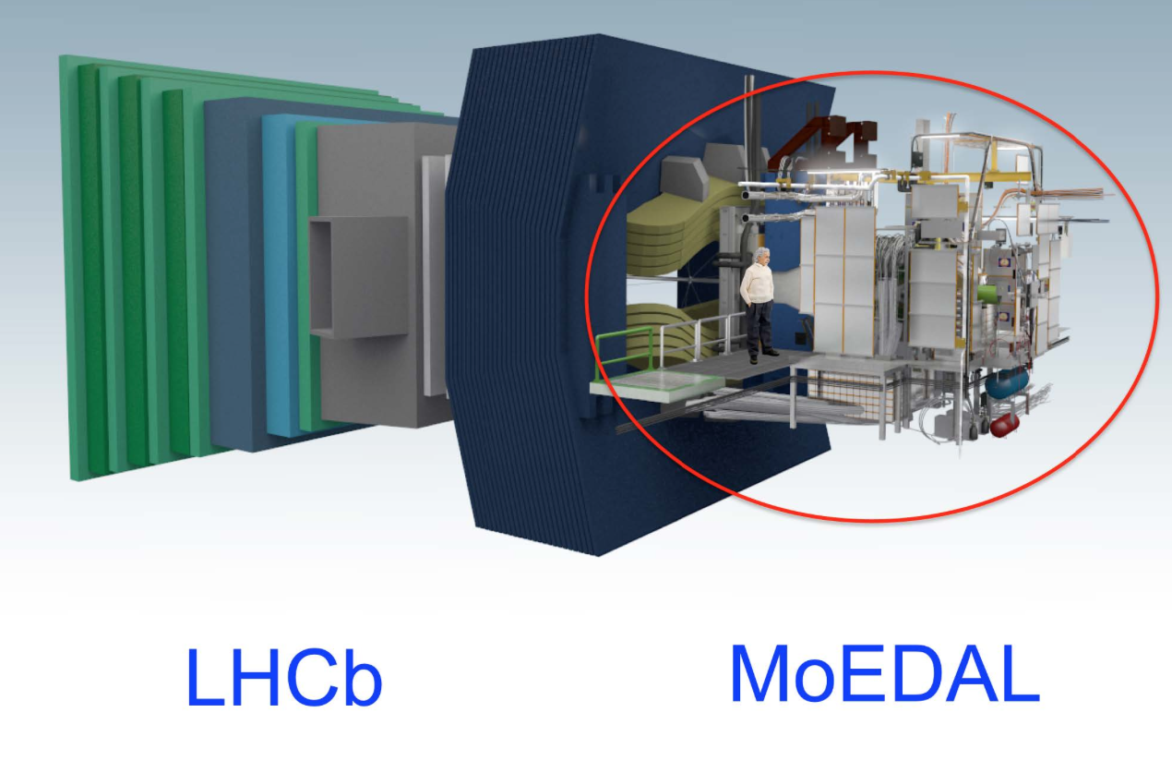
New Physics Hunters @ the LHC
The ATLAS experiment
The CMS experiment
…And also LHCb and MoEDAL

Slide 5
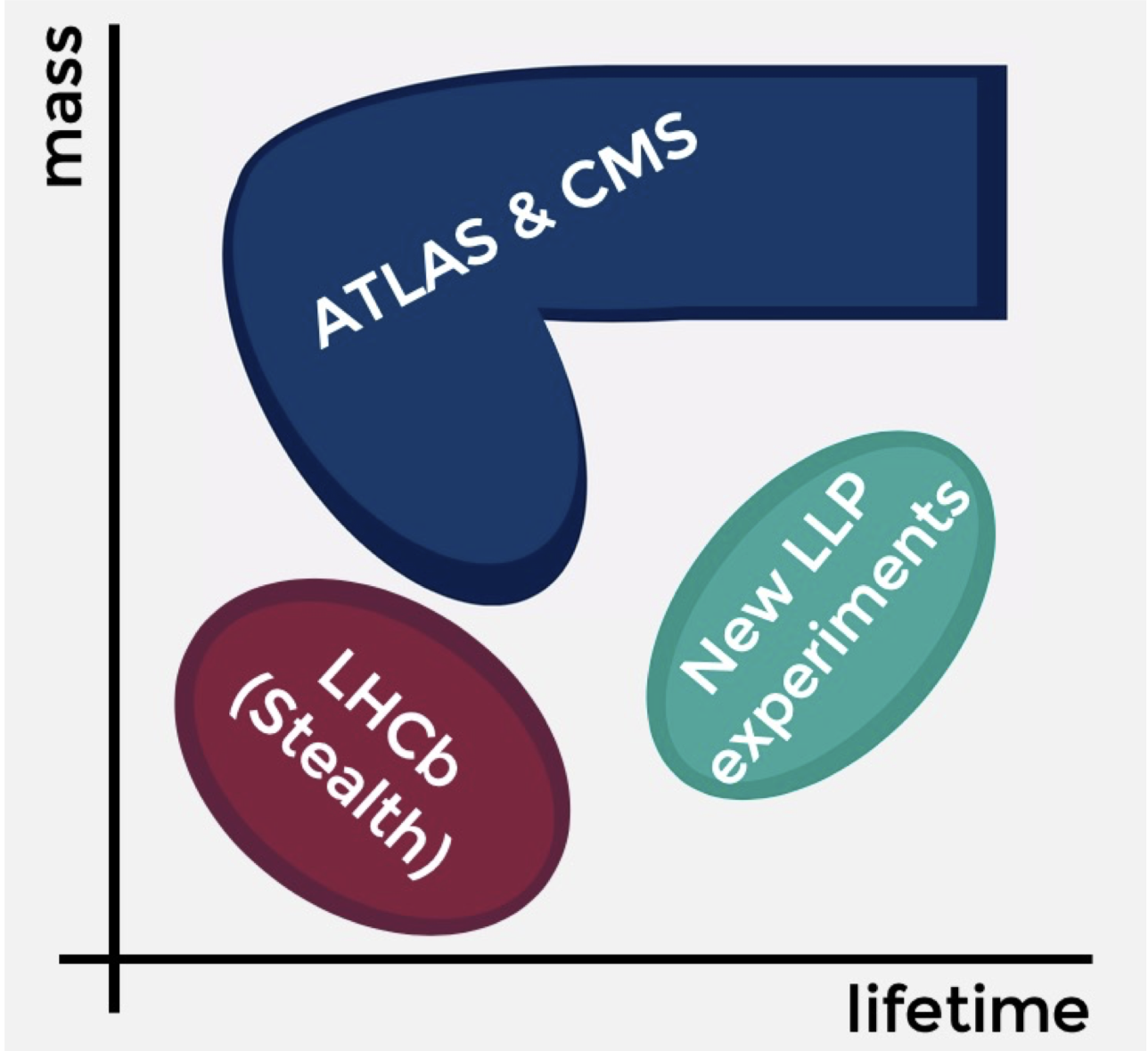
Coverage Sketch
Xabier:
first day

Slide 6
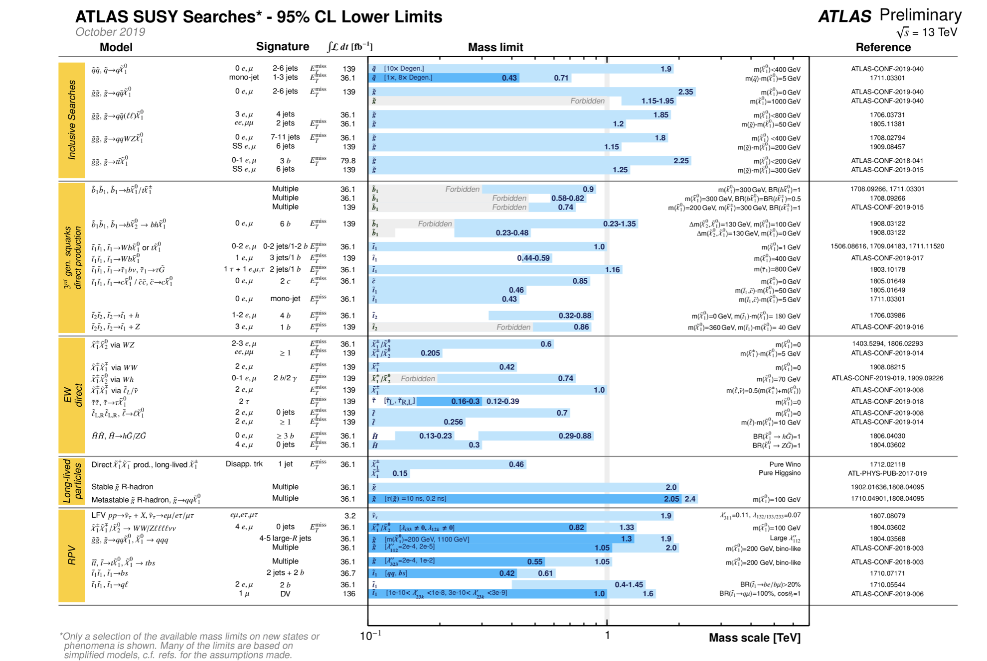
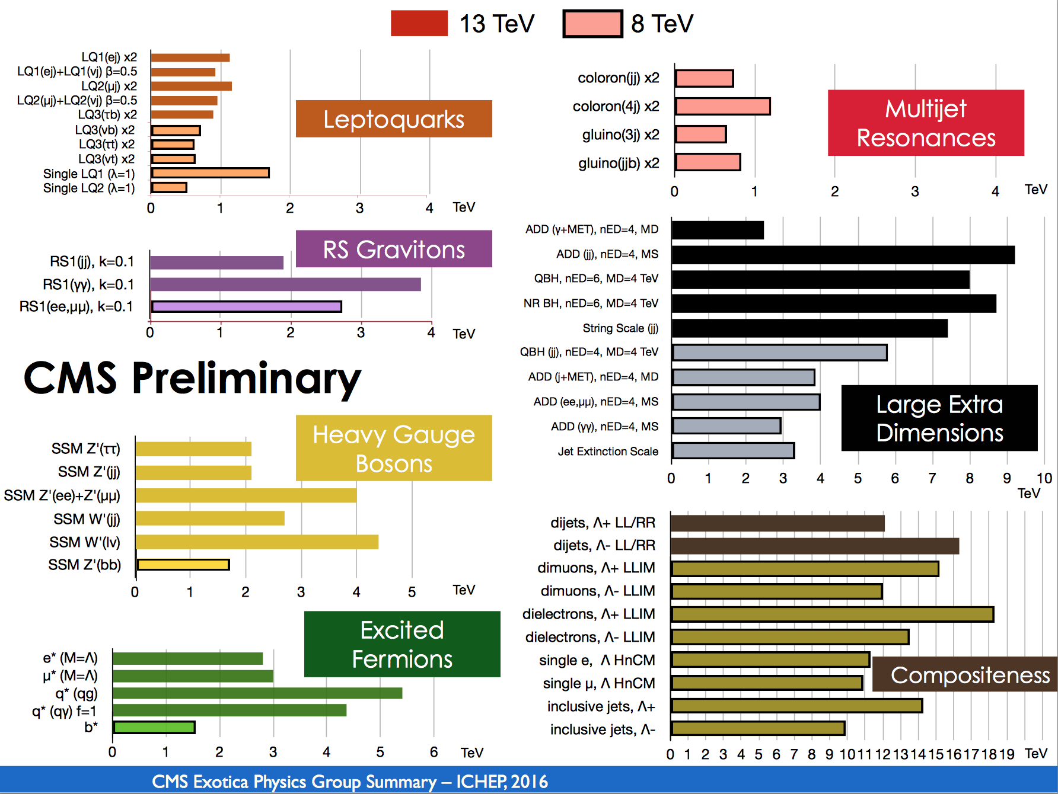
LHC: So far no New Physics
Classical Searches
Superymmetry
Exotica
Flavor Universality
…
No signal of new physics so far!!

Slide 7
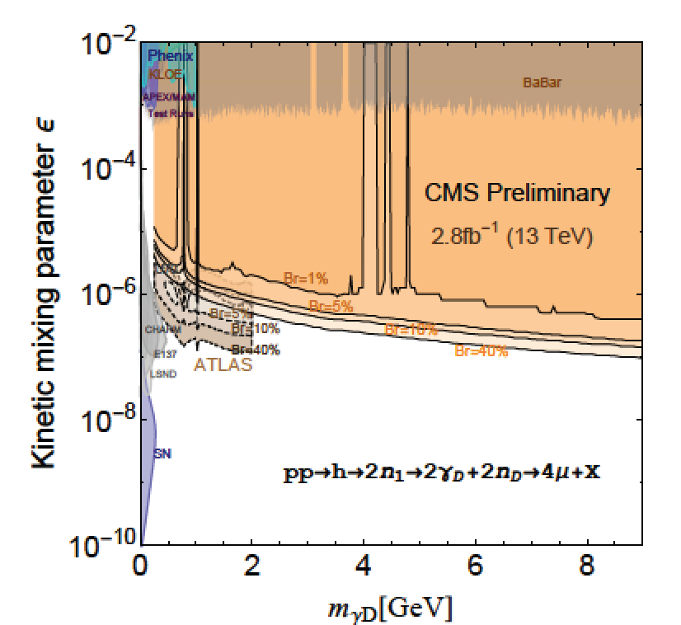
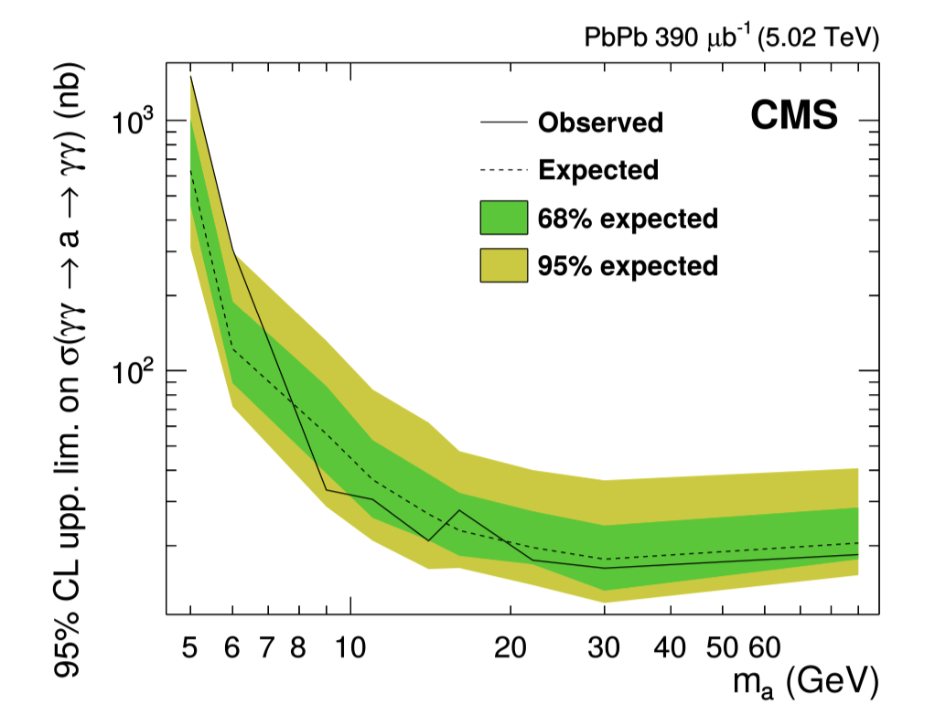
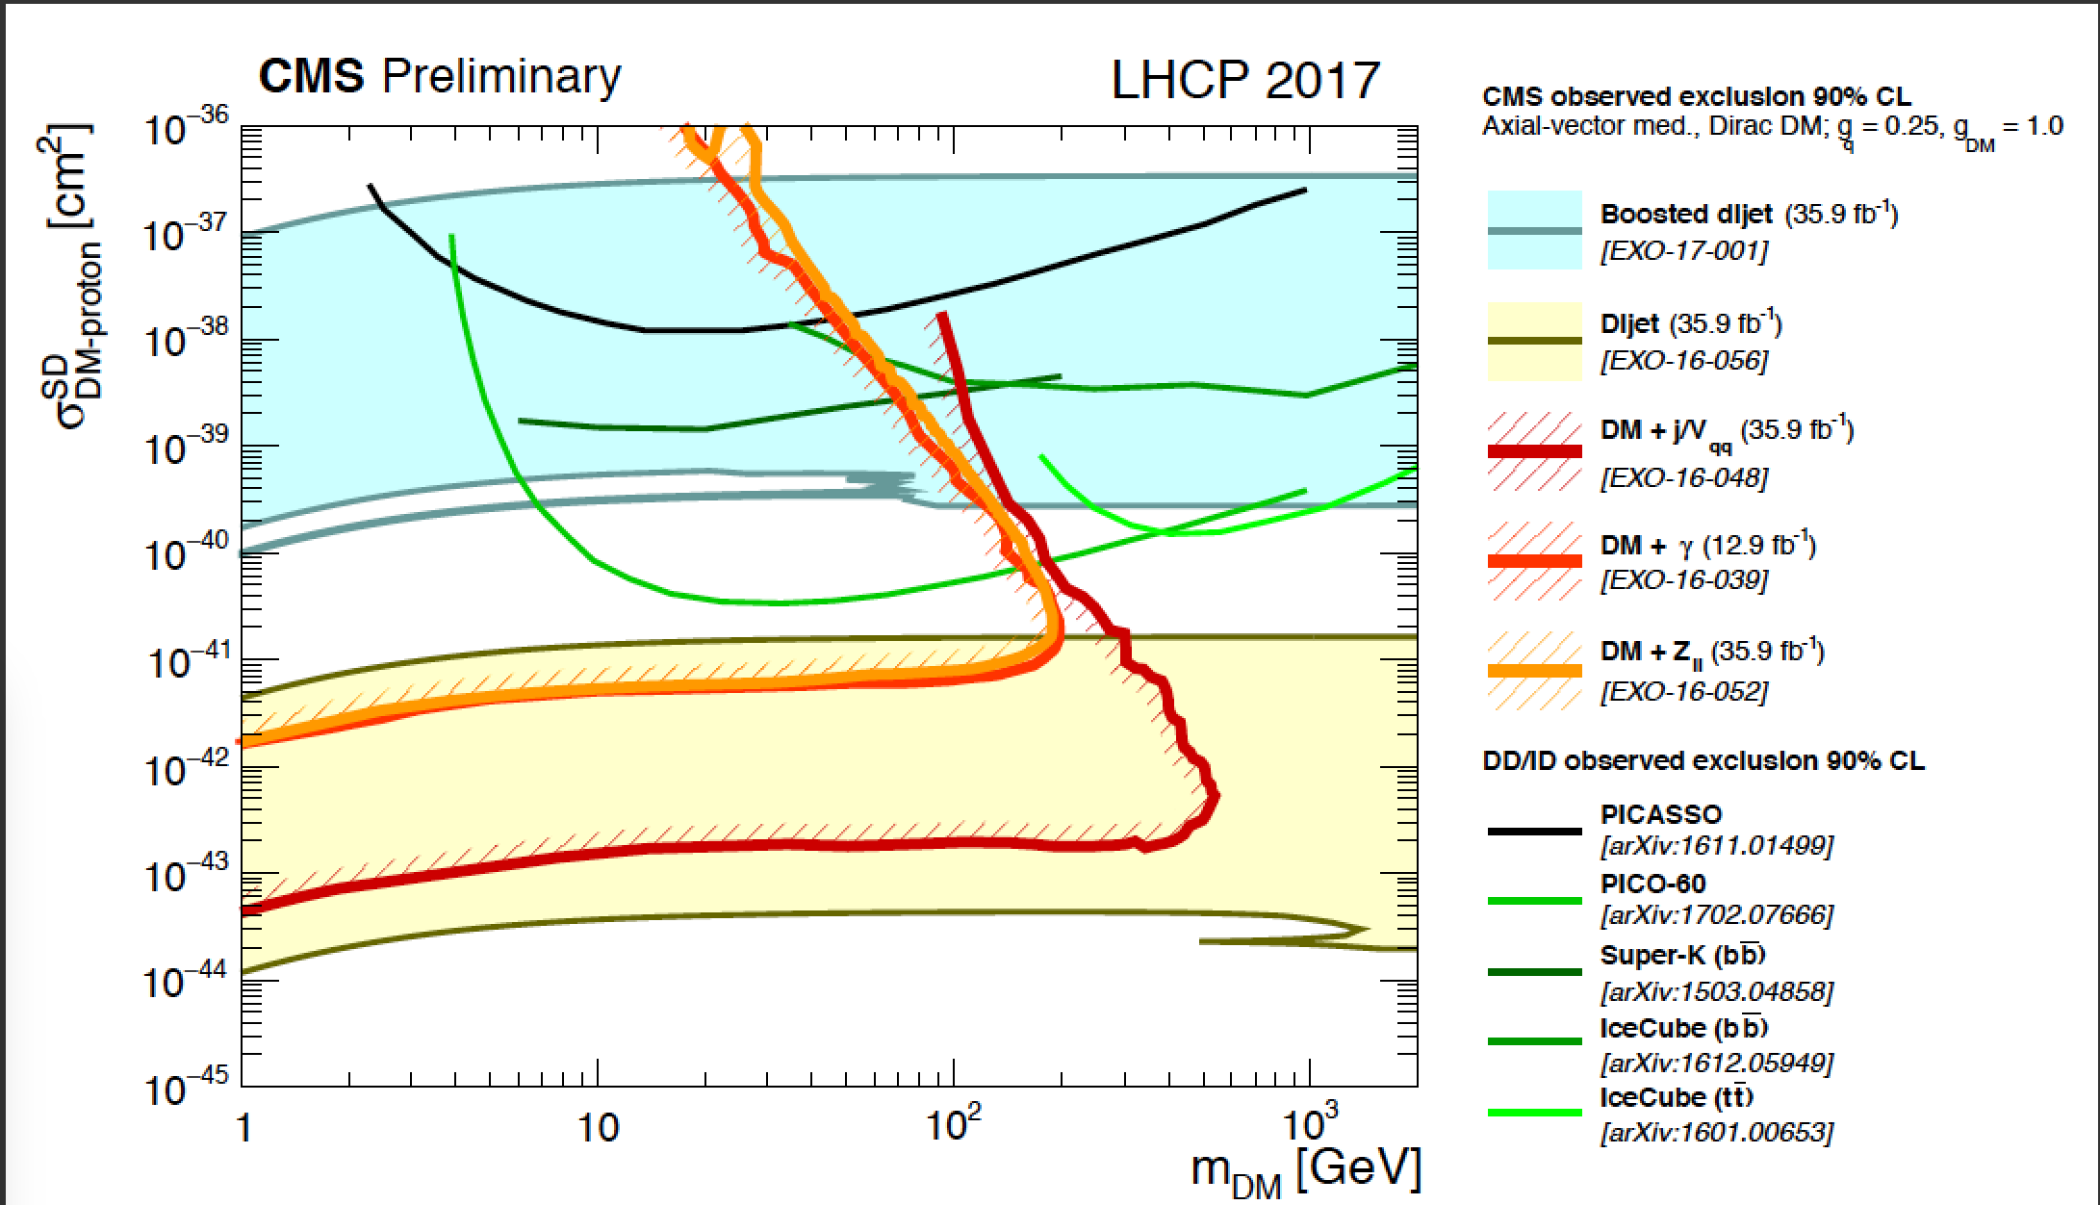
ATLAS/CMS Searches
Generally high mass, high p_{T}
An important issue is the trigger
Cross section (x BR) limits to ~0.01 fb
A few low mass analyses - often resonance searches but also eg DM searches via mono-object production…
Examples of searches ->
Dark photon > 250 MeV
HIG-16-035
Axion > 5 GeV
Dark Matter > 1 GeV

Slide 8
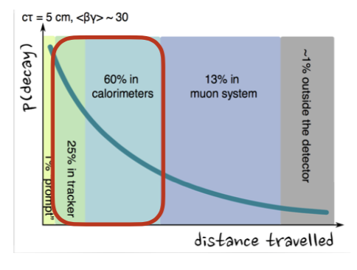
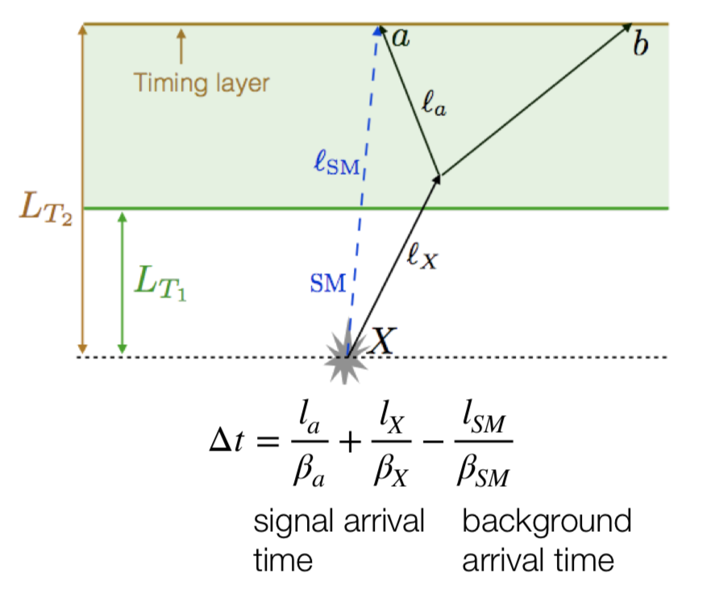
Trigger Improvements for Run3/Phase 2
Trigger upgrades in hardware trigger part for run3 for LLPs
  HCalorimeters: delayed jets, energy depth and timing lifetimes nanasecods to micro seconds)
  Muons: less constrained from the vertex
More tailored software triggers in run3 for LLPs, GPUs?
LLP trigger updates for the Phase 2
  Tracking trigger at hardware level
  Muon trigger improvements for LLPs
  Good timing in barrel and endcaps (30ps)

Slide 9
Data Set Collection Improvements
Normally the data taking rate is ~1 kHz, for events of about 1.5 Mb in size. This is mostly limited by the data handling off-line (prompt ReCo). Special data taking:
Scouting data: reduce event information by a factor ~100, and collect much higher rate (eg jets evts with low treshold)
Parked data: collected another 1-2 kHz of data but just store them. Processing of these data at quiet times (eg shutdowns). Eg unbiased b-sample -> 10¹⁰ events in 2018!
Minimum bias data: All triggers have the hard scatter event + 20-30 minimum bias events. Exploring how we can use these events for -> potential to access low masses and couplings for new particles (HNLs, A0, LDM…)
Special runs: (especially in 2021) with lower rates

Slide 10
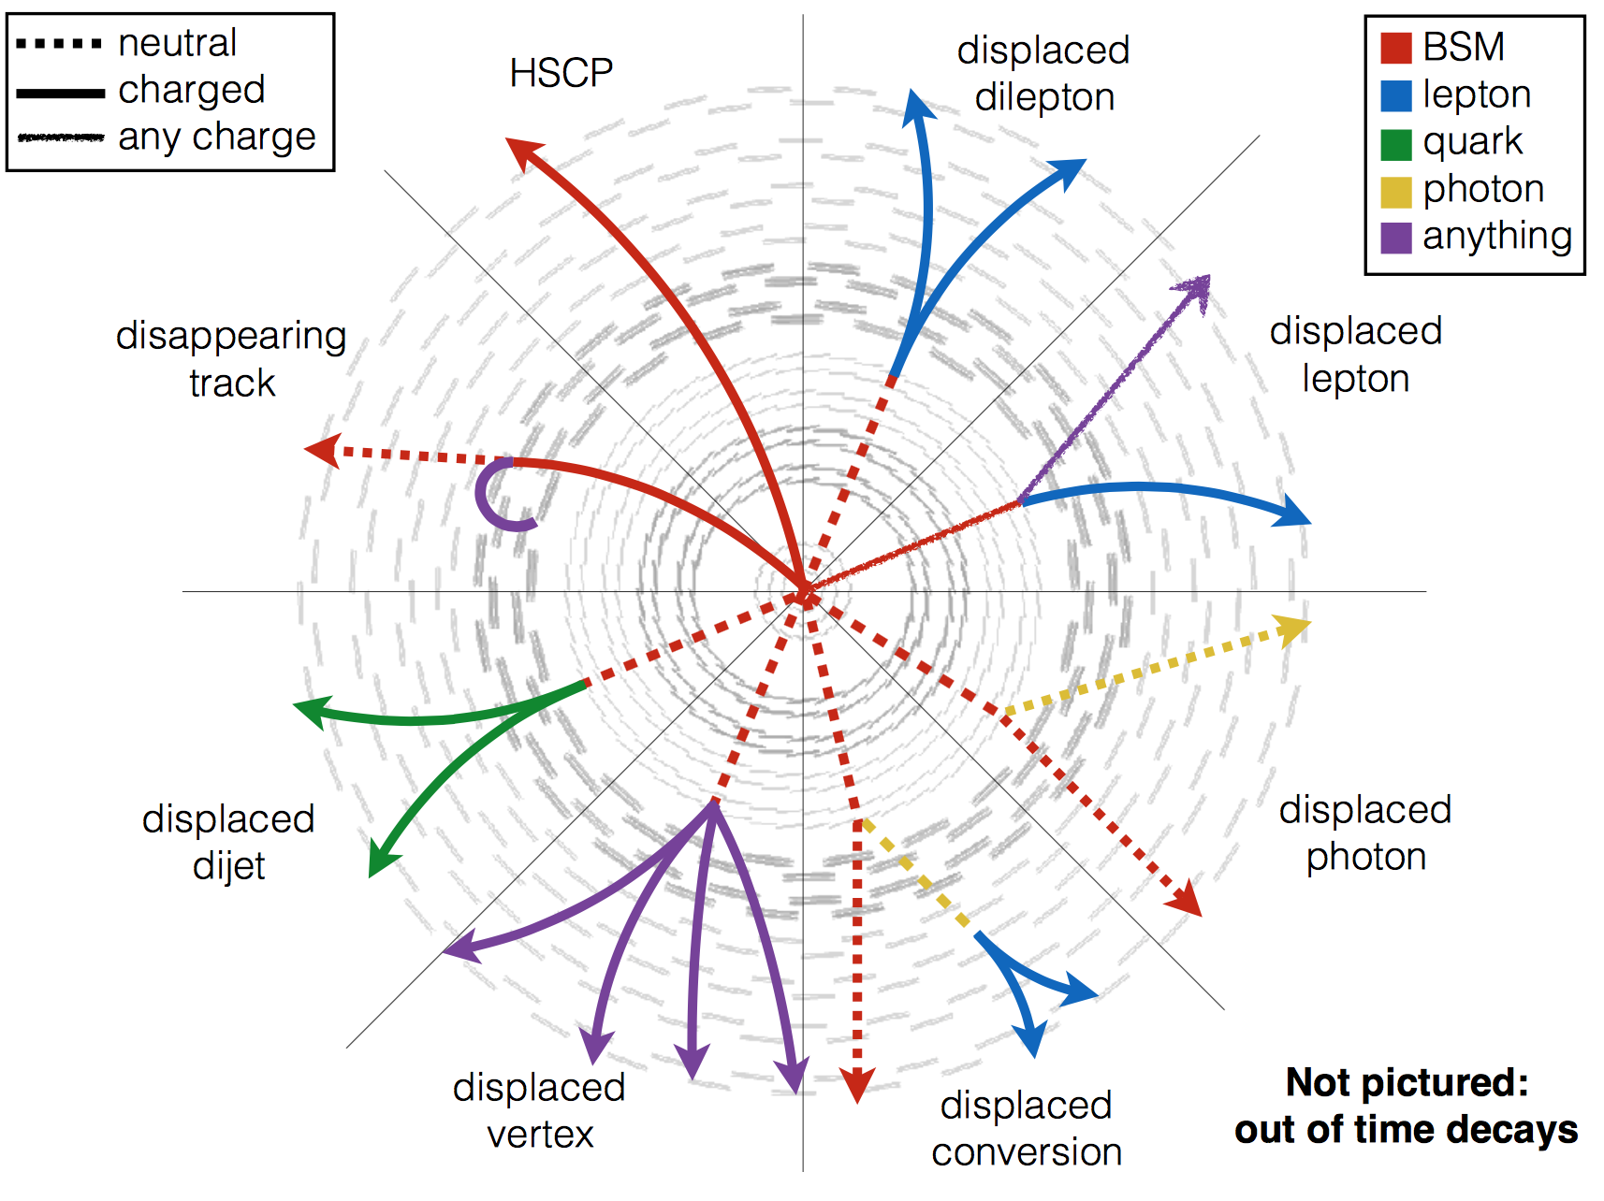
Long Lived Particles @LHC
Signatures of LLPs
Some of the Challenges
Triggers: Tracking detectors
are powerful but difficult
to use in trigger
SM backgrounds often low.
But need special studies
(punch through, secondary
interactions, tails, cosmics…)
Special reconstruction is
often needed
Some detector upgrades for
High-Luminosity LHC (>2026)
address these issues.

Slide 11
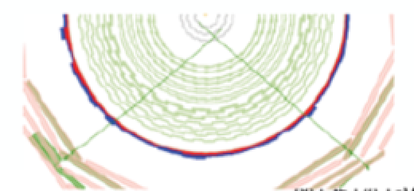
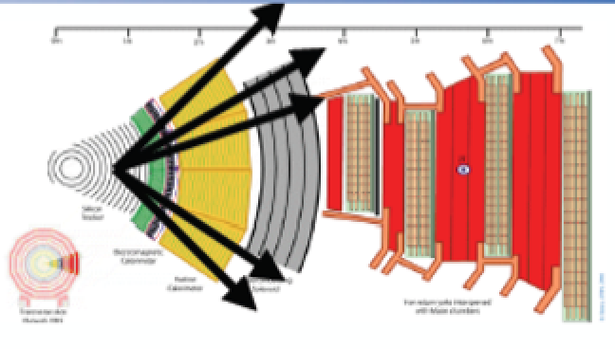
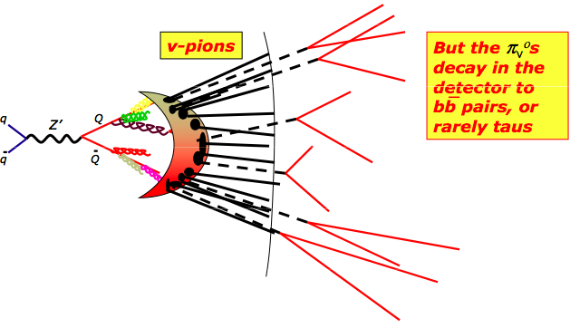
ATLAS/CMS LLP Searches
Displaced jets, dijets, vertices
Disappearing tracks
Displaced leptons & lepton jets
Displaced photons
Dark photon decays
Heavy Stable Charged Particles
Stopped particles
Emerging jets/dark showers
Monopoles
Heavy Neutral Lepton searches
Strongly Interaction Massive Particles
….

Slide 12
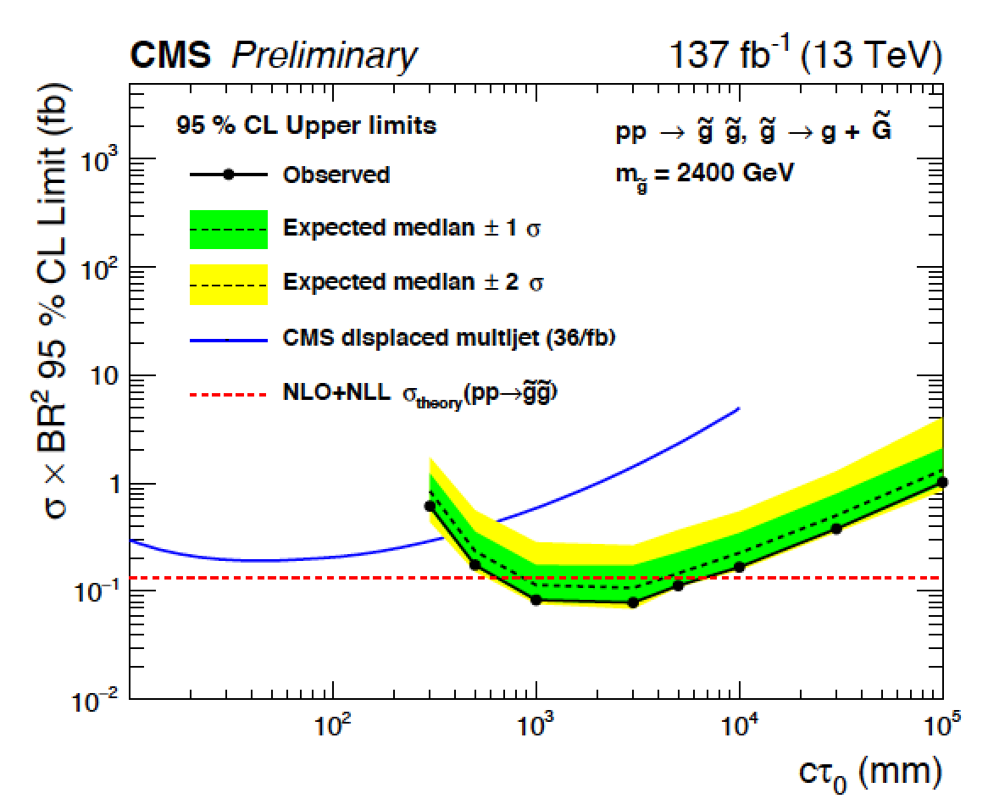
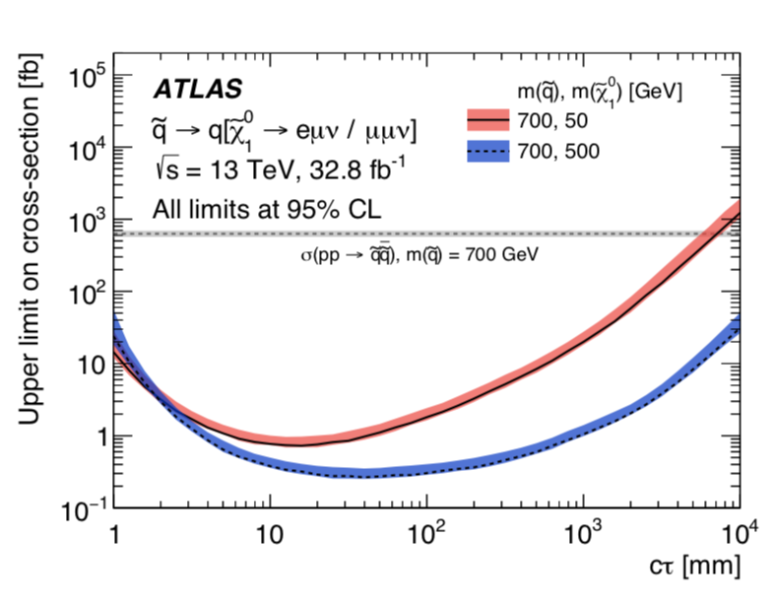
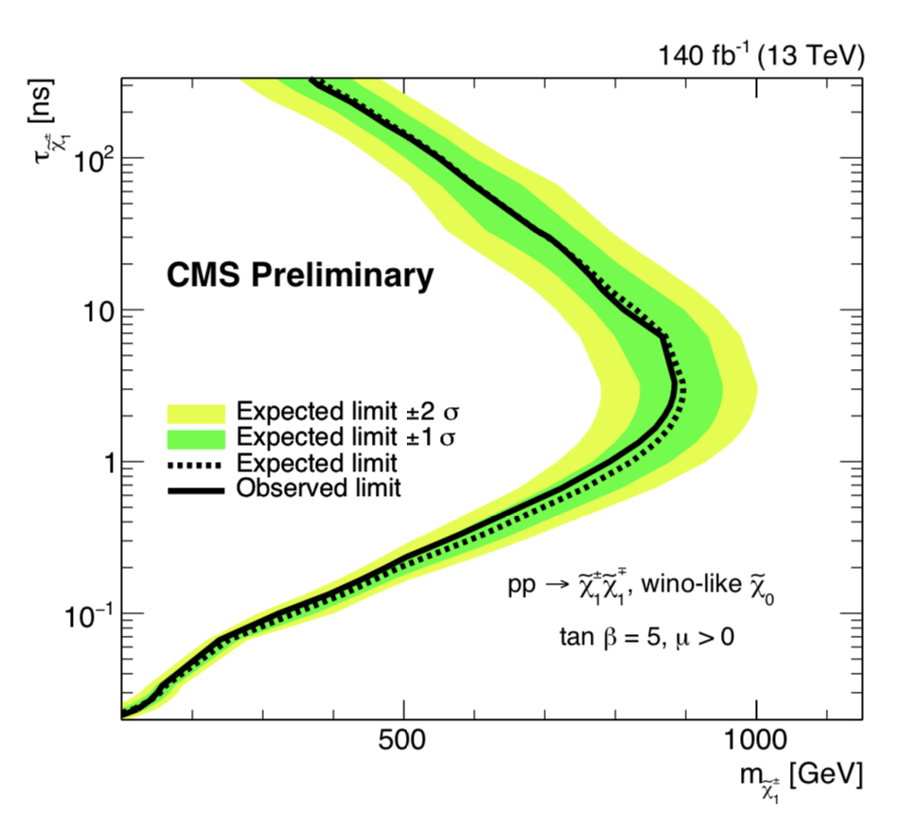
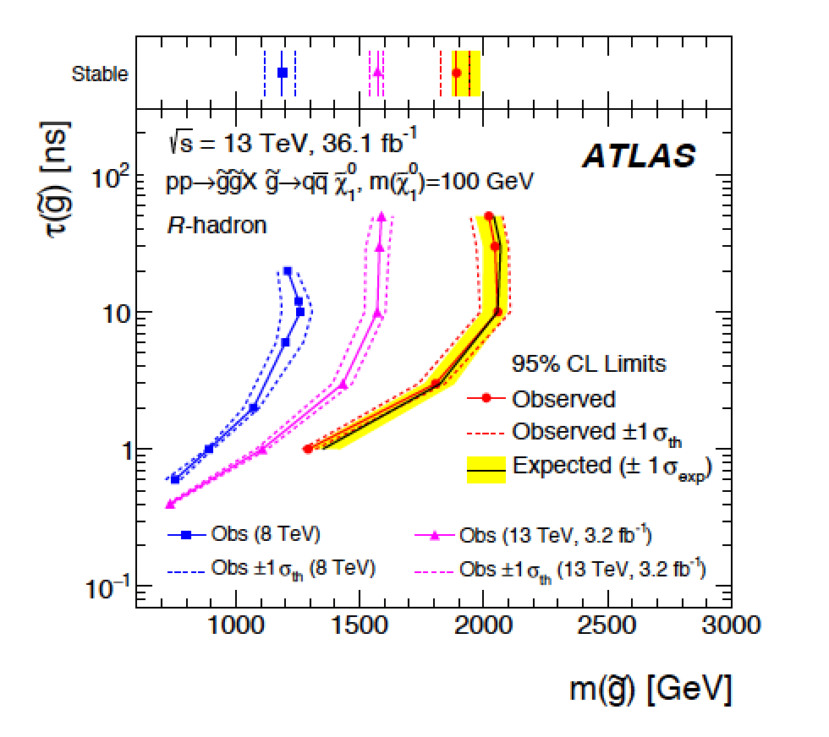
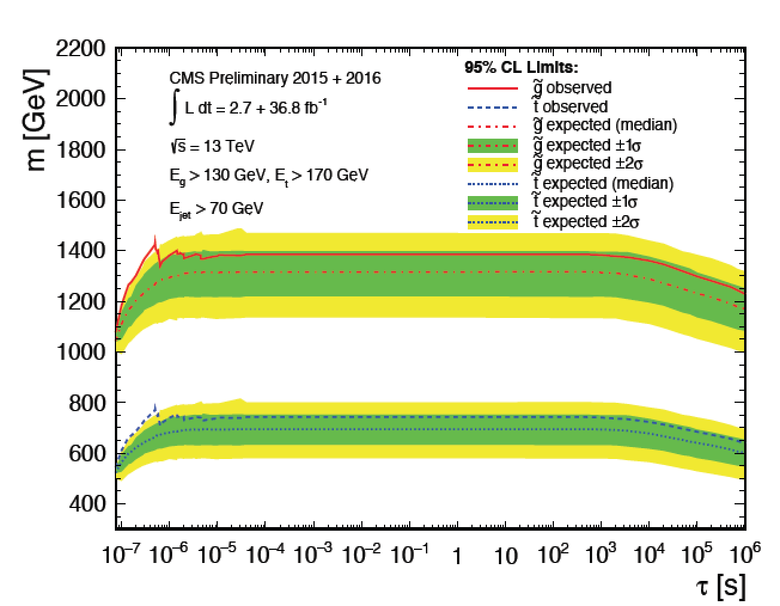
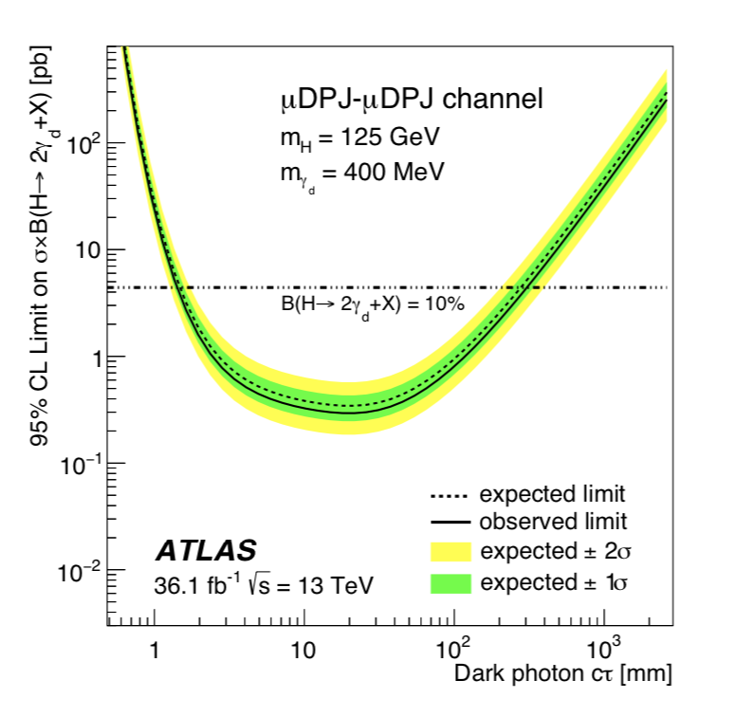
Long Lived Searches: Examples
delayed jets
displaced leptons
disappearing tracks
metastable R-hadrons
stopped particles
Low mass dark photons

Slide 13
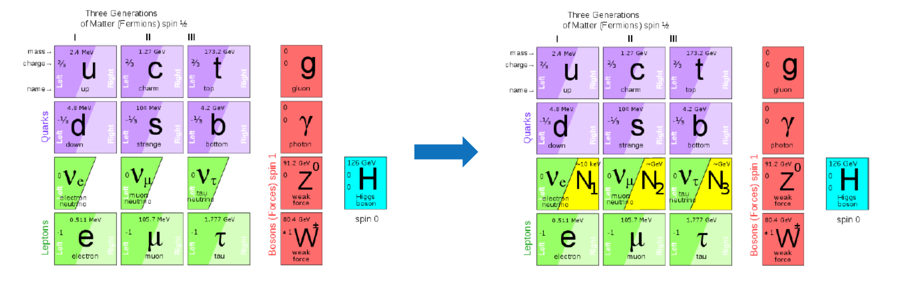
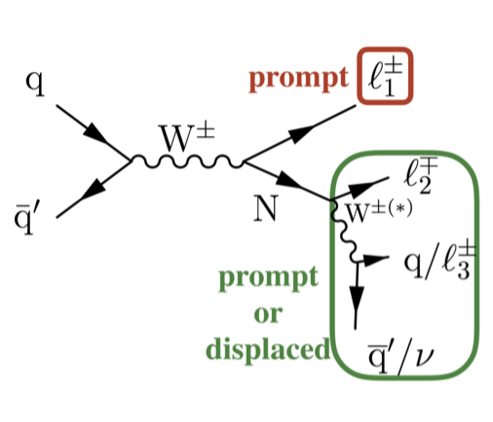
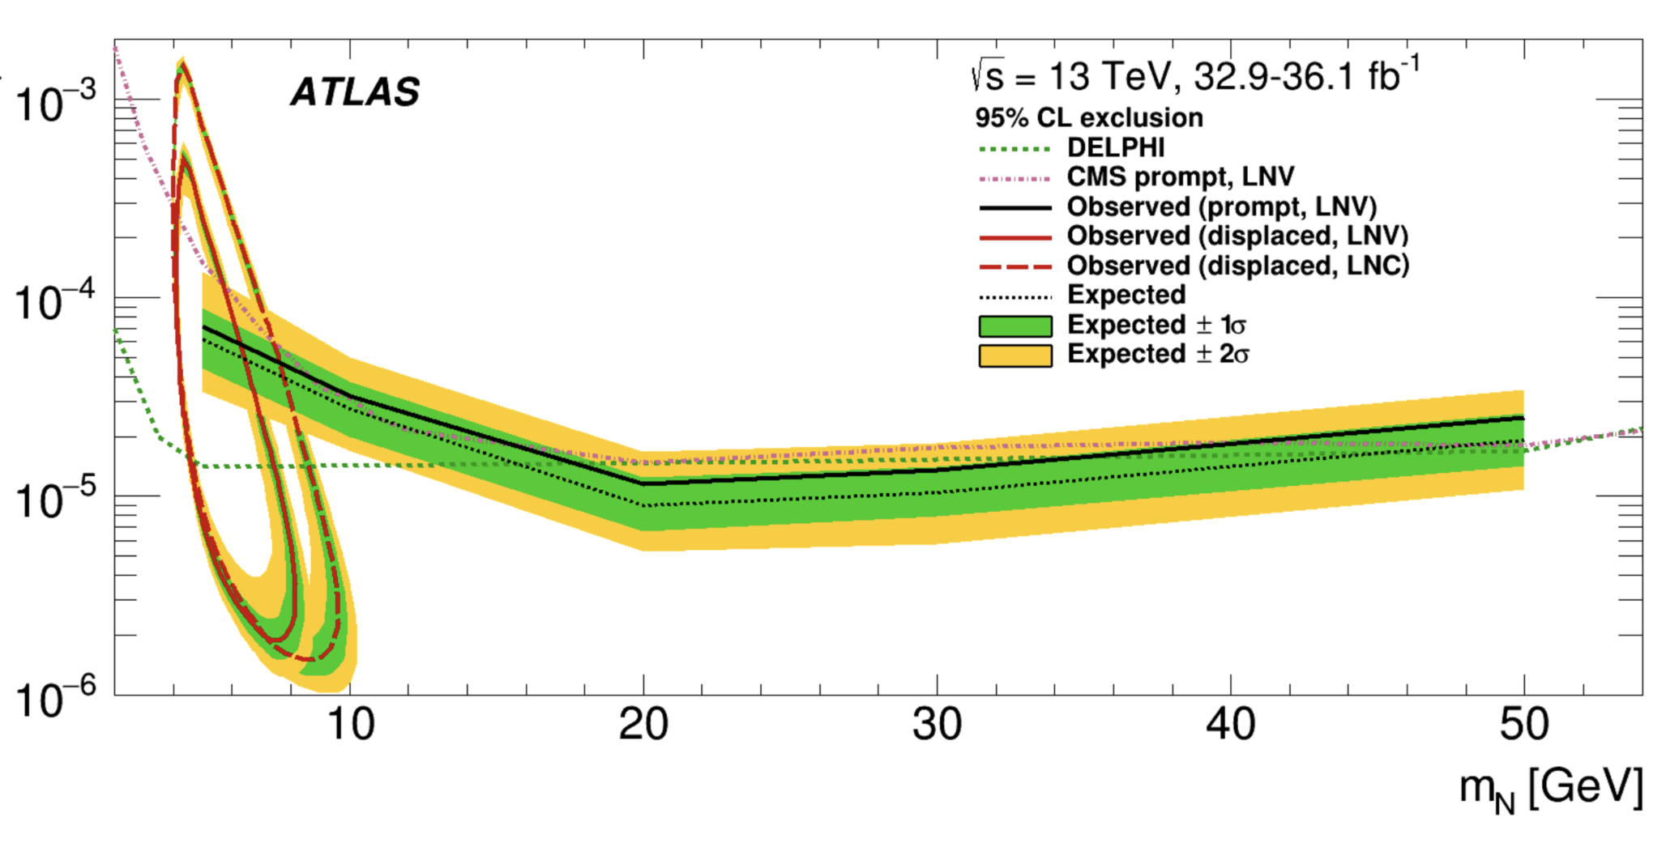
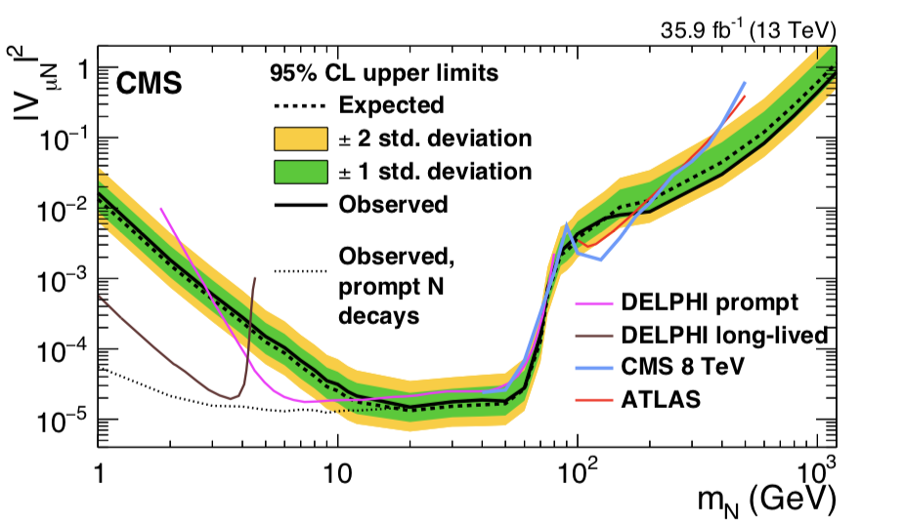
Search for Heavy Neutral Leptons
Neutrino portal: νMSM (Neutrino Minimal Standard Model)
Minimal extension of the SM fermion sector by Right Handed HNLs: N1, N2, N3.
arXiv:1802.02965
arXiv:1905.09787
Tri-lepton analysis
-> HNL hunting also focus of the SHIP experiment proposal

Slide 14
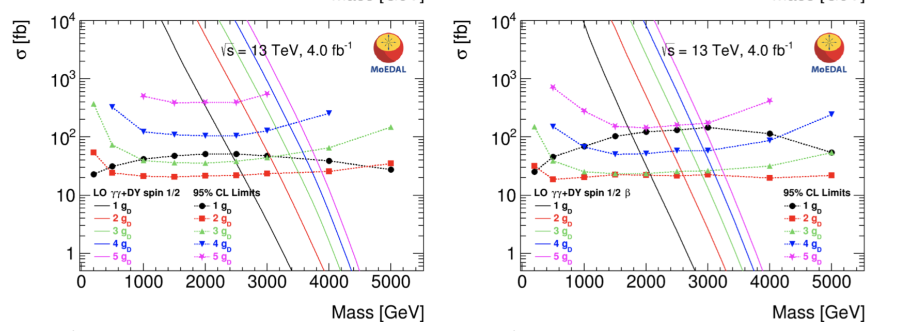
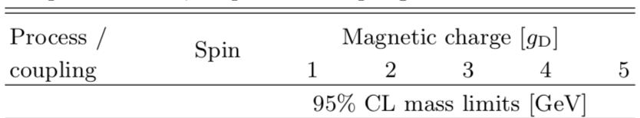
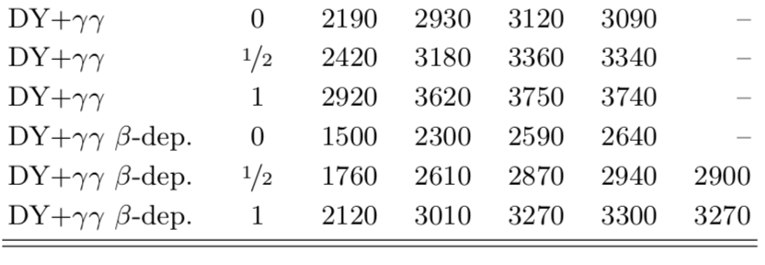
Monopole Searches: MoEDAL @ 13TeV
Run-2 data analysis base on 794 kg Aluminium to “stop” the monopoles and
search for them with a SQUID precision magnet (4.0fb⁻¹) arXiv:1903.08491
•Limits for different
monopole charges
•First monopole search
result @LHC at 13 TeV
No signal yet.

Slide 15
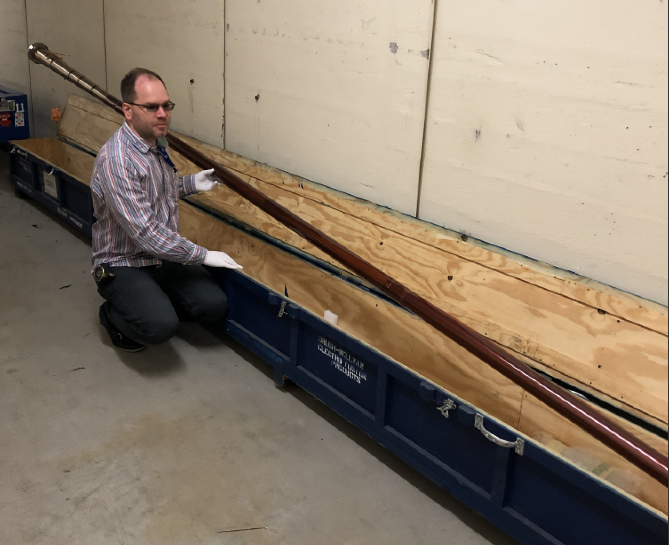

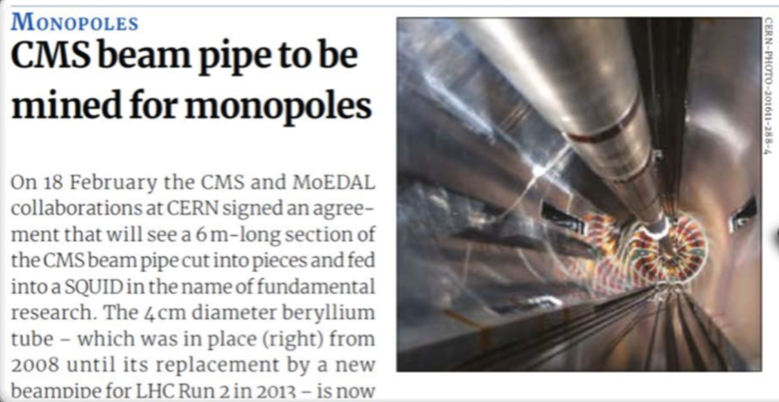
Monopoles Stopped in the Beampipe
ADR et al., Eur. Phys .J. C72 (2012) 2212
Test performed with pieces of material from the LHC from 18 m away from
the interaction region in 2012: set up SQUID procedure
CERN Courier 18/2/2019!!
A beampipe analysis effort has been put into place in MoEDAL
-> CMS beampipe being prepared for the ETH SQUID in Alberta right now
Other beampipes under discussion (RHIC, BaBar…)

Slide 16
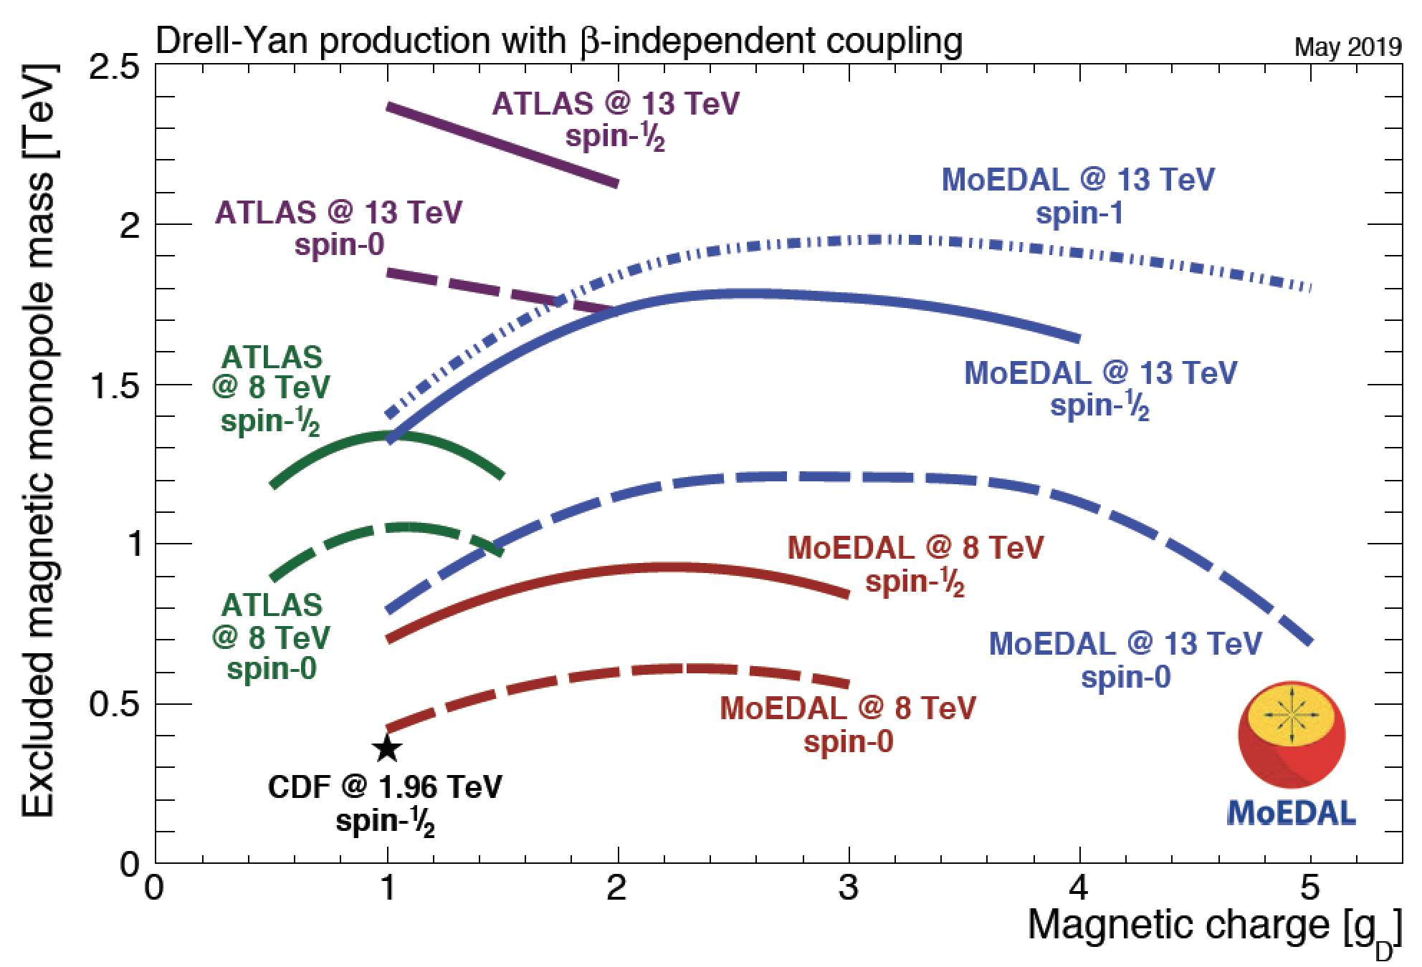
LHC Monopole Searches
V. Mitsou

Slide 17
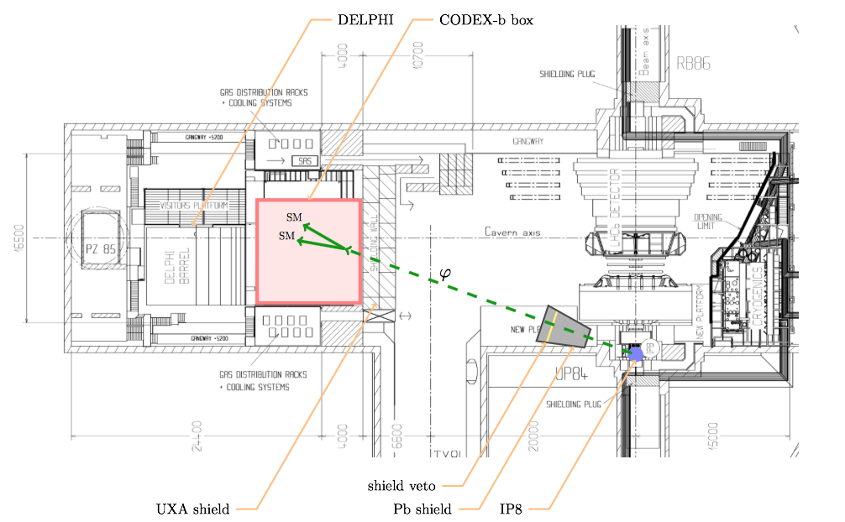
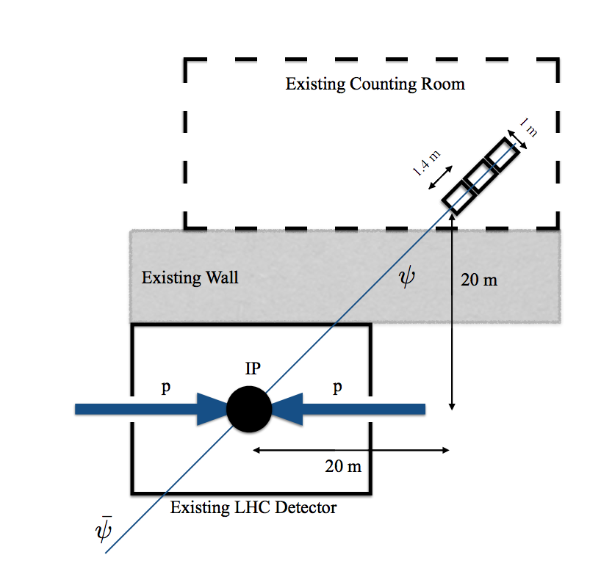
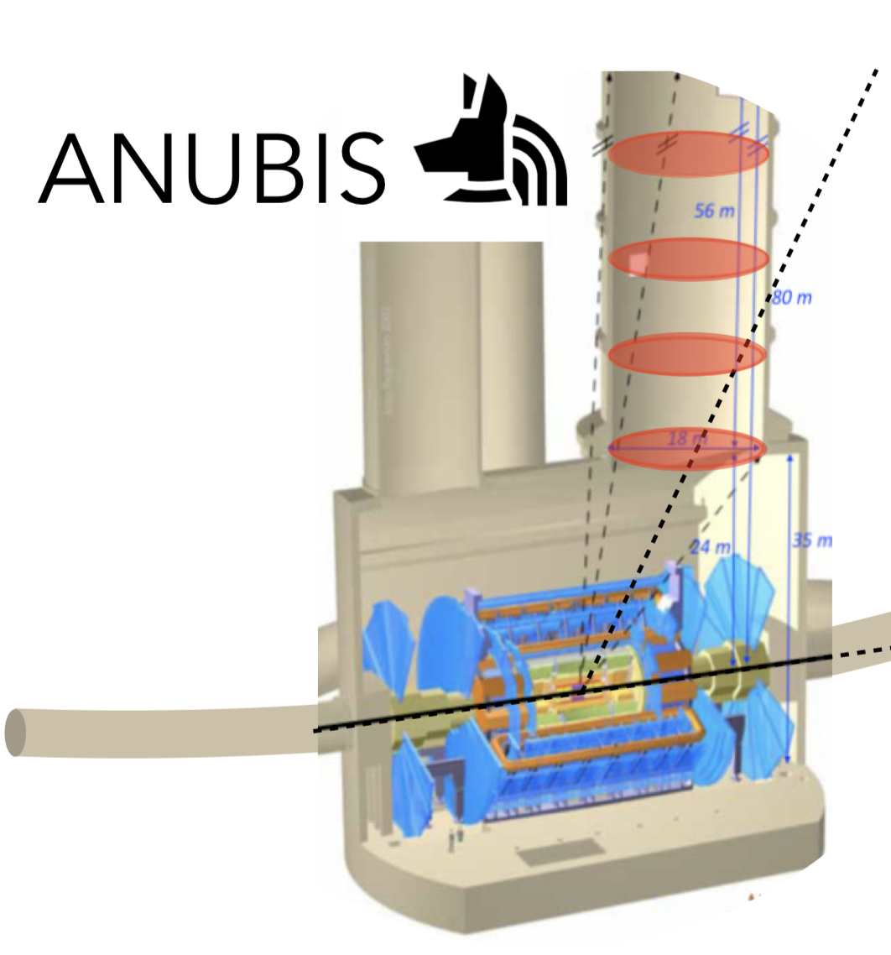
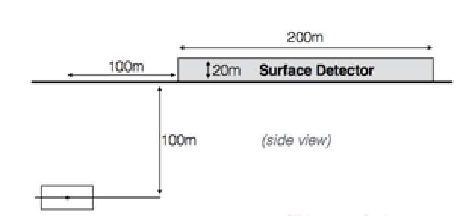
Proposals for New Experiments @LHC
MilliQan: searches for
millicharged particles
MAPP: Similar to MoEDAL
CODEX-b: searches for long lived
weakly interacting neutral particles
Also: AL3X (‘ALICE’ for LLP arXiv.1810.03636)…
MATHUSLA: searches for long lived
weakly interacting neutral particles
ANUBIS: searches
for long lived weakly
interacting neutral
particles
+ Experiment
Proposals for
TeV neutrinos

Slide 18
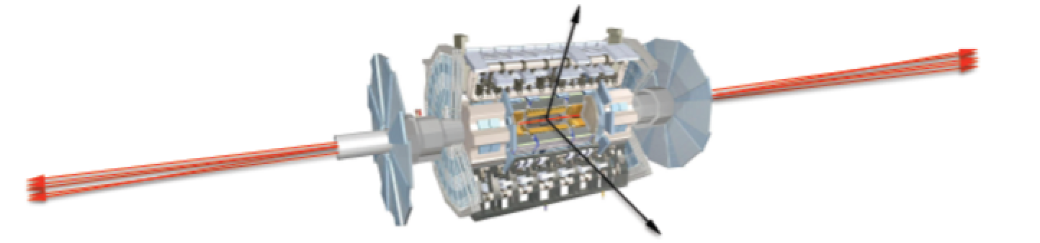
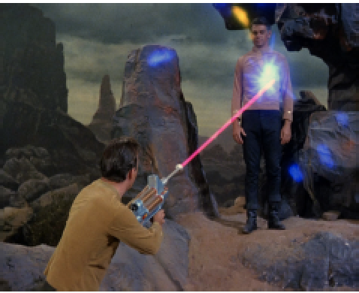
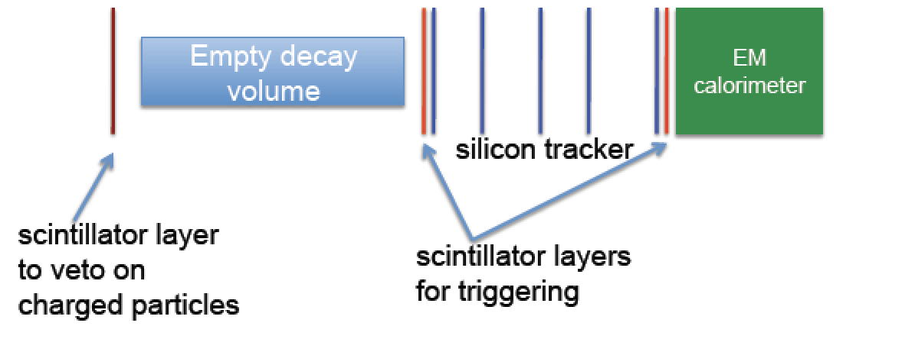
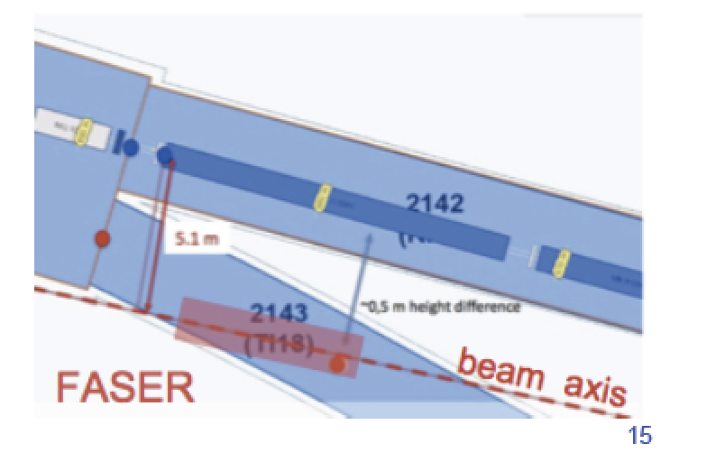
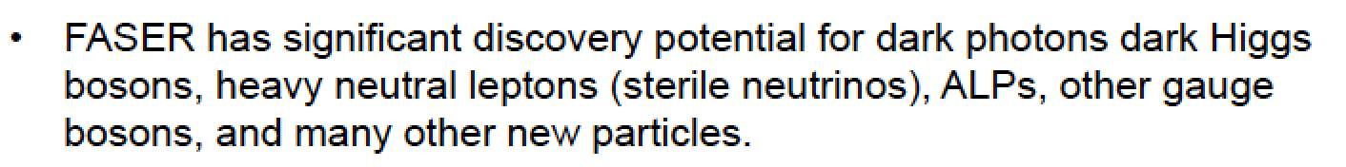
FASER Experiment
FASER
arXiv:1708.09389
~ 480m

Slide 19
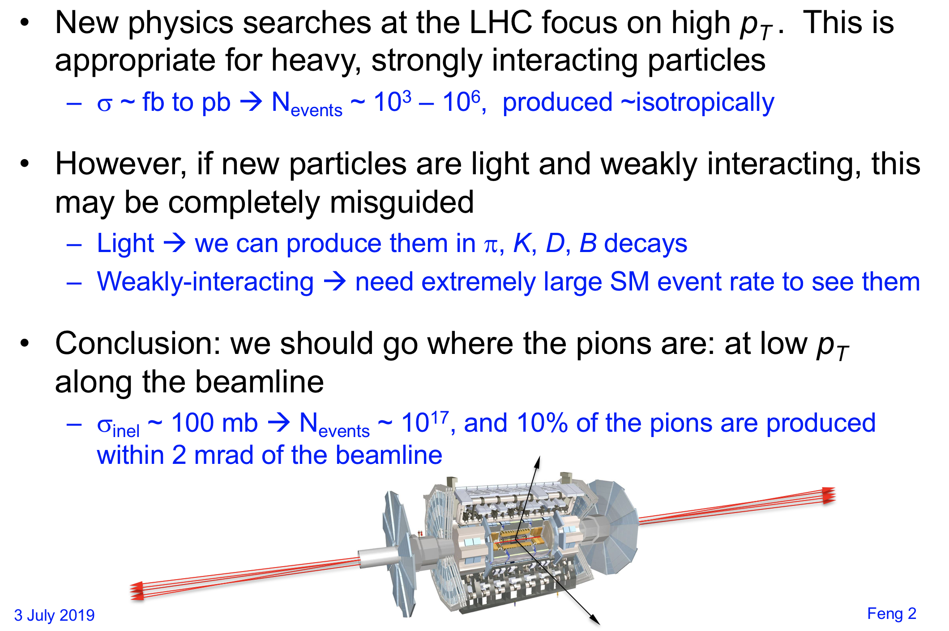
FASER: The Idea
J. Feng

Slide 20
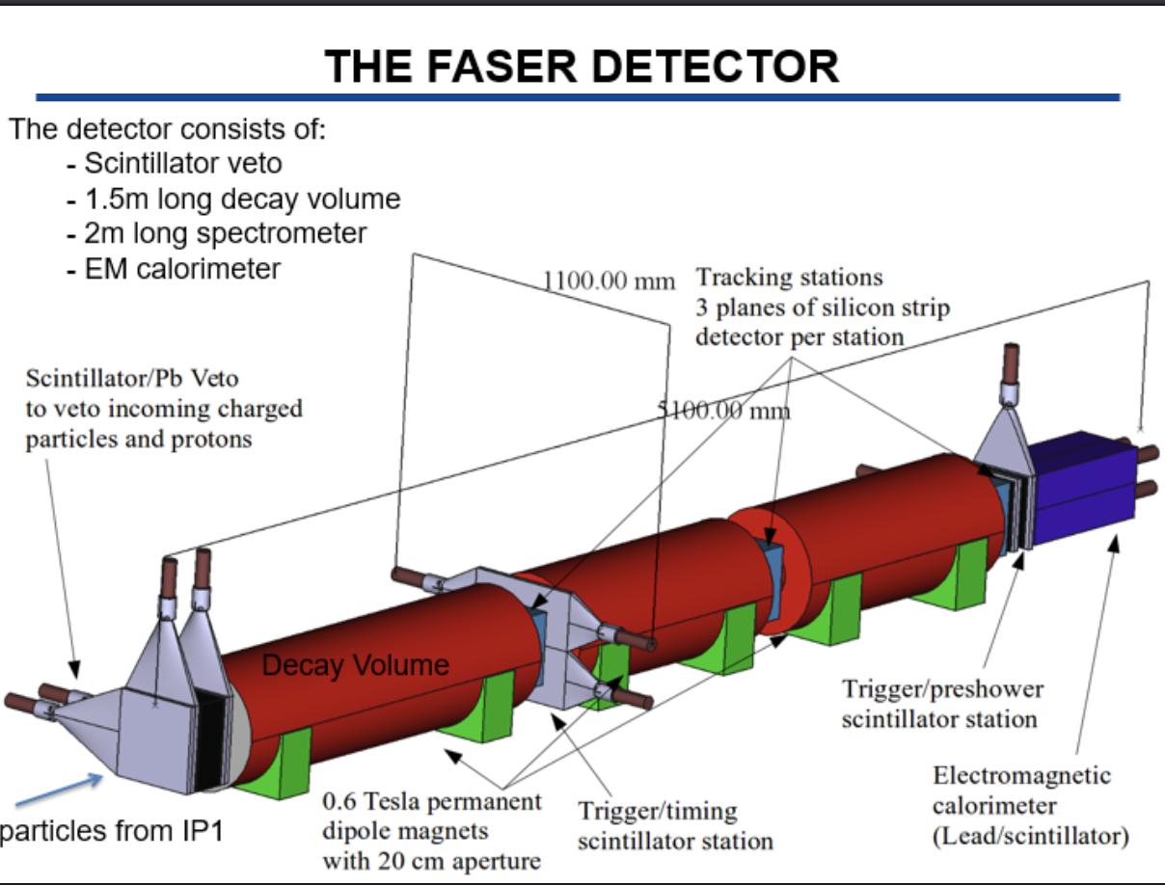

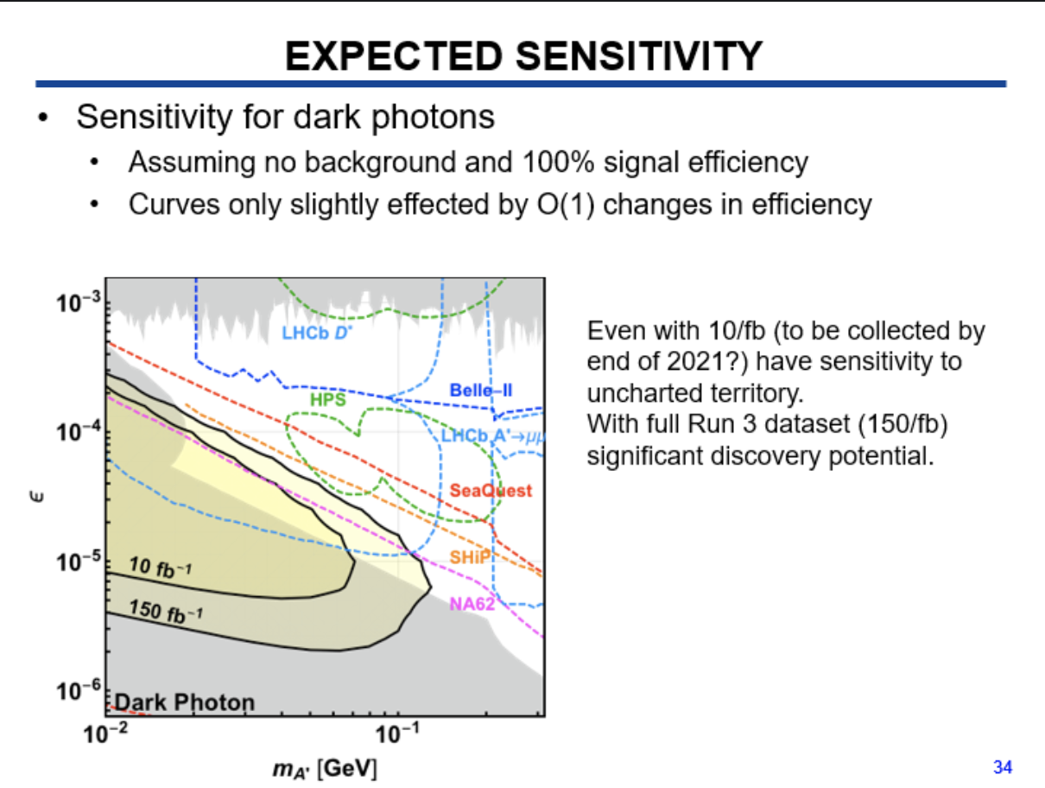
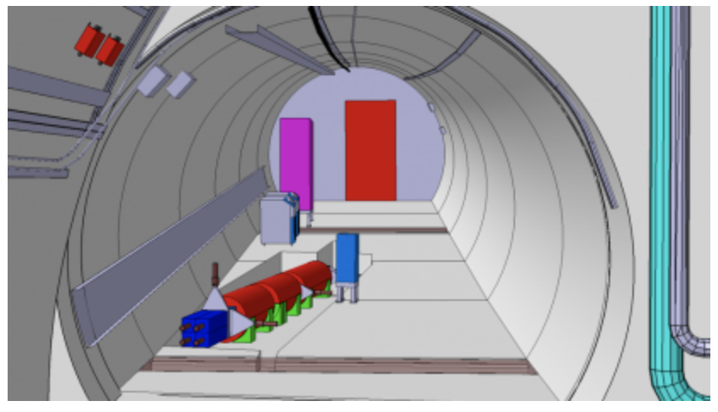
FASER Approval
The FASER experiment (phase-I) has
been approved March 5th
FASER is the 8th LHC experiment

Slide 21
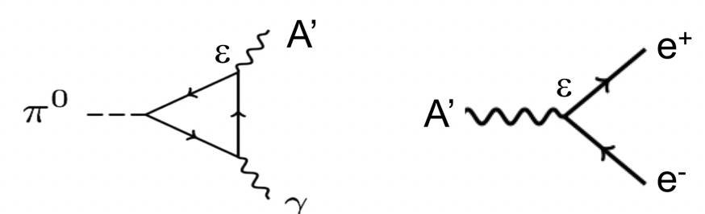
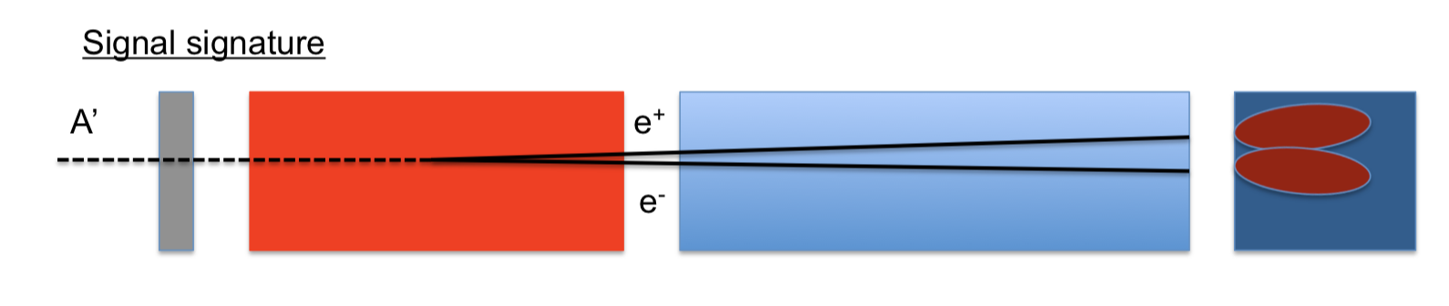
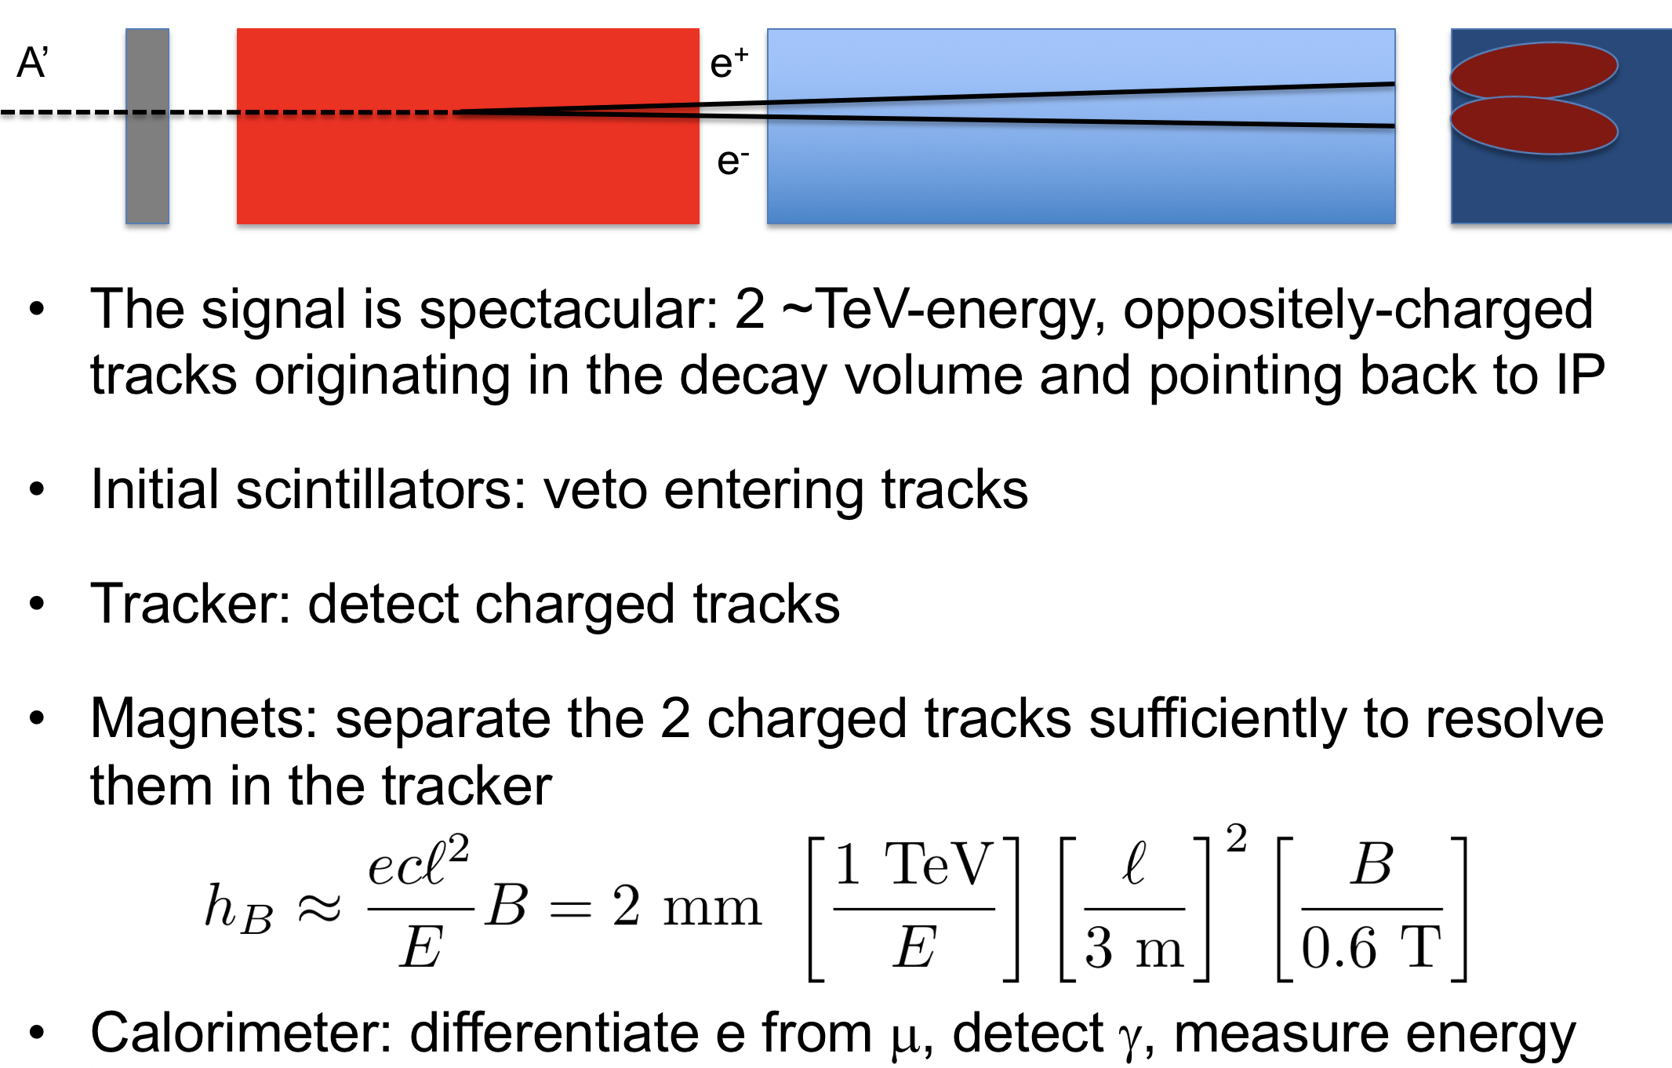
Dark Photon Detection

Slide 22

Dark Photon Sensitivity Reach
FASER should be completed before run-3 starts
FASER 2 still needs approval

Slide 23



Particles with Milli-Charges?
“New” idea -> Hunting for particles with charges ~ 0.3-0.001e
Baseline paper: arXiv:1410.6816
Proposal for a new experiment/CMS subdetector.
Demonstrator (1%) taking data since mid-2017
arXiv:1607.04669
MilliQan Experiment

Slide 24

MilliQan Experiment

Slide 25




MilliQan Experiment
Installed demonstrator in 2017
• Took data since September 2017
→ ~37 fb⁻¹ of data on tape
• Data well understood!
• First physics paper in preparation

Slide 26

MilliQan Experiment
Projections using the 1% demonstrator
and the full detector
Demonstrator results paper in preparation

Slide 27


Slide 28


Slide 29

Similar acceptance
as MilliQan

Slide 30

No documentation
avaialble yet.

Slide 31





MATHUSLA
A proposal for a large area surface array to detect ultra
long lived particles coming
from the pp collisions
Aim to cover the range
~ BBN constrained inspired
Physic case arXiv:1806.07396
arXiv:1811-00927
Detector surface array eg above ATLAS or CMS: ~ (200m)²
100m
100m

Slide 32

Recent developments

Slide 33


CODEX-b Proposal
An LLP detector in
the LHCb area
RPCs
See Xabier’s talk

Slide 34

Re-using the ALICE detector?
For LHC Run 5??
So far just an idea
Not really followed
up right now…
1810.03636

Slide 35


Physics Reach: Example
x
x
1810.03636

Slide 36




Proposals for New Experiments @LHC
ANUBIS: searches for long lived weakly interacting neutral particles
• 4 tracking stations
of RPCs
• Propose to have
1x1m² test set-up
• Could also be in the
CMS shaft

Slide 37

arXiv:1909.13022

Slide 38




TeV Neutrinos at the LHC
No neutrinos at the LHC have been seen so far. Recent proposals for experiments 400m forward of the IPs to study TeV-neutrinos from forward meson decays with emulsion detectors: FASER-Nu and XSEN
arXiv:1908.02310
FASER-Nu
XSEN
1903.06564

Slide 39



SND@LHC: LHC neutrinos
Proposal (LOI) prepared for the LHCC this week
  SND= Ship Neutrino Detector
Aim for :
-Test run in 2021
-Full run in 2022 +..
Some acceptance Light
Dark Matter etc..
Target: Nuclear emulsion/lead +SciFi tracker
Bulk: muon system+timing detector

Slide 40


Physis Beyond Colliders
arXiv:1901.09966
Summarize sensitivities of experiments now and for the next 10-15 years

Slide 41





Sensitivity Summaries
Search for dark photons (visible mode)
Search for millicharges
Search for dark scalars
Search for heavy neutral leptons

Slide 42




Sensitivity Summaries (Updates)
Search for dark photons (visible mode)
Search for dark photons (invisible)
Search for dark scalars
Search for heavy neutral leptons
November 2019: updates from NA64, NA62, REDTOP, Belle II, T2K…

Slide 43


Neutrino Experiments
High intensity frontier for low mass particles with very weak couplings
->upcoming neutrino experiments (SBL, LBL) foresee very high intensity beams
Near Detector: few 100m
away from the dump
White paper 2019!
arXiv:1907.08311
~ 10²¹ POT/Year
https://indico.fnal.gov/event/18430/
These experiments can
perform searches for low
mass New Physics particles eg
-HNL/sterile neutrinos
-dark photons
-ALPs
-mini/millicharges
…
<- Example for millicharges
FerMINI @FNAL?
arXiv:1806.03310

Slide 44



Example: Low Mass Dark Matter
Light DM produced in meson decays, eg 𝛑⁰s
ICARUS Experiment at SBN
Use the FNAL NuMi beam!
Angle to CARUS is ~6 degrees
120 GeV protons on target
Results available in a few years

Slide 45

Summary
Clearly and increased interest in low mass/coupling and LLP searches at the LHC in CMS, ATLAS, LHCb, MoEDAL. Many analyses done or in are progress. No signal observed yet, but only top of the iceberg covered so far.
LHC-LLP White Paper released! arXiv:1903.04497
New ideas for additional small experiments at the LHC to increase the coverage: MilliQan, MAPP, MATHUSLA, CODEX-b, FASER, AL3X, ANUBIS,.. New: LHC neutrino experiments! LLPs also focus in the Physics Beyond Collider studies.
Of interest to study in detail the complementarity with LLP searches at Neutrino Near Detectors. Can these be further optimized? (tentative workshop in Pittsburgh spring 2020)
If we would observe one significant anomaly …

Slide 46

Coming Soon @ CERN
https://indico.cern.ch/event/864648

