Slide 1
36GHz high RF power system. Conceptual studies & design efforts.
I. Syratchev (CERN), V. Teryaev (BINP) and J. Cai (ULAN/CERN)
October 2019.

Slide 2
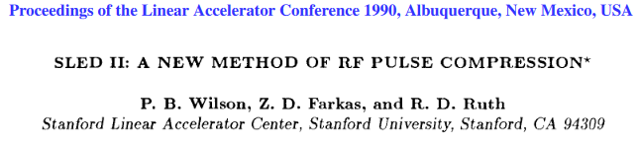
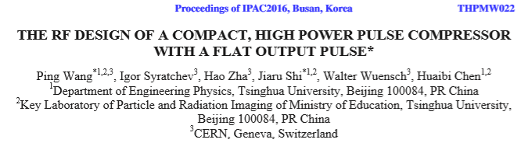
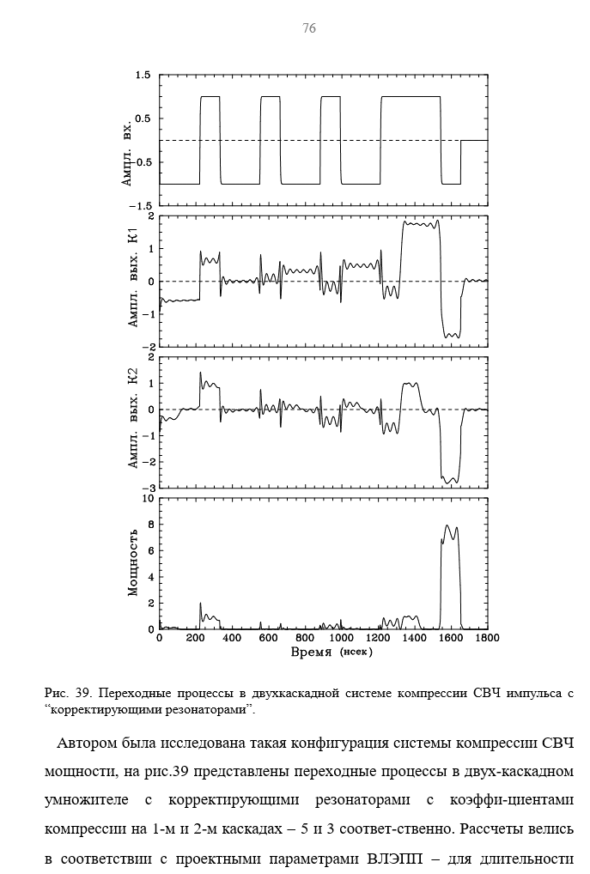
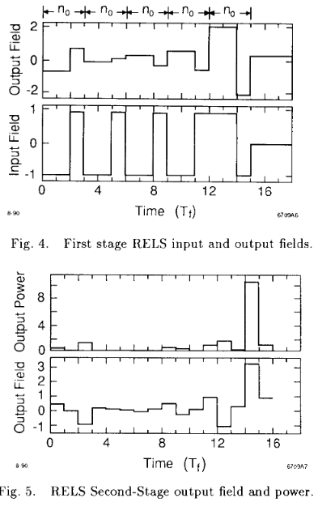
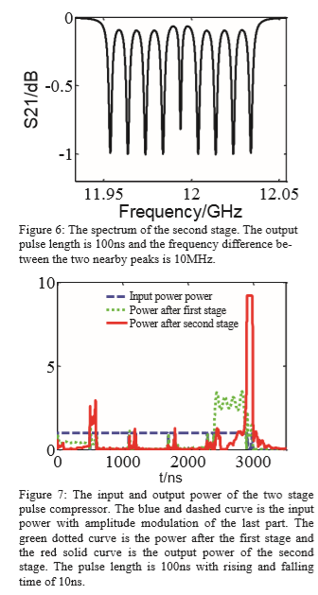
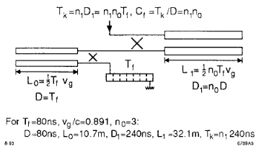
Original idea from
P.B Wilson, 1990
Two stages RF pulse compressor summary
2016
2stages PC with correction cavities.
Captured from Igor’s PhD, 1996.
modulation
At 36GHz with short pulses (~30ns), the expected efficiency will be similar to the one at X-band with 100 ns pulses. Thus factor ~10 in power gain with pulse compression of 30 can be expected.
The details of delay lines topology shall be optimized (single/multi moded, correction cavities, coupled cavities etc.) to reduce the size&cost of the system.
With 10 times the power gain, the 36GHz; 2MW; 1000-1500 ns RF power source, the RF system with TS PC will be able to deliver 20MW 30-50s pulses.
1st stage out
11.4 GHz/NLC
2st stage out
Power out
14 GHz/VLEPP
12 GHz/CLIC
More details see in X. Wu talk

Slide 3
High Order Modes (HOM) Multi-Beam Klystron concepts and development.
General remarks:
Multi-beam device (10-20 beamlets) operated at low (60 kV) voltage will be able to produce 36GHz; 2-3MW RF power 1500 ns long pulses with efficiency ~40%.
At this voltage level the absence of the oil tank allows to locate the tube in the vicinity of accelerating structure, thus to reduce the modulator, installation and vacuum system cost, as well as overall Ohmic losses in the complicated RF transport line.
The beam optic (solenoid) will require modest focusing field (<0.25T). Together with compact tube length (<0.1m), the permanent magnet solenoid can be decided as a natural choice. Though, the convectional coil will be compact as well.
The preliminary design indicates that the single cathode current density could be as low as 8A/cm², which is compatible/smaller than in existing cathodes of 6MW and 50MW X-band klystrons.
Preliminary design of the individual cathode with two stages of magnetic compression promises high beam quality along the beam channel, thus a large filling factor (ratio of beam radius to beam tunnel radius) 80% can be adopted.

Slide 4
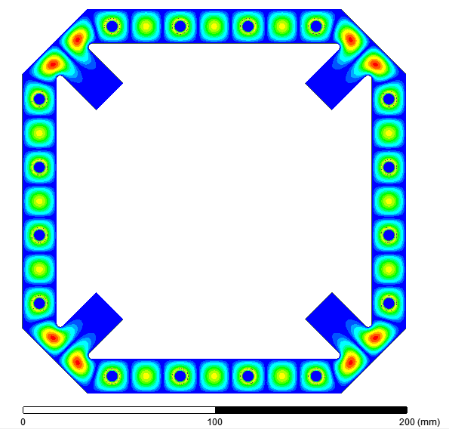
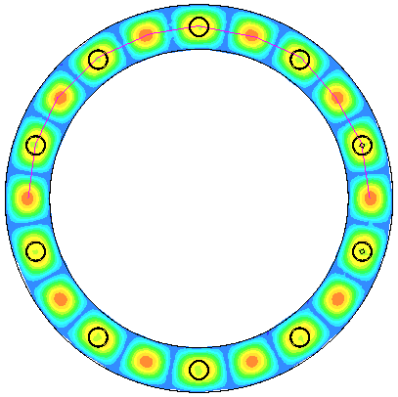
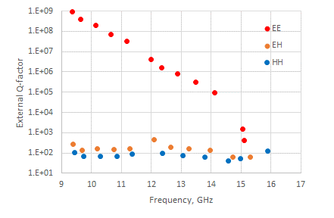
The simplest HOM MBK implies the coaxial cavities with large azimuthal index (N), so that the number of beam lets (M) can be chosen as an integer fraction of N: M=N, M=N/2, M=N/3... The choice depends on the frequency of the cavity, power needs and the space reservation for the given cathode parameters (radius, current etc.). M=N/2 has been adopted for 36GHz device.
Examples of the HOM MBK common cavities topologies
Special cavity with modes symmetry rejection filters (M=12).
Supports the heavy suppression of all the harmonics bands.
Classical, ‘folded in waveguide’ cavity (M=10)
Damped modes
12 GHz example

Slide 5
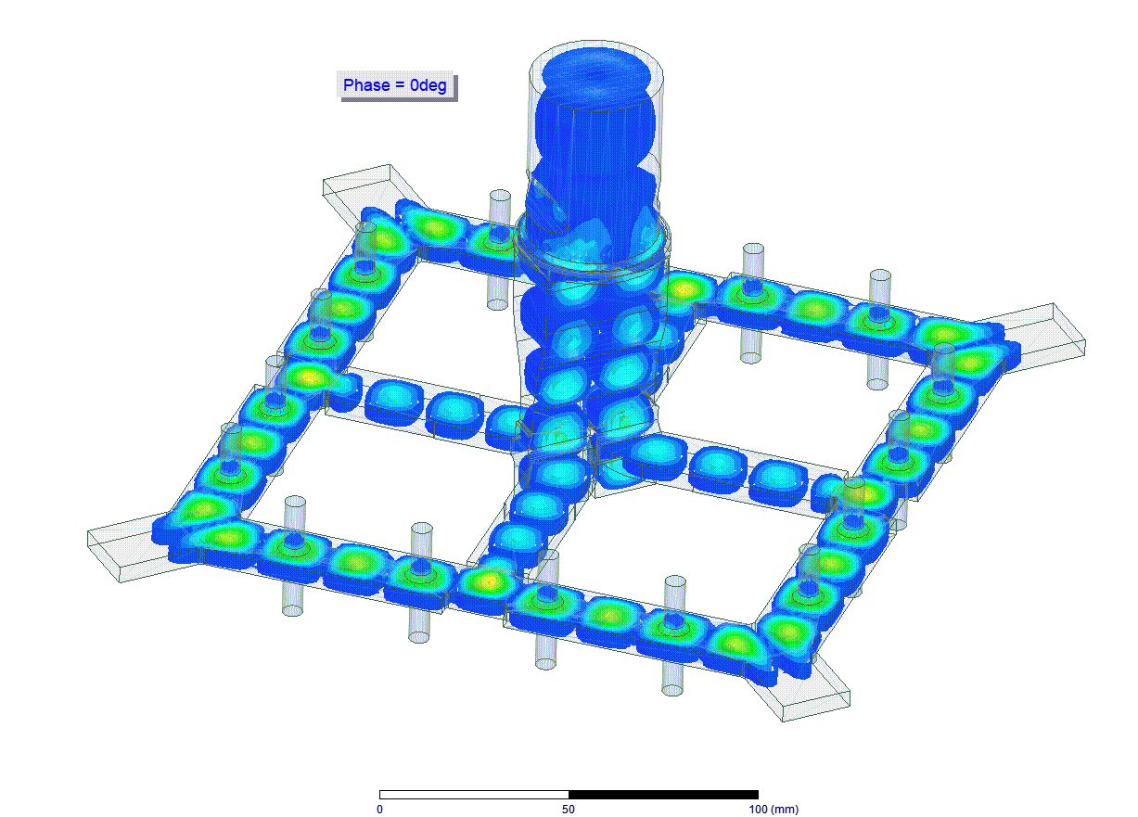
Novel concept of the output cavity power combiner/mode converter for HOM MBK
Single beam
…provides almost instant power extraction from the cavity into the low losses H₀₁ circular waveguide. Topology is compatible with high power H₀₁ RF window design used in X-band 50MW tubes.
Qext=170
HOM load

Slide 6
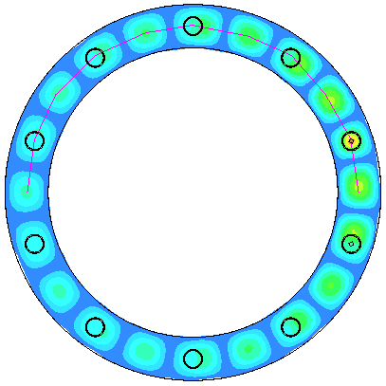
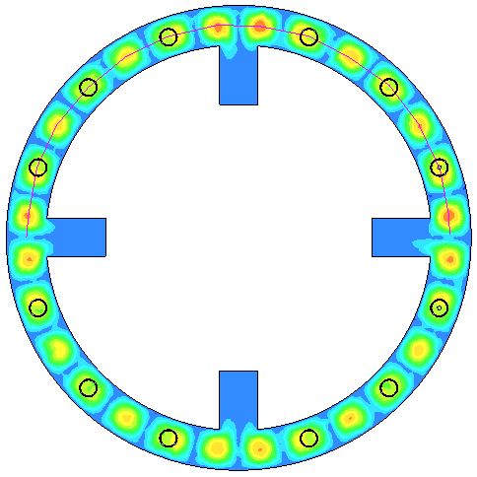
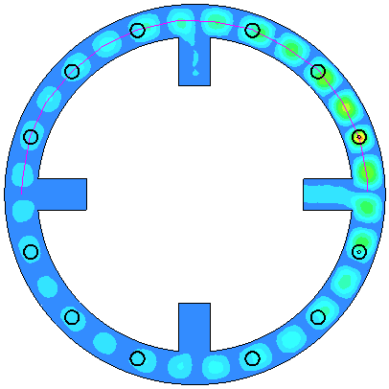
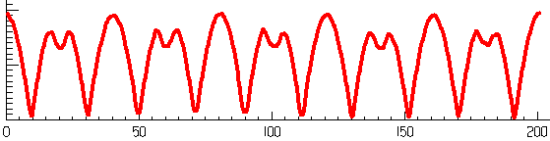
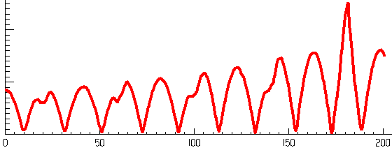
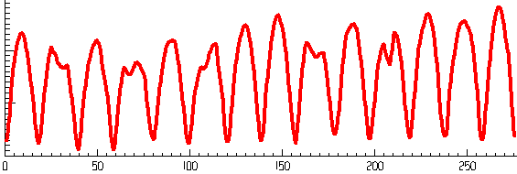
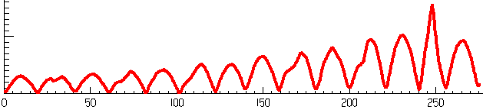
Common HOM cavities electric field symmetry issues
In the convectional klystrons bunching technology, all the cavities (apart from input and output ) have an optimized frequency detuning from the bunching/operating frequency. At 36GHz this detuning will be +200 MHz.
In HOM MBK cavities with common volume, these needs cause a significant electric field azimuthal asymmetry. Thus making the use of such cavities with large N (>10) impractical ☹
Classical cavity
Single port (coax in a beam pipe) excitation
Damped classical cavity
f=f₀
f=f₀ +100MHz
f=f₀
f=f₀ +100MHz
RF Power ‘leak’
E_{max}/E_{min}=1.6
E_{max}/E_{min}=3

Slide 7
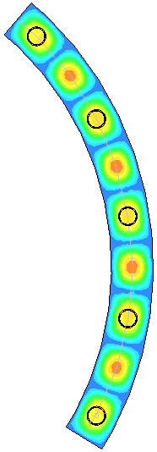
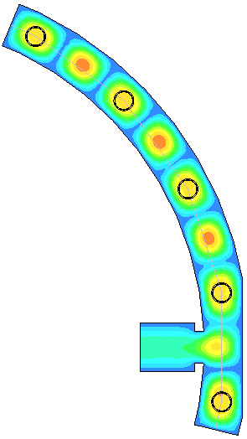
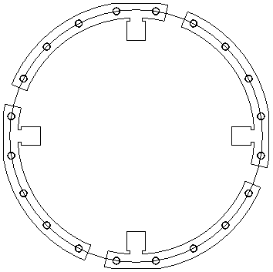
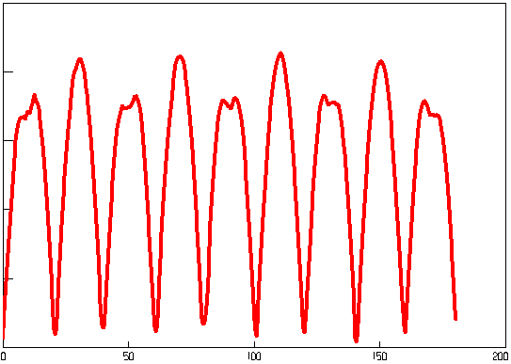
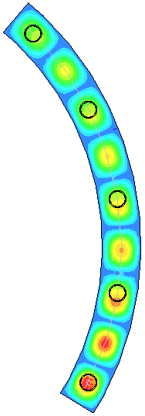
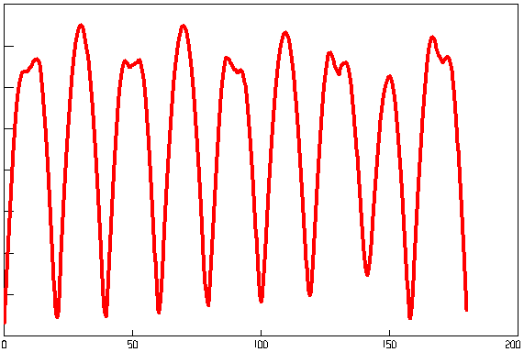
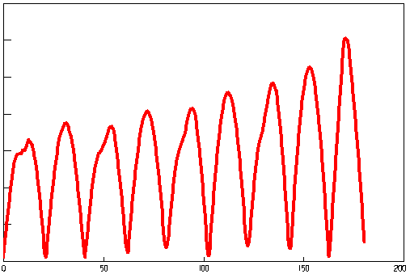
The concept of the 20 beams HOM MBK Cluster (5x4)
The cluster klystrons have been discussed for many years. For the HOM MBKC, the number of beamlets/single brunch shall be chosen maximal possible under the condition of the reasonably small field symmetry distortion.
The proposed HOM MBKC arrangement and special features
1.Single brunch asymmetric coupling in the input/output cavities support the field symmetry.
2. The cluster brunches are organized in a compact way to be used with common cathode block, collector and solenoid
3. At the moment 5 beams/brunch are considered, providing 40% field asymmetry (to be studied in more details)
f=f₀
Input/output cavities of the 4 brunches
f=f₀ +100MHz

Slide 8
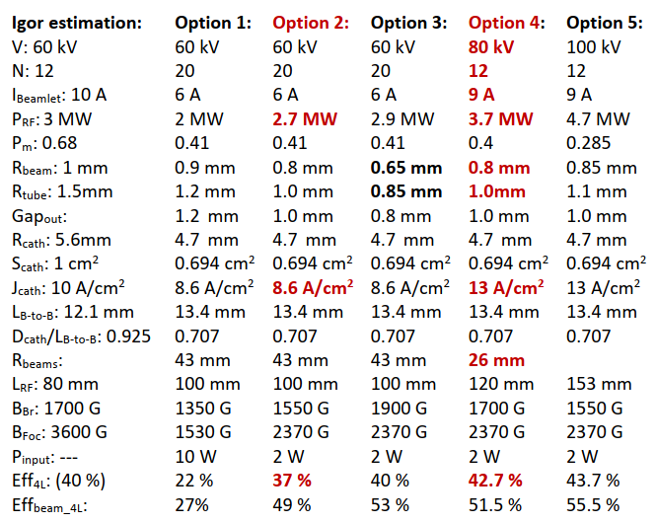
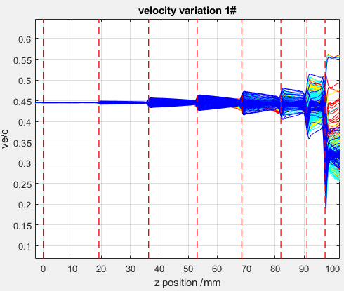
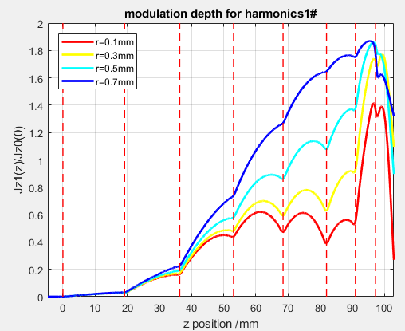
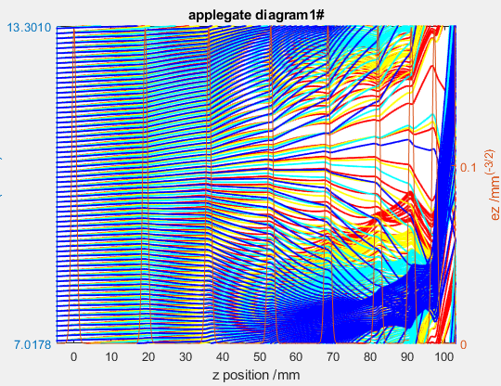
Preliminary optimization (KlyC) of the different HOM MBKC options
Option 2 (COM tube)
/beam

Slide 9
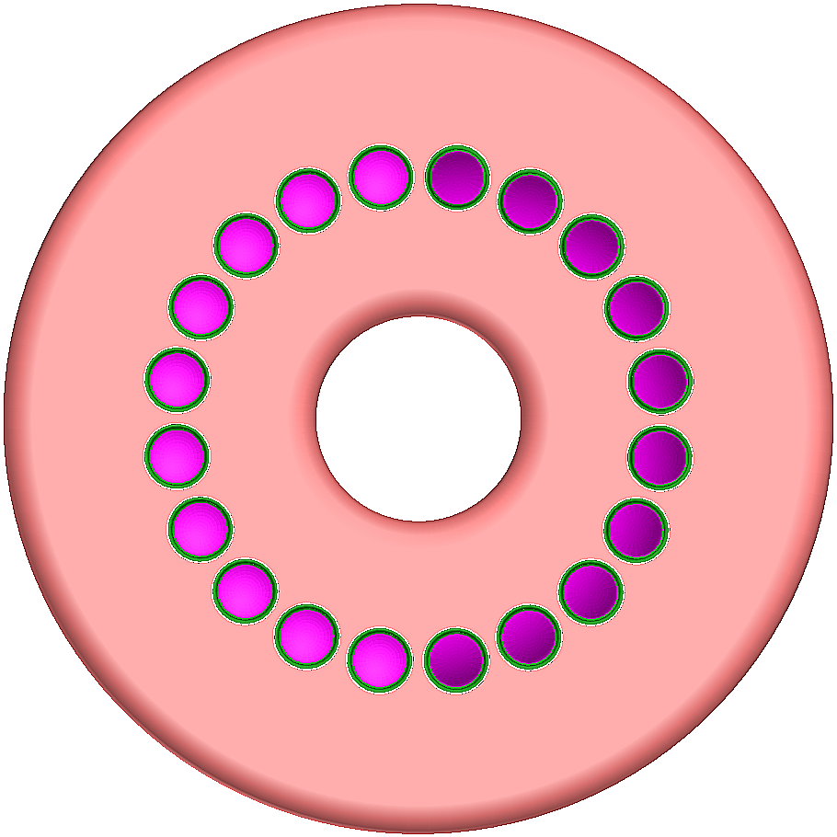
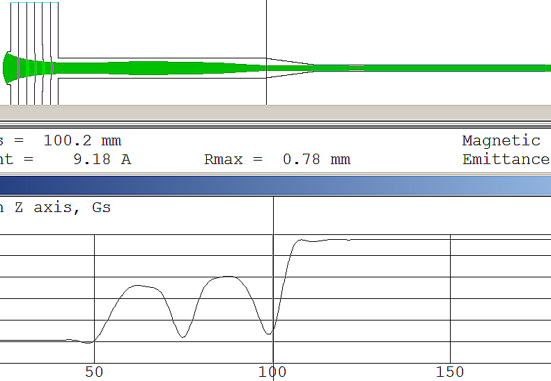
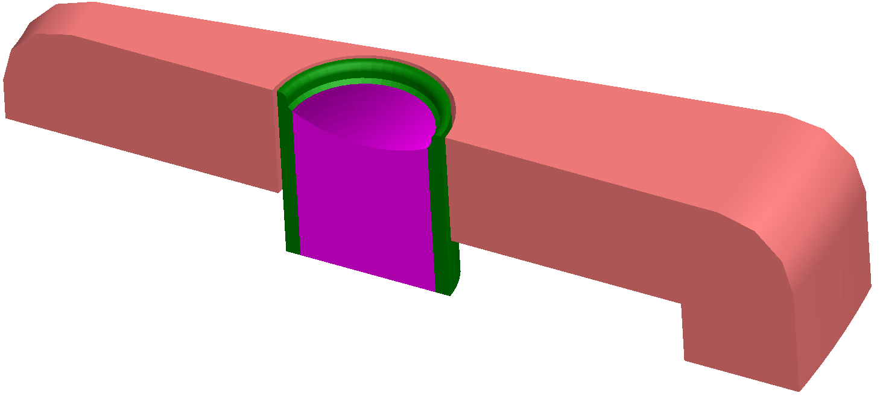

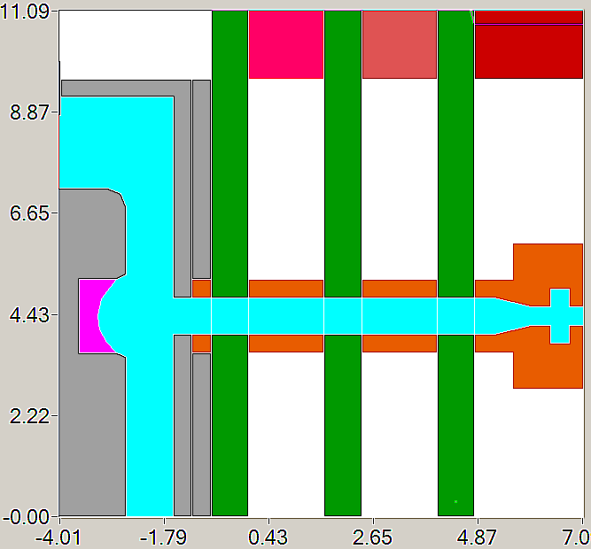
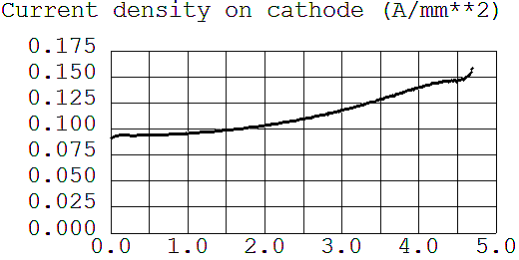
Single beamlet (6A) optics with two stages of magnetic compression (DGUN simulations)
Common cathode block (20 beams)
Cathode diameter 9.4mm (option 4, 80kV; 9A).
Bz=0.24T
R_{tube}=1mm, R_{Beam}=0.64mm/0.75mm

Slide 10
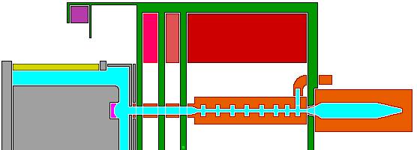
Summary
The 36GHz HOM MBKC klystron development is almost completed. The proposed options can be considered and the chosen one to be fixed (Option 2?)
Device is compact and inexpensive in fabrication (high precision 2D milling is available in many places).
Moderate magnetic field amplitude(<0.25T), short length (0.1m) and small bore diameter (<0.15m) makes the EM solenoid at convenient cost and power consumption (1.5kW). PM version can be also evaluated.
The design of the input/output combiner, window (individual/brunch, or common? ), cooling system, collector etc. can undergo technical development.
Finalized design shall be benchmarked using PIC codes to ensure the tube stability and field symmetry issues.
The 20 beams HOM MBKC (5x4) technical layout
Option 2: 60kV, 2.7MW
∅ 0.33m
Drawback.
The cluster will need 4 individual drivers to adjust the amplitude and phase of each individual brunch RF signal before combination. Neither common input/output can be used (CPI experience with the 10MW L-band MBK with common input/output and individual bunching cavities, which showed 10% efficiency degradation).
0.45m

