Slide 1
PySixDesk—A new tool for managing massive sixtrack jobs
X. Lu, A. Mereghetti, L. T. D. Coyle
06/11/2019

Slide 2
Outline
Background
Structure of pySixDesk
Workflow
The main features
Next steps
Conclusion

Slide 3
Background
SixTrak is a single particle tracking code widely used at CERN.
e.g. DA and collimation studies of LHC/HL-LHC and FCC.
SixDesk environment is the simulation framework used to manage and control the large amount of SixTrack jobs for DA studies.
e.g. prepare input files, submit to clusters (e.g. LSF, HTCondor, BOINC, etc..), collect the results for analysis.
SixDesk is a bash-based environment:
  It scales badly with number of jobs per study – e.g. random issues at processing, slow processing, …happening when approaching very large number of jobs (e.g. 10⁵-10⁶);
  Scanning new parameters implies using wrappers around the existing structure;
We developed a new python environment: pySixDesk

Slide 4
SixDesk vs pySixDesk: Design Choices
SixDesk
PySixDesk
Bash-based:
‘awk’, ‘sed’, ‘head/tail’…. are used to process the files:
  Plurality of syntaxes – not every user is acquainted to them;
  Difficult to debug complex piped commands;
  Not a single language is capable of carrying out the entire processing;
File/Folder-based processing:
We need to generate large amount of folders and files which is inefficient, space-consuming, and constrained to a specific tree structure;
Input spread over few files:
Sysenv, sixdeskenv, scan_definition
Python-based (3.6.8):
python is one of the most popular programming/analysis languages:
  Large community and shared knowledge;
  It allows to perform all operations in only one environment, dealing with one syntax only;
  Enhanced flexibility (e.g. on arrays);
Processing based on a DB:
compared to a dir structure, the DB scales more easily with number of jobs and scan parameters;
Input info in one configuration file

Slide 5
Deployment and Boundary Conditions
On CERN-lxplus (recommended)
AFS / openAFS for disk storage;
kerberos, for user authentication;
htcondor, as batch service native to CERN;
BOINC, as additional batch service for long-term, large simulation campaigns;
Sqlite3 / mySQL, as the database monitoring the progress of jobs and storing data;
python3, as main language. (3.6.8)
git clone https://github.com/SixTrack/pysixdesk.git
Add pysixdesk path to the PYTHON enviroment variable:
export PYTHONPATH=$PYTHONPATH:$pysixdesk_path/
…finalization on-going…
On local machine
Preliminary: setup kerberos and HTCondor on local computer:
https://twiki.cern.ch/twiki/bin/view/ABPComputing/LxbatchHTCondor
(Instructions mainly ubuntu18.04)
git clone https://github.com/SixTrack/pysixdesk.git
Add pysixdesk path to the PYTHON enviroment variable:
export PYTHONPATH=$PYTHONPATH:$pysixdesk_path/
P.S. From local machine, you should submit jobs with ‘-spool’ option.
Sqlite3:
  DB on local file system of user;
  HTCondor jobs need access to the DB file;
mySQL:
  DB on server maintained by IT;
  HTCondor jobs can query directly the DB;
For the moment, the user decides which one to use for each study

Slide 6
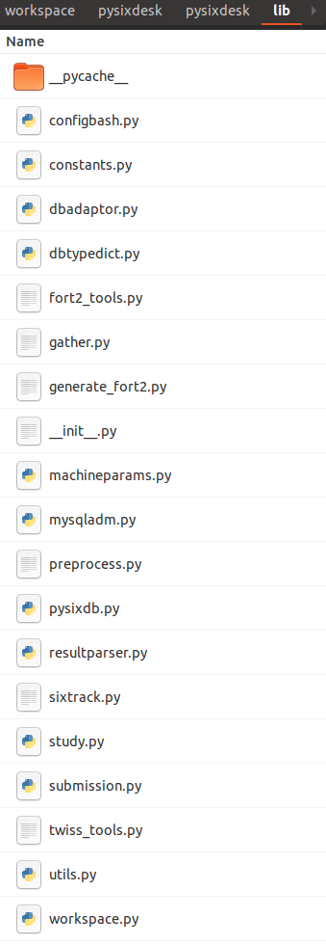
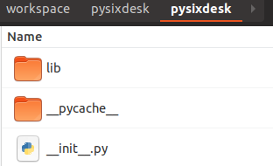
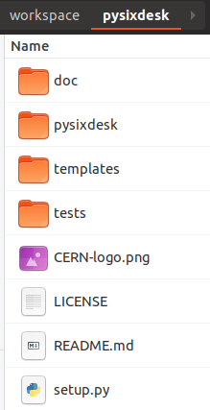
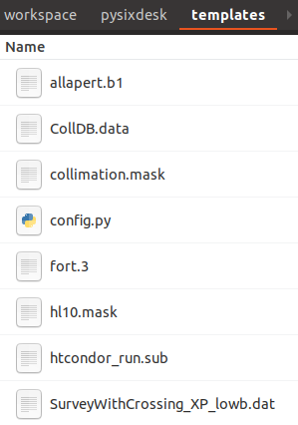
Repo Structure
Documentation
Core modules
Template files
Test unit
The main configuration file,
contains all the necessary input information for a study
Inherit

Slide 7
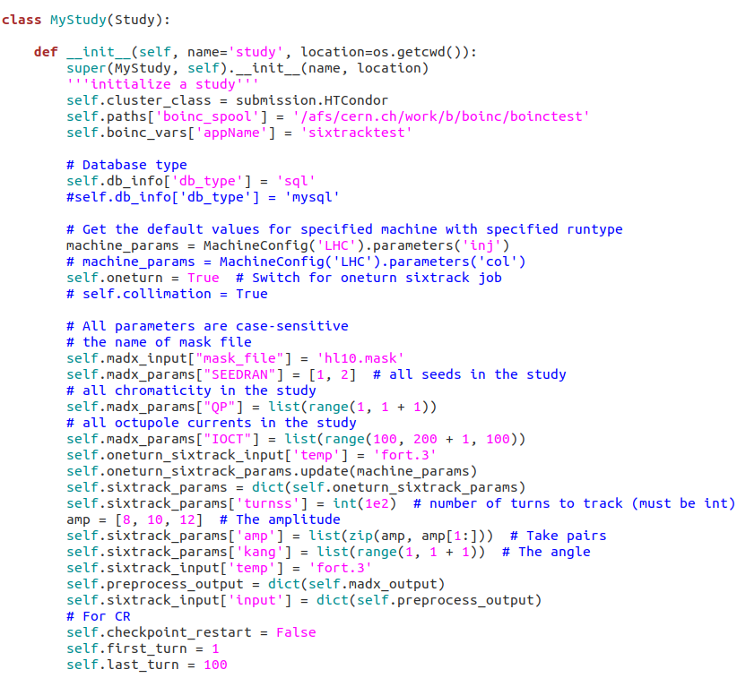
Structure of config.py
‘ MyStudy’ class is a subclass of ‘Study’:
‘Study’ class: a template study (pySixDesk core code);
‘MyStudy’ class: the user declares what is needed for the specific study wrt the template (local user file system);
Some general info, e.g. boinc_spool, boinc configuration
Database info, e.g. db type
Define the machine type and study type, e.g. LHC or HLLHC, injection or collimation
Parameters for the “study”, e.g. turnss, seed, amplitude, angle… , input files list and output list…

Slide 8
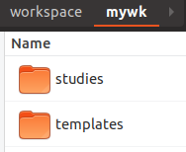
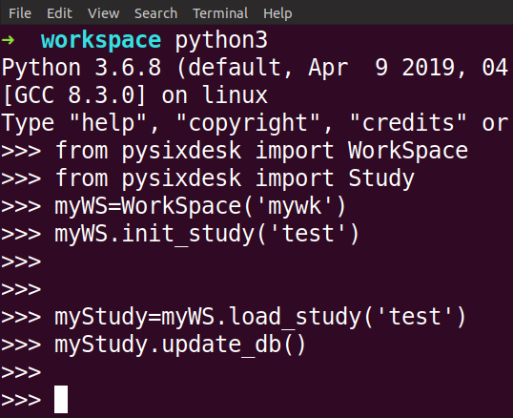
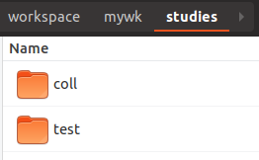
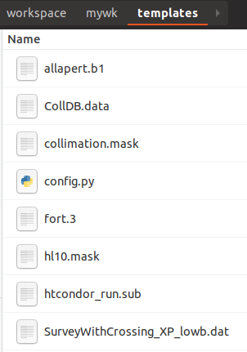
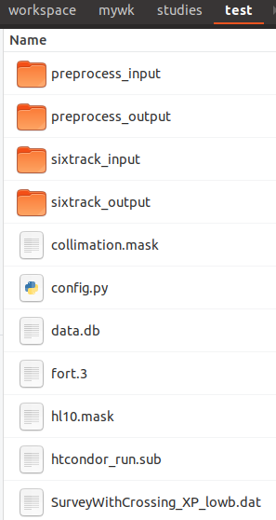
Workflow
myWS.init_study(‘test’)
myStudy = myWS.load_study(‘test’)
edit ‘config.py’ as you need

Slide 9
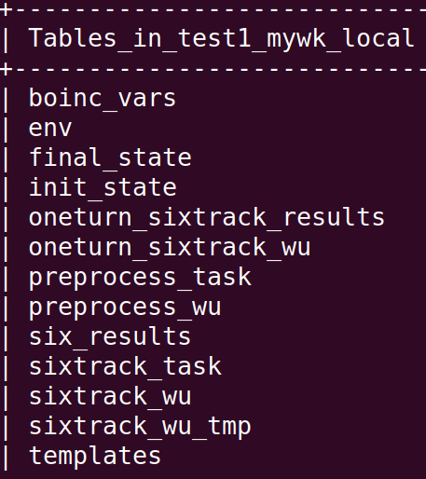
Workflow
myWS.init_study(‘test’)
myStudy = myWS.load_study(‘test’)
edit ‘config.py’ as you need

Slide 10
Workflow
The starting point is:
  .mask file: template MAD-X job for computing the machine optics and working point;
  config.py file: the parameter scans;
Steps:
  Pre-processing:
    Generate the actual MAD-X job files:
      1 MAD-X file per machine configuration;
      Generate actual SixTrack input files for machine description;
    Further pre-processing:
      For DA: one-turn jobs, to get optics functions from SixTrack and properly set initial conditions of particle tracking;
      For collimation: merge aperture model onto machine description;
  Actual job submission;
  Collection of results and analysis;
This step will disappear once we will make operational the new DIST block in SixTrack
This step will disappear once aperture markers and aperture offsets can be consistently generated by MAD-X

Slide 11
Workflow
with placeholders
e.g. %turnss, %emit
fort.3 mother file
Workflow of a typical study
parameters
fort.2
fort.3
fort.8
fort.16
….
parameters
run sixtrack
Twiss parameters, tunes, chromaticity…
SEED
QP
…..
fc.2
fc.3
fc.8
fc.16
….
run madx
oneturn sixtrack job
actual madx input file
‘DA‘ study
madx mask file
with placeholders for each machine parameter
e.g. %SEED
‘Collimation‘ study
fort.2
fort3.limi
….
preprocess jobs
suvery.dat, aperture.dat colldb.dat

Slide 12
Workflow
Workflow of a typical study
with placeholders
e.g. %turnss, %emit
fort.2
fort.3
fort.8
fort.16
….
run sixtrack
fort.10
fc.2
fc.3
fc.8
fc.16
….
DA study
fort.3 mother file
parameters
fort.2
fort3.limi
fort.3
fort.8
….
run sixtrack
aperture_losses.dat
init_state.dat
final_state.dat
Coll_Scatter.dat
sixtrack jobs
collimation study

Slide 13
Workflow
Prepare the submission file: htcondor.sub, job_list (task_ids), input.ini and sub.db if ‘sqlite3’ is used
myStudy.prepare_preprocess_input()
Submit to HTCondor, 0 stands for preprocess job, 5 is trial number
myStudy.submit(0, 5)
Collect the results, only needed when ‘sqlite3’ is used
myStudy.collect_result(0)
myStudy.prepare_sixtrack_input()
Prepare the submission file for actual sixtrack job
Submit sixtrack jobs to HTCondor, 1 stands for sixtrack job
myStudy.submit (1, 5)
myStudy.collect_result (1)
Collect the sixtrack results, only needed when ‘sqlite3’ is used

Slide 14
The main features
For ‘one turn sixtrack job’ and ‘generate_fort2’ (i.e. merge aperture markers and offsets onto sequence), there are two flags to control the selection:
self.oneturn = True
self.collimation = True
Supported study type
Dynamic aperture study (DA)
Collimation study
DA with Collimation
Preprocess job
Preprocess job
Preprocess job
Madx job
Madx job
Madx job
One turn sixtrack job
One turn sixtrack job
Generate_fort2
Generate_fort2
Actual sixtrack job
Actual sixtrack job
Actual sixtrack job

Slide 15
Clusters
Supported cluster
HTCondor
By default, all the jobs will be submitted to HTCondor.
BOINC
We can also use a custom cluster to run the jobs.
The ‘custom_cluster’ should inherit from submission.Cluster and all the abstract methods should be overridden.
In ‘config.py’, import the custom cluster, then set:
self.cluster_class = custom_cluster
Custom cluster

Slide 16
Clusters (II)
Supported cluster
HTCondor
If the user needs to submit actual sixtrack jobs to BOINC, just assign ‘boinc=True’ when calling ‘prepare_sixtrack_input’ and ‘collect_result’
myStudy.prepare_sixtrack_input(boinc=True)
myStudy.collect_result(1, True)
P.S. The job will anyway be submitted to HTCondor at first for filtering, then to BOINC.
BOINC
Custom cluster
Pass-test
Sixtrack jobs
HTCondor
BOINC
Run sixtrack job with ‘test_turn’

Slide 17
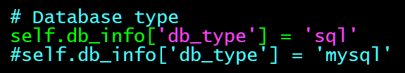
DBs
Supported database
For the moment, we support two types of database to the users.
To choose the database, the user need only to change the ‘db_type’ in ‘config.py’ file, and prepare the ‘.my.cnf’ config file under the $HOME directory with the ‘port’, ‘host’, ‘user’, ‘password’ info for ‘mysql’, nothing else.
local
Sqlite3
central
MySQL
With the ‘Mysql’ DB, the workflow will be simpler. The condor jobs will get input information directly from DB and push the results back to DB automatically once the job is finished.
That means the user don’t need to call the ‘collect_result()’ method when the job is finished.

Slide 18
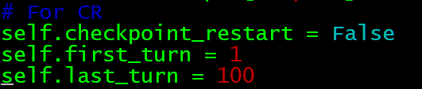
The main features
Operational only for HTCondor, under finalization for BOINC
Checkpoint/Restart
1st Sixtrack job - eg. 1000 turns
2nd Sixtrack job – e.g. 1001~2000 turns
Continue
There are three flags in ‘config.py’ for CR. If the user set ‘self.checkpoint_restart = True’, the program will prepare the jobs from the given ‘first_turn’.
The checkpoint/restart (CR) feature was originally designed for BOINC (e.g. host being restarted). But we can also use it to split/prolong the tracking.

Slide 19
Next steps
Complete the documentation.
Embed analysis part (DA, losses, etc..).
Possible improvements based on feedback from users.

Slide 20
Conclusion
A new tool ‘pySixDesk’ is being developed to manage massive SixTrack jobs. It’s more flexible and robust than the bash-based SixDesk.
All the tracking parameters and results are stored into DB, together with the management of the jobs;
  It’s very convenient for the analysis;
  It enhances scalability;
The program can prolong the completed tracking with the CR feature.
Scalability tests just started.
Welcome to get and try the new tool:
git clone https://github.com/SixTrack/pysixdesk.git

Slide 21
Thanks for your attention!

