Slide 1
Actions for Triplet and beam screen vibrations
R. Corsini, D. Gamba

Slide 2
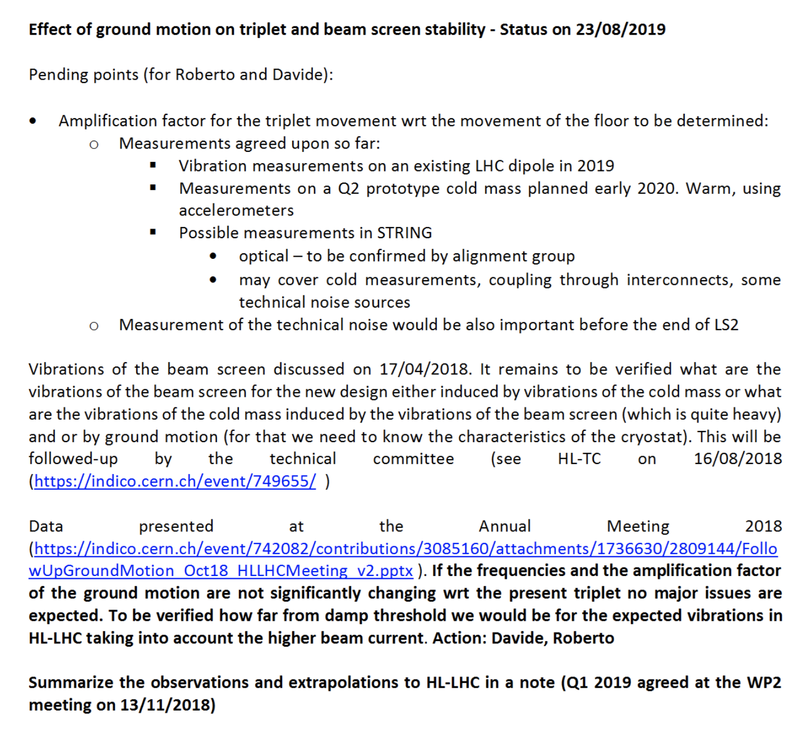
Effect of ground motion on Triplet and beam screen
Measurements of ground to cold mass transfer function:
  Confirmed within 2019 for dipole (October) and later in 2020 for Q2 (date to be fixed when prototype available).
  STRING: still waiting for an answer from alignment on the maximum frequency of the optical measurements acquisition in STRING, which is presently 1 Hz (mail from H. Mainaud of 15 July, follow-up done today).
  STRING cold mass measurements are still considered in principle relevant for possible differences cold/warm. Technical noise sources will be likely quite different from final location, and coupling through interconnects should be negligible - D. Duarte Ramos, oral communications at: https://indico.cern.ch/event/741801/timetable/
  and
  https://indico.cern.ch/event/741801/contributions/3063285/attachments/1727449/2793548/181005_String_Review_v1.2.pdf

Slide 3
Effect of ground motion on Triplet and beam screen
Beam screen
  Presentation at TCC 18th July by D. Gamba.
  BS moves rigidly with cold mass (within a few % for <60 Hz) → No enhancement of ground motion to be expected.
  No need for beam screen vibration test on a long magnet outside of the STRING.
  However, a measurement (frequency and amplitude) of turbulent-flow induced vibration in cooling tubes (without a magnet) is planned by TE/VSC (date still unknown, follow-up done today).
Dump threshold
  From collimation group: collimator system was scaled up to cope with higher intensity, no increased threshold.
Documentation
  Paper at IPAC 2019 on observations.
  Complete summary note in preparation, jointly with OP:
  (Ed: M. Schaumann, D. Gamba, H. Garcia-Morales).

