Slide 1
News from CERN
May-Oct 2019
Ana Godinho
EPPCN Meeting, CERN
31.10.2019

Slide 2
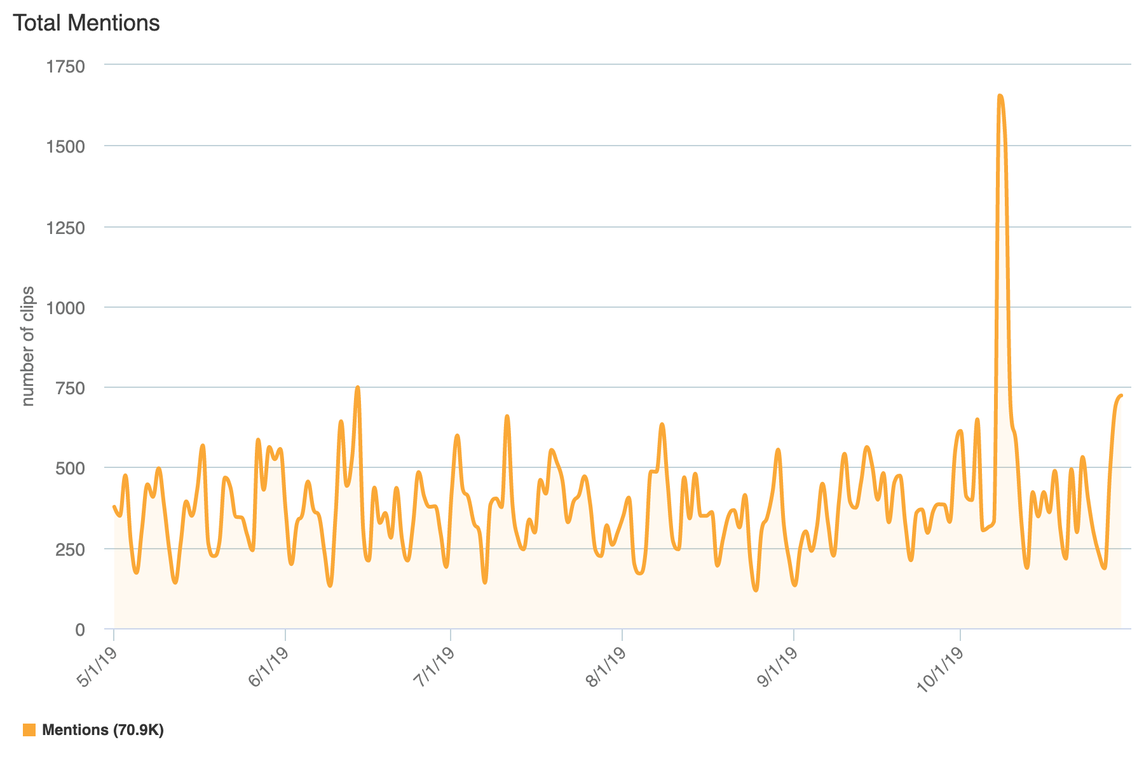
Media mentions
May – Oct 2019
Physics Nobel Prize*
Microsoft alternative project
* Mention – “dark matter”

Slide 3
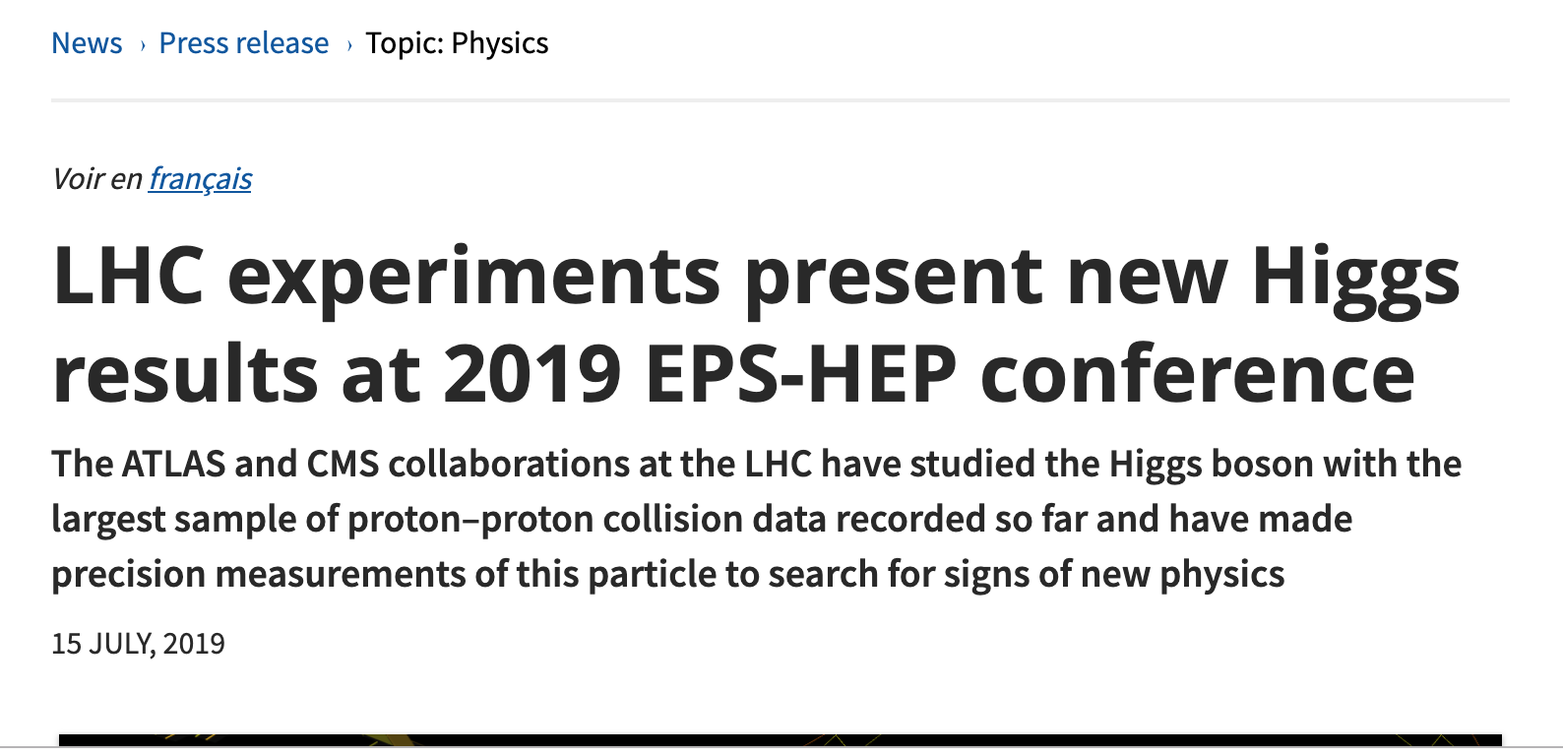
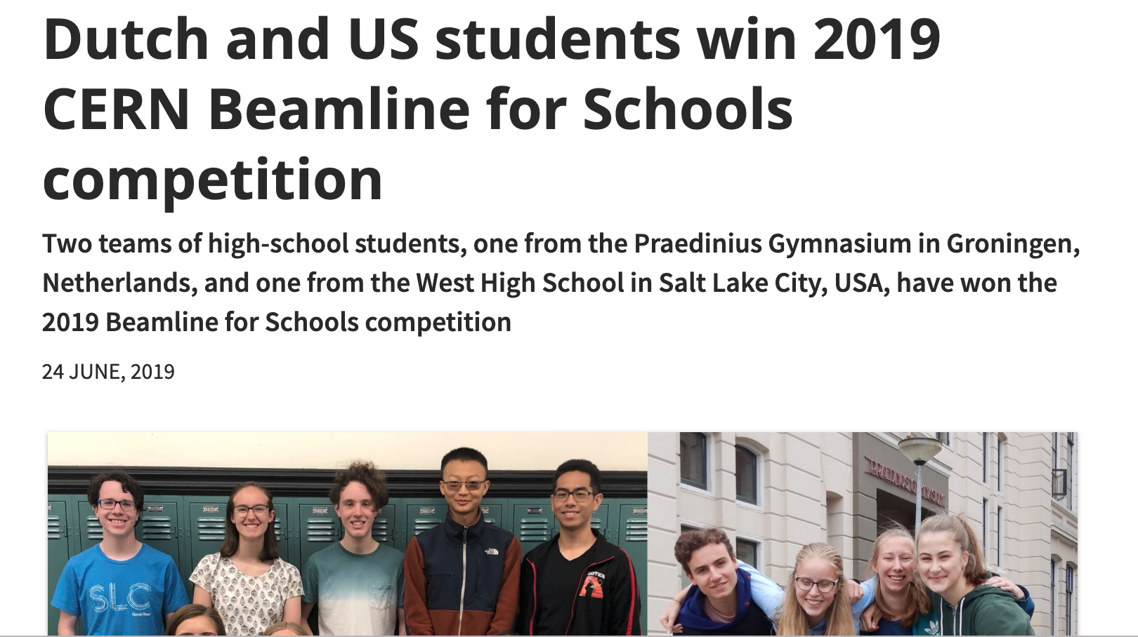
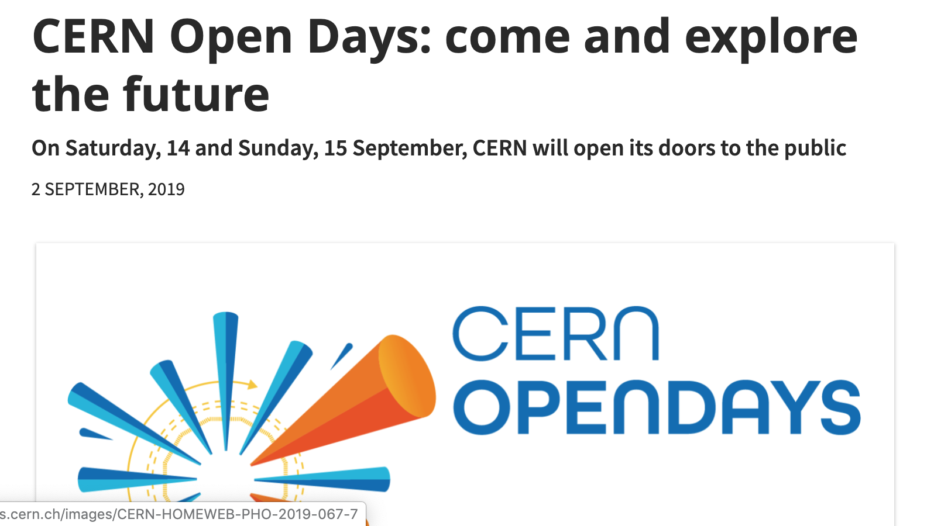
12 March 2019

Slide 4
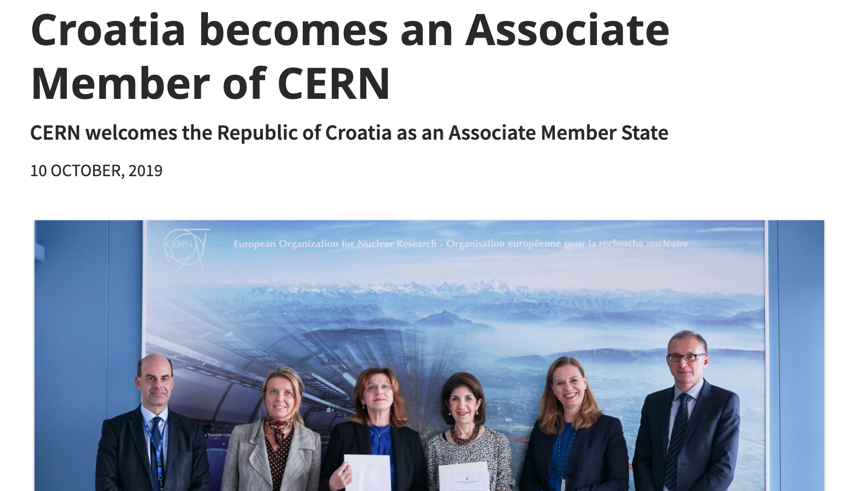
News update

Slide 5
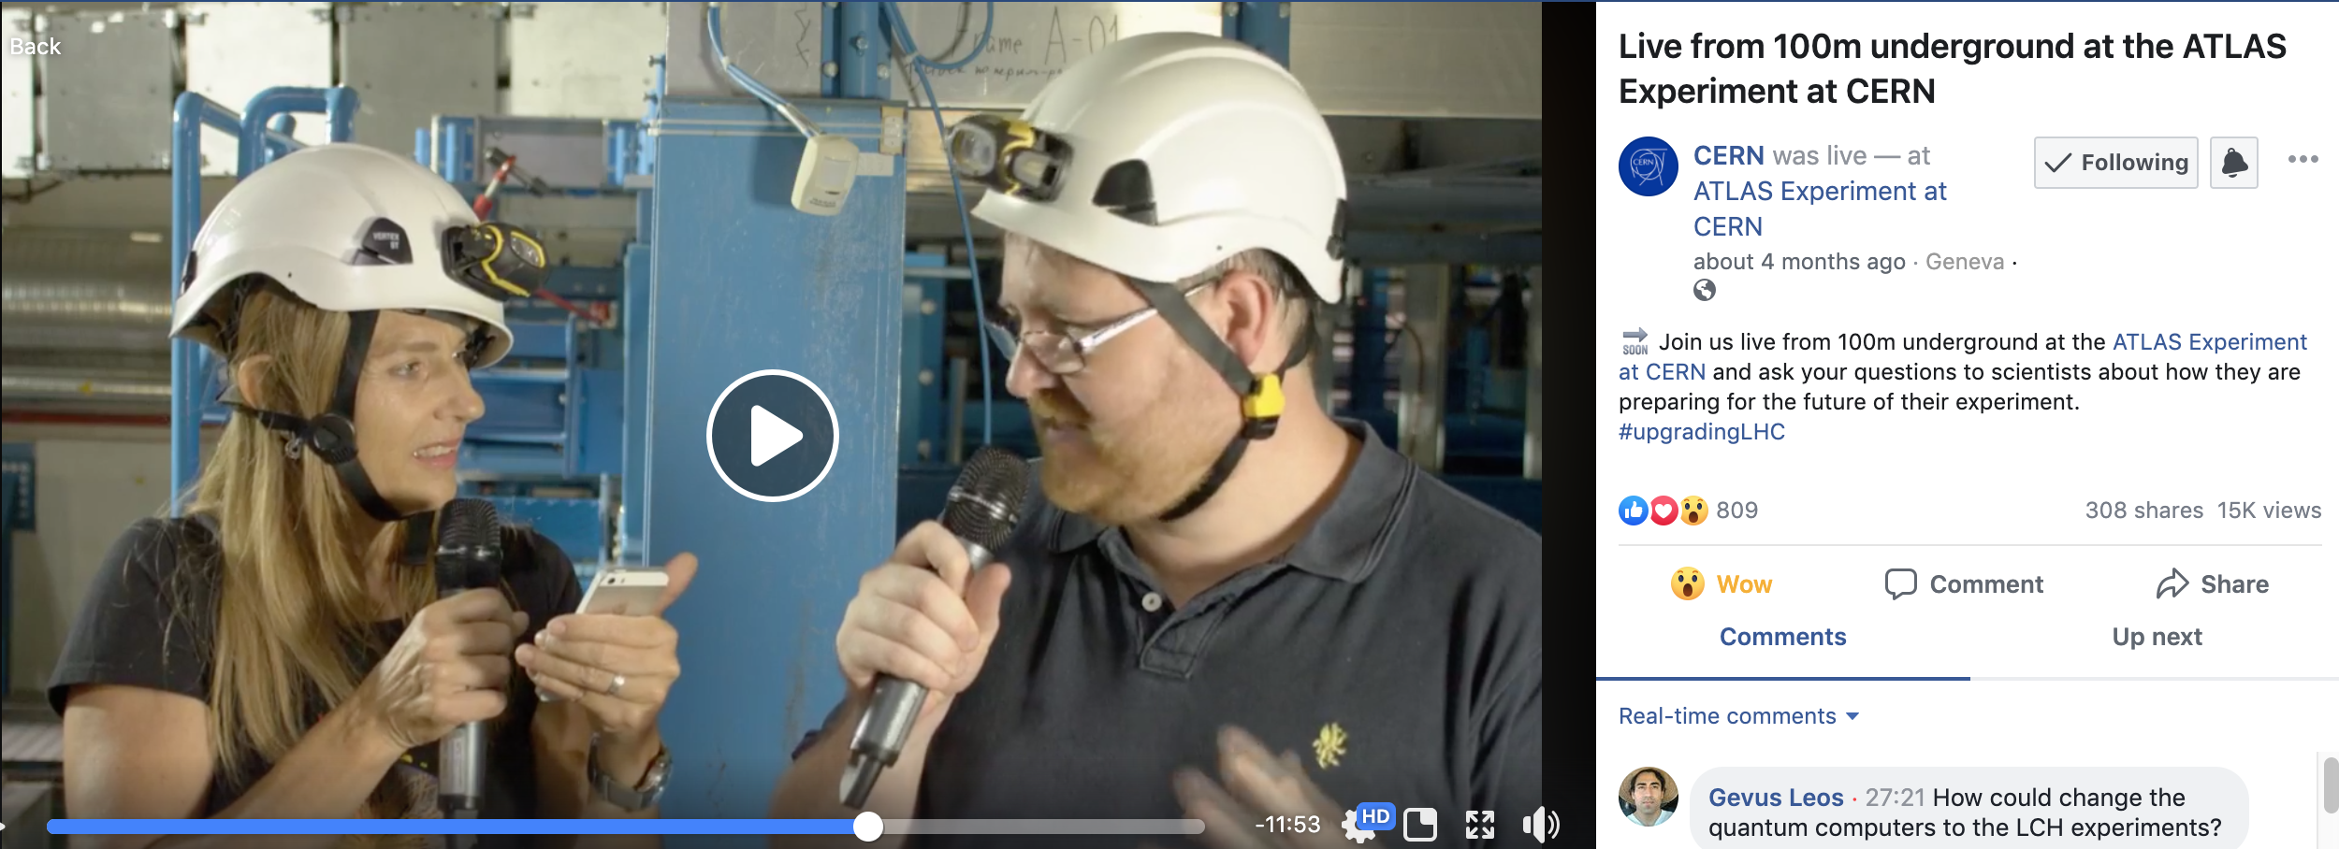
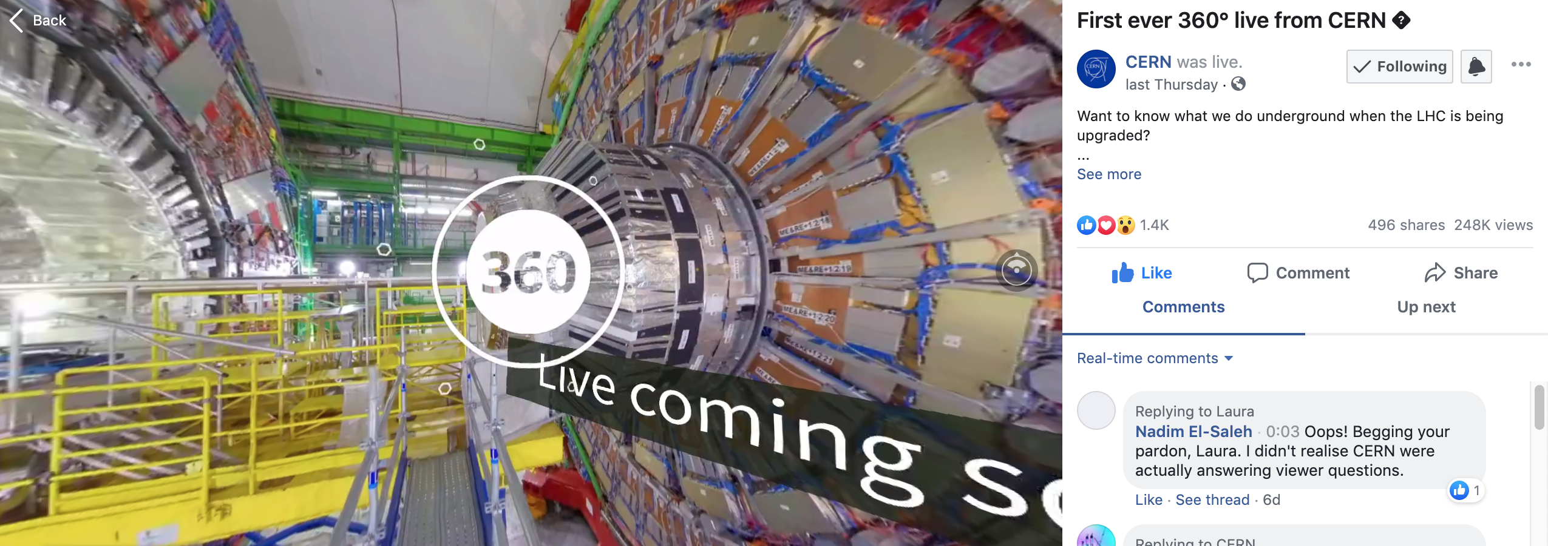
LS2 Facebook Lives
ATLAS (1 July)
CMS (24 October)
First 360 Live
+24hrs - 180k views (usually ˜15k)
Almost 3 000 simultaneous viewers (average is 200)
YouTube: 3k views and more than 350 simultaneous viewers

Slide 6
Planned LS2 Facebook Lives (some TBC)
AMS – ISS spacewalk (November)
LHCb (December)
Linac4, PS and SPS (TBD)
HL-LHC tunnel boring (Spring 2020)
Brand new LHC (Summer 2020)

Slide 7
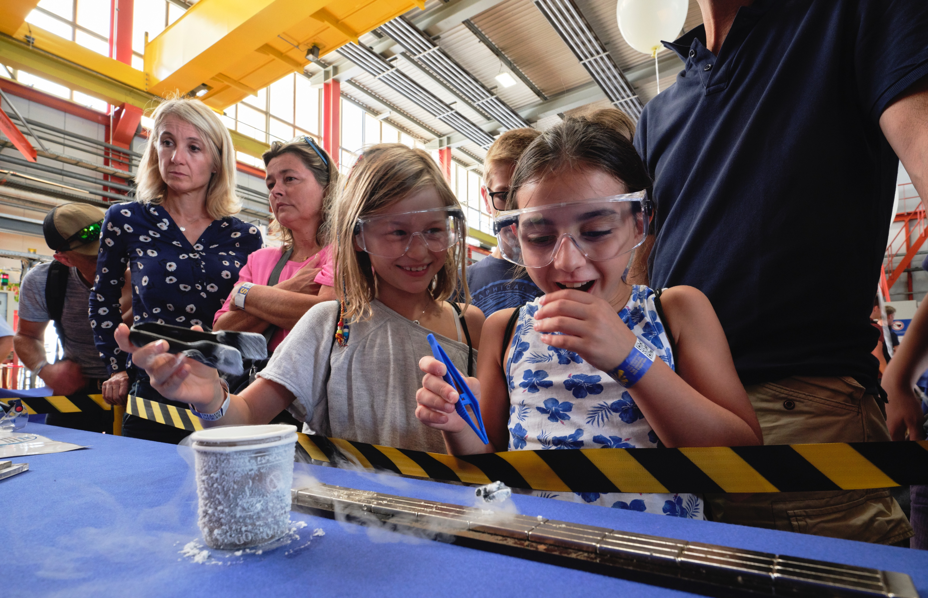


Slide 8
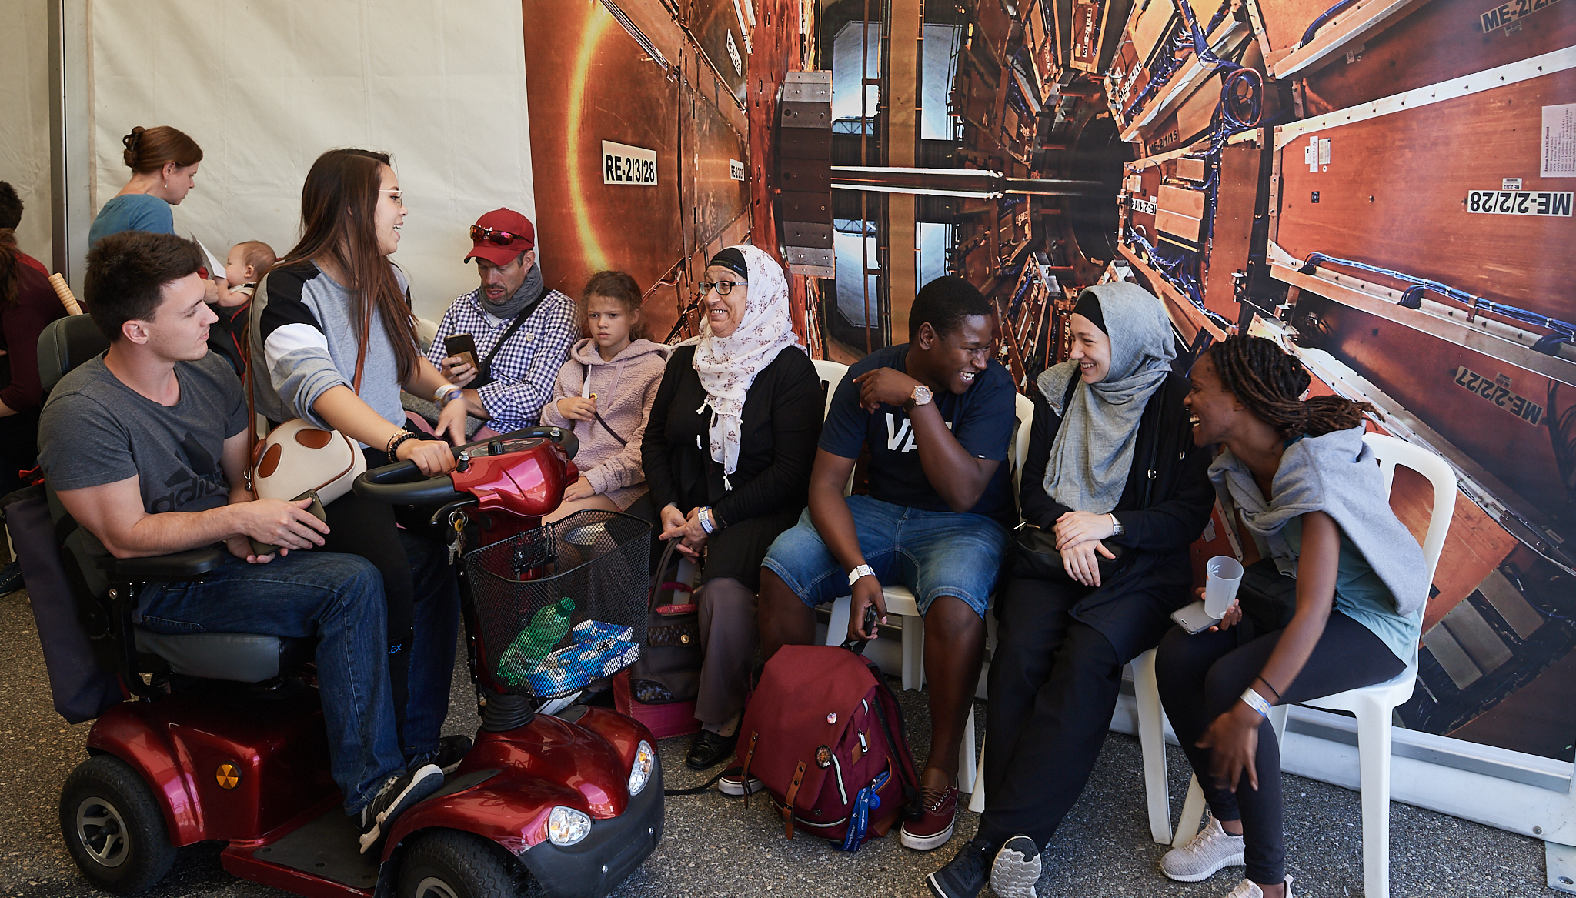
75 000 visitors of all ages
Neighbours and visitors from further afield*
155 activities – visits, hands-on, exhibitions, debates, theatre, music
9 sites – 6 LHC sites, Meyrin, Prevessin, SM18
* Demographic data being collected through surveys

Slide 9
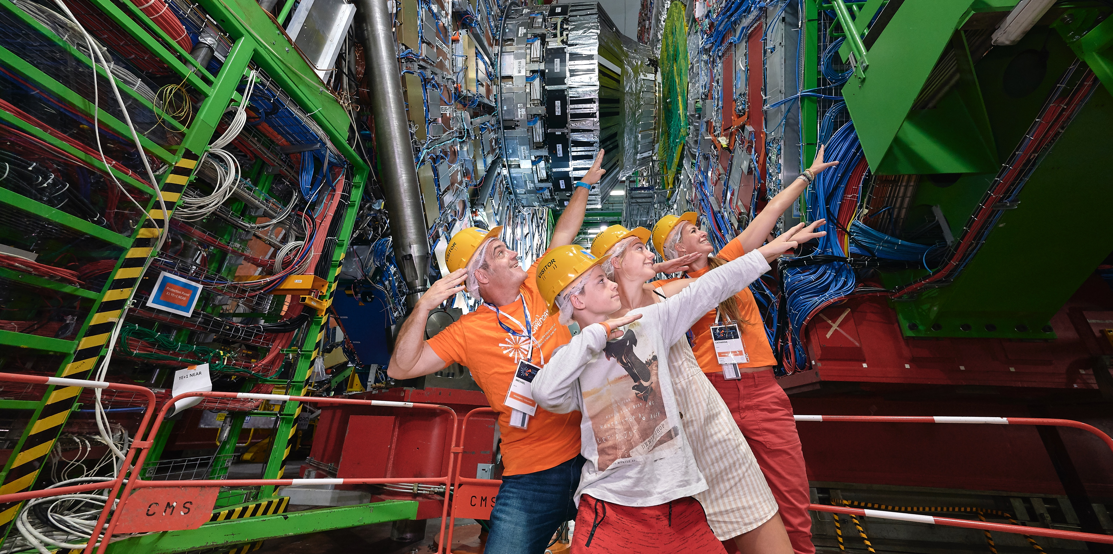
2 800 volunteers (staff, users, students, contractors, alumni)*
Several hundred CERNois involved in preparing the Open Days*
Collaboration with host-states: police, emergency services, fire brigades, public transport
* Feedback survey ongoing (>650 responses)

Slide 10
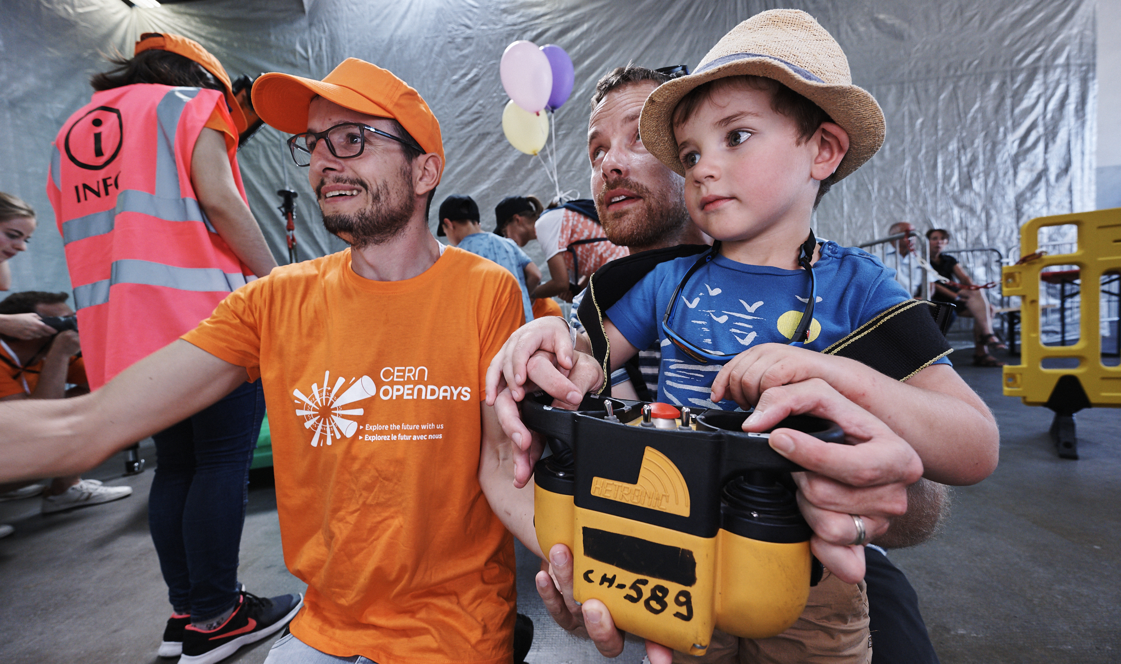
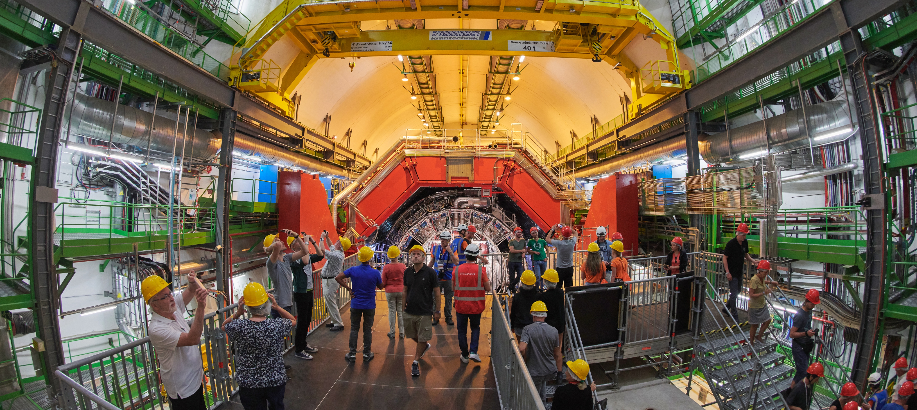

Slide 11
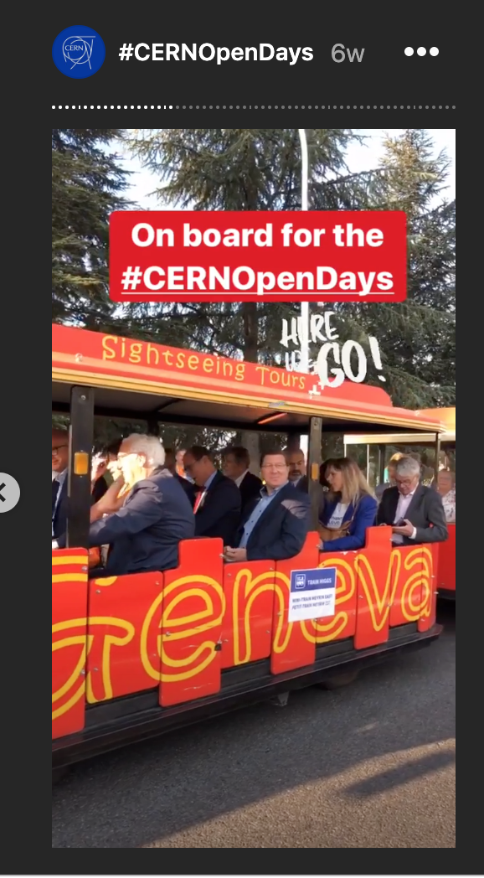
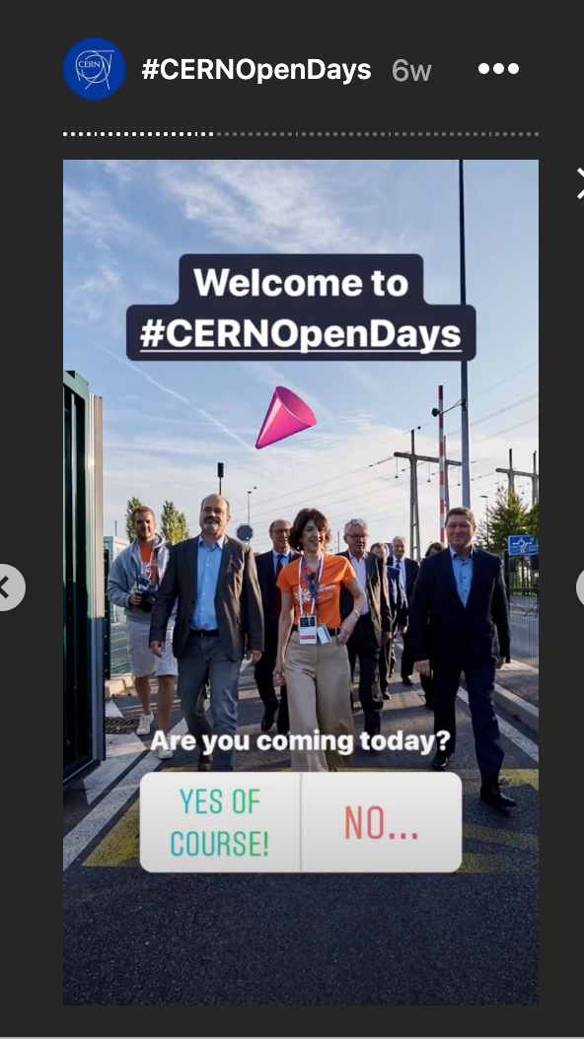
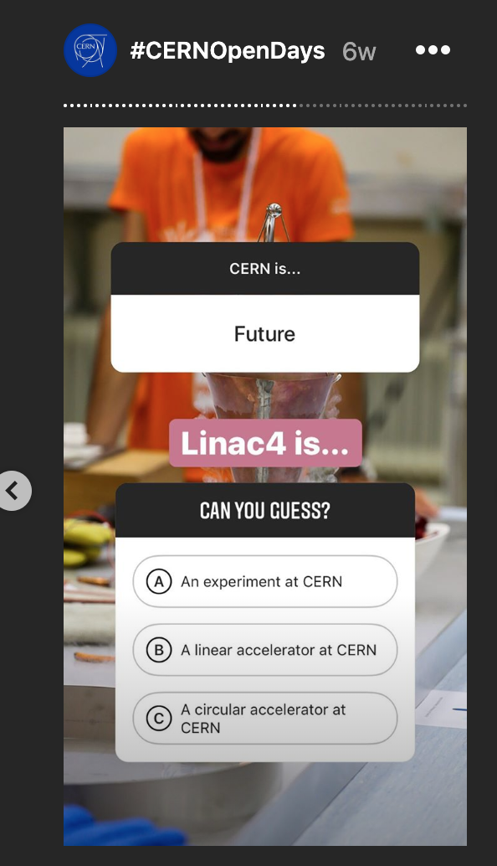
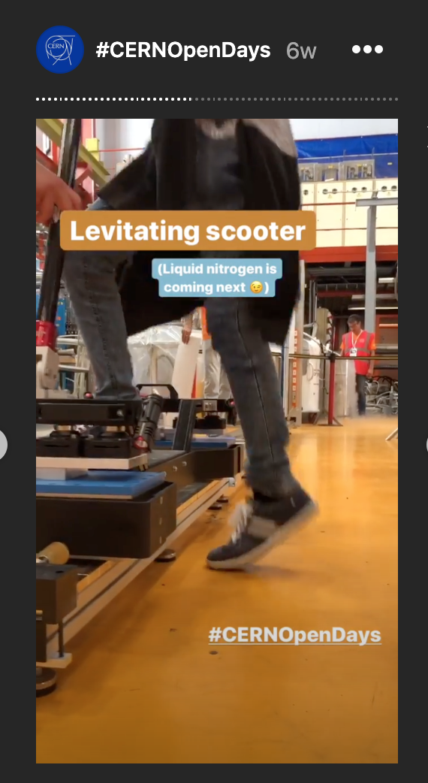
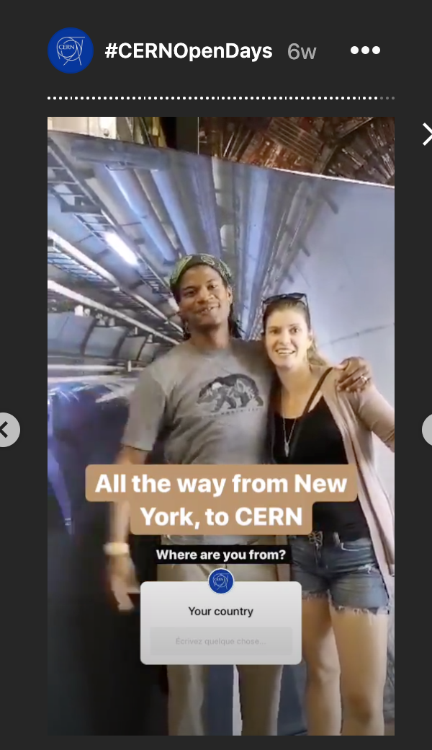
4 700 social media posts mentioning the Open Days
  40% of them are positive (70% of joy!); only 1% negative
Instagram story seen 1.6 million times
Potential reach of the OD - 78 millions people worldwide
Facebook Live (Saturday) live viewed 30k times (OD + 2 days)

Slide 12
Coming up
Election of next CERN DG (November or December Council meetings)
European Strategy for Particle Physics Update (January, May 2020)
Kick-off workshop for education content for Science Gateway (January 2020)
Science Gateway scenographer chosen (March/April 2020)
10th anniversary of first physics at LHC (March 2020)
ESOF 2020 (July 2020)
And of, course, saying “au revoir” to Arnaud (November) and welcoming a new Head of Media Relations (January 2020)

