Slide 1


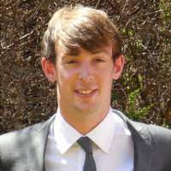
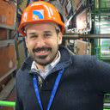



Lab 3-Thin Moderate Gain Ultrafast Timing detectors
Laser Transient Current Technique (TCT) to characterize Low Gain Avalanche Detectors (LGAD) for Timing and Tracking applications
Location: UAM, facultad ciencia, modulo 15, lab Microelectronica
Giulio Pellegrini and Neil Moffat, from IMB-CNM (CSIC)
Sebastian Grinstein and Pablo Fernández-Martínez, from IFAE

Slide 2
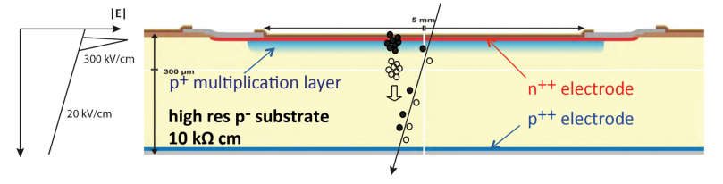
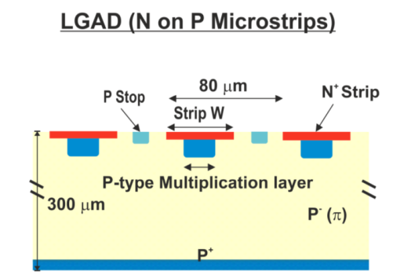
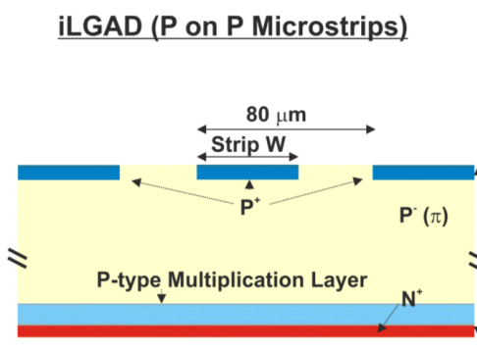
Low Gain Avalanche Detectors
Why Low Gain?
Examples of Segmented LGADs + many more
Charged particles already produce large signals (mip: ~80 ehp/µm) → Very large gain is not required
Lower gain → Lower mult. noise
Easier segmentation (lower electric fields involved)
Lower power consumption after irradiation
Fast timing information
[G. Pellegrini, doi:10.1016/j.nima.2014.06.008]
[G. Pellegrini, doi:10.1016/j.nima.2016.05.066]
2
Lab 3 – Thin Moderate Gain Ultrafast Timing Detectors: A short into on TCT

Slide 3
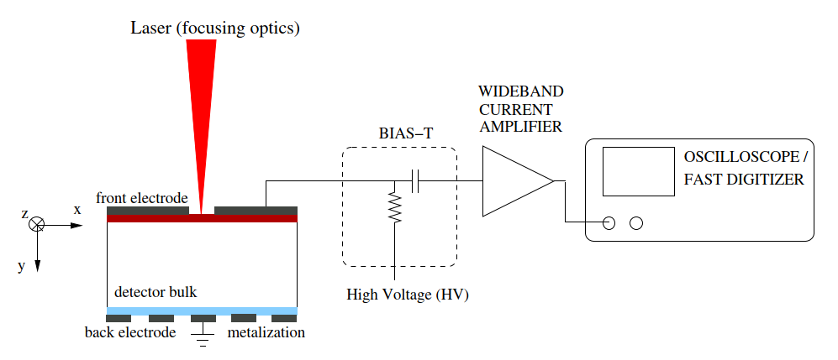
Transient Current Technique
TCT exploits the signal induced in electrodes by the motion of non-equilibrium free carriers (e-h pairs) in a semiconductor structure to study the properties of the structure
+
-
[G. Kramberger, doi:10.22323/1.227.0032]
+
-
+
-
+
-
Laser (typically IR) is a convenient method to generate e-h pairs:
  You can easily average (cancelling noise)
  Triggering (exactly known time of your pulse)
  Generation depth can be tuned with wavelength
  Controllable beam position
  But! You have to open metallization!!!
+
-
+
-
+
-
+
-
+
-
+
-
+
-
+
-
+
-
+
-
Lab 3 – Thin Moderate Gain Ultrafast Timing Detectors: A short into on TCT
3

Slide 4
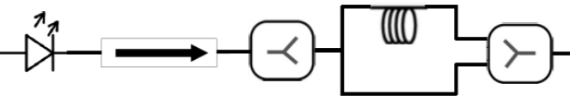
Timing measurements using a TCT
TCT can also be used for timing measurements
Particulars 1064nm Laser Diode
Splitter
Combiner
Isolater
DUT
Laser light is split by the 50:50 beam splitter
Half of light travels along the delay line (11.4 m long fiber) ,=50 ns delay
Light is combined and two signals are seen by the DUT with a delay of 50ns.
Copy of the pulse (#2) used as time reference – Δt = t1 – t2
Time resolution measured by taking the sigma of the histogram of the time difference.
Lab 3 – Thin Moderate Gain Ultrafast Timing Detectors: A short into on TCT
4

Slide 5
In this lab:
First part: TCT and LGAD basics
        How it works, how to analyse the data and understand the results
Second Part: Focus
        How to set the focus and run the analysis
Third Part: Scan
        Run and Analyse a Voltage and Line Scan
Fourth Part: Timing
        Run and Analyse (external data) a timing analysis
Lab 3 – Thin Moderate Gain Ultrafast Timing Detectors: A short into on TCT
5

