Slide 1


Detection lab
J.-G. Cuby
Speaker A. Le Van Suu
Credits: Hervé Le Coroller & Christophe Adami, LAM

Slide 2
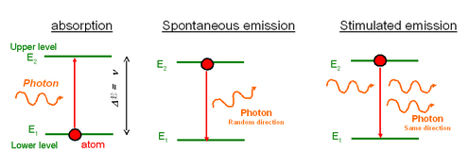
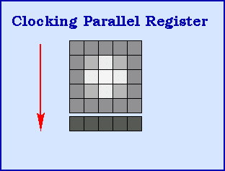
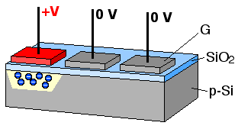
CCDs

Slide 3
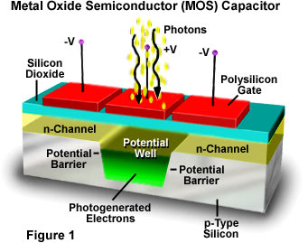
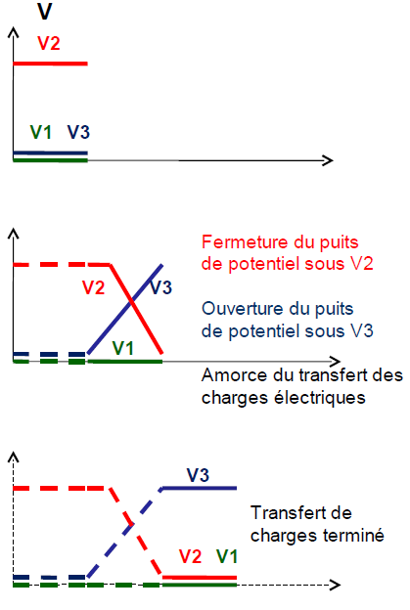
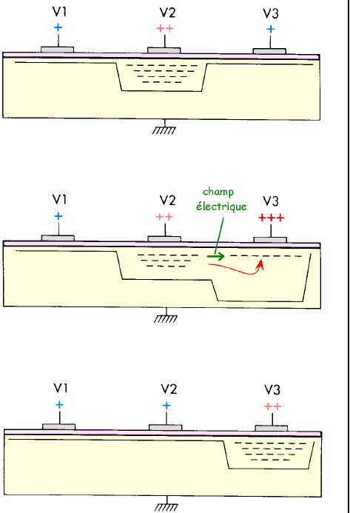
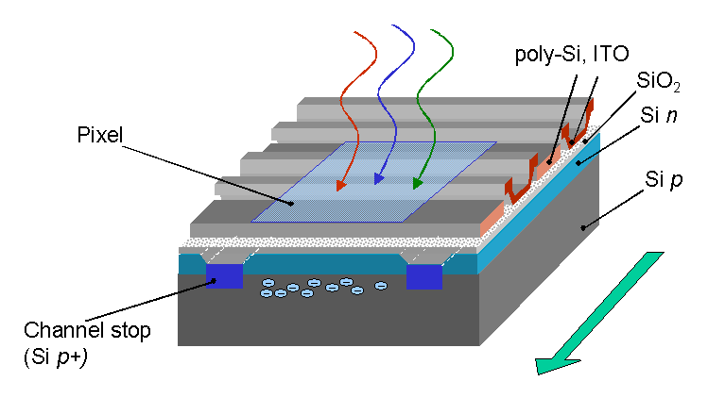
CCDs
Electric field
Closing potential well under V2
Opening potential well under V3
Starting charge transfer
Charge transfer completed
Charges are collected under electrodes (as long as the voltage is applied)
Charges are then transferred pixel to pixel by adequate clocking of the electrodes

Slide 4
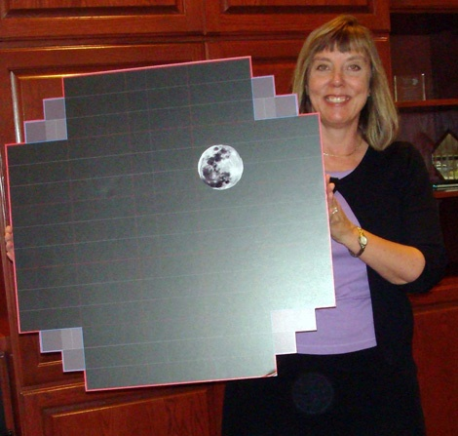
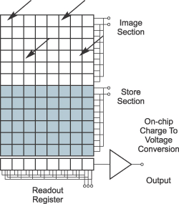
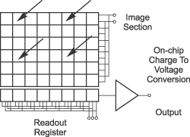
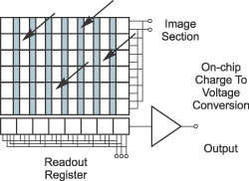
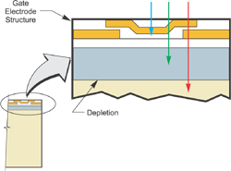
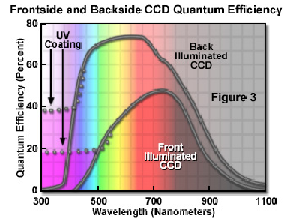
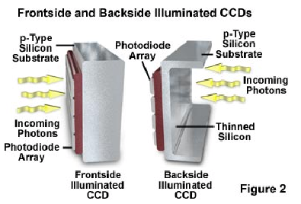
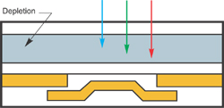
A large variety of CCDs
Formats
Readout architecture
Frontside vs backside illumination
Full frame CCD
Interline transfer CCD
Frame transfer CCD

Slide 5
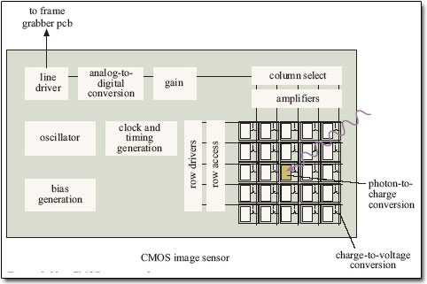
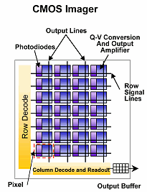
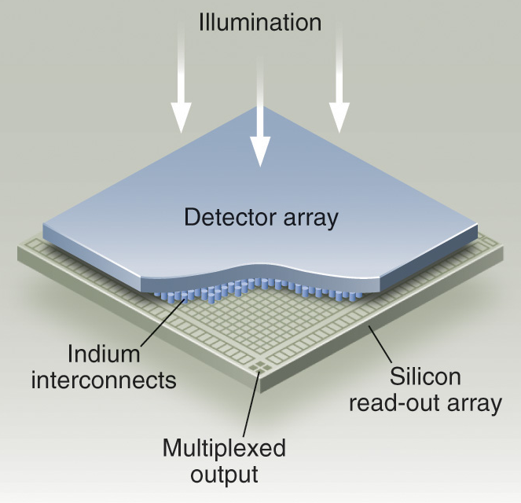
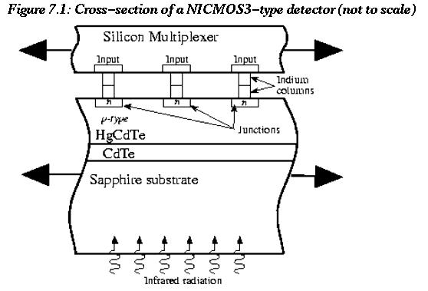
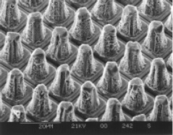
CMOS, infrared detectors
CMOS
CMOS vs. CCDs
Infrared detectors
Lower fill factor (hence QE). Higher readout noise. Higher readout speed. No blooming. Integration of processing functions. Lower electrical consumption. Less expensive
Hybridization of the detector layer to a CMOS readout circuit

Slide 6
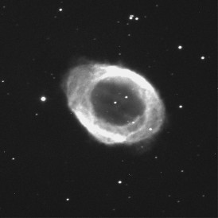

Correction of Raw Image with Bias, Dark, Flat Images
Raw File
Dark + Sky Frame
“Raw” − “Dark”
“Raw” − “Dark”
“Flat” − “Bias”
Flat Field Image
Output
Image
Bias Image
“Flat” − “Bias”

Slide 7
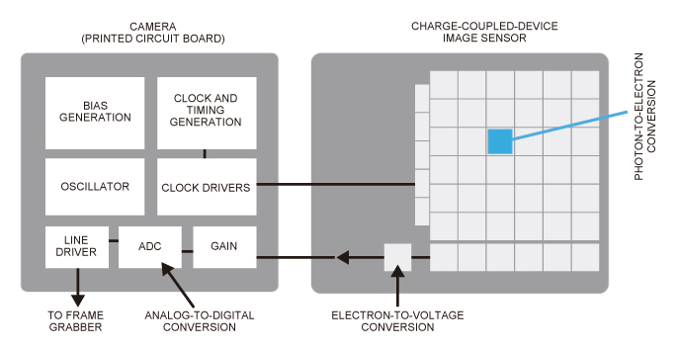
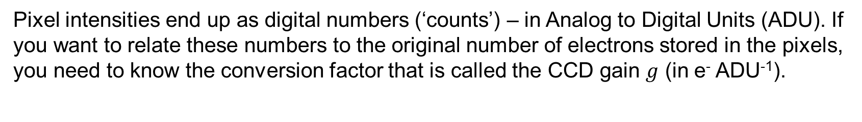
CCD gain
Pixel intensities end up as digital numbers (‘counts’) – in Analog to Digital Units (ADU). If you want to relate these numbers to the original number of electrons stored in the pixels, you need to know the conversion factor that is called the CCD gain $g$ (in e⁻ ADU⁻¹).

Slide 8
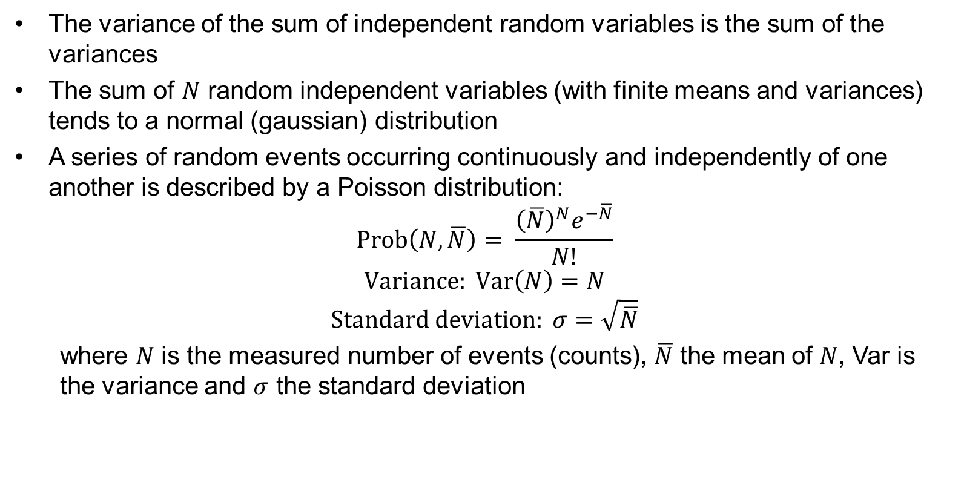
Basics of noise
The variance of the sum of independent random variables is the sum of the variances
The sum of $N$ random independent variables (with finite means and variances) tends to a normal (gaussian) distribution
A series of random events occurring continuously and independently of one another is described by a Poisson distribution:
$$Prob\left(N,\overline{N}\right)= \frac{{\left(\overline{N}\right)}^{N}e^{−\overline{N}}}{N!}$$
$$Variance: Var\left(N\right)=N$$
$$Standard deviation: σ=\sqrt{\overline{N}}$$
  where $N$ is the measured number of events (counts), $\overline{N}$ the mean of $N$, Var is the variance and $σ$ the standard deviation

Slide 9
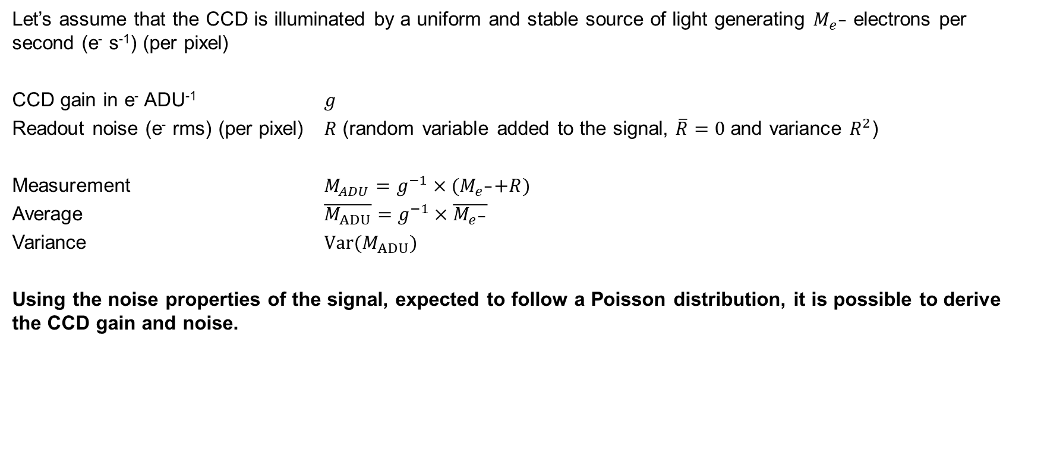
Sources of signal and noise
Let’s assume that the CCD is illuminated by a uniform and stable source of light generating $M_{e^{−}}$ electrons per second (e⁻ s⁻¹) (per pixel)
CCD gain in e⁻ ADU⁻¹ $g$
Readout noise (e⁻ rms) (per pixel) $R$ (random variable added to the signal, $\overline{R}=0$ and variance $R^{2}$)
Measurement $M_{ADU}=g^{−1}×{(M}_{e^{−}}+R)$
Average $\overline{M_{ADU}}=g^{−1}×\overline{M_{e^{−}}}$
Variance ${Var(M}_{ADU})$
Using the noise properties of the signal, expected to follow a Poisson distribution, it is possible to derive the CCD gain and noise.

Slide 10
Lab summary
Get familiarized with a CCD, take images, change parameters (integration time, temperature, etc.)
Do basic image processing (bias and dark frame subtraction, flat-fielding)
Do basic statistical analysis (histograms, average, standard deviation)
Study the statistical properties of the dark current at different temperatures
Study the CCD linearity range
Determine the gain and readout noise of the CCD from the statistical properties of the measured signal

Slide 11

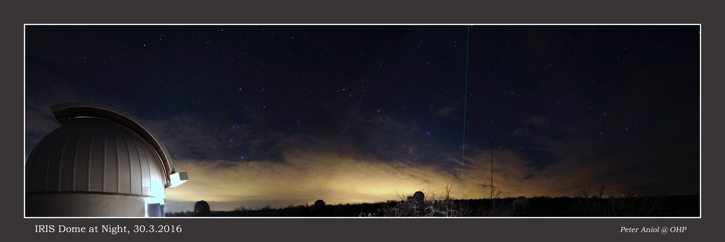
Optional
Astronomical observations with a 50-cm telescope at Observatoire de Haute Provence (IRiS)

Slide 12
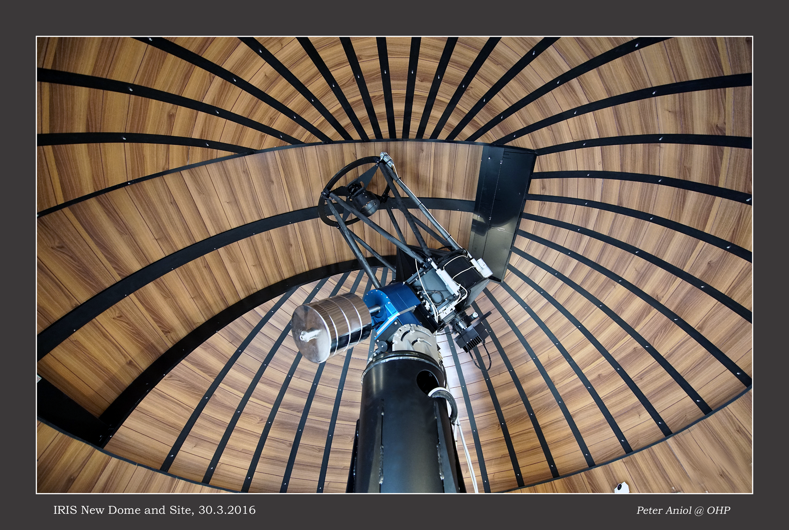
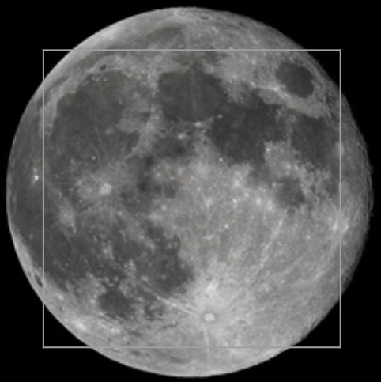
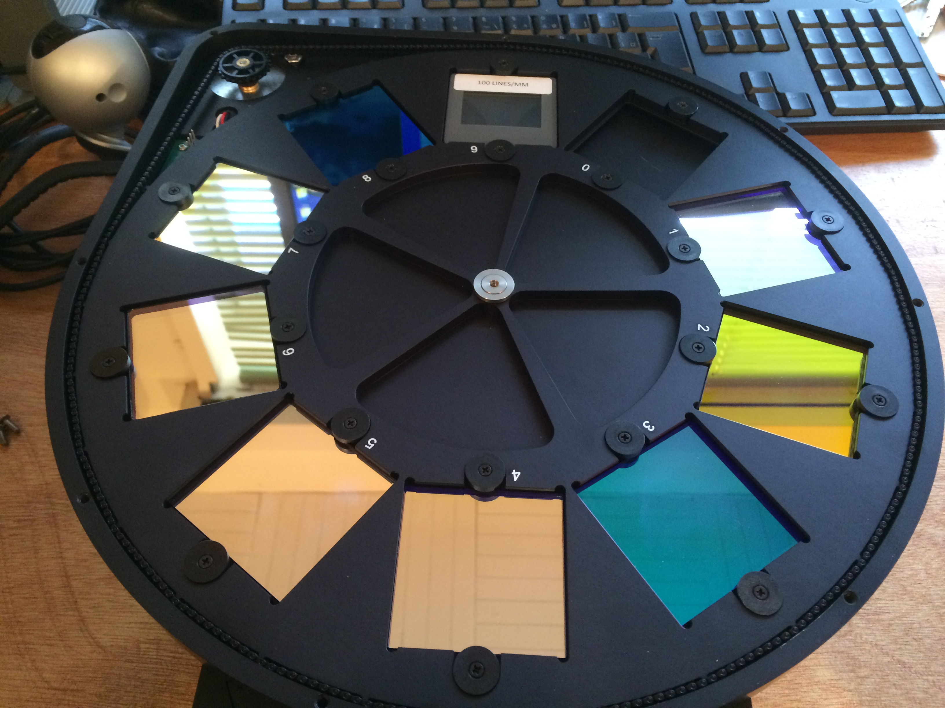
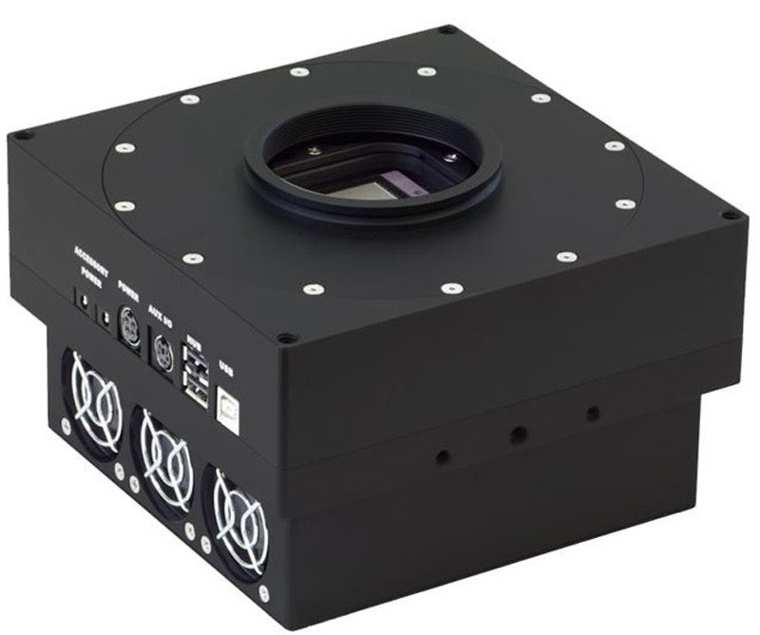
Equipment
Characteristics | Value
Telescope diameter | 50 cm
Beam speed / numerical aperture | f/8
Pixel size (on sky) | 0.7 arcsec pixel⁻¹
Field of view | 24 arcmin
Camera | E2V 42-40
Size | 2048 x 2048 pixels
Minimum integration time | 5 s (for shutter safety)
Filters | g, r, i et z, H-alpha, OII

Slide 13
Astronomical observations
Some remote Night Observation session will be organized depending on weather conditions and practical aspects in UAM
If you are interested, please contact us
Prepare your targets !
More at http://iris.lam.fr/ (mostly in French)
Simulators http://iris.lam.fr/observer-sur-iris/controle-du-telescope

