Slide 1

Digital Positron Emission Tomography
6th Summer School on Intelligent Signal Processing for frontier research and industry
Prof. Dr. Nicola D’Ascenzo
Huazhong University of Science and Technology
August 23rd 2021

Slide 2
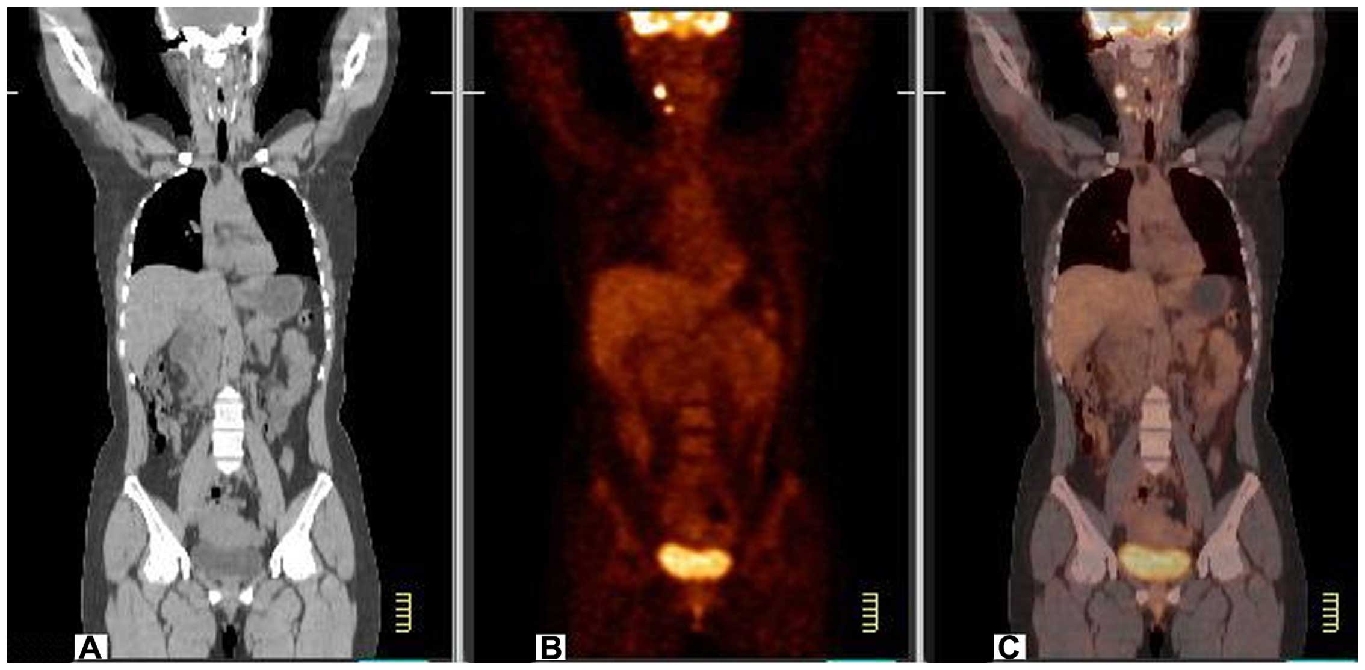
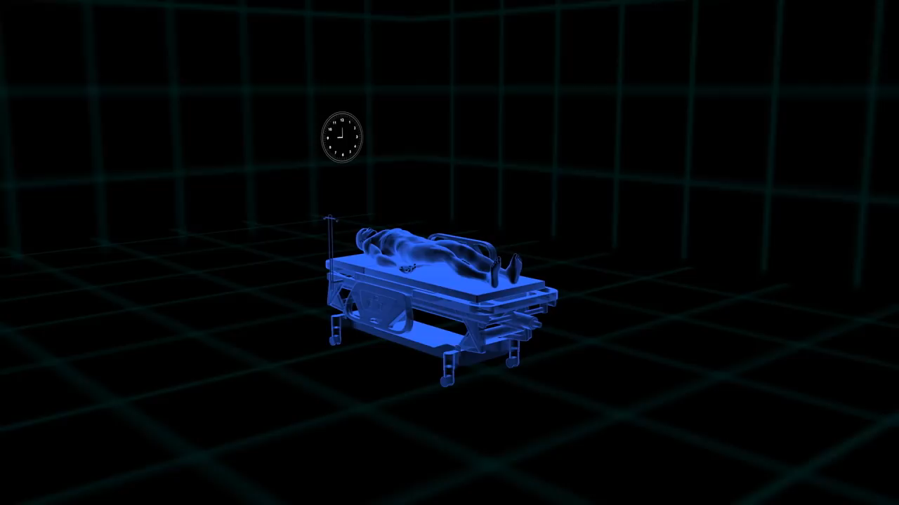
The concept of «functional imaging»
The figure A is from CT. It is showing only the morphological structure of the patient.
The figure B is showing the glucose metabolism of the cells in the patient.

Slide 3
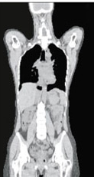
The concept of «functional imaging»
One of these two patients is dead. Can you tell who?

Slide 4
The concept of «functional imaging»
One of these two patients is dead. Can you tell who?

Slide 5
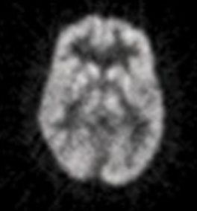

“Functional imaging” is a measurement of the functions
of biological systems
Glucose uptake
Water perfusion

Slide 6
Positron Emission Tomography
The classical concept of PET

Slide 7
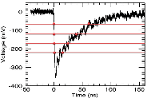
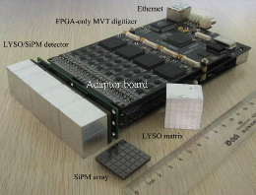
The concept of modern digital PET
Arificial Intelligence algorithms
Imaging
Risk calculation
Sampling
Patient’s information
CT,MRI
Other images
Single crystal readout: hardware corresponding to single pixel
Digitalization of the pulse: analysis and reconstruction performed offline
Artificial intelligence algorithms for the combination with other digital information
Modern digital PET: a risk prediction diagnostic concept

Slide 8
In this lab we will explore the concept of modern digital PET as a risk prediction imaging technology

Slide 9

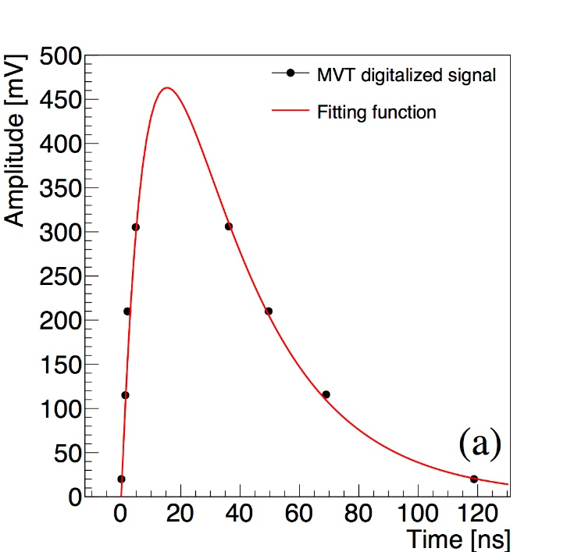

Part 1 – Analysis of the digital signal
$$S\left(t\right)=a\exp\left(−bt\right)\left(1−\exp\left(−ct\right)\right)$$
Evaluation of the energy resolution and spatial resolution of a digital PET system
Analysis of raw experimental data collected with a digital PET system

Slide 10
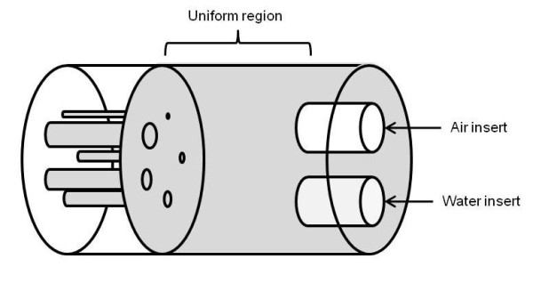
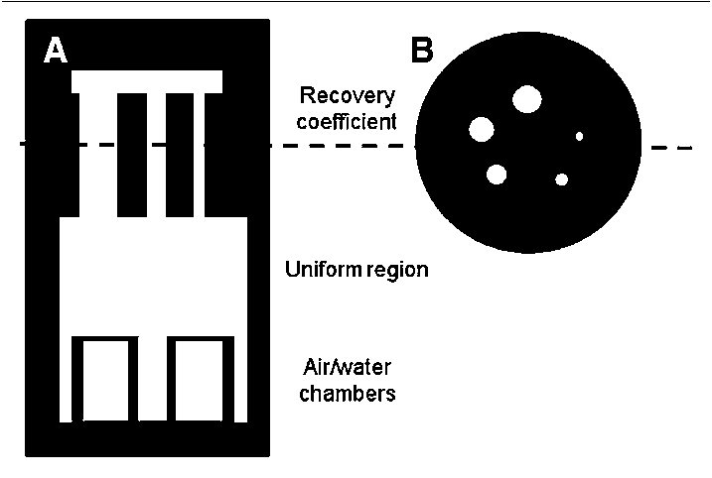
Part 2 – Imaging performances
Evaluation of the image quality of a digital PET system
Analysis of reconstructed experimentl data collected with a digital PET system

Slide 11
After part 1 and 2, students can select an application

Slide 12
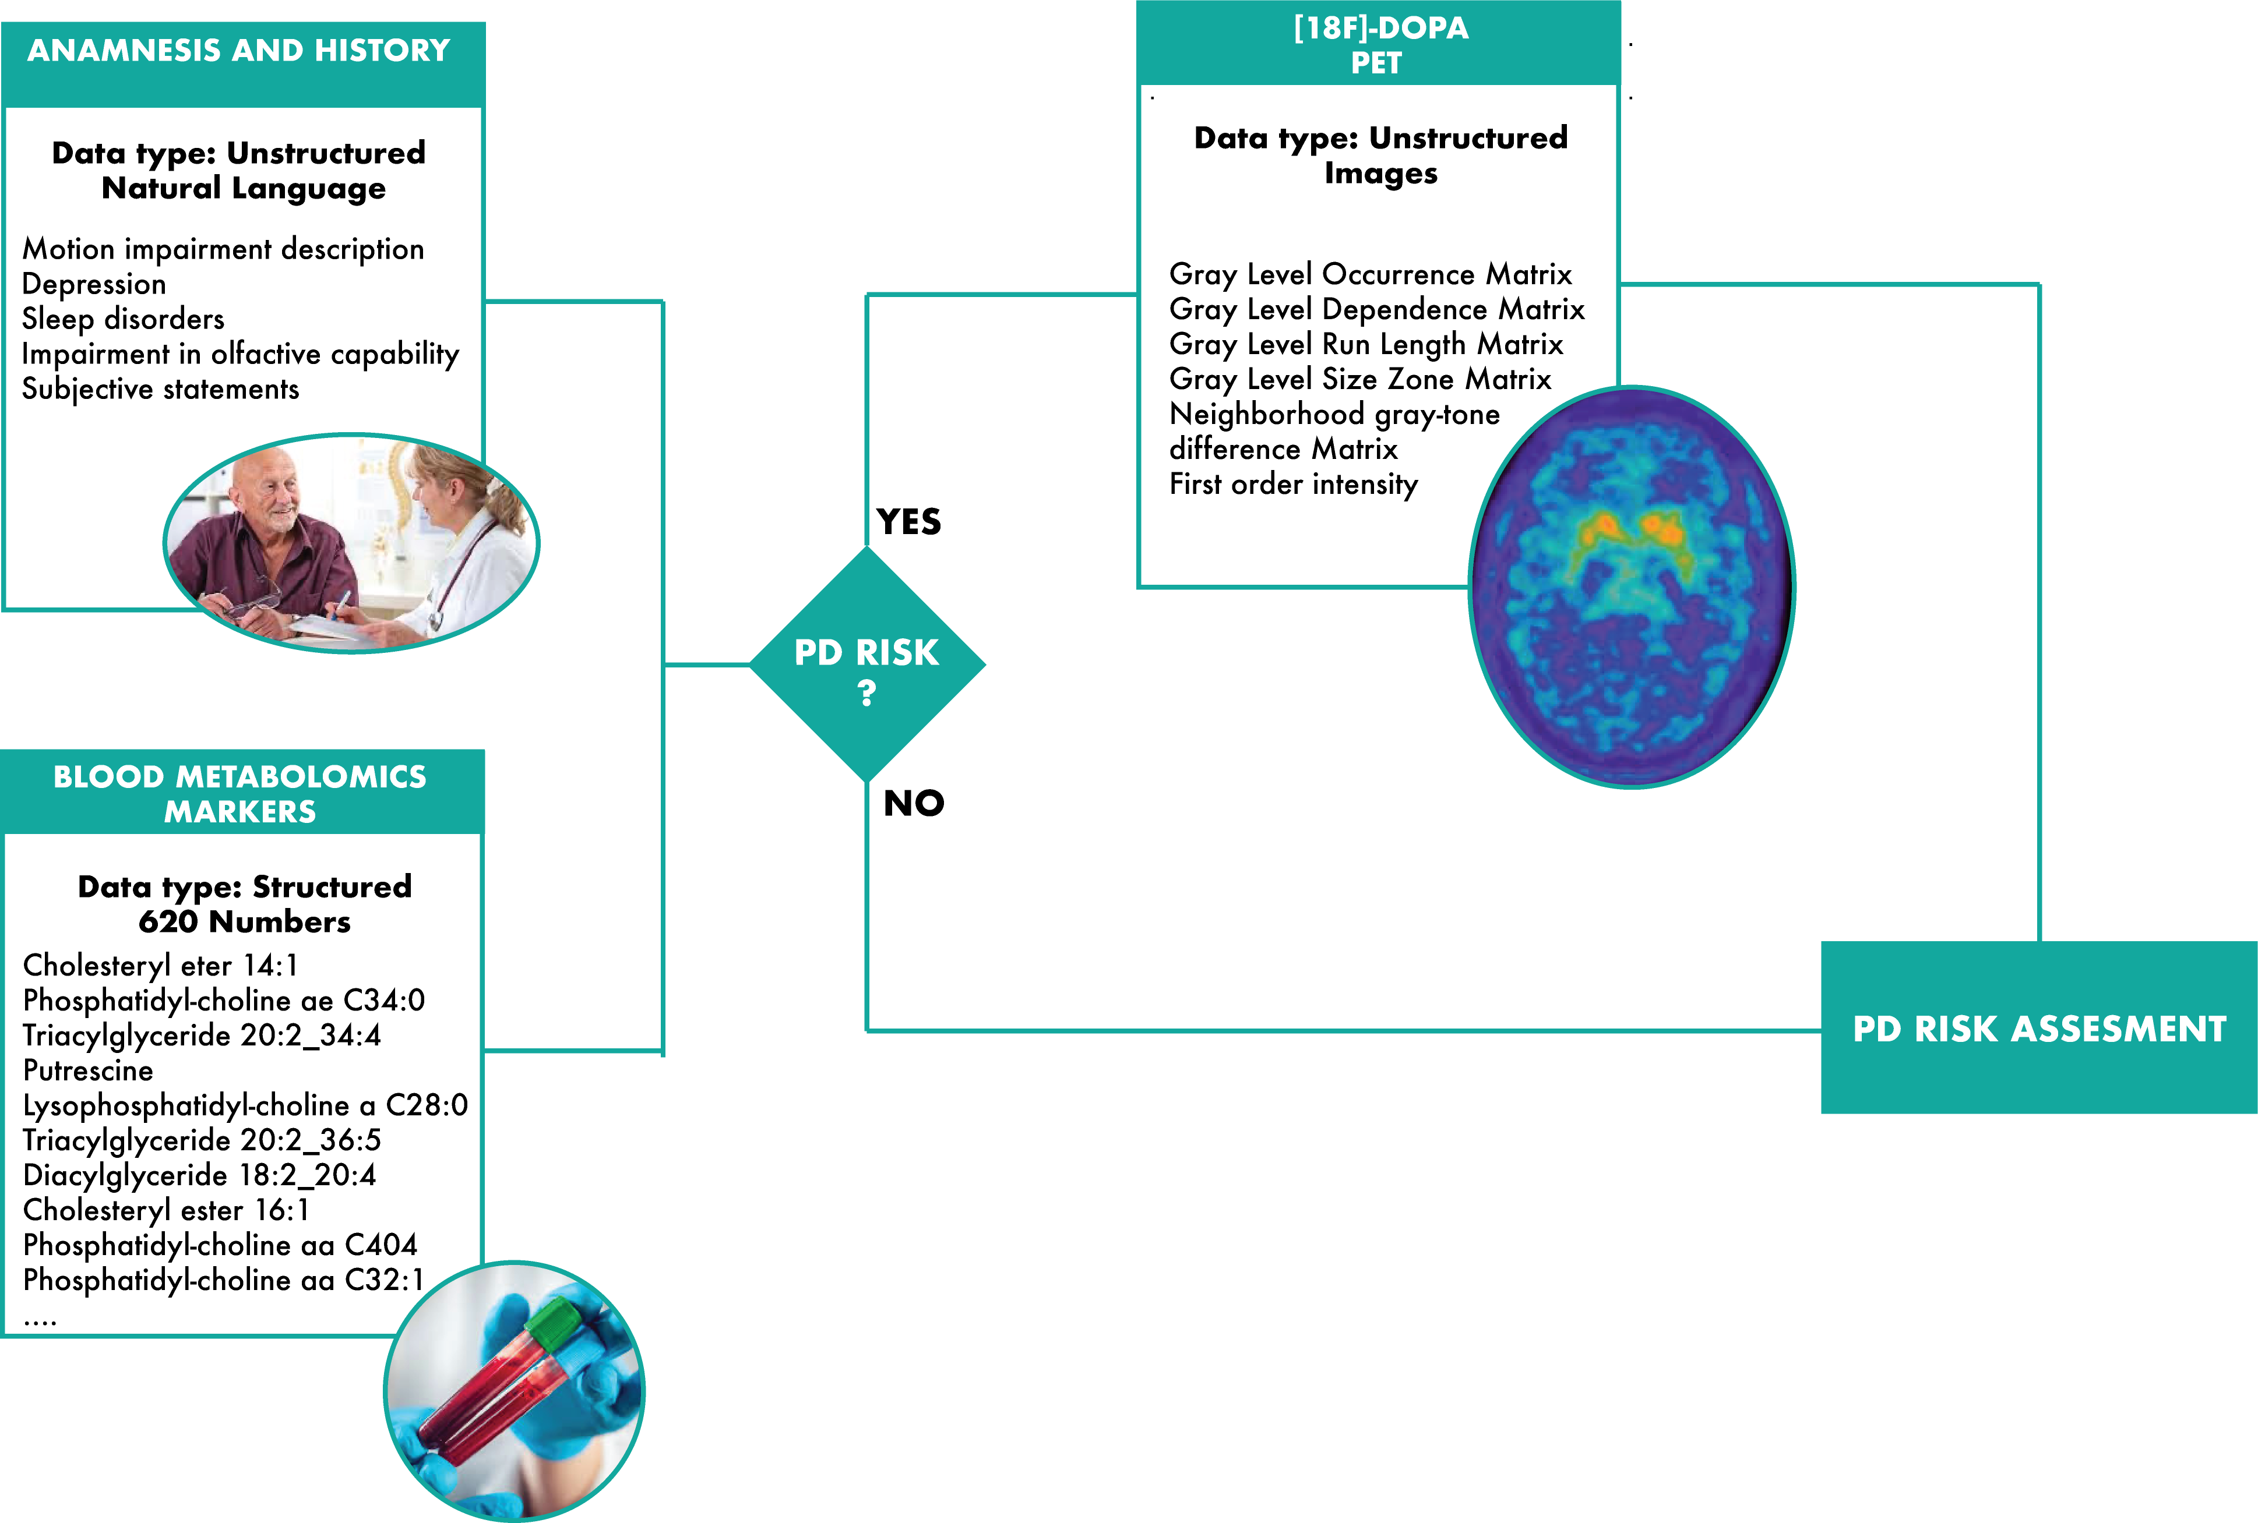

Part 3.1 – Parkinson’s Disease
Analysis of a PD patient PET image and correlation with blood metabolomics

Slide 13
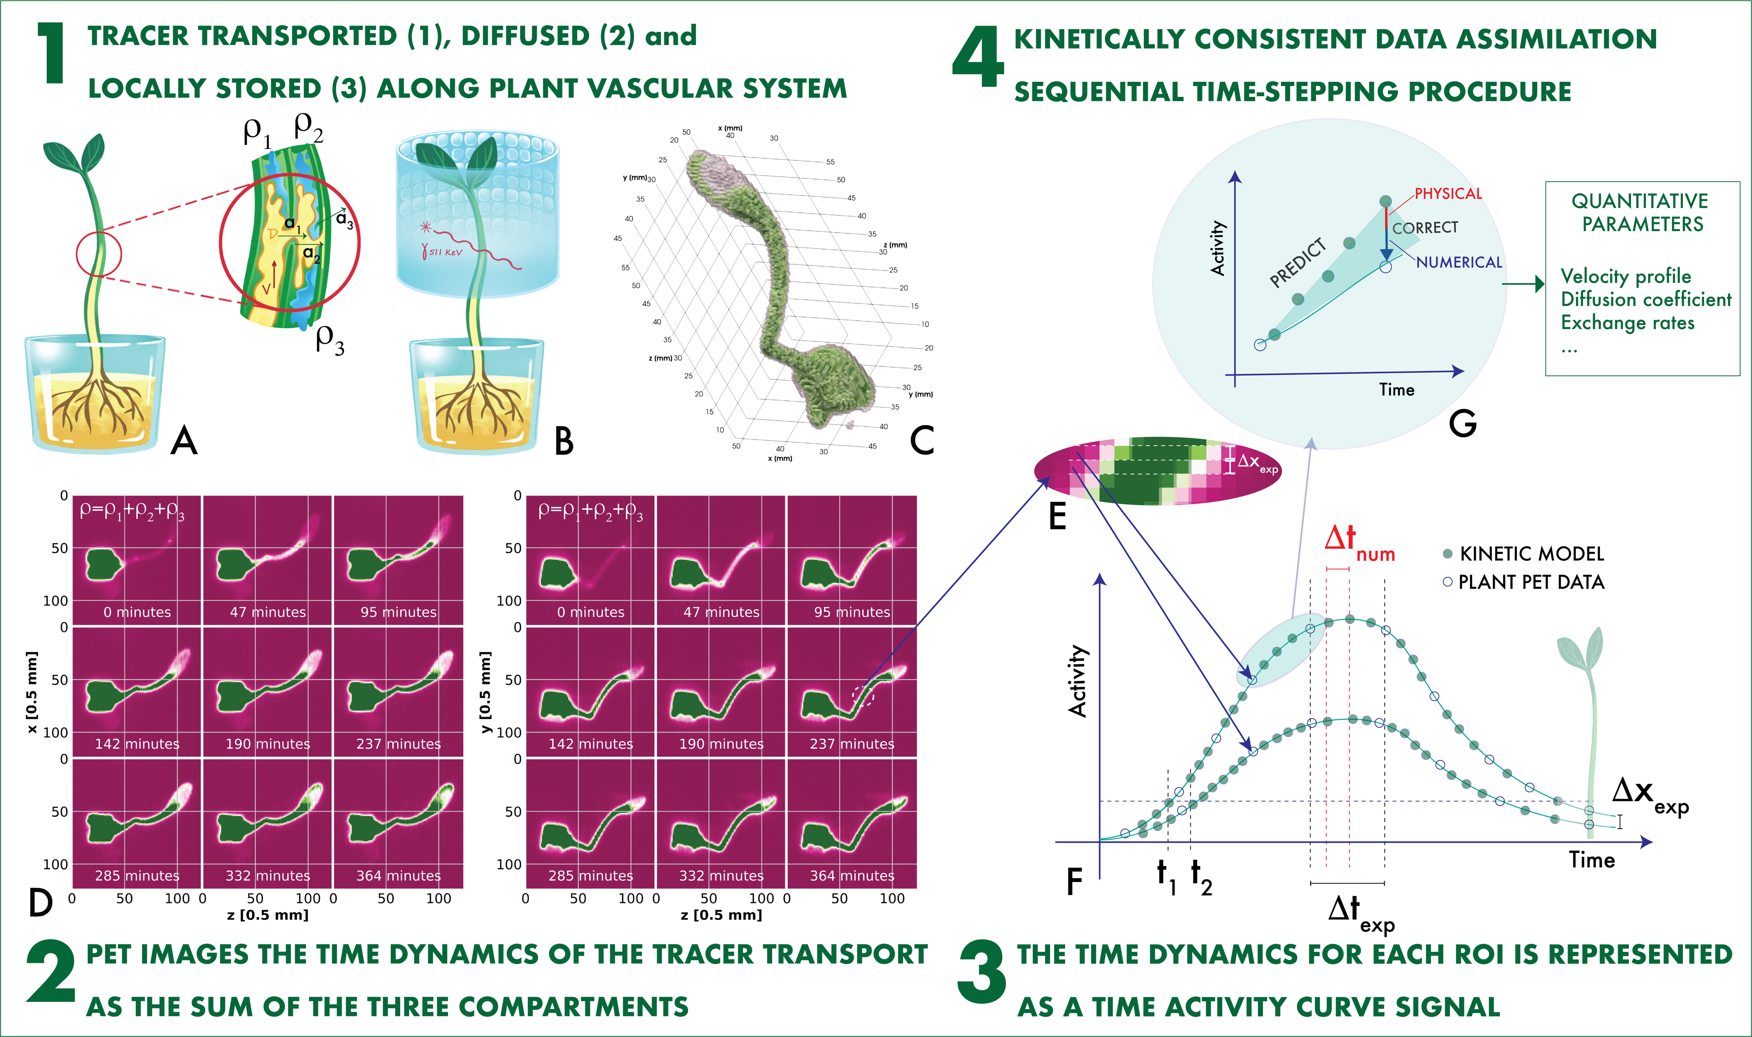

Part 3.2 – Plant stress
Analysis of Plant PET imaging of a stressed plant

Slide 14
The lab will start on Monday August 30th
Bring your laptop!
Online ZOOM

