Slide 1
Welcome to JUAS 2020 Course 2 The technology and applications of particle accelerators Philippe Lebrun Director, JUAS
ESI Archamps Technopole
17 February 2020

Slide 2
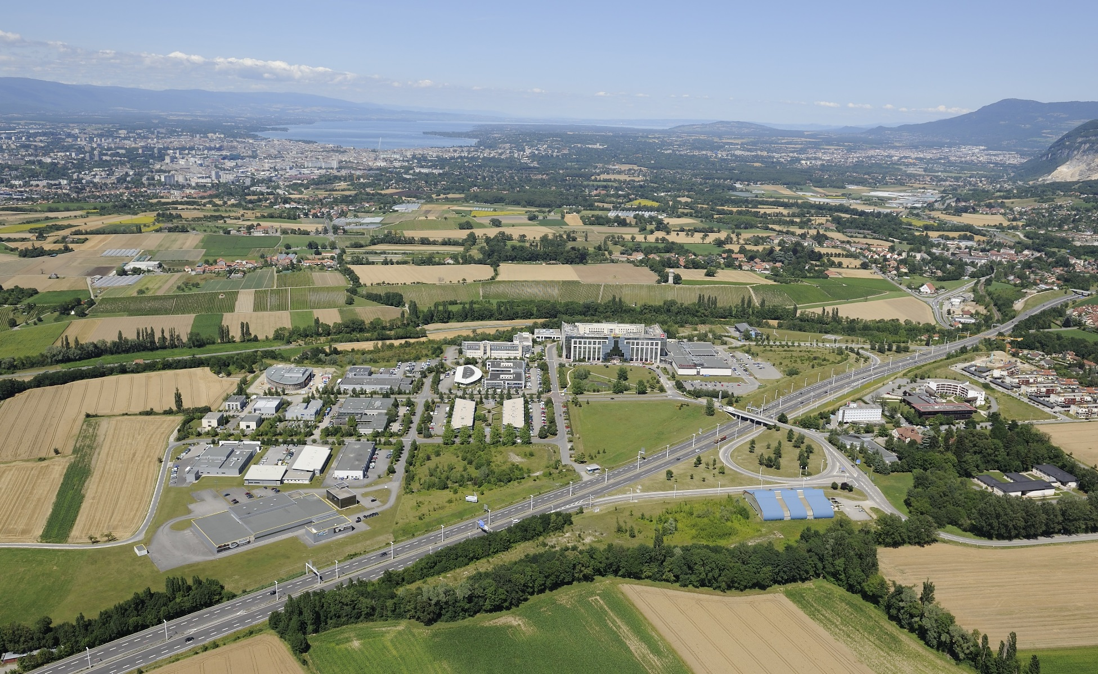
ESI Archamps Technopole, host of JUAS
Geneva
Chamonix
Paris

Slide 3

ESI Scientific Schools

Slide 4
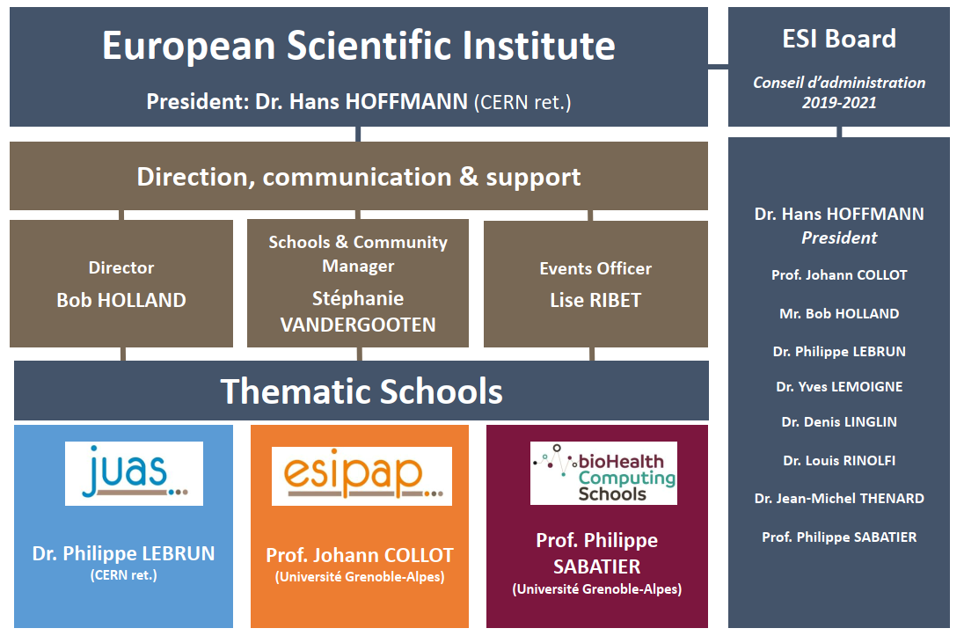
ESI Organization

Slide 5
JUAS mission
Invented a century ago as instruments of basic science, particle accelerators have also become essential tools of applied science, engineering and medicine. There are today more than 40’000 particle accelerators in operation worldwide. Their design, construction and operation have developed into a specific domain of science and technology, resulting in a growing demand for training
The mission of the Joint Universities Accelerator School (JUAS) is primarily to train graduate students from its Partner Universities in the science, technology and applications of particle accelerators
For this purpose, JUAS holds two five-week courses yearly at the European Scientific Institute (ESI) in Archamps, taught by renowned experts from universities and laboratories and accredited by the Partner Universities:
A course on the Science of Particle Accelerators
A course on the Technology and Applications of Particle Accelerators
Depending on the availability of places, JUAS also welcomes graduate students from other universities as well as professionals
Additionally, JUAS contributes to knowledge dissemination and outreach in the field of particle accelerators

Slide 6
















16 Partner Universities offer JUAS as an accredited component of a Master and/or Doctoral programme

Slide 7























JUAS is supported by 23 European research programmes, particle accelerator facilities, hospitals and private companies

Slide 8
A brief history of JUAS
Origins (1994)
Accelerator courses given by CERN staff at Université Joseph Fourier in Grenoble
Creation of ESI by Département de la Haute-Savoie (France)
Previous directors
M. Rey-Campagnolle (founder)
J. Le Duff
F. Méot
L. Rinolfi
More than 1000 students trained
JUAS alumni active in many accelerator laboratories worldwide
We have celebrated the 25th session of JUAS in 2018, and the 25th anniversary of ESI in 2019

Slide 9
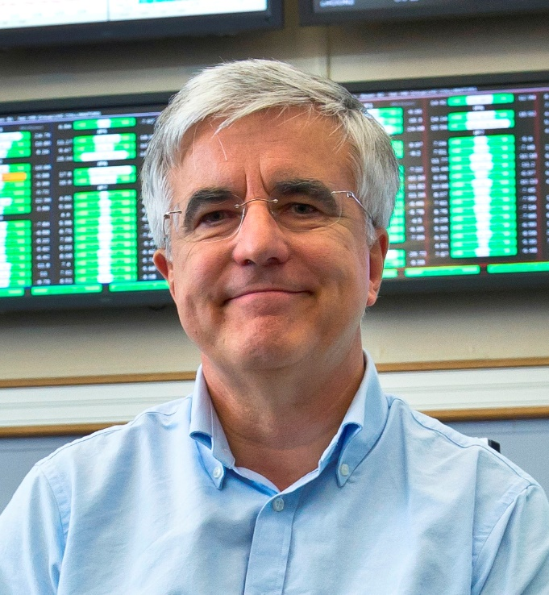
Welcome new Director designate
JUAS 2020 will be my last session as Director of the school
Dr. John Jowett has been appointed new Director designate, he is already with us and will be in charge from JUAS 2021 onwards

Slide 10
JUAS pedagogy
Two courses, each 4 weeks + 1 week exams
The science of particle accelerators
The technology and applications of particle accelerators
Expert lecturers from universities, national labs and CERN
Lectures + tutorials + seminars + workshops + practical work + lab visits
Syllabus and appointment of lecturers submitted to Advisory Board
Lecture slides are available in INDICO prior to the lectures/tutorials
No distribution of paper documents, except lecture write-ups when available
Students are required to have a computer/tablet, get USB stick with memory space to download material
«Refresher» lecture and tutorial documents available to students well before the course for personal work
Written exams
Oral presentations by students on design workshops and practical work

Slide 11
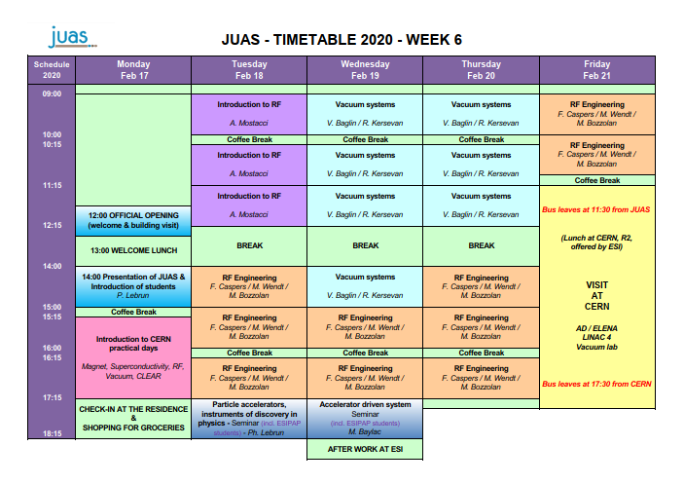

Slide 12
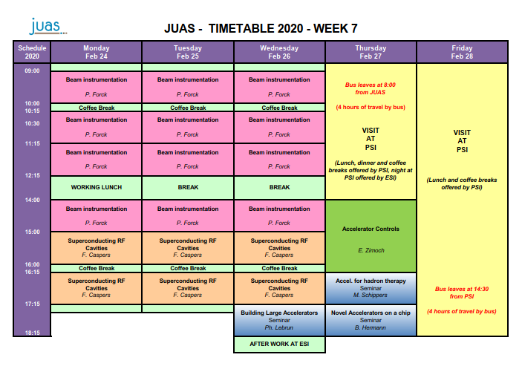

Slide 13
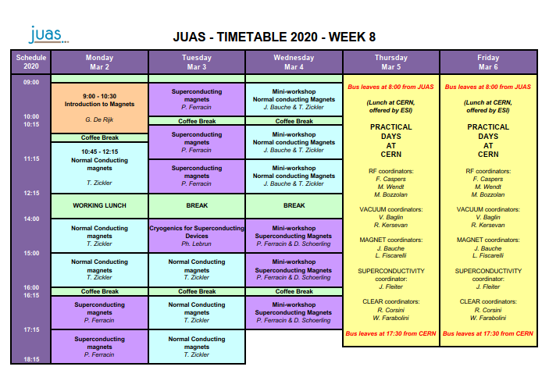

Slide 14
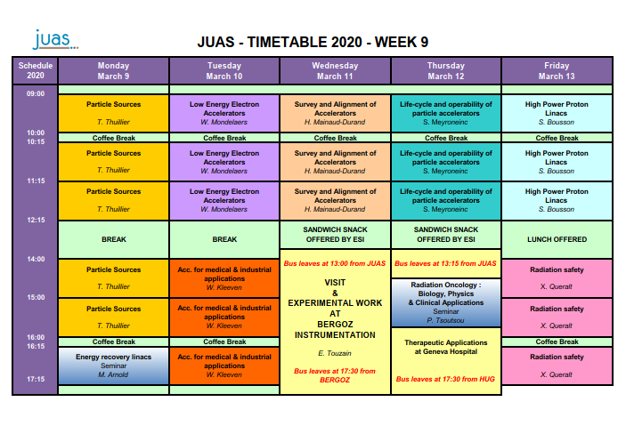

Slide 15
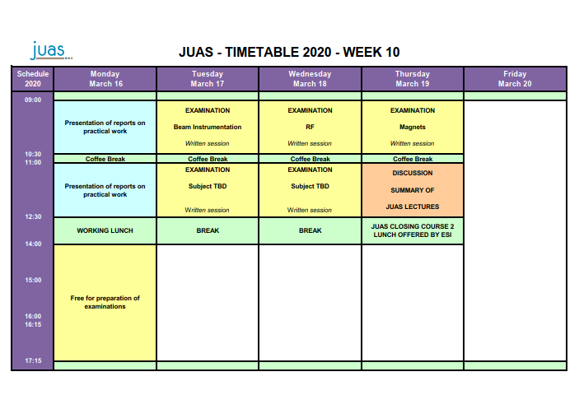

Slide 16
JUAS 2020 Course 2 Examination
Written examination
5 topics, each allocated one and a half hours
RF engineering (coefficient 12)
Magnets, normal conducting (coefficient 12)
Beam instrumentation (coefficient 12)
Remaining two topics (each coefficient 6) announced in week 9 (i.e. one week before examination)
Students have access to paper documents and computer/tablet with USB stick
WIFI and wire connections disabled in exam room
No cell phone or connected electronic device allowed
Written reports
NC magnets design workshop (coefficient 3)
SC magnet design workshop (coefficient 3)
Oral report
Practical days at CERN (coefficient 3)

Slide 17
Practical Days at CERN on 5 & 6 March 2020 Oral presentations on 16 March 2020
Two full days at CERN
One subject per day per student
Students asked to rank their preferences
Five subjects proposed (see presentations later)
RF
Vacuum
Magnets
Superconductivity
Beam measurements on CLEAR linear accelerator
Students, in groups of 4 maximum, prepare oral reports on one of the two subjects they have worked on during the practical days
Oral presentations (max 15 minutes) to be made at ESI on Monday 16 March morning and evaluated by a panel of the group coordinators and ESI/JUAS
⇒ Please indicate your preferences on the form circulated, before 21 February

Slide 18
Attendance Certificates & Grade Sheets Master and Doctoral students
If not taking the exams, they get
Certificate of Attendance with mention «has opted not to take the examinations»
If taking the exams, they get
Certificate of Attendance with
Overall grade of student
Overall class average grade & standard deviation
Grade Sheet with, for each subject
Student grade
Class average grade
Class average grades are based only on results of Master and Doctoral students
All grades out of 20

Slide 19
Attendance Certificates & Grade Sheets Professional students
All students get
Certificate of Attendance, bearing no mention relative to examinations
If taking the exams, they get additionally
Grade Sheet with, for each subject, the student grade
Grades of Professional students are not included in class averages
All grades out of 20

Slide 20
Evaluation of lectures and seminars by students
The students are asked (anonymously) to evaluate the lectures and seminars, on the basis of several criteria:
Fulfilment of personal learning expectations
Quality of slides and written documents
Level of treatment of the subject
Quality of oral presentation
Guidance during lectures and tutorials
The students are also asked for possible improvements to the course
Evaluation is done on-line using Google Forms
Evaluation results are communicated
Individually to the lecturers
Statistically to the JUAS Advisory Board

Slide 21
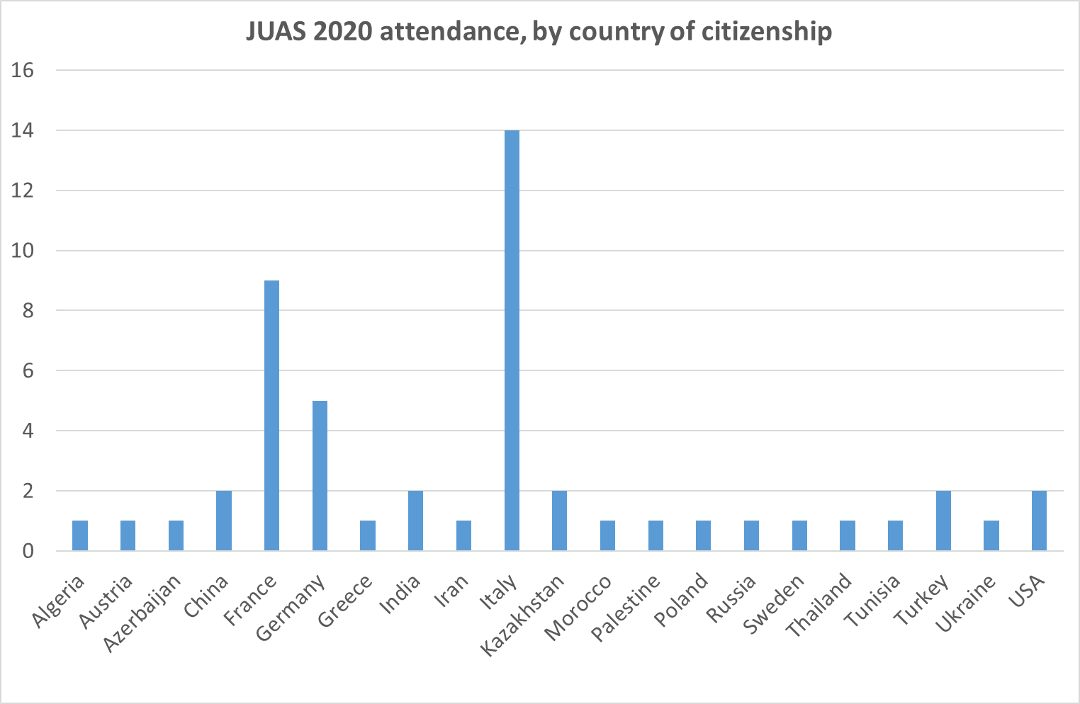
Origin of JUAS 2020 students

Slide 22
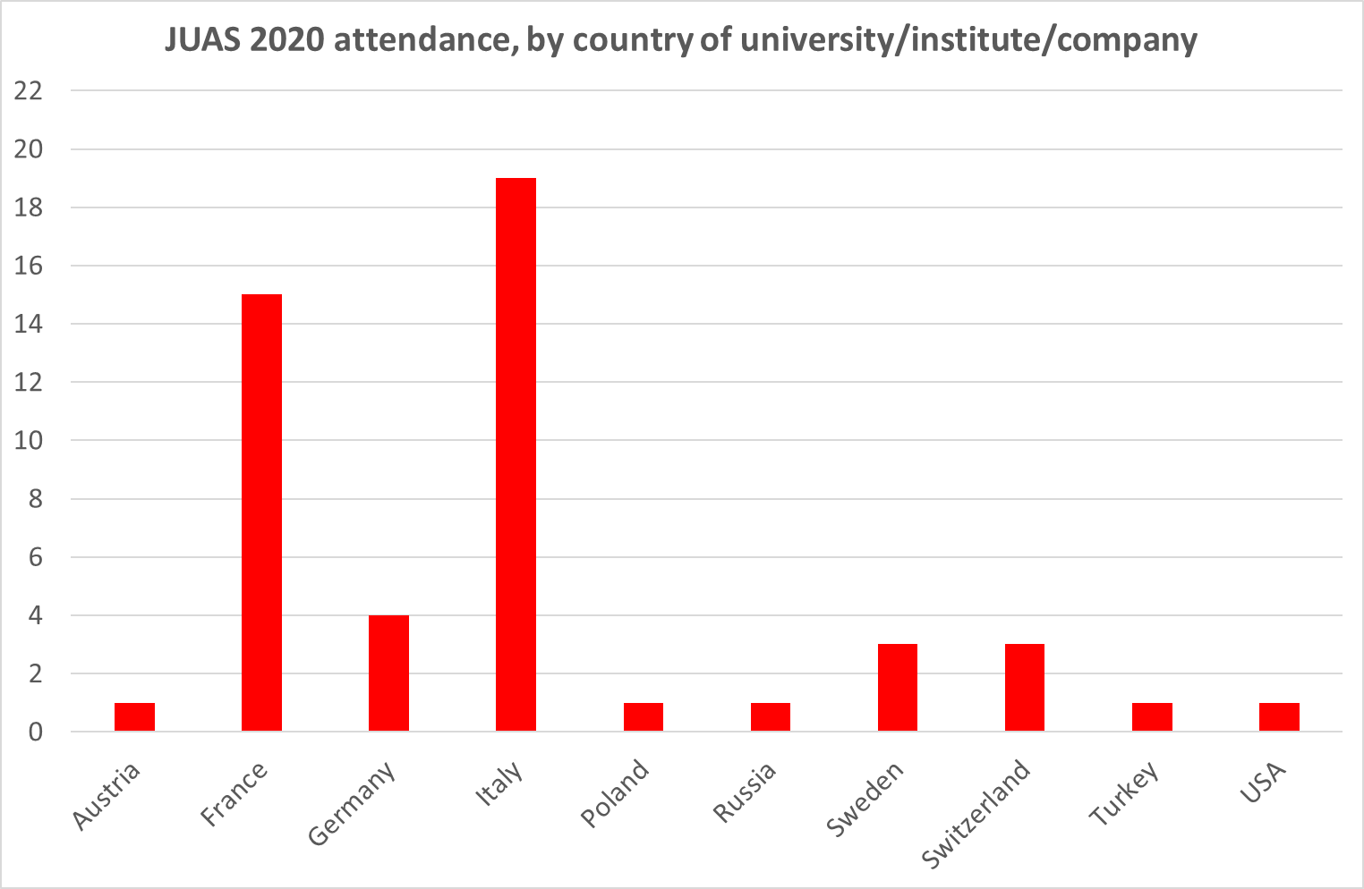
Origin of JUAS 2020 students

Slide 23
JUAS code of conduct [1/2]
Mutual respect
Freedom of opinion and of belief
Cultural diversity
Gender equality
⇒ Constitution of France, Article 1
La France… assure l'égalité devant la loi sans distinction d'origine, de race ou de religion. Elle respecte toutes les croyances
France… shall ensure the equality before the law, without distinction of origin, race or religion. It shall respect all beliefs
No dress code, but
⇒ Loi du 11 octobre 2010 interdisant la dissimulation du visage dans l'espace public
Nul ne peut, dans l'espace public, porter une tenue destinée à dissimuler son visage
Nobody may, in public space, wear a dress hiding his/her face

Slide 24
JUAS code of conduct [2/2]
Behaviour
Arrive on time at the lectures
Individual and collective behaviour, in particular during visits, must not impair the good reputation of JUAS… but rather improve it further!
Examinations
Respect the ban on cell phones and connected electronic devices
Cheating will result in immediate exclusion

Slide 25
Job opportunities
Studying at JUAS is a good opportunity to find a position
Internship in national or international laboratory
Summer job
PhD grant
Post doctoral
…
Do not hesitate to
Talk to the lecturers during coffee and lunch breaks
Talk to the people you will meet during laboratory visits
Consult our updated job opportunity web site
http://www.esi-archamps.eu/Thematic-Schools/JUAS/Job-opportunities

Slide 26
Developing the JUAS network
CV Yearbook
We publish a CV (curriculum vitae) Yearbook
Introducing JUAS,
Containing the curriculum vitae of each JUAS 2020 student (with his/her agreement)
Distributed to our partner universities and industrial sponsors
Alumni network
Build up the JUAS Alumni network using social media
More information will be communicated to you on these matters during the Course

Slide 27
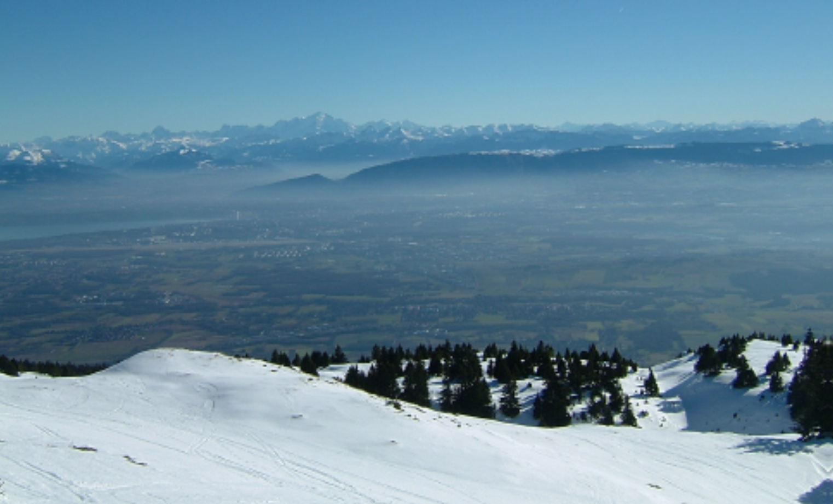
Have a pleasant and fruitful time at JUAS!

