Slide 1
Superconductivity
Practical Days at CERN
4-5th March 2020
Jerome Fleiter, Iole Falorio CERN TE/MSC/SCD

Slide 2
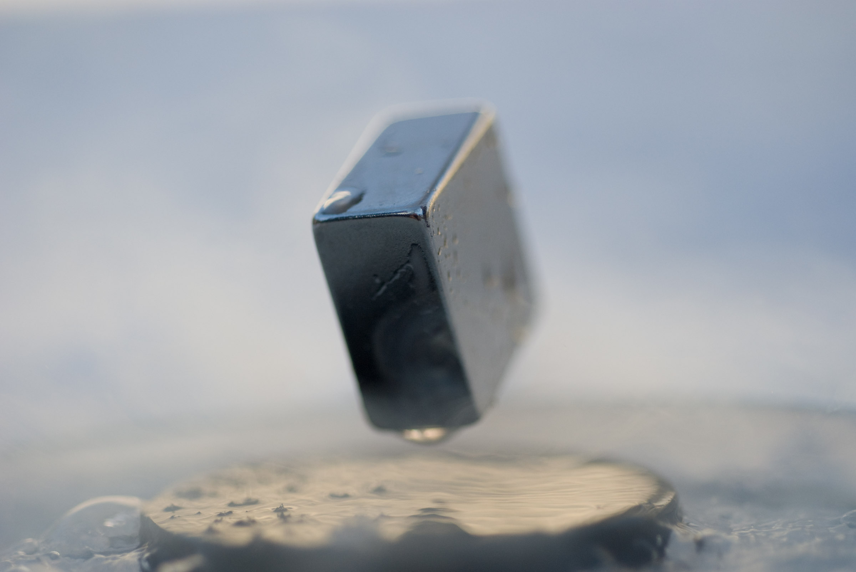
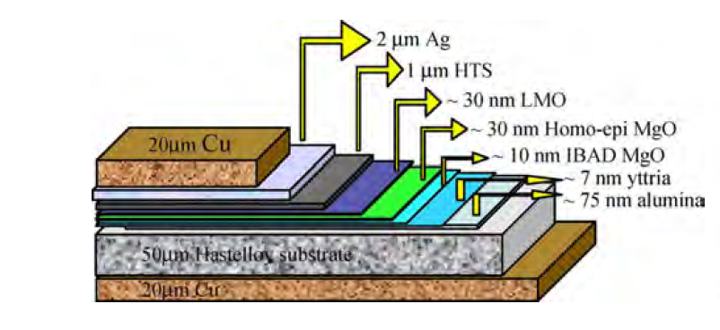
Few Definitions to start
Superconductivity
“Superconductivity is a phenomenon occurring in certain materials at very low temperatures , characterized by exactly zero electrical resistance and the exclusion of the interior magnetic field (the Meissner effect). from Wikipedia
Superconductor
A conductor that exhibit superconducting properties. It is an assembly of low resistive metal and superconducting material.
Cryogenics
Cryogenic: for Greek “kryos", which means cold or freezing, and "genes" meaning born or produced.“In physics, cryogenics is the study of the production and the behaviour of materials at very low temperature (<-150-180°C ) ”
from Wikipedia

Slide 3
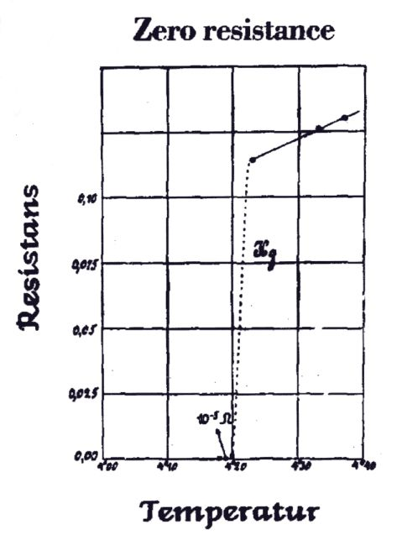
Main properties of superconductors
For T<T_{c}
Zero resistance Perfect conductors
Exclusion of magnetic field Perfect diamagnets
Zero resistance
Meissner effect
Onne’s measurement on mercury (1911)
Discovered by Meissner and Oschenfeld (1933)
Perfect conductivity + perfect diamagnetism = superconductors

Slide 4
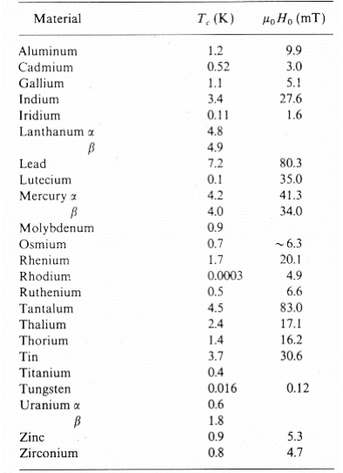
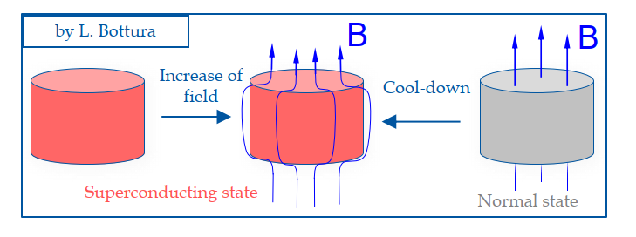
Type 1 Superconductors
1933:Meissner effect discovered: magnetic field is expelled from Type 1 superconductors for T<T_{c} and B<B_{c1}.
B_{c1} is the critical field.
For B>B_{c1} material is in normal state
For T>T_{c} material is in normal state
Superconductors = zero resistance+ perfect diamagnetism
for T<Tc and B<Bc

Slide 5
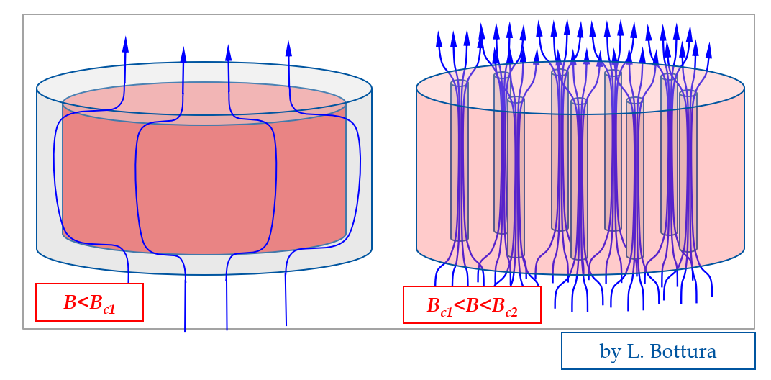
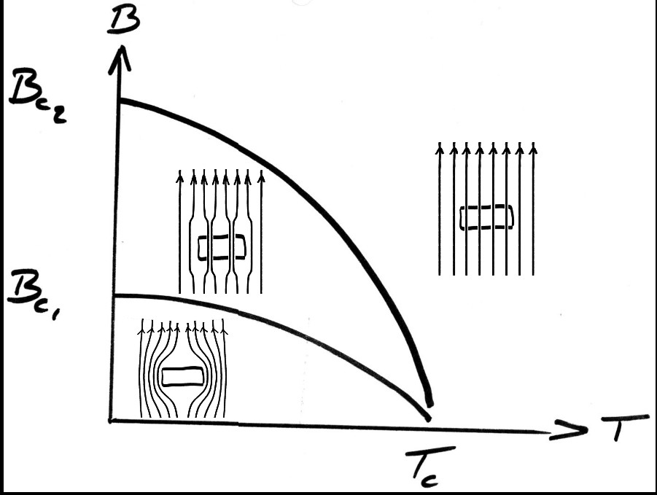
Type 2 Superconductors
1952: Abrikosov Vortices: In the mixed state, B_{c1}<B<B_{c2} magnetic flux penetrates the superconductor as a small independent vortices. In the vortex core the material is in normal state.
  For B<B_{c1} => perfect diamagnet, no vortices
  For B_{c1}<B<B_{c2} , mixed state magnetic flux penetrates locally the material as vortex with a flux quanta Φ₀ = h/2e = 2 .10⁻¹⁵ Wb.
  For B>B_{c2} material is fully penetrated, no more superconducting

Slide 6
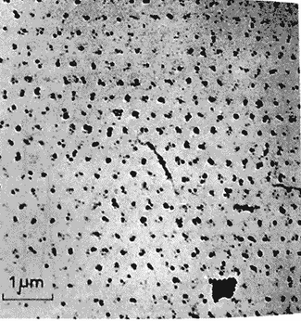
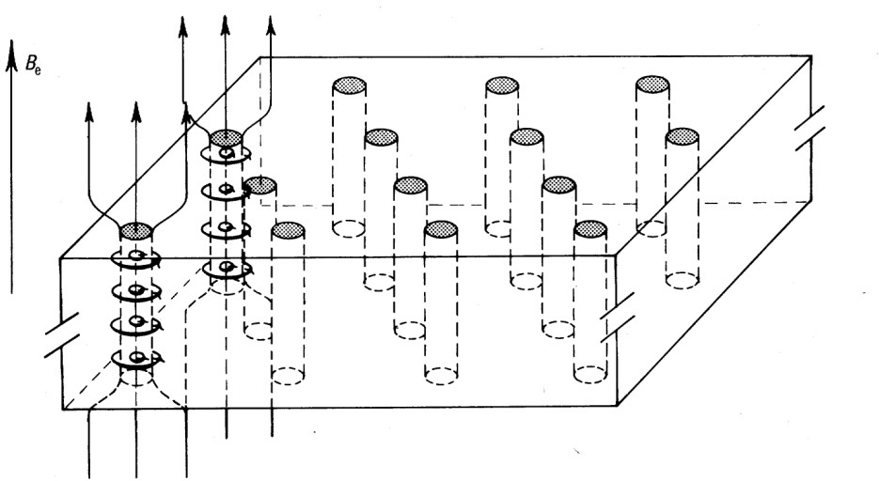
Flux pinning
In the mixed state the transport current (use to generate the field in a electromagnet) interact with each of the vortices: F= J x B
The motion of the vortex cause energy dissipation that may induce a lost of Sc state
To transport current, the vortex must be pinned to the microstructure of the material.
Some defects, dislocation, impurities act as pinning centers, exerting a pinning force (f_{p})on the vortex.
The maximum current (Jc) than can be transported without losses by a superconductor is defined as Jc =f_{p}/B
Example of Type II Sc materials

Slide 7
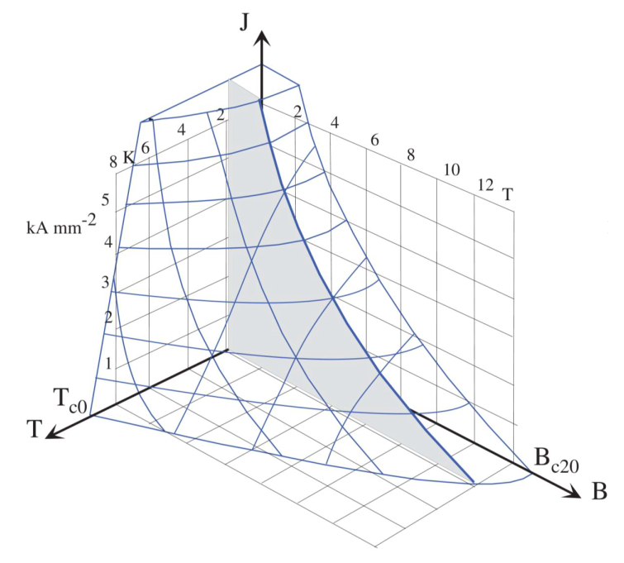
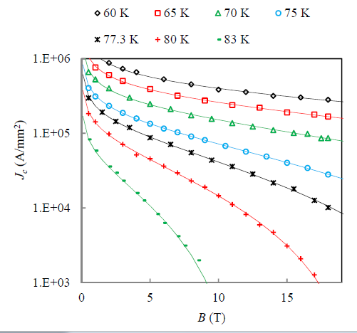
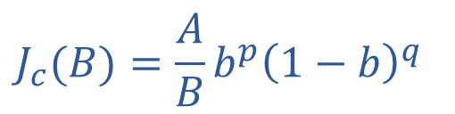
Critical surface of Superconductors
A Type II material is superconductor below the critical surface defined by:
Critical temperature (T_{c}) intrinsic of material
Critical field (B_{c}) intrinsic of material
Critical current density (J_{c}) extrinsic (pinning centers induced during fabrication)
For a given temperature (T₀)
$$J_{c}(B)=\frac{A}{B}b^{p}{\left(1−b\right)}^{q}$$
b=B/B_{c2}(T₀)

Slide 8
Critical surface of LTS vs HTS
Cuprates
7×10⁶ (A/cm²)
Bc=15T
Bc=100T
Tc=10K
Tc=110K
LNeon (27 K)
LHydrogen (20.3 K)

Slide 9
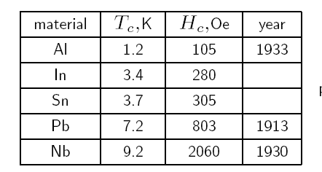
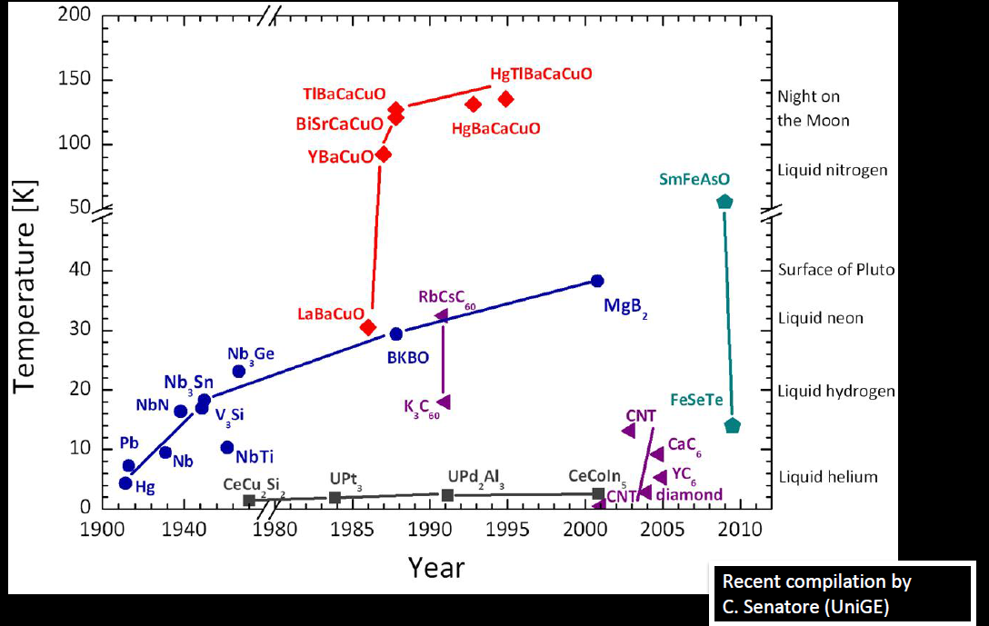
Various Superconducting materials
Low Temperature Superconductors (LTS)T_{c}<39K
High Temperature Superconductors (HTS) T_{c}>39K
Pure metals
Cuprates
Alloys and Intermetallic compounds
LNeon (27 K)
LHydrogen (20.3 K)

Slide 10
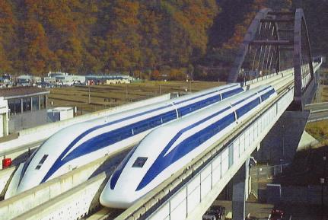
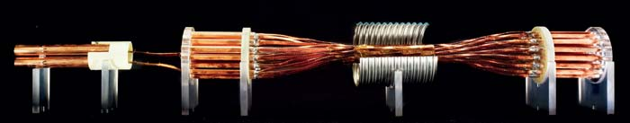
Superconductivity applications
Generate high DC field: (MRI, NMR, particle Physics)
Current limiters
Electronics, detectors (SQUIDS)
Power transmission
Magnetic levitation (Maglev)
Current leads
RF cavities

Slide 11
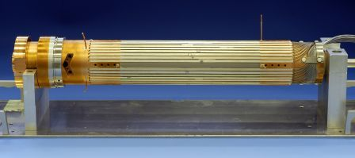
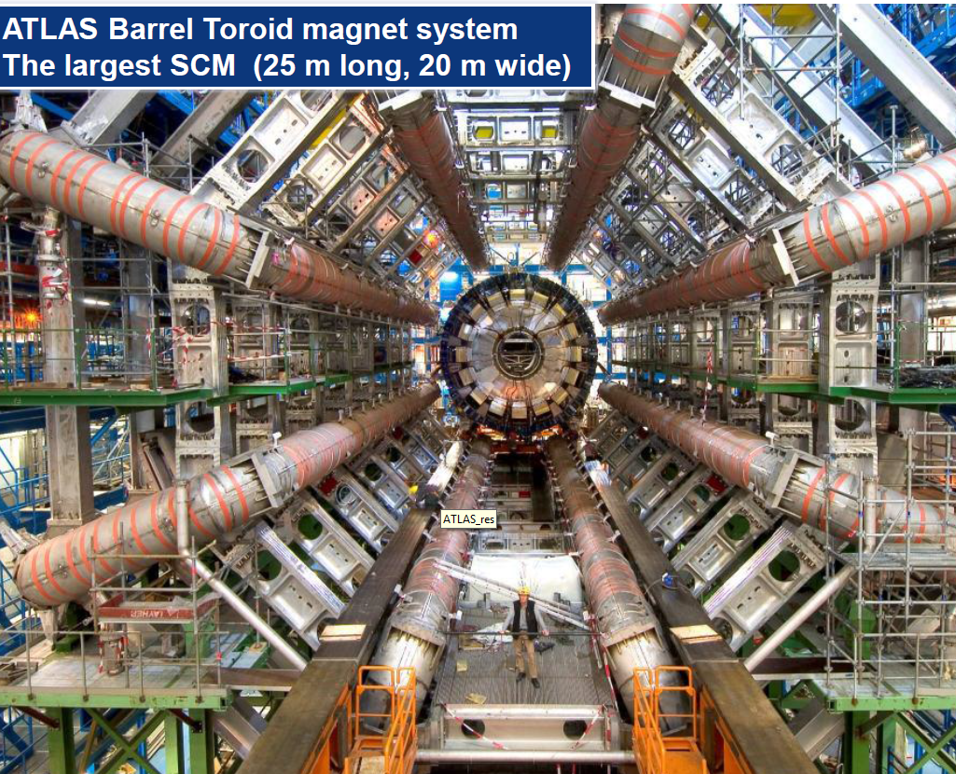
Superconducting devices @CERN
Superconductivity = a core technology of LHC
LHC ring magnets (Nb-Ti):
  1232 main dipoles: 8.3 T x 15 m
  392 Lattice quadrupoles 223 T/m (7 T) x 4m
  Zoo of 7600 others
LHC detector magnets (Nb-Ti ):
  ATLAS: Toroid 4 T, 25 x20 m
  CMS solenoid: 4 T, 12 x15 m
LHC current leads (HTS BSCCO)
  ~1000, rated for I ϵ[0.6,13 kA]
RF cavities (N_{b} coating)

Slide 12
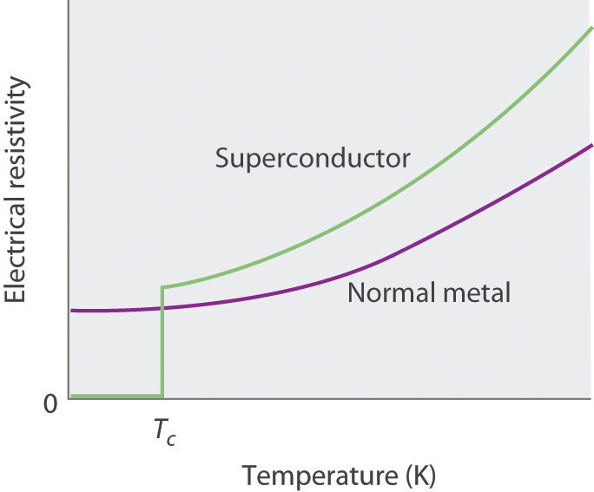
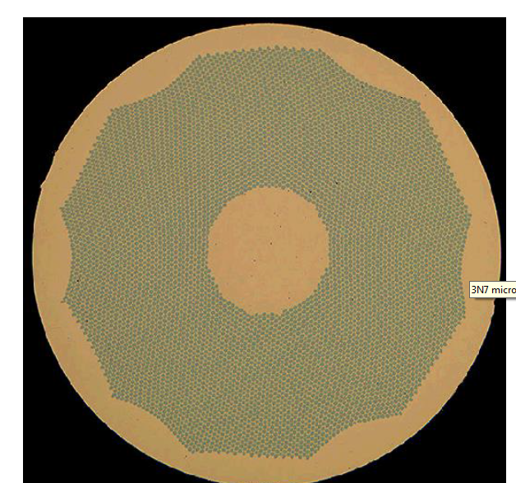
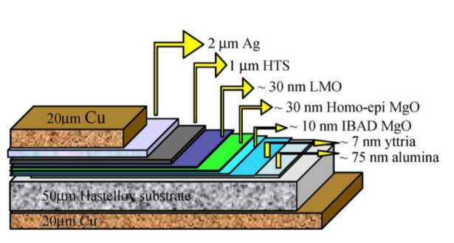
Superconductor for accelerator magnets
Superconductor = numerous small superconducting filaments embedded in a low resistance matrix
Small filaments to reduce the hysteresis losses
Low resistance matrix to carry the large current for the few millisecond after a quench (see next slide)

Slide 13
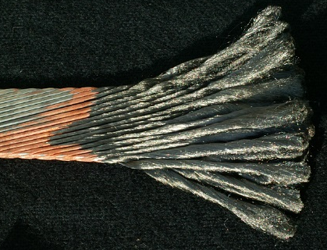
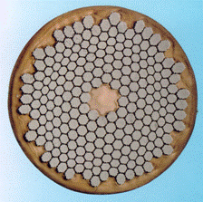
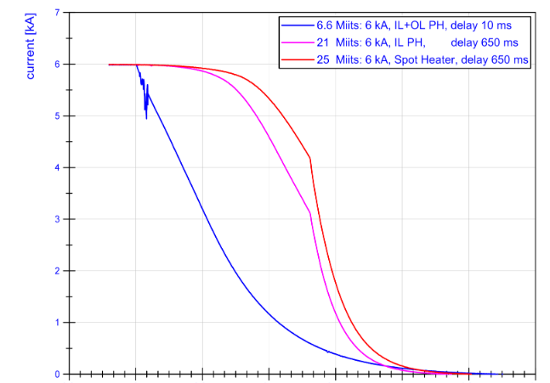
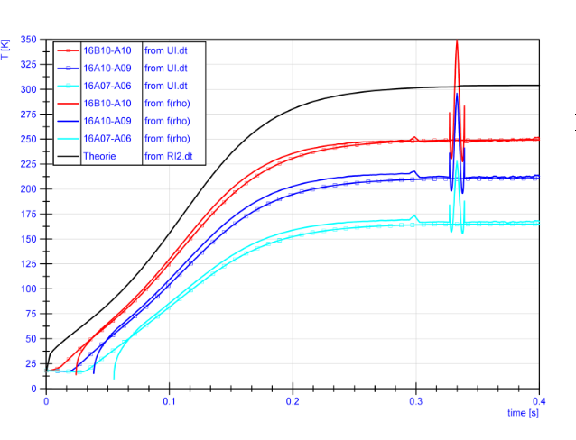
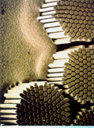
Accelerator magnets use large current cable
Large stored magnetic energy
Use of large current cable to reduce inductance (10-20 kA)
Wires are assembled in Rutherford cables (18-50 strands)
This allows for:
  short piece length of conductor
  Low inductance magnet
  Made the winding stage shorter
  Allow for reliability (current sharing)
  Reduce the dumping time (for a given voltage (kV)
H. Bajas
H. Bajas

Slide 14
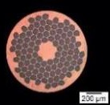
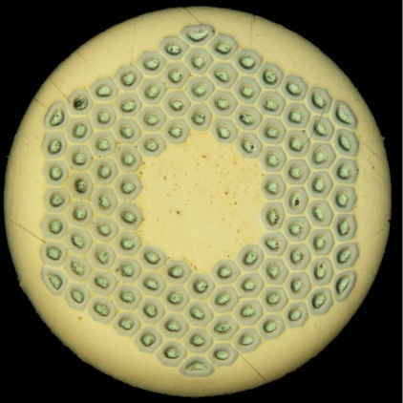
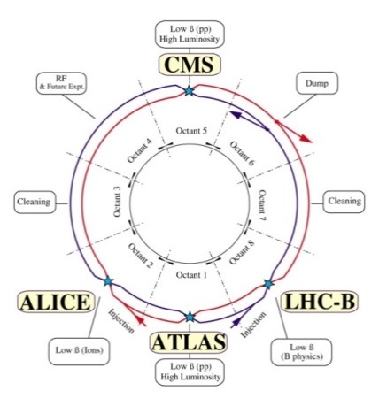
Superconducting strands (for magnets)
Relevant parameters for accelerator magnets (Nb-Ti, Nb₃Sn..)
  Large overall current density ~400–500 A/mm²
  Cu fraction of about 50% with RRR >100
  Small filaments to reduce magnetization and flux jumps
  Twist of the filaments
  Sufficient mechanical properties (axial and transverse)
  Long piece length (~1 km)
  Good uniformity of electrical performances
  …
Practical superconductors
Nb-Ti B_{0max}= 9 T
Nb₃Sn B_{0max}=16 T
REBCO B_{0max}> 30T
BSCCO B_{0max}> 30T
Beam energy: E [TeV]~0.3 B[Tesla] R[km]

Slide 15
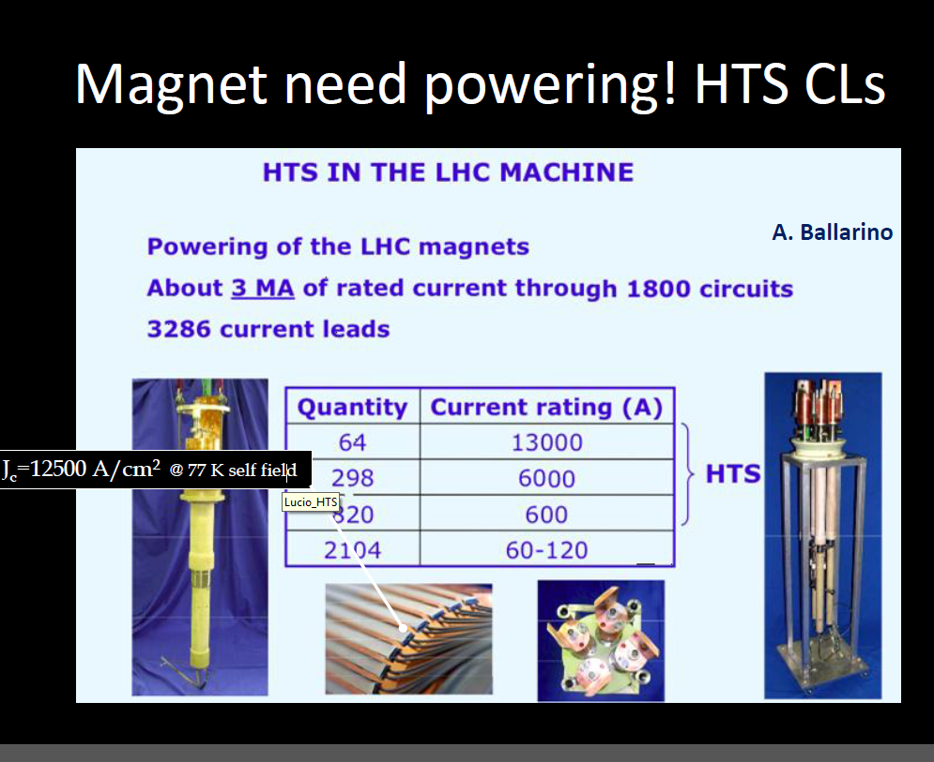
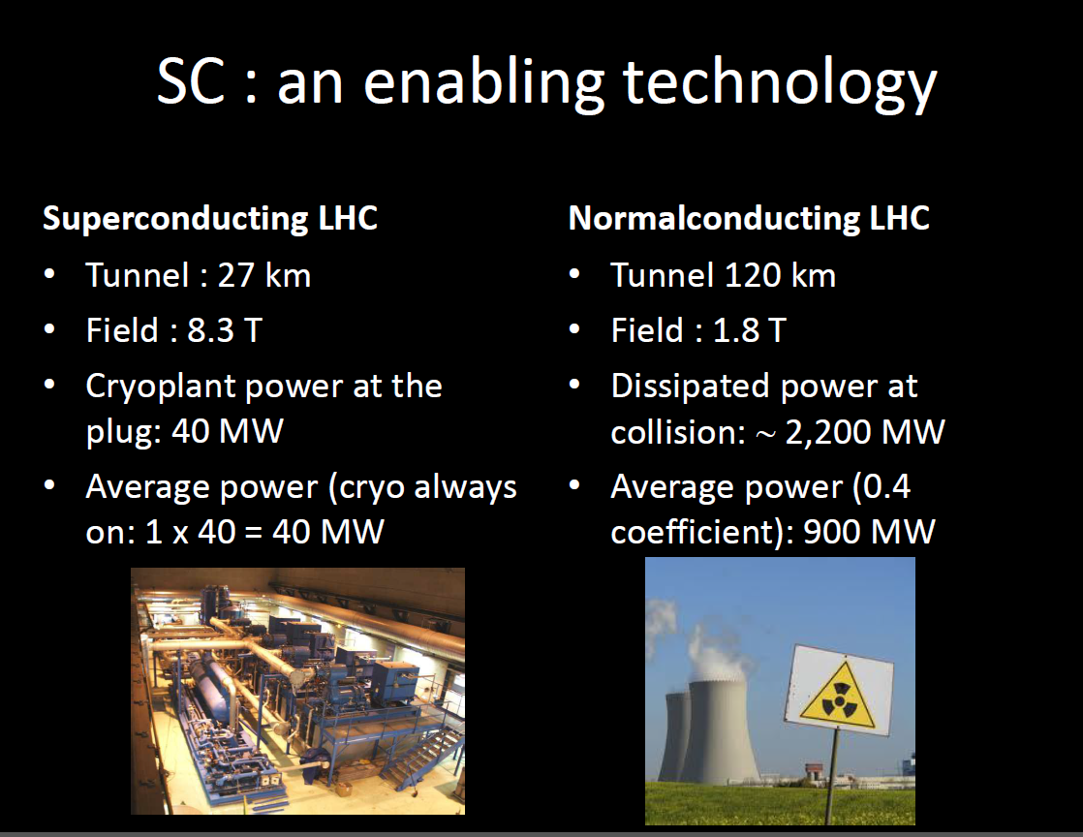

Slide 16
Cryogens for superconductor
 | Triple point (K) | Boiling point (1 atm, K) | Critical Point (K)
Methane | 90.7 | 111.6 | 190.5
Oxygen | 54.4 | 90.2 | 154.6
Argon | 83.8 | 87.3 | 150.9
Nitrogen | 63.1 | 77.3 | 126.2 | HTS low fied
Neon | 24.6 | 27.1 | 44.4
Hydrogen | 13.8 | 20.4 | 33.2
Helium | λ-point | 4.2 | 5.2 | HTS high field and LTS
Saturated
Vapor/liquid
  Today we will use HTS material with nitrogen. In accelerator LTS are operated in Helium bath. This will be most likely the case for HTS (larger Bc2)

Slide 17


Properties of Liquid Nitrogen (1/2)
Nitrogen=78% of atmosphere
Colorless, odorless, non-toxic. The liquid is similar in appearance to water.
Boiling point (1 atm): 77 K (-196 °C). It is colder than liquid oxygen (boiling point = -183 °C): oxygen in the air condenses out.
Critical temperature: 126 K (-147 °C).
Latent heat of vaporization: 197 J/g. 1 W boils off 22.5 cc/hour.
Volume of expansion liquid to gas (15 °C, 1 atm): 682. Closed containers very likely burst.
1 liter LN₂
3 ×
Gaz N₂
Standard liquid nitrogen dewars:150-200 liters….136m³ of gas

Slide 18
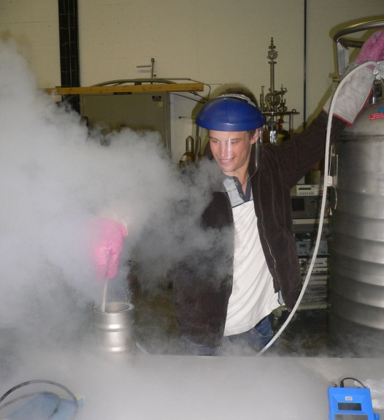
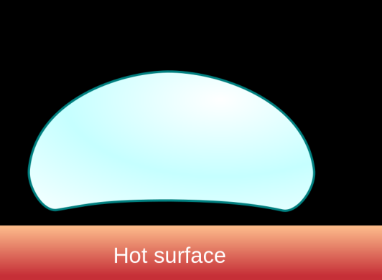
Properties of Liquid Nitrogen (2/2)
Nitrogen (liquid and gas) is colorless. But it appears as a cloudy white vapor when exposed to air.
Why does liquid nitrogen smoke?
The vapor spreads itself out through the air and condenses the water out of it. The water droplets scatter light and produced the smoking effect.
Leidenfrost effect: on a smooth surface with a temperature much higher than the nitrogen boiling point, the liquid vaporizes quickly and lifts itself above the surface. If the surface is irregular, this effect doesn’t occur and the vaporization is even more rapid.

Slide 19
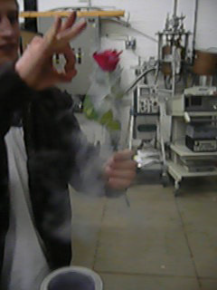
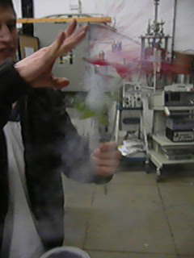

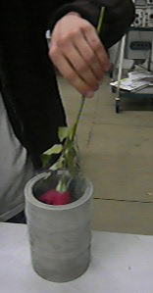
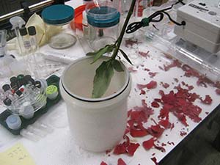
Mechanical properties at cold
Most of the common materials becomes brittle at cryogenic temperature. What happens to a rose when immersed in liquid nitrogen?

Slide 20
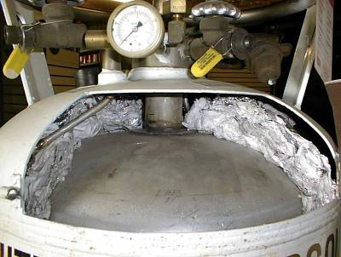
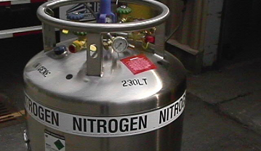
Dewar for Liquid Nitrogen
LN₂ is stored in vacuum insulated storage vessels (dewars), with a vacuum space and a special thermal insulation. However, leaks into the vessel cause the cryogenic liquid to vaporize and build up pressure. In optimum conditions, the liquid-to-gas conversion rate per day is about 2.3 %.
Pressure relief valve to protect the vessel against over-pressure.
Level gauge.
Rupture disk.

Slide 21
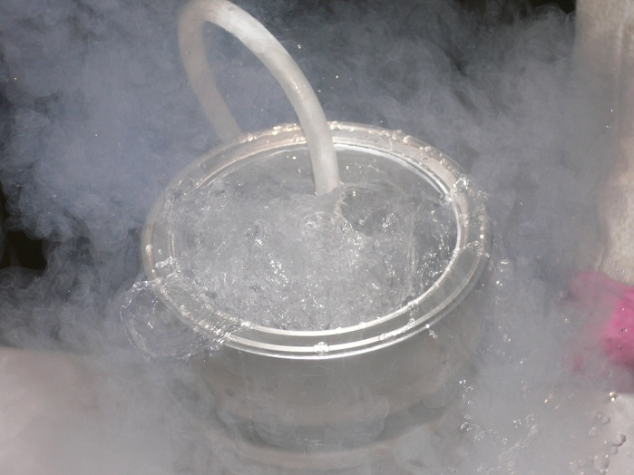
Dealing with LN2: safety first
Like other cryogens, may be harmful if not handled properly!
The extremely low temperature of the liquid nitrogen (LN₂) can cause severe burn-like damage to the skin either by contact with the fluid, surfaces cooled by the fluid or evolving gas.
Skin can freeze and adhere to LN₂ cooled surfaces causing tearing on removal. Thermal gloves must be worn when handling objects cooled by LN₂ (transfer lines, test materials,…). DO NOT touch cold surfaces with bare hands to avoid severe cold-burns !
Boiling and splashing will always occur when filling a warm container. Protection glasses must be worn.
Oxygen condenses and collects on objects cooled in LN2 (nitrogen smokes, but you should not do it in his presence !).
Many materials (common glass, plastics, iron…) become brittle and may shatter when cooled in LN2.
Nitrogen can easily replace air in poorly ventilated areas (risk of asphyxiation).

Slide 22
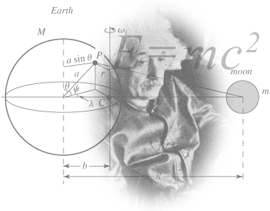
Superconductivity Practical Days at CERN
We will work with cryogenics and superconductivity to understand and verify the unique properties of superconductors
YBCO 123 bulk
BSCCO and YBCO tape
SmCo, NeFeB magnets
Liquid nitrogen
………
Levitation
Flux pinning
Zero resistance
Jc,Tc,Hc
………

Slide 23
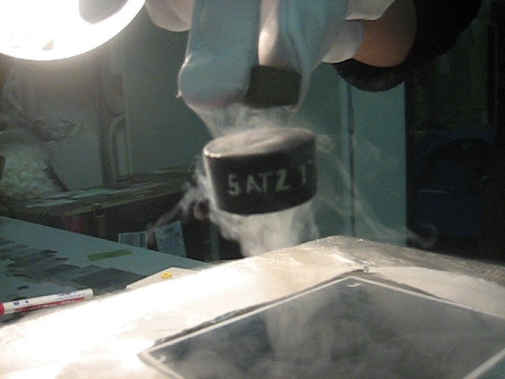

Experiments
Experiments will be performed with HTS superconductors and liquid nitrogen
1.Levitation experiment,
2.Flywheel demonstration.
2.Critical temperature experiment
3.Zero resistance experiment
4.Critical current experiment
.
YBCO 123 Melt Textured Bulk.
Tc= 92 K.
HTS
SmCo
YBCO 123 Tape. Tc= 92 K.

Slide 24
Properties of Superconductors
Zero resistance
Perfect conductors
Exclusion of magnetic field
Perfect diamagnets
Zero resistance
Meissner effect
Onne’s measurement on mercury (1911)
Discovered by Meissner and Oschenfeld (1933)
The magnetic behavior of a superconductor follows the Faraday-Lenz’s law of electromagnetism. A superconductor reacts to changes in externally applied magnetic field. Circulating currents are induced to oppose the build-up of magnetic field in the conductor.
Perfect conductivity + perfect diamagnetism = superconductors

Slide 25
Meissner effect
Zero field-cooled method: the materials are first cooled and then placed in an external magnetic field.
“Perfect” conductor (zero resistance)
Superconductor
H=0
H=0
cool
cool
H=0
H=0
Apply
H
Apply
H
Remove
H
B=0
Remove
H
B=0

Slide 26
Meissner effect
Field-cooled method: the materials are in the presence of an external magnetic field at room temperature. After they are cooled.
“Perfect” conductor Zero resistance
Superconductor
H
H
cool
cool
H
H
T<T_{c}
H
H
Remove
H
B≠0
Remove
H
B=0
Meissner effect
Levitation experiment

Slide 27
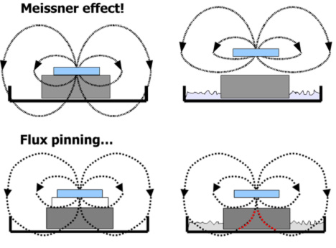
Levitation experiment
Permanent
magnet
HTS
T>Tc:
No levitation
T<Tc:
Levitation
Levitation experiment

Slide 28
Levitation experiment
We will perform two experiments:
Field-cooled conditions: the field is applied to the superconductor at room temperature, before cool-down in liquid nitrogen.
Zero field-cooled conditions: the superconductor is cooled-down in zero field conditions. Only when the temperature is below Tc, the field is applied.
H=0
H
cool
cool
H=0
H
Apply
H
H
Remove
H
B=0
Remove
H
B=0
Meissner effect
Levitation experiment
Levitation experiment

Slide 29
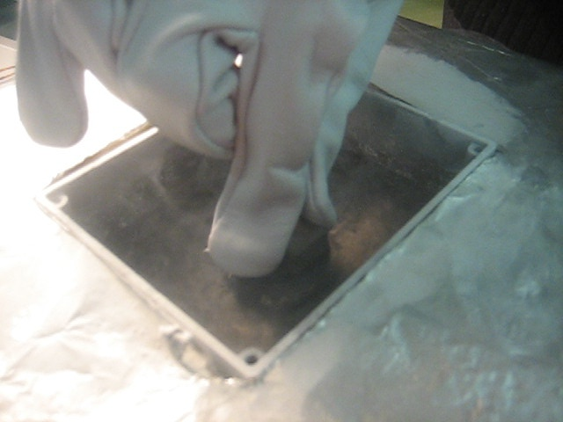
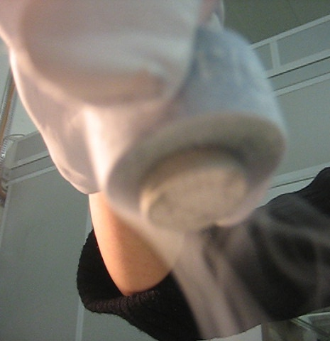
Field-cooled Levitation experiment
The magnet is put, at room temperature, on the top of the superconductor (no levitation).
The assembly is cooled with LN₂ to 77 K. The YBCO becomes superconducting and the magnet jumps up in the air.
The magnet levitates stably in mid air and can be moved in the vertical position only by applying a strong force. It will rotate in the air when kicked with a non-magnetic material.
Observe also stability in the horizontal plane due to the magnetization of the residual flux.
Appreciate the intensity of the max levitation force !
HTS
SmCo
HTS
SmCo
J.Fleiter, A.Ballarino
Levitation experiment

Slide 30
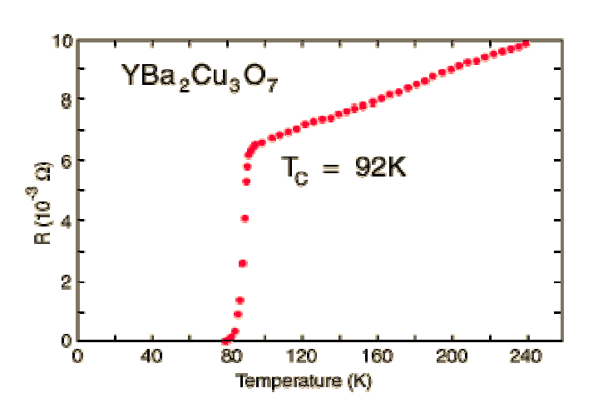
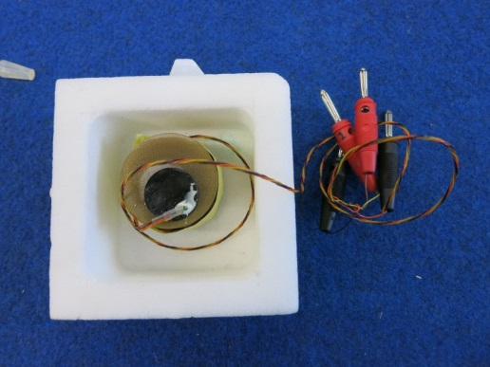
Critical temperature experiment
Measurement of critical temperature by using the Meissner effect.
The critical temperature is defined as the temperature measured on the superconductor when the permanent levitating on it comes to complete rest on the superconductor’s surface.
In reality, the critical temperature is defined as the temperature below which a material exhibits superconductivity at zero magnetic field strength.
Levitation experiment

Slide 31
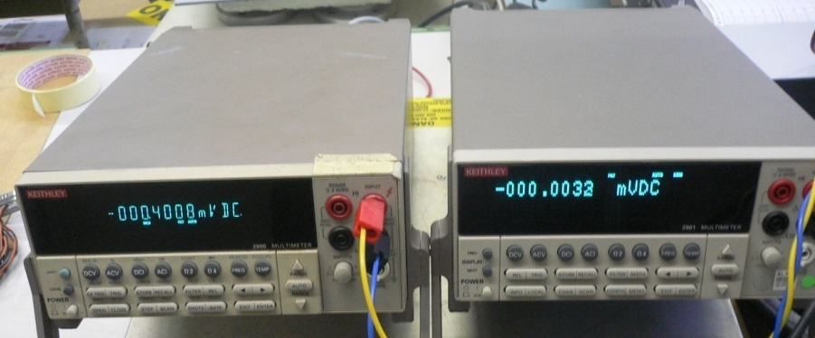
Zero resistance direct current experiment
A superconducting tape and a pure silver tape are connected in series, Measure the voltages (resistances) as the specimens are inserted into liquid nitrogen and cooled to 77 K.
A see-through glass walled dewar is used for the LN₂.
ρ_{Ag}(293 K)∼1.46∙10⁻⁶ Ω∙m
ρ_{Ag}(77 K) ∼0.2∙ ρ_{Ag}(293 K)
HTS:BSCCO 2223 multi-filamentary tape in silver alloy matrix.
Zero resistance experiment

Slide 32
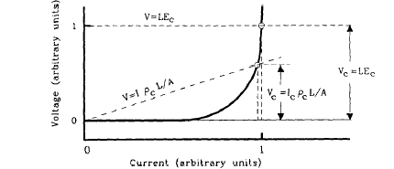

DC Critical current experiment
Critical current (I_{c}): current at which a specified electric field criterion E_{c}, or resistivity criterion ρ_{c} is achieved in the specimen. Losses through a Type II superconductors (H_{c1}<H<H_{c2}) depend on the sample geometry and on the vortex pinning.
n=n-value (-)
Ic critical current (A)
E electric field (V/m)
Ec electric field criterion (1 uV/cm)
$$E=E_{c}{\left(\frac{I}{I_{c}}\right)}^{n}$$
H=const
T=const
Critical current experiment
Notes:
N reflects the abruptness of the transition from superconducting to normal state

Slide 33


Critical current experiment self-field and with perpendicular field
E_{c}= 1 μV/cm
Measure I_{c} in liquid nitrogen.
f=filling factor=A_{HTS}/Atot
f=1%
Derive
J_{eng} (Engineering critical current density=current over the
total cross section of the tape) and
J_{ph} (Physical critical current density=current in the HTS).
T=77 K
YBCO tape: 4mm wide
0.1 mm thick
Critical current experiment
Notes:
N reflects the abruptness of the transition from superconducting to normal state

Slide 34


Critical current experiment: anisotropy
Orientation of field is important, because HTS materials are highly anisotropic.
Critical current experiment
Notes:
N reflects the abruptness of the transition from superconducting to normal state

Slide 35

Thanks for your attention

Slide 36
A few reference books
M.N. Wilson, Superconducting Magnets, Clarendon Press Oxford.
K.-H. Mess, P. Schmüser, S. Wolff, Superconducting Accelerator Magnets, World Scientific.
H.A. Brechna, Superconducting Magnet Systems, Springer Verlag.
Y. Iwasa, Case Studies in Superconducting Magnets, Plenum Publ. Corp.
K. D. Timmerhaus, T.M.Flynn, Cryogenic Process Engineering, Plenum Press, New York.
T.P. Sheahen, Introduction to High-Temperature Superconductivity, Plenum Press, New York.
G.Burns, High-Temperature Superconductivity, Academic press, Inc.

