Slide 1
Science Gateway
Inspire | Educate | Engage | Treasure | Collaborate

Slide 2
Why Science Gateway?
CERN has:
Reputation as a world-leading scientific centre
Unparalleled research infrastructures
Renowned expertise in science education and outreach
Well-established ability to foster peaceful collaboration of scientists from all over the world
Science Gateway will position CERN to uniquely:
engage the public in the value and multi-faceted role of science in society
inspire young generations

Slide 3
An education and outreach centre that will
Inspire & Educate
Inspire more young students to pursue a career in science. Expand our current offer of educational programmes to ages 5+.
Expand and diversify CERN’s portfolio of education, communication and outreach actions aimed at the general public
Conserve and display the heritage of big science, the objects and stories that transmit the tremendous human endeavour in a tangible way.
Build ties across Member States and beyond, sharing content and encouraging co-creation with other museums, science centres and education networks.
Engage
Treasure
Collaborate
Notes:
The number of daily visitors mentioned in the slide is the estimate for the peak day, calculated as 1% of total number of visitors in a year. For Science Gateway, this is 300 000.

Slide 4
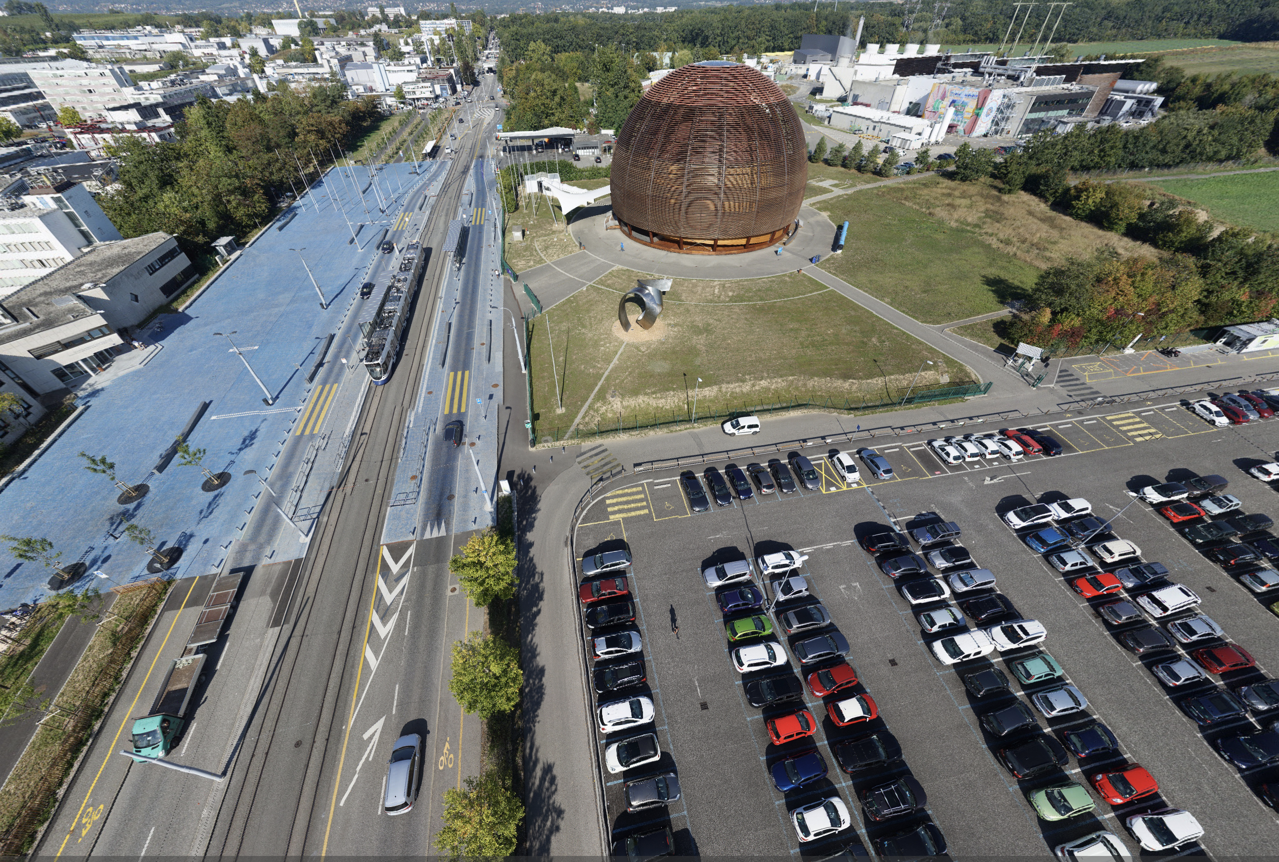
Science Gateway will be an integral part of the CERN site

Slide 5
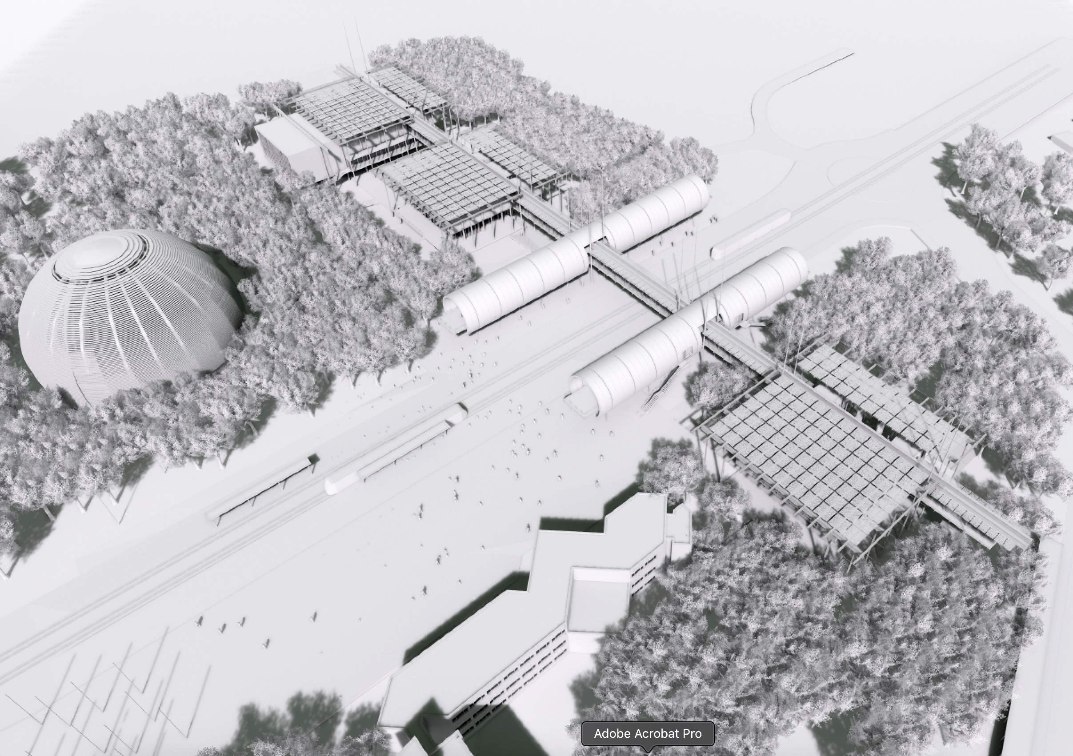
Building by architect
Renzo Piano
(RPBW)
“It’s a place where people will meet. Kids, students, adults, teachers and scientists, everybody attracted by the exploration of the Universe, from the infinitely vast to the infinitely small. It is a bridge, in the metaphorical and real sense, and a building fed by the energy of the sun, nestling in the midst of a newly grown forest.”
Notes:
Centre Pompidou, New York Times, California academy of Sciences, Nemo (National Center for science and technology (NL), The Shard, Fondation Beyeler, Osaka airport

Slide 6
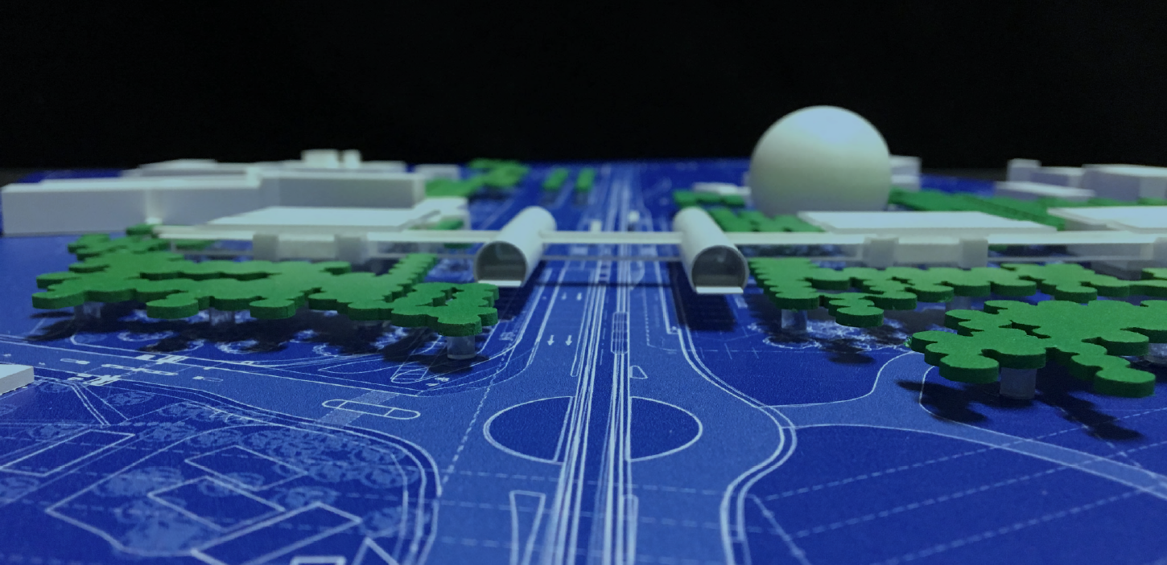

Slide 7
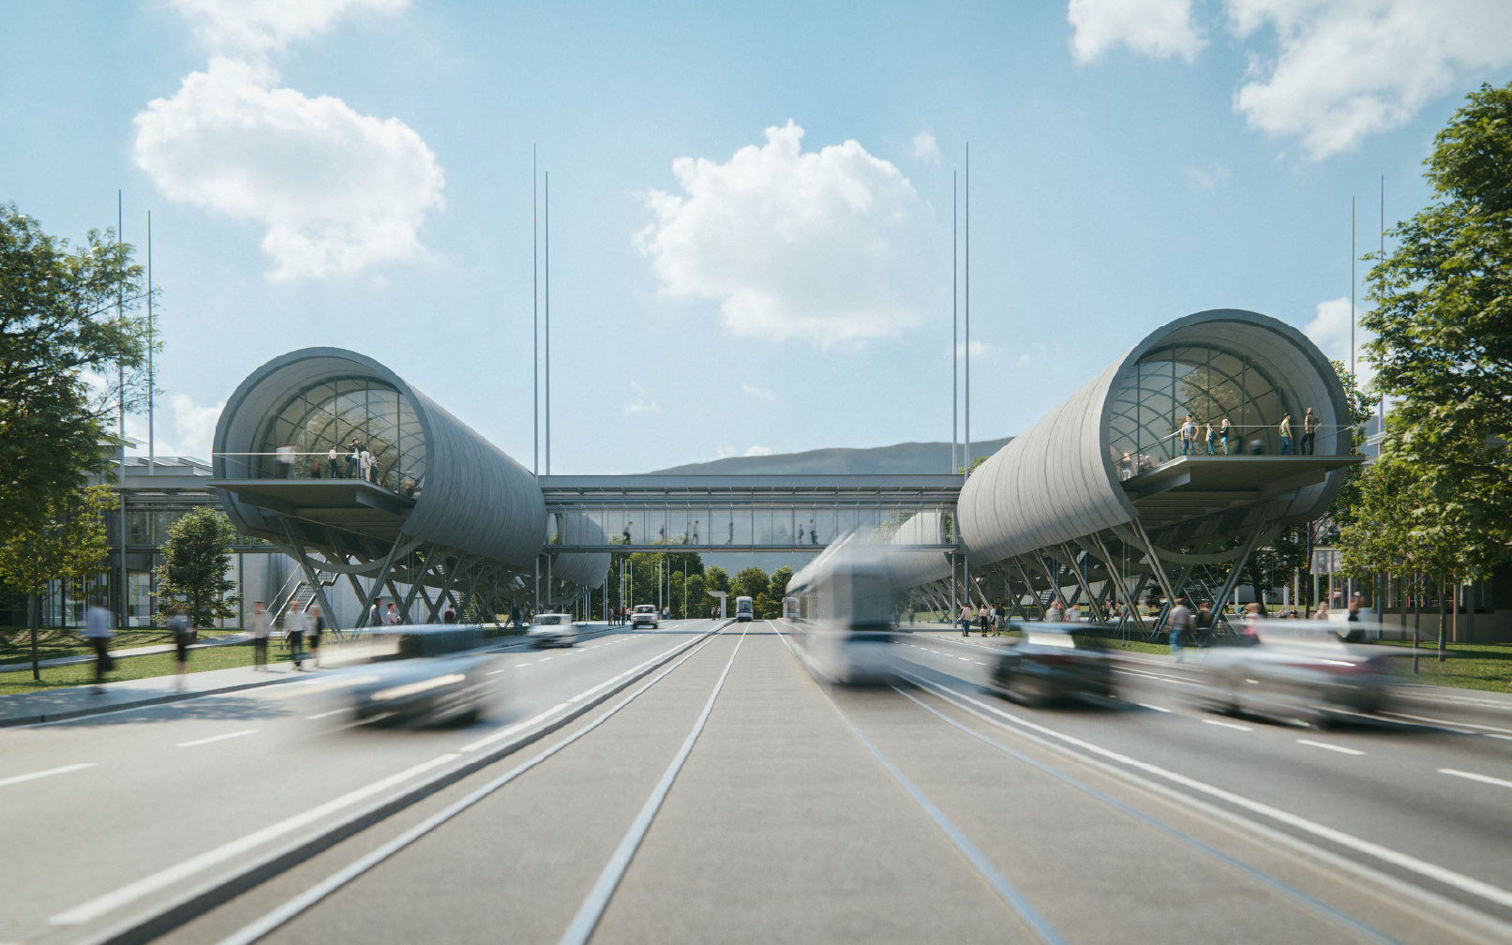

Slide 8
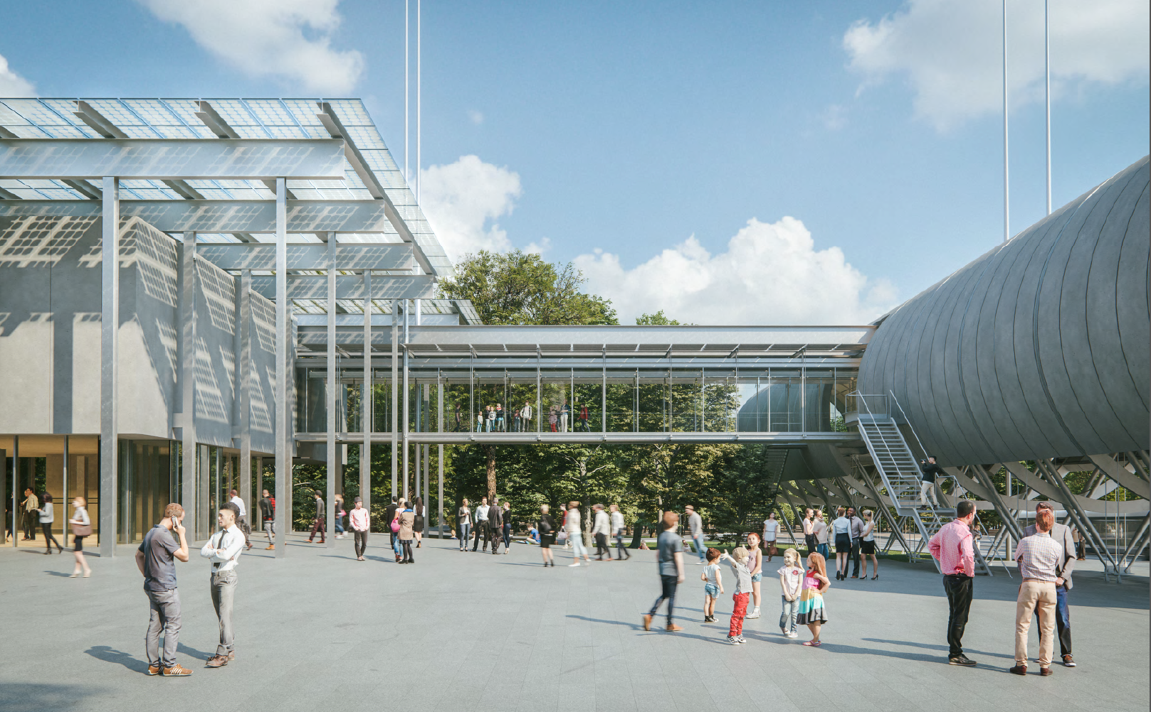

Slide 9
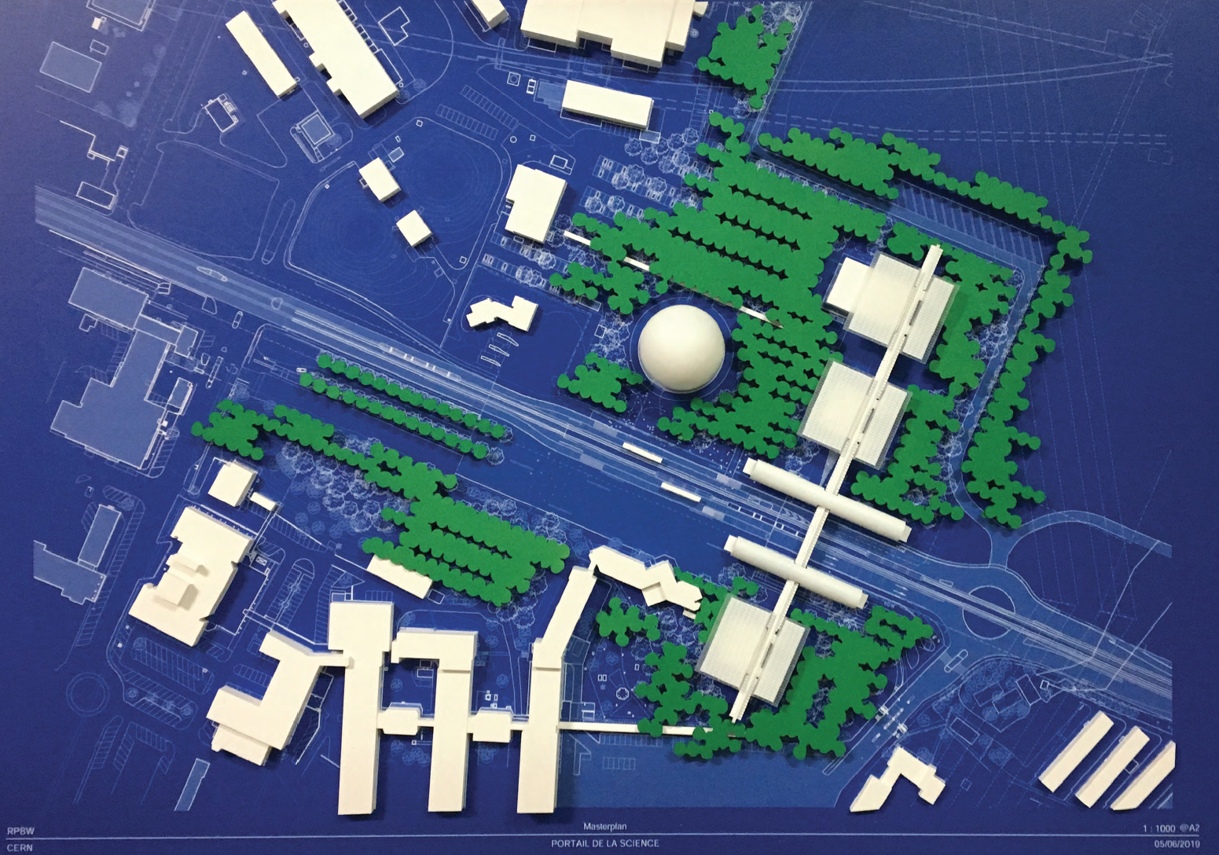
Footprint of 7 000 sqm

Slide 10
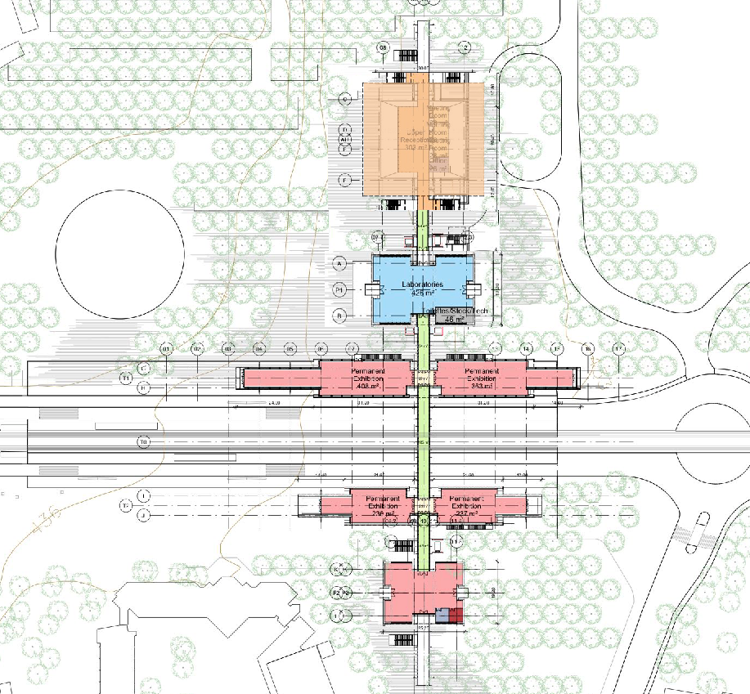
Auditorium
Science shows
Conferences
Debates
Science film screenings
The Globe
Start of guided tours
Temporary exhibitions
Temporary
exhibitions
Labs
Enquiry-based learning
Hands-on experimentation
Discover CERN
Permanent
Exhibitions
Discover CERN
Our Universe
Explore and learn
Our Universe
EXPLORE

Slide 11
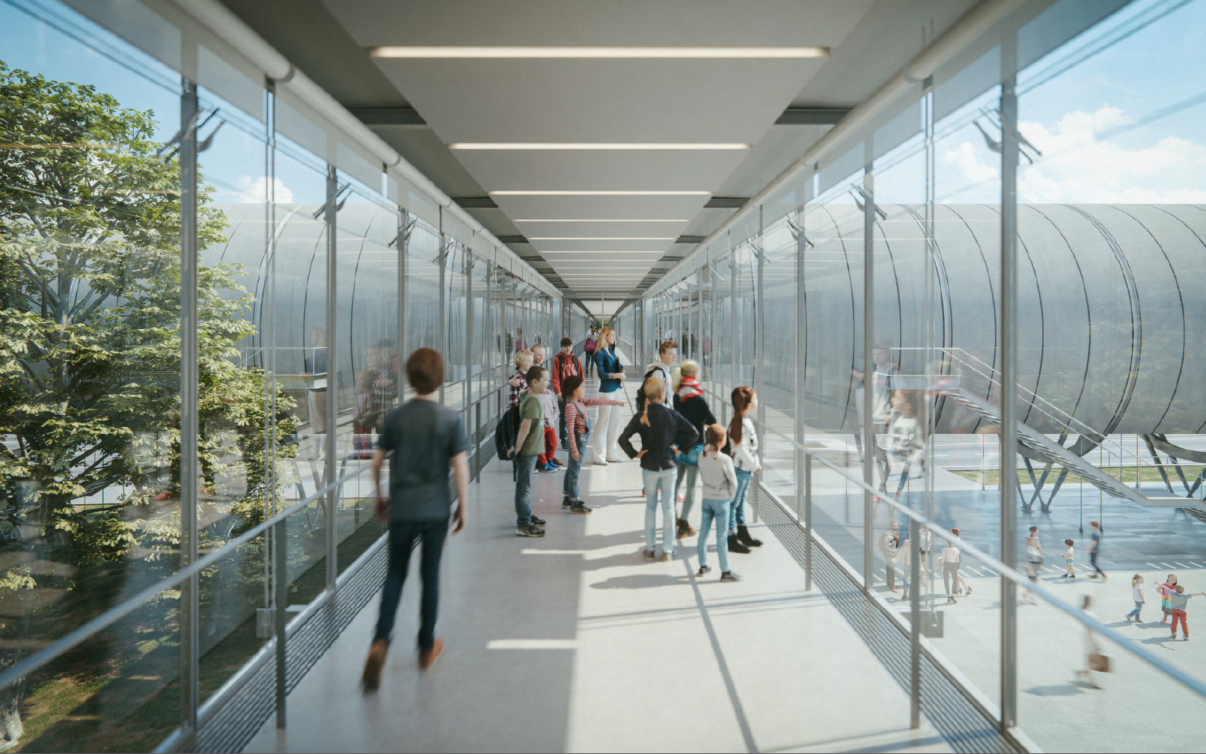
Acknowledgements
Emma Sanders
François Briard
Sascha Schmeling
Patrick Geeraert

