Slide 1
Bus Tape FDR
Concern #1: still need to identify producer as Alatflex have had problems.
Carl investigating two new US companies and Altaflex + outsourcing.
Producing prototypes with CS Electronics (China)
Producing prototypes at CERN in Rui’s (new) workshop.
Concern #2: Distortions along short direction of tape
See next slides.

Slide 2
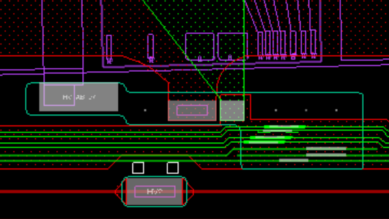
Tape Dimensions
Lock points added wrt MFFs.
Modules mounted wrt lock points.
In x-direction:
If tape too short or too long, would need to use very large angle for bond wires
In y-direction
If distortion too large silicon sensor will be too close to LV pads on either the data or the power side of the stave.
MFF1
MFF2
y
x
1.5 mm

Slide 3
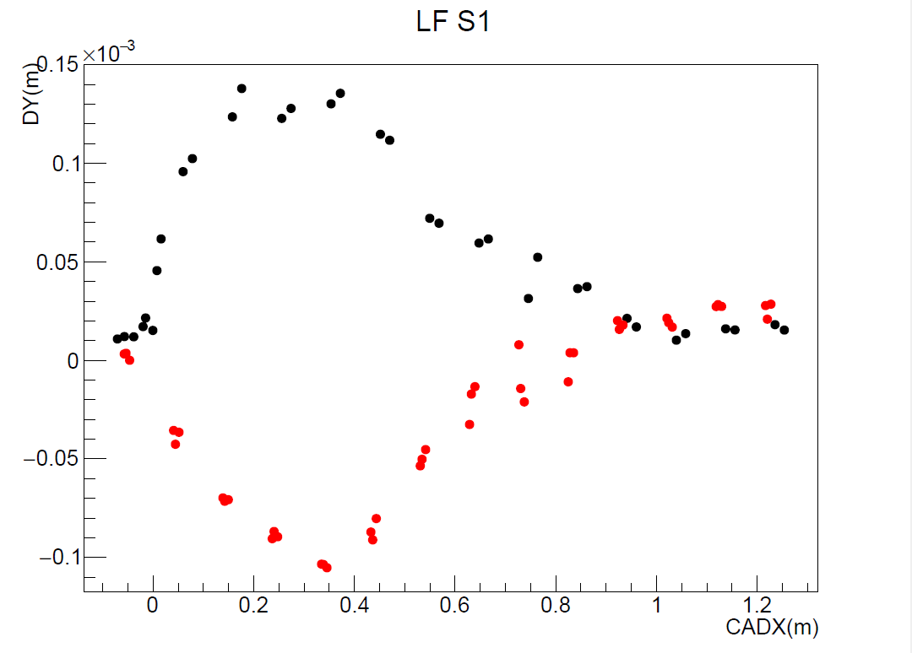
Y-distortion
Cut |DY| < 300 mm
Use local fiducials
Line from MFF1 to MFF2
Calculate distance d_{i} from LFID_{i} to line.
Plot d_{i} measured – nominal vs x for two sides of tape
High y
Low y
y
MFF1
MFF2
x
LFID_{i}
d_{i}

Slide 4
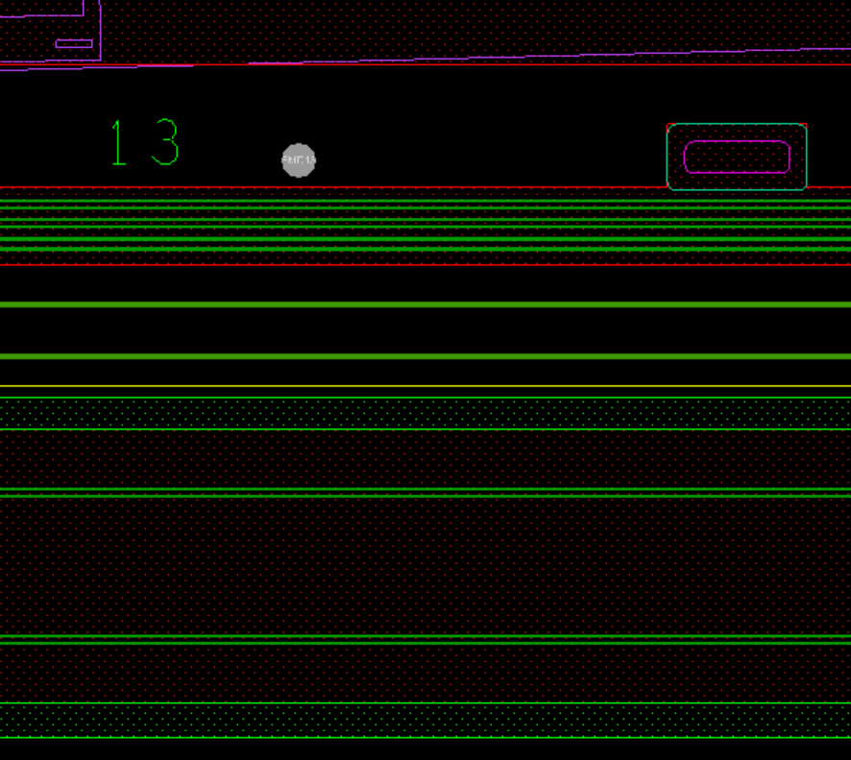
New Co-cure jig (Rui)
HV lines near edge of tape
Add row of holes & slots in tape in sacrificial area of tape.
Use invar jig with dowel pins to ensure tape is held straight during co-cure.
Dowel pins become glued in during co-cure but can be removed with tapping.
Edge of tape after sacrificial area cut
4 mm diameter hole in tape

