Slide 1
CERN IdeaSquare
Hans Hagenes Bøe

Slide 2
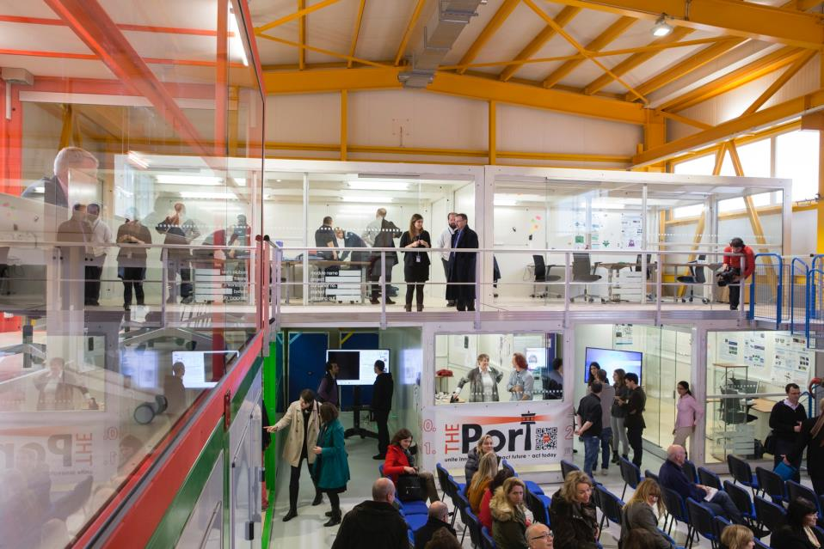
IDEASQUARE IN BRIEF
“Ideasquare is an experiment that brings together researchers, engineers, industrial partners and cross-disciplinary student teams to work together on detector upgrade R&D technologies. The dual purpose is to co-develop new technologies for research purposes and create a fruitful environment for socially and globally relevant new product ideas and innovation.”

Slide 3
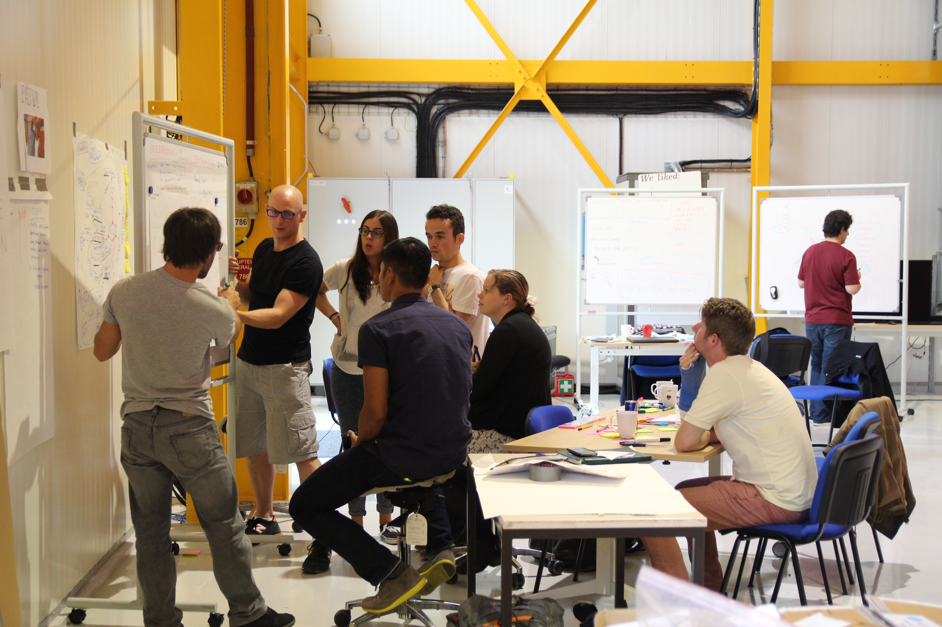

IDEASQUARE IS
A project with a dedicated building, hosting:
  Detector upgrade R&D projects
  Innovation events, workshops, hackathons
  Multidisciplinary master level student programs
...to prototype, test and iterate new forms of collaboration and co-creation in the areas or Research, Education and Technology - RET
Research
Education
Technology

Slide 4
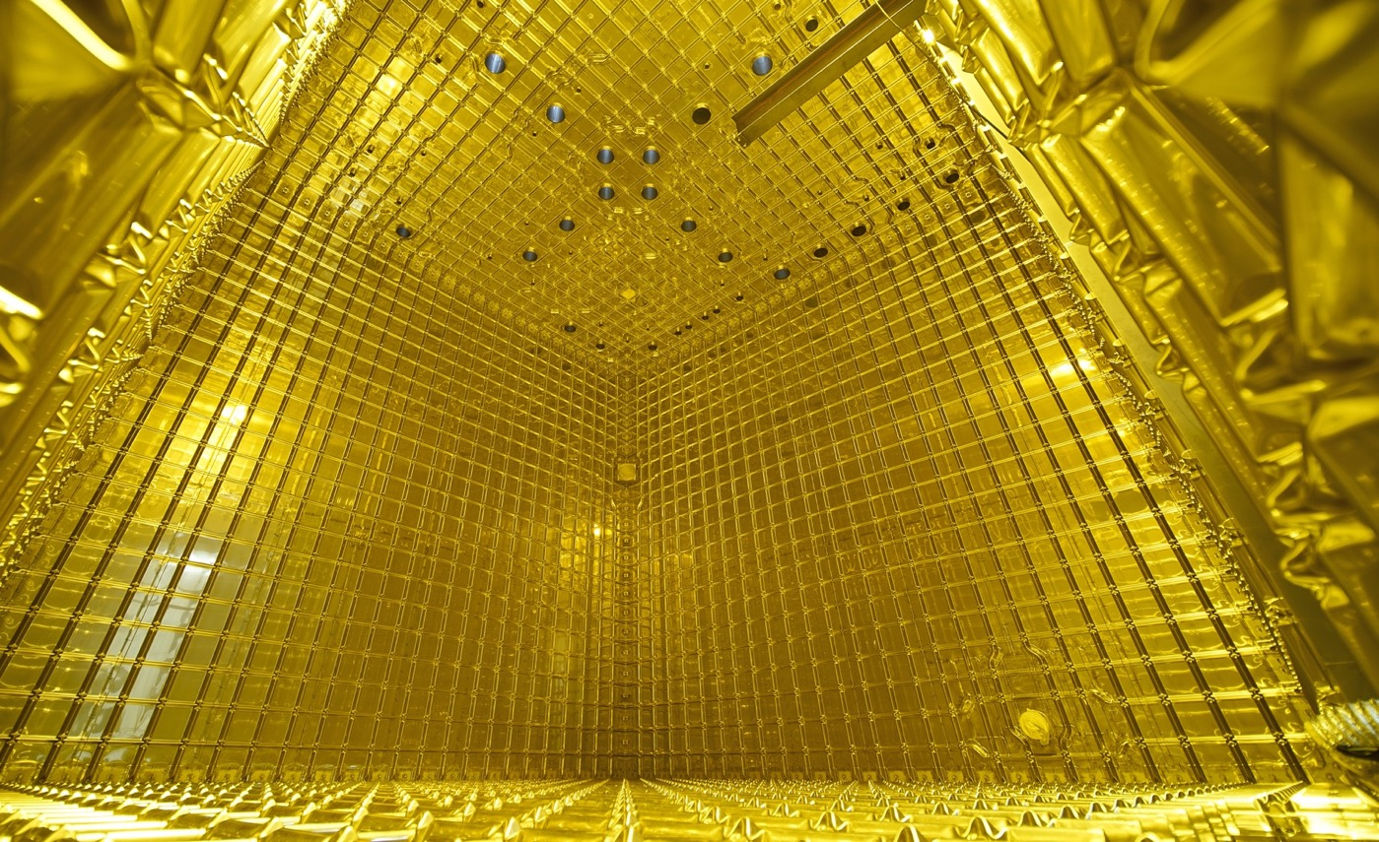

EXAMPLE: NEUTRINO PLATFORM PROJECTS
Neutrino Platform (CENF) fosters fundamental research in the field of Neutrino Accelerator Physics
CENF supports generic detector, neutrino beams R&D and large detector prototypes or demonstrators. It gives technical, financial and logistics support to approved projects
Currently includes seven projects, including significant involvement in (Proto)Dune
CERN & IdeaSquare provides a facility for R&D on future technologies (HW and SW) and partner in several neutrino research programs
www.attract-eu.com

Slide 5
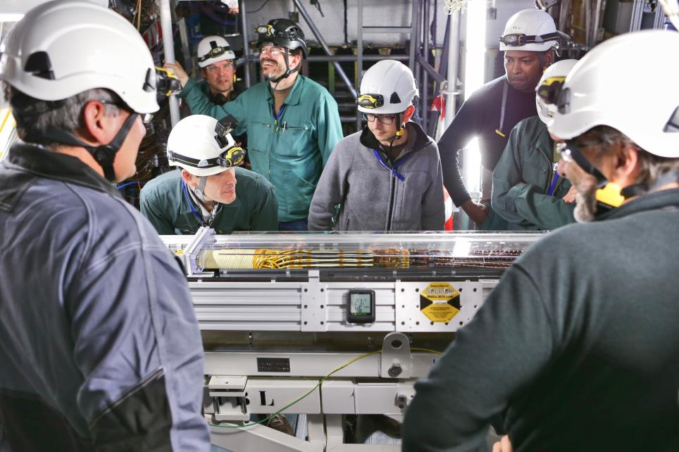

EXAMPLE: EU-FUNDED ATTRACT PROJECT(S)
ATTRACT funds 170 breakthrough projects in Detection & Imaging
Provides funding for developing early-stage ideas and prototypes
Focuses on high innovation with potential outside research
Engages with CBI-like student activities, seeking for unforeseen entrepreneurial opportunities for the young
Purpose is to create a new innovation ecosystem in Europe
ATTRACT is coordinated by CERN (IdeaSquare)
www.attract-eu.com

Slide 6
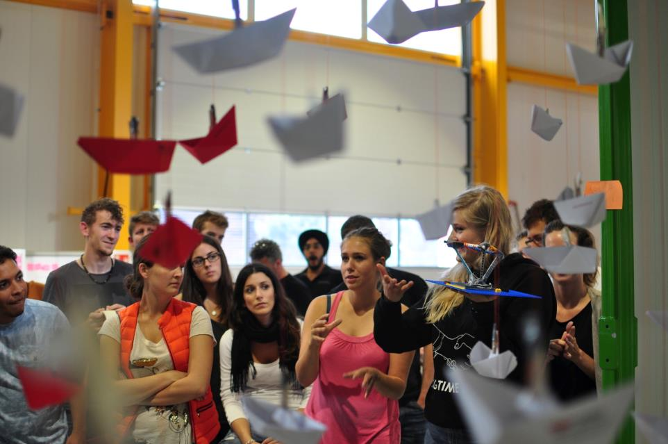

EXAMPLE: MASTER-LEVEL STUDENT COURSE
Challenge Based Innovation (CBI) is 5-6 month MSc-level specialization course for product and service development, run by participating universities from 8 countries around the world
Over 600 students have participated with more than100 conceptual prototypes produced, contributing to UN Sustainable Development Goals
In the course, multidisciplinary student teams learn how to apply Design Thinking – process for new product/service development; engaging with CERN researchers who act as technological coaches in the process
“Work extremely hard, learn and have fun!”
“Fail fast and often to succeed sooner”
Dedicated versions created for several partners

Slide 7

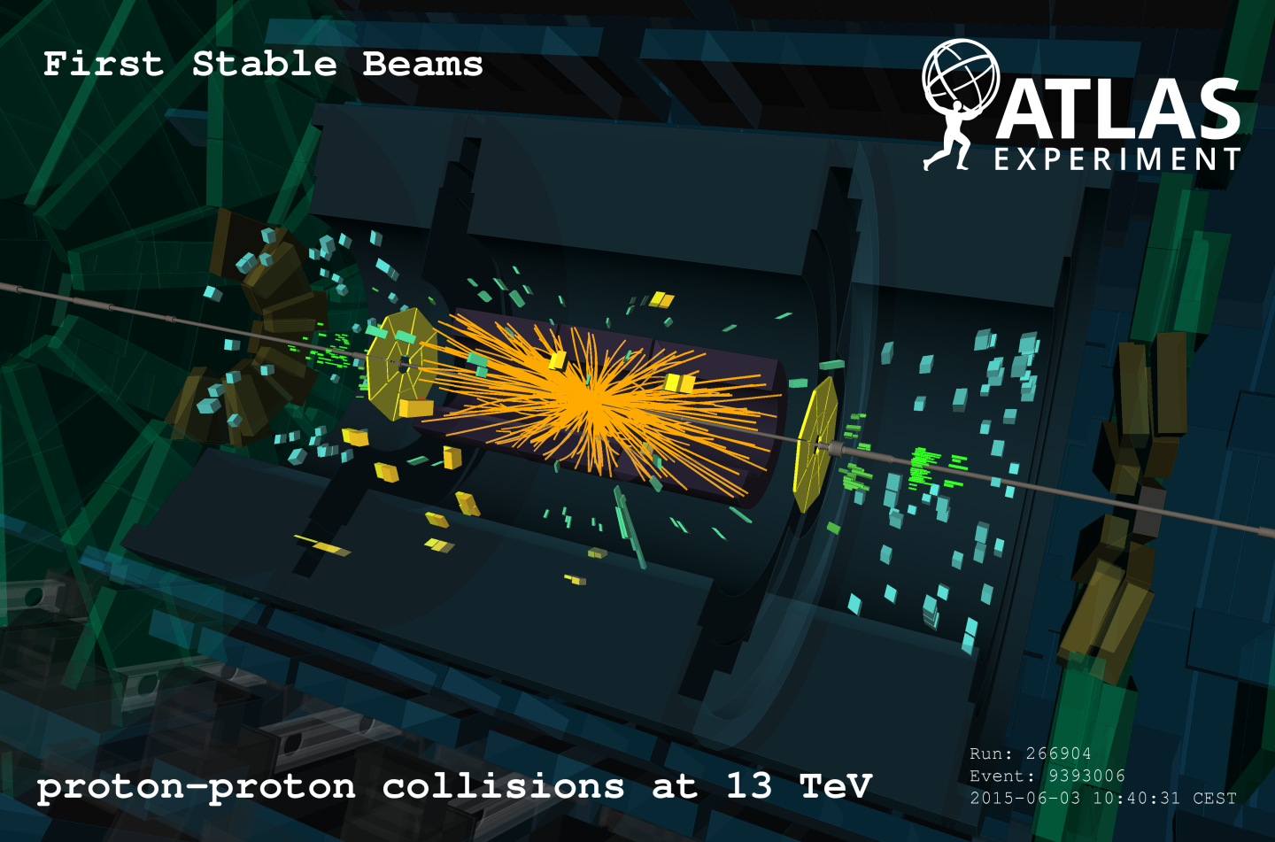


WHAT IS THE MOST INTERESTING LINK FOR NEW INNOVATION?
Detector R&D
Projects
Defined/closed
Technology
MSc-Level Student Programs, Hacks etc.
Initially undefined/open
Product
Process
Focus

Slide 8
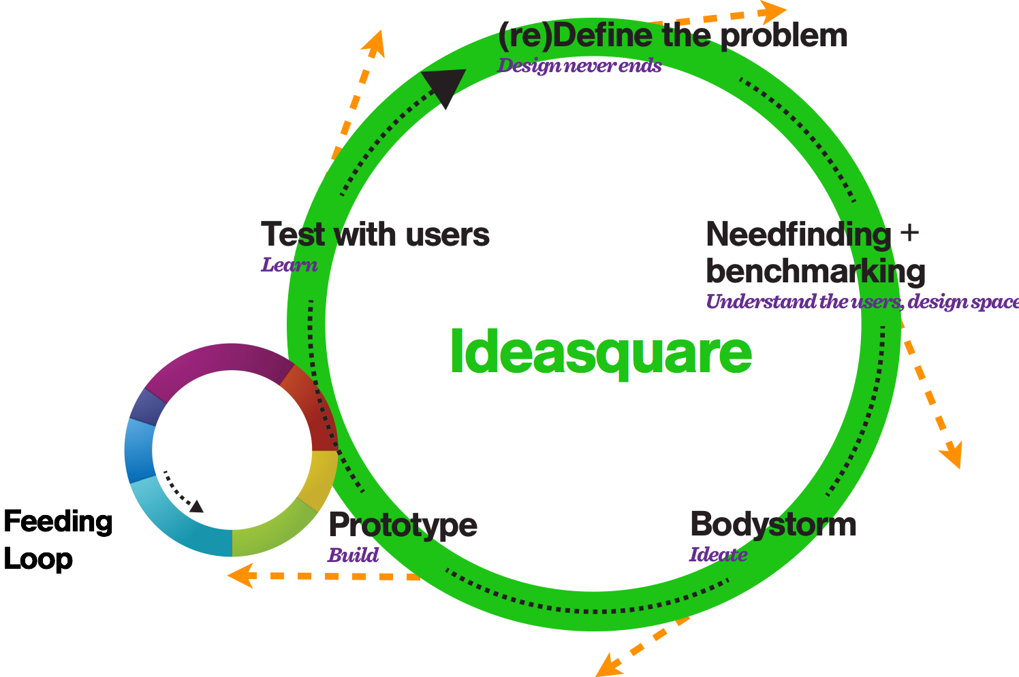
IDEASQUARE
The Small Human Collider

Slide 9
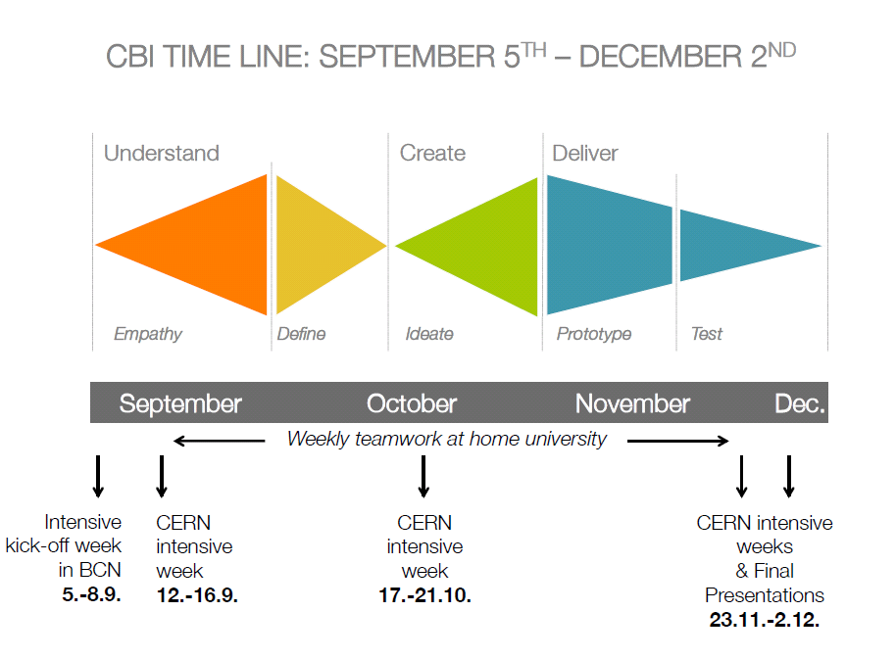
TYPICAL STRUCTURE OF MSC-LEVEL STUDENT PROGRAM AT IDEASQUARE (CBI)
Design Thinking
http://www.cbi-course.com/

Slide 10
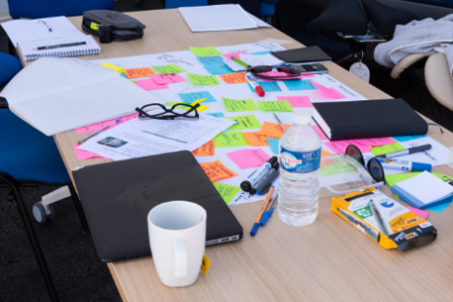
EXAMPLES OF STUDENT PROJECTS

Slide 11

PREVENTING HIP INJURY FROM INVOLUNTARY FALL
http://2014.cbi-course.com/

Slide 12
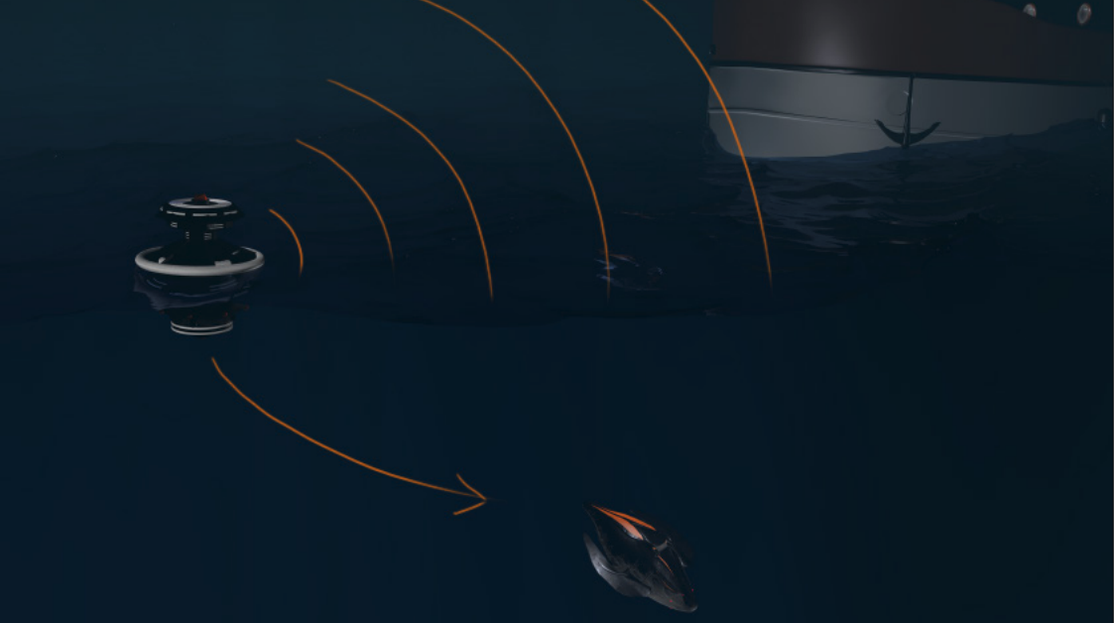
A SHEPHERD FISH TO PREVENT OVERFISHING BY SHEPHERDING SCHOOLS OF FISH AWAY FROM FISHING FLEET BEFORE THEY HAVE REACHED OPTIMAL SIZE

Slide 13
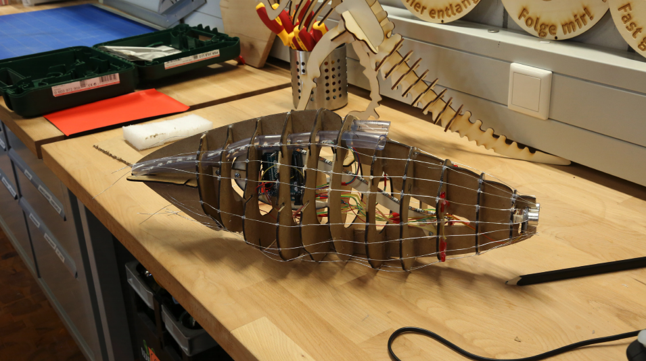
http://2014.cbi-course.com/

Slide 14
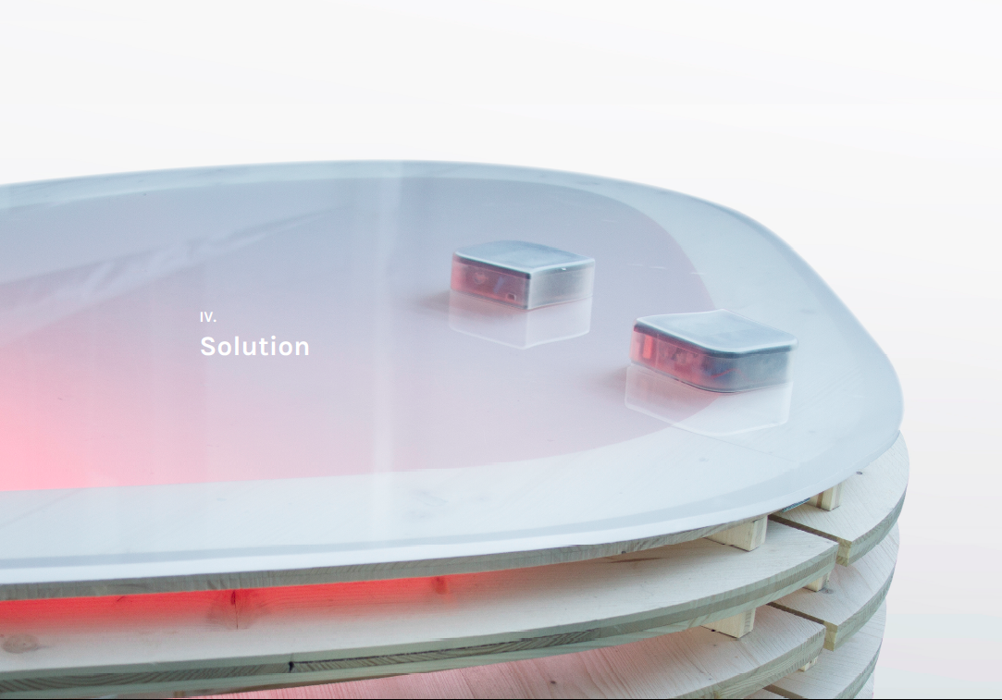
HELPING CHILDREN IN THE AUTISM SPECTRUM TO COMMUNICATE
https://www.youtube.com/watch?v=w5S8vSHH_XA
Notes:
Another example is Team Edumind – combining inspiration from a research project on augmented reality for maintenance workers with a societal challenge on helping autistic kids to communicate better with their surroundings

Slide 15
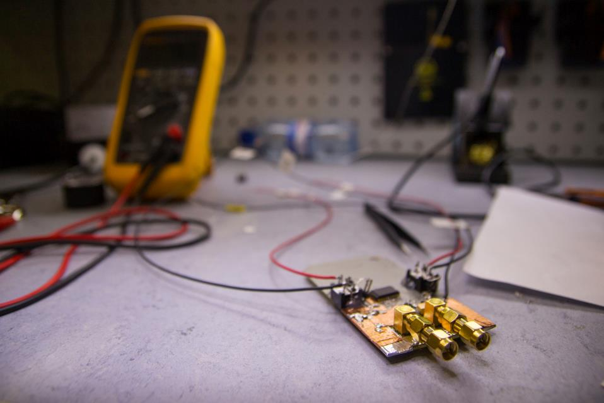
IDEASQUARE OUTPUT
Education of future scientists and innovators
Creating talent for both basic research and entrepreneurship (iterative prototyping, new business concepts)
Sharing of ideas, spaces and resources improved in and between versatile development projects in a high-tech environment
Societal value from basic research
Shared experimental data on innovation processes (CIJ)
Demonstrator for ATTRACT (www.attract-eu.org) to create local entrepreneurial ecosystems using centers like CERN as engines of innovation

Slide 16
SOCIO-ECONOMIC RESEARCH ON EXPERIMENTAL INNOVATION
IdeaSquare Journal of Experimental Innovation
Online, cited (Reuters) open access journal
Targeted for research on experimental innovation processes and methodologies, (to be) tested or used at IdeaSquare
Short, peer-reviewed articles to communicate key results
Annual workshops to work further on published articles for special issues in well-established journals
First issue in Autumn, 2016
Editor-in-chief: Prof. Saku Makinen (Tampere University)
Senior Editors: Prof. Julian Birkinshaw (LBS), Roberto Verganti (Milan), Henry Chesbrough (UC Berkeley)
http://cij-ei.web.cern.ch/cij-ei/

Slide 17
HOW TO GET INVOLVED WITH IDEASQUARE?
Through physics experiments at CERN doing detector R&D that have some connection with society (e.g. non-physics student initiatives)
  e.g. ATTRACT
Proposing and participating in initiatives to bring together engineering, business management and design students (and their professors) who ask IdeaSquare to host them (e.g. CBI)
Participating in new events and initiatives (e.g. hackathons, see Port)
Doing research (e.g. PhD) together with us on innovation processes (CIJ)
https://ideasquare.cern

Slide 18


Questions? Comments?
Contact information:
Email: santeri.palomaki@cern.ch
@ideasCERN
#Ideasquare #ThinkDoCollaborate #CERN
Let’s have a cup of coffee and make it happen!

