Slide 1


Open Science, Open Innovation, and Disruptive Thinking
– Some Personal Reflections
Markus Nordberg (CERN)

Slide 2

What is Wrong with this Picture?

Slide 3


Slide 4


Slide 5

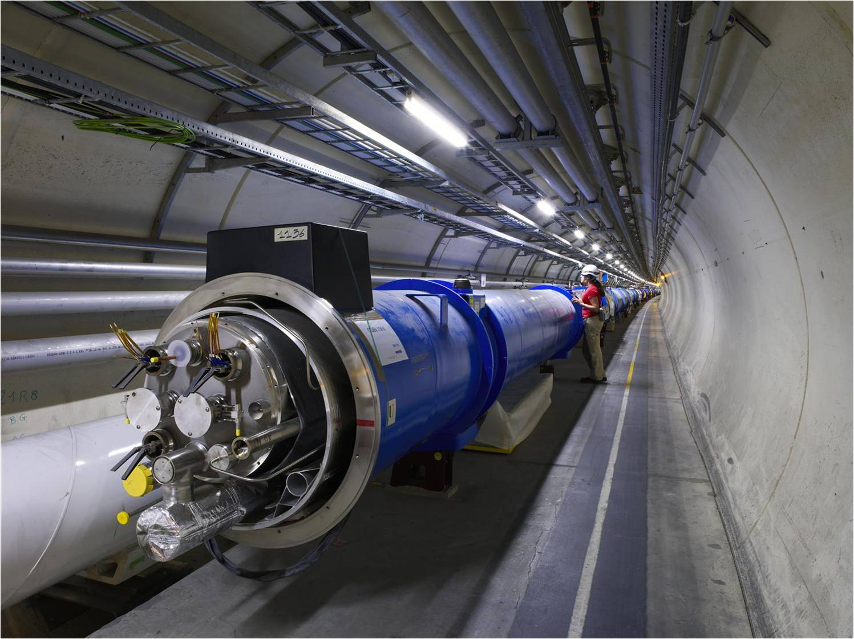
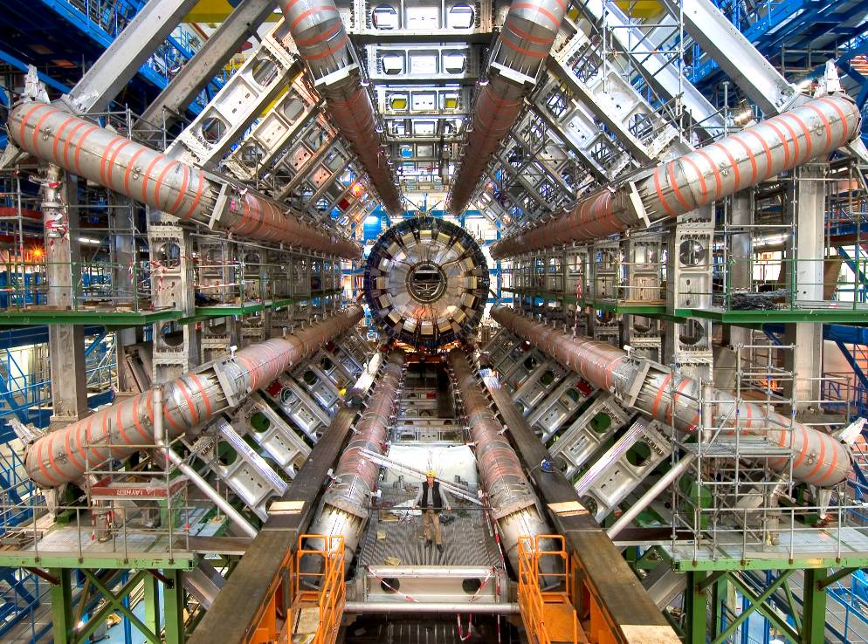
We Use Scientific Instruments of Industrial Scale

Slide 6
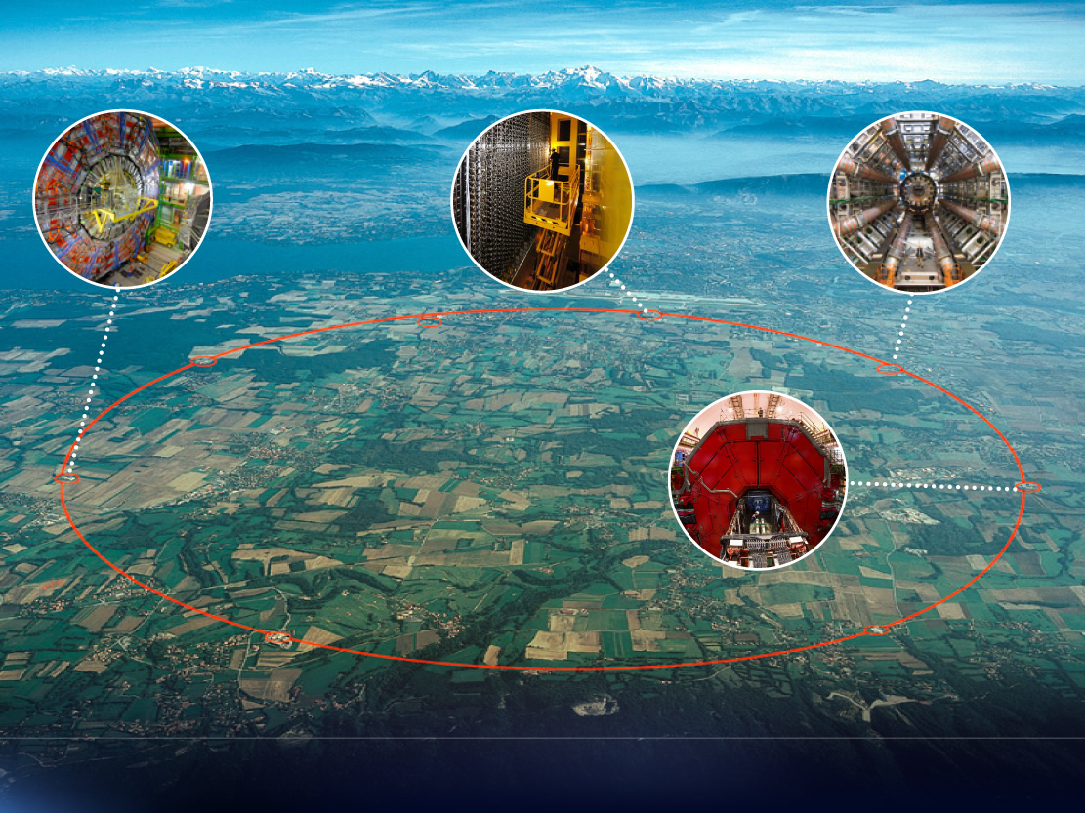

Slide 7
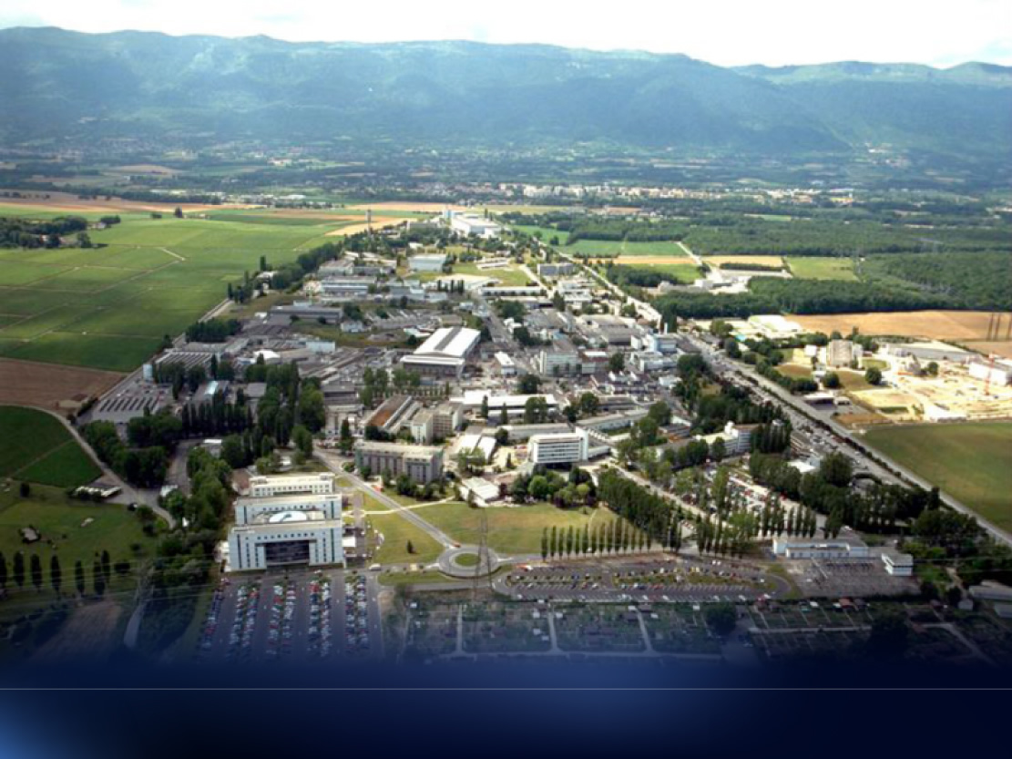

Slide 8
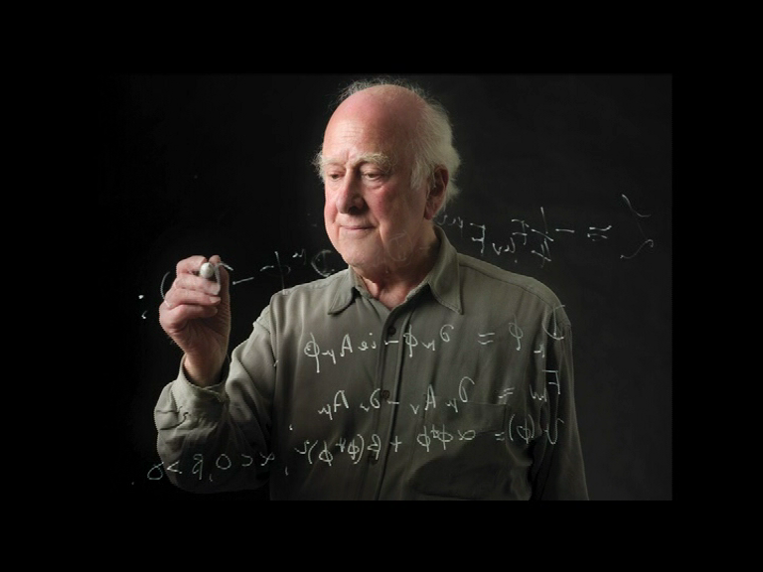
What Is The Process?

Slide 9
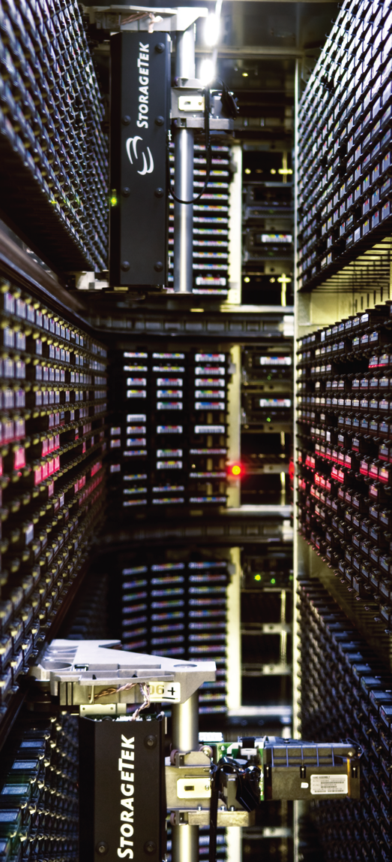
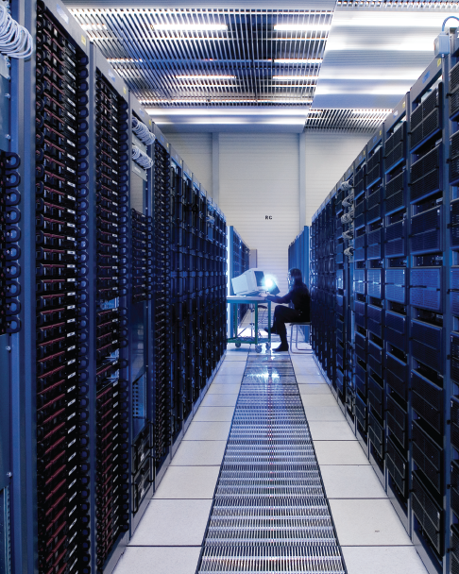

European Organization for Nuclear Research Organisation européenne pour la recherche nucléaire

Slide 10
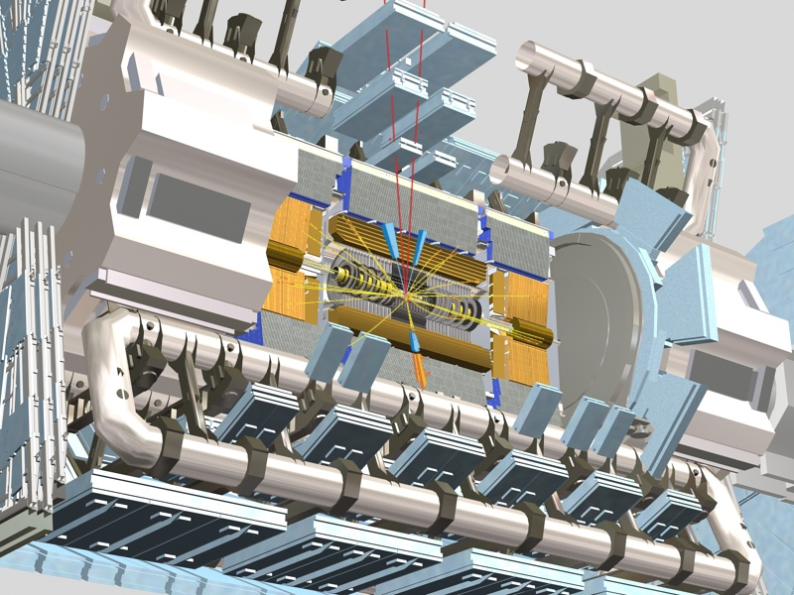

Slide 11
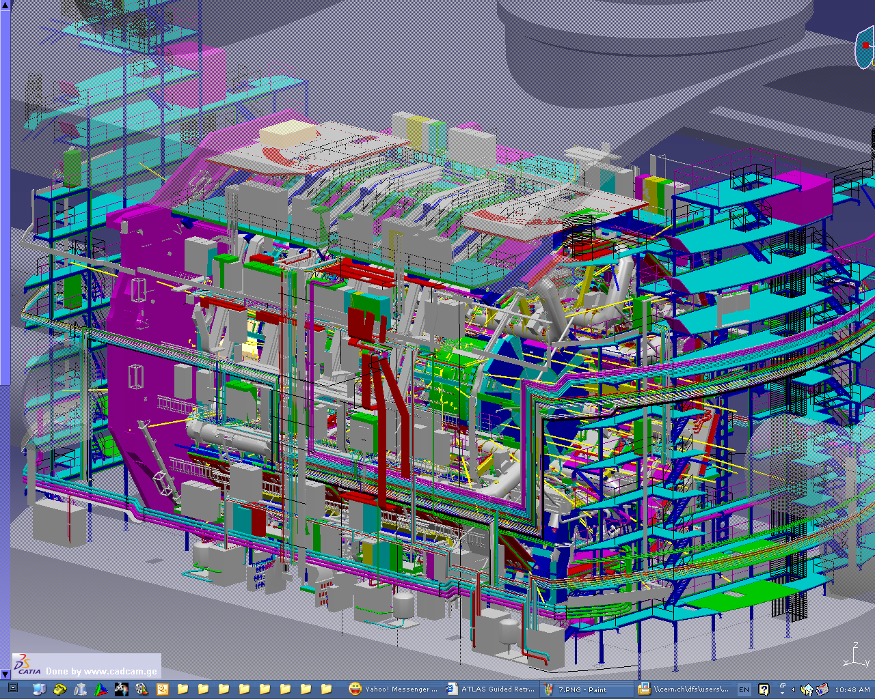

Slide 12
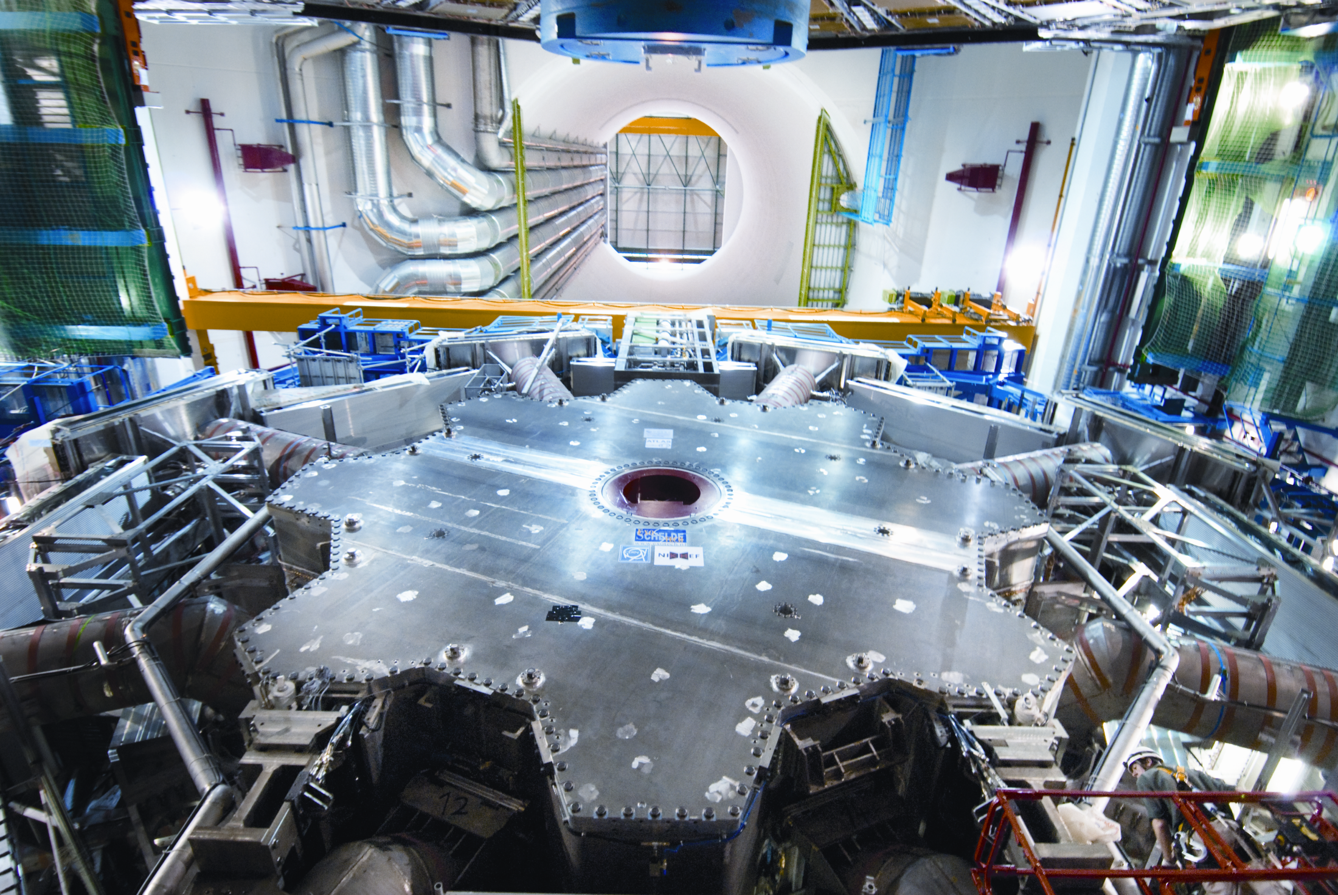

Slide 13
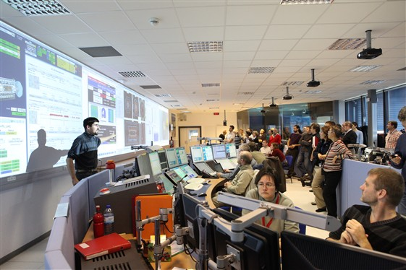

Slide 14
How Does CERN Contribute to The Process?
CERN provides the infrastructure for studying the conditions of the early Universe by developing and using industrial-scale accelerators and detectors
CERN and Particle Physics (PP) is about interfacing between fundamental science and long-term technological development
CERN is designed for generating new knowledge, to contribute to paradigm shifts, not incremental or linear progress (Web, Grid, PET, MRI etc.)
It is also about training of next-generation scientists and engineers to the benefit of Member States and their industries

Slide 15
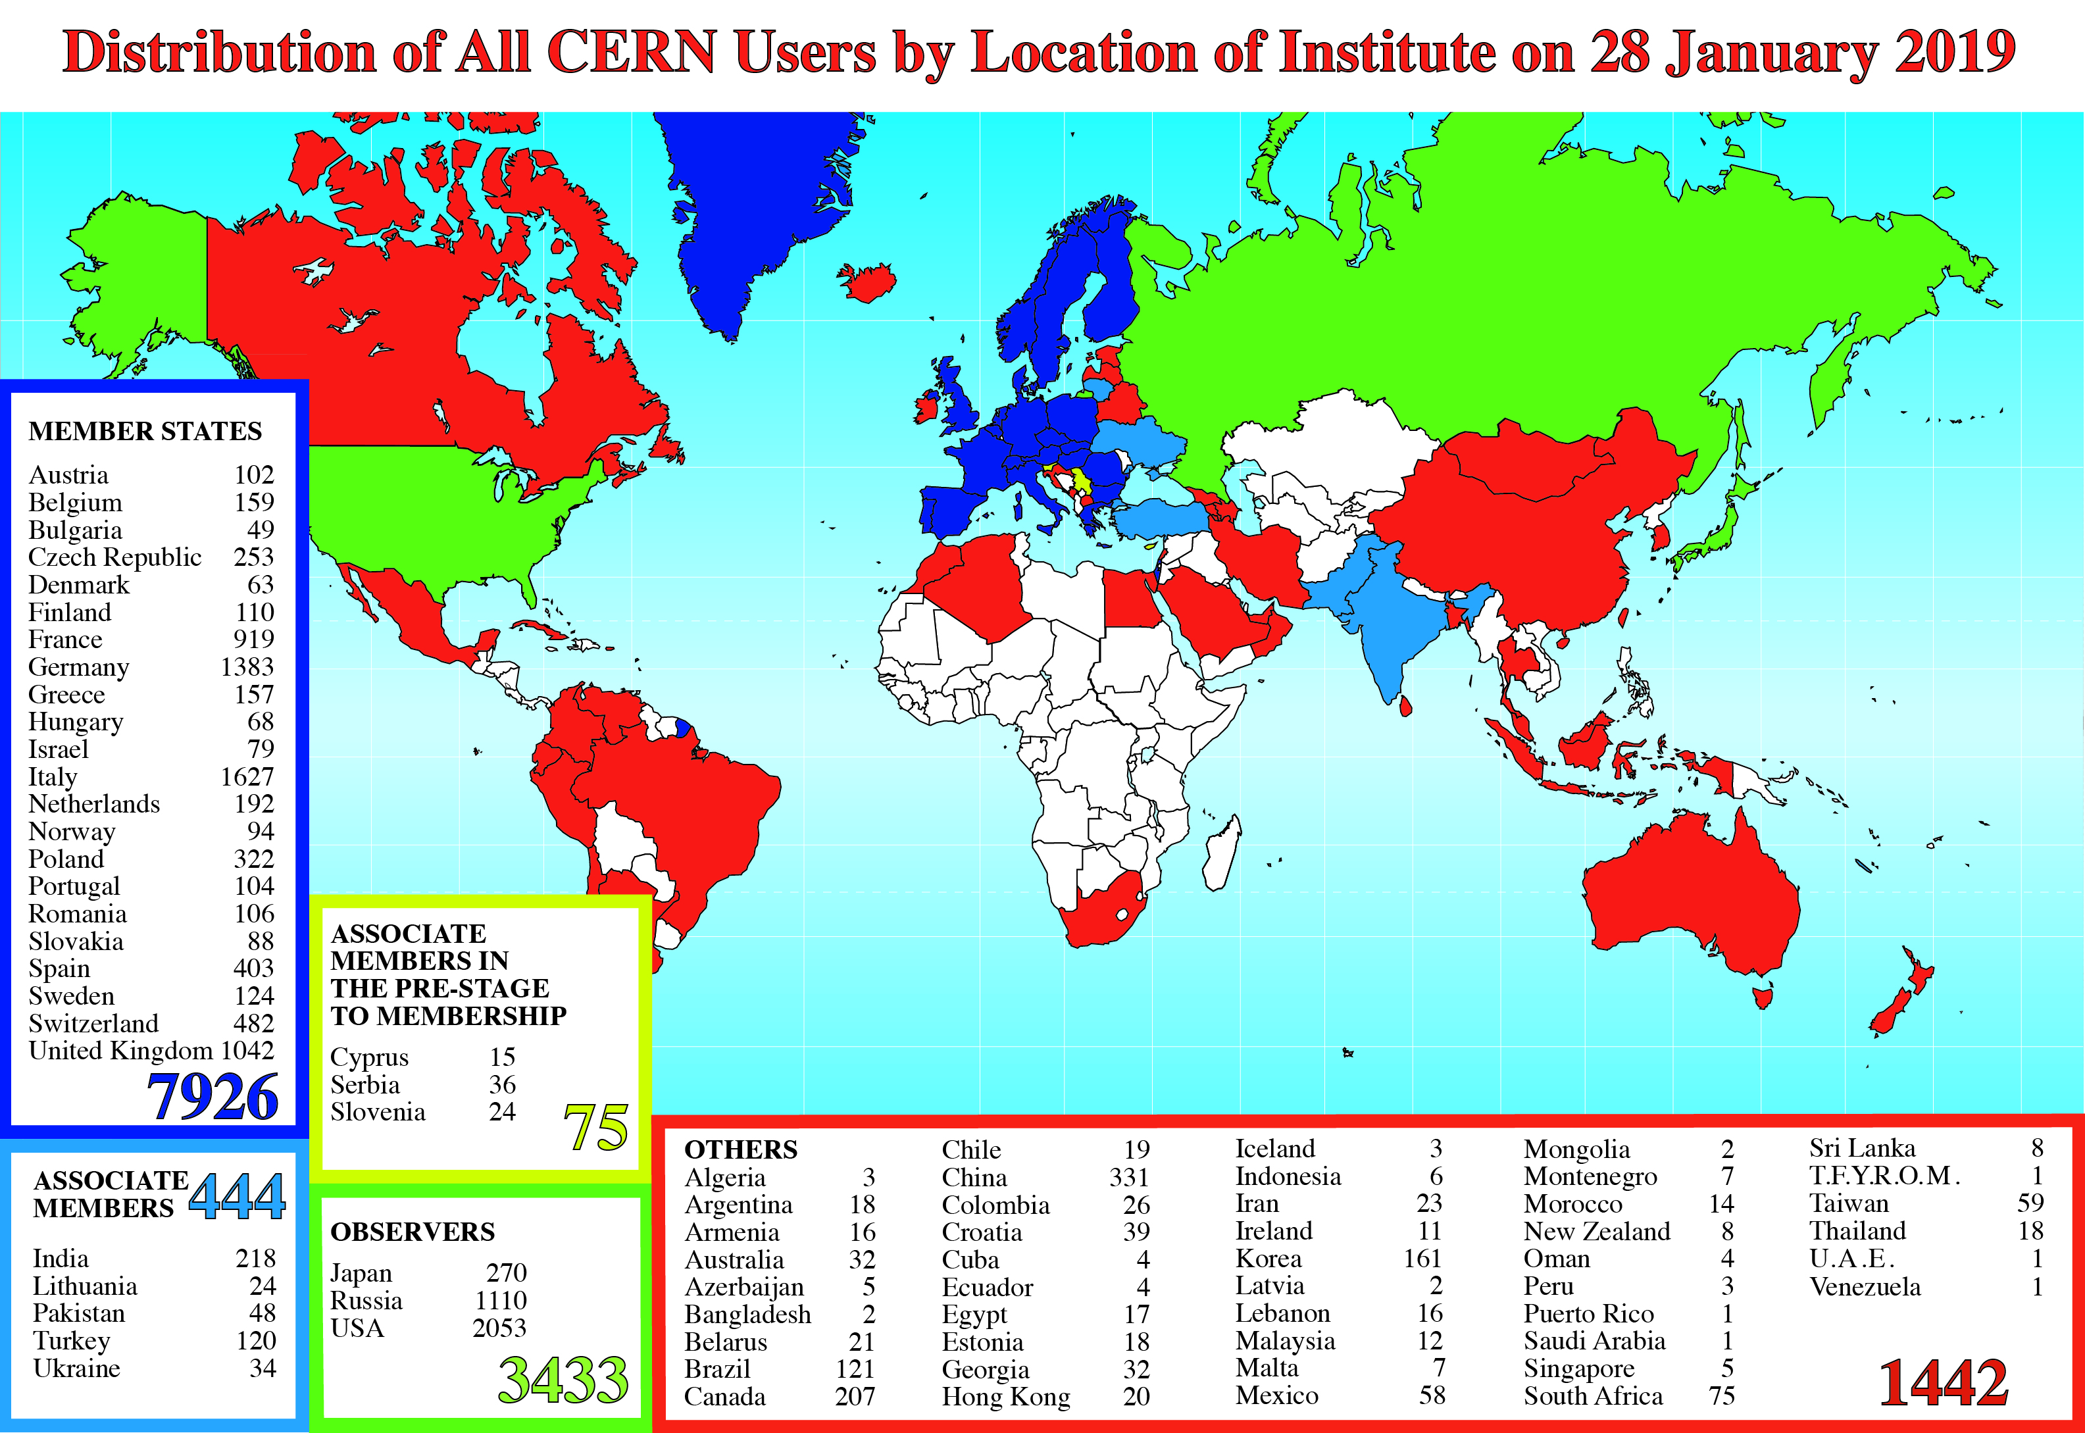
A Global Reach

Slide 16
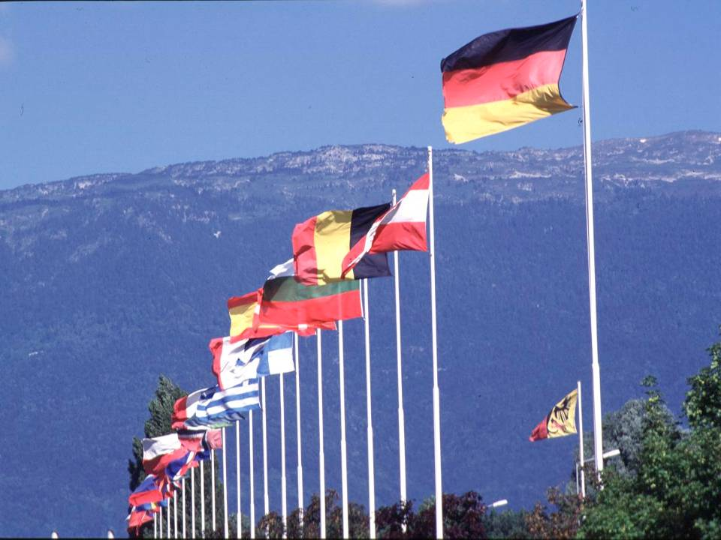

CERN: founded in 1954: 12 European States
“Science for Peace”
Today: 22 Member States
~ 2300 staff
~ 1800 other paid personnel
~ 14000 scientific users
Budget (2019) ~1200 MCHF
Member States: Austria, Belgium, Bulgaria, Czech Republic, Denmark, Finland, France, Germany, Greece, Hungary, Israel, Italy, Netherlands, Norway, Poland, Portugal, Romania, Slovak Republic, Spain, Sweden, Switzerland and
United Kingdom
Associate Members in the Pre-Stage to Membership: Cyprus, Serbia, Slovenia
Associate Member States: India, Lithuania, Pakistan, Turkey, Ukraine
Applications for Membership or Associate Membership:
Brazil, Croatia, Estonia
Observers to Council: Japan, Russia, United States of America;
European Union, JINR and UNESCO
16
Notes:
16
----- Meeting Notes (09/01/2013 14:16) -----
nnn

Slide 17
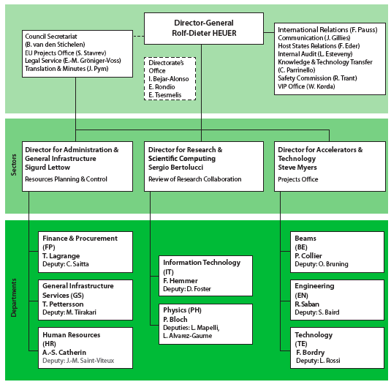
CERN Organization
Scientific Policy Committee
COUNCIL
Finance Committee

Slide 18

(How) Do We Manage The Process?

Slide 19
Simple Micro Rules
Allow people to dream (5% makes already a difference)
Tolerate diversity
Let the physics decide, not the hierarchy
Collaborate and compete
Question and justify – Respect the Dukes of Doubt rather than Kings of Truth

Slide 20
Simple Macro Rules (2)
Set up Collaboration structures that respect individual freedom and which do not impose formal authority
Elect leaders based on technical competence, credibility and trust rather than ego and authority
Allow ad-hoc expert teams to emerge and quickly respond to encountered scientific and technical hurdles
Keep everyone on board, give everyone a voice
Set up peer review processes and arbitration mechanisms

Slide 21
Collaboration Foundations
The LHC Experiments are founded on 7-page Memorandum of Understanding
Not a legal document, rather an informal agreement relying on a best-effort basis of all participating countries and institutions
  e.g. in ATLAS and CMS, some 40 countries and over 170 institutions committing to over 540 MCHF each
Describes the deliverables and sharing of responsibilities and principles of decision-making (e.g. voting rights; one institute one vote)

Slide 22
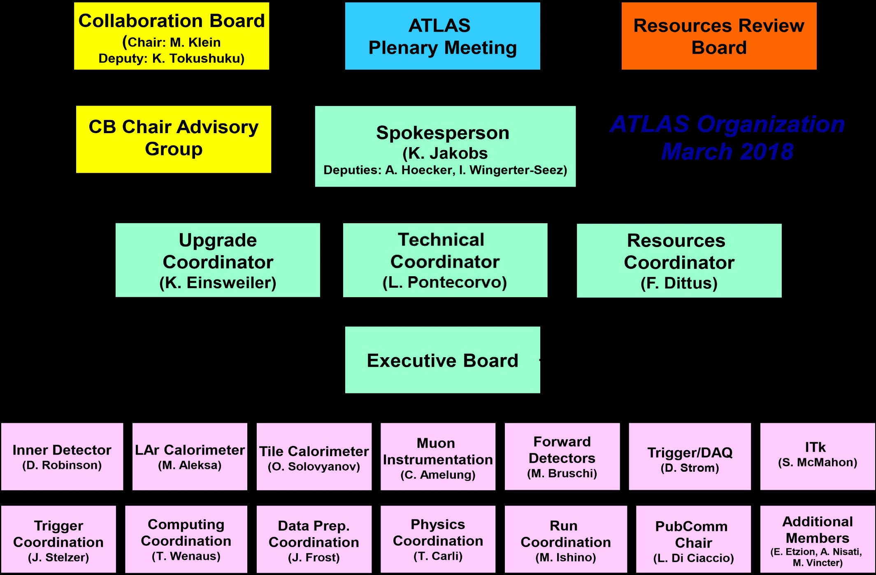
Example: The ATLAS Organization

Slide 23
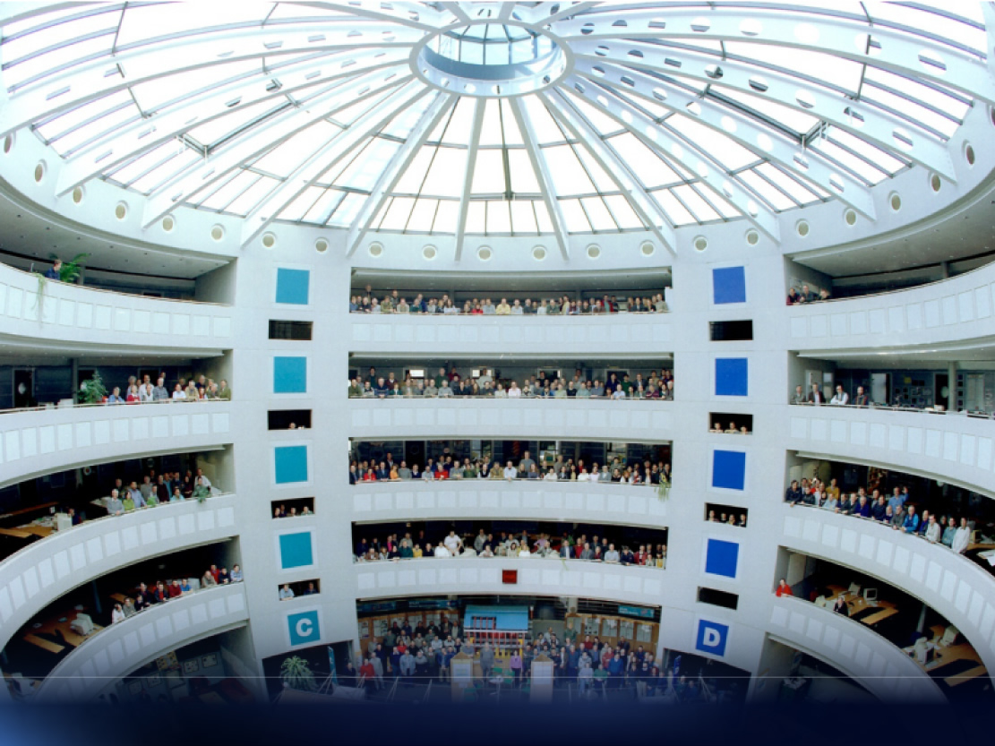

Slide 24
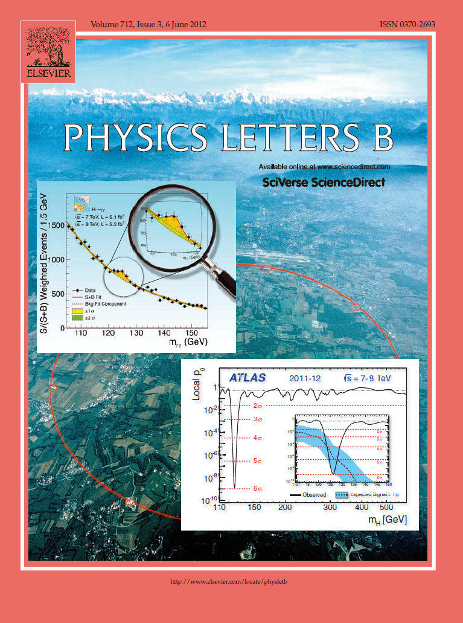
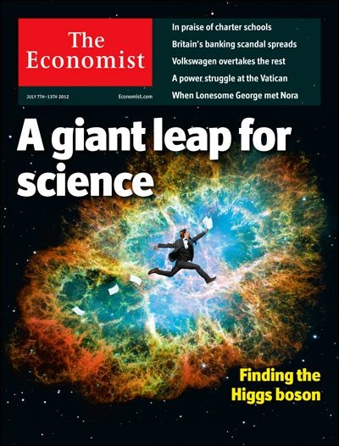

Slide 25
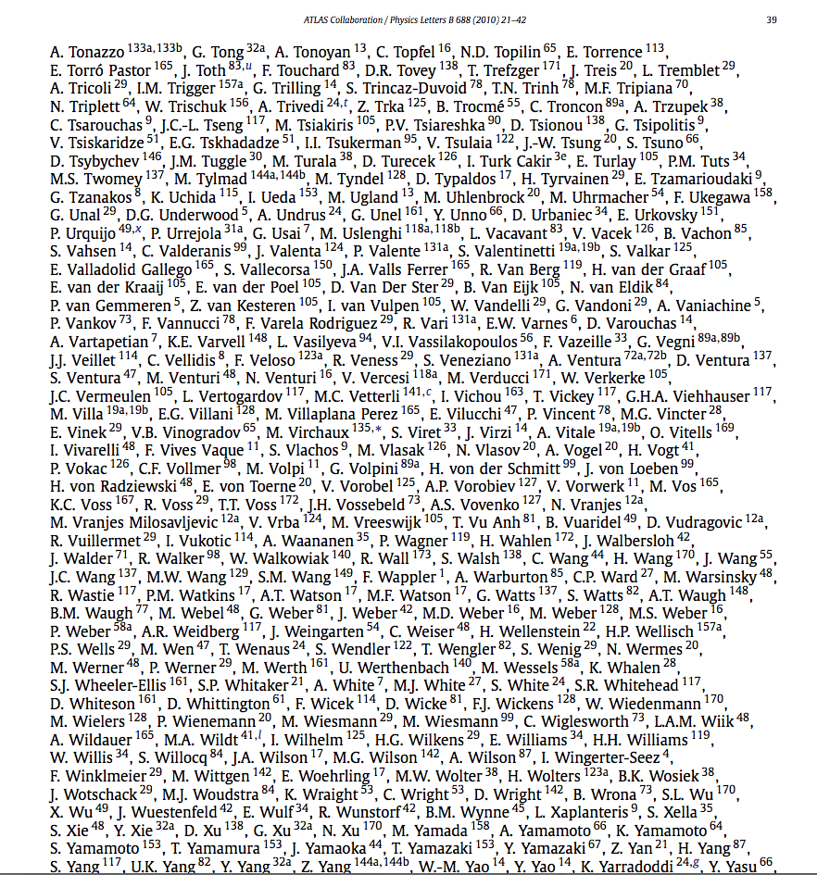
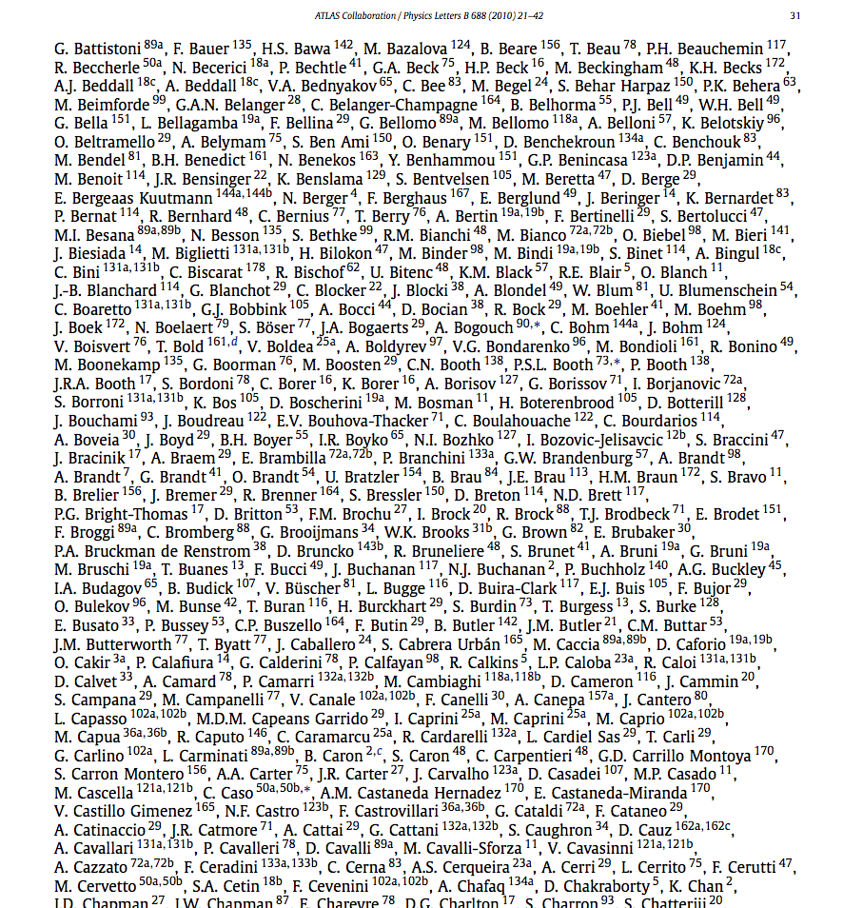
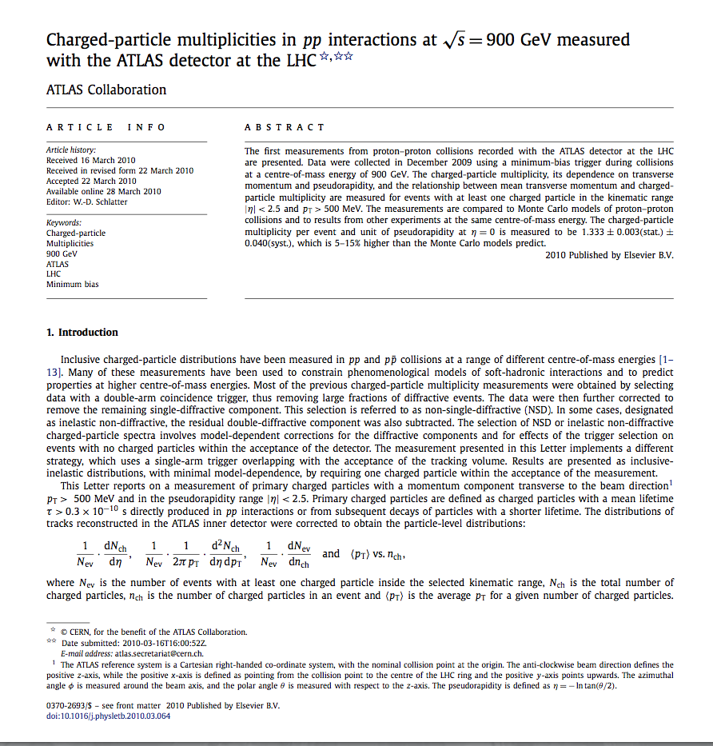
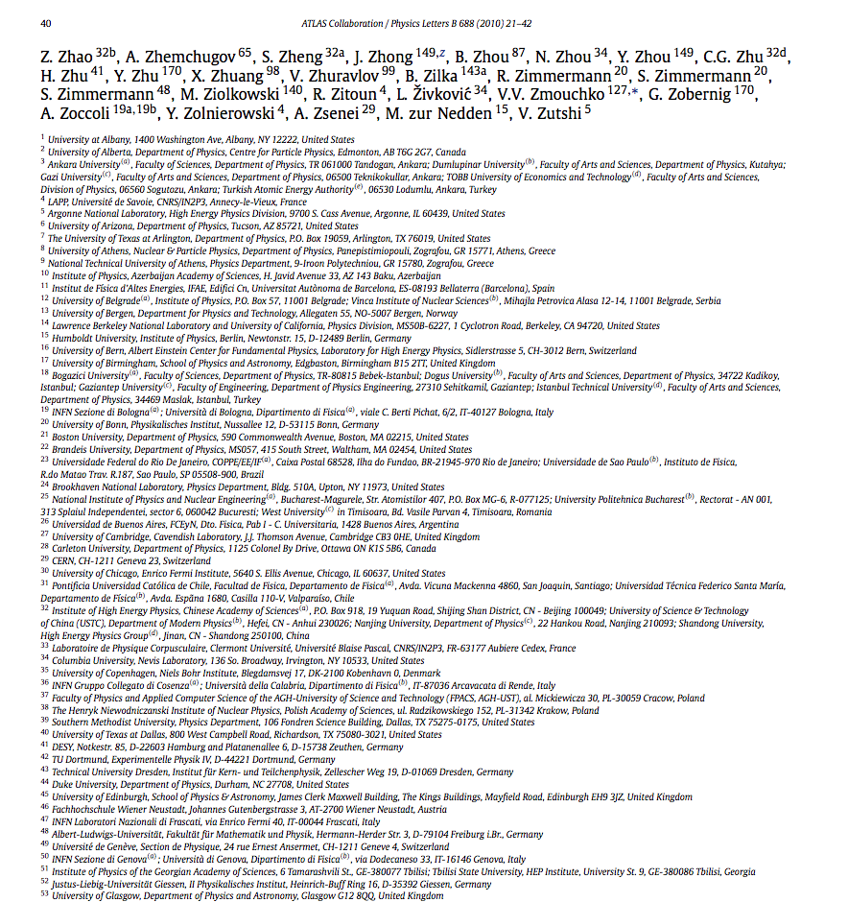
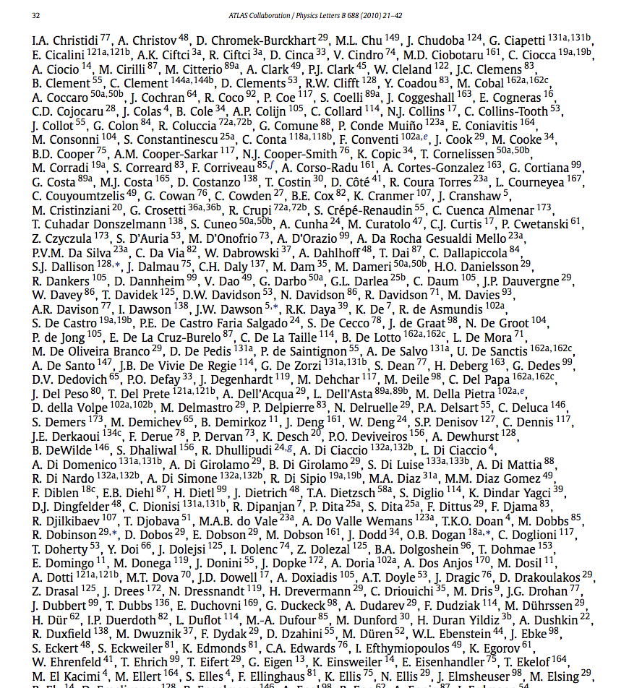
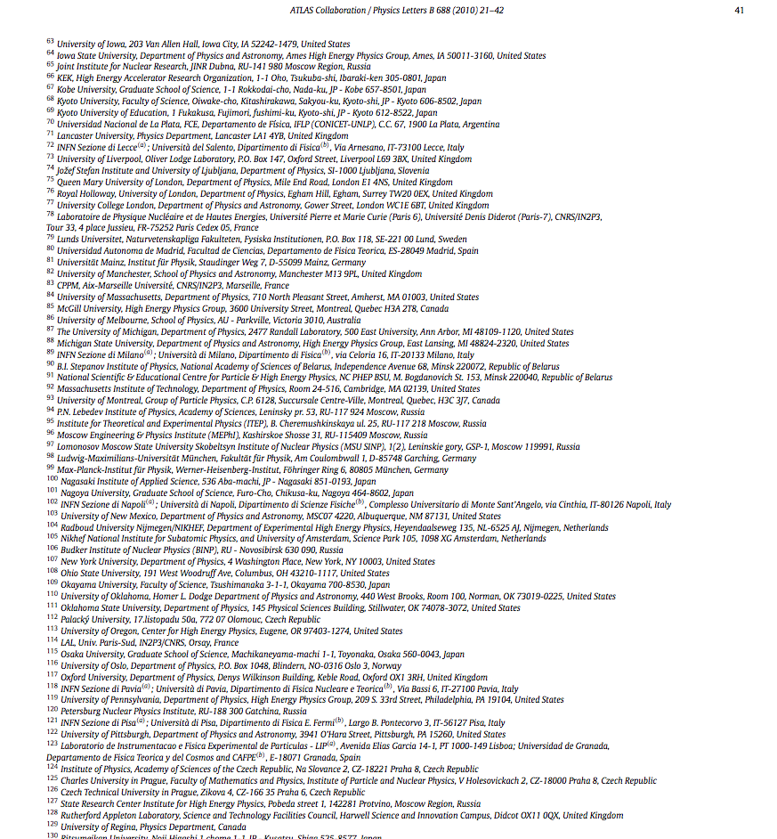
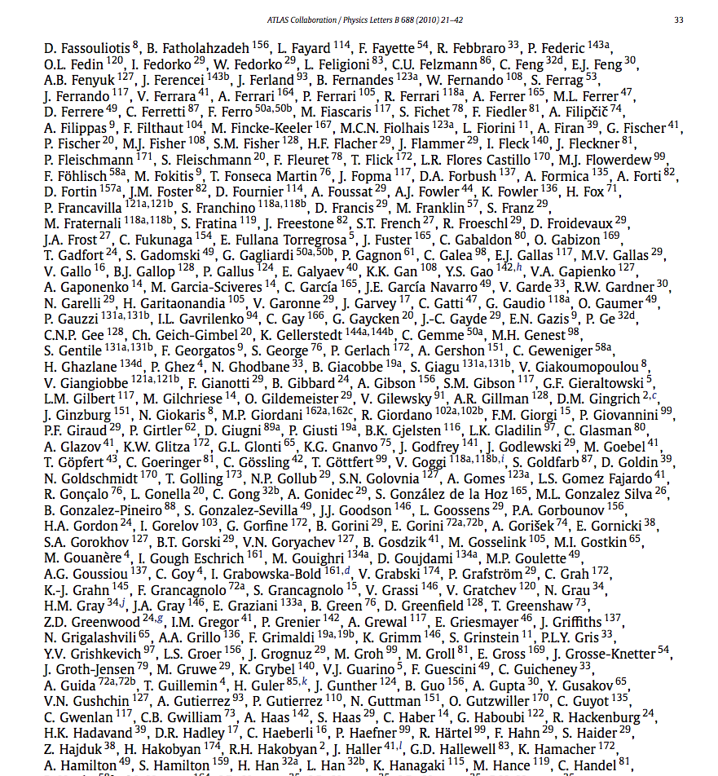
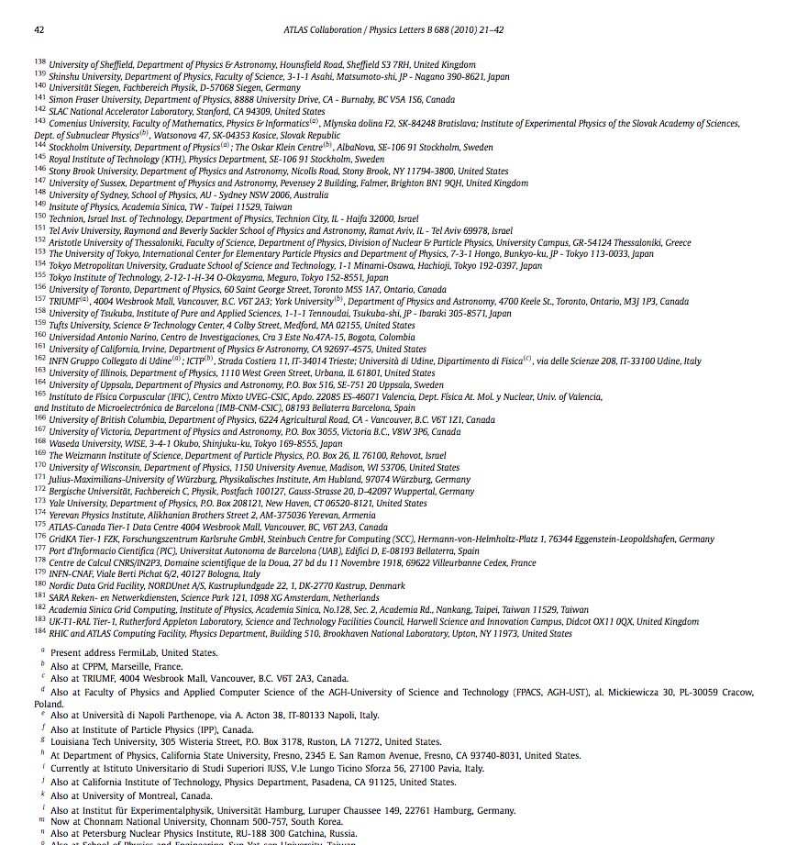
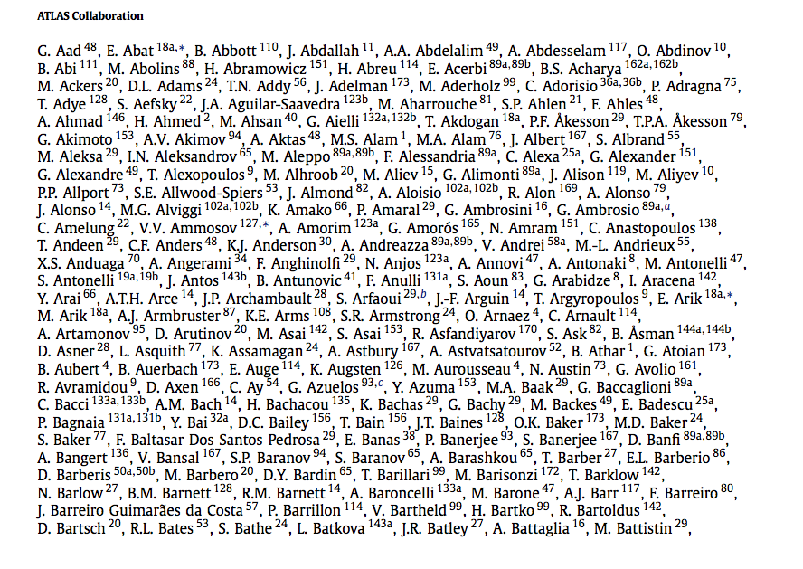
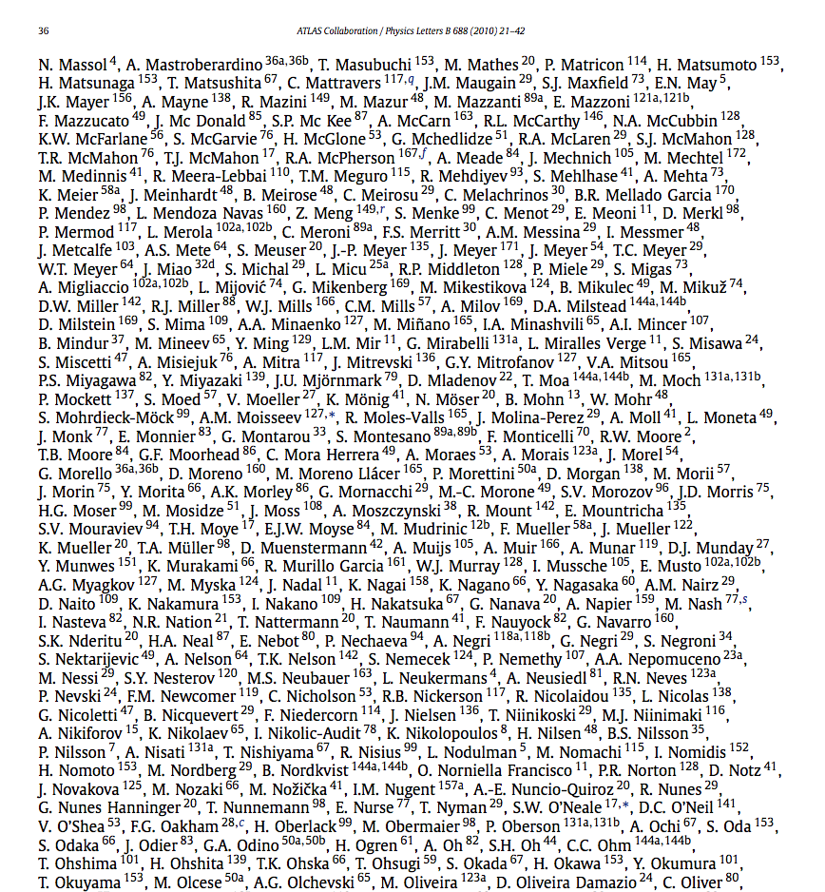

Slide 26



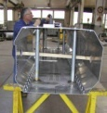
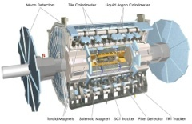
Implementing Strategy is Not Linear
Progress
B
Parallel reality 1
Parallel reality 2
Theory
A
Design
Prototyping
Construct
Install
Operate
Time

Slide 27
Absorbing vs. Reducing Uncertainty
Uncertainty
A
B
Time

Slide 28


Slide 29
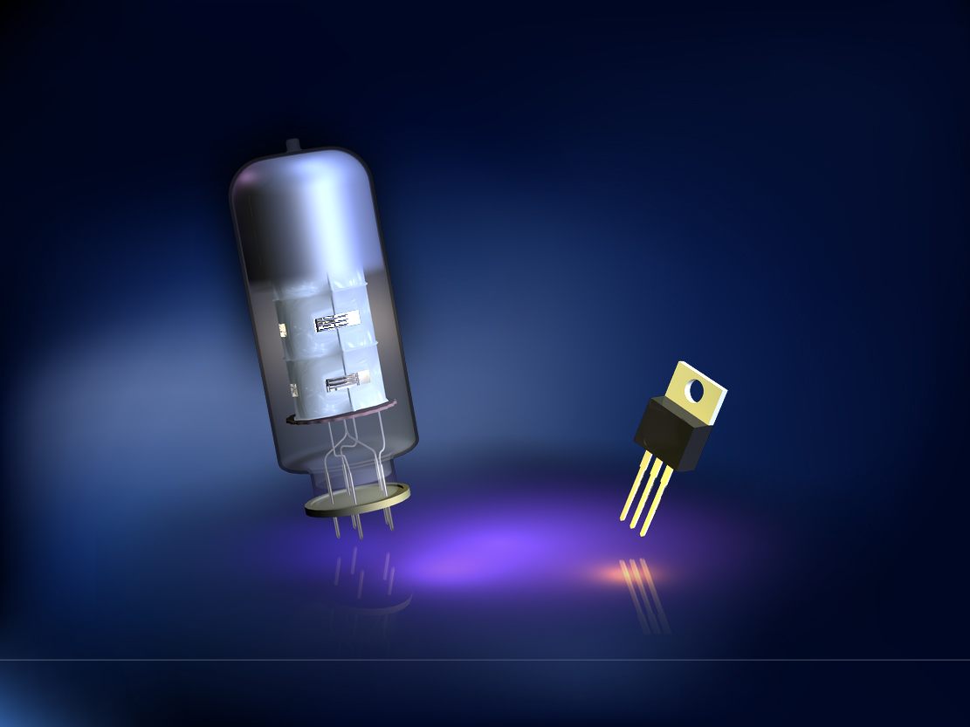

Slide 30

    Antimatter saves lives today

Slide 31
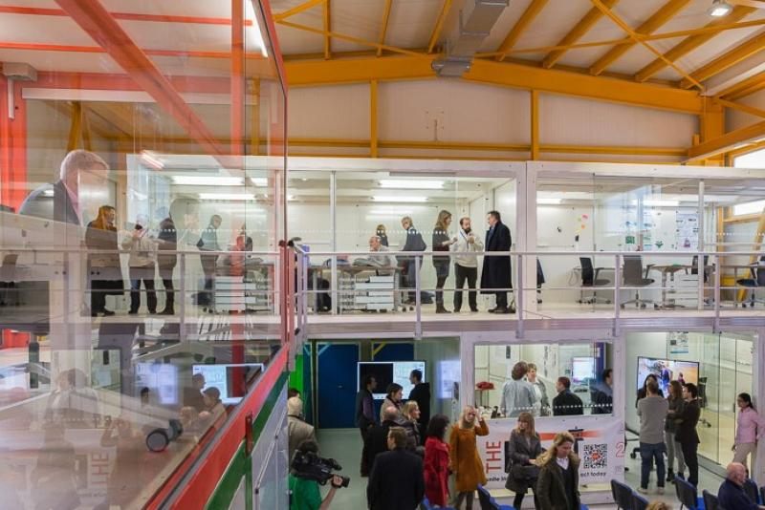
Can Science And Industry Driven Cycles Coexist?

Slide 32
Experimenting at IdeaSquare
Dedicated location at CERN that hosts and facilitates EU-funded detector upgrade/R&D activities and facilitates cross-disciplinary MSc-level student projects.
It provides technical facilities for its project partners, as well as admin support (“innovation in the making”)
  Rapid prototyping (7 meters, 7 seconds)
  Mechanical, electronics labs, cleanroom for advabced assemblies
IdeaSquare hosts R&D projects (e.g. TALENT, EDUSAFE) related to semiconductor sensors and augmented reality technologies and training
In parallel, we facilitate Design Thinking-inspired Challenge Based Innovation Program (CBI)
  MSc students from six countries, teams from product design, business management and engineering students
  Society-driven challenges (not physics!)
European Organization for Nuclear Research Organisation européenne pour la recherche nucléaire

Slide 33
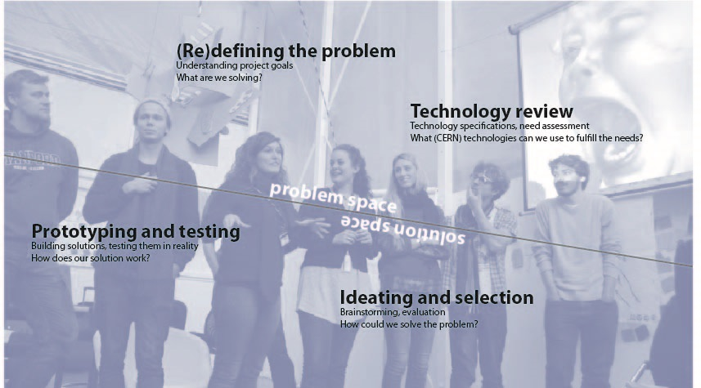
Strong Student Involvement, Inspired by Design Thinking

Slide 34
Experimenting Innovation at IdeaSquare@CERN
IdeaSquare
CERN R&D
Narrow
Initial scope
Wide
“Classical” Knowledge
Transfer route
Solution/technology-driven
Need/user-driven
Initial focus
European Organization for Nuclear Research Organisation européenne pour la recherche nucléaire

Slide 35

Gravity’s Angels

Slide 36
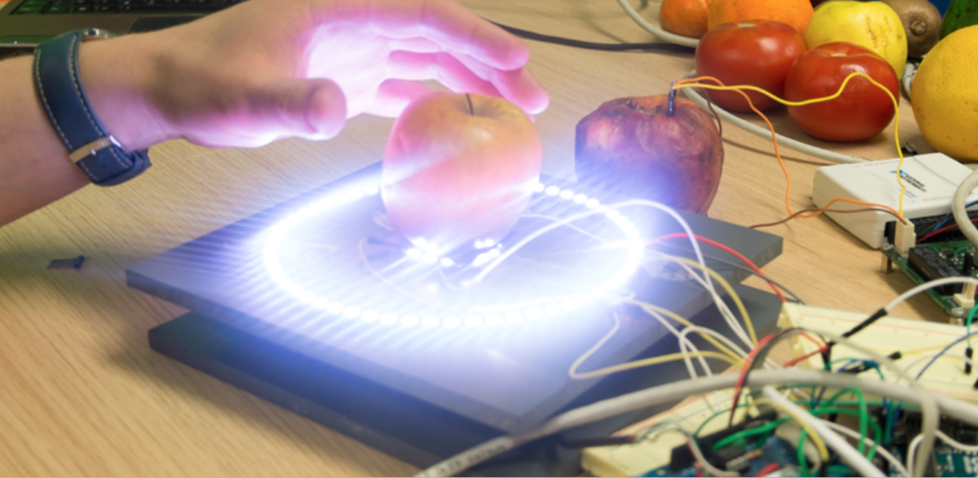
When Is It Right for You?

Slide 37
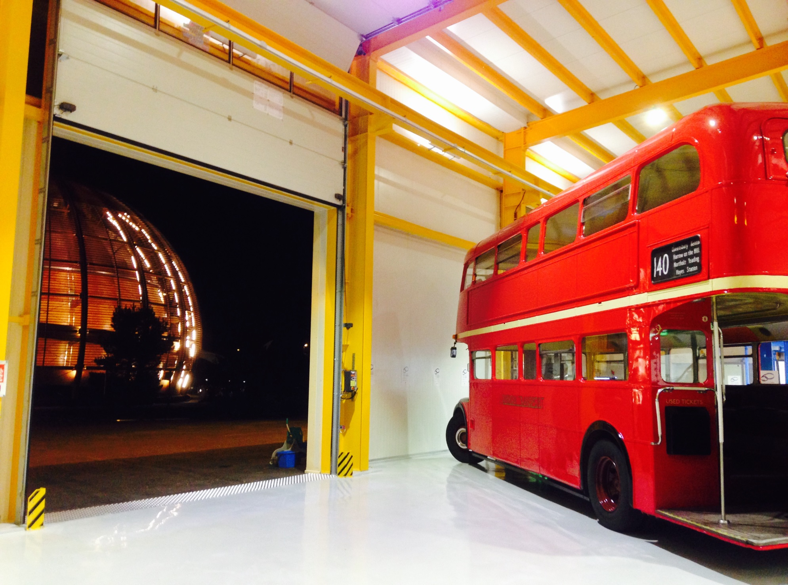
Open Science, Open Innovation

Slide 38
Thank you
European Organization for Nuclear Research Organisation européenne pour la recherche nucléaire

