Slide 1
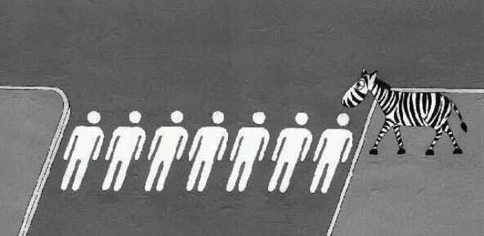
Multiverse Thinking
Pablo Garcia Tello, CERN, IdeaSquare

Slide 2
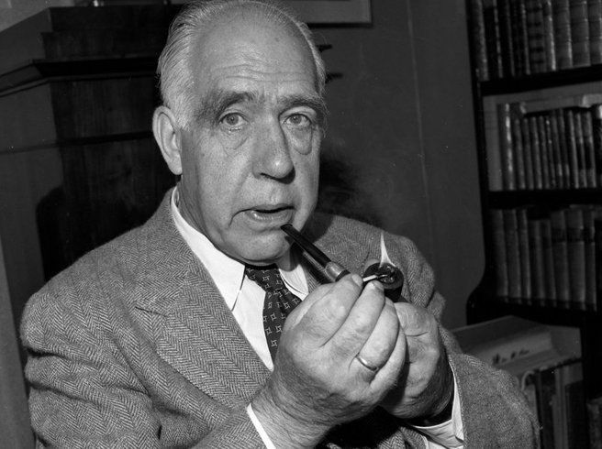
Prediction is very difficult, especially if it's about the future.
Niels Bohr

Slide 3
Despite Bohr’s advice we keep on doing it…
…and proving ourselves wrong…
"X-rays will prove to be a hoax.“
Lord Kelvin, President of the Royal Society, 1883.
"This 'telephone' has too many shortcomings to be seriously considered as a means of communication."
William Orton, President of Western Union, 1876.
“I think there is a world market for maybe five computers.”
Thomas Watson, chairman of IBM,1943.
"Nuclear powered vacuum cleaners will probably be a reality within 10 years.“
Alex Lewyt, President of the Lewyt Vacuum Cleaner Company, 1955.
"I predict the Internet will soon go spectacularly supernova and in 1996 catastrophically collapse.“
Robert Metcalfe, founder of 3Com, 1955.
"There is practically no chance communications space satellites will be used to provide better telephone, telegraph, television or radio service inside the United States.“
T.A.M. Craven, Federal Communications Commission (FCC) commissioner, 1961.

Slide 4
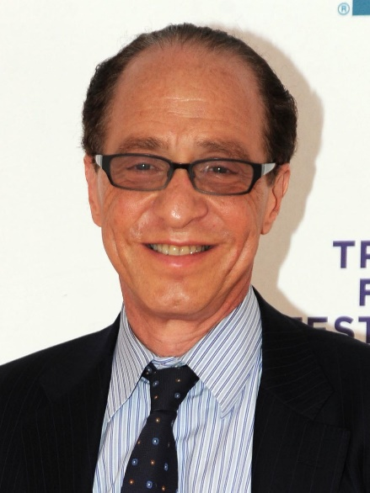

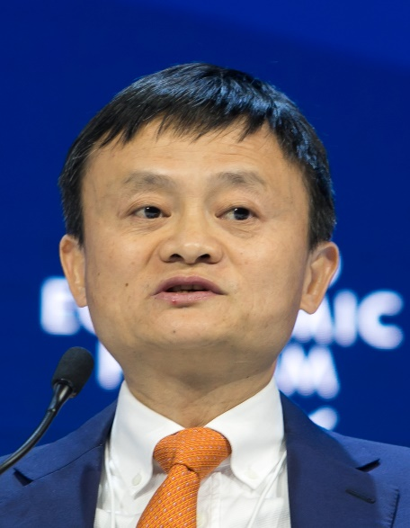
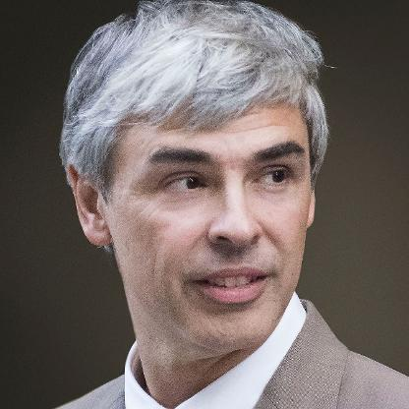
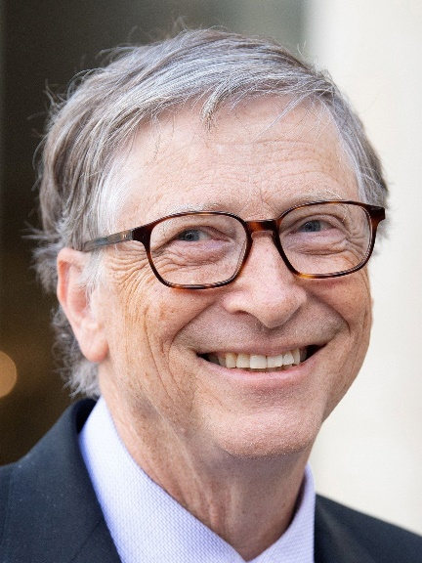
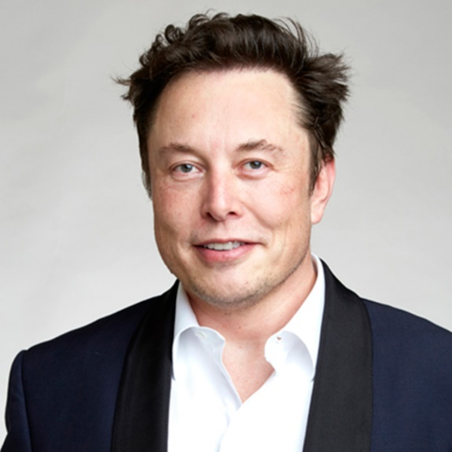
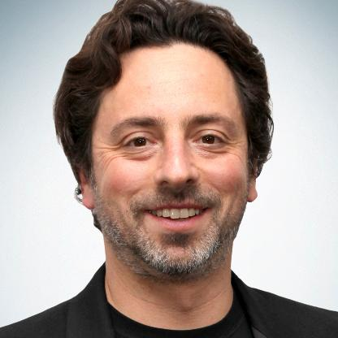
So, what makes
you think
they will be right?

Slide 5
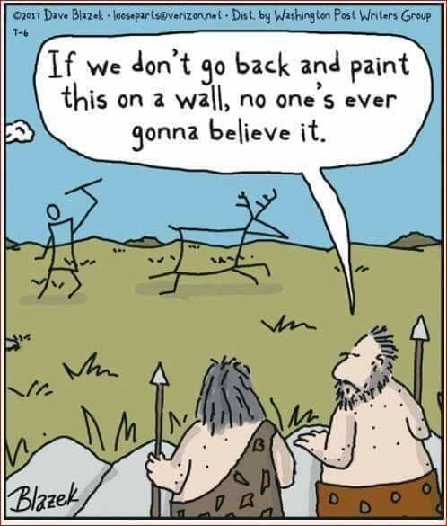
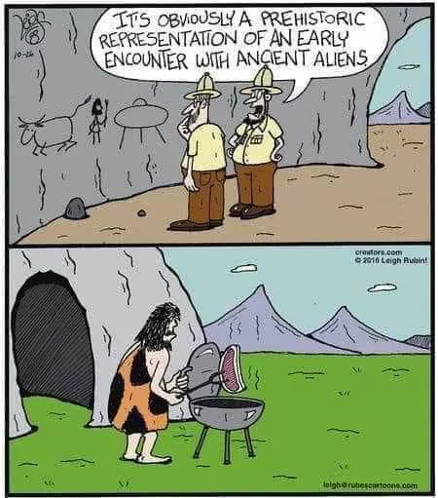
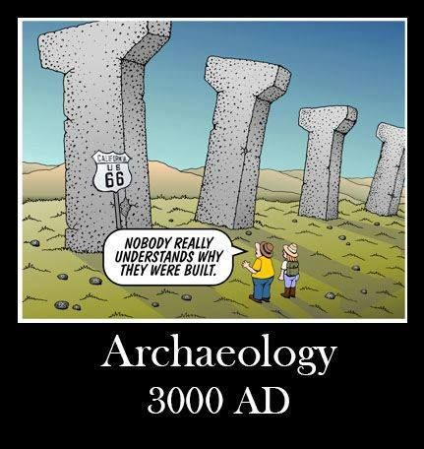
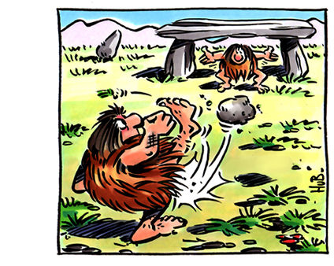
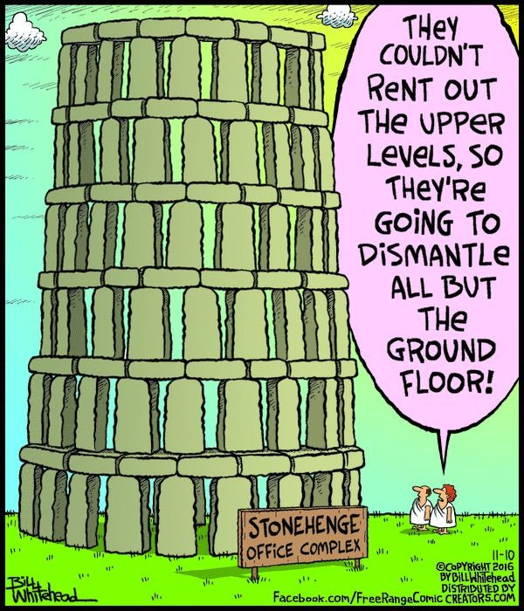
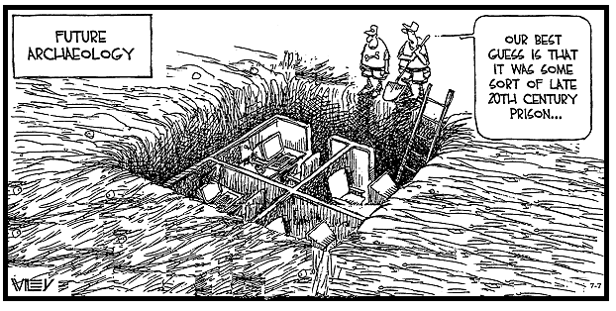
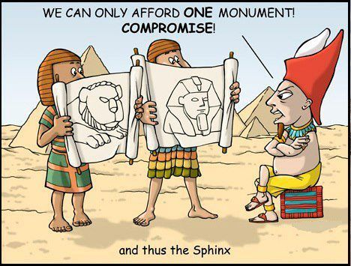
I love future archeology cartoons!!!

Slide 6
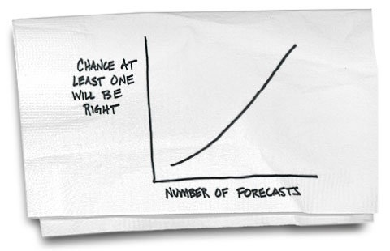
The only way to stay safe in the art of forecasting…

Slide 7
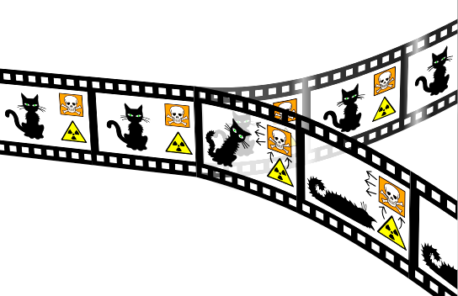
Why Multiverse (Thinking)?
Inspired by the Many Wolds Interpretation of Quantum Mechanics
Anything that can happen does happen…
…in multiple parallel universes.

Slide 8
The Multiverse Thinking (MT) Framework
Option
Thinking
Multiverse
Thinking
System
Thinking
Combinatorial
Thinking

Slide 9
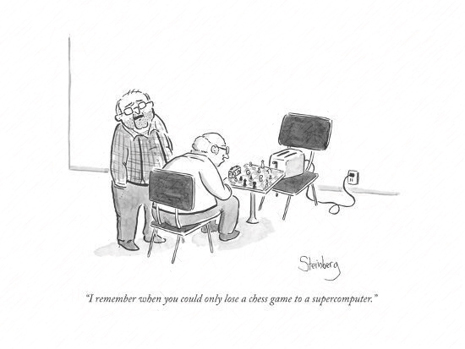
Please, let me show you how to play and you decide how complex you want the game to be…

Slide 10
Step1: Building Block Selection: Social Constructs and the Resources as building blocks
Money
Democracy
Poverty
Property rights
Free Market
Freedom of Expression
Family
Job
Salary….
Social Constructs: an idea that has been created and accepted by the people in a society.
Energy
Population
Data
Capital
Labor
Water
Food
Education….
Resources: sources of supply or support.

Slide 11

Step 2: Scenario Building: Scarcity, Absence and Abundance as options
Scarcity
Social Construct Scenarios
Absence
Abundance
Scarcity
Resources Scenarios
Absence
Abundance

Slide 12
Step 3: Scenario(s) Canvas
Social Constructs vs Social Constructs
Social Constructs vs Resources
Abundance
Abundance
Scarcity
Scarcity
Resources vs Resources
Absence
Absence
Abundance
Absence
Scarcity
Abundance
Absence
Scarcity
Abundance
Scarcity
Absence
Absence
Scarcity
Abundance

Slide 13
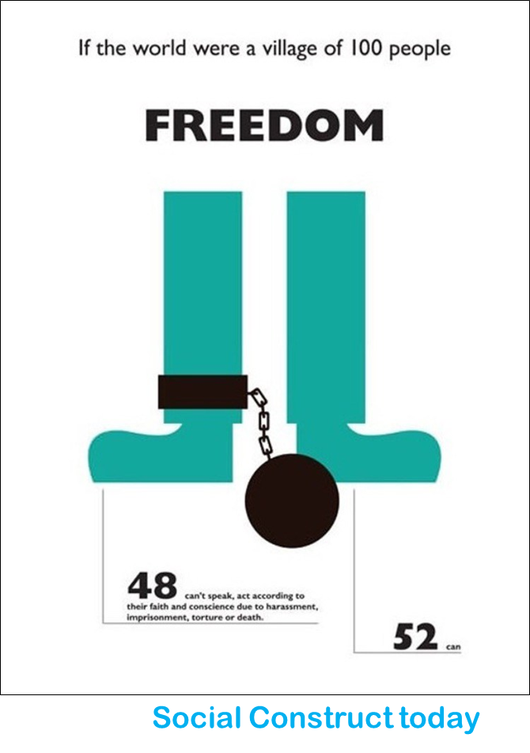
Step 4: Starting Point (nowadays)
Social Constructs vs Resources
Abundance
Scenario Building starts with the world as it is today
…scarcity of Freedom of Expression and abundance of Data
(data is an abundant resource today)
Freedom
of
Expression
Scarcity
Absence
Absence
Scarcity
Abundance
Data
Example

Slide 14
Step 5: My Future (Example)
Social Constructs vs Resources
Abundance
But this is the scenario where we would like to be in
Abundance of Data creates Abundance of Freedom of Expression
Freedom
of
Expression
Scarcity
The goal of MT is to propose a scope of technologies enabling the Transition
Absence
Absence
Scarcity
Abundance
Data

Slide 15
Social Constructs vs Resources
Social Constructs vs Resources
Abundance
Abundance
Freedom
of
Expression
Freedom
of
Expression
Scarcity
Scarcity
Absence
Absence
Absence
Scarcity
Abundance
Absence
Scarcity
Abundance
Data
Data
Nowadays
My Future
Now, we know what our transformative technology should enable
It should lead to and keep a social status quo with abundance of data and abundance of freedom of expression

Slide 16
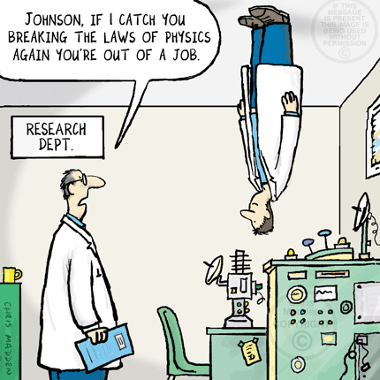
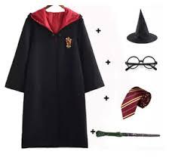
Technology Formulation (conditions)
No violation of Physics Laws.
No “Harry Potter-based Technology.

Slide 17
Step 6: Technology Formulation Canvas
Technology
Modes of Production
Modes of Distribution
Modes of Consumption
Modes of Revenue
Conventional
Unconventional

Slide 18
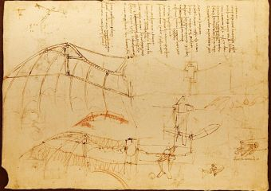
Step 7: Conceptual Prototype
Since MT focuses on (far) future scenarios with envisioned not yet available transformative technologies, prototypes are conceived as conceptual compasses.
The goal of prototyping is not instantiating a solution for a problem of today but envisioning a transformative technology not yet available considering the created scenarios.
The Technology Formulation Canvas is taken as the specs of the not yet available technology.
The prototypes are elaborated using drawings, conceptual pictures, cardboard models, etc,
(I call it Leonardo’s approach).

Slide 19
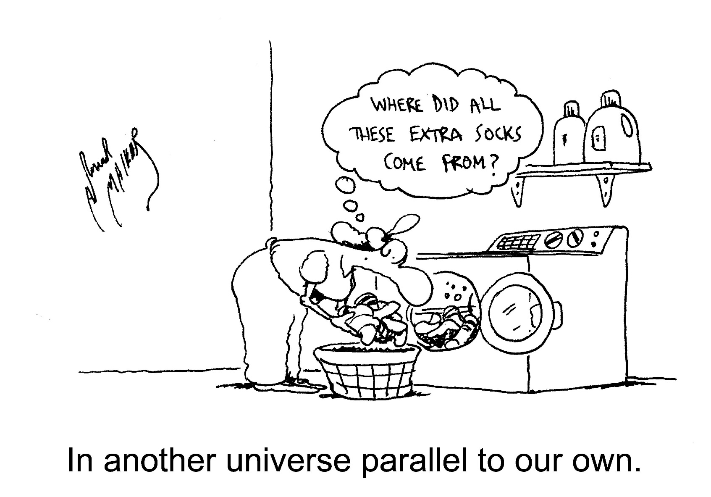
Thanks and Questions

Slide 20
A Little Exercise: Design the Future
In teams.
Choose 3 Social Constructs and 3 Resources.
Following the steps of the MT methodology:
Start with a snapshot of the World Today
Choose your Future in 2100
Consider all (Combinatorial) relations among Social Constructs and Resources
Propose a Technology that enables your future (any technology would be valid as long as it doesn’t break the laws of physics).

