Slide 1
Please, give us advise
Pablo G. Tello
EU Office/IdeaSquare
CERN

Slide 2
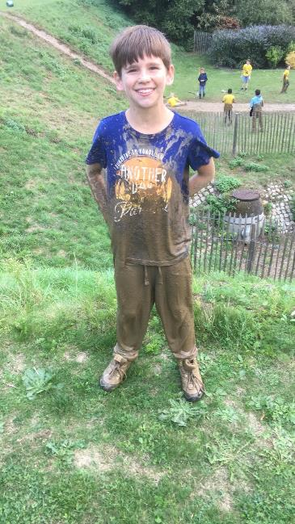
He never follows advise…

Slide 3

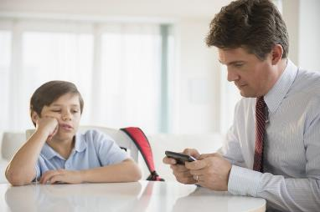
Why children don’t follow advice? ☺…Of course I don’t know. Personal reflection as a parent ☺
Too many
In a rush
Based on “dos and don'ts”
Too little
No time
Based on “or else”

Slide 4
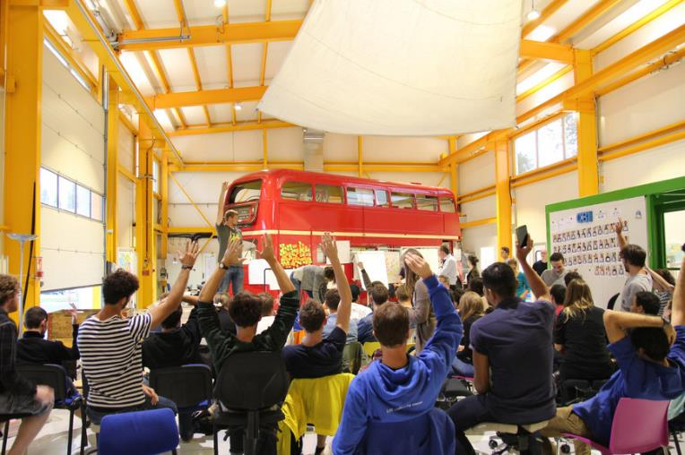
IdeaSquare…we are little kids

Slide 5
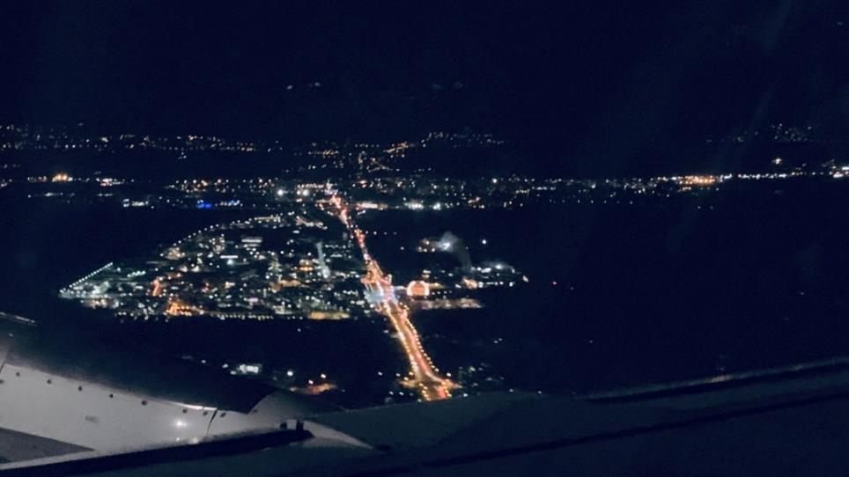
MY MAGIC MOMENT…
When CERN, IdeaSquare and whatever is what I do become insignificant…

Slide 6
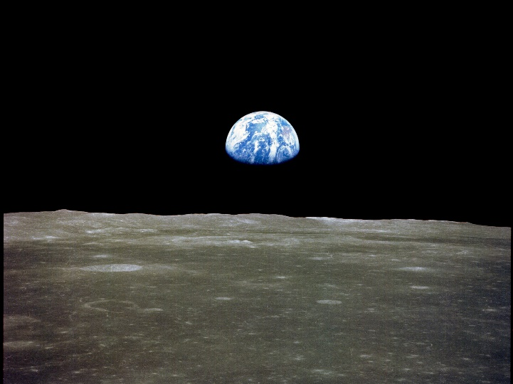
“I do not know what I may appear to the world; but to myself I seem to have been only like a boy, playing on the seashore, and diverting myself, in now and then finding a smoother pebble or a prettier shell than ordinary, while the great ocean of truth lay all undiscovered before me.”
Carl Sagan

Slide 7

What have I learnt?
What I could not learn?
What I will remember?

Slide 8
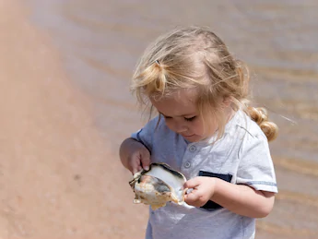
Thank you
Any questions?

