Slide 1
The new PS optics repository
A. Huschauer
LIU-PS Beam Dynamics WG Meeting, 09 October 2019
Acknowledgements
T. Birtwistle, D. Gamba, M. Giovannozzi, K. Li, R. de Maria, J. Renedo Anglada, G. Sterbini

Slide 2
Motivation
Establish coherency between optics created by BE-ABP and optics used by BE-OP
  PS sequence files were updated over the years to incorporate modifications according to ECRs
  PS strengths files haven’t been updated since ~ 10 years
  2018 reference measurement campaigns provided necessary data to update the repository
Improved understanding about the PS main units (MUs)
  Collaboration with TE-MSC on the magnetic model provided new information about the distribution of non-linearities inside the MUs
  Redefinition of layout of MUs and straight sections (SSs) to more accurately represent reality
LS2 perfect time slot to review the PS optics model and create a new repository
  Aiming at:
    a single repository for the whole complex
    a sequence extraction from the layout DB for all accelerators and transfer lines

Slide 3
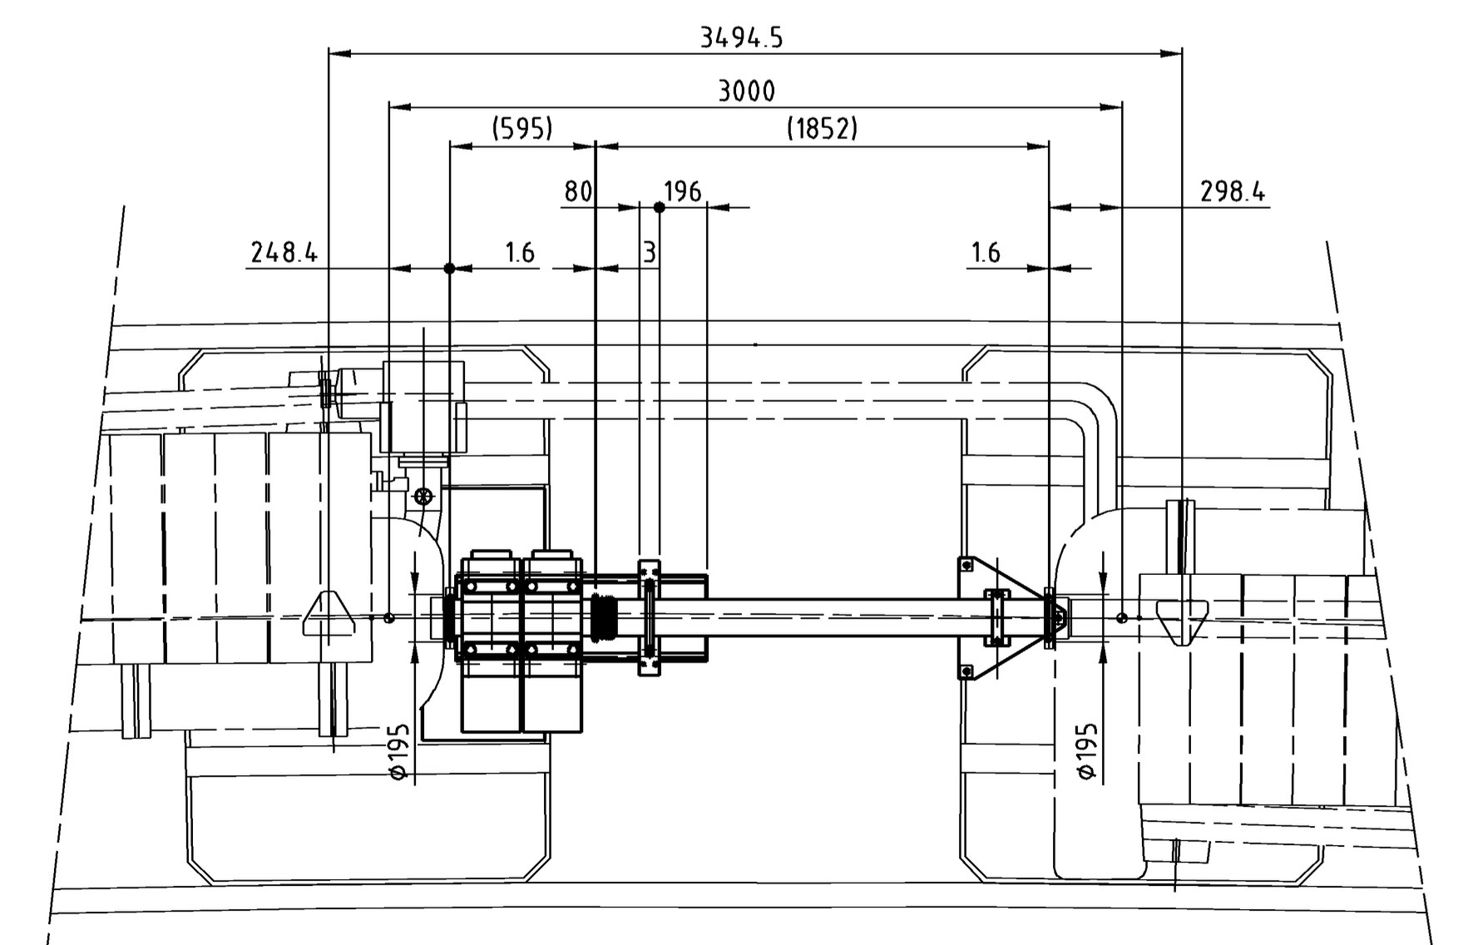
Layout of the PS lattice
Previous PS sequence description considered SSs to extend from flange to flange
  Resulting in 20 long SSs of 2.4 m and 80 short SSs of 1.0 m
  Low-energy quads (LEQ) and BPMs were therefore allocated to the MUs as they are mounted in the drift space between the main coils
  In view of extracting the sequence from LDB this had to be corrected

Slide 4
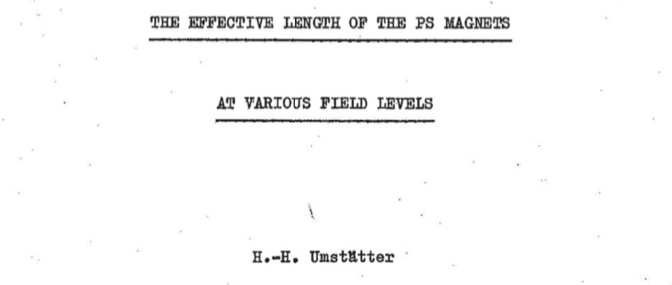



Layout of the PS lattice
Revision of the SS and MU definitions
  In 1972 H. Umstätter nicely described the nominal PS layout in the following document (EDMS2026379)
  Nominal circumference:
    Including 20 SSs with a length of 3.0 m and 80 SSs with 1.6 m
    (188.0 m in total)
    This leads to a magnetic length of each MU of
    And a bending radius of

Slide 5
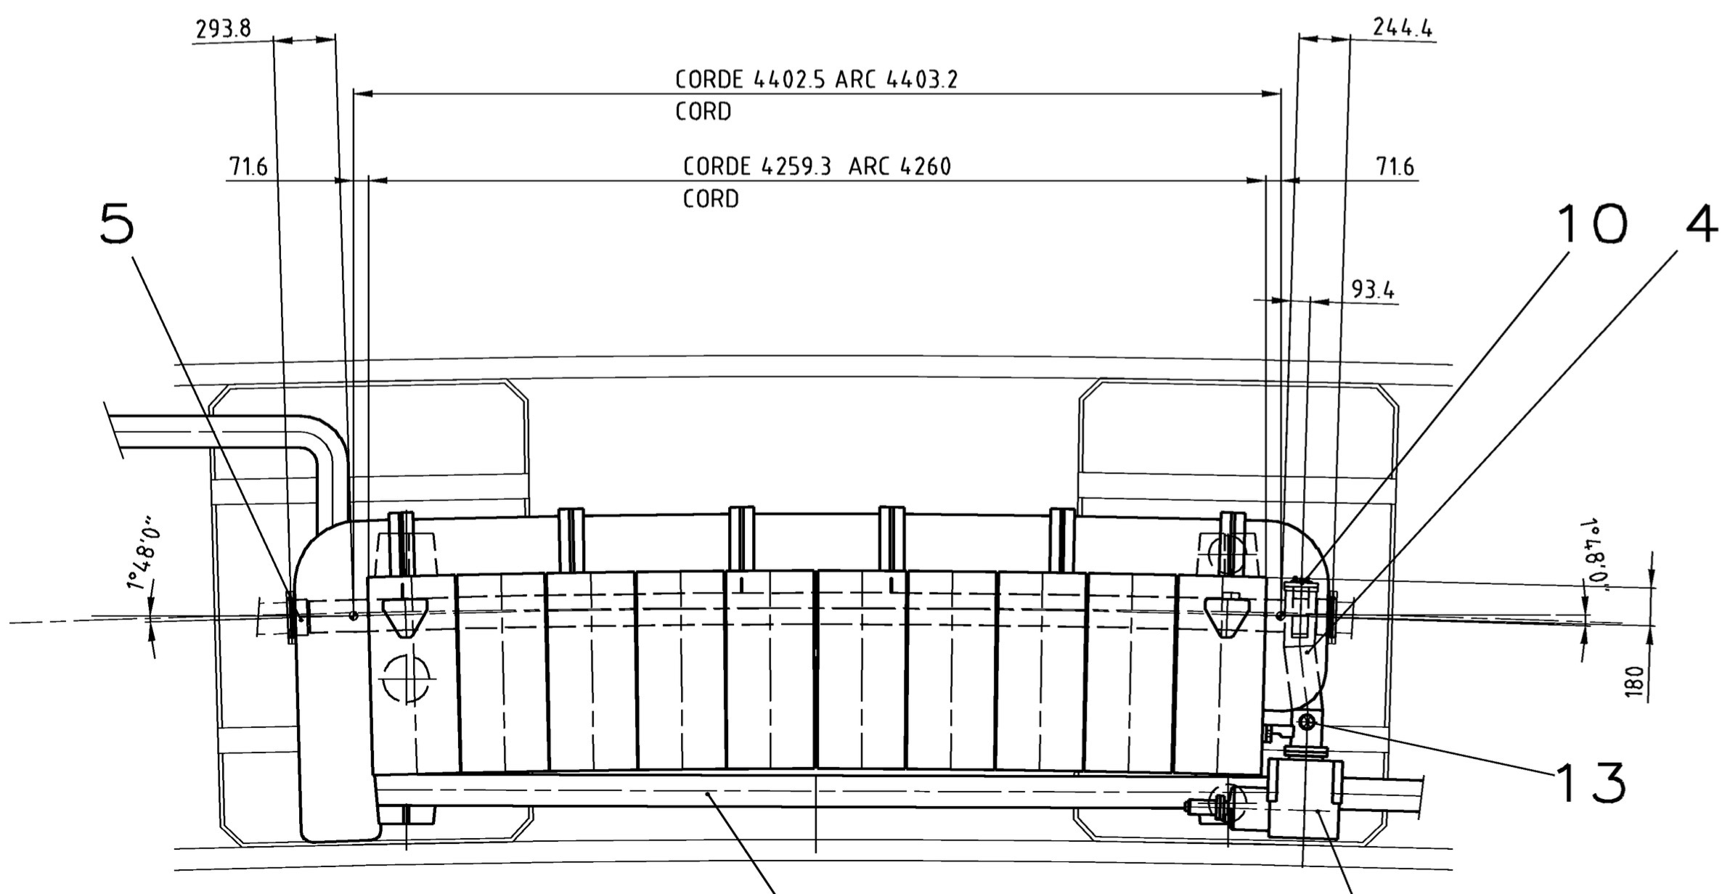
Layout of the PS lattice
Definition of SSs and MUs has been updated to adhere to this definitions
  Collaboration with Tom (EN-ACE) to update the LDB accordingly
  Length of MUs is defined as their magnetic length as indicated by the two reference points on the drawings
    The full MU assembly length is therefore composed of the lengths of the iron blocks, the central and the mini junctions and a correction length between end of the iron and magnetic length reference point
Example of SS01 and MU01

Slide 6
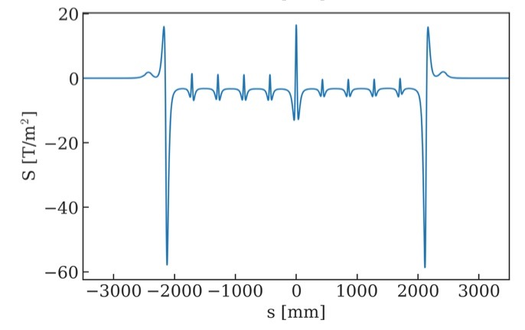
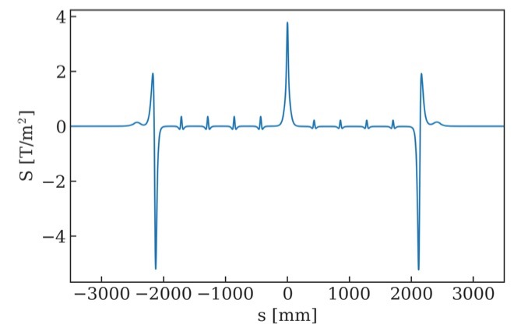
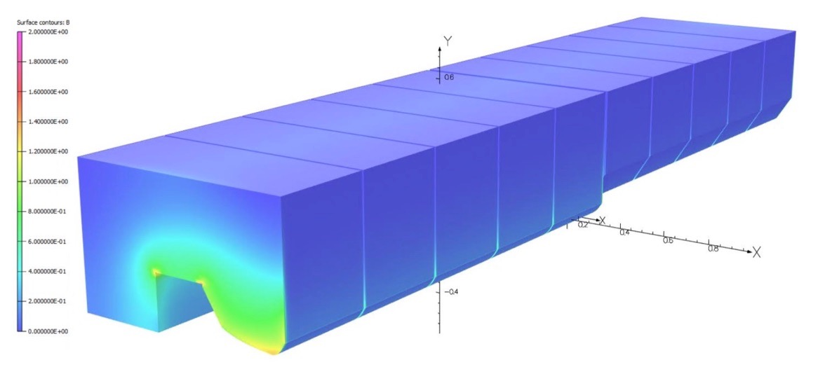
Layout of the PS lattice
OPERA description of the PS MUs
  TE-MSC improved the meshing used in the 3D OPERA model of the Mus
    Convergence of the obtained harmonics independent of the reference radius
    In the absence of saturation effects, higher order components mainly localized at extremities and in the junction
    Saturation effects lead to an important contribution of the body as well

Slide 7
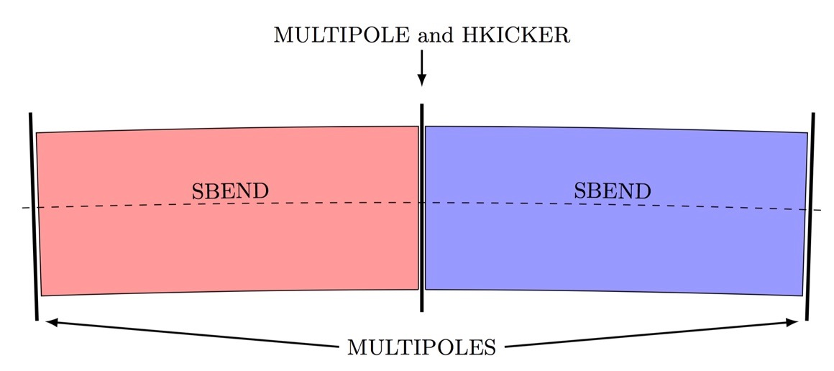
Layout of the PS lattice
OPERA description of the PS MUs
  TE-MSC improved the meshing used in the 3D OPERA model of the Mus
    Convergence of the obtained harmonics independent of the reference radius
    In the absence of saturation effects, higher order components mainly localized at extremities and in the junction
MAD-X description of the PS MUs
  Description improved based on information from OPERA simulations
    Concerns mainly the distribution of the multipoles inside the MUs, i.e. three multipoles only (entrance, junction, exit)
      Previously there were four at the entrance and exit of each half-unit, with their effects basically cancelling out in the junction

Slide 8
Layout of the PS lattice
OPERA description of the PS MUs
  TE-MSC improved the meshing used in the 3D OPERA model of the Mus
    Convergence of the obtained harmonics independent of the reference radius
    In the absence of saturation effects, higher order components mainly localized at extremities and in the junction
MAD-X description of the PS MUs
  Description improved based on information from OPERA simulations
    Concerns mainly the distribution of the multipoles inside the MUs, i.e. three multipoles only (entrance, junction, exit)
      Previously there were four at the entrance and exit of each half-unit, with their effects basically cancelling out in the junction
  Additional modification to the lattice concerns the treatment of the effect of the PFW:
    Previously incorporated using the multipoles, their quadrupolar and sextupolar effect are now directly assigned to the SBEND
    Only octupole component will still be included using the multipoles
  Saturation effects at high-energy are now also accounted for by distributing the bare-machine non-linearities between multipoles and SBENDs

Slide 9
Extraction of the PS lattice from LDB
New LDB currently under development by BE-CO
  Possibility to extract the sequences should be available this month
Extraction of the PS lattice
  Definition of SS-sequence will come directly from LDB
    Currently verifying lengths and positions of all elements with Tom
    Any modification announced by an ECR will be automatically incorporated
  Definition of MU-sequence will remain with BE-ABP, as the description of the MUs does not have a real correspondence to mechanical elements as it is the case in the SSs

Slide 10
The new optics repository
Repository has been completely restructured
  Previously various folders such as sequence, strength, madx,… contained all files
  New structure follows the approach implemented by Riccardo for the LHC, and for each accelerator we now have:
    Different optics scenarios (i.e. bare machine, EAST, LHC, TOF, ... in the case of the PS) and
    Different configurations for each scenario (i.e. injection, flat bottom, flat top, extraction, …)
    Each configuration is based on the 2018 reference measurements
Information for the whole chain is now centralized on a new webpage
  For the moment only PS and PSB follow the new structure, others to come
  Webpage is basically displaying the content of the underlying Gitlab repository
    Using MkDocs to write the page content in Markdown and automatically transform it into html code
      Initial steps provided by Davide and Guido (link) much appreciated!

Slide 11
The new optics repository
    http://acc-models.web.cern.ch

Slide 12
Concluding remarks
New PS optics repository available online and on Gitlab
  Files will also soon be made available on EOS and AFS
Missing steps:
  Finalize setup of EAST slow extraction configuration
  Finalize cross-check of transfer functions for different magnetic elements
  Correct lengths and positions of certain elements in LDB
Latest versions will be tagged on Gitlab
  Aiming at the use of a single repository for OP and ABP/ABT
  JMAD configuration files to be included in the repo
Also working on a PS aperture model
  Help provided by Oliver and Tom to include aperture information in LDB
  Possibility to define apertures of arbitrary geometry implemented in MAD-X and PTC
Any feedback on the new repository is highly appreciated!

