Slide 1
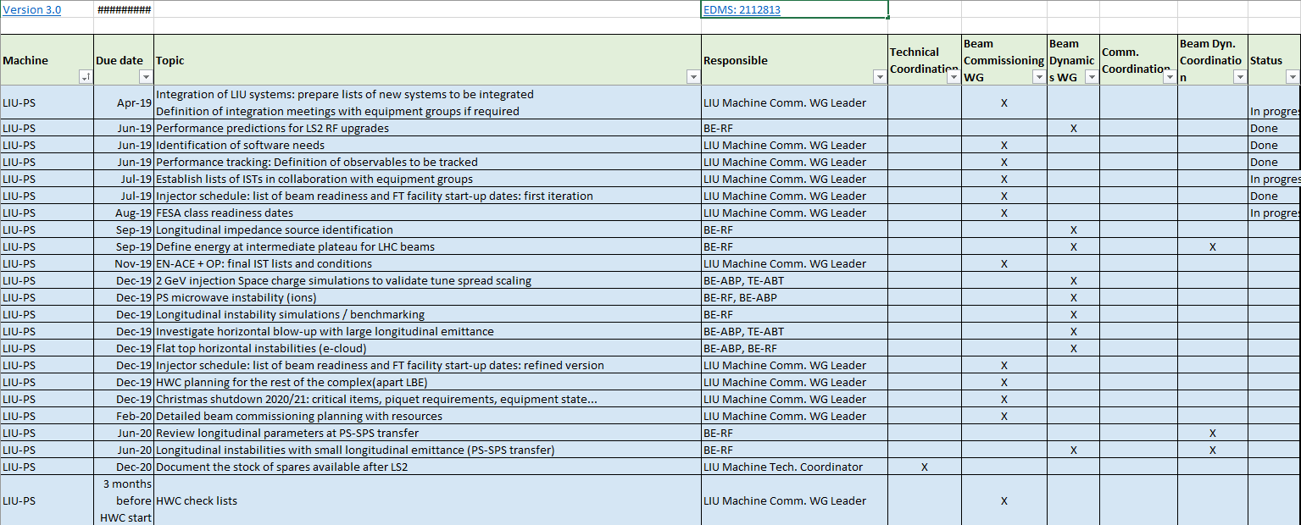
Follow-up of milestones from Montreux
EDMS document: 2112813
Conclusions from LIU Workshop, February 2019 in Montreux
Covering all accelerators in LIU

Slide 2
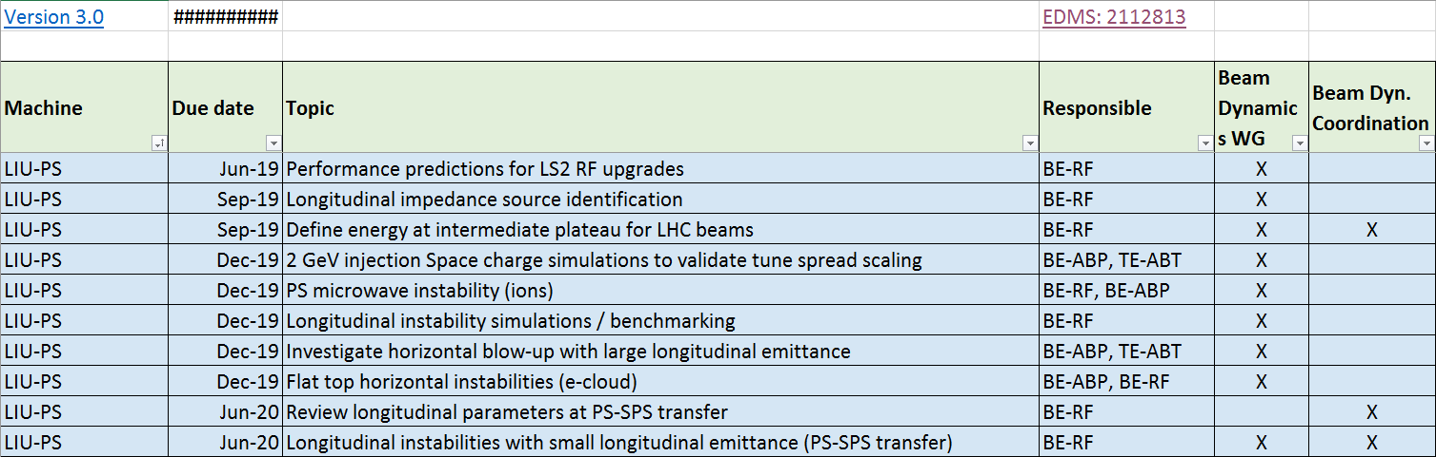
Follow-up of milestones from Montreux
EDMS document: 2112813
Conclusions from LIU Workshop, February 2019 in Montreux
Covering all accelerators in LIU

