Slide 1



Understanding Brain Function in Psychiatric Disease
MEDAMI 2022 – 5th September 2022
E A Rabiner,
EVP, Head of Translational Applications
Invicro
Reader in Molecular Neuroimaging,
Centre for Neuroimaging Sciences,Institute of Psychiatry, Psychology and Neuroscience, King’s College, London

Slide 2
Pharmacokinetic and Pharmacodynamic Biomarkers
Concentration of drug in tissue
Drug-target interaction
Change in molecular target density
Change in molecular target affinity (allosteric modulation)
Change in neurotransmitter release
Change in brain activity and/or metabolism

Slide 3
Applications of Imaging in Translational Medicine
Investigate Normal State
  Normal Function
  Link to Individual Differences
    Genetic
    Environmental
Investigate Disease
  Evaluate Pathological Changes
  Disease Progression
  Effects of Treatment
Evaluate Pharmacology
  Drug/Target Interaction
  Dose Selection
  Off-target interactions
Anatomy
X-ray
Computerised Tomography (CT)
Structural Magnetic Resonance Imaging (MRI)
Ultra-sound (US)
Light Photography
Physiology/Biochemistry/Pharmacology
Positron Emission Tomography (PET)
Single Photon Tomography (SPET)
2D γ-Scintigraphy
Magnetic Resonance Spectroscopy (MRS)
Functional Magnetic Resonance (BOLD/ALS)
Near Infrared Spectroscopy (NIRS)
Electroencephalography (EEG)
Electrocardiography (ECG)
Magnetoencephalography (MEG)
Evaluates anatomical features e.g. organ size, shape, tissue density, water/fat content
Evaluates specific molecules in tissue. Exogenous probes or endogenous molecular markers
Evaluates electromagnetic fields generated by excitable tissues

Slide 4
Pharmacokinetic and Pharmacodynamic Biomarkers
Concentration of drug in tissue
Drug-target interaction
Change in molecular target density
Change in molecular target affinity (allosteric modulation)
Change in neurotransmitter release
Change in brain activity and/or metabolism

Slide 5
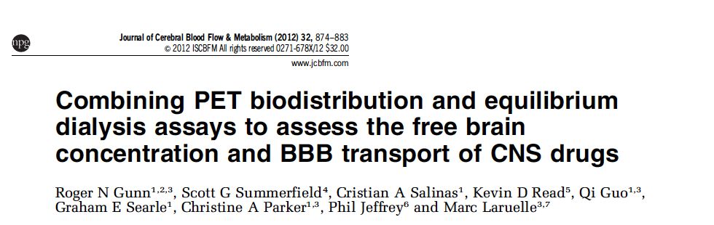


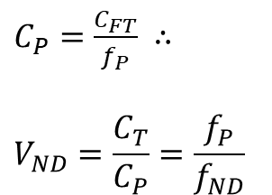
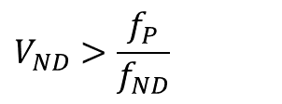
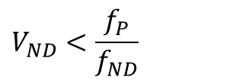

Biodistribution⁺- Assessing Free Drug Brain Concentrations
Biodistribution⁺
Measuring Free Drug Concentration in Brain
Assessing Active Transport Liability
Plasma Sampling
Equilibrium Dialysis
PET
$$C_{FT}=f_{ND}{V_{ND}C}_{P}$$
BBB Transport Assessment
$$V_{ND}<\frac{f_{P}}{f_{ND}}$$
BBB Transport Assessment
$C_{P}=\frac{C_{FT}}{f_{P}}$ $∴$
$$V_{ND}=\frac{C_{T}}{C_{P}}=\frac{f_{P}}{f_{ND}}$$
Efflux Gradient
$$V_{ND}>\frac{f_{P}}{f_{ND}}$$
Assuming in vitro K_{D} = in vivo K_{D}
Passive Diffusion
Influx Gradient

Slide 6
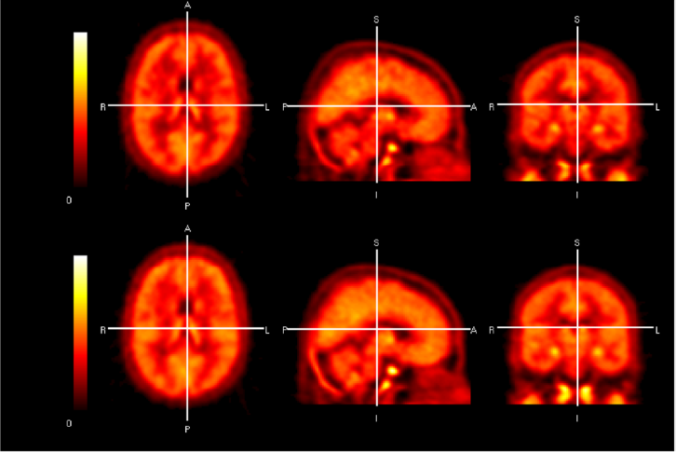
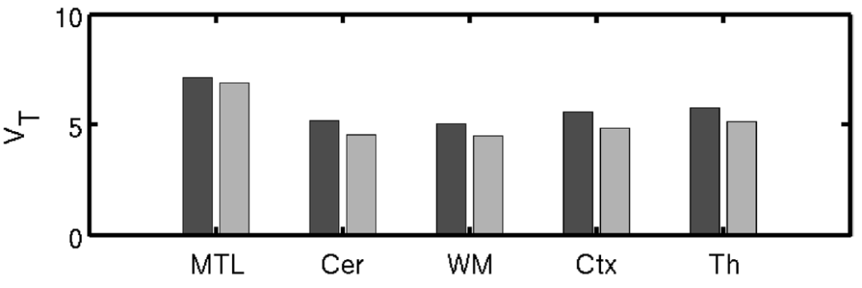
Characterising BBB transport of GSK1034702
A novel mAChR₁ PAM that is a weak PgP substrate in vitro
  efflux ratio 2.6:1 in MDCK cell line expressing human MDR1
  Species variability in brain-to-plasma ratios
    mouse, rat and marmoset ratios of 0.4, 0.6 and 2.0
  Human PET study investigated the brain penetration of [¹¹C]GSK1034702 in 4 subjects before and after a single oral dose of 5mg of GSK1034702
Baseline
Post 5mg of GSK1034702
[¹¹C] GSK1034702 regional V_{T}
[¹¹C] GSK1034702 distribution in the brain of a representative subject
Results: Human brain V_{T} ~ 4.9 broadly similar to NHP brain V_{T} ~ 3.9 & f_{P}/f_{ND} ~ 2.6
Conclusion: No evidence of liability to efflux pumps
Ridler et al. EJNMMI Research 2014

Slide 7
Pharmacokinetic and Pharmacodynamic Biomarkers
Concentration of drug in tissue
Drug-target interaction
Change in molecular target density
Change in molecular target affinity (allosteric modulation)
Change in neurotransmitter release
Change in brain activity and/or metabolism

Slide 8
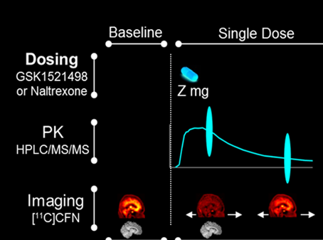
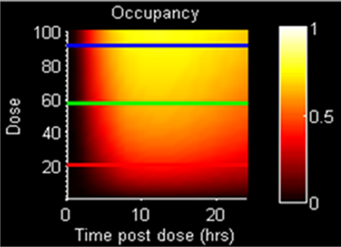
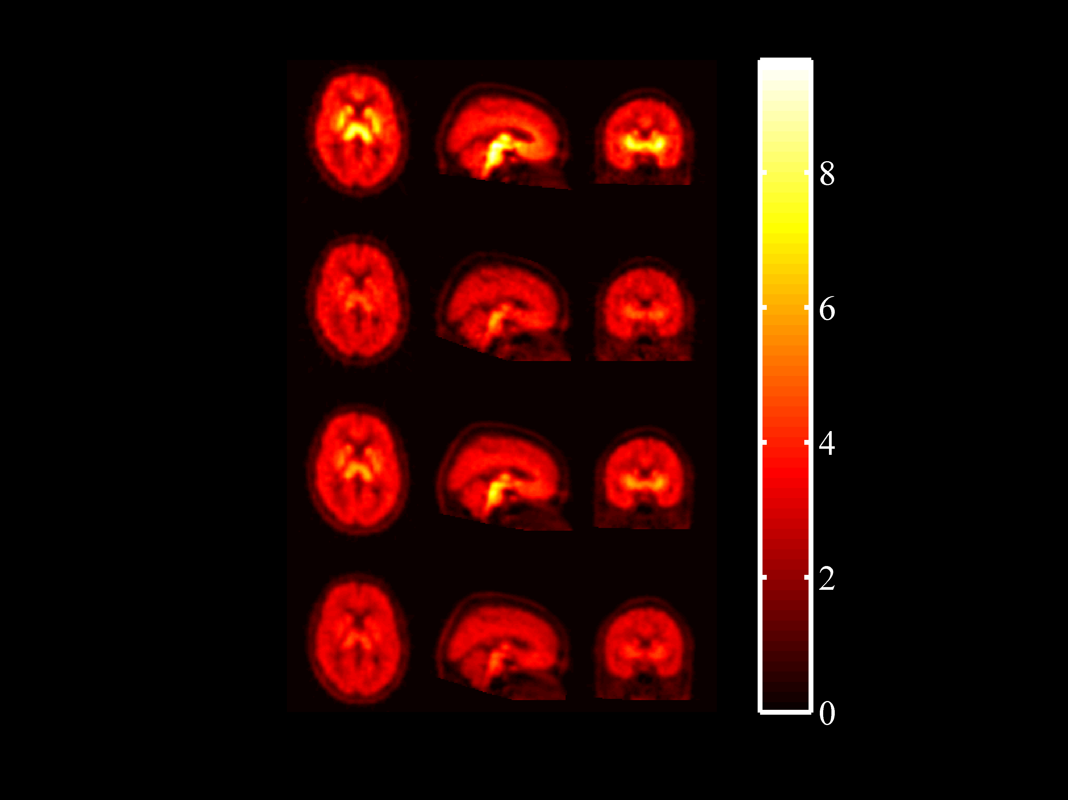
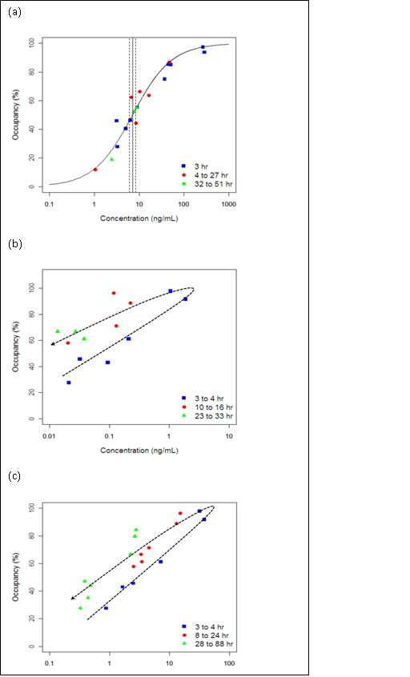
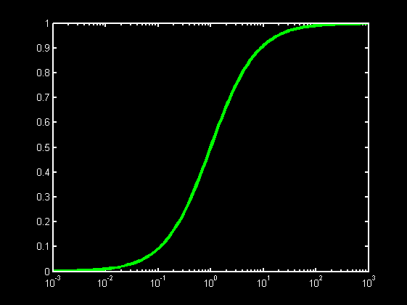
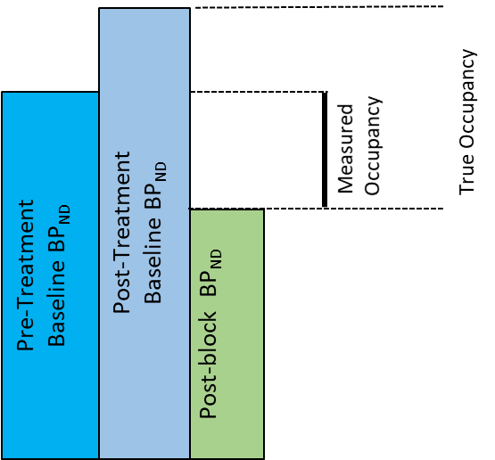
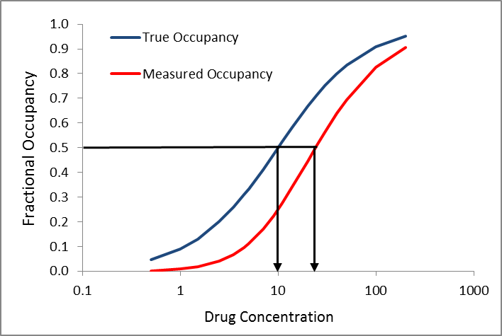
Quantifying Target Engagement to Optimise Dose Selection
Better, Faster and Cheaper Clinical Trials
Baseline
B_{A}
Post Drug
B_{A}
Invicro Target Engagement⁺
Adaptive Design
PK-RO Modelling Indirect Kinetics
RD Prediction from SD
Upregulation RD Modelling
Occupancy
Plasma Conc
EC₅₀ < EC₅₀

Slide 9
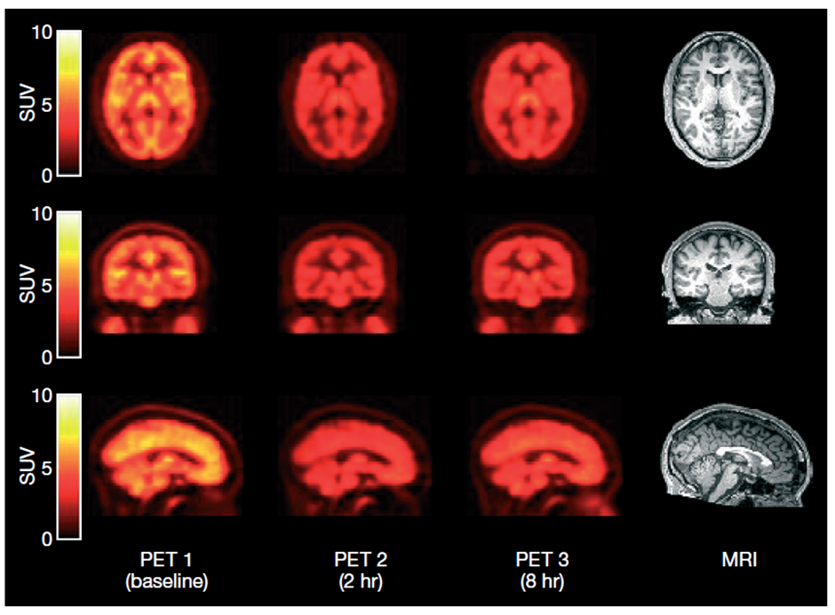
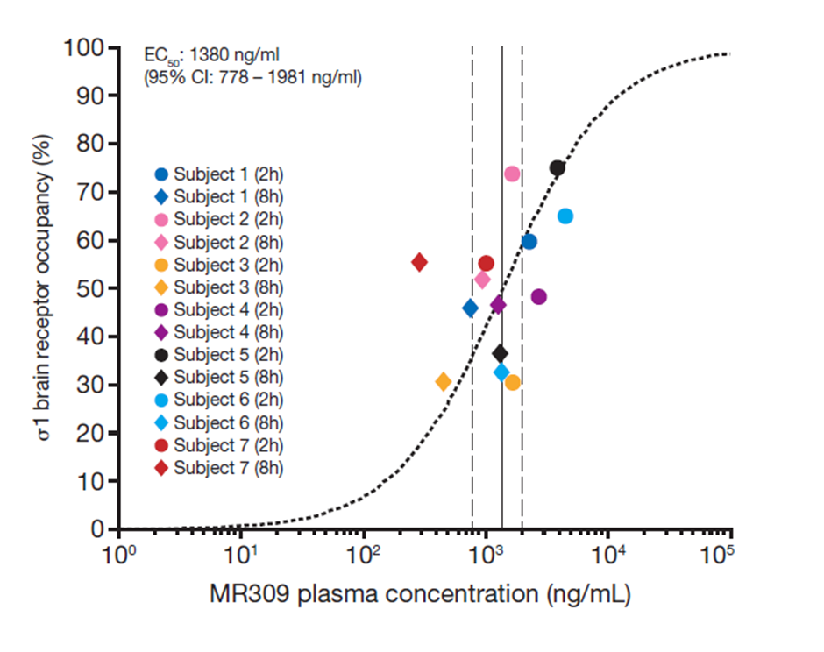
Target occupancy of a novel σ1 receptor antagonist
MR309, a selective σ1R antagonist in development for the treatment of neuropathic pain
PET study used the selective σ1R radioligand [¹¹C]SA-4503
to establish the relationship between plasma concentration and σ1R occupancy of MR309
Conclusions: MR309 200 mg BID dose produced σ1R occupancy below the 75% occupancy threshold expected to elicit maximal antinociceptive effect as observed in neuropathic pain models.
Further investigations of MR309 for neuropathic pain will require higher brain σ1R occupancy
Pharmacokinetics and brain sigma 1 (σ1) receptor occupancy of MR309, a selective σ1 receptor antagonist, Rabiner et al, British Journal of Clinical Pharmacology, In Press

Slide 10
5-HT release in the treatment of depressive disorders
5-HT neuron
Post-synaptic
neuron
Antidepressants block the 5-HT transporter or MAO within hours/days of administration
Clinical effect of antidepressants requires 4-6 weeks of treatment
The activation by increased 5-HT concentration of 5-HT_{1A/B} autoreceptors is proposed to reduce 5-HT release and delay onset of clinical efficacy
Blockade of 5-HT_{1A/B} autoreceptors was proposed as a strategy to accelerate and augment SSRI treatment
Acute SSRI
5-HT_{1A} autoreceptor
activated
5-HT
-ve
Chronic SSRI
5-HT_{1A} autoreceptor
desensetised
5-HT_{1A}
autoreceptor
5-HT
Pindolol +Acute SSRI
5-HT_{1A} autoreceptor
blocked
x
5-HT
Pindolol

Slide 11
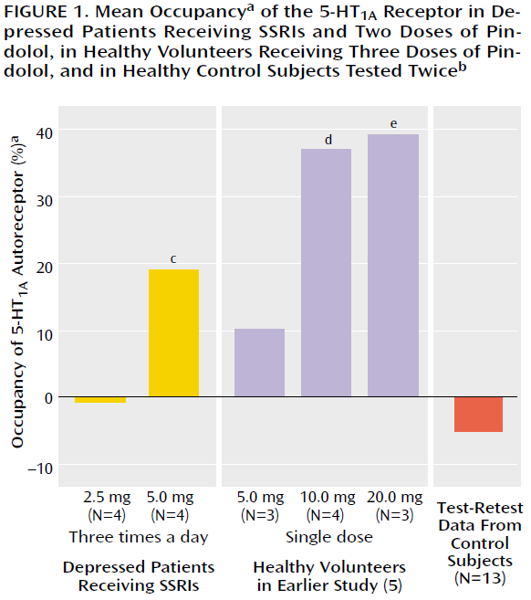
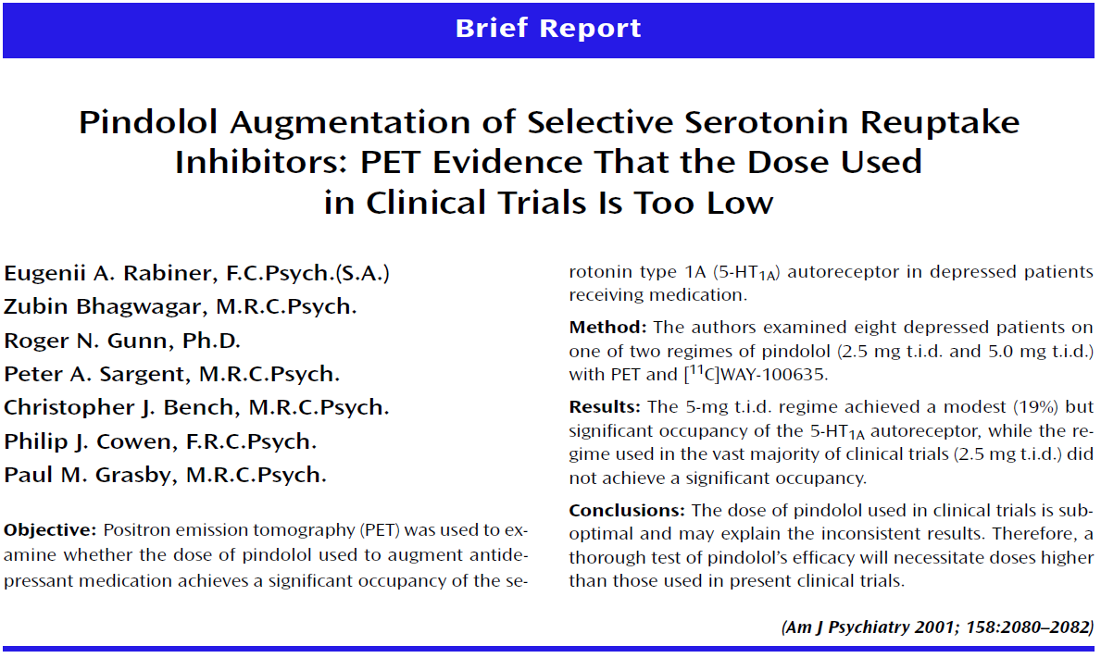
Evaluation of pindolol augmentation of SSRI in depression – evaluation of 5-HT_{1A} autoreceptor blockade
Pindolol (a β-blocker with 5-HT_{1A} affinity) proposed to accelerate and augment SSRI treatment in depression
Clinical trials of 2.5 mg dose provided disappointing results
A PET study using [¹¹C]WAY-100635 evaluated pindolol occupancy of the 5-HT_{1A} receptor and found occupancy of 2.5 mg dose to be too low for clinical efficacy

Slide 12
Pharmacokinetic and Pharmacodynamic Biomarkers
Concentration of drug in tissue
Drug-target interaction
Change in molecular target density
Change in molecular target affinity (allosteric modulation)
Change in neurotransmitter release
Change in brain activity and/or metabolism

Slide 13
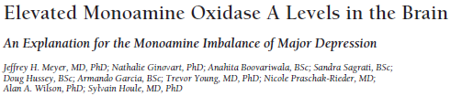
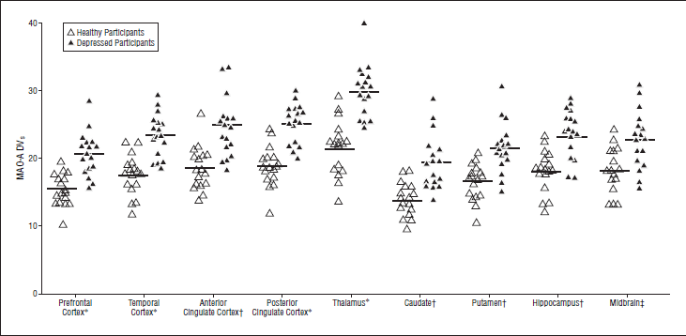
5-HT neurotransmission in depression – MAO-A
5-HT dysregulation is implicated in the pathophysiology of depression
  Most antidepressants increase brain 5-HT levels
Monoamine Oxidase A (MAO-A) a major path for the breakdown of 5-HT
[¹¹C]harmine is a PET ligand suitable to evaluate MAO-A density
Patients with major depression demonstrated widespread increases in MAO-A expression implying reduction in brain 5-HT levels

Slide 14
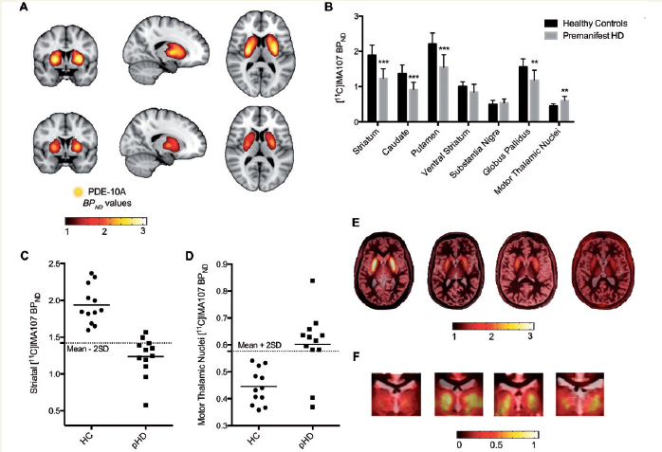
Second Messenger function in Huntington’s Disease – PDE 10A
Significant changes in PDE-10A in pre-manifest HD
Up to 43 years pre-manifestation of clinical symptoms
Earliest abnormal finding in HD (No Atrophy)
Niccolini et al , Brain (2015)

Slide 15
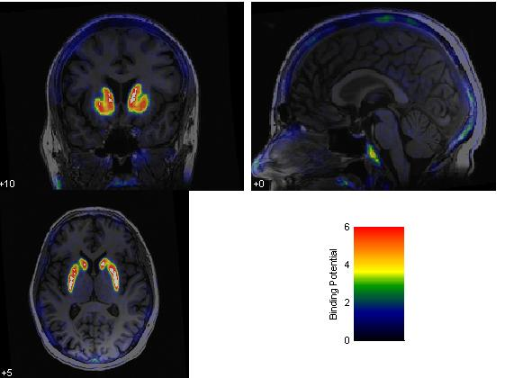
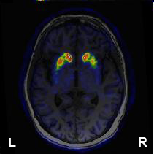
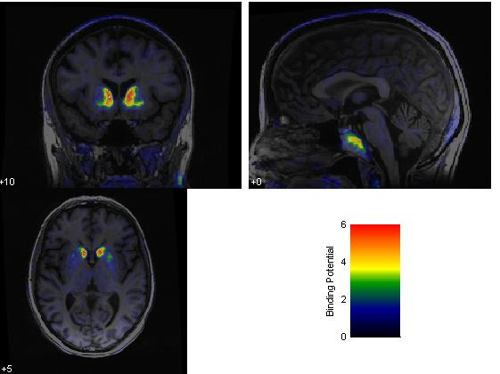
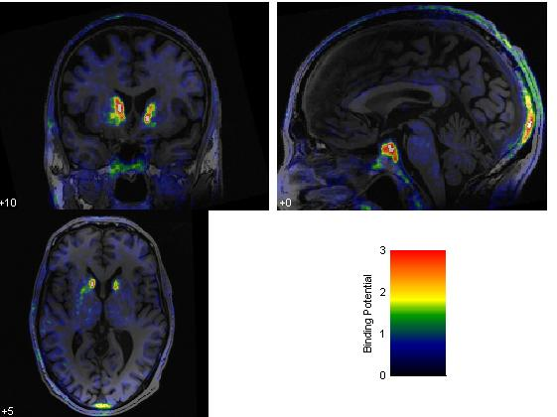
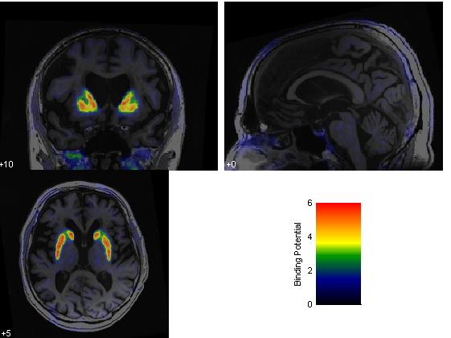
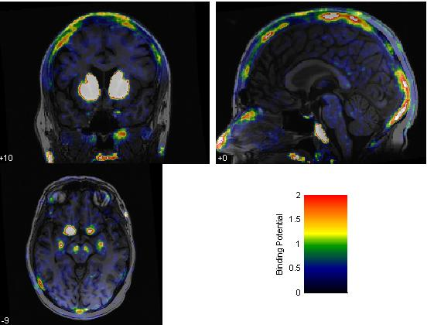
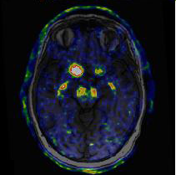
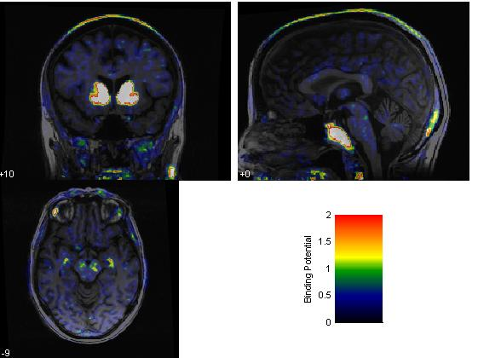
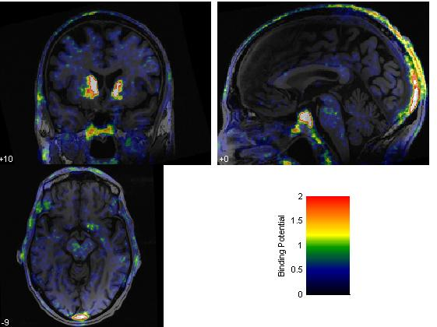
Dopamine Transporter (DAT)– [¹⁸F]FE-PE2I
BP_{ND}
Control
H&Y 1
H&Y 1.5
H&Y 2
Parkinson

Slide 16
Pharmacokinetic and Pharmacodynamic Biomarkers
Concentration of drug in tissue
Drug-target interaction
Change in molecular target density
Change in molecular target affinity (allosteric modulation)
Change in neurotransmitter release
Change in brain activity and/or metabolism

Slide 17
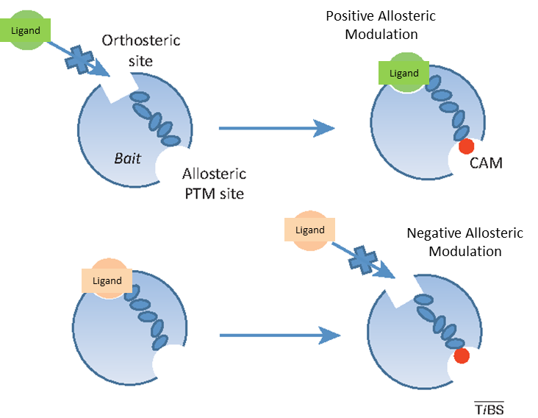
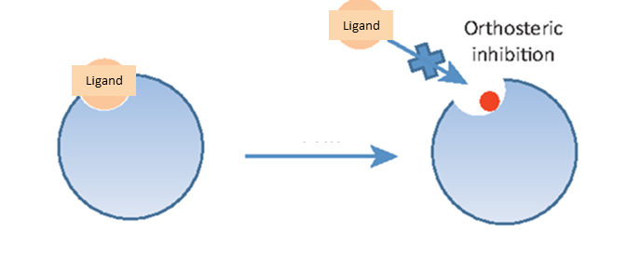
Allosteric Modulators

Slide 18
Modulation of PDE radioligand binding by cN’s
PDE2 and [¹⁸F]PF-05270430
PDE10 and [¹⁸F]JNJ42259152
Effect of PDE10 blockade by MP-10
PDE4 blockade by rolipram PDE2 blockade by JNJ49137530
Ooms et al, 2016

Slide 19
Modulation of the affinity of m4AChR PAM by agonist stimulation

Slide 20
Pharmacokinetic and Pharmacodynamic Biomarkers
Concentration of drug in tissue
Drug-target interaction
Change in molecular target density
Change in molecular target affinity (allosteric modulation)
Change in neurotransmitter release
Change in brain activity and/or metabolism

Slide 21
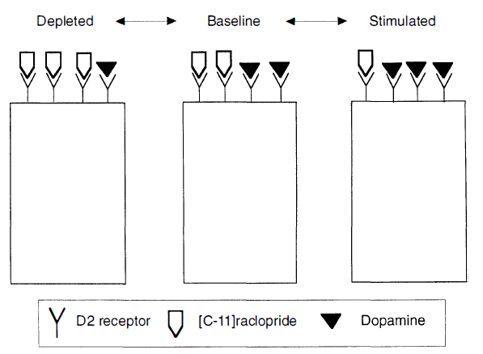
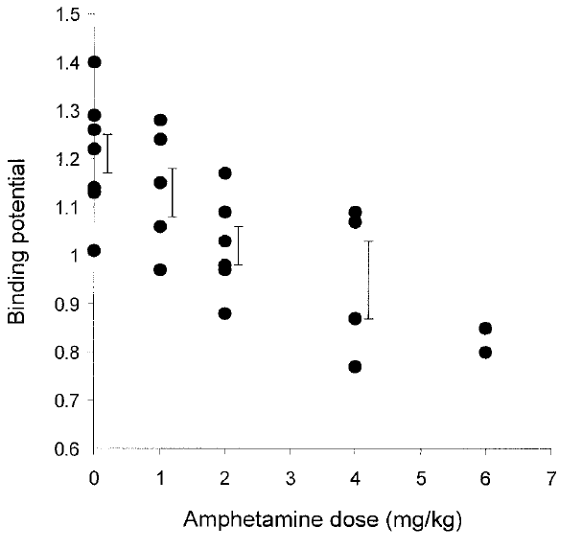
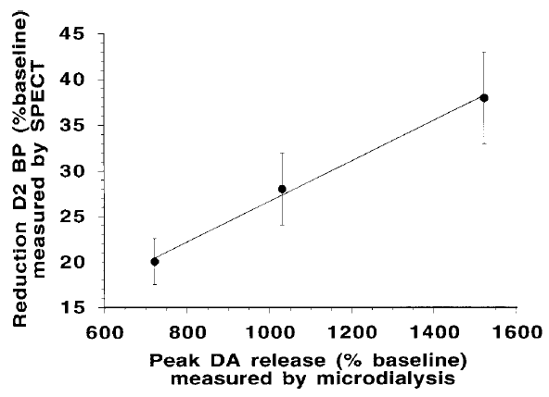
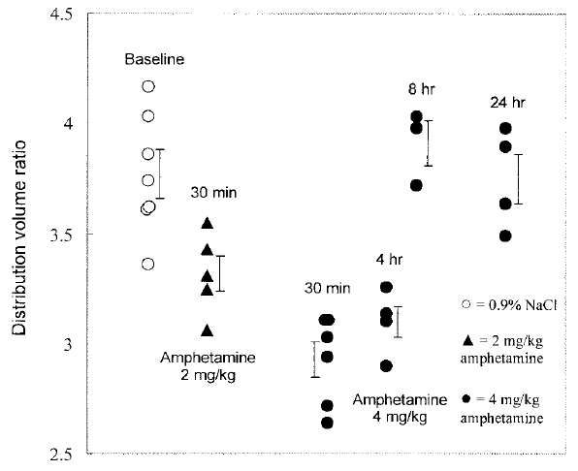
Measuring Neurotransmitter Release - Dopamine
Houston, Synapse 2004
Laruelle, JCBFM 2000
Laruelle, Synapse 1997

Slide 22
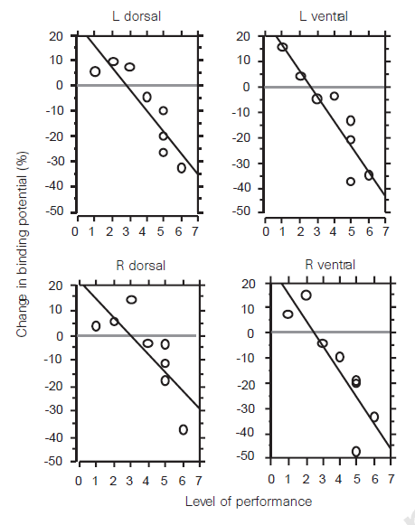
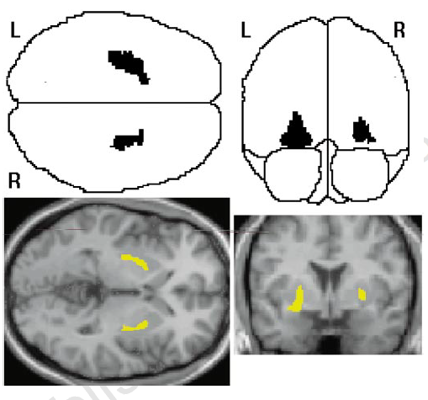
Evaluation of Dopamine Involvement in Reward
Reward was postulated to be mediated by dopamine released in the striatum
First direct evaluation of the relationship between reward and dopamine release in the human brain using [¹¹C]raclopride PET
Individuals playing a video game demonstrated dopamine release that correlated with the performance level and the monetary reward received
Koepp et al, Evidence for striatal dopamine release during a video game. Nature 393, 266–268; 1998

Slide 23
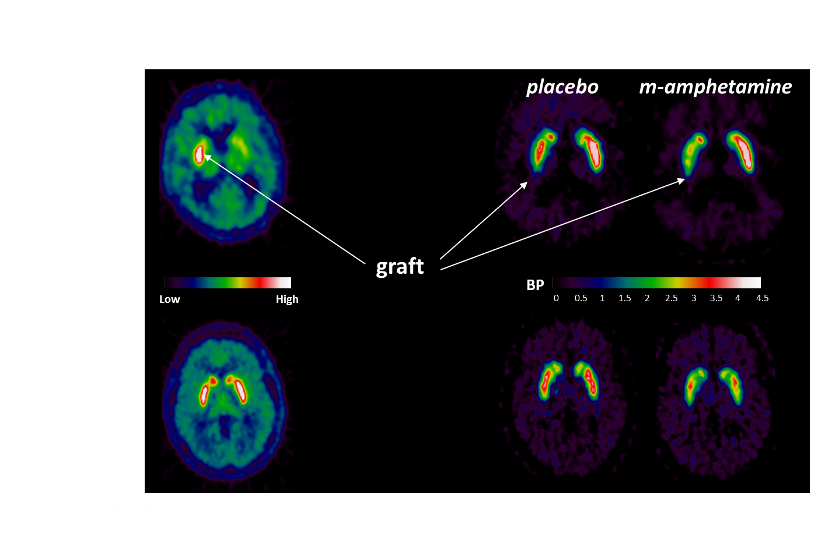
Imaging Neuronal Viability & Function
[¹⁸F]DOPA
[¹¹C]raclopride
Patient
Control
Piccini, Nature 1999

Slide 24
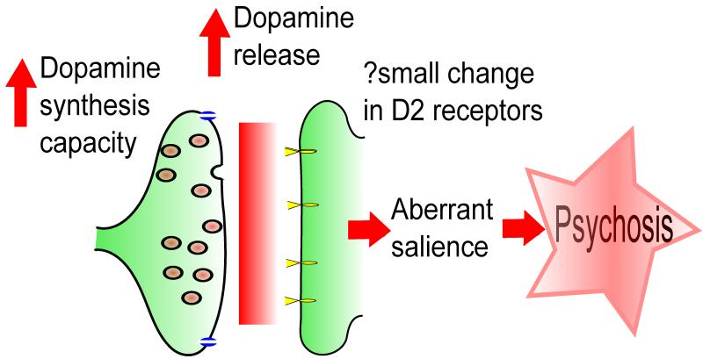
Dopaminergic Abnormalities in Schizophrenia
Howes, Current Pharm Des, 2009

Slide 25
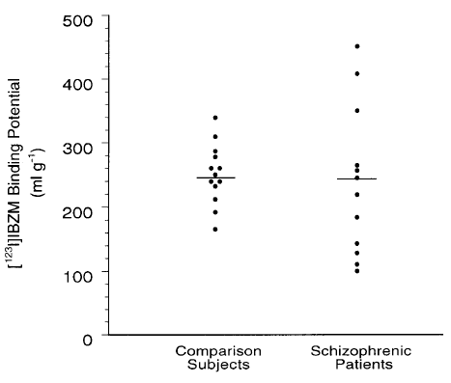
Dopaminergic Neurotransmission in Schizophrenia
D₂ receptor density does not differ between patients with schizophrenia and healthy individuals
Abi-Dargham et al, Increased striatal dopamine transmission in schizophrenia: confirmation in a second cohort. Am J Psychiatry 155 (6), 761-7; 1998

Slide 26
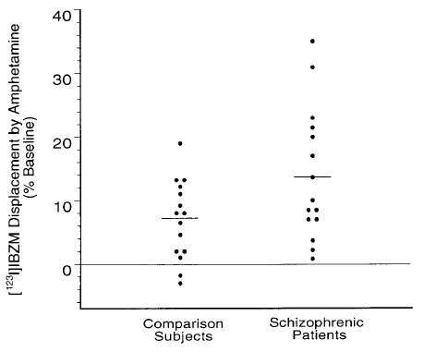
Dopaminergic Neurotransmission in Schizophrenia
D₂ receptor density does not differ between patients with schizophrenia and healthy individuals
Dopamine release capacity is significantly higher in patients with schizophrenia compared to healthy individuals
Abi-Dargham et al, Increased striatal dopamine transmission in schizophrenia: confirmation in a second cohort. Am J Psychiatry 155 (6), 761-7; 1998

Slide 27
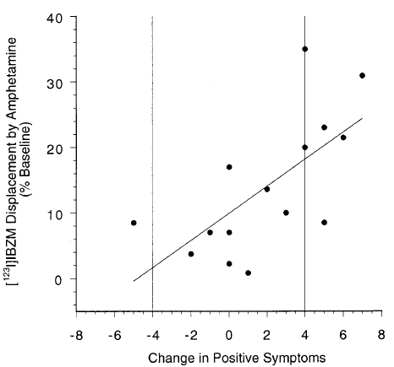
Dopaminergic Neurotransmission in Schizophrenia
Dopamine release capacity is related to the intensity of positive symptoms
D₂ receptor density does not differ between patients with schizophrenia and healthy individuals
Dopamine release capacity is significantly higher in patients with schizophrenia compared to healthy individuals
Abi-Dargham et al, Increased striatal dopamine transmission in schizophrenia: confirmation in a second cohort. Am J Psychiatry 155 (6), 761-7; 1998

Slide 28
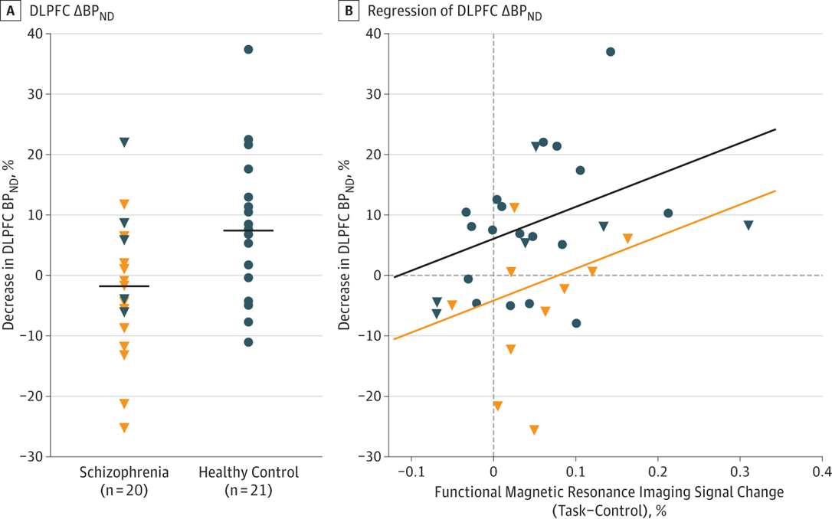
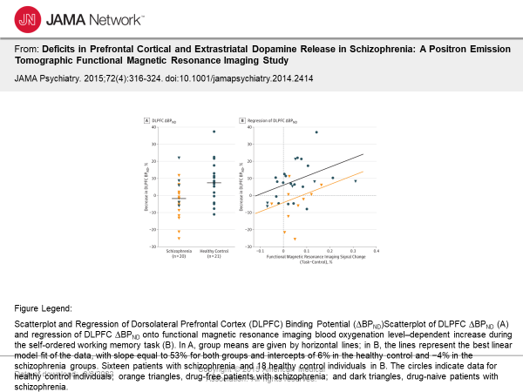
Dopaminergic Neurotransmission in Schizophrenia

Slide 29
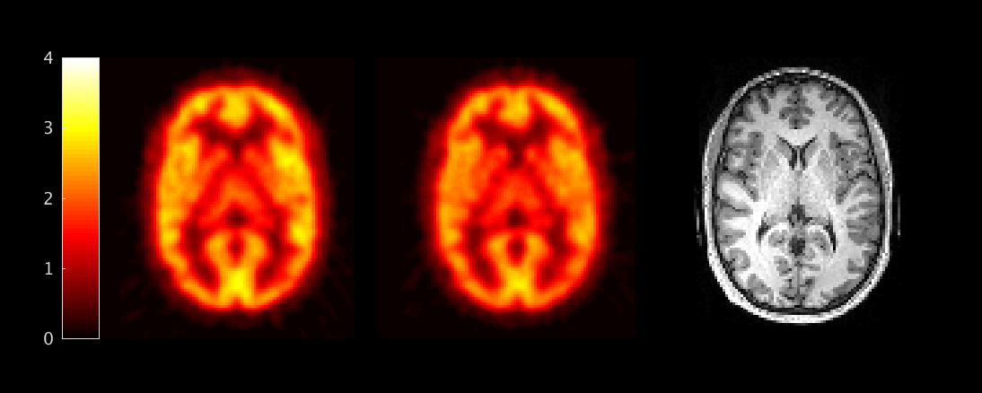
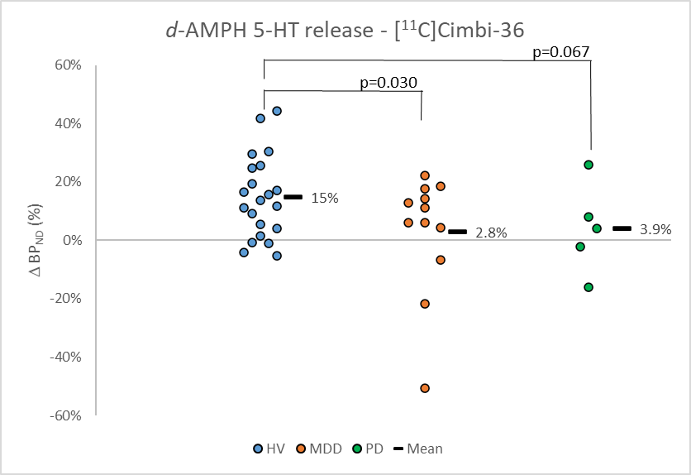
Measuring Neurotransmitter Release – 5-HT
High affinity 5-HT₂ agonist
Demonstrated sensitivity to 5-HT fluctuation in preclinical species
Baseline
Post-amphetamine
MRI
SUV
Fig 1: [¹¹C]Cimbi-36 binding before and after d-amphetamine in a male HC
Effect of d-amphetamine on [¹¹C]Cimbi-36 BP_{ND} in healthy volunteers
Comparison of d-amphetamine on [¹¹C]Cimbi-36 BP_{ND} in healthy volunteers and depressed patients
Erritzoe, Neuropsychopharmacology 2020
[¹¹C]Cimbi-36 Δ BP^{FCx}_{ND} in HC, MDD & PD

Slide 30
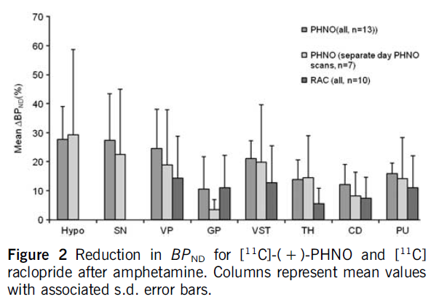
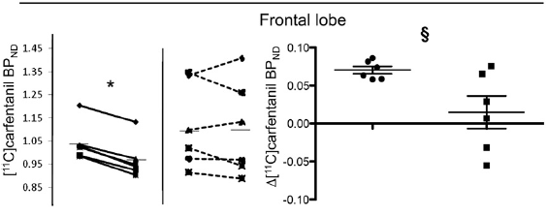
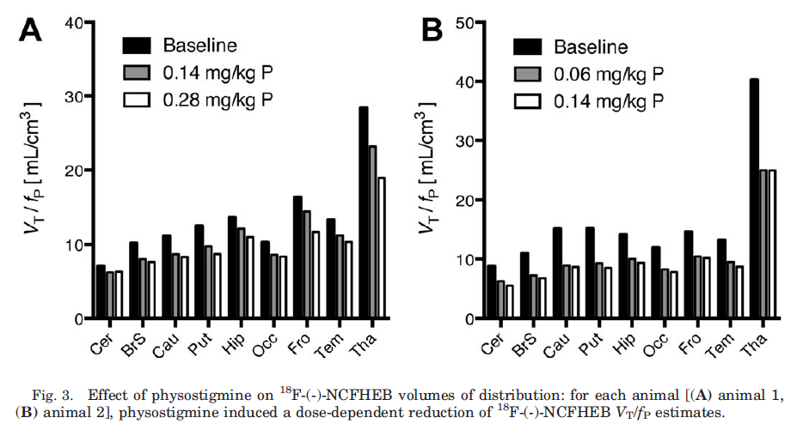
Measuring Endogenous Neurotransmitter Release
Dopamine
5-HT
Shotbolt, JCBFM 2012
Opioids
Erritzoe, Neuropsychopharmacology 2020
Acetylcholine
Colasanti, Biol Psychiatry 212
Gallezot, Synapse 2014

Slide 31
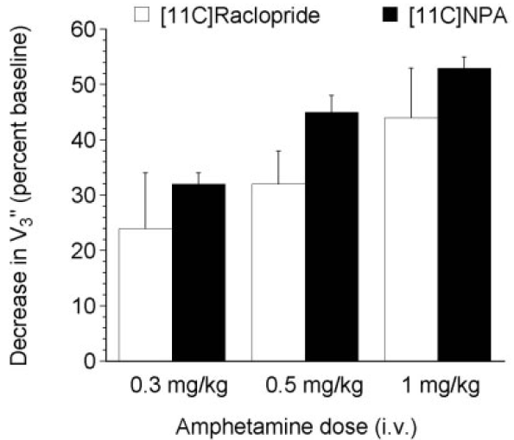
Agonist Radioligands – Improved Sensitivity
[¹¹C]PHNO and 0.3 mg/kg d-amphetamine p.o. in the human brain
[¹¹C]NPA and d-amphetamine i.v. in the NHP brain
Shotbolt, JCBFM 2012
Narendran, Synapse 2004

Slide 32





Dopamine Modulation – Drug modified NT release
TAK-041 – Targets GPR-139 (orphan receptor) – no selective ligands identified
Rabiner et al, Neuropsychopharmacology, 2021

Slide 33
Pharmacokinetic and Pharmacodynamic Biomarkers
Concentration of drug in tissue
Drug-target interaction
Change in molecular target density
Change in molecular target affinity (allosteric modulation)
Change in neurotransmitter release
Change in brain activity and/or metabolism

Slide 34
Evaluation of Target Engagement and Target Modulation in Phase I
Background:
GSK1521498 a novel m-opioid receptor (mOR) antagonist/inverse agonist in development for appetite dysregulation
Modulation of mOR neurotransmission hypothesised to modulate brain reward mechanisms associated with eating behaviour
Naltrexone – a relatively unselective mOR antagonist (affinity for dOR and kOR) is on the market
Aim:
Demonstrate the relationship between plasma drug concentration and mOR occupancy over time following a single oral dose, to enable the prediction of plasma concentration : mOR occupancy relationship following repeat dosing in clinical populations
Demonstrate modulation of brain activity following mOR engagement by GSK1521498
Compare GSK1521498 to Naltrexone
Study:
Healthy volunteers, in parallel with first in human safety study
Use [¹¹C]carfentanil PET to evaluate mOR time-occupancy relationship
Use fMRI with a palatable food stimulus to evaluate brain reward mechanisms following drug administration
        Rabiner et al, Mol Psychiatry 2011

Slide 35

Study Design
        Rabiner et al, Mol Psychiatry 2011

Slide 36
Evaluation of the relationship between plasma concentration and target occupancy
Quantification of Target Engagement
GSK1521498

Slide 37
Evaluation of the relationship between plasma concentration and target occupancy
Quantification of Target Engagement
GSK1521498 Naltrexone
0 20 40 60 80 100
Occupancy (%)
3 hr
4 to 27 hr
32 to 51 hr
3 To 4 hr
10 to 16 hr
23 to 33 hr
0.1 1 10 100 1000
0.01 0.1 1 10
Concentration (ng/mL)

Slide 38



Synergies between Target Engagement and Target Modulation Evaluation
Assessment of Functional Modulation
Whole Brain Activation by High Fat/High Sugar Smoothie vs Water
Effects of m-OR Blockade on Brain Activation in Response to Palatable Food
Relationship Between m-OR Occupancy and Amygdala Activation by Palatable Food
        Rabiner et al, Mol Psychiatry 2011

Slide 39
Relationship of BOLD fMRI signal change and occupancy of a novel target
N-Back task
“switching” task

Slide 40
THANK YOU

Slide 41
Effects of Receptor Upregulation on PET Occupancy Measurement
PET studies estimate target occupancy by comparing ligand binding pre- and post-administration of a drug
Assumption of lack of change in total receptor availability
A change in total receptor availability will induce bias in the estimation of occupancy, if not accounted for
True Occupancy
Measured
Occupancy
Post-Treatment
Baseline BP_{ND}
Pre-Treatment
Baseline BP_{ND}
Post-block BP_{ND}
EC₅₀ < EC₅₀

Slide 42

Human Brain Dopamine-D2 Receptor Occupancy
Human PET studies of D2R occupancy by antipsychotics consistently report discrepancies between single-dose (SD) and repeat-dose (RD)
The observed lower apparent affinity seen in repeat dose studies is consistent with an upregulation of D2R induced by repeated antipsychotic administration leading to an underestimation of D2R occupancy
Drug | Single dose | Repeat dose | References
JNJ-37822681 | 15.8 ng/ml | 26 ng/ml | Te Beek 2012 Schmidt 2012
Lurasidone | 7.6 ng/ml | 29 ng/ml | Wong 2013 Potkin 2014
Ziprasidone | 19.3 ng/ml | 33 ng/ml 84 ng/ml | Bench 1993, 1996; Vernalaken 2008 Mamo 2004 Suzuki 2013

Slide 43




Target Upregulation – RD Occupancy Bias example: D₂R occupancy by antipsychotics
$$O^{M}=\frac{[Drug] }{{[Drug]+EC}_{50}}$$
$$O^{M}=\frac{[Drug]−{EC}_{50}\frac{[Drug]}{{[Drug]+EC}_{50}}(U_{max}−1)}{{[Drug]+EC}_{50}}$$
 | EC₅₀ (ng/ml)
SD | 15.7 (14.2-17.3)
RD | 26.8 (24.1-30.0)
 | EC₅₀ (ng/ml) | U_{max}
SD | 14.3 (5.6 -23.0) | 1.10 (0.53 – 1.67)
RD |  | 1.62 (1.05 – 2.20)
Occupancy Data from:
Single dose (Te Beek et al, J Psychopharmacology (2012) 26; 1128 – 1135)
Repeat dose (Schmidt et al, Psychopharmacology (2012) 224:549–557)

Slide 44
Dopamine-D2 Receptor Upregulation
Upregulation of Dopamine-D2 receptor (D2R) has been demonstrated in the rodent brain following several weeks dosing with antipsychotics D2R antagonists
Magnitude of upregulation is expected to vary with the target occupancy, duration of treatment and intrinsic efficacy of the blocker
Reference | Drug | Ventral Striatum Dorsal Striatum
Tarazi, 2001 Florijn, 1997 Tarazi, 1997 Tarazi, 2008 | Asenapine Risperidone Olanzepine Quetiapine Haloperidol Clozapine Raclopride Fluphenazine NPA | 132% 137% 128% 107% 126% 102%, 110% 113% 127% 105% | 141% 141% 125% 101% 126% 105% 113% 115% 100%
Huang, 1997 | Haloperidol Clozapine | 141% 185% | 132% 152%
Inoue, 1997 | Haloperidol Aripiprazole ( 12 mg/kg) Aripiprazole (100 mg/kg) | 140% 102% 121%

