Slide 1


Availability and affordability of PET tracers, the challenges and opportunities in developing countries
Dr. Ibrahim Elsayed Saad
Chairman of NMT program -Inaya Medical Colleges- Riyadh- KSA
Associate Professor of Nuclear Medicine Physics -Faculty of Medicine- Cairo University - EGYPT

Slide 2
Objectives
The current status of PET-CT in developing countries.
Challenges facing the availability of PET tracers in developing countries
Opportunities for increasing the availability and affordability of PET tracers in developing countries
Egypt , a developing country success story .

Slide 3

Developing countries
There are more than 50 definitions for developing countries in the literature.
According to the UN, a developing country is a country with a relatively low standard of living.
HDI index is a comparative measure of poverty, literacy, education, life expectancy, and other factors for countries worldwide.
The index was developed in 1990 by Pakistani economist Mahbub ul Haq.

Slide 4
Development entails a modern infrastructure (both physical and institutional.
Developed countries or economies are the countries that enjoy certain high standards.
Asish Kumar Pal (Rabindra Mahavidyalaya, India) and Atanu Sengupta (The University of Burdwan, India)Handbook of Research on Economic and Political Implications of Green Trading and Energy Use 2019, DOI: 10.4018/978-1-5225-8547-3.ch019

Slide 5
According to the World Bank Country Classifications
Developing countries are defined according to their Gross National Income (GNI) per capita per year, as calculated by the World Bank Atlas method, in October 2020.
Those countries GNI starts from 240 USD ( Burundi) up to 12,056 are considered developing countries.
They include countries from all continents including Europe.

Slide 6
The current status of PET-CT in developing countries.

Slide 7
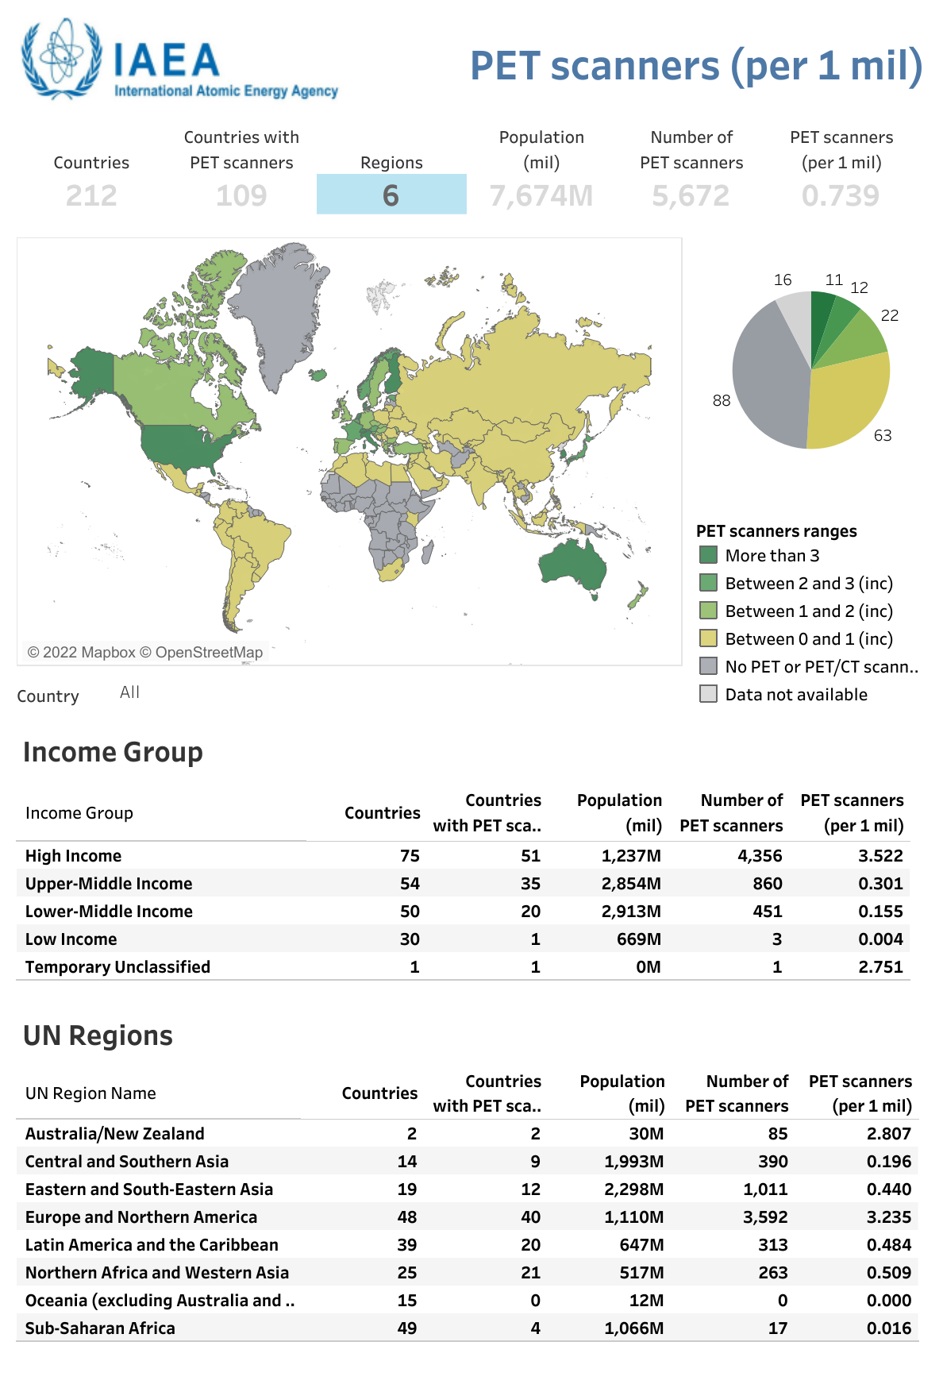
IAEA-IMAGINE database
https://humanhealth.iaea.org/HHW/DBStatistics/IMAGINE.html

Slide 8
https://humanhealth.iaea.org/HHW/DBStatistics/IMAGINE.html

Slide 9
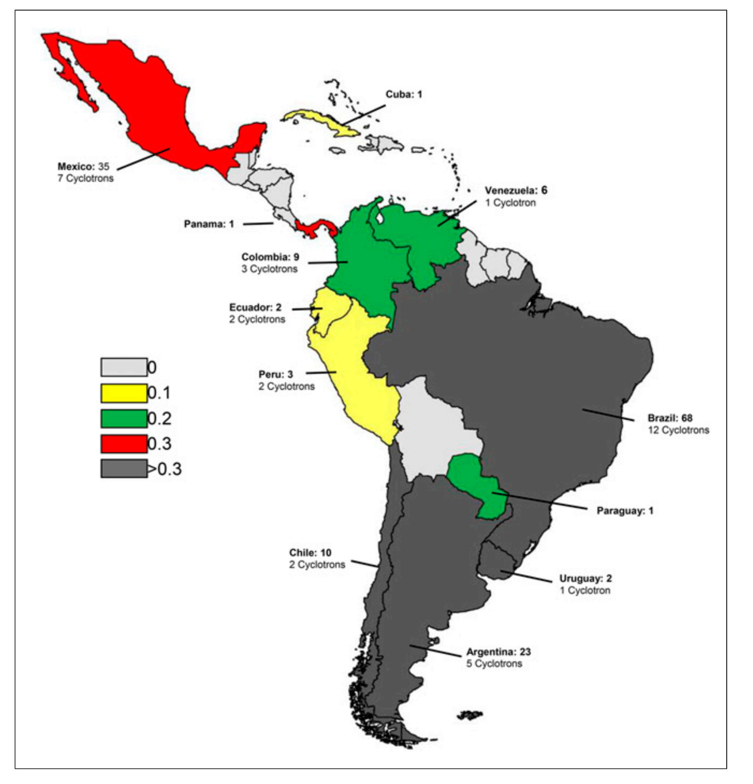
PET and PET-CT installed per Million Inhabitant and the number of cyclotrons in LAC region
Diana Páez, Pilar Orellana et.al, Current Status of Nuclear Medicine Practice in Latin America and the Caribbean, J Nucl Med 2015; 56:1629–1634

Slide 10
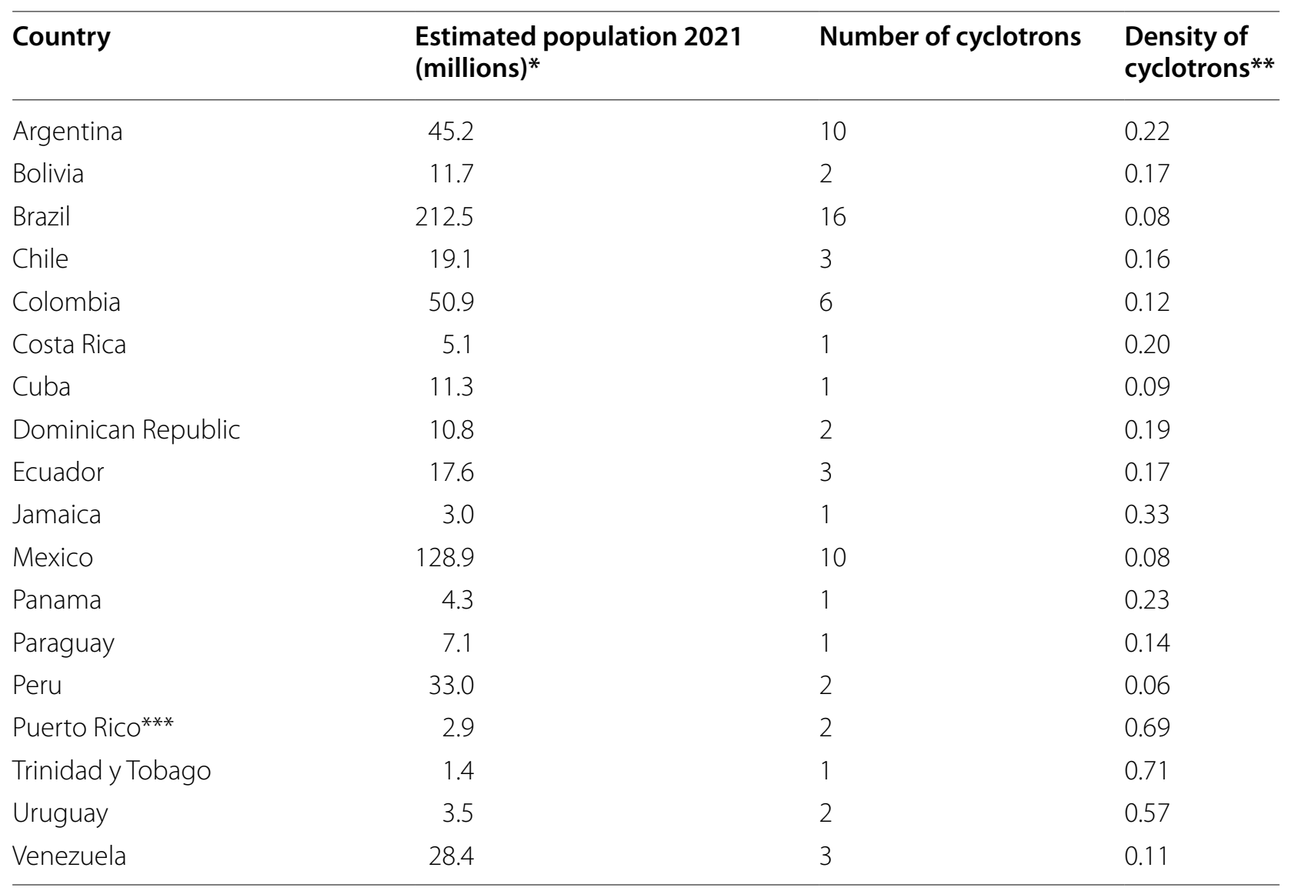
Cyclotron distribution in Latin America
Number of cyclotrons by country and estimated population
Miguel A. Avila‑Rodriguez, et.al., Current status on cyclotron facilities and related infrastructure supporting PET applications in Latin America and the Caribbean, EJNMMI Radiopharmacy and Chemistry (2022) 7:14.

Slide 11
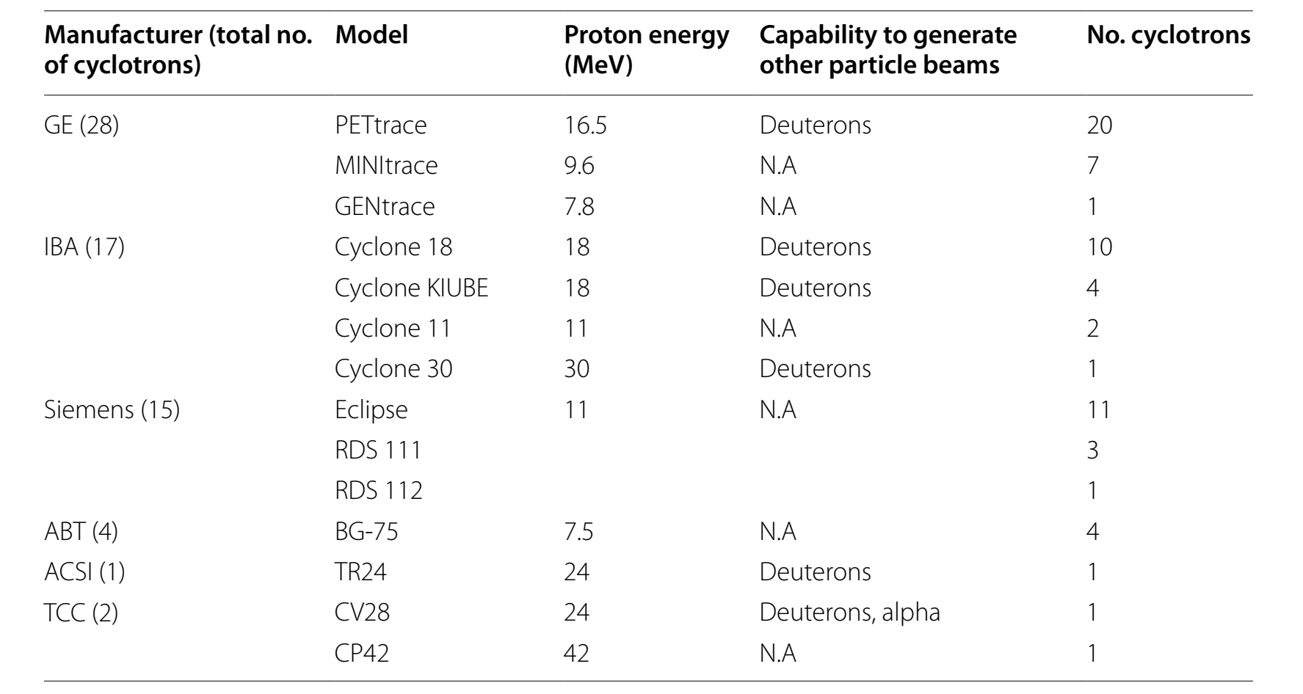
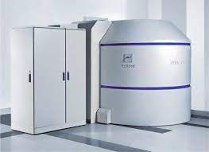
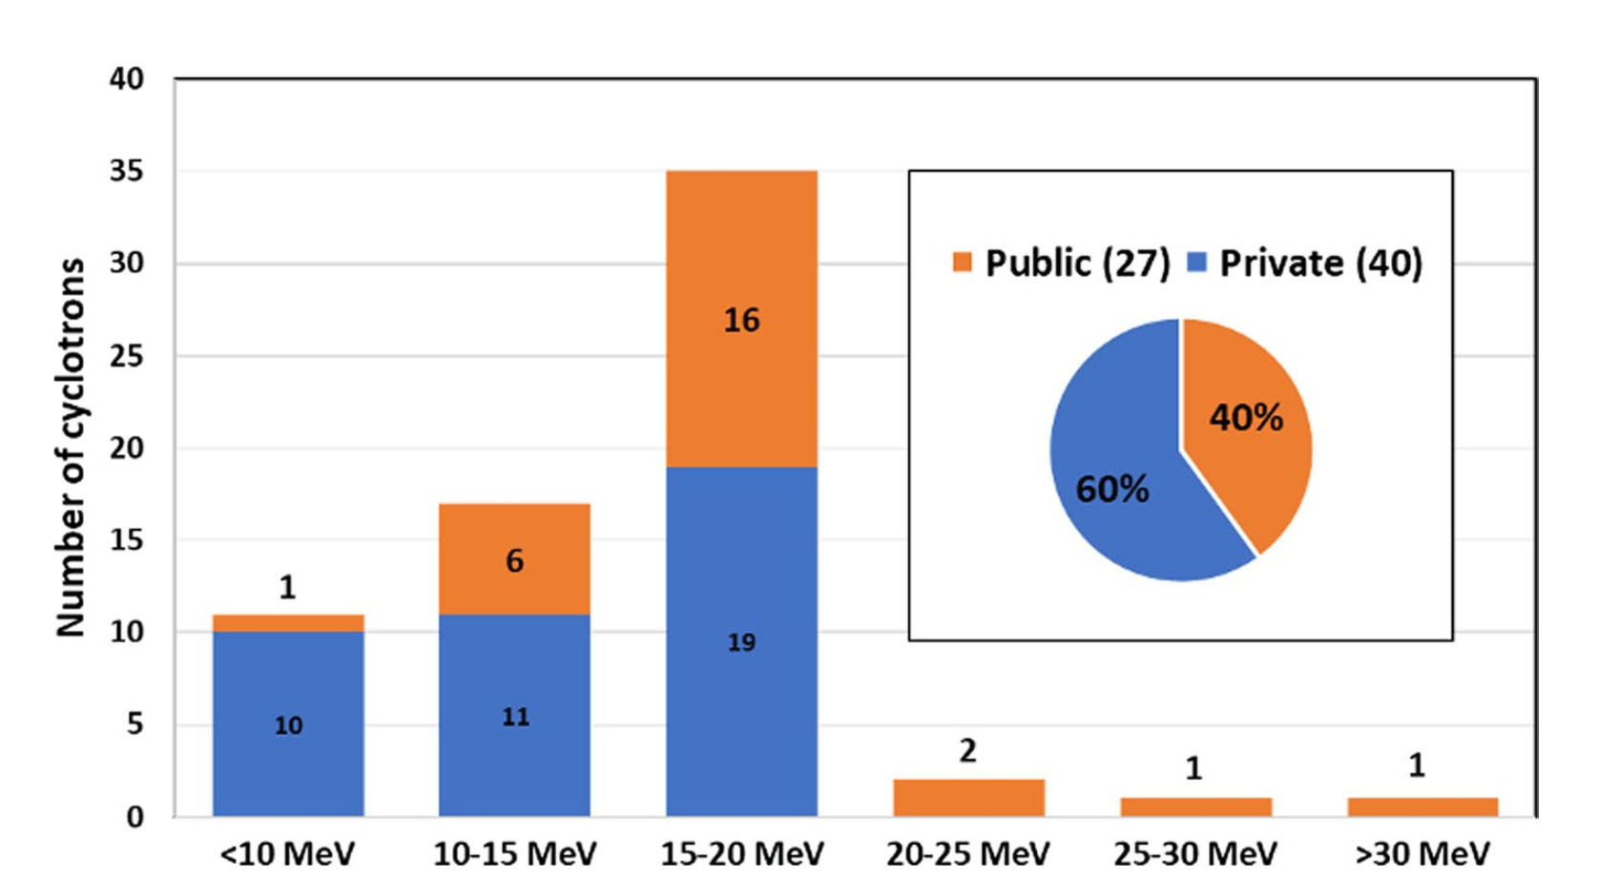
Distribution of Cyclotrons in LAC region
Miguel A. Avila‑Rodriguez, et.al., Current status on cyclotron facilities and related infrastructure supporting PET applications in Latin America and the Caribbean, EJNMMI Radiopharmacy and Chemistry (2022) 7:14.

Slide 12
Although the growth was higher in the LAC region than the global nuclear medicine imaging devices market, the number of PET scanners per million inhabitants is around 0.47.
Also, In the Middle East (ME), the number of PET scanners in 2016 was 194 and grew to 220 scanners in 2019, the number of PET scanners per million inhabitants in the ME is 0.66.
In both cases LAC and the ME, the number of PET scanners/million inhabitants is still far below the recommended 2.0 to 2.5 scanners per million in an optimal health setting.
Diana Paez, Francesco Giammarile, Pilar Orellana, (Nuclear medicine: a global perspective) Clinical and Translational Imaging (2020) 8:51–53.

Slide 13
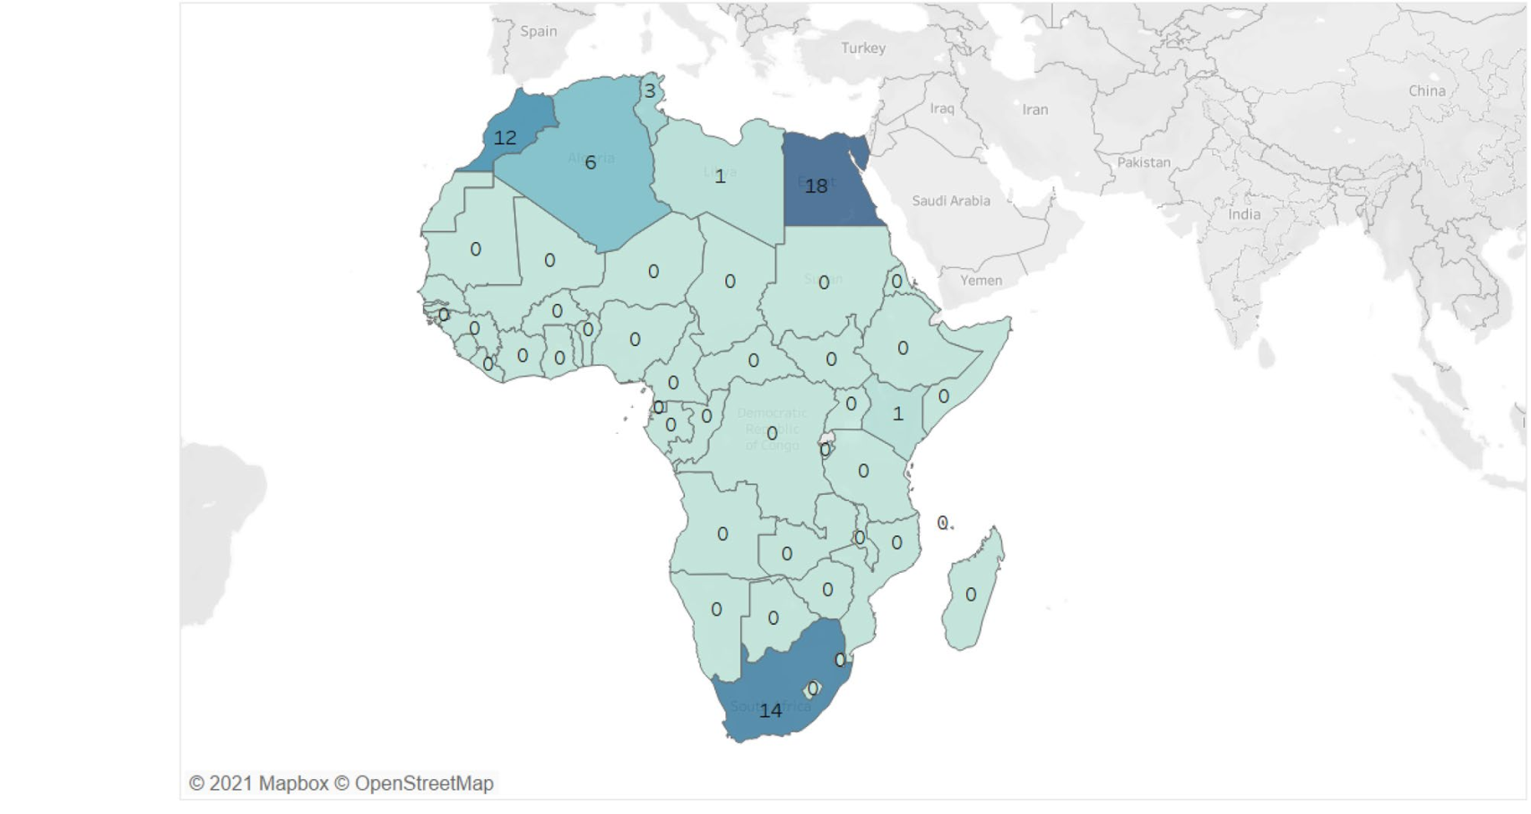
Number of PET-CT in Africa
Anna Grigoryan , Salah Bouyoucef, et.al, Development of nuclear medicine in Africa , Clinical and Translational Imaging (2022) 10:101–111

Slide 14
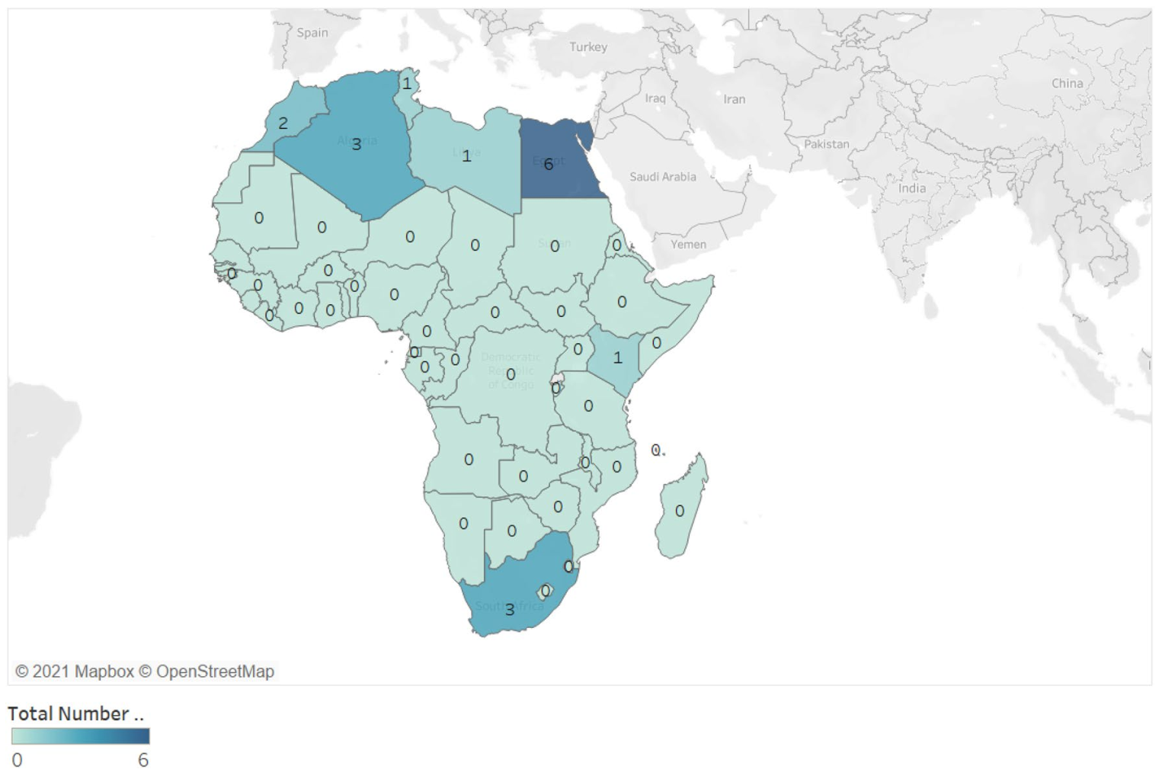
Number of cyclotrons in Africa
Anna Grigoryan , Salah Bouyoucef, et.al, Development of nuclear medicine in Africa , Clinical and Translational Imaging (2022) 10:101–111

Slide 15
Currently, the discipline of diagnostic nuclear medicine (SPECT and PET) has the smallest share of the global medical imaging market (including CT, MRI, US, and X-ray) at 6.5%.
Diana Paez, Francesco Giammarile, Pilar Orellana, (Nuclear medicine: a global perspective) Clinical and Translational Imaging (2020) 8:51–53.

Slide 16
Challenges facing the availability of PET tracers in developing countries

Slide 17
Challenges facing the availability of PET tracers in developing countries
Lack of Awareness about the importance of PET-CT and theranostic applications for management of several diseases.
Poor economic status of developing countries.
Political instability in some developing countries.
Regularity issues.
Small market size and limited availability of vendors in those markets.

Slide 18
Lack of Awareness about the importance of PET-CT and theranostic applications for management of several diseases.
Human resource capacity building in the NM field.
Scientific bodies gathering Nuclear medicine specialist.
The role of International organizations (IAEA).
Conferences by NM societies about the new issues in NM including PET-CT
Conferences and workshops for other medical specialties.

Slide 19
Human resource capacity building in the NM field.
Building capacities in the nuclear medicine field is the corner stone for overcoming the lack of awareness about PET-CT.
Taking Africa as an example, 27 countries have at least one qualified nuclear medicine physician. Only five countries (Algeria, Egypt, Morocco, South Africa and Tunisia), where nuclear medicine is an independent specialty, have been offering both undergraduate and postgraduate training for nuclear physicians for the past 2–3 decades.
This explains the fact that 85% of the total number of nuclear physicians in Africa are working in those countries.
The radiopharmacists are showing a very prominent shortage , only 8 African countries have at least one radiopharmacists most of them trained abroad.
Nowadays only three countries has a radiopharmacy training program on the university level.
Only 8 countries (South Africa, Egypt, Algeria, Morocco, Tunisia, Sudan, Ghana, and Zimbabwe) have their own education system for MP.
Six African countries are providing specialized training for technologists in nuclear medicine either at universities (Egypt, Sudan, and South Africa) or at dedicated schools for technologists and nurses (Algeria, Morocco, and Tunisia).
Anna Grigoryan , Salah Bouyoucef, et.al, Development of nuclear medicine in Africa , Clinical and Translational Imaging (2022) 10:101–111

Slide 20
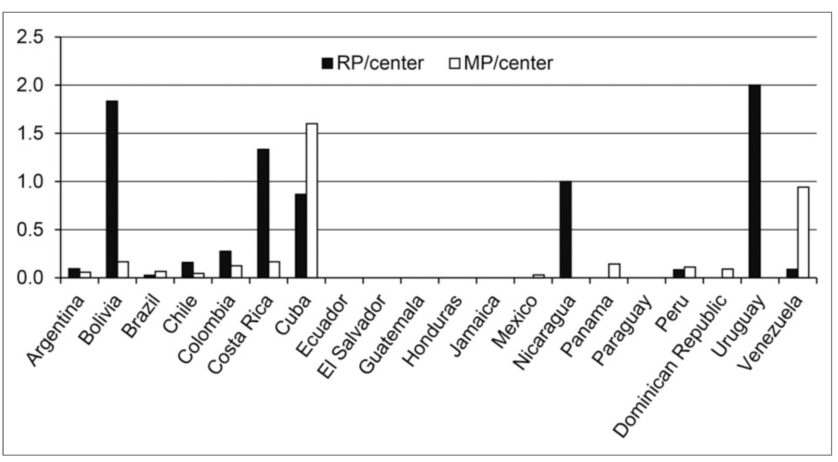
Nuclear physicists (MP) and radiopharmacists (RP) per centre in LAC region..
Diana Páez, Pilar Orellana et.al, Current Status of Nuclear Medicine Practice in Latin America and the Caribbean, J Nucl Med 2015; 56:1629–1634

Slide 21
Scientific bodies gathering Nuclear medicine specialist.
Arab Society of Nuclear Medicine (ARSNM)
Asia Oceania Federation of Nuclear Medicine and Biology (AOFNMB)
Asociación Latinoamericana de Sociedades de Biología y Medicina Nuclear (ALASBIMN)
Bosnian Society of Nuclear Medicine
Brazilian Society of Biology and Nuclear Medicine
Bulgarian Society of Nuclear Medicine
Colegio Internacional de Médicos Nucleares (ICNP) (Mexico)
Egyptian Society of Nuclear Medicine Specialists (ESNMS)
Estonian Nuclear Medicine Society (ENMS)
Iranian Society of Nuclear Medicine

Slide 22
Scientific bodies gathering Nuclear medicine specialist.
Jordanian Society of Nuclear Medicine (JOSNM)
National Society of Nuclear Medicine of the Republic of Kazakhstan
Nigerian Association of Nuclear Medicine
Nuclear Medicine Society of Tajikistan
Pakistan Society of Nuclear Medicine (PSNM)
Philippines National Society of Nuclear Medicine (PSNM)
Society of Nuclear Medicine Bangladesh
Society of Nuclear Medicine India
South African Society of Nuclear Medicine
Tunisian Society of Nuclear Medicine (STMN)

Slide 23
Conferences by NM societies about the new issues in NM including PET-CT
The fact that those societies are suffering from several economic and regulatory problems is prominent.
The low fund available for those societies and the legal issues governing its work led to decrease in its activities in the awareness of NM field and its new technologies such as PET-CT and theranostic applications.

Slide 24
Conferences and workshops for other medical specialties.
The lack of activities within the local societies will decrease the awareness of the importance of the NM, PET-CT and theranostic applications for other specialties.

Slide 25

Poor economic status of developing countries.
Developing countries are defined according to their Gross National Income (GNI) per capita per year, as calculated by the World Bank Atlas method, in October 2020 to be less than 12,056 USD.
Due to those reasons, there is no health technology assessment studies which prioritises the pathway of the disease management and this includes NM and PET-CT usage.

Slide 26

Political instability in some developing countries.
The political instability in many of the developing countries is an important factor that affects the availability of the new technologies within those countries.
Also, if there is an implementation of new projects, the idea that regular maintenance will be difficult is a fact.

Slide 27
Regularity issues
In some developing countries those regulations are not supervised by those authorities ( no follow up) , and in other countries it is so restricted.
Sometimes those regulations can cause delay in the implementation of new cyclotrons and in the delivery of radioactive materials.
Those regulations will cause a decrease in the number of private companies working in the field due to the fear of their investment loss.

Slide 28
Small market size and limited availability of vendors in those markets.
Knowing that the diagnostic nuclear medicine (SPECT and PET) has the smallest share of the global medical imaging market (including CT, MRI, US, and X-ray) at 6.5%.
The lack of awareness about these technologies in the developing countries , will be reflected on the interest of main vendors in the PET- CT market to invest, as the market size is small.
Also, the economic status will be reflected on the ability of the patients to afford the cost of such tools.

Slide 29
Opportunities for increasing the availability and affordability of PET tracers in developing countries

Slide 30
Opportunities for increasing the availability and affordability of PET tracers in developing countries
Effective human resource training ( building capacities)
Increase the awareness about PET-CT and theranostic applications.
Increase this awareness among other specialties.
Effective distribution of resources ( Cyclotrons +PET-CT)
Facilitate the regulations especially for radioactive materials transportation.
Facilitate the problems facing small private companies to take a major role in radioactive materials transportation and delivery.
Effective utilization of the cyclotron output products by using effective ways. (patient scheduling + lowering patient dose + use of new sensitive scanners ).
Investments in the research for using generators as source of PET tracer in all types of diseases.
Minimize the cost per scan.

Slide 31
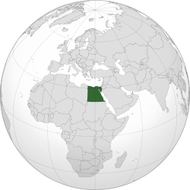
Egypt , a developing country success story
106 M population with median age of 24.6 years.
GNI 3510 USD & HDI is 0.707.
Only 2 cyclotrons are running in Cairo (Capital of Egypt)
42 Running PET-CT scanners at 34 centres.
15 governmental and semi governmental.
19 private diagnostic centres.

Slide 32
Human resources
Nuclear medicine was evolved in Egypt since late 1950s and early 1960s as one of the few countries who started the use of radionuclides in medicine.
Three universities offering residency program with required Master degrees followed by Doctorate degree.
Medical physicist are graduated from more than 26 universities among them three medical physics and 5 biophysics programs which are followed by Master degree in Medical physics.
Four universities are offering programs for radiological technologists.
Biomedical engineering programs are found at several universities.
Licensing for the RSO & RSE is done through the EAEA

Slide 33
Egyptian Society of Nuclear medicine Specialists
The Egyptian Society of Nuclear Medicine Specialists (ESNMS) began on the first day of October 1997.
The ESNMS now has membership larger than most of the European societies. It is the largest and is the leader in the Middle East.
16 yearly conferences till now.
Egyptian journal of nuclear medicine ( EGYJNM) since 2009 biannually.

Slide 34
List of the centers and the required activity of F-18/FDG per week
The total needed activity per week is 11 Ci
Centre | Activity /Week (Ci)
Central complex of the Armed forces in Maadi | 0.14
Wadi El Nile hospital | 0.14
Air forces specialized hospital | 0.14
El Gala hospital | 0.07
International medical center | 0.3
Moustafa Kamel hospital | 0.2
Kasr Al Ainy | 0.3
National cancer institute | 0.7
Ain Shams hospital- diagnostic radiology | 0.3
Tanta oncology center | 0.1
International educational hospital- Tanta | 0.1
National liver institute | 0.14
Naser Institute | 0.9
Children cancer hospital 57357 | 0.9
Ayady al mostakbal organization | 0.4
Orman oncology hospital | 0.1
Nile radiology center- Maadi | 0.6
Nile radiology center- Dokki | 0.6
Dokki radiology center | 0.3
Cairo scan center- el mohandseen | 0.5
Cairo scan center- Heliopolis | 0.3
Alpha scan center- Maadi | 0.6
Alpha scan center- Heliopolis | 0.6
Misr scan center | 0.4
Techno scan center | 0.5
Dar El foad hospital | 0.07
Mega scan center | 0.5
Saudi German hospital | 0.07
Darwesh scan center | 0.2
Damanhour scan center | 0.07
Lakouz scan center | 0.2
El masriyaa scan | 0.2
Al Haya Beni Sweif center | 0.2
Semouha scan center | 0.2
Total/week (Ci) | 11 CI

Slide 35
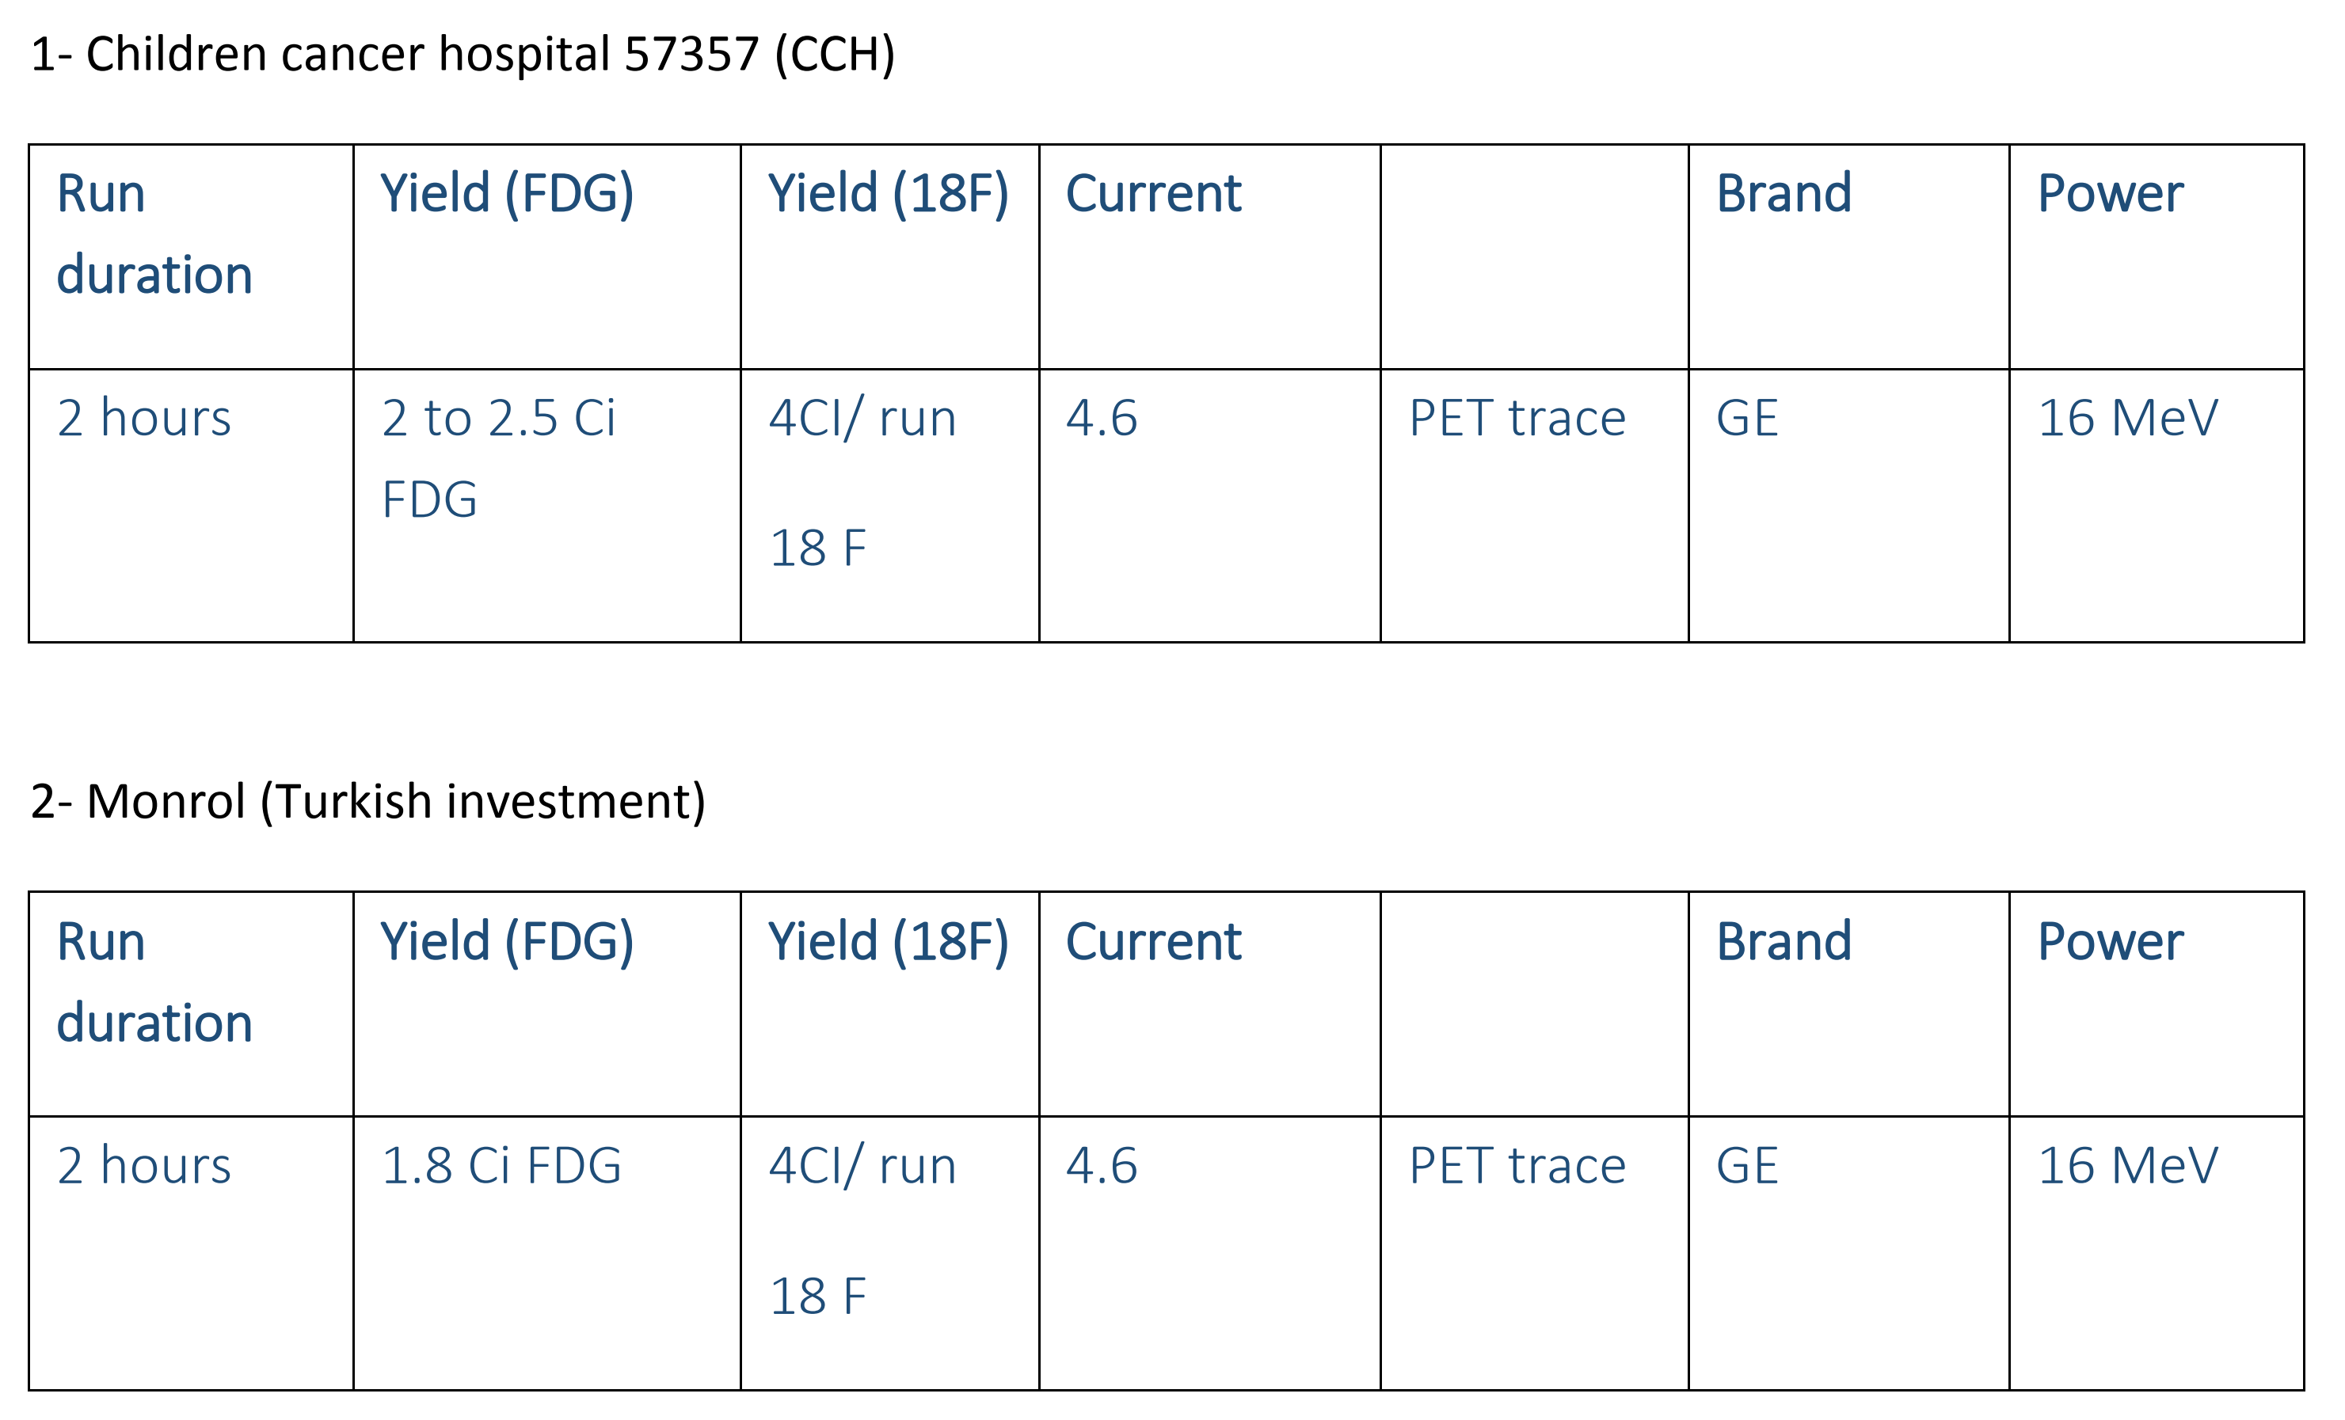
2 Running Cyclotrons
2 under installation or maintenance.

Slide 36
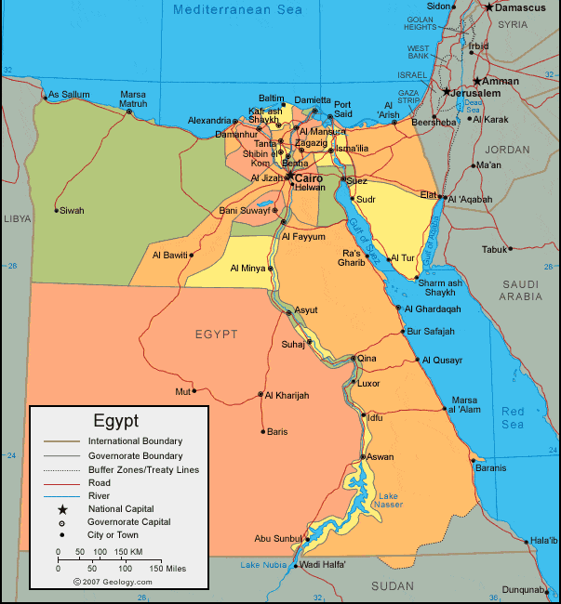
The two running cyclotron are found in Cairo.
The distribution of F18/FDG extend 200 Km to the north (Alexandria) and reaches about 400 Km to the south (Asuit).

Slide 37
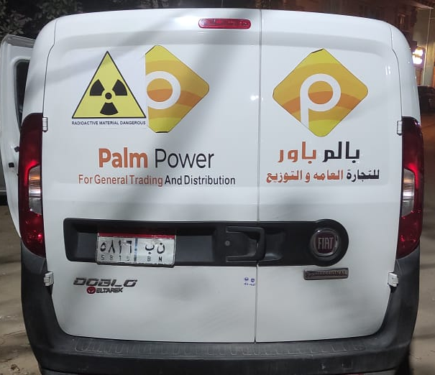
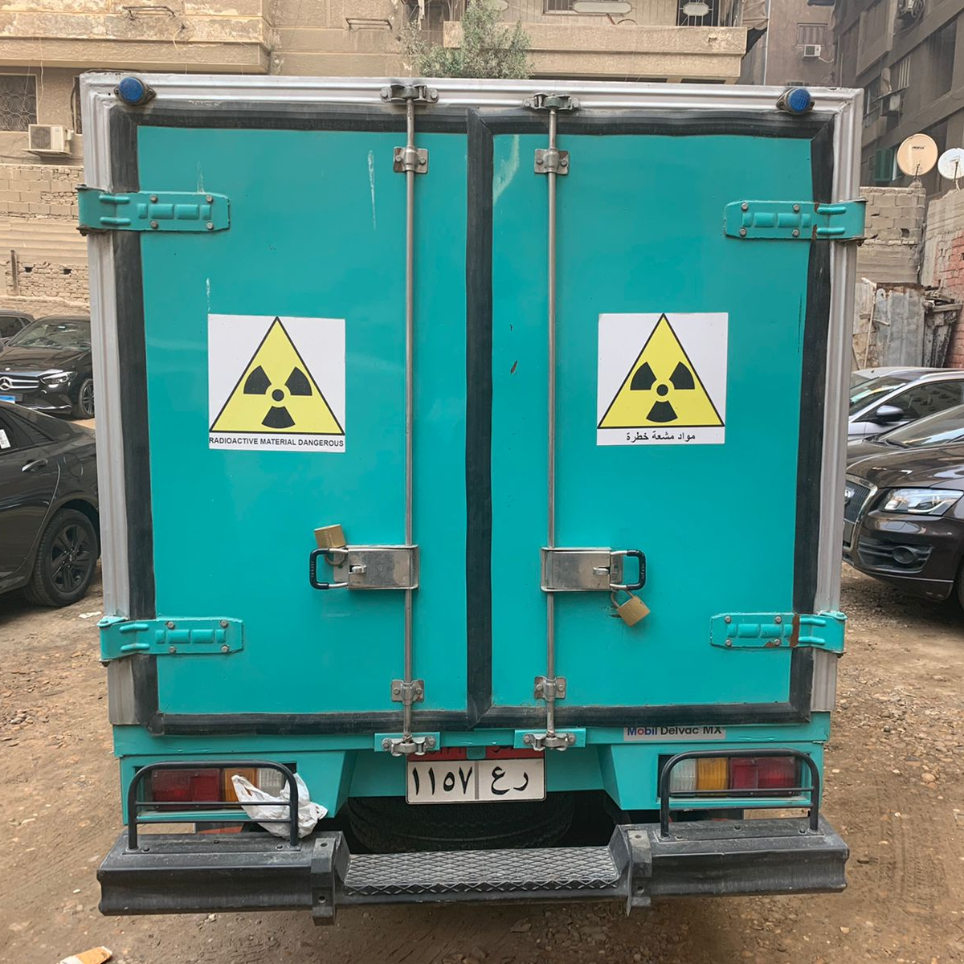
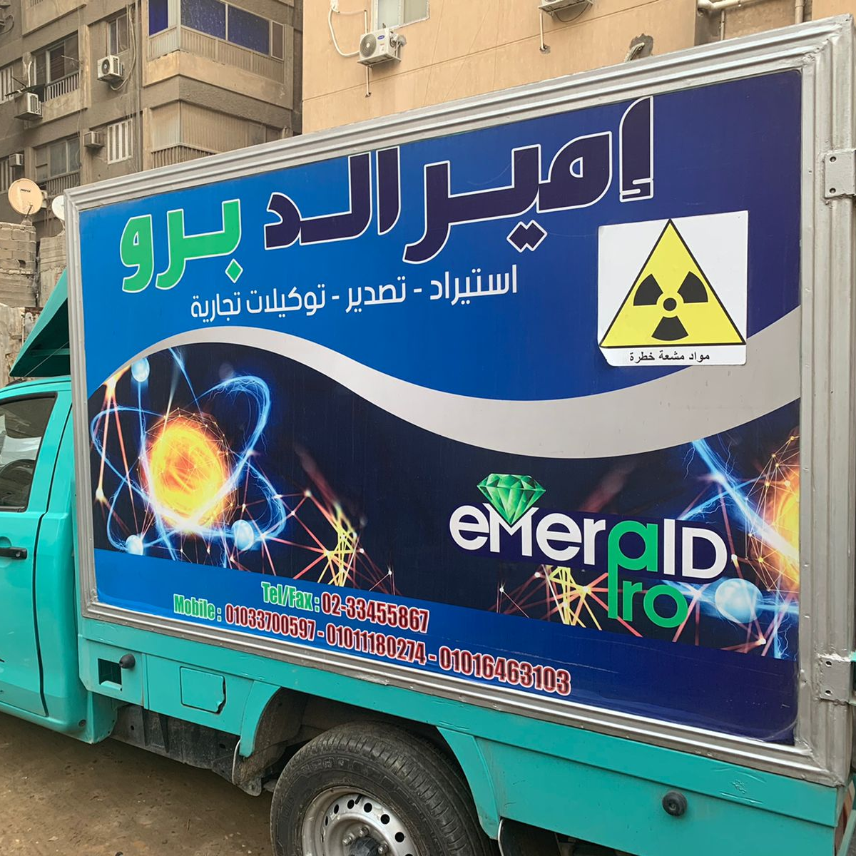
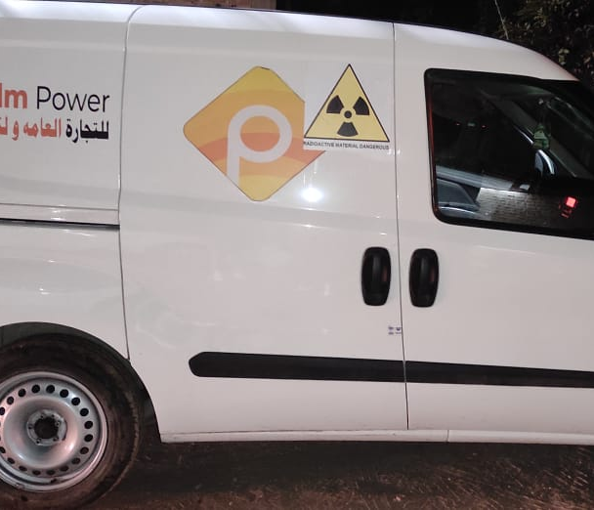
The role of Private sector
The government and academic institutions has a limited financial support
More than have of the PET-CT centres are private , The two running cyclotron run under private companies.
Companies responsible for transportation of F18/FDG are private.

Slide 38
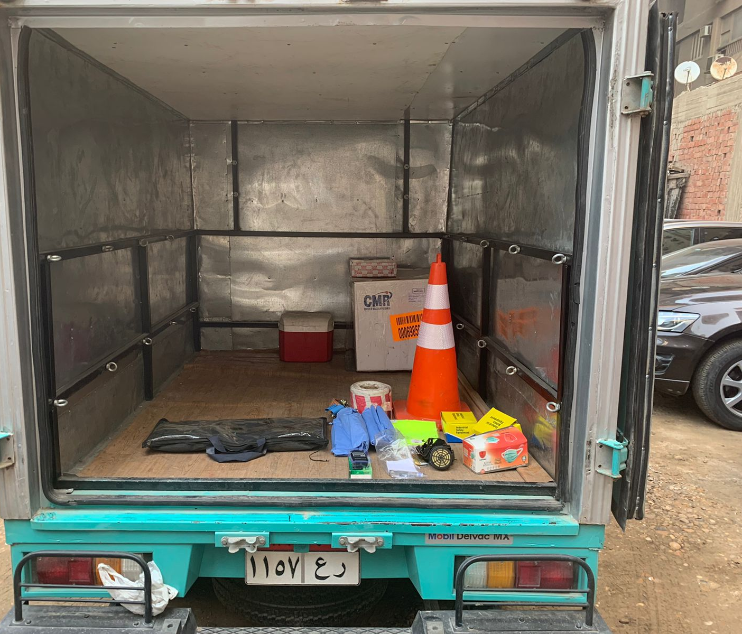
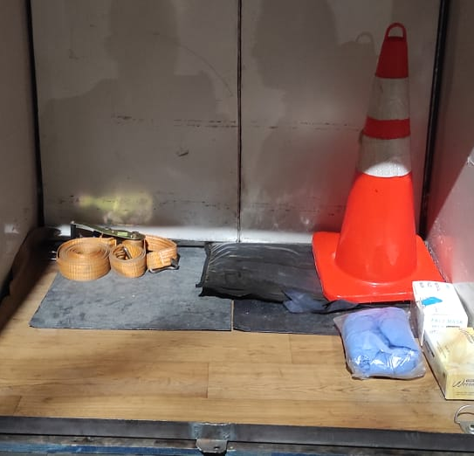
Decreasing the scan cost
The cost per scan has been decreased due to:
Efficient patient scheduling in different centres.
Efficient regulatory and supervisory processes by (ENRRA) the Egyptian nuclear and radiological regularity authority

Slide 39
The current cost
The average cost per dose per patient ranging from 26 -40 USD in cairo region and increase by distance to reach 55 USD.
The price per scan paid by the patient in private centres 260 -360 USD, and in governmental hospitals 150 -200 USD.

Slide 40
conclusions
Inequities in access to PET-CT are striking. In high-income countries, there are 3.52 scanners/million inhabitants and in low-income settings, 0.004 scanners/million.
In the African continent, there are only 9 out of the 54 countries have PET scanners, Seventeen cyclotrons supply 63 PET/CT cameras within the continent.
The main obstacles for the availability of PET tracers in developing countries are economical, political , regularity and human resource awareness.
The opportunities exists in developing the human resources , effective utilization of resources, regularity facilitation , involvement of private sector and the use of radioactive generators for all types of diseases instead of cyclotron produced ones.

Slide 41
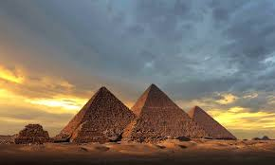

Thank you

